Slide 1
Supporting and Enhancing Mathematics and Statistics
UNIT: Formulae

Slide 2
Formulae
UNIT:
Formulae
In formulae, letters are used to represent numbers.
You have five sections to work through and there are check up audits through fitness tests for each section.
Using Formulae
Construct and Use Simple Formulae
Substitution into Formulae
More Complex Formulae
Changing the Subject

Slide 3
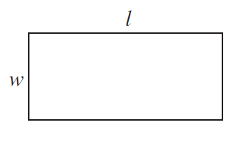
UNIT:
Formulae
Section 1
Using Formulae
In formulae, letters are used to represent numbers.
For example, the formula
A = l w
can be used to find the area of a rectangle.
Here A is the area, l the length and w the width.
In this formula, lw means l × w.
Formulae are usually written in this way,
without multiplication signs.

Slide 4
UNIT:
Formulae
Section 1
Using Formulae: Examples
Example
The perimeter of a rectangle can be found
using the formula:
P = 2l + 2w
Here P is the perimeter, l the length and w the width.
Use the formula above to find the perimeter if l = 8 and w = 4.
Solution
Given the information that l = 8 and w = 4, the letters l and w are replaced by the numbers 8 and 4. This gives:
P = 2 × 8 + 2 × 4
= 16 + 8
= 24

Slide 5
UNIT:
Formulae
Section 1
Using Formulae: Examples
Example
The final speed of a car is v and this can be calculated using the formula
v = u + a t
where u is the initial speed, a is the acceleration and t is the time taken.
Find v if the acceleration is 2 ms⁻², the time taken is 10 seconds and
the initial speed is 4 ms⁻¹.
Solution
The acceleration is 2 ms⁻² so a = 2.
The initial speed is 4 ms⁻¹ so u = 4.
The time taken is 10 seconds so t = 10.
Using the formula above gives: v = 4 + 2 × 10 = 4 + 32 = 36 ms⁻ ¹

Slide 6
UNIT:
Formulae
Section 1
Section 1: Fitness Check
Here are some questions to check your progress;
there are more practice questions if needed.
26
1. If Q = 3x + 7y, find the value of Q if x = 4 and y = 2
2. If Q = xy + 4, find the value of Q if x = 3 and y = 5
19
A rectangle has a length of a cm and a width of b cm.
The perimeter of a rectangle is given by the formula
P = 2(a + b)
Calculate the perimeter of a rectangle when a = 4.5 and b = 4.2.
17.4 cm

Slide 7
UNIT:
Formulae
Section 1
Section 1: Review
You have completed the first Section.
If you have completed and understood this section,
click to start the next Section
If you need more examples and interactive practice,
press here
You might also find it helpful to look at:
Essential Information: press here

Slide 8
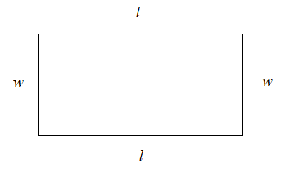
UNIT:
Formulae
Section 2
Constructing and Using Formulae
A formula can be constructed to match a problem. For example, a formula for the perimeter of a rectangle describes how to find the perimeter, given the length and width of the rectangle.
We can name the perimeter P, the length l and the width w.
The perimeter is found by adding the lengths of the sides together.
So we construct the formula as follows:
P =
l + w + l + w
This gives P = 2l + 2w

Slide 9
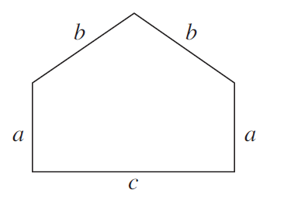
UNIT:
Formulae
Section 2
Constructing and Using Formulae: Examples
Example
a) Write down a formula for the perimeter of the shape shown.
b) Find the perimeter if:
a = 2 cm, b = 3 cm and c = 5 cm
Solution
a) The perimeter is found by adding together the lengths of all the sides, so the formula will be:
P = a + b + b + a + c
As a and b are both added in twice, this can be simplified to:
P = 2a + 2b + c
b) If a = 2 cm, b = 3 cm and c = 5 cm,
P = 2 × 2 + 2 × 3 + 5 = 4 + 6 + 5 = 15 cm

Slide 10
UNIT:
Formulae
Section 2
Constructing and Using Formulae: Examples
Example
When laying a patio, a landscape gardener charges a basic fee of £30 plus £12 per hour.
Find a formula for calculating the gardener's charge.
Solution
Let C = charge and n = number of hours.
The charge is made up of
a fixed £30 plus £12 × the number of hours
(£12 × the number of hours can be written as £12n)
So the total charge in £ is given by C = 30 + 12n

Slide 11
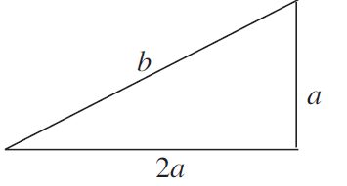
UNIT:
Formulae
Section 2
Section 2: Fitness Check
Here are some questions to check your progress;
there are more practice questions if needed.
a) Tickets for a school concert are sold at £6 for adults and
£4 for children. If p adults and q children buy tickets,
write a formula for T, the total value of the ticket sales in £s.
T = 6p + 4q
b) Find the total value of the ticket sales if p = 50 and q = 20 .
£380
Find a formula for the perimeter of the
shape shown here, and find the perimeter for the values specified.
P = 3a + b
P = 21 cm
a = 4 cm, b = 9 cm

Slide 12
UNIT:
Formulae
Section 2
Section 2: Review
You have completed the second Section.
If you have completed and understood this section,
click to start the next Section
If you need more examples and interactive practice,
press here
You might also find it helpful to look at:
Essential Information: press here

Slide 13
UNIT:
Formulae
Section 3
Substitution into Formulae
The process of replacing the letters in a formula is known as substitution.
Example
The length of a metal rod is l cm. The length changes with temperature and can be found by the formula
l = 40 + 0.02T
where T is the temperature.
Find the length of the rod when T = 50 °C
Solution
Using T = 50 gives
l = 40 + 0.02T
l = 40 + 50 × 0.02 = 40 + 1 = 41 cm

Slide 14
UNIT:
Formulae
Section 3
Substitution into Formulae: Examples
Example
The profit in £ made by a salesman when he sells n books is calculated by the formula:
P = 4n − 50
Find the profit if he makes 30 sales.
Solution
Using n = 30 gives
P = 4n − 50
P = 4 × 30 − 50 = 120 – 50
P = 70

Slide 15
UNIT:
Formulae
Section 3
Substitution into Formulae: Examples
Example
If z = x² − 4y² what is the value of z when x = 4 , y = −2 ?
Solution
z = x² − 4y²
= 4² − 4 × (−2)²
= 4×4 − 4 × (−2)×(−2)
= 16 − 4 ×4
= 16 − 16
z = 0

Slide 16
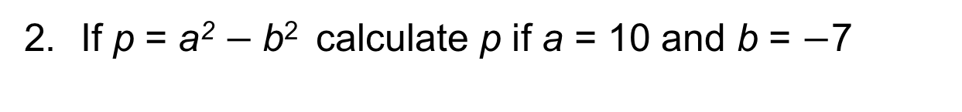
UNIT:
Formulae
Section 3
Section 3: Fitness Check
Here are some questions to check your progress;
there are more practice questions if needed.
The formula below is used to convert temperatures in degrees Celsius to degrees Fahrenheit, where F is the temperature in degrees Fahrenheit and C is the temperature in degrees Celsius:
F = 1.8 C + 32
Calculate F if C = 20
F = 68 degrees Fahrenheit
2. If p = a² $−$b² calculate p if a = 10 and b = $−$7
p = 51

Slide 17
UNIT:
Formulae
Section 3
Section 3: Review
You have completed the third Section.
If you have completed and understood this section,
click to start the next Section
If you need more examples and interactive practice,
press here
You might also find it helpful to look at:
Essential Information: press here

Slide 18
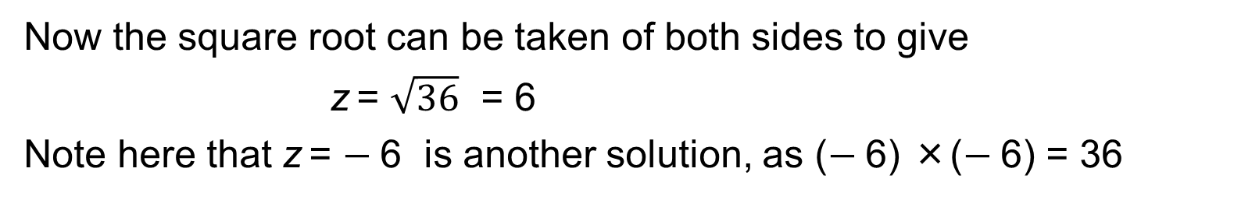
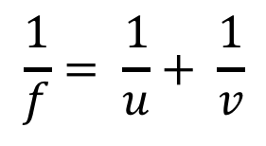
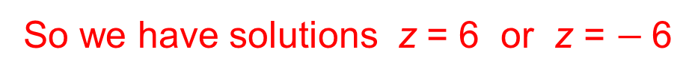
UNIT:
Formulae
Section 4
More Complex Formulae: Examples
$$\frac{1}{f}= \frac{1}{u}+ \frac{1}{v}$$
Some formulae such as
and
z² = x² + y²
do not give you a value straight away when you substitute in.
For example:
Find the value of z when z² = x² + y², if x = 3.6 and y = 4.8
z² = x² + y²
z² = 3.6² + 4.8²
z² = 12.96 + 23.04
z² = 36
Now the square root can be taken of both sides to give
z = $\sqrt{36}$ = 6
Note here that z = $−$6 is another solution, as ($−$6) ×($−$6) = 36
So we have solutions z = 6 or z = $−$6

Slide 19
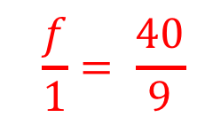
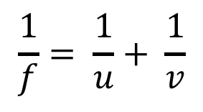
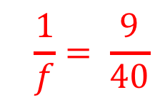
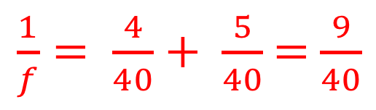
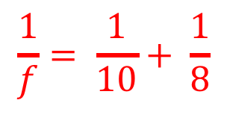
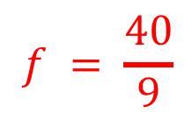
UNIT:
Formulae
Section 4
More Complex Formulae: Examples
Example
$$\frac{1}{f}= \frac{1}{u}+ \frac{1}{v}$$
Find the value of $f$when if u = 10 and v = 8
Solution
$$\frac{1}{f}= \frac{1}{10}+ \frac{1}{8}$$
Substituting into the formula gives
Add the two fractions, with 40 as a common denominator:
$\frac{1}{f}= \frac{4}{40}+ \frac{5}{40}$ = $\frac{9}{40}$
$$\frac{1}{f}= \frac{9}{40}$$
We have found that
but to find $f$, turn both fractions upside-down
$$\frac{f}{1}= \frac{40}{9}$$
$$f = \frac{40}{9}$$
this gives
or

Slide 20
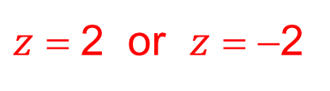
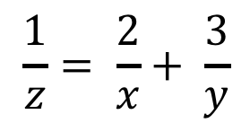
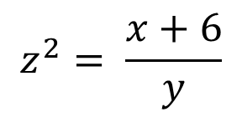
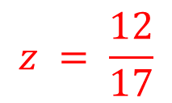
UNIT:
Formulae
Section 4
Section 4: Fitness Check
Here are some questions to check your progress;
there are more practice questions if needed.
$$\frac{1}{z}= \frac{2}{x}+ \frac{3}{y}$$
1. Find the value of $z$ when if $x$ = 3 and y = 4
$$z = \frac{12}{17}$$
$$z^{2}= \frac{x+6}{y}$$
2. Find the value of $z$when if $x$ = 6 and y = 3
$z$ = 2 or $z$ = −2

Slide 21
UNIT:
Formulae
Section 4
Section 4: Review
You have completed the fourth Section.
If you have completed and understood this section,
click to start the next Section
If you need more examples and interactive practice,
press here
You might also find it helpful to look at:
Essential Information: press here

Slide 22
UNIT:
Formulae
Section 5
Changing the Subject
Sometimes a formula can be rearranged into a more useful format. For example, the formula
F = 1.8C + 32
can be used to convert temperatures in degrees Celsius to degrees Fahrenheit. It can be rearranged into the form
C = . . .
to enable temperatures in degrees Fahrenheit to be converted to degrees Celsius.
We say that the formula has been
“rearranged to make C the subject of the formula”.

Slide 23
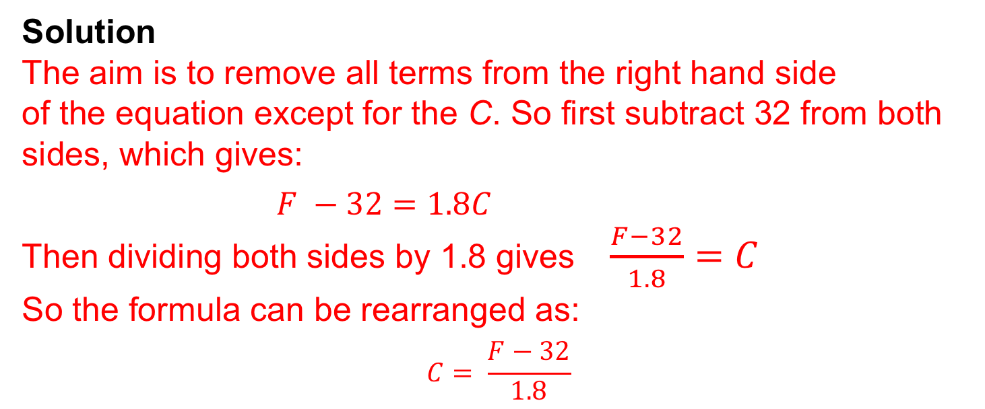
UNIT:
Formulae
Section 5
Changing the Subject: Examples
Example
Rearrange the formula
F = 1.8C + 32
to make C the subject of the formula.
Solution
The aim is to remove all terms from the right hand side
of the equation except for the C. So first subtract 32 from both sides, which gives:
$F −32=1.8C$
Then dividing both sides by 1.8 gives $\frac{F−32}{1.8}=C$
So the formula can be rearranged as:
$$C= \frac{F−32}{1.8}$$

Slide 24
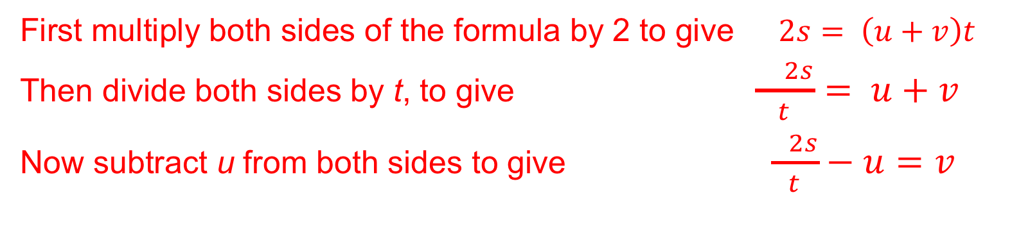
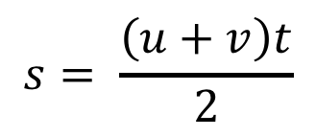
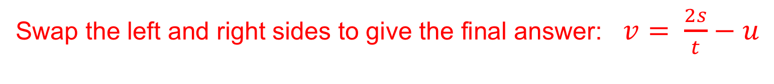
UNIT:
Formulae
Section 5
Changing the Subject: Examples
Example
The distance, s, travelled by a car in time t from initial speed u to final speed v is given by the formula:
$$s= \frac{\left(u+v\right)t}{2}$$
Make v the subject of the formula.
Solution
First multiply both sides of the formula by 2 to give $2s= \left(u+v\right)t$
Then divide both sides by t, to give $\frac{ 2s}{t}= u+v$
Now subtract u from both sides to give $\frac{ 2s}{t}−u=v$
Swap the left and right sides to give the final answer: $v= \frac{2s}{t}−u$

Slide 25
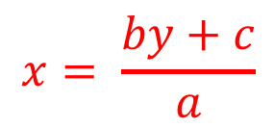
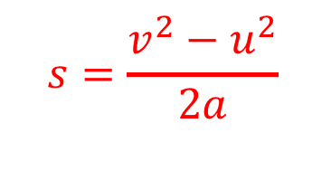
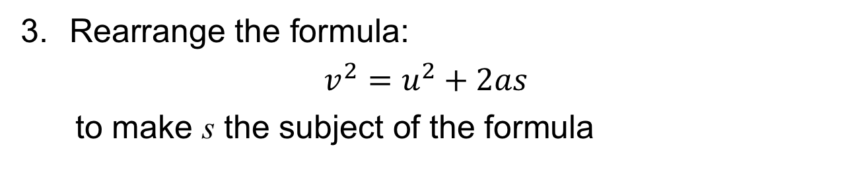

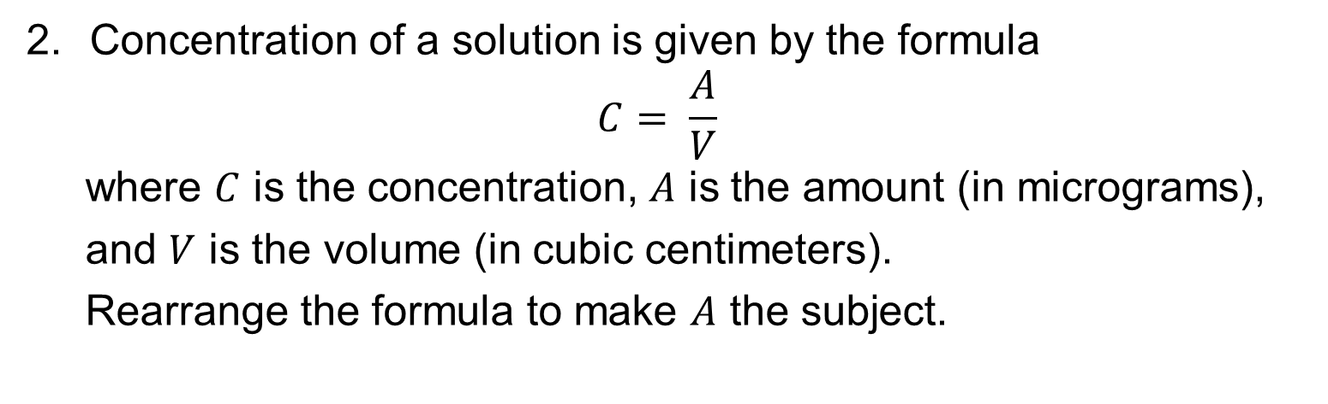
UNIT:
Formulae
Section 5
Section 5: Fitness Check
Here are some questions to check your progress;
there are more practice questions if needed.
Rearrange $y = \frac{ax−c}{b}$to make x the subject of the formula
$$x= \frac{by+c}{a}$$
2. Concentration of a solution is given by the formula
$$C= \frac{A}{V}$$
where $C$ is the concentration, $A$ is the amount (in micrograms),
and $V$ is the volume (in cubic centimeters).
Rearrange the formula to make $A$ the subject.
$$A=VC or A=CV$$
3. Rearrange the formula:
$$v^{2}=u^{2}+2as$$
to make s the subject of the formula
$$s=\frac{v^{2}−u^{2}}{2a}$$

Slide 26
UNIT:
Formulae
Section 5
Section 5: Review
You have completed the fifth Section.
If you have completed and mastered this last section,
click here for the Unit audit
If you need more examples and interactive practice,
press here
You might also find it helpful to look at:
Essential Information: press here

