Slide 1
Supporting and Enhancing Mathematics and Statistics UNIT: Algebraic Fractions and Equations

Slide 2
UNIT:
Algebraic Fractions and
Equations
Algebraic Fractions and Equations
Manipulating and solving Algebraic Fractions and Equations
is an important part of algebra work.
You have five sections to work through and there are check up audits and fitness tests for each section.
Algebraic Manipulation
Algebraic Fractions: Part 1
Algebraic Fractions: Part 2
Algebraic Fractions and Quadratic Equations
Algebraic Solution of Simultaneous Equations - One Linear and One Quadratic

Slide 3
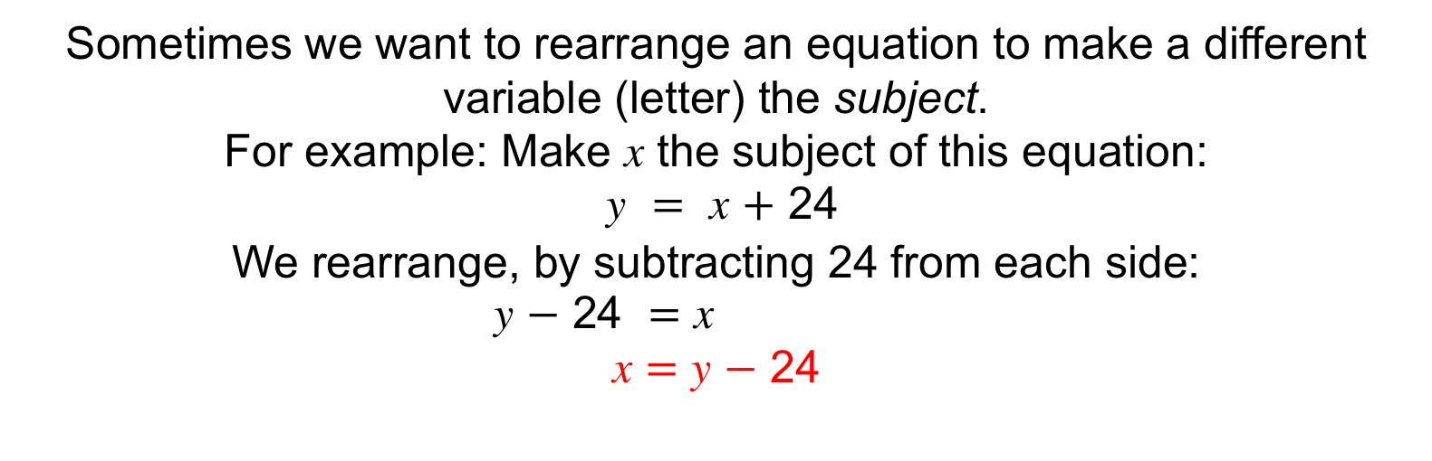
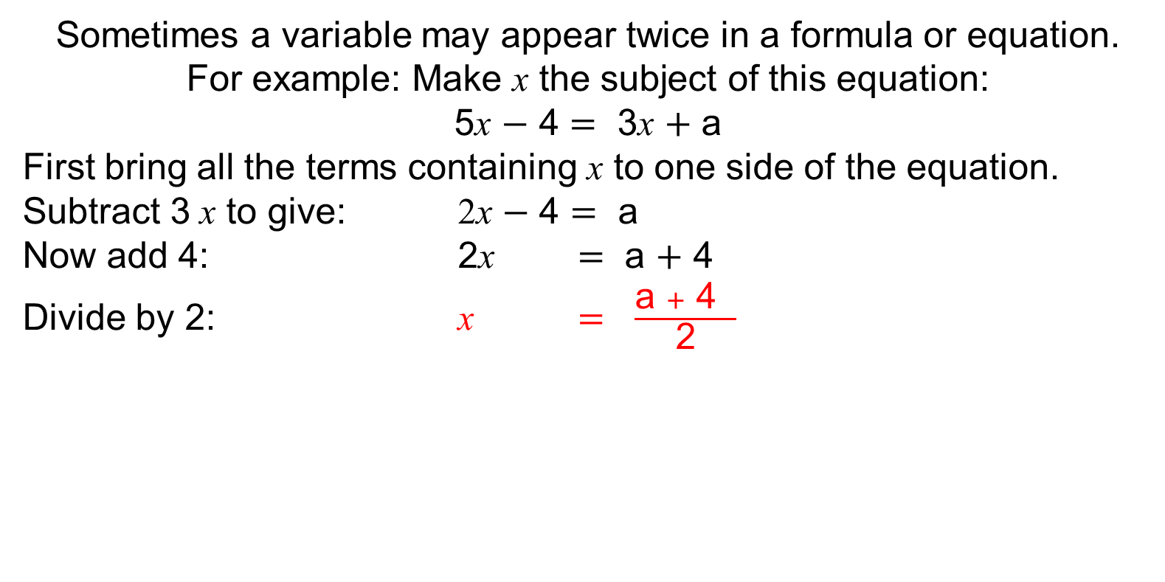
UNIT:
Algebraic Fractions and
Equations
Section 1
Algebraic Manipulation
Sometimes we want to rearrange an equation to make a different variable (letter) the subject.
For example: Make x the subject of this equation:
y $=$ x $+$ 24
We rearrange, by subtracting 24 from each side:
y $−$ 24 $=$ x
x $=$ y $−$ 24
Sometimes a variable may appear twice in a formula or equation.
For example: Make x the subject of this equation:
5x $−$ 4 $=$ 3x $+$ a
First bring all the terms containing x to one side of the equation. Subtract 3 x to give: 2x $−$ 4 $=$ a
Now add 4: 2x $=$ a $+$ 4
Divide by 2: x $=$ $\frac{\text{a} +\text{ 4} }{\text{2}}$

Slide 4
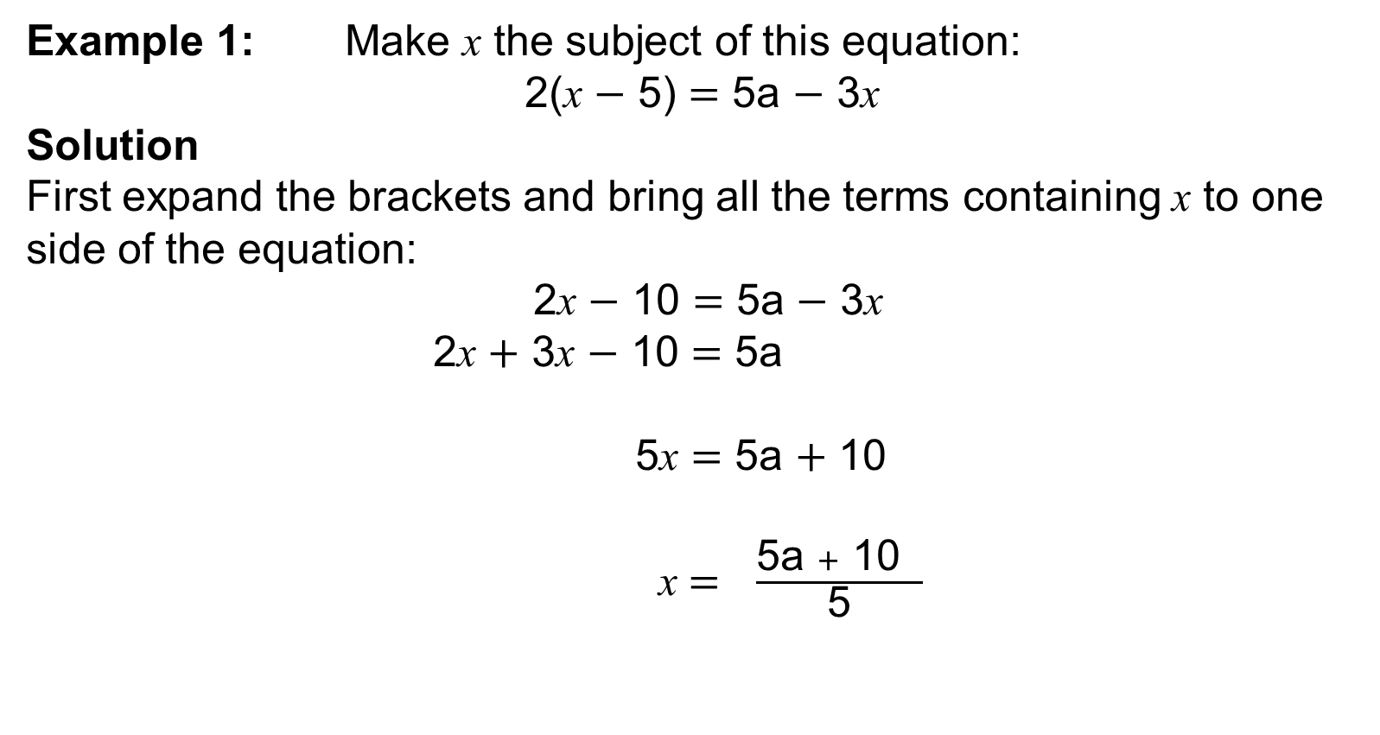

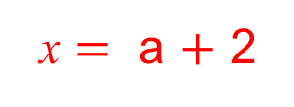
UNIT:
Algebraic Fractions and
Equations
Section 1
Algebraic Manipulation
Example 1: Make x the subject of this equation:
2(x $−$ 5) $=$ 5a $−$ 3x
Solution
First expand the brackets and bring all the terms containing x to one side of the equation:
2x $−$ 10 $=$ 5a $−$ 3x
2x $+$ 3x $−$ 10 $=$ 5a
5x $=$ 5a $+$ 10
x $=$ $\frac{\text{5}\text{a} + \text{10} }{\text{5}}$
Now eliminate the $−$10
by adding 10 to each side:
Divide both sides by 5:
x $=$ a $+$ 2

Slide 5
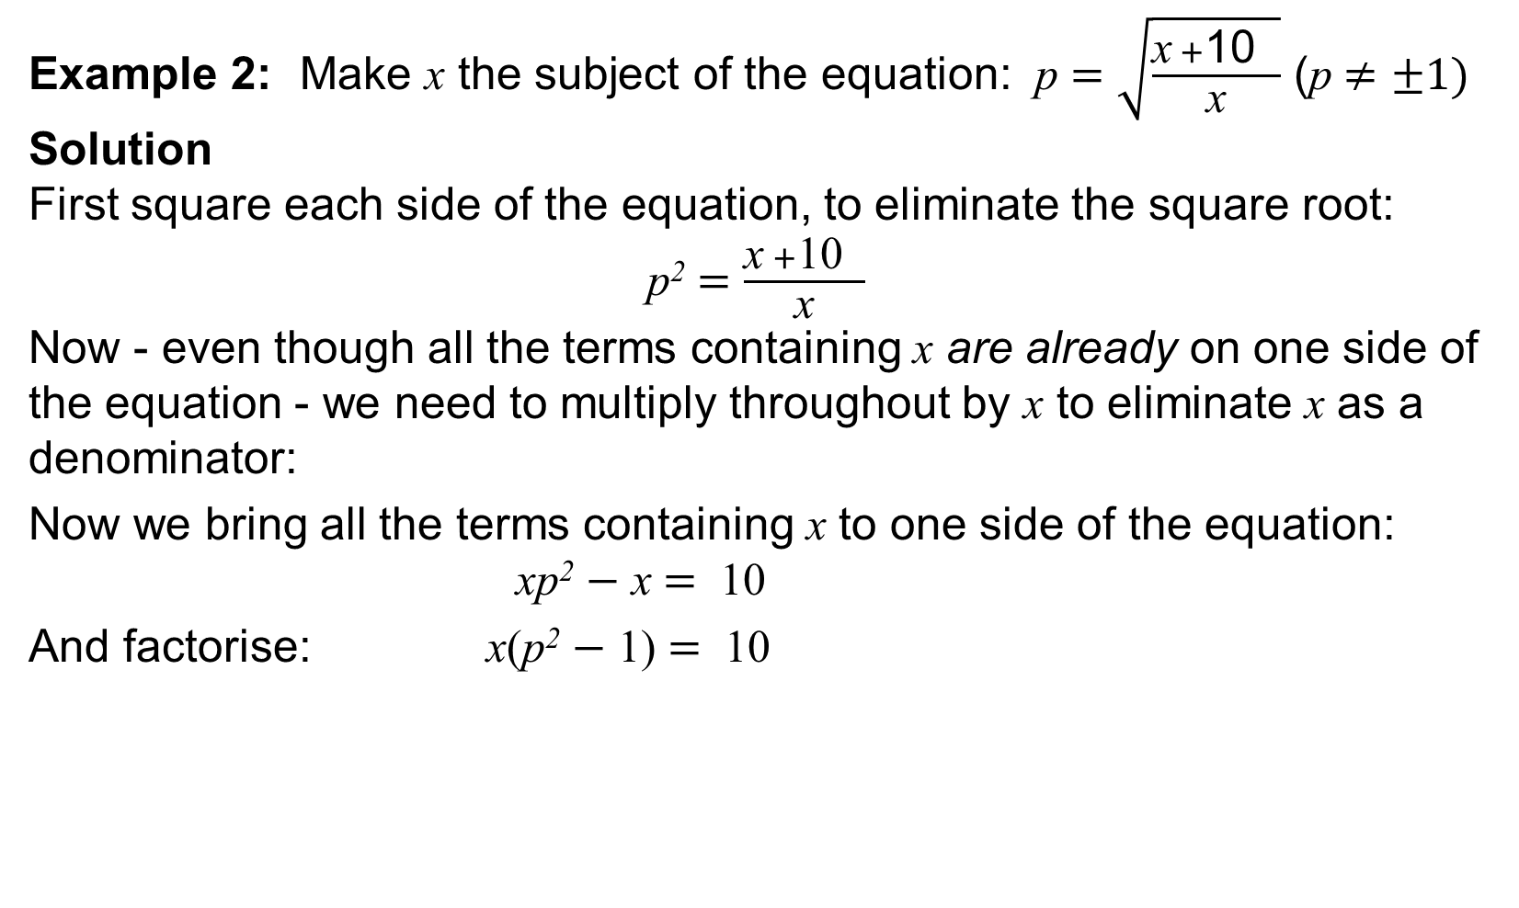
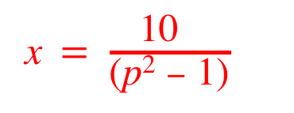


UNIT:
Algebraic Fractions and
Equations
Section 1
Algebraic Manipulation
Example 2: Make x the subject of the equation: p $=\sqrt{\frac{\text{x} +\text{10} }{\text{x}}}$ (p $≠±1)$
Solution
First square each side of the equation, to eliminate the square root:
p² $=\frac{\text{x} +\text{10} }{\text{x}}$
Now - even though all the terms containing x are already on one side of the equation - we need to multiply throughout by x to eliminate x as a denominator:
Now we bring all the terms containing x to one side of the equation: xp² $−$ $\text{x}$ $= \text{10}$
And factorise: x(p² $−$ $\text{1)}$ $= \text{10}$
xp² $=\text{x} +\text{10}$
Finally, divide throughout by (p² $−$ $\text{1)} \text{to} \text{give}\text{:}$
x$=$ $\frac{\text{10} }{\text{(}\text{p}\text{2} −\text{ 1)}}$

Slide 6
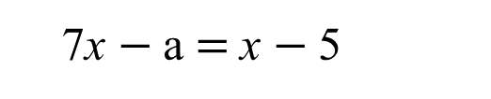
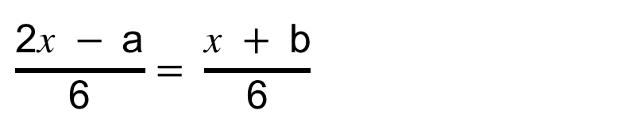
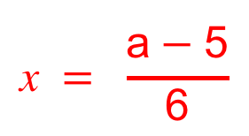
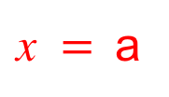
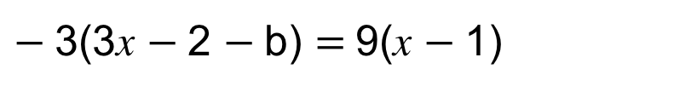
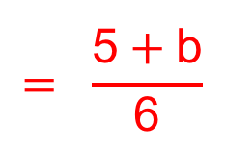
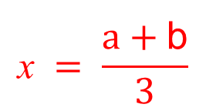
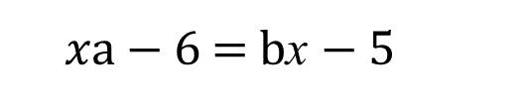
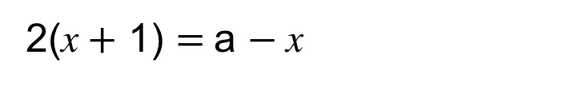
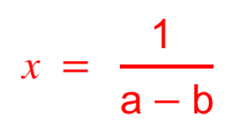
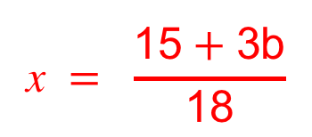
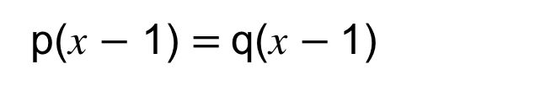
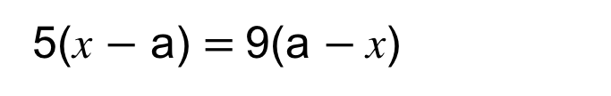
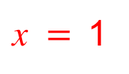
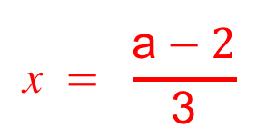
UNIT:
Algebraic Fractions and
Equations
Section 1
Section 1: Fitness Check
Here are some questions to check your progress;
there are more practice questions if needed.
Make x the subject of each of the following:
$$\text{x} = \frac{\text{a} −\text{5}}{\text{6}}$$
7x $−$a $=$x $−$5
$$\text{x} = \frac{\text{1} }{\text{a} −\text{b}}$$
$xa$ $−$ 6 $=$ bx $−$5
5(x $−$ a) $=$9(a $−$x)
$\text{x} =$a
p(x $−$ 1) $=$q(x $−$1)
$\text{x} =$1
$$\text{x} = \frac{\text{a} −\text{2}}{\text{3}}$$
2(x$+$ 1) $=$a $−$x
$$\text{x} = \frac{\text{15} +\text{3}\text{b}}{\text{18}}$$
$$= \frac{\text{5} +\text{b}}{\text{6}}$$
$−$3(3x $−$2 $−$b) $=$9(x $−$1)
$$\frac{\text{2}\text{x} − \text{a}}{\text{6}}= \frac{\text{x} + \text{b}}{\text{6}}$$
$$\text{x} = \frac{\text{a} +\text{b}}{\text{3}}$$

Slide 7
UNIT:
Algebraic Fractions and
Equations
Section 1
Section 1: Review
You have completed the first Section.
If you have completed and understood this section,
click to start the next Section
If you need more examples and interactive practice,
press here
You might also find it helpful to look at:
Essential Information: press here

Slide 8
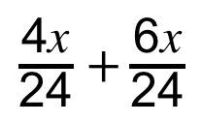
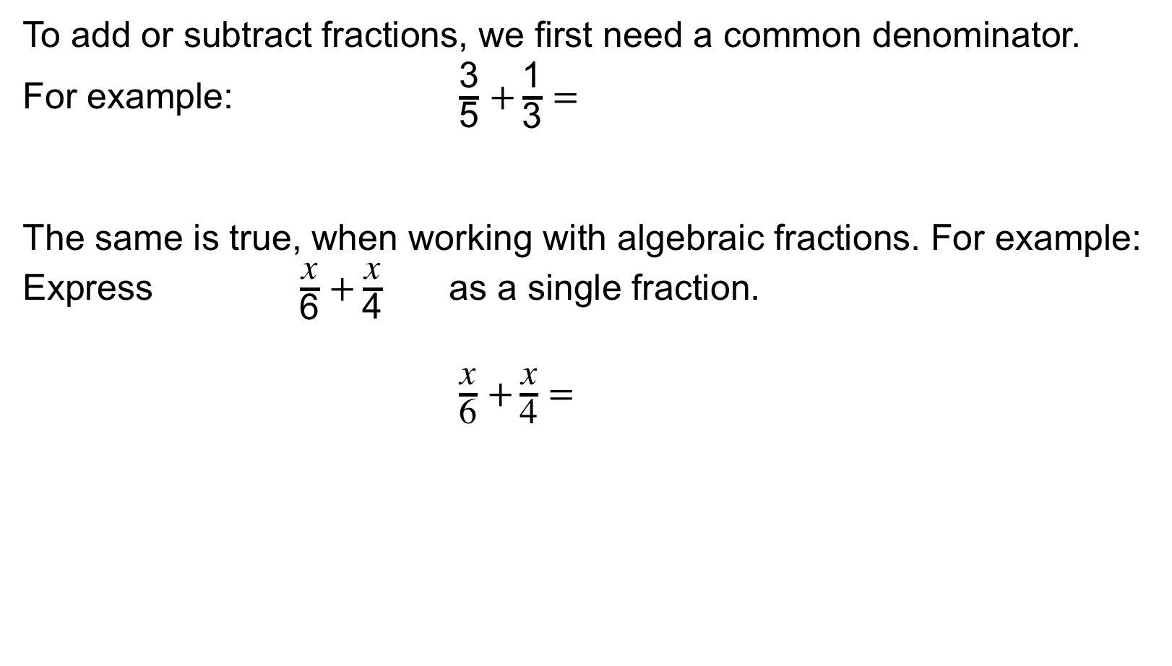
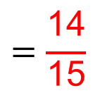
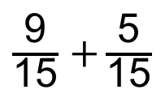
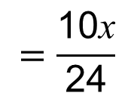
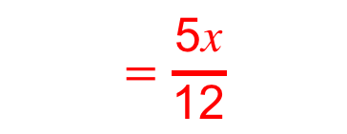
UNIT:
Algebraic Fractions and
Equations
Section 2
Algebraic Fractions: Part 1
To add or subtract fractions, we first need a common denominator.
For example: $\frac{\text{3}}{\text{5}}$ $+\frac{\text{1}}{\text{3}}$ $=$
The same is true, when working with algebraic fractions. For example: Express $\frac{\text{x}}{\text{6}}$ $+\frac{\text{x}}{\text{4}}$ as a single fraction.
$\frac{\text{x}}{\text{6}}$ $+\frac{\text{x}}{\text{4}}$ $=$
$\frac{\text{9}}{\text{15}}$ $+\frac{\text{5}}{\text{15}}$
$$=\frac{\text{14}}{\text{15}}$$
$\frac{\text{4}\text{x}}{\text{24}}$ $+\frac{\text{6}\text{x}}{\text{24}}$
$$=\frac{\text{10}\text{x}}{\text{24}}$$
$$=\frac{\text{5}\text{x}}{\text{12}}$$

Slide 9
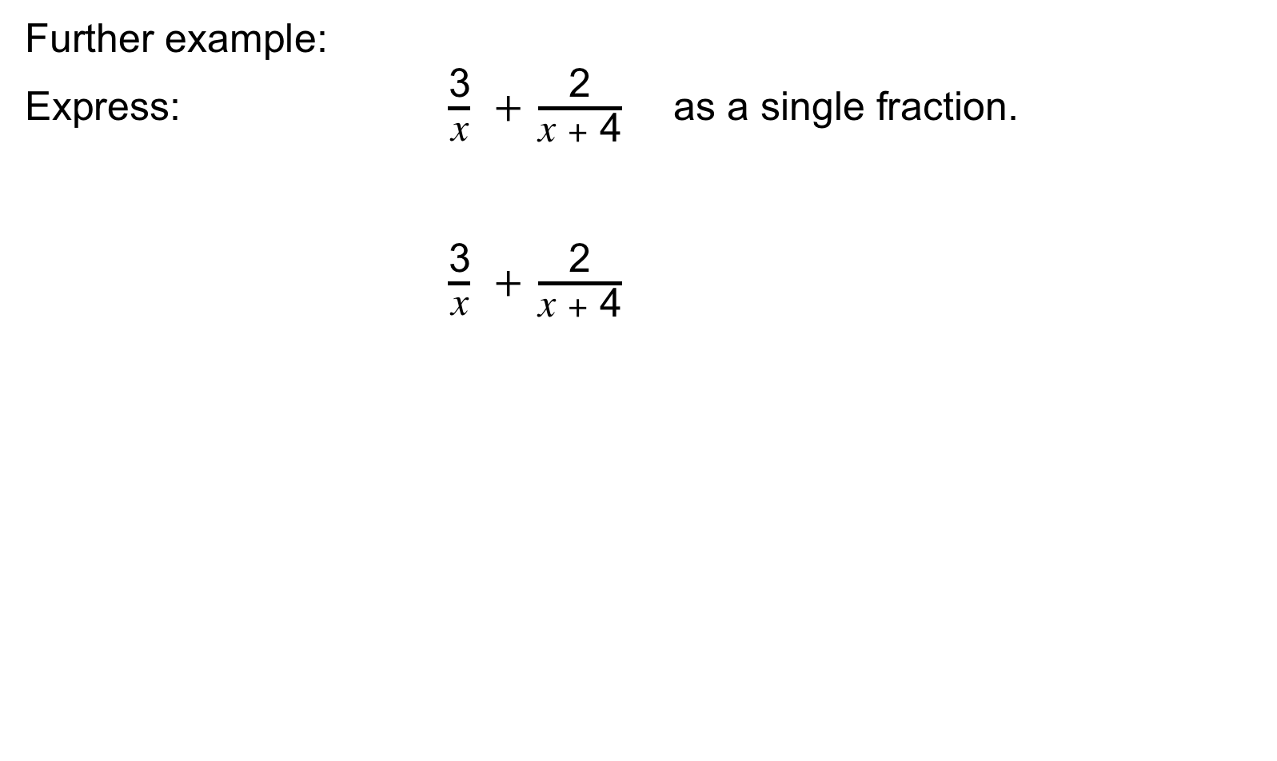
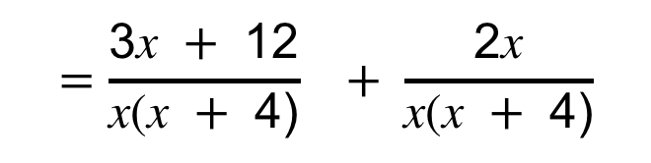
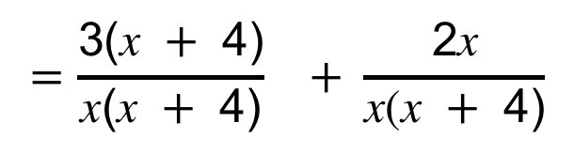
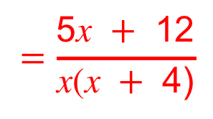
UNIT:
Algebraic Fractions and
Equations
Section 2
Algebraic Fractions: Part 1
Further example:
Express: $\frac{\text{3}}{\text{x}}$ $+ \frac{\text{2}}{\text{x} +\text{ 4}}$ as a single fraction.
$\frac{\text{3}}{\text{x}}$ $+ \frac{\text{2}}{\text{x} +\text{ 4}}$
In this case, the common denominator will be x($\text{x} +\text{ 4}$)
$$=\frac{\text{3}\text{(}\text{x} +\text{ 4}\text{)}}{\text{x}\text{(}\text{x} +\text{ 4}\text{)}} + \frac{\text{2}\text{x}}{\text{x}\text{(}\text{x} +\text{ 4}\text{)}}$$
$$=\frac{\text{3}\text{x} + \text{12}}{\text{x}\text{(}\text{x} +\text{ 4}\text{)}} + \frac{\text{2}\text{x}}{\text{x}\text{(}\text{x} +\text{ 4}\text{)}}$$
$$=\frac{\text{5}\text{x} +\text{ 12}}{\text{x}\text{(}\text{x} +\text{ 4}\text{)}}$$

Slide 10
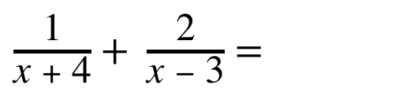
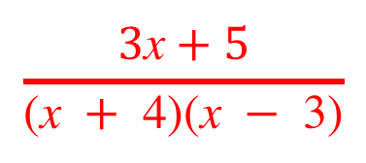
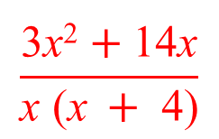
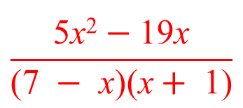
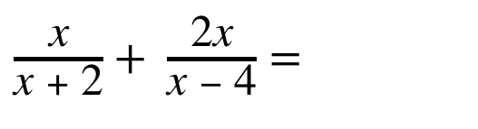
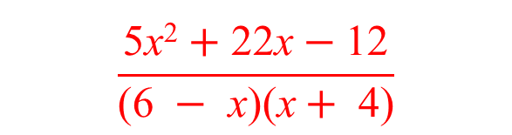
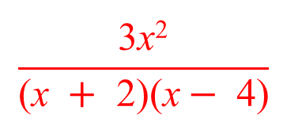
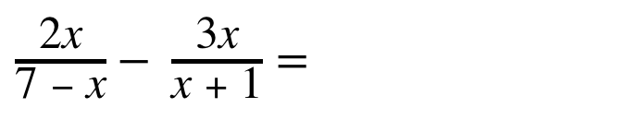
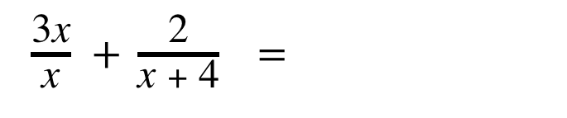
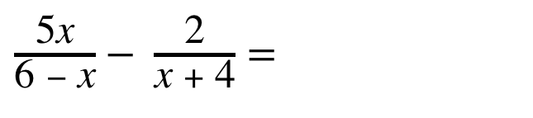
UNIT:
Algebraic Fractions and
Equations
Section 2
Section 2: Fitness Check
Here are some questions to check your progress;
there are more practice questions if needed.
Simplify each expression:
$\frac{\text{1}}{\text{x} +\text{ 4}}+ \frac{\text{2}}{\text{x} − \text{3}}$ $=$
$$\frac{\text{3}\text{x} +\text{5}}{\text{(}\text{x} +\text{ 4}\text{)(}\text{x} − \text{3)}}$$
$$\frac{\text{3} \text{x}\text{2} }{\text{(}\text{x} + \text{2}\text{)(}\text{x}− \text{4}\text{)}}$$
$\frac{\text{x}}{\text{x} + \text{2}}+ \frac{\text{2}\text{x}}{\text{x} −\text{ 4}}$ $=$
$\frac{\text{3}\text{x}}{\text{x}}$ $+ \frac{\text{2}}{\text{x} +\text{ 4}}$ $=$
$$\frac{\text{3} \text{x}\text{2} +\text{1}\text{4}\text{x} }{\text{x} \text{(}\text{x} +\text{ 4)}}$$
$\frac{\text{5}\text{x}}{\text{6} − \text{x}}− \frac{\text{2}}{\text{x} +\text{ 4}}$ $=$
$$\frac{\text{5} \text{x}\text{2} +\text{2}\text{2}\text{x}−\text{12}}{\text{(6} − \text{x}\text{)(}\text{x}+\text{ 4)}}$$
$$\frac{\text{5} \text{x}\text{2} −\text{19}\text{x}}{\text{(}\text{7} − \text{x}\text{)(}\text{x}+ \text{1}\text{)}}$$
$\frac{\text{2}\text{x}}{\text{7} − \text{x}}− \frac{\text{3}\text{x}}{\text{x} + \text{1}}$ $=$

Slide 11
UNIT:
Algebraic Fractions and
Equations
Section 2
Section 2: Review
You have completed the second Section.
If you have completed and understood this section,
click to start the next Section
If you need more examples and interactive practice,
press here
You might also find it helpful to look at:
Essential Information: press here

Slide 12

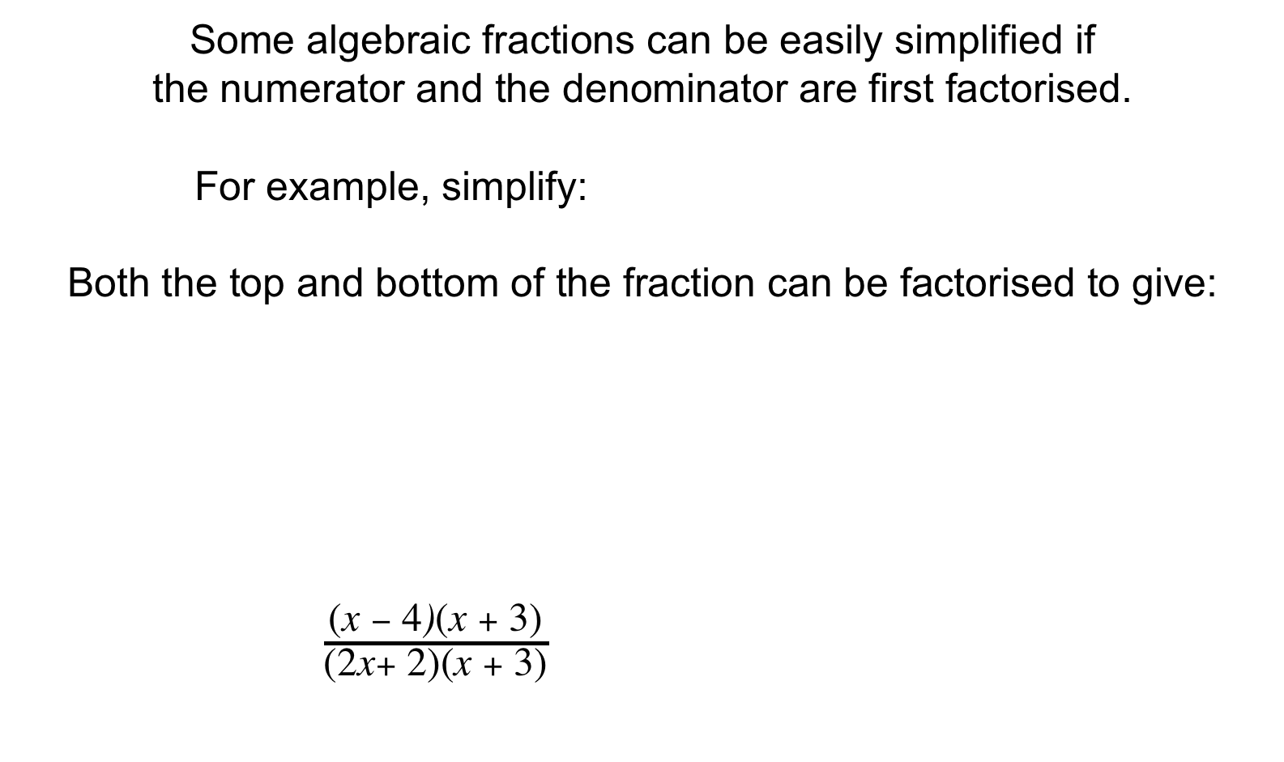
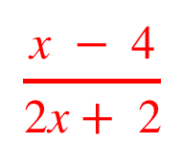
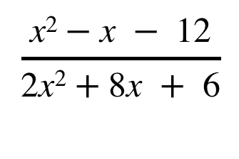
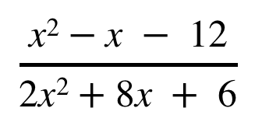

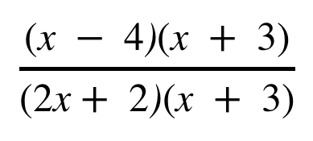
UNIT:
Algebraic Fractions and
Equations
Section 3
Algebraic Fractions: Part 2
Some algebraic fractions can be easily simplified if
the numerator and the denominator are first factorised.
For example, simplify:
Both the top and bottom of the fraction can be factorised to give:
$\frac{\text{(}\text{x} − \text{4}\text{)}\text{(}\text{x} + \text{3)}}{\begin{aligned}\text{(}\text{2}\text{x} +\text{ 2)(}\text{x} + \text{3)} \\ \\ \end{aligned}}$
$$\frac{\text{x}\text{2} −\text{x} −\text{ 12}}{\text{2}\text{x}\text{2} +\text{8}\text{x} + \text{6}}$$
$$\frac{\text{x}\text{2} −\text{x} −\text{ 12}}{\text{2}\text{x}\text{2} +\text{8}\text{x} +\text{ 6}}$$
$$\frac{\text{(}\text{x} − \text{4}\text{)}\text{(}\text{x} +\text{ 3)}}{\text{(}\text{2}\text{x} +\text{ 2}\text{)}\text{(}\text{x} +\text{ 3)}}$$
$$=$$
The term $\text{(}\text{x} +\text{ 3)}$appears as a factor on both the top and bottom
of the fraction so it cancels to give:
$$\frac{\text{x} − \text{4}}{\text{2}\text{x} +\text{ 2}}$$
$$=$$
No further simplification is possible.

Slide 13
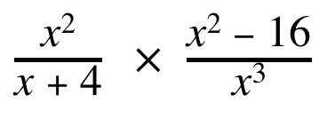
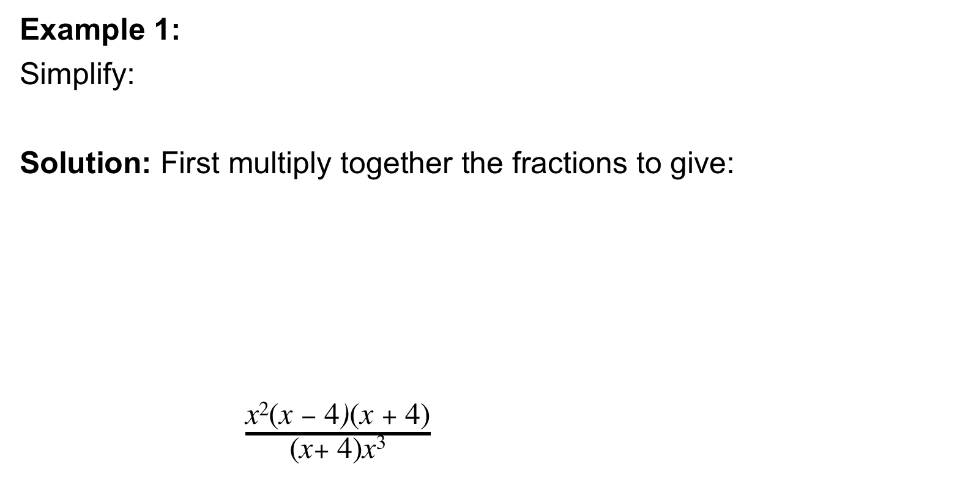
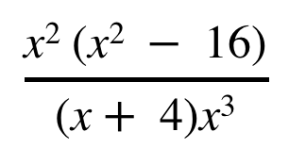


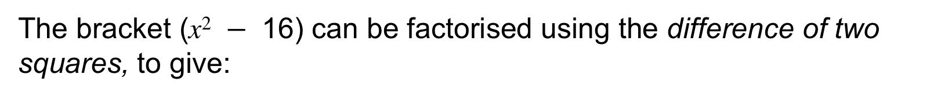






Algebraic Fractions: Part 2
UNIT:
Algebraic Fractions and
Equations
Section 3
Example 1:
Simplify:
Solution: First multiply together the fractions to give:
$\frac{\text{x}\text{2} \text{(}\text{x} − \text{4}\text{)}\text{(}\text{x} +\text{ 4)}}{\text{(}\text{x} +\text{ 4)}\text{x}\text{3} }$
$\frac{\text{x}\text{2} }{\text{x} + \text{4}}$ $×$ $\frac{\text{x}\text{2} − \text{16}}{\text{x}\text{3} }$
$$\frac{\text{x}\text{2} \text{(}\text{x}\text{2} − \text{16}\text{)}}{\text{(}\text{x} + \text{4}\text{)}\text{x}\text{3} }$$
The bracket $\text{(}\text{x}\text{2} − \text{16}\text{)}$ can be factorised using the difference of two squares, to give:
$$\frac{\text{x}\text{2} \text{(}\text{x}\text{2} − \text{16}\text{)}}{\text{(}\text{x} +\text{ 4)}\text{x}\text{3} }$$
$$\frac{\text{x}\text{2} \text{(}\text{x} − \text{4)(}\text{x} + \text{4}\text{)}}{\text{(}\text{x} +\text{ 4)}\text{x}\text{3} }$$
$$=$$
The term $\text{(}\text{x} +\text{ 4)}$can be cancelled to give:
$$\frac{\text{x}\text{2} \text{(}\text{x} − \text{4})}{\text{x}\text{3 }}$$
$$=$$
$$\text{1}$$
$$\frac{ \text{(}\text{x} − \text{4})}{\text{x}}$$
The term$\text{x}\text{2}$ can be cancelled to give:
No further simplification is possible.

Slide 14









UNIT:
Algebraic Fractions and
Equations
Section 3
Algebraic Fractions: Part 2
Example 2:
Simplify:
Solution: So we now have a multiplication:
$\frac{\text{(}\text{x} + \text{2}\text{)}\text{(}\text{x} +\text{ 3)} \text{(}\text{x} −\text{ 4)}\text{(}\text{x} + \text{2}\text{)} }{\text{(}\text{x} −\text{ 4)}\text{(}\text{x} +\text{ 3)} }$
$\frac{\text{x}\text{2} + \text{5}\text{x} + \text{6} }{\text{x} − \text{4}}$ $÷$ $\frac{\text{x} + \text{3}}{\text{x}\text{2} − \text{2}\text{x} − \text{8} }$
$\frac{\text{x} +\text{ 3}}{\begin{aligned}\text{x}\text{2} − \text{2}\text{x} −\text{ 8} \\ \end{aligned}}$
Note: To divide by a fraction, we multiply by its reciprocal.
$\frac{\text{x}\text{2} + \text{5}\text{x} +\text{ 6} }{\text{x} −\text{ 4}}$ $×$ $\frac{\text{x}\text{2} − \text{2}\text{x} −\text{ 8}}{\text{x} +\text{ 3} }$
$$\frac{\text{(}\text{x}\text{2} + \text{5}\text{x} +\text{ 6}) (\text{x}\text{2} − \text{2}\text{x} −\text{ 8})}{\text{(}\text{x} −\text{ 4}\text{)}\text{(}\text{x} + \text{3}\text{)} }$$
$$=$$
The expressions in the brackets $\text{(}\text{x}\text{2} + \text{5}\text{x} +\text{ 6}) \text{an}\text{d} (\text{x}\text{2} − \text{2}\text{x} −\text{ 8})$
can be factorised to give:
$$=$$
$$\text{(}\text{x}+\text{ 2)(}\text{x}+\text{ 2)}$$
Cancelling terms simplifies this expression
This can be simplified to:
$$\text{(}\text{x}+\text{ 2)}\text{2}$$

Slide 15









UNIT:
Algebraic Fractions and
Equations
Section 3
Algebraic Fractions: Part 2
Further Example 3:
Simplify:
In this case, the lowest common denominator is ($\text{x} +\text{ 2}) (\text{x} + \text{1)}$
Algebraic fractions are added in the same
way as ordinary fractions, by using the
lowest common denominator.
$\frac{\text{x} − \text{3} }{\text{x} + \text{2}}$ $+$ $\frac{\text{x} − \text{7}}{\text{x} + \text{1} }$
$\frac{\text{x} −\text{ 3} }{\text{x} +\text{ 2}}$ $+$ $\frac{\text{x} −\text{ 7}}{\text{x} +\text{ 1} }$
$$\frac{\text{(}\text{x} −\text{3}\text{)} \text{(}\text{x} +\text{1)} }{\text{(}\text{x} +\text{2}\text{)}\text{(}\text{x} +\text{1)} } + \frac{\text{(}\text{x}−\text{7}\text{)}\text{(}\text{x}+\text{2}\text{)} }{\text{(}\text{x}+\text{2)} \text{(}\text{x}+\text{1)} }$$
$$=$$
Now we can expand the brackets in the numerators:
$$\frac{\text{x}\text{2} −\text{2}\text{x}−\text{3}}{\text{(}\text{x}+\text{2)}\text{(}\text{x}+\text{1)} } + \frac{\text{x}\text{2} −\text{5}\text{x}−\text{14}}{\text{(}\text{x}+\text{2)} \text{(}\text{x}+\text{1)} }$$
$$=$$
And now add:
$$\frac{\text{x}\text{2} −\text{2}\text{x}−\text{3}+\text{x}\text{2} −\text{5}\text{x}−\text{14}}{\text{(}\text{x}+\text{2)}\text{(}\text{x}+\text{1)} }$$
$$=$$
$$\frac{\text{2}\text{x}\text{2} −\text{7}\text{x}−\text{17}}{\text{(}\text{x}+\text{2)}\text{(}\text{x}+\text{1)} }$$
Which can be simplified to:

Slide 16
















UNIT:
Algebraic Fractions and
Equations
Section 3
Section 3: Fitness Check
Here are some questions to check your progress;
there are more practice questions if needed.
Simplify each expression:
$$\frac{\text{(}\text{x} −\text{2)}\text{(}\text{x} +\text{3}\text{)}}{\text{(}\text{2}\text{x} +\text{2)}\text{(}\text{x} +\text{3)}} =$$
$$\frac{\text{x} −\text{2} }{\text{2}\text{x} +\text{2} }$$
$\frac{\text{x}\text{2} + \text{x} − \text{6}}{\text{2}\text{x}\text{2} + \text{8}\text{x} +\text{ 6}}=$
$$\frac{\text{(}\text{x} −\text{1}\text{)}\text{(}\text{x} +\text{1}\text{)}}{\text{(}\text{x} −\text{1)}} =$$
$\frac{\text{x}\text{2} − \text{1}}{\text{x} − \text{1}}$ $=$
$$\text{x} +\text{1}$$
$\frac{\text{x}\text{2}− \text{9} }{\text{x}\text{3} \text{(}\text{x} +\text{ 4}\text{)}}$ $×$ $\frac{\text{x}\text{2} }{\text{x} + \text{3} }=$
$$\frac{\text{(}\text{x} −\text{3}\text{)}\text{(}\text{x} +\text{3}\text{)}\text{x}\text{2} }{\text{x}\text{3} \text{(}\text{x} +\text{ 4)}\text{(}\text{x} +\text{3}\text{)}} =$$
$$\frac{\text{x} −\text{3} }{\text{x}\text{(}\text{x} +\text{ 4)} }$$
$\frac{\text{x} }{\text{x} −\text{ 4}}$ $÷$ $\frac{\text{x}\text{3 } − \text{2}\text{x}\text{2} +\text{ 3}\text{x}}{\text{x}\text{2} − \text{2}\text{x} −\text{ 8} }=$
$$\frac{\text{x}\text{(}\text{x} −\text{4}\text{)}\text{(}\text{x} +\text{2}\text{)}}{\text{(}\text{x} −\text{4}\text{)} \text{x}\text{(}\text{x}\text{2} − \text{2}\text{x} +\text{ 3}\text{)}}$$
$$=\frac{\text{x} +\text{2}}{\text{x}\text{2 } − \text{2}\text{x} +\text{ 3}}$$
$\frac{\text{x} −\text{ 3} }{\text{x} + \text{7}}$ $−$ $\frac{\text{x} −\text{ 7}}{\text{x} + \text{6} }=$
$\frac{\text{(}\text{x} −\text{3}\text{)}\text{(}\text{x}+\text{6}\text{)}−\text{(}\text{x} −\text{7}\text{)}\text{(}\text{x} +\text{7}\text{)}}{\text{(}\text{x}+\text{7}\text{)}\text{(}\text{x} +\text{6}\text{)}}$ $=$
$\frac{\text{x}\text{2}+\text{3}\text{x} −\text{18}−(\text{x}\text{2}−\text{49}\text{)}}{\text{(}\text{x}+\text{7)}\text{(}\text{x} +\text{6)}}$
$= \frac{\text{3}\text{x} +\text{31}}{\text{(}\text{x}+\text{7)}\text{(}\text{x} +\text{6)}}$

Slide 17
UNIT:
Algebraic Fractions and
Equations
Section 3
Section 3: Review
You have completed the third Section.
If you have completed and mastered this last section,
click to start the next Section
If you need more examples and interactive practice,
press here
You might also find it helpful to look at:
Essential Information: press here

Slide 18












UNIT:
Algebraic Fractions and
Equations
Section 4
Algebraic Fractions and Quadratic Equations
Some quadratic equations may be presented in algebraic fraction form. We need to first simplify the fraction, then solve the equation.
For example: simplify and solve:
$$\frac{\text{x} }{\text{2}\text{x} + \text{1}} + \frac{\text{x} }{\text{x} − \text{1} } = \frac{\text{12}}{\text{5}}$$
In this case, the lowest common denominator is ($\text{2}\text{x} +\text{ 1}) (\text{x} −\text{ 1)}$
So:
$$\frac{\text{x} }{\text{2}\text{x} +\text{ 1}} + \frac{\text{x} }{\text{x} −\text{ 1} }$$
$$\frac{\text{x}(\text{x} −\text{ 1)}+\text{x}\text{(2}\text{x} +\text{ 1})}{\text{(2}\text{x} +\text{ 1}) (\text{x} −\text{ 1)}}$$
$$= \frac{\text{12}}{\text{5}}$$
Expanding
brackets:
$$\frac{\text{x}\text{2}−\text{x}+ \text{2}\text{x}\text{2}+\text{x}}{\text{2}\text{x}\text{2}− \text{2}\text{x}+\text{ 1}\text{x} −\text{ 1}}$$
$$\frac{ \text{3}\text{x}\text{2}}{\text{2}\text{x}\text{2}− \text{x} −\text{ 1}}$$
$$= \frac{\text{12}}{\text{5}}$$
Simplifying by cross multiplying:
$$\text{5} × \text{3}\text{x}\text{2}$$
$$= \text{12}×\text{(}\text{2}\text{x}\text{2}− \text{x} −\text{ 1}\text{)}$$
$$\text{1}\text{5}\text{x}\text{2}$$
$$= \text{2}\text{4}\text{x}\text{2}−\text{12}\text{x}−\text{12}$$
Now we are ready to solve!
0 $= \text{9}\text{x}\text{2}−\text{12}\text{x} −\text{12}$

Slide 19









UNIT:
Algebraic Fractions and
Equations
Section 4
Algebraic Fractions and Quadratic Equations
We can now solve the quadratic equation:
This is the same as:
$$\text{0} = \text{9}\text{x}\text{2}−\text{12}\text{x}−\text{12}$$
$$\text{9}\text{x}\text{2}−\text{12}\text{x} −\text{12}= \text{0 }$$
First we factorise:
$$\text{(}\text{3}\text{x} + \text{2})\text{(3}\text{x}− \text{6}\text{)}=\text{ 0}$$
So:
$$\text{(3}\text{x} +\text{ 2})=\text{ 0}$$
or
$$\text{(3}\text{x}−\text{ 6)}=\text{ 0}$$
We solve each:
$$\text{3}\text{x} =−\text{2}$$
or
$$\text{3}\text{x}= \text{6}$$
$$\text{x} =−\frac{\text{2}}{\text{3}}$$
or
$$\text{x} =\text{ 2}$$

Slide 20










UNIT:
Algebraic Fractions and
Equations
Section 4
Section 4: Fitness Check
Here are some questions to check your progress;
there are more practice questions if needed.
Simplify each expression:
$$\frac{\text{8}\text{x} }{\text{x} + \text{3}} − \frac{\text{x} }{\text{x} − \text{2} } =\text{1 }$$
$$\text{3 }\text{and} \frac{\text{1} }{\text{3} }$$
$$\frac{\text{4} }{\text{x} } + \frac{\text{3} }{\text{1}\text{0}−\text{x} } =\text{2 }$$
$$\text{8} \text{and} \frac{\text{5 }}{\text{2} }$$
$\frac{\text{1} }{\text{2}\text{x} + \text{3}} +\frac{\text{1} }{\text{6 }−\text{x} }= \frac{\text{2}}{\text{5}}$
$$\text{1} \text{and} \frac{\text{9} }{\text{4} }$$
$$\frac{\text{2} }{\text{x} }− \frac{\text{1 } }{\text{x} + \text{6} } = \frac{\text{7}}{\text{8}}$$
$$\text{2} \text{and}−\frac{\text{48} }{\text{7} }$$
$$\frac{\text{1} }{\text{10}−\text{x} }+ \frac{\text{x} }{\text{x} + \text{4} } = \frac{\text{4}}{\text{7}}$$
$$\text{3 }\text{and} \frac{\text{44}}{\text{3} }$$

Slide 21
UNIT:
Algebraic Fractions and
Equations
Section 4
Section 4: Review
You have completed the fourth Section.
If you have completed and mastered this section,
click to start the next Section
If you need more examples and interactive practice,
press here
You might also find it helpful to look at:
Essential Information: press here

Slide 22












UNIT:
Algebraic Fractions and
Equations
Section 5
Algebraic Solution of Simultaneous Equations
Previously you will have solved simultaneous equations where both equations are linear. Now we will solve simultaneous equations where one equation is linear and one equation is quadratic.
For example, solve:
$$\text{y} =\text{2}\text{x}\text{2}+ \text{x} − \text{3}$$
$$\text{y} =\text{3}\text{x} +\text{ 1 }$$
$$\text{(}\text{1}\text{)}$$
$$\text{(2)}$$
Now the $\text{y} \text{from} \text{equation} \text{(1)} \text{ha}\text{s} \text{exactly} \text{the} \text{same} \text{value}$
$\text{as} \text{the} \text{y} \text{from} \text{equation} \text{(}\text{2}\text{)}$, in other words:
$\text{y} = \text{y}$
$\text{(}\text{equation}\text{ 1) (}\text{equation}\text{ 2}\text{)}$
$$= \text{3}\text{x} +\text{ 1 }$$
Therefore:
$$\text{2}\text{x}\text{2}+ \text{x} − \text{3}$$
This equation simplifies to:
$$\text{2}\text{x}\text{2}−\text{2}\text{x} − \text{4}= \text{0}$$
Factorising:
$$\text{(}\text{2}\text{x} +\text{ 2})\text{(}\text{x}− \text{2}\text{)}= \text{ 0}$$
And solving:
$$\text{(2}\text{x} +\text{ 2})=\text{ 0}$$
or
$$\text{(}\text{x}−\text{ 2)}=\text{ 0}$$
$$\text{x} = −\text{1}$$
$\text{x} = \text{2}$

Slide 23









UNIT:
Algebraic Fractions and
Equations
Section 5
Algebraic Solution of Simultaneous Equations
The values of x are now substituted into one of the original equations to find the corresponding values of y. It is usually easier to use the linear equation for this.
$$\text{y} =\text{2}\text{x}\text{2}+ \text{x} − \text{3}$$
$$\text{y} =\text{3}\text{x} +\text{ 1 }$$
$$\text{(}\text{1}\text{)}$$
$$\text{(2)}$$
$$\text{x} = −\text{1} \text{or} \text{x} =\text{ 2}$$
Substituting the first solution into$\text{equation} \text{(}\text{2}\text{)}$:
$\text{y} =\text{3}\text{x} +\text{ 1}$
gives:
$$\text{y} =\text{3}x−\text{1}+\text{ 1}$$
$$= −\text{2}$$
Substituting the first solution into$\text{equation} \text{(}\text{2}\text{)}$:
$$\text{y} =\text{3}\text{x} +\text{ 1}$$
gives :
$$= \text{7}$$
$$\text{y} =\text{3}×\text{2}+\text{ 1}$$
The solutions are:
$$\text{x} = −\text{1}\text{, }\text{y}= −\text{2}$$
and
$$\text{x} = \text{2,} \text{y}= \text{7}$$

Slide 24











UNIT:
Algebraic Fractions and
Equations
Section 5
Algebraic Solution of Simultaneous Equations
$$\text{y} =\text{3}\text{x}\text{2}− \text{4}$$
$$\text{y} =\text{2}\text{x} + \text{3}$$
Example 1: Solve
$$\text{(1)}$$
$$\text{(}\text{2}\text{)}$$
Solution $\text{3}\text{x}\text{2}−\text{ 4}$ $=\text{2}\text{x} +\text{ 3}$
$\text{3}\text{x}\text{2}−\text{ 4}−\text{2}\text{x} −\text{ 3}=\text{0}$
$$\text{3}\text{x}\text{2}−\text{2}\text{x} − \text{7}=\text{0}$$
This quadratic does not factorise, so we need to use the formula:
$$x=\frac{−b±\sqrt{b^{2}−4ac}}{2a}$$
Here:
$$a=\text{3,} b=−\text{2} \text{a}\text{n}\text{d} c=−\text{7}$$
$$\text{x}= \frac{\text{2}±\sqrt{4+84}}{\text{6}}$$
Substituting:
$$\text{x}= \frac{\text{2}+\sqrt{88}}{\text{6}} ≈\text{1.8968}$$
$\text{x}= \frac{\text{2}−\sqrt{88}}{\text{6}}≈$ $−\text{1.2301}$
And solving:
$$\text{x} =\text{ 1}\text{. (}\text{to}\text{ 2.}\text{d}\text{.}\text{p}\text{.)}$$
or
$$\text{x} = −\text{1.}\text{23}\text{ (}\text{to}\text{ 2.}\text{d}\text{.}\text{p}\text{.)}$$

Slide 25











UNIT:
Algebraic Fractions and
Equations
Section 5
Algebraic Solution of Simultaneous Equations
The values of $x$ are now substituted into one of the original equations to find the corresponding values of y.
It is usually easier to use the linear equation for this.
$$\text{y} =\text{3}\text{x}\text{2}− \text{4}$$
$$\text{y} =\text{2}\text{x} + \text{3}$$
$$\text{(}\text{1}\text{)}$$
$$\text{x} ≈\text{ 1.}\text{8968}$$
$$\text{x} ≈ −\text{1.23}\text{01}$$
$$\text{(2)}$$
Substituting the first solution into$\text{equation} \text{(}\text{2}\text{)}$:
$\text{y} =\text{2}\text{x} +\text{ 3 }$
gives:
$$\text{y} =\text{2} × \text{1.8968}+ \text{3}$$
$$≈ \text{6}\text{.7936}$$
Substituting the first solution into$\text{equation} \text{(}\text{2}\text{)}$:
$$\text{y} =\text{2}\text{x} +\text{ 3}$$
gives :
$$≈ \text{0.539}8$$
$$\text{y} =\text{2} × −\text{1.2301}+\text{3}$$
The solutions are:
$$\text{x} =\text{ 1.90}\text{, }\text{y}= \text{6}\text{.79}$$
and
$$\text{x} = −\text{1.23}\text{,} \text{y}= \text{0.5}\text{4}$$

Slide 26












UNIT:
Algebraic Fractions and
Equations
Section 5
Algebraic Solution of Simultaneous Equations
$\text{x}\text{2}+ \text{y}\text{2}=$ 10
$$\text{y} =\text{x} +\text{ 2 }$$
$$\text{(}\text{1}\text{)}$$
Example 2:
$$\text{x} +\text{ 2 }$$
$$\text{(2)}$$
This is the equation of a circle
Solution: In this case, we use the value of $\text{y}$from$\text{equation} \text{(}\text{2}\text{) }$and substitute it into $\text{equation} \text{(}\text{1}\text{)}$
$$\text{x}\text{2}+ \text{y}\text{2} =\text{ 10}$$
$$\text{x}\text{2}+ \text{(}\text{x} +\text{ 2}\text{)}\text{2}=\text{ 10}$$
$$\text{x} +\text{ 2}$$
Expanding:
$$\text{x}\text{2}+\text{x}\text{2}+\text{4}\text{x} + \text{4}=\text{ 10}$$
Simplifying:
$$\text{2}\text{x}\text{2}+\text{4}\text{x} − \text{6}=\text{ 0}$$
Simplifies again:
$$\text{x}\text{2}+\text{2}\text{x} − \text{3}=\text{ 0}$$
Factorising:
$$\text{(}\text{x} +\text{ 3})\text{(}\text{x} − \text{1})=\text{0}$$
$$\text{x} +\text{ 3}=\text{0} \text{x} −\text{ 1}=\text{0}$$
Solve for $\text{x}$:
$$\text{x} = −\text{3}$$
and
$$\text{x} =\text{ 1}$$

Slide 27












UNIT:
Algebraic Fractions and
Equations
Section 5
Algebraic Solution of Simultaneous Equations
The values of $\text{x}$ are now substituted into one of the original equations to find the corresponding values of $y$.
It is usually easier to use the linear equation for this.
$\text{x}\text{2}+ \text{y}\text{2}=$ 10
$$\text{y} =\text{x} +\text{ 2 }$$
$$\text{(}\text{1}\text{)}$$
$$\text{x} = −\text{3}$$
$$\text{x} =\text{ 1}$$
$$\text{(2)}$$
Substituting the first solution into$\text{equation} \text{(}\text{2}\text{)}$:
$\text{y} =\text{x} + \text{2}$
gives:
$$\text{y} =−\text{3}+ \text{2}$$
$$= −\text{1}$$
Substituting the first solution into$\text{equation} \text{(}\text{2}\text{)}$:
$$\text{y} =\text{x} + \text{2}$$
gives :
$$= \text{3}$$
$$\text{y} =\text{1} +\text{2}$$
$$\text{x} = −\text{3, }\text{y}= −\text{1}$$
$$\text{x} =\text{ 1}\text{,} \text{y}= \text{3}$$
The solutions are:
and

Slide 28












UNIT:
Algebraic Fractions and
Equations
Section 5
Algebraic Solution of Simultaneous Equations
$\text{x} +\text{2}$y $= \text{2}$
$\text{x}\text{2} +\text{8}\text{y}= \text{8}$
$$\text{(}\text{1}\text{)}$$
Example 3:
$$\text{(2)}$$
Solution: We first rearrange $\text{equation} \text{(1) }$to make x the subject:
and then substitute ($\text{2}−\text{2}\text{y}\text{) }$from$\text{equation} \text{(}\text{3}\text{) }$into $\text{equation} \text{(}\text{2}\text{)}\text{:}$
$$\text{x} = \text{2}−\text{2}\text{y}$$
$$\text{2}−\text{2}\text{y}$$
$$\text{(}\text{3}\text{)}$$
$$\text{x}\text{2} +\text{8}\text{y}= \text{8}$$
$$\text{(}\text{2}−\text{2}\text{y}\text{)}\text{2}+\text{8}\text{y}= \text{8}$$
$$\text{2}−\text{2}\text{y}$$
$$\text{2}−\text{2}\text{y}$$
Expanding:
$$\text{4} −\text{4}\text{y} +\text{4}\text{y}\text{2}+\text{8}\text{y}=\text{ 8}$$
Simplifying:
$$\text{4}\text{y}\text{2} \text{+ 4}\text{y}−\text{4}= \text{0}$$
Simplifies again:
$$\text{y}\text{2} +y−\text{1}=\text{ 0}$$
Now we have a quadratic equation we can solve to find $\text{y}$.
(This quadratic does not factorise, so we would need to use
the quadratic formula to solve.)
Once solutions for $\text{y}$ have been found, solutions for $x$ can also
be found by substituting the $\text{y}$ values into $\text{equation} \text{(}\text{3}\text{)}$.

Slide 29










UNIT:
Algebraic Fractions and
Equations
Section 5
Section 5: Fitness Check
Here are some questions to check your progress;
there are more practice questions if needed.
Solve each pair of simultaneous equations.
y $= \text{x}\text{2} − \text{4}$
y $= \text{3}\text{x}$
$$\text{x}=\text{4}\text{,} \text{y}=\text{12 }\text{and}$$
$$\text{x}=−\text{1,} \text{y}=−\text{3}$$
$$\text{x}=\text{2}\text{, }\text{y}=\text{7} \text{and}$$
$$\text{x}=−\text{1,} \text{y}=−\text{2}$$
(b) y $= \text{2}\text{x}\text{2} +\text{x} − \text{3}$
y $= \text{3}\text{x} + \text{1}$
(c) y $= \text{2}\text{x}\text{2} +\text{12}\text{x} − \text{4}$
y $= \text{2}\text{x} − \text{1}$
$$\text{x}=\text{0.28}\text{, }\text{y}=−\text{0.43} \text{and}$$
$$\text{x}=−\text{5.28}\text{,} \text{y}=−\text{11.57}$$
(d) $\text{x} +\text{2}$y $= \text{2}$
$\text{x}\text{2} +\text{8}\text{y}= \text{8}$
$$\text{x}=\text{0}\text{, }\text{y}=\text{1} \text{and}$$
$$\text{x}=\text{4}\text{,} \text{y}=−\text{1}$$
(e) $\text{x}\text{2} +$y$\text{2}$ $= \text{8}$
y $= \text{x} +\text{4}$
x $=$ $−$2; y $=$2
There is only one solution which actually
means the straight line is a tangent to
(and only just touches) the circle.

Slide 30
UNIT:
Algebraic Fractions and
Equations
Section 5
Section 5: Review
You have completed the fifth and last Section.
If you have completed and mastered this last section,
click here for the Unit audit
If you need more examples and interactive practice,
press here
You might also find it helpful to look at:
Essential Information: press here

