Slide 1
Supporting and Enhancing Mathematics and Statistics
UNIT: Vectors

Slide 2
UNIT:
Vectors
Vectors
Vectors can be used to describe translations.
You have two sections to work through and there are check up audits and fitness tests for each section.
Vectors and Scalars
Vectors and Geometry

Slide 3
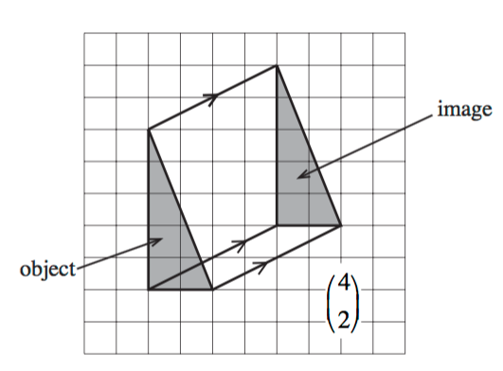
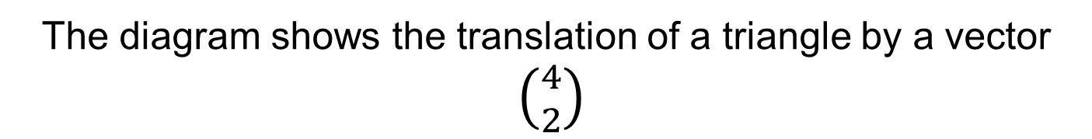
UNIT:
Vectors
Section 1
Vectors and Scalars
Translations can be described using 2-dimensional vectors.
The ‘image’ is the
translated object
The diagram shows the translation of a triangle by a vector
$\left({4 \atop 2}\right)$
4 units to the right
2 units up
The vector specifies the length (how far) and the direction
in which the triangle is to be moved.

Slide 4

UNIT:
Vectors
Section 1
Vectors and Scalars
As we have just seen, vectors have magnitude (size) and direction.
Quantities which have only size are known as scalars
or scalar quantities.
Examples of vectors are: displacement, force and velocity.
Examples of scalars are: mass, length, distance, area and speed.
Notation:
A vector is written in bold, like a and b, and
a scalar quantity is written normally like c.
A vector can also be written using the letters if its start and finish
with an arrow above, like this: AB
AB $=$ a
a
B
A

Slide 5
UNIT:
Vectors
Section 1
Vectors and Scalars
Clear distinctions can be made between:
Distance and Displacement
Distance is a scalar (like ‘5 miles’).
Displacement is a vector (‘5 miles north-east).
You can walk a long way and the distance travelled may be great, but
if you return to the start your displacement will be zero!
Speed and Velocity
Speed is how fast something moves: it is a scalar
(like ‘5 miles per hour’).
Velocity is speed with direction: it is a vector
(‘5 miles per hour south-west’).

Slide 6
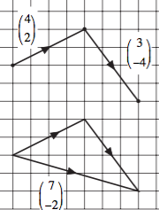
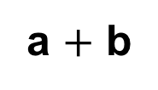
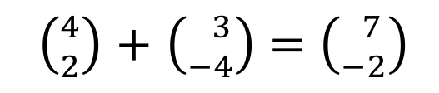
UNIT:
Vectors
Section 1
Vectors and Scalars
Using vectors:
We can add two vectors by joining them together:
a
b
a $+$ b
Adding vectors is easy:
$\left({4 \atop 2}\right)$ $+$ $\left({ 3 \atop −4}\right)=\left({ 7 \atop −2}\right)$
You simply add together
the top numbers
And add together
the bottom numbers

Slide 7
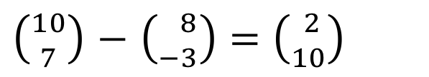
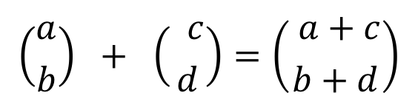
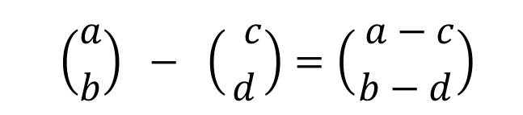
UNIT:
Vectors
Section 1
Vectors and Scalars
A similar method is used for subtraction:
$\left({10 \atop 7}\right)$ $−$ $\left({ 8 \atop −3}\right)=\left({ 2 \atop 10}\right)$
$$\left({a \atop b}\right) + \left({ c \atop d}\right)=\left({ a+c \atop b+d}\right)$$
In general
and
$$\left({a \atop b}\right) − \left({ c \atop d}\right)=\left({ a−c \atop b−d}\right)$$

Slide 8
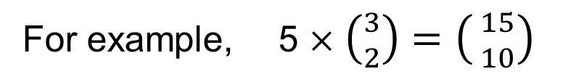
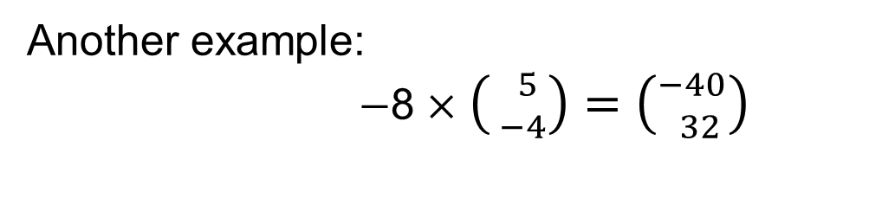
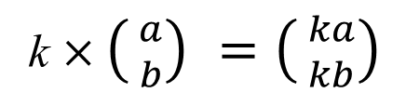
UNIT:
Vectors
Section 1
Vectors and Scalars
Multiplying vectors by scalars is also easy:
For example, 5 ×$\left({3 \atop 2}\right)$ $=\left({ 15 \atop 10}\right)$
Each component is simply multiplied by the scalar.
k × $\left({ a \atop b}\right) =\left({ ka \atop kb}\right)$
In general:
Another example:
$−$8 ×$\left({ 5 \atop −4}\right)$ $=\left({−40 \atop 32}\right)$

Slide 9
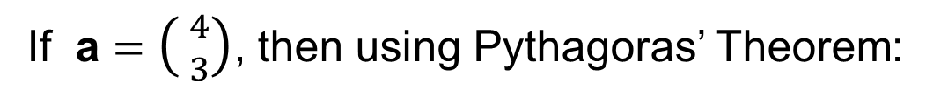
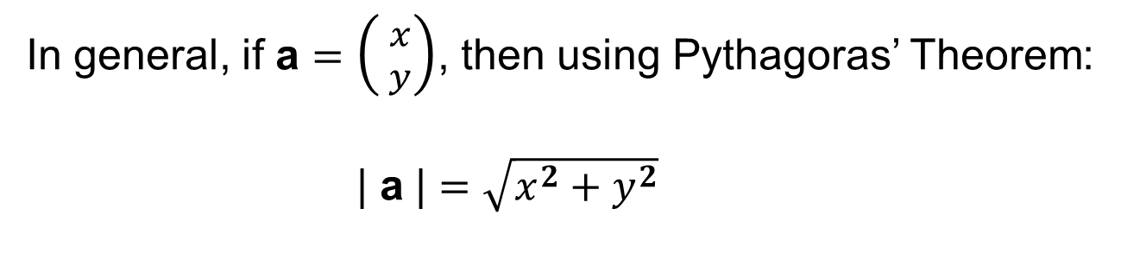
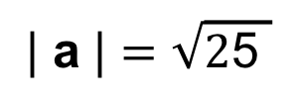
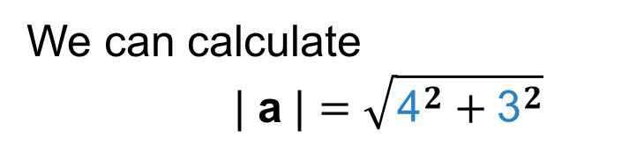
UNIT:
Vectors
Section 1
Vectors and Scalars
The length of a vector is called its magnitude or modulus:
We write this as | a | .
If a $=$ $\left({ 4 \atop 3}\right)$, then using Pythagoras’ Theorem:
a
We can calculate
| a | $=\sqrt{{\text{4}}^{2}+{\text{3}}^{2}}$
3
4
$$\text{| }\text{a}\text{ |}=\sqrt{\text{2}\text{5 }}$$
= 5
In general, if a $=$ $\left({ x \atop y}\right)$, then using Pythagoras’ Theorem:
| a | $=\sqrt{x^{2}+y^{2}}$

Slide 10
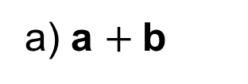


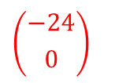

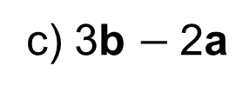



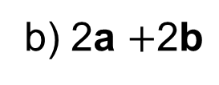
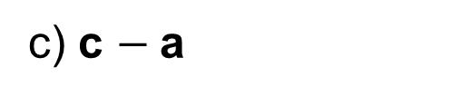

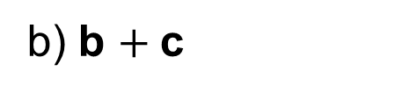

UNIT:
Vectors
Section 1
Section 1: Fitness Check
Here are some questions to check your progress;
there are more practice questions if needed.
1. Which of the following are vectors and which are scalars?
a) Time
$$\text{scalar}$$
b) Temperature
$$\text{scalar}$$
c) Velocity
$$\text{vector}$$
2. If a $= \left({12 \atop 7}\right)$ $,\text{b} = \left({ 3 \atop −4}\right) \text{and} \text{c} = \left({−6 \atop 2}\right)$ find:
a) a $+ \text{b}$
$$\left({15 \atop 3}\right)$$
b) b $+ \text{c}$
$$\left({−3 \atop −2}\right)$$
c) c $− \text{a}$
$$\left({−18 \atop −5}\right)$$
3. If a $= \left({ 2 \atop −3}\right)$ $,\text{b} = \left({ 2 \atop 5}\right) \text{and} \text{c} = \left({−4 \atop 0}\right)$ find:
a) 6c
$$\left({−24 \atop 0}\right)$$
b) 2a $+\text{2}\text{b}$
$$\left({ 8 \atop 4}\right)$$
c) 3b $− \text{2}\text{a}$
$$\left({ 2 \atop 21}\right)$$

Slide 11
UNIT:
Vectors
Section 1
Section 1: Review
You have completed the first Section.
If you have completed and understood this section,
click to start the next Section
If you need more examples and interactive practice,
press here
You might also find it helpful to look at:
Essential Information: press here

Slide 12
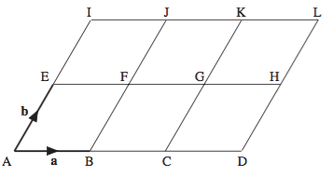
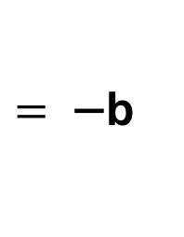
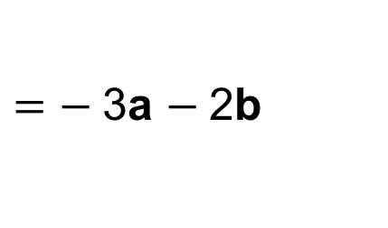
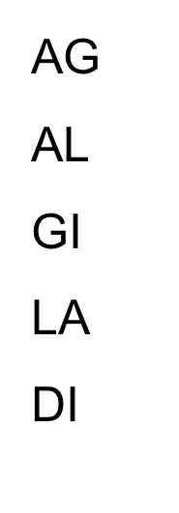
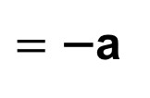
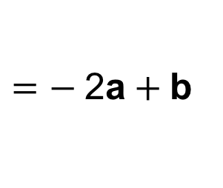
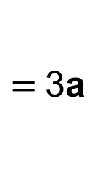
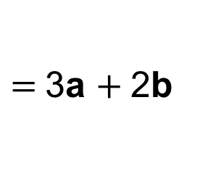
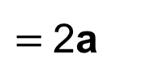
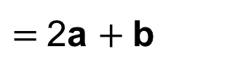
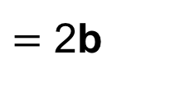
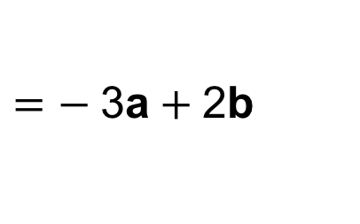
UNIT:
Vectors
Section 2
Vectors and Geometry
Vectors can be used to solve problems in geometry.
It is possible to describe any point, in 2 dimensions, using two vectors.
For example, using multiples of the vectors a and b, we can get to all the points shown on the diagram, assuming that the AE = EI and AB = BC = CD and lines AI and BJ etc. and AD and EH etc. are parallel.
AC
EH
KJ
KG
BJ
$=$2a
AG
AL
GI
LA
DI
$=$2a $+ \text{b}$
$=$3a
$=$3a $+ \text{2}\text{b}$
$=\text{−}$a
$=− \text{2}$a$+ \text{b}$
$= \text{−}$b
$=−$3a $− \text{2}\text{b}$
$=$ 2b
$=− \text{3}$a$+ \text{2}\text{b}$
Parallel vectors are those with the same direction;
they do not have to be the same size.
Examples of parallel vectors are: AE, CK and HL.
Note: to reverse the
direction of a vector,
reverse the sign
of the vector

Slide 13
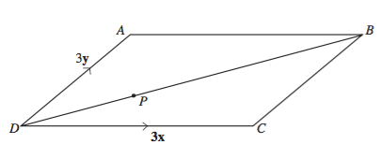
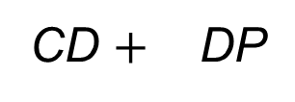
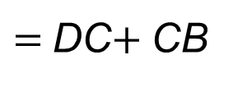
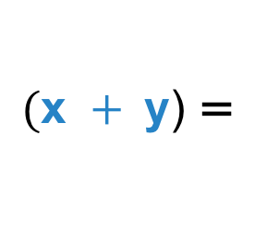

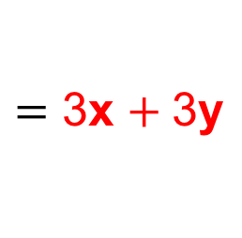
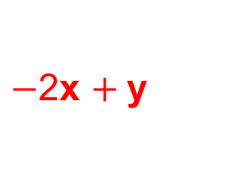
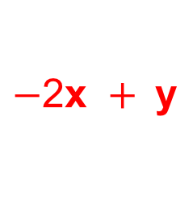
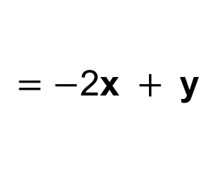
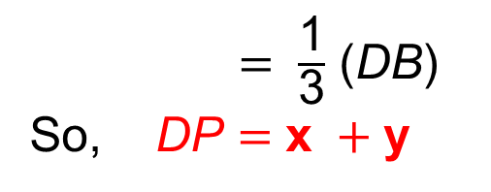
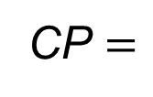
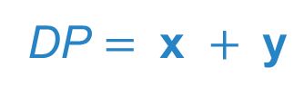
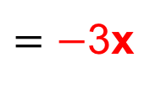
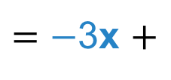
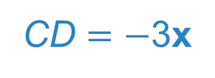
UNIT:
Vectors
Section 2
Vectors and Geometry
Example 1:
ABCD is a parallelogram such that DC $=$ 3x and DY $=$ 3y.
Not drawn to scale
Solution:
The point P is on DB such that DP : PB $=$ 1 : 2
Express in terms of x and y:
BA DB DP
$=$ $−$3x
$=$DC$+$CB
$=$ $\frac{\text{1}}{\text{3}}$ (DB)
So, DP $=$ $\text{x} +\text{y}$
$=$ 3x $+ \text{3}\text{y}$
Show that CP
$$=−\text{2}\text{x} + \text{y}$$
$−$2x $+ \text{y}$
CD $=−$3x
CP $=$
CD $+$ DP
DP $= \text{x} + \text{y}$
$=−$3x $+$
$$\text{(}\text{x} + \text{y}\text{)} \text{=}$$
$−$2x $+ \text{y}$

Slide 14
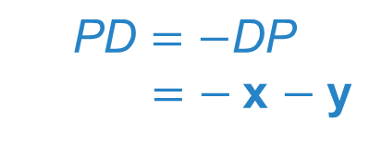
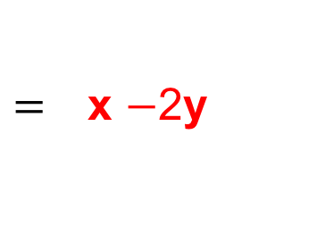

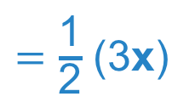









Vectors and Geometry
UNIT:
Vectors
Section 2
Example 2:
ABCD is a parallelogram such that DC $=$ 3x and DY $=$ 3y.
The point P is on
DB such that
DP : PB $=$ 1 : 2
Not drawn to scale
Solution
Given that E is the midpoint of DC, prove that A, P and E are collinear.
We know:
AP $= \text{A}\text{D} + \text{D}\text{P}$
and
PE$= \text{P}\text{D} + \text{D}\text{E}$
$=$ $−\text{3}\text{y} + \text{(}\text{x} + \text{y}\text{)}$
$$=−\text{x} − \text{y} +\frac{\text{1}}{\text{2}}\text{ (3}\text{x}\text{)}$$
$\text{A}\text{D}=$ $−\text{3}\text{y}$
$=$ $\text{x}$ $−\text{2}\text{y}$
$= \frac{\text{1}}{\text{2}}$ $\text{x}$ $− \text{y}$
$\text{D}\text{P}=$ $\text{x} + \text{y}$
Hence, 2 × PE $=$ $\text{x}$ $−\text{2}\text{y}=$ AP
$$\text{P}\text{D}=−\text{DP}$$
$=−$x $− \text{y}$
that is PE and AP have the same direction.
And AP and PE have point P in common, so
A, P and E are collinear (i.e. all lie on a single straight line).
$=$ $\frac{\text{1}}{\text{2}}$ (3$\text{x}$)
DE

Slide 15
















UNIT:
Vectors
Section 2
Vectors and Geometry
Example 3:
ABCDEF is a regular hexagon, with centre O. OA $=$ a and OB $=$ b.
Solution
Find, in terms of a, the vector AD
$$\text{AD}=$$
$−\text{2}$a
Find, in terms of a and b, the vector AB
$$\text{A}\text{B}=$$
AO $+$ OB
$=$ $−$a
$$+ \text{b}$$
Find, in terms of b, the vector AF
$$\text{A}\text{F}=$$
$$−\text{b}$$
(as is parallel to OB)
Find, in terms of a and b, the vector FC
$$\text{FC}=$$
FA $+$ AB $+$BC
$(−\text{a}$)
$=$ $\text{b}$ $+$
$=$ $−\text{2}$a $+\text{2}\text{b}$
$(−$a $+ \text{b}\text{)}+$

Slide 16












Section 2: Fitness Check
UNIT:
Vectors
Section 2
Here are some questions to check your progress;
there are more practice questions if needed.
The diagram shows the parallelogram OABC, in which OA $=$ a
and OC $=$ c.
Write the following vectors
in terms of a and c.
AB
CB
BC
$=$c
AC
OB
CA
$$=\text{c}−\text{a}$$
$$= \text{a}$$
$$=\text{c}+\text{a}$$
$$=−\text{a}$$
$$=−\text{c}+\text{a}$$
In the diagram, if X is the midpoint of AB and Y is the midpoint of BC, find the following in terms of a and c.
$$=\frac{1}{2}\text{c}$$
OY
XY
$$= \text{c}+\frac{1}{2}\text{a}$$
AX
OX
$$=\text{a}+\frac{1}{2}c$$
$$=\frac{1}{2}\text{c}−\frac{1}{2}\text{a}$$

Slide 17
UNIT:
Vectors
Section 2
Section 2: Review
You have completed the second Section.
If you have completed and mastered this last section,
click here for the Unit audit
If you need more examples and interactive practice,
press here
You might also find it helpful to look at:
Essential Information: press here

