Slide 1
Supporting and Enhancing Mathematics and Statistics
UNIT: Binomial Theorem

Slide 2
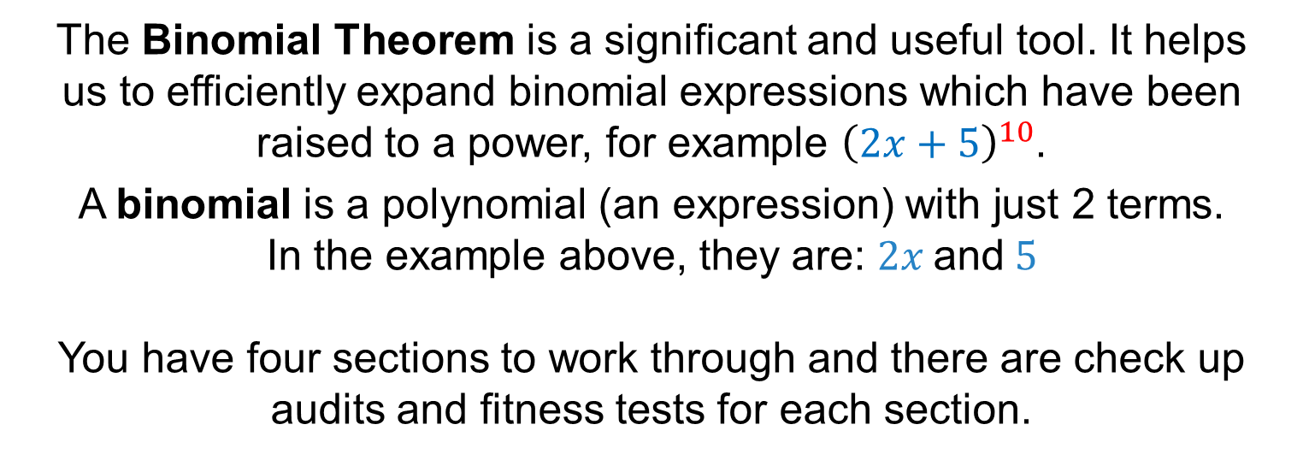
UNIT:
Binomial Theorem
Binomial Theorem
The Binomial Theorem is a significant and useful tool. It helps
us to efficiently expand binomial expressions which have been raised to a power, for example ${\left(2x+5\right)}^{10}$.
A binomial is a polynomial (an expression) with just 2 terms.
In the example above, they are: $2x \text{and} 5$
You have four sections to work through and there are check up audits and fitness tests for each section.
Binomial Expansion
Binomial Coefficients
Factorials
Binomial Theorem

Slide 3


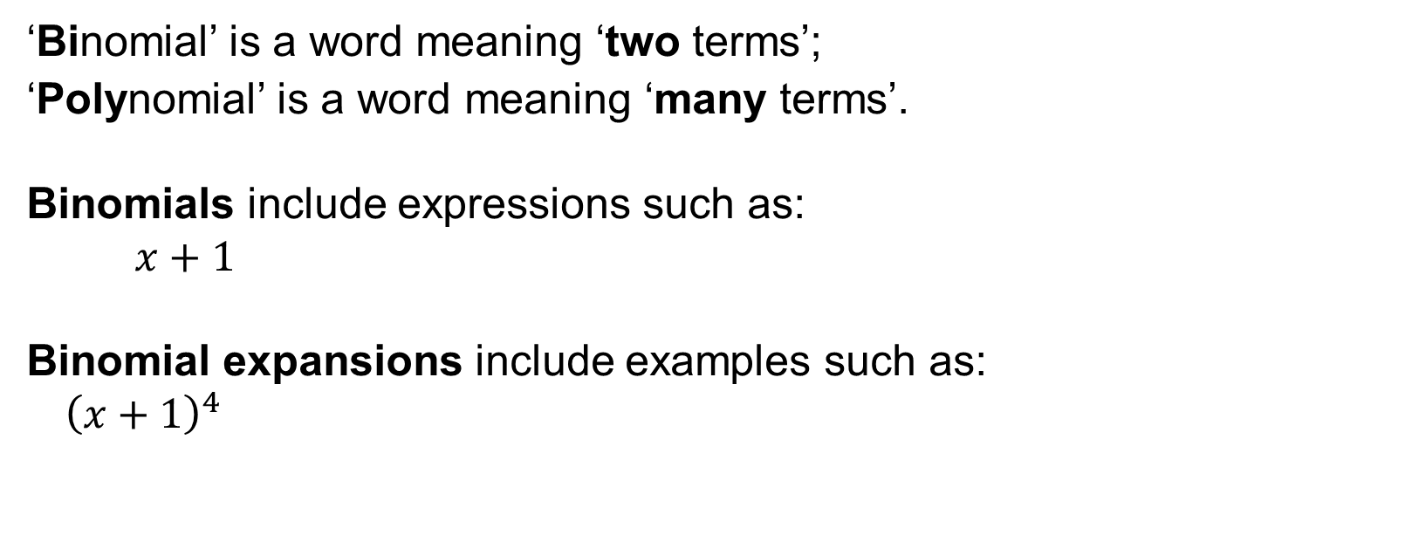


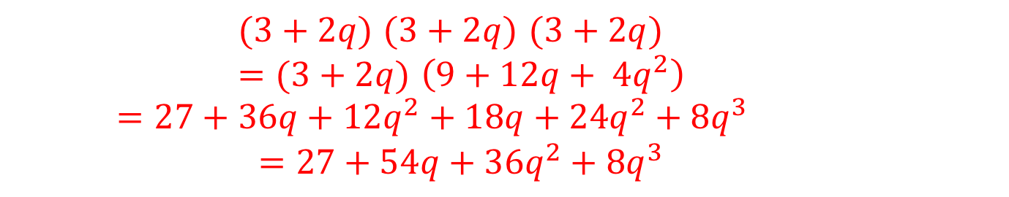
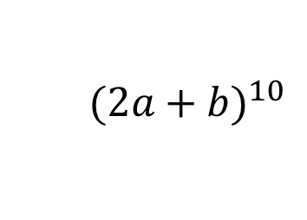
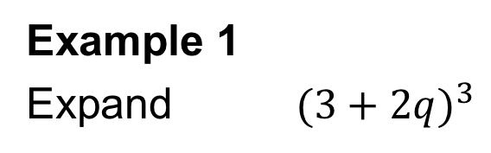


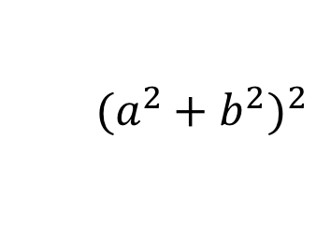
UNIT:
Binomial
Theorem
Section 1
Binomial Expansion
‘Binomial’ is a word meaning ‘two terms’;
‘Polynomial’ is a word meaning ‘many terms’.
Binomials include expressions such as:
$x+1$
Binomial expansions include examples such as:
$${ \left(x+1\right)}^{4}$$
$$2a+b$$
$$x+y$$
$$12x+5$$
$$a^{2}+b^{2}$$
$${ (2a+b)}^{10}$$
$${(x+y)}^{8}$$
$${(13x+5)}^{5}$$
$${ (a^{2}+b^{2})}^{2}$$
Example 1
Expand ${ (3+2q)}^{3}$
$(3+2q)$ $(3+2q)$ $(3+2q)$
$=(3+2q)$ $\left(9+12q+ {4q}^{2}\right)$
$=27+36q+12q^{2}+18q+24q^{2}+{8q}^{3}$
$=27+54q+36q^{2}+{8q}^{3}$
Solution
First write out the expansion longhand.
Multiply together the final 2 brackets.
Then multiply by the first bracket
and collect like terms

Slide 4

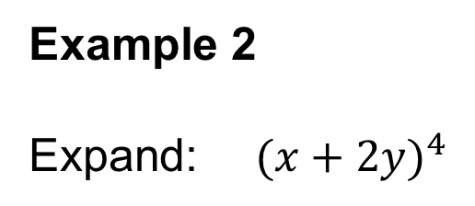
UNIT:
Binomial
Theorem
Section 1
Binomial Expansion: Examples
Example 2
Expand: ${ (x+2y)}^{4}$
Solution
First write out the expansion longhand:
$(x+2y)$ $(x+2y)$ $(x+2y)(x+2y)$
Multiply together the first two brackets and the final 2 brackets:
$$(x^{2}+4xy+ {4y}^{2})(x^{2}+4xy+ {4y}^{2})$$
Then multiply together these brackets:
$$x^{4}+{4x}^{3}y+{4x}^{2}y^{2}+ {4x}^{3}y+{16x}^{2}y^{2}+{16xy}^{3}+{4x}^{2}y^{2}+{16xy}^{3}+{16y}^{4}$$
Collect like terms together:
$$x^{4}+{8x}^{3}y+24x^{2}y^{2}+ {32xy}^{3}+{16y}^{4}$$

Slide 5
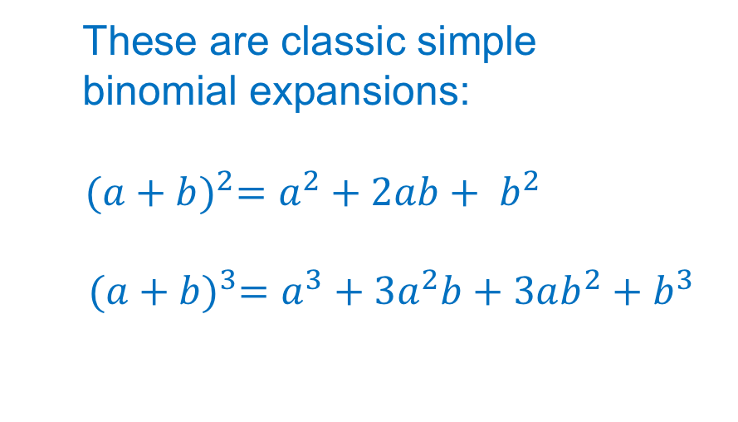
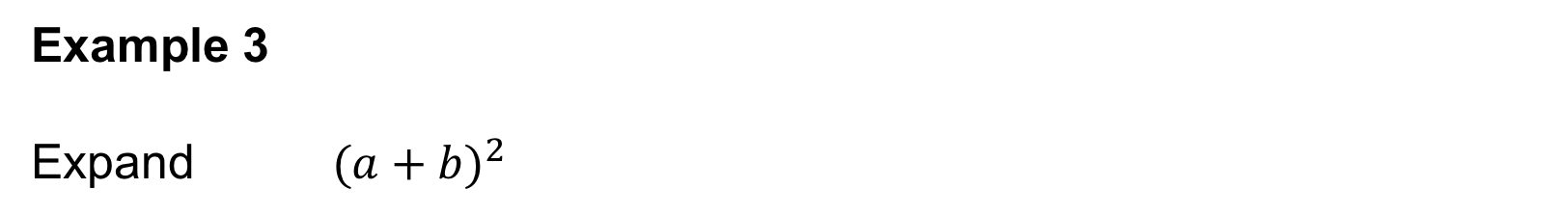


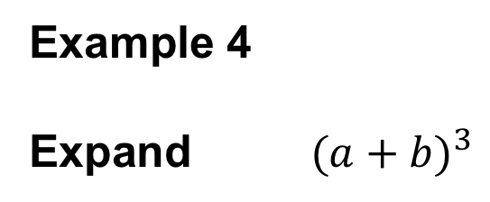
UNIT:
Binomial
Theorem
Section 1
Binomial Expansion: Examples
Example 3
Expand ${ (a+b)}^{2}$
These are classic simple
binomial expansions:
$${ (a+b)}^{2}=a^{2}+2ab+ b^{2}$$
$${ (a+b)}^{3}=a^{3}+3a^{2}b+3ab^{2}+b^{3}$$
Solution $(a+b)$ $\left(a+b\right)$
${=a}^{2}+2ab+ b^{2}$
Example 4
Expand ${ (a+b)}^{3}$
Solution: $(a+b)$ $(a+b)$ $(a+b)$
$=(a+b)$ $\left(a^{2}+2ab+ b^{2}\right)$
${=a}^{3}+3a^{2}b+3ab^{2}+b^{3}$

Slide 6

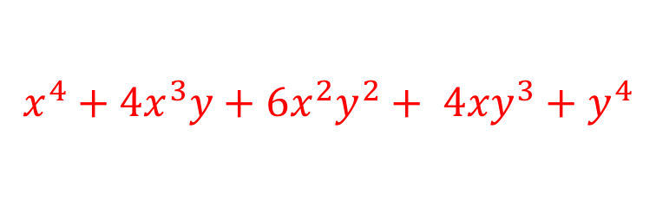
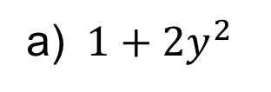
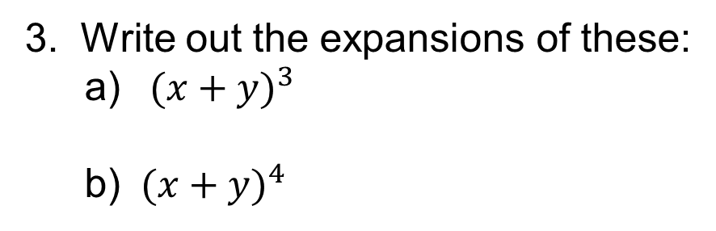


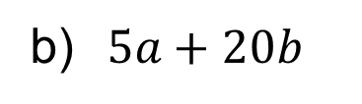
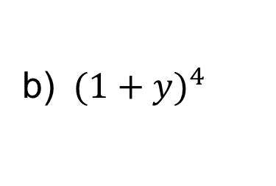
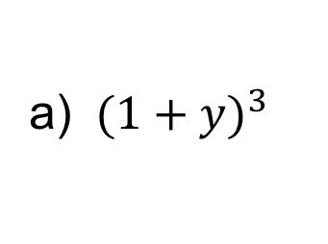
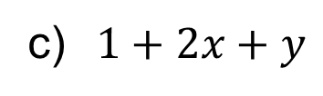
UNIT:
Binomial
Theorem
Section 1
Section 1: Fitness Check
Here are some questions to check your progress;
there are more practice questions if needed.
1. Are these binomial expressions?
a) ${ 1+2y}^{2}$
Yes
b)$5a+20b$
Yes
c)$1+2x+y$
No
2. Write out the expansions of these:
a) ${ (1+y)}^{3}$
b) ${ (1+y)}^{4}$
$$1+3y+3y^{2}+y^{3}$$
$$1+4y+6y^{2}+{4y}^{3}+y^{4}$$
3. Write out the expansions of these:
a) ${ (x+y)}^{3}$
b) ${ (x+y)}^{4}$
$$x^{3}+3x^{2}y+3xy^{2}+y^{3}$$
$$x^{4}+{4x}^{3}y+6x^{2}y^{2}+ {4xy}^{3}+y^{4}$$

Slide 7
UNIT:
Binomial Theorem
Section 1
Section 1: Review
You have completed the first Section.
If you have completed and mastered this last section,
click here to start the next Section
If you need more examples and interactive practice,
press here
You might also find it helpful to look at:
Essential Information: press here

Slide 8
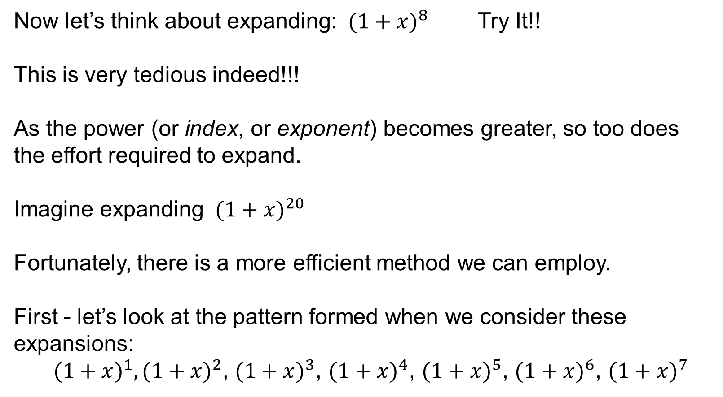
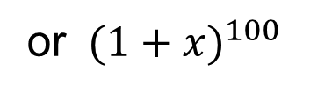
UNIT:
Binomial
Theorem
Section 2
Binomial Coefficients
Now let’s think about expanding: ${ (1+x)}^{8}$ Try It!!
This is very tedious indeed!!!
As the power (or index, or exponent) becomes greater, so too does the effort required to expand.
Imagine expanding ${ (1+x)}^{20}$
Fortunately, there is a more efficient method we can employ.
First - let’s look at the pattern formed when we consider these expansions:
${(1+x)}^{1},{(1+x)}^{2}$, ${(1+x)}^{3}$, ${(1+x)}^{4}$, ${(1+x)}^{5}$, ${(1+x)}^{6}$, ${(1+x)}^{7}$
or ${ (1+x)}^{100}$

Slide 9
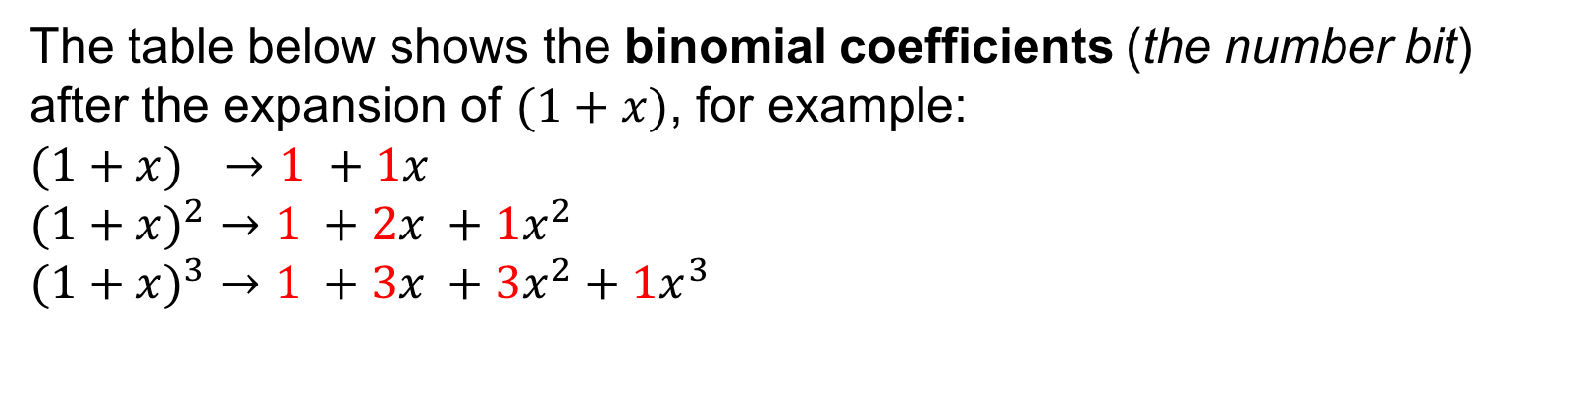
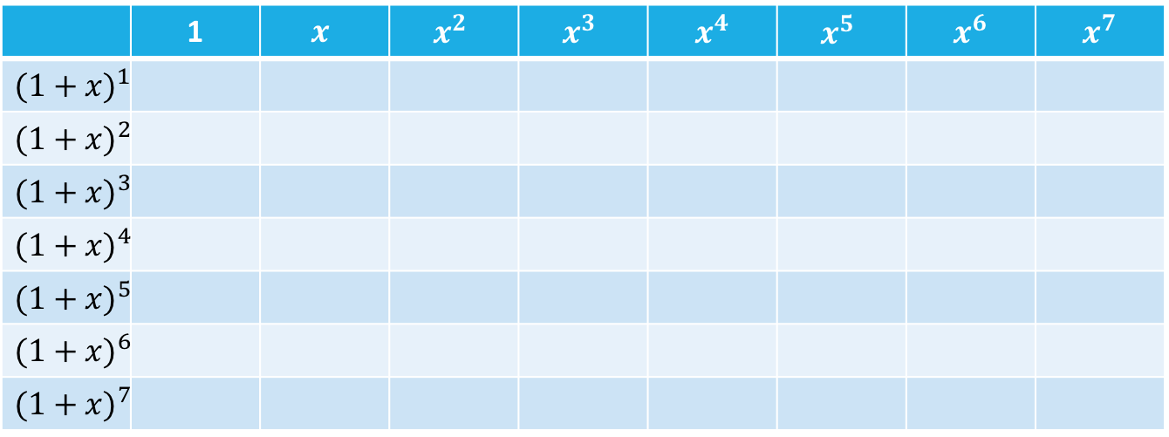
UNIT:
Binomial
Theorem
Section 2
Binomial Coefficients
The table below shows the binomial coefficients (the number bit)
after the expansion of $(1+x)$, for example:
$(1+x)$ $→$ $1 +1x$
${(1+x)}^{2}$ $→$ $1 +2x +1x^{2}$
${(1+x)}^{3}$ $→$ $1 +3x +3x^{2}+{1x}^{3}$
 | 1 | $$x$$ | $$x^{2}$$ | $$x^{3}$$ | $$x^{4}$$ | $$x^{5}$$ | $$x^{6}$$ | $$x^{7}$$
$${(1+x)}^{1}$$
$${(1+x)}^{2}$$
$${(1+x)}^{3}$$
$${(1+x)}^{4}$$
$${(1+x)}^{5}$$
$${(1+x)}^{6}$$
$${(1+x)}^{7}$$
1
1
1
2
1
1
3
3
1
continued…

Slide 10
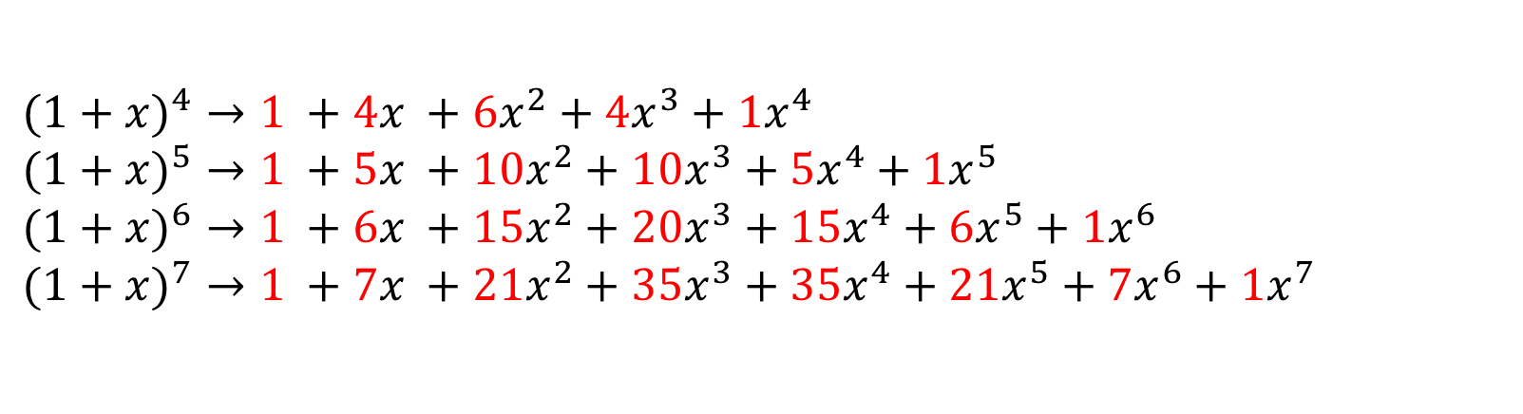

UNIT:
Binomial
Theorem
Section 2
Binomial Coefficients
${(1+x)}^{4}$ $→$ $1 +4x +6x^{2}+4x^{3}+{1x}^{4}$
${(1+x)}^{5}$ $→$ $1 +5x +10x^{2}+{10x}^{3}+5x^{4}+{1x}^{5}$
${(1+x)}^{6}$ $→$ $1 +6x +15x^{2}+{20x}^{3}+15x^{4}+{6x}^{5}+{1x}^{6}$
${(1+x)}^{7}$ $→$ $1 +7x +21x^{2}+{35x}^{3}+{35x}^{4}+21x^{5}+{7x}^{6}+{1x}^{7}$
 | 1 | $$x$$ | $$x^{2}$$ | $$x^{3}$$ | $$x^{4}$$ | $$x^{5}$$ | $$x^{6}$$ | $$x^{7}$$
$${(1+x)}^{1}$$
$${(1+x)}^{2}$$
$${(1+x)}^{3}$$
$${(1+x)}^{4}$$
$${(1+x)}^{5}$$
$${(1+x)}^{6}$$
$${(1+x)}^{7}$$
1
1
1
2
1
1
3
3
1
1
4
6
4
1
1
5
10
10
5
1
1
6
15
20
15
6
1
1
7
21
35
35
21
7
1

Slide 11
UNIT:
Binomial
Theorem
Section 2
Binomial Coefficients: Pascal’s Triangle
The binomial coefficients follow a pattern.
Did you spot it?
Each row begins and ends with a ‘1’.
Subsequent terms can be found by summing two consecutive
terms from the row above.
The coefficients actually make Pascal’s Triangle:
1
1 1
1 2 1
1 3 3 1
1 4 6 4 1
1 5 10 10 5 1
1 6 15 20 15 6 1
1 7 21 35 35 21 7 1
Row 0
Row 1
Row 2
Row 3
Row 4
Row 5
Row 6
Row 7

Slide 12
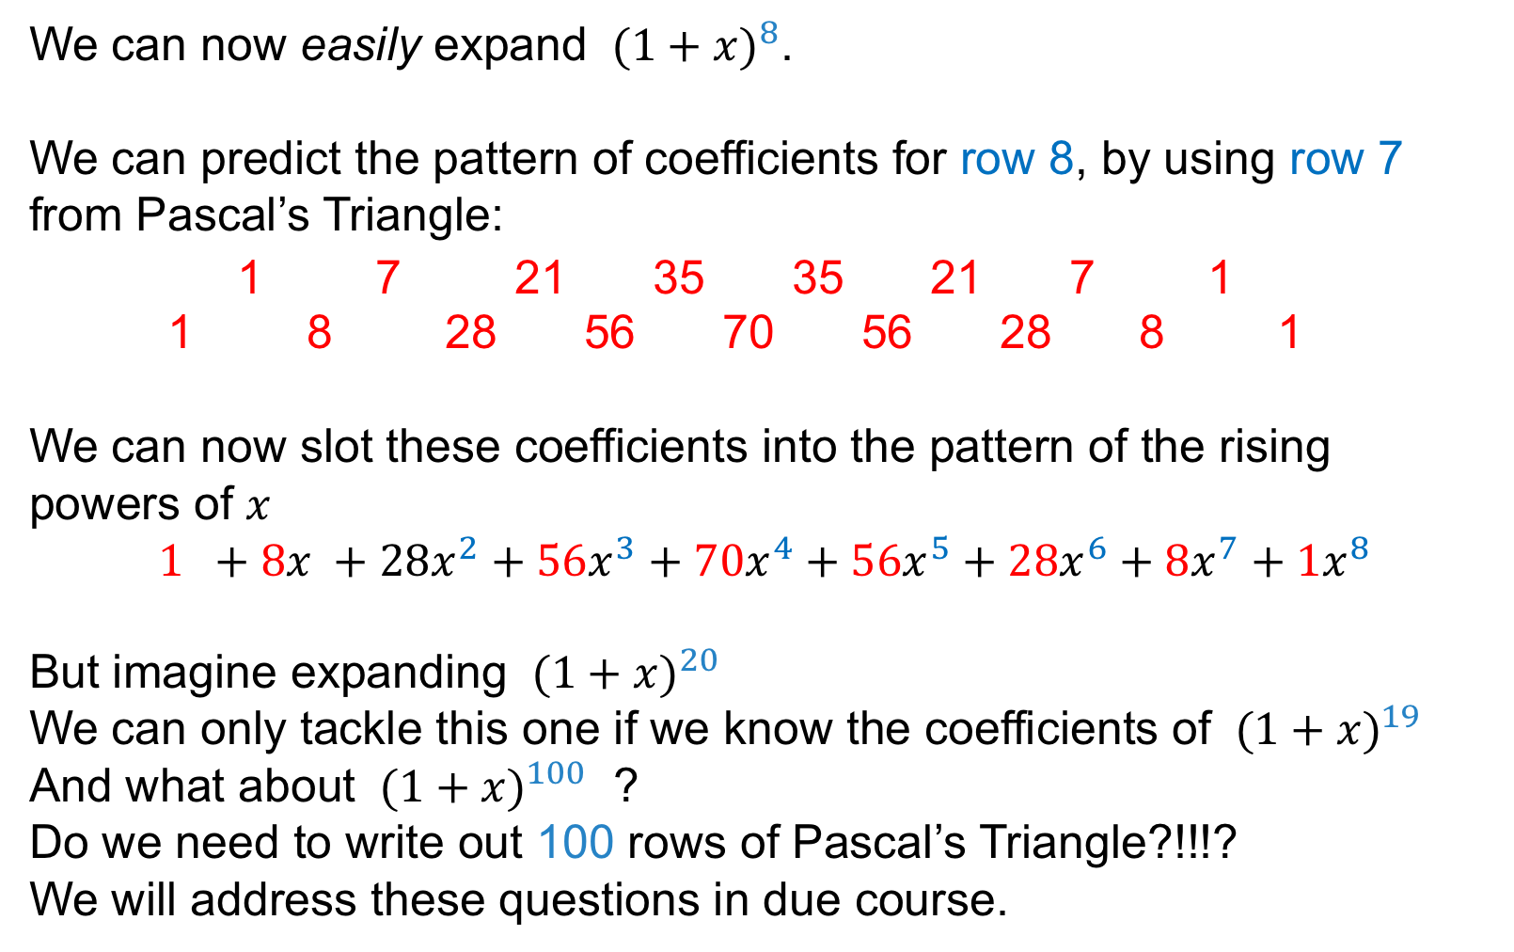



UNIT:
Binomial
Theorem
Section 2
Binomial Coefficients
We can now easily expand ${ (1+x)}^{8}$.
We can predict the pattern of coefficients for row 8, by using row 7 from Pascal’s Triangle:
1 7 21 35 35 21 7 1
1 8 28 56 70 56 28 8 1
We can now slot these coefficients into the pattern of the rising
powers of $x$
$$1 +8x +28x^{2}+{56x}^{3}+70x^{4}+{56x}^{5}+28x^{6}+{8x}^{7}+{1x}^{8}$$
But imagine expanding ${ (1+x)}^{20}$
We can only tackle this one if we know the coefficients of ${ (1+x)}^{19}$
And what about ${ (1+x)}^{100}$ ?
Do we need to write out 100 rows of Pascal’s Triangle?!!!?
We will address these questions in due course.
Row 7
Row 8
$$x^{0}$$
$${}^{1}$$
We could add in $x^{0}$ if we wish, but remember $x^{0}=1$
And remember $x=x^{1}$

Slide 13



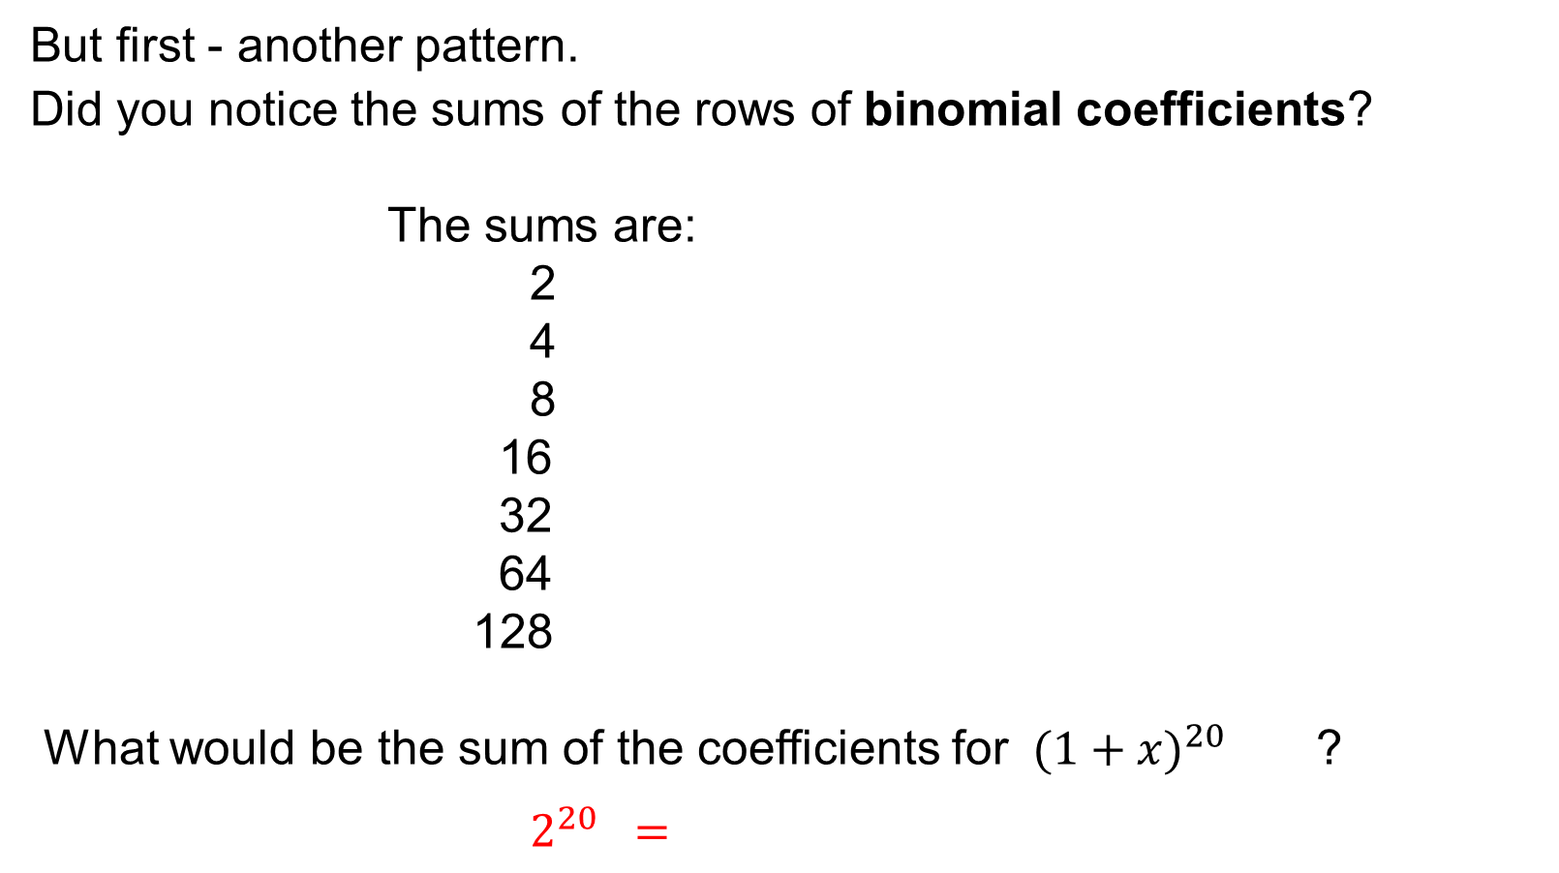











UNIT:
Binomial
Theorem
Section 2
Binomial Coefficients
But first - another pattern.
Did you notice the sums of the rows of binomial coefficients?
The sums are:
2
4
8
16
32
64
128
What would be the sum of the coefficients for ${ (1+x)}^{20}$ ?
$2^{20} =$
$${ (1+x)}^{1}$$
$$2^{1}$$
$${ (1+x)}^{2}$$
$$2^{2}$$
$${ (1+x)}^{3}$$
$$2^{3}$$
$${ (1+x)}^{4}$$
$$2^{4}$$
$${(1+x)}^{5}$$
$$2^{5}$$
$${ (1+x)}^{6}$$
$$2^{6}$$
$${ (1+x)}^{7}$$
$$2^{7}$$
1 048 576

Slide 14
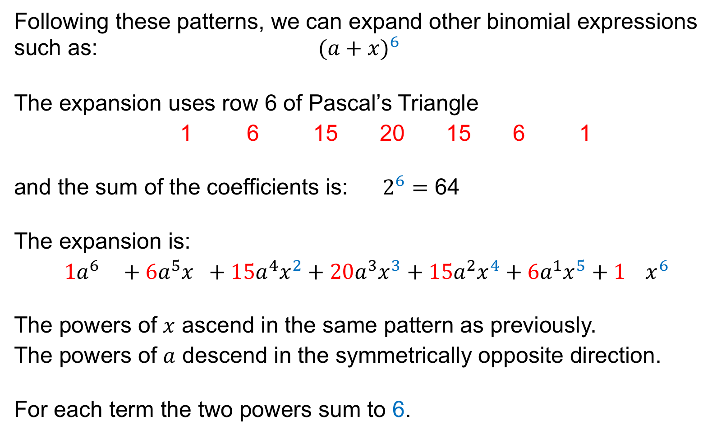



UNIT:
Binomial
Theorem
Section 2
Binomial Coefficients: Examples
Following these patterns, we can expand other binomial expressions such as: ${ (a+x)}^{6}$
The expansion uses row 6 of Pascal’s Triangle
1 6 15 20 15 6 1
and the sum of the coefficients is:$2^{6}=$ 64
The expansion is:
$$1a^{6 } +6a^{5}x +15{a^{4}x}^{2}+{20a^{3}x}^{3}+15a^{2}x^{4}+{6a^{1}x}^{5}+1{ x}^{6}$$
The powers of $x$ ascend in the same pattern as previously.
The powers of $a$ descend in the symmetrically opposite direction.
For each term the two powers sum to 6.
Row 6
$$x^{0}$$
$${}^{1}$$
$$a^{0}$$

Slide 15
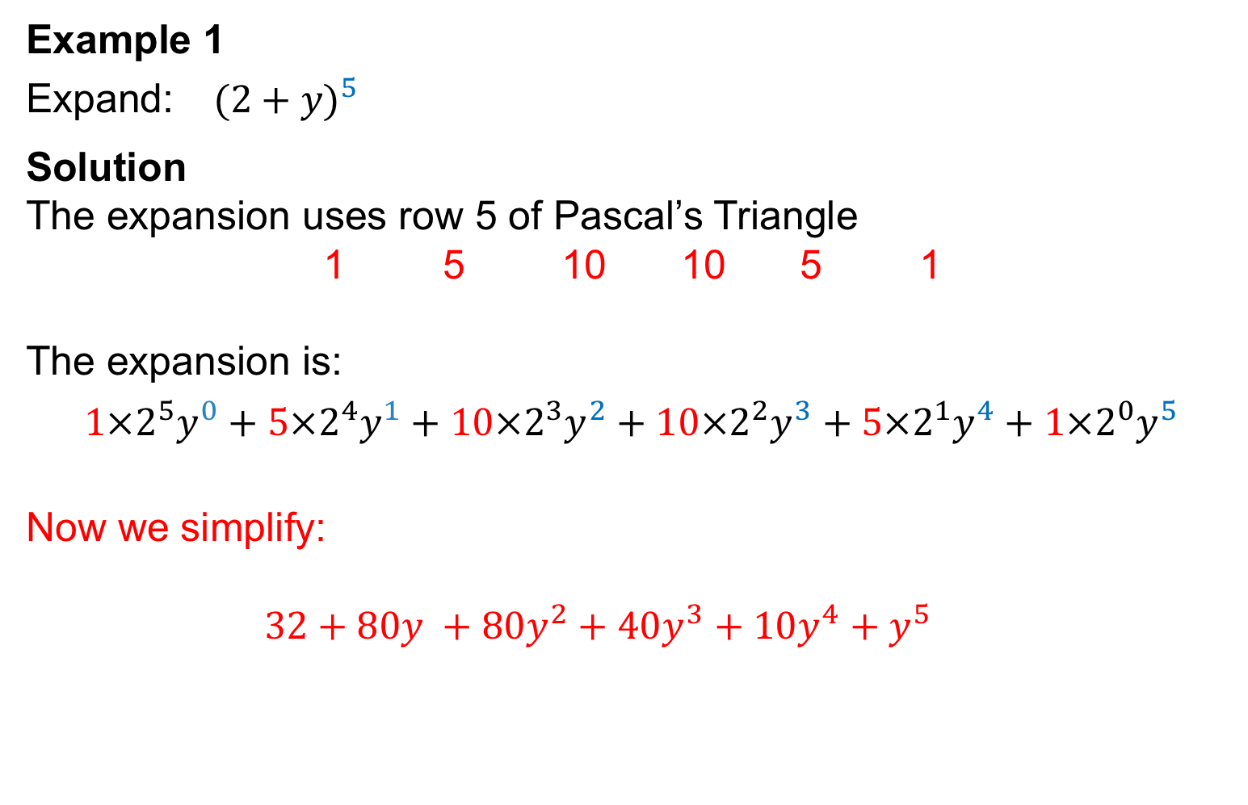
UNIT:
Binomial
Theorem
Section 2
Binomial Coefficients: Examples
Example 1
Expand: ${ (2+y)}^{5}$
Solution
The expansion uses row 5 of Pascal’s Triangle
1 5 10 10 5 1
The expansion is:
$${1×2}^{5}y^{0}+5×2^{4}y^{1}+10{{×2}^{3}y}^{2}+{10×2^{2}y}^{3}+5×2^{1}y^{4}+{1{×2}^{0}y}^{5}$$
Now we simplify:
$32+80y +80y^{2}+{40y}^{3}+10y^{4}+y^{5}$
Row 5

Slide 16
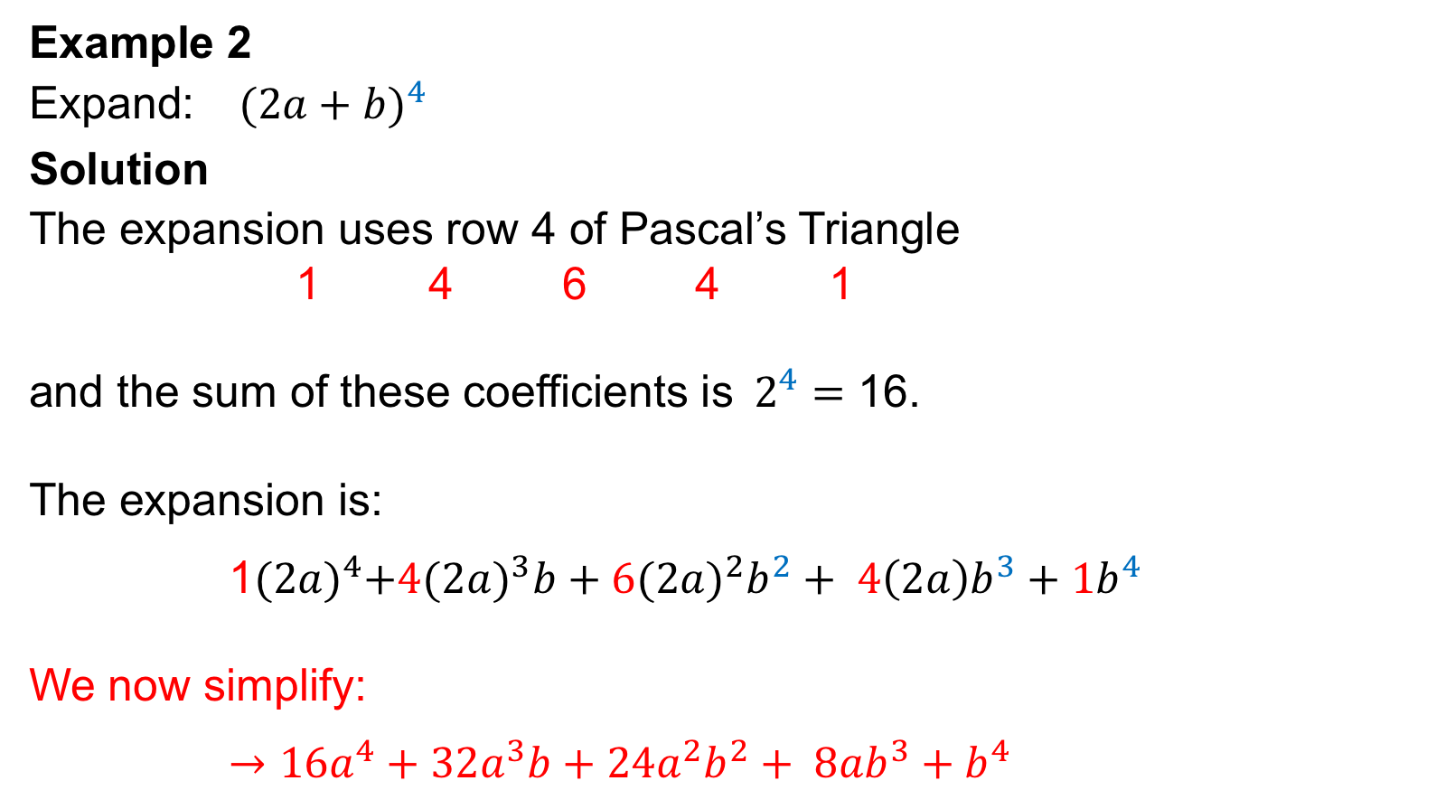
UNIT:
Binomial
Theorem
Section 2
Binomial Coefficients: Examples
Example 2
Expand: ${ (2a+b)}^{4}$
Solution
The expansion uses row 4 of Pascal’s Triangle
1 4 6 4 1
and the sum of these coefficients is$2^{4}=$ 16.
The expansion is:
1${(2a)}^{4}+{4(2a)}^{3}b+6{(2a)}^{2}b^{2}+ {4\left(2a\right)b}^{3}+{1b}^{4}$
We now simplify:
$→{16a}^{4}+{32a}^{3}b+{24a}^{2}b^{2}+ {8ab}^{3}+b^{4}$
Row 4

Slide 17
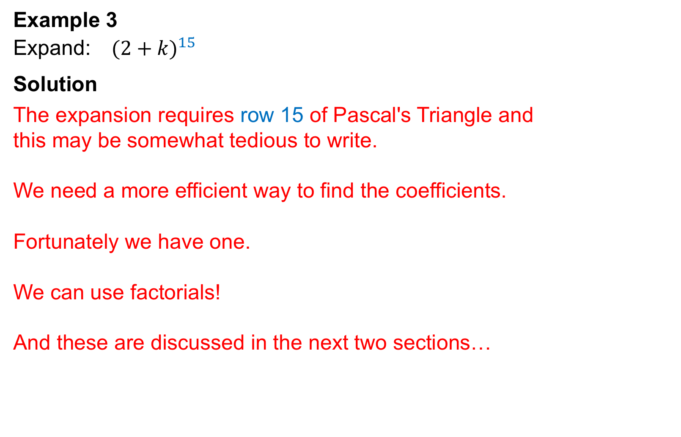
UNIT:
Binomial
Theorem
Section 2
Binomial Coefficients: Examples
Example 3
Expand: ${ (2+k)}^{15}$
Solution
The expansion requires row 15 of Pascal's Triangle and
this may be somewhat tedious to write.
We need a more efficient way to find the coefficients.
Fortunately we have one.
We can use factorials!
And these are discussed in the next two sections…

Slide 18
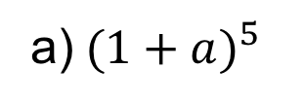
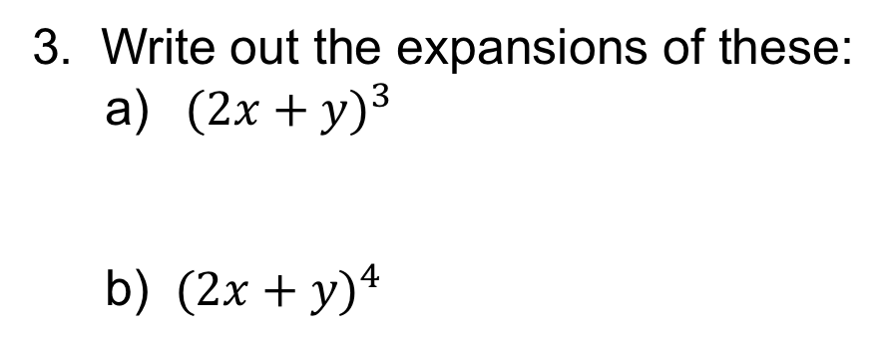


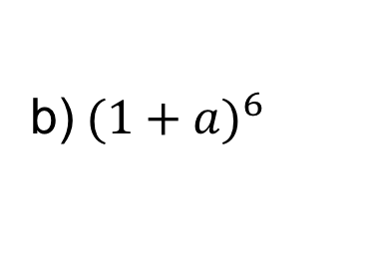
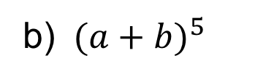

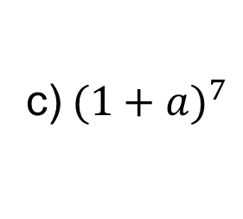
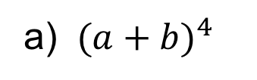

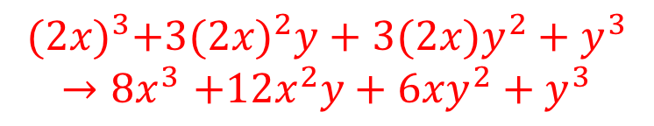
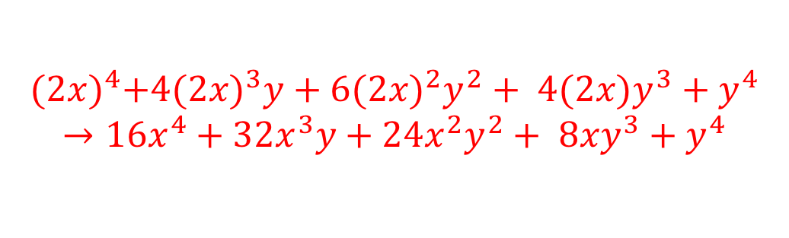
UNIT:
Binomial
Theorem
Section 2
Section 2: Fitness Check
Here are some questions to check your progress;
there are more practice questions if needed.
1. In each of the following expansions, what is the coefficient for $a^{4}$ ?
a)${ (1+a)}^{5}$
$$5$$
b)${ (1+a)}^{6}$
$$15$$
c)${ (1+a)}^{7}$
$$35$$
2. Write out the expansions of these:
a) ${ (a+b)}^{4}$
$$1a^{4}+4a^{3}b +6{a^{2}b}^{2}+{4ab}^{3}+1b^{4}$$
b) ${ (a+b)}^{5}$
$$1a^{5}+5a^{4}b +10{a^{3}b}^{2}+{10a^{2}b}^{3}+5ab^{4}+{1b}^{5}$$
3. Write out the expansions of these:
a) ${ (2x+y)}^{3}$
b) ${ (2x+y)}^{4}$
$${(2x)}^{3}+3{(2x)}^{2}y+3(2x)y^{2}+y^{3}$$
$${→8x}^{3}+12x^{2}y+6xy^{2}+y^{3}$$
$${(2x)}^{4}+{4(2x)}^{3}y+6{(2x)}^{2}y^{2}+ {4(2x)y}^{3}+y^{4}$$
$$→{16x}^{4}+{32x}^{3}y+{24x}^{2}y^{2}+ {8xy}^{3}+y^{4}$$

Slide 19
UNIT:
Binomial Theorem
Section 2
Section 2: Review
You have completed the second Section.
If you have completed and mastered this last section,
click here to start the next Section
If you need more examples and interactive practice,
press here
You might also find it helpful to look at:
Essential Information: press here

Slide 20
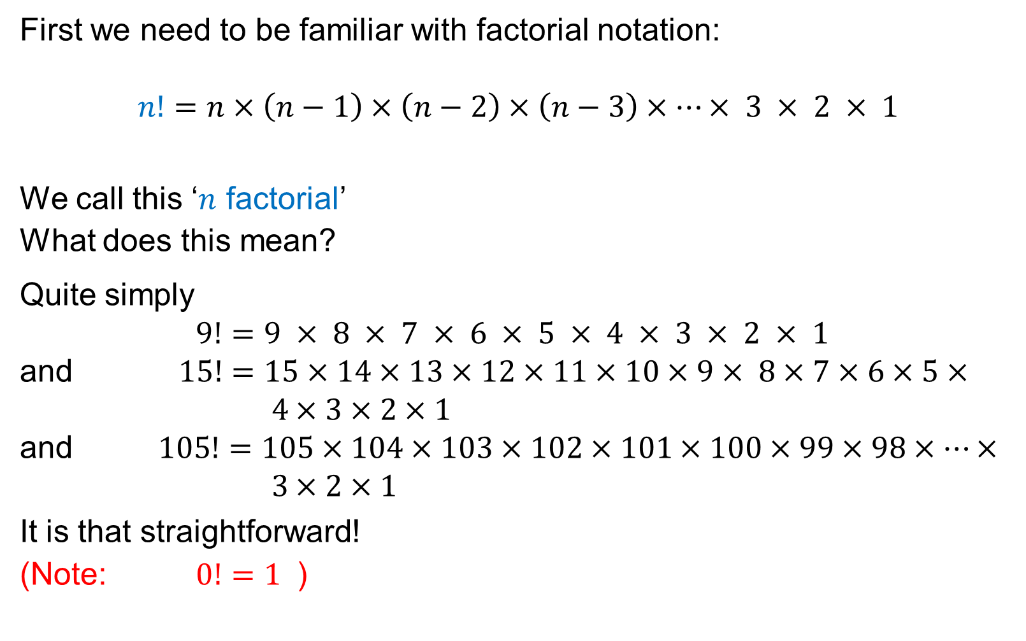
UNIT:
Binomial
Theorem
Section 3
Factorials
First we need to be familiar with factorial notation:
$$n!=n×\left(n−1\right)×\left(n−2\right)×\left(n−3\right)×…× 3 × 2 × 1$$
We call this ‘$n$ factorial’
What does this mean?
Quite simply
$9!=9 × 8 × 7 × 6 × 5 × 4 × 3 × 2 × 1$
and $15!=15×14×13×12×11×10×9× 8×7×6×5× 4×3×2×1$
and $105!=105×104×103×102×101×100×99×98×…× 3×2×1$
It is that straightforward!
(Note: $0!=1$ )

Slide 21
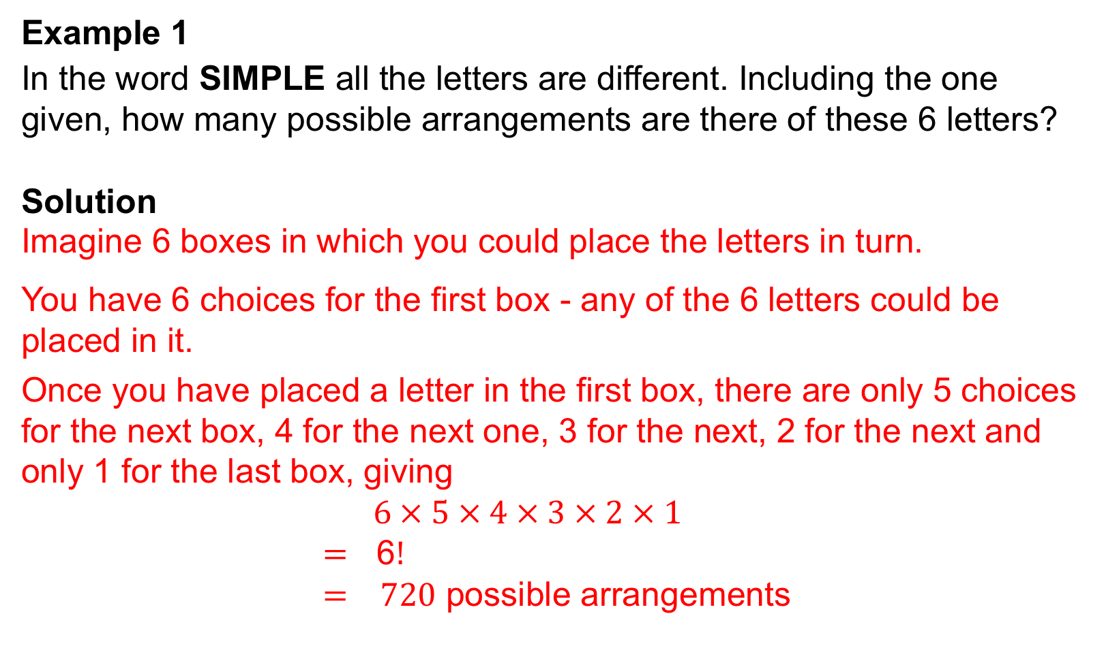
UNIT:
Binomial
Theorem
Section 3
Arrangements: Examples
Example 1
In the word SIMPLE all the letters are different. Including the one given, how many possible arrangements are there of these 6 letters?
Solution
Imagine 6 boxes in which you could place the letters in turn.
You have 6 choices for the first box - any of the 6 letters could be placed in it.
Once you have placed a letter in the first box, there are only 5 choices for the next box, 4 for the next one, 3 for the next, 2 for the next and only 1 for the last box, giving
$6 × 5 × 4 × 3 × 2 × 1$
$=$ 6$!$
$= 720$ possible arrangements

Slide 22

UNIT:
Binomial
Theorem
Section 3
Arrangements: Examples
Example 2
The word EXCEL has one letter which repeats: the ‘E’ repeats twice.
How many different arrangements are there of these 5 letters?
Solution
Imagine 5 boxes in which you could place the letters in turn.
You have 5 choices for the first box, then 4 choices for the next box,
3 for the next one, and so forth.
BUT, because we have a repeated letter, some of these arrangements
look the same and we have actually counted them twice!!
Imagine we had numbered the E’s before placing them in the boxes.
We could have placed them as so: E₁E₂XCL or as so: E₂E₁XCL
But E₁E₂XCL is the same arrangement of letters as E₂E₁XCL
$5 × 4 × 3 × 2 × 1 =$ 5$! =$120
continued…

Slide 23
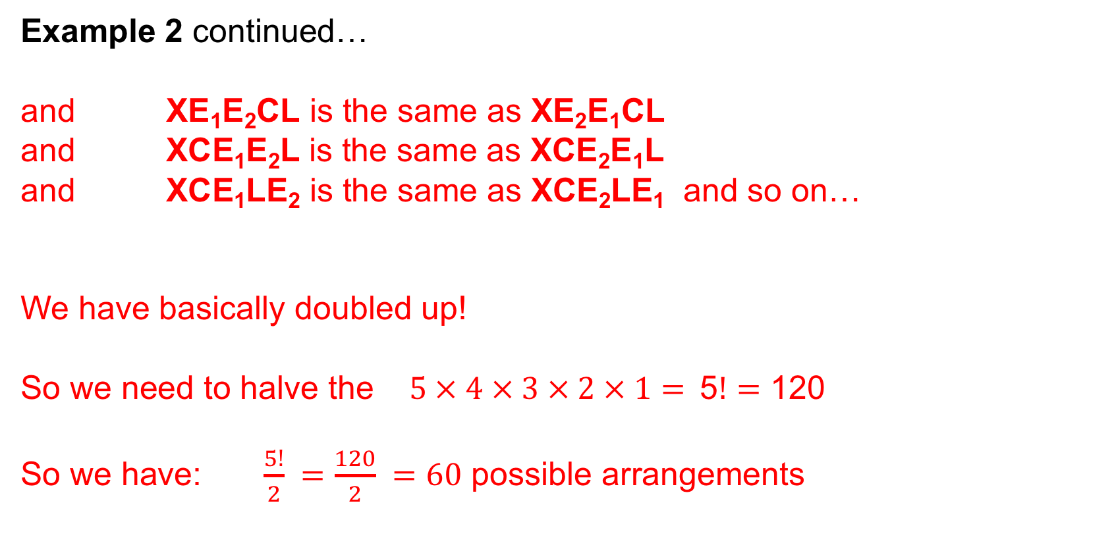
UNIT:
Binomial
Theorem
Section 3
Arrangements: Examples
Example 2 continued…
and XE₁E₂CL is the same as XE₂E₁CL
and XCE₁E₂L is the same as XCE₂E₁L
and XCE₁LE₂ is the same as XCE₂LE₁ and so on…
We have basically doubled up!
So we need to halve the $5 × 4 × 3 × 2 × 1=$5$!$ $=$ 120
So we have: $\frac{5!}{2} =\frac{120}{2} =60$ possible arrangements

Slide 24
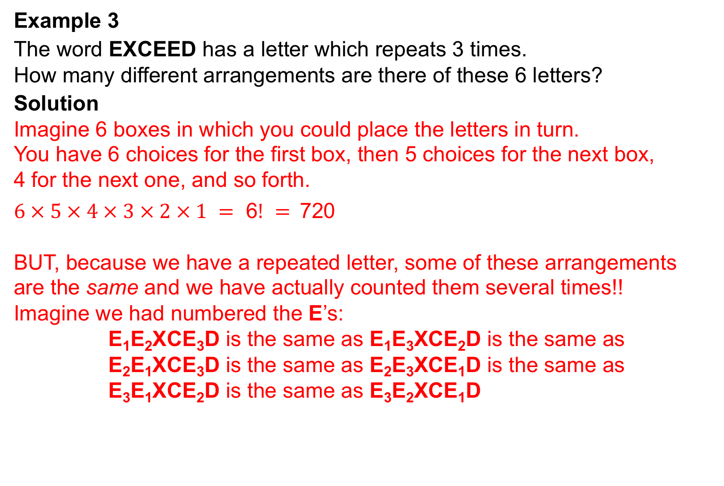
Arrangements: Examples
UNIT:
Factorials
Section 3
Example 3
The word EXCEED has a letter which repeats 3 times.
How many different arrangements are there of these 6 letters?
Solution
Imagine 6 boxes in which you could place the letters in turn.
You have 6 choices for the first box, then 5 choices for the next box,
4 for the next one, and so forth.
$6 × 5 × 4 × 3 × 2 × 1 =$ 6$! =$720
BUT, because we have a repeated letter, some of these arrangements
are the same and we have actually counted them several times!!
Imagine we had numbered the E’s:
E₁E₂XCE₃D is the same as E₁E₃XCE₂D is the same as E₂E₁XCE₃D is the same as E₂E₃XCE₁D is the same as E₃E₁XCE₂D is the same as E₃E₂XCE₁D
continued…

Slide 25
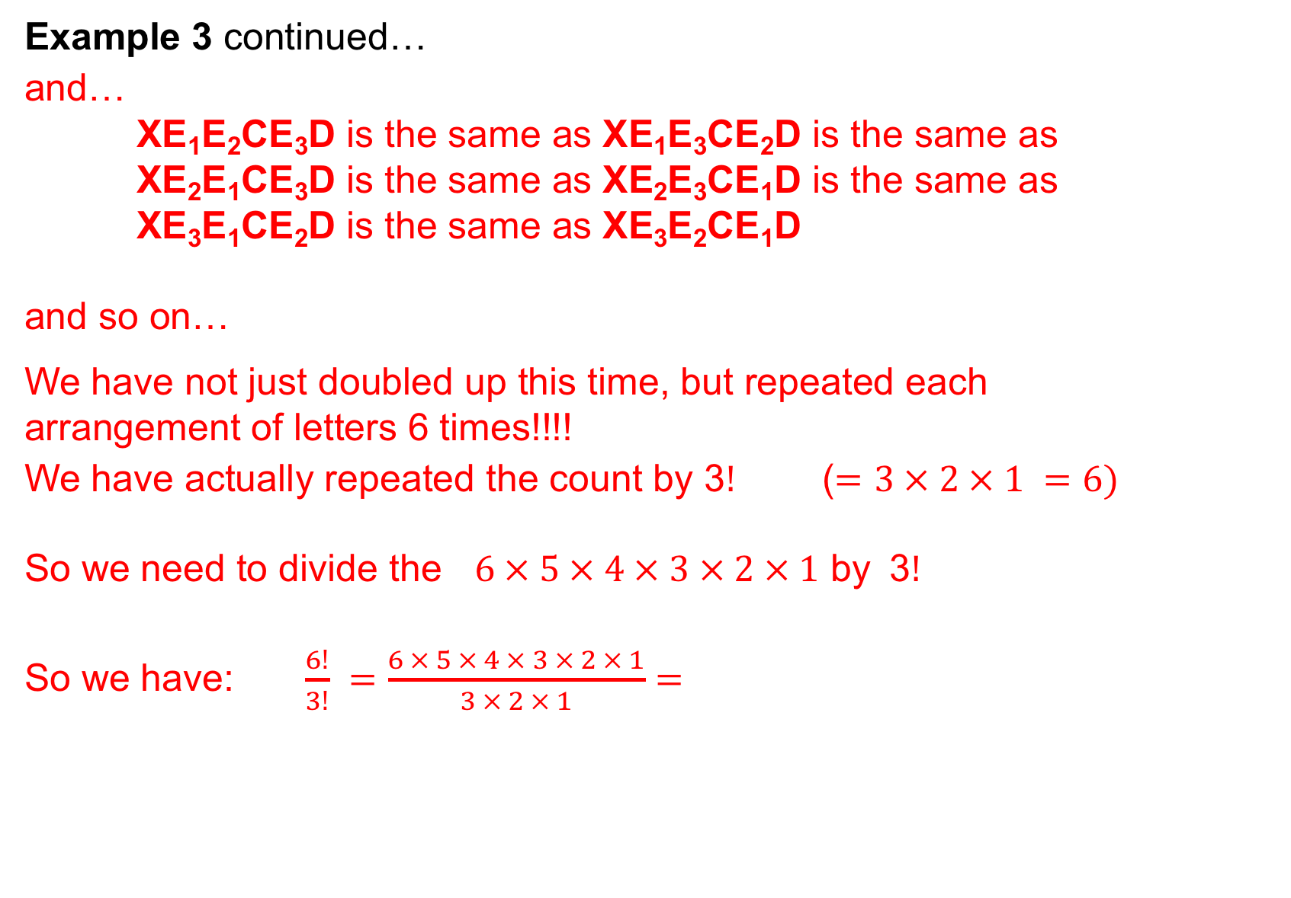
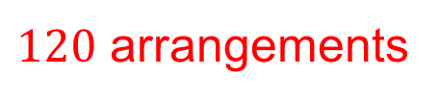
UNIT:
Binomial
Theorem
Section 3
Arrangements: Examples
Example 3 continued…
and…
XE₁E₂CE₃D is the same as XE₁E₃CE₂D is the same as XE₂E₁CE₃D is the same as XE₂E₃CE₁D is the same as XE₃E₁CE₂D is the same as XE₃E₂CE₁D
and so on…
We have not just doubled up this time, but repeated each
arrangement of letters 6 times!!!!
We have actually repeated the count by 3$!$ ($=$ $3 × 2 × 1 =$ $6)$
So we need to divide the $6 × 5 × 4 × 3 × 2 × 1$ by 3$!$
So we have: $\frac{6!}{3!} =\frac{6 × 5 × 4 × 3 × 2 × 1}{3 × 2 × 1}=$
$120$ arrangements

Slide 26
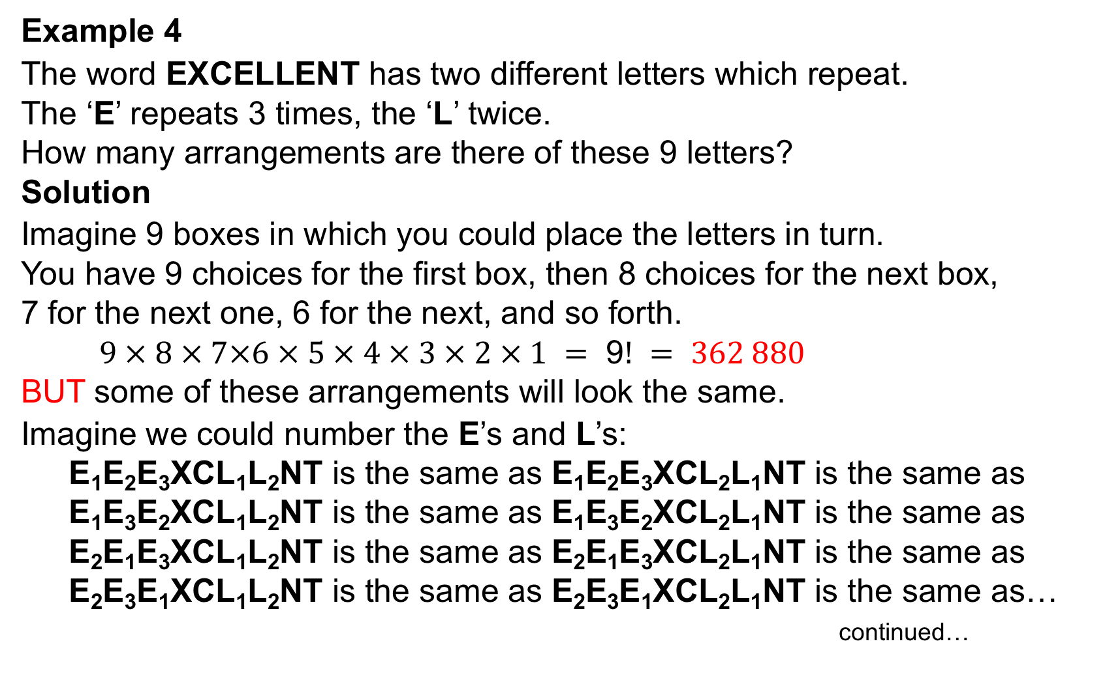
UNIT:
Binomial
Theorem
Section 3
Arrangements: Examples
Example 4
The word EXCELLENT has two different letters which repeat.
The ‘E’ repeats 3 times, the ‘L’ twice.
How many arrangements are there of these 9 letters?
Solution
Imagine 9 boxes in which you could place the letters in turn.
You have 9 choices for the first box, then 8 choices for the next box,
7 for the next one, 6 for the next, and so forth.
$9 × 8 × 7×6 × 5 × 4 × 3 × 2 × 1 =$ 9$! = 362 880$
BUT some of these arrangements will look the same.
Imagine we could number the E’s and L’s:
E₁E₂E₃XCL₁L₂NT is the same as E₁E₂E₃XCL₂L₁NT is the same as
E₁E₃E₂XCL₁L₂NT is the same as E₁E₃E₂XCL₂L₁NT is the same as
E₂E₁E₃XCL₁L₂NT is the same as E₂E₁E₃XCL₂L₁NT is the same as E₂E₃E₁XCL₁L₂NT is the same as E₂E₃E₁XCL₂L₁NT is the same as…
continued…

Slide 27
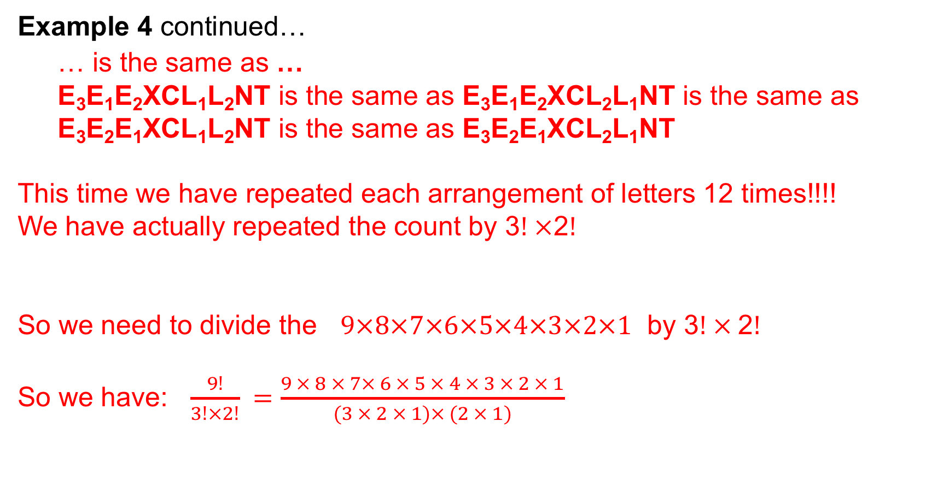

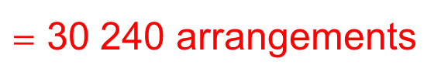
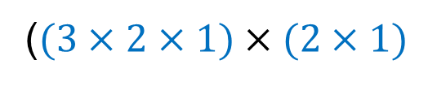
Arrangements: Examples
UNIT:
Factorials
Section 3
Example 4 continued…
… is the same as …
E₃E₁E₂XCL₁L₂NT is the same as E₃E₁E₂XCL₂L₁NT is the same as
E₃E₂E₁XCL₁L₂NT is the same as E₃E₂E₁XCL₂L₁NT
This time we have repeated each arrangement of letters 12 times!!!!
We have actually repeated the count by 3$! ×\text{2}!$
So we need to divide the $9×8×7×6×5×4×3×2×1$ by 3$! × \text{2}!$
So we have: $\frac{9!}{3!×2!} =\frac{9 × 8 × 7× 6 × 5 × 4 × 3 × 2 × 1}{(3 × 2 × 1)× (2 × 1)}$
($(3×2×1)×(2×1)$
$=$ $12$
the number of times the letter ‘E’ was repeated
the number of times the letter ‘L’ was repeated
$=$ 30 240 arrangements

Slide 28
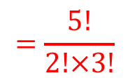
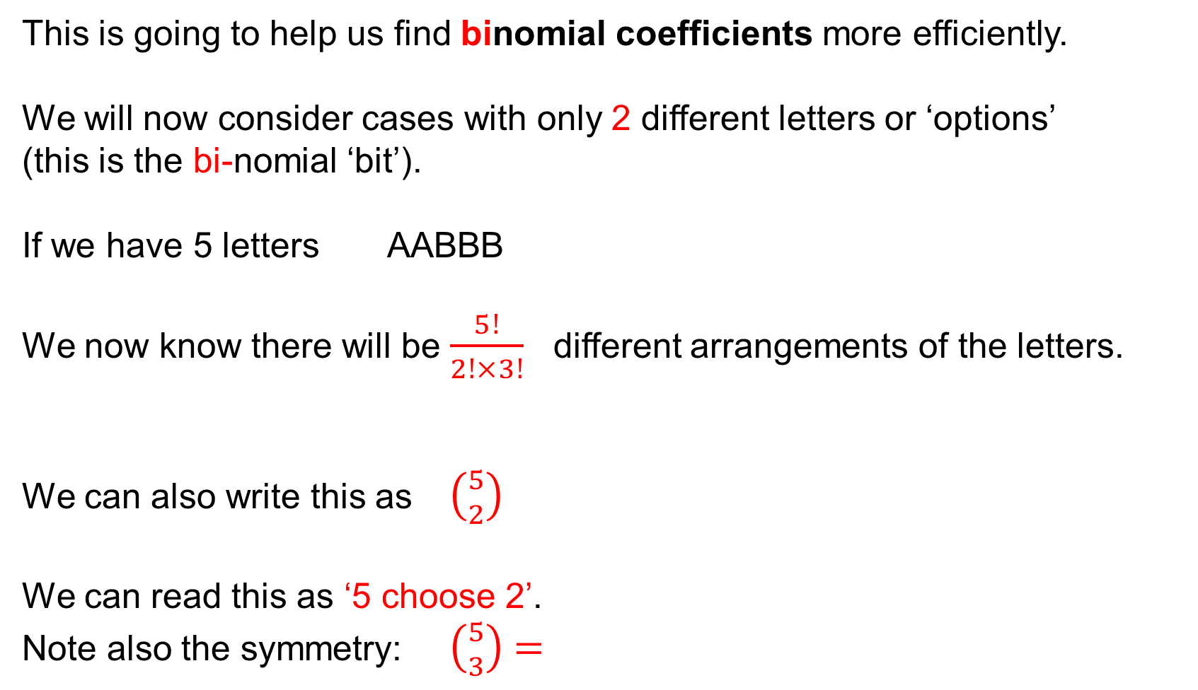
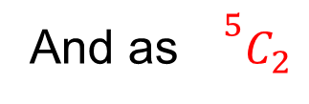
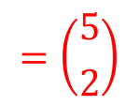


UNIT:
Binomial
Theorem
Section 3
Arrangements: Notation
This is going to help us find binomial coefficients more efficiently.
We will now consider cases with only 2 different letters or ‘options’
(this is the bi-nomial ‘bit’).
If we have 5 letters AABBB
We now know there will be $\frac{5!}{2!×3!}$ different arrangements of the letters.
We can also write this as $\left({5 \atop 2}\right)$
We can read this as ‘5 choose 2’.
Note also the symmetry: $\left({5 \atop 3}\right)$ $=$
the total number of letters
the number of times the letter ‘A’ was repeated
the number of times the letter ‘B’ was repeated
And as${}^{5}C_{2}$
$$=\frac{5!}{2!×3!}$$
$$\frac{5!}{3!×2!}$$
$$=\frac{5!}{2!×3!}$$
$$=\left({5 \atop 2}\right)$$

Slide 29




UNIT:
Binomial
Theorem
Section 3
Notation for Arrangements
In general then,
we may write $\left({n \atop r}\right)$
Where $n$ is the total number of letters/players/options/…
and $r$ is the number we are ‘choosing’.
$\left({n \atop r}\right)$ $=$ $\frac{n!}{r! ×(n−r)!}$
or ${}^{n}C_{r}$
the total number of letters or ‘options’
${}^{n}C_{r}$ $=$
the number of times the ‘option’
we are choosing is required/repeated
the number of times for
the remaining ‘option’,
i.e. the difference between $n and r$

Slide 30


Worked Example
UNIT:
Factorials
Section 3
For example:
How many different ways are there of selecting a swimming
relay-team of 4 swimmers from a squad of 7?
The two (bi-nomial) options are:
1. to be in the team (T) or
2. not to be in the team (NT)
Imagine all 7 swimmers in a line, 4 can be labelled T and 3 labelled NT.
(Note: the 4 T and the 3 NT must sum to the total squad of 7).
How many different arrangements are there?
One arrangement could be:
T T T T NT NT NT
We know from previous examples, this is:
$$\frac{7!}{4!×3!}$$
$=35$different ways

Slide 31





UNIT:
Binomial
Theorem
Section 3
Calculations
We can also use the notation:
$\left({7 \atop 4}\right)$
$\left({7 \atop 4}\right)$ $=$ $\frac{7!}{4! ×(7−4)!}$
There are 35 different possible ‘relay-teams’.
the total number of swimmers’
the number of swimmers
who can be in the team
$$= \frac{7!}{4!×3!}$$
the number of number of
swimmers who
can not be in the team,
i.e. the difference between $7 and 4$
Note how we can simply
cancel out the 4!
$$= \frac{7×6×5×4×3×2×1}{(4×3×2×1)×(3×2×1)}$$
$$= 35$$

Slide 32




Important Results
UNIT:
Binomial Theorem
Section 4
We have seen that:
$\left({n \atop r}\right)$ $=$ $\frac{n!}{r! ×(n−r)!}$
Here are some interesting results:
$\left({n \atop 0}\right)$ $=$ $\frac{n!}{0! ×(n−0)!}=$ $\frac{n!}{n!}$ $=1$
$\left({n \atop 1}\right)$ $=$ $\frac{n!}{1! ×(n−1)!}=$ $\frac{n×\left(n−1\right)×\left(n−2\right)×\left(n−3\right)…3×2×1}{\left(n−1\right)×\left(n−2\right)×\left(n−3\right)…3×2×1}$ $=n$
$\left({n \atop n}\right)$ $=$ $\frac{n!}{n! ×(n−n)!}=$ $\frac{n!}{n!}$ $=1$
We have also seen the symmetry of this notation, for example:
$\left({8 \atop 3}\right)$ $=$
$\frac{8!}{3! ×5!}$ $=$
$\frac{8!}{5! × 3!}$ $=$
$$\left({8 \atop 5}\right)$$

Slide 33

Summary of Results
UNIT:
Binomial Theorem
Section 4
In summary:
$\left({n \atop r}\right)$ $=$ $\frac{n!}{r! ×(n−r)!}$
$\left({n \atop 0}\right)$ $=1$
$\left({n \atop 1}\right)$ $=n$
$\left({n \atop n}\right)$ $=1$
$\frac{n!}{r! ×(n−r)!}$ $=$ $\frac{n!}{(n−r)! ×r!}$

Slide 34



Section 3: Fitness Check: Part 1
UNIT:
Factorials
Section 3
Here are some questions to check your progress;
there are more practice questions if needed.
How many different ways are there of arranging the letters in these names:
a) YASMIN
$6!$ $=$ 720 ways
$$\frac{5!}{2!} =\frac{5 × 4 × 3 × 2 × 1}{2 × 1}=60 \text{ways}$$
b) JAMAL
$$\frac{10!}{4!×2!×2!} =\frac{10×9×8×7×6×5×4×3×2×1}{(4×3×2×1)×(2×1)×(2×1)}=37 800$$
c) ANNASTASIA
2. How many different ways are there of arranging the letters in SUPERCALIFRAGILISTICEXPIALIDOCIOUS
$$\frac{34!}{3!×2!×2!×2!×2!×3!×3!×3!×7!×2!} =$$
$= 1.41124695…× {10}^{30}$
A HUGE number!!!

Slide 35







Section 3: Fitness Check: Part 2
UNIT:
Factorials
Section 3
Here are some questions to check your progress;
there are more practice questions if needed.
4. How many ways are there of selecting a tennis team of 6 from 10 players?
$\frac{10!}{6!×4! }$ $=$
$$\frac{10×9×8×7}{4×3×2×1}=$$
$210$ways
5. A school council of 5 children is to be selected from a class of 18 children. How many different possible groups are there?
$$\frac{18!}{5!×13! } =\frac{18×17×16×15×14}{5×4×3×2×1}=$$
$8 568$ groups
Seven netball players are to be selected from a squad of 12.
How many possible ways are there of selecting the team?
$$\frac{12!}{7!×5! } =\frac{12×11×10×9×8}{5×4×3×2×1}=$$
$792$ ways

Slide 36
UNIT:
Binomial Theorem
Section 3
Section 3: Review
You have completed the third Section.
If you have completed and mastered this last section,
click here to start the next Section
If you need more examples and interactive practice,
press here
You might also find it helpful to look at:
Essential Information: press here

Slide 37

UNIT:
Binomial Theorem
Section 4
Binomial Theorem
We have previously expanded ${ (1+x)}^{8}$
by using row 8 from Pascal’s Triangle:
1 8 28 56 70 56 28 8 1
We slotted these coefficients into the pattern of the rising powers of $x$
$$1 +8x +28x^{2}+{56x}^{3}+70x^{4}+{56x}^{5}+28x^{6}+{8x}^{7}+{1x}^{8}$$
But expanding something like ${ (1+x)}^{20}$ would require many rows of Pascal’s Triangle. And what about ${ (1+x)}^{100}$ ?!!!??
Fortunately, we can use our work on factorials to help.
Lets work out a few and see what happens.
Calculate: $\left({8 \atop 0}\right)$, $\left({8 \atop 1}\right)$, $\left({8 \atop 2}\right)$, $\left({8 \atop 3}\right)$, $\left({8 \atop 4}\right)$, $\left({8 \atop 5}\right)$, $\left({8 \atop 6}\right)$, $\left({8 \atop 7}\right)$, $\left({8 \atop 8}\right)$

Slide 38







UNIT:
Binomial Theorem
Section 4
Binomial Theorem
Calculate: $\left({8 \atop 0}\right)$, $\left({8 \atop 1}\right)$, $\left({8 \atop 2}\right)$, $\left({8 \atop 3}\right)$, $\left({8 \atop 4}\right)$, $\left({8 \atop 5}\right)$, $\left({8 \atop 6}\right)$, $\left({8 \atop 7}\right)$, $\left({8 \atop 8}\right)$
$\left({8 \atop 0}\right)$ $=\frac{8!}{0!×8! } =$
$\left({8 \atop 1}\right)$ $=\frac{8!}{1!×7! }$ $=$
$\left({8 \atop 2}\right)$ $=\frac{8!}{2!×6! } =$
$\left({8 \atop 3}\right)$ $=\frac{8!}{3!×5! } =$
$\left({8 \atop 4}\right)$ $=\frac{8!}{4!×4! } =$
These match the numbers in row 8 of Pascal’s Triangle.
1 8 28 56 70 56 28 8 1
1
8
28
56
70
56
28
8
1
$$1$$
$$= \left({8 \atop 8}\right)$$
$$=\left({8 \atop 7}\right)$$
$$\text{8}$$
$$=\left({8 \atop 6}\right)$$
28
Using symmetry
$$=\left({8 \atop 5}\right)$$
56
70
Clever!

Slide 39

UNIT:
Binomial Theorem
Section 4
Binomial Theorem
We can now use this notation for binomial expansions instead of Pascal’s Triangle.
We can now expand ${ (1+x)}^{20}$ as:
$$\left({20 \atop 0}\right)+\left({20 \atop 1}\right)x +\left({20 \atop 2}\right)x^{2}+{\left({20 \atop 3}\right)x}^{3}+\left({20 \atop 4}\right)x^{4}+{\left({20 \atop 5}\right)x}^{5}+\left({20 \atop 6}\right)x^{6}+{\left({20 \atop 7}\right)x}^{7}+{\left({20 \atop 8}\right)x}^{8}+\left({20 \atop 9}\right)x^{9}+{\left({20 \atop 10}\right)x}^{10}+\left({20 \atop 11}\right)x^{11}+{\left({20 \atop 12}\right)x}^{12}+\left({20 \atop 13}\right)x^{13}+{\left({20 \atop 14}\right)x}^{14}+{\left({20 \atop 15}\right)x}^{15}+\left({20 \atop 16}\right)x^{16}+{\left({20 \atop 17}\right)x}^{17}+\left({20 \atop 18}\right)x^{18}+{\left({20 \atop 19}\right)x}^{19}+\left({20 \atop 20}\right)x^{20}$$
And we may ask such questions as ‘What is the coefficient of $x^{16} ?^{′}$
Answer:
$\left({20 \atop 16}\right)=$ $\frac{20!}{16! × 4!}=$ $\frac{20 × 19 × 18 × 17}{4 × 3 × 2 × 1}$ $=$ 4 845

Slide 40

UNIT:
Binomial Theorem
Section 4
Binomial Theorem
Similarly we can now expand ${ (a+x)}^{12}$ as:
$$\left({12 \atop 0}\right)a^{12}+\left({12 \atop 1}\right)a^{11}x +\left({12 \atop 2}\right){a^{10}x}^{2}+{\left({12 \atop 3}\right)a^{9}x}^{3}+\left({12 \atop 4}\right){a^{8}x}^{4}+{\left({12 \atop 5}\right)a^{7}x}^{5}+\left({12 \atop 6}\right){a^{6}x}^{6}+{\left({12 \atop 7}\right)a^{5}x}^{7}+{\left({12 \atop 8}\right)a^{4}x}^{8}+\left({12 \atop 9}\right){a^{3}x}^{9}+{\left({12 \atop 10}\right)a^{2}x}^{10}+\left({12 \atop 11}\right){a^{1}x}^{11}+{\left({12 \atop 12}\right)x}^{12}$$
We expand ${ (3+x)}^{12}$ as:
$\left({12 \atop 0}\right)3^{12}+\left({12 \atop 1}\right)3^{11}x +\left({12 \atop 2}\right){3^{10}x}^{2}+{\left({12 \atop 3}\right)3^{9}x}^{3}+\left({12 \atop 4}\right){3^{8}x}^{4}+{\left({12 \atop 5}\right)3^{7}x}^{5}+\left({12 \atop 6}\right){3^{6}x}^{6}+{\left({12 \atop 7}\right)3^{5}x}^{7}+{\left({12 \atop 8}\right)3^{4}x}^{8}+\left({12 \atop 9}\right){3^{3}x}^{9}+{\left({12 \atop 10}\right)3^{2}x}^{10}+\left({12 \atop 11}\right){3^{1}x}^{11}+{\left({12 \atop 12}\right)x}^{12}$
We may ask such questions as ‘What is the coefficient of $x^{7} ?^{′}$
Answer:
$\left({12 \atop 7}\right)3^{5}=$ $\frac{12!}{7! × 5!}{×3}^{5}=$ $\frac{12 × 11 × 10 × 9 × 8}{5 × 4 × 3 × 2 × 1}$ $×$243 $=$ 192 456

Slide 41

UNIT:
Binomial Theorem
Section 4
Binomial Theorem
The general result of expanding in this way is called the
binomial theorem.
Here, some terms of the general binomial theorem are illustrated:
$${ (a+x)}^{n}=\left({n \atop 0}\right)a^{n}+\left({n \atop 1}\right)a^{n−1}x +\left({n \atop 2}\right){a^{n−2}x}^{2}+…+\left({n \atop r}\right){a^{n−r}x}^{r}+…+{\left({n \atop n−1}\right)a^{1}x}^{n−1}+{\left({n \atop n}\right)x}^{n}$$
The general term is:
${\left({n \atop r}\right)a^{n−r}x}^{r}$

Slide 42

UNIT:
Binomial Theorem
Section 4
Binomial Theorem
We can now revist Example from Section 2:
Expand: ${ (2+k)}^{15}$
$\left({15 \atop 0}\right)2^{15}+\left({15 \atop 1}\right)2^{14}k +\left({15 \atop 2}\right){2^{13}k}^{2}+\left({15 \atop 3}\right)2^{12}k^{3}+\left({15 \atop 4}\right)2^{11}k^{4}+\left({15 \atop 5}\right){2^{10}k}^{5}+{\left({15 \atop 6}\right)2^{9}k}^{6}+\left({15 \atop 7}\right){2^{8}k}^{7}+{\left({15 \atop 8}\right)2^{7}k}^{8}+\left({15 \atop 9}\right){2^{6}k}^{9}+{\left({15 \atop 10}\right)2^{5}k}^{10}+{\left({15 \atop 11}\right)2^{4}k}^{11}+\left({15 \atop 12}\right){2^{3}k}^{12}+{\left({15 \atop 13}\right)2^{2}k}^{13}+\left({15 \atop 14}\right){2^{1}k}^{14}+{\left({15 \atop 15}\right)k}^{15}$
We may ask such questions as ‘What is the coefficient of $k^{11} ?^{′}$
Answer:
$\left({15 \atop 11}\right)2^{4}=$ $\frac{15!}{11! × 4!}{×2}^{4}=$ $\frac{15 × 14 × 13 × 12 }{4 × 3 × 2 × 1}$ $×$16 $=$ 21 840

Slide 43

UNIT:
Binomial Theorem
Section 4
Binomial Theorem
One typical use of the binomial theorem is to give
approximations to numbers like ${(1.02)}^{7}$.
We can write $1.02$ as $1+0.02$
$${(1+0.02)}^{7}$$
$$=1+\left({7 \atop 1}\right)0.02+\left({7 \atop 2}\right){0.02}^{2}+{\left({7 \atop 3}\right)0.02}^{3}+\left({7 \atop 4}\right){0.02}^{4}+{\left({7 \atop 5}\right)0.02}^{5}+{\left({7 \atop 6}\right)0.02}^{6}+{\left({7 \atop 7}\right)0.02}^{7}$$
$$=1+7×0.02+21×{0.02}^{2}+{35×0.02}^{3}+35×{0.02}^{4}+{21×0.02}^{5}+{7×0.02}^{6}+{1×0.02}^{7}$$
$=1+0.14+0.0084+0.00028+0.0000056+$…
$=$ 1.1486856…
$=$ 1.148686 (to 7 significant figures)
We may not need to calculate all the ‘bits’-
depending on how many significant figures we need

Slide 44

UNIT:
Binomial Theorem
Section 4
Binomial Theorem
Example 1
Expand in full:
${ (3m+2n)}^{6}$
Solution
$\left({6 \atop 0}\right){(3m)}^{6}{(2n)}^{0}+\left({6 \atop 1}\right){(3m)}^{5}{(2n)}^{1} +\left({6 \atop 2}\right){{(3m)}^{4}(2n)}^{2}+{\left({6 \atop 3}\right){(3m)}^{3}(2n)}^{3}+\left({6 \atop 4}\right){{(3m)}^{2}(2n)}^{4}+{\left({6 \atop 5}\right){(3m)}^{1}(2n)}^{5}+\left({6 \atop 6}\right){{(3m)}^{0}(2n)}^{6}$
$=$
1$×$729$m^{6}×1+6×{243m}^{5}{(2n)}^{1} +15{{×81m}^{4}(2n)}^{2}+{20{×27m}^{3}(2n)}^{3}+15×{{9m}^{2}(2n)}^{4}+{6×{3m}^{1}(2n)}^{5}+{1×1×(2n)}^{6}$
$=$
729$m^{6}+6×{243m}^{5}×2n+15{{×81m}^{4}×4n}^{2}+{20{×27m}^{3}×8n}^{3}+15×{{9m}^{2}×16n}^{4}+{6×3m×32n}^{5}+{64n}^{6}$
$=$
729$m^{6}+2916m^{5}n+{{4860m}^{4}n}^{2}+{{4320m}^{3}n}^{3}+2160{m^{2}n}^{4}+{576mn}^{5}+{64n}^{6}$

Slide 45













UNIT:
Binomial Theorem
Section 4
Section 4: Fitness Check
Here are some questions to check your progress;
there are more practice questions if needed.
1. In each of the following expansions, what is the coefficient for $x^{3}$
$$\left({9 \atop 6}\right)=84$$
a)${ (1+x)}^{8}$
$$56$$
b)${ (x+a)}^{9}$
c)${ (2+x)}^{10}$
$$15360$$
2. Expand in full:
a) ${ (1+2b)}^{4}$
$$1+8b +24b^{2}+{32b}^{3}+16b^{4}$$
b) ${ (5−2a)}^{3}$
$$125−150a +60a^{2}−{8a}^{3}$$
Find these to 3 s.f. without using a calculator:
a) ${ (2.01)}^{3}$
b) ${ (99.5)}^{4}$
$$8.12$$
$$98 000 000$$

Slide 46
UNIT:
Binomial Theorem
Section 4
Section 4: Review
You have completed the fourth and final Section.
If you have completed and mastered this last section,
click here for the Unit audit
If you need more examples and interactive practice,
press here
You might also find it helpful to look at:
Essential Information: press here

