Slide 1
Supporting and Enhancing Mathematics and Statistics
UNIT: Factorising Polynomials

Slide 2
UNIT:
Factorising
Polynomials
Factorising Polynomials
Factorising Polynomials is an interesting algebraic technique.
It is elegant!
You have five sections to work through and there are check up audits and fitness tests for each section.
The Cubic Equation
Cubic Equation: Number of Roots
Factor Theorem
Factors of Higher Order Polynomials
Remainders

Slide 3
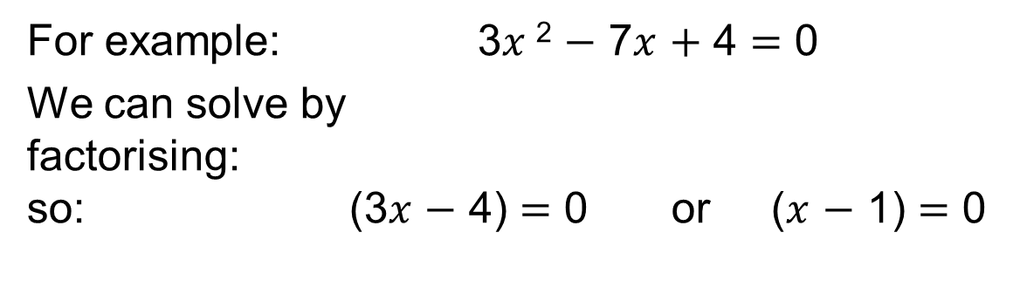
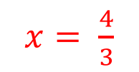



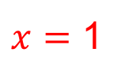
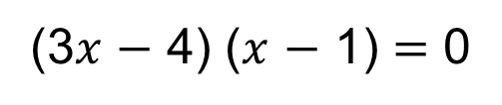
UNIT:
Factorising
Polynomials
Section 1
The Cubic Equation
Previously you would have
factorised quadratic equations of the form:
$${ax}^{2}+bx+c=0$$
For example: 3$x$² $−$ 7$x$ $+$ 4 $=$ 0
We can solve by
factorising:
so: (3$x$ $−$ 4) $=$ 0 or ($x$ $−$ 1) $=$ 0
(3$x$ $−$ 4) ($x$ $−$ 1) $=$ 0
$x$ $=$ $\frac{4}{3}$
$x$ $=$ 1
Now we want to solve cubic equations of the form:
$${ax}^{3}+{bx}^{2}+cx+d=0$$
For example: $x^{3}−{20x}^{2}+100x−125=0$
We want to be able to solve in a similar way, by factorising.

Slide 4
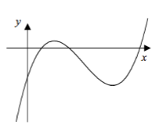

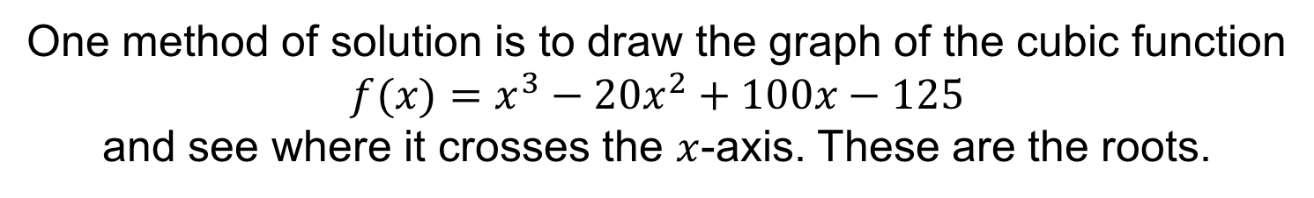

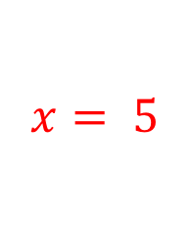
UNIT:
Factorising
Polynomials
Section 1
The Cubic Equation
For example: $x^{3}−{20x}^{2}+100x−125=0$
One method of solution is to draw the graph of the cubic function
$$f(x)=x^{3}−{20x}^{2}+100x−125$$
and see where it crosses the $x$-axis. These are the roots.
5
Now imagine we know the graph crosses the $x$-axis in
one of the three places. This gives us the solution
$x$ $=$ $5$

Slide 5
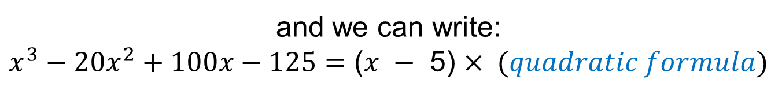
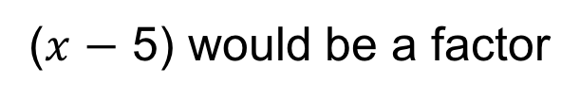
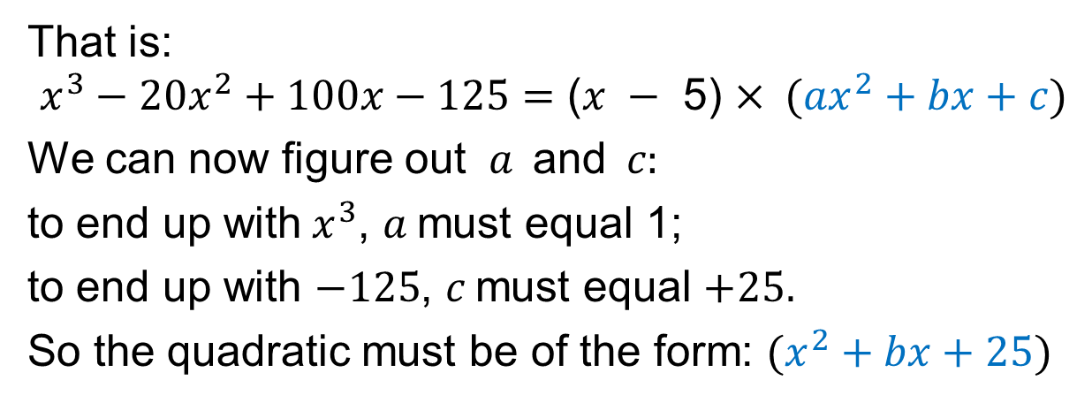
UNIT:
Factorising
Polynomials
Section 1
The Cubic Equation
So for: $x^{3}−{20x}^{2}+100x−125=0$
5
($x$ $−$ 5) would be a factor
and we can write:
$x^{3}−{20x}^{2}+100x−125=\text{(}x −\text{ 5)}$ $× (quadratic formula)$
That is:
$x^{3}−{20x}^{2}+100x−125=\text{(}x −\text{ 5)}$ $× ({ax}^{2}+bx+c)$
We can now figure out $a \text{a}\text{nd} c:$
to end up with$x^{3}$, $a$must equal 1;
to end up with $−125$, $c$must equal $+25.$
So the quadratic must be of the form: $(x^{2}+bx+25)$
Finding $b$ is not quite so straightforward, but it can be done…

Slide 6
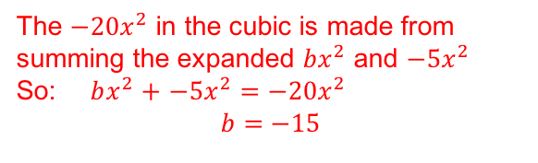
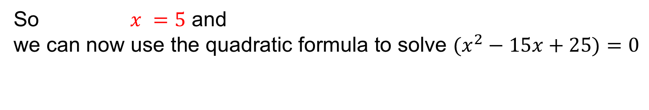
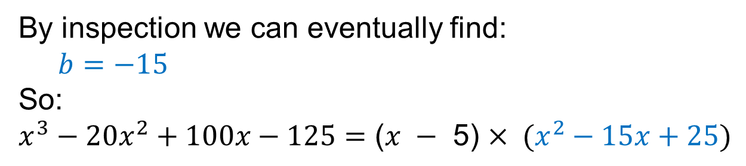
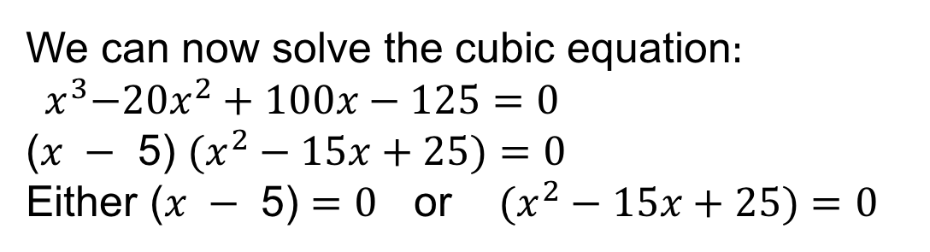

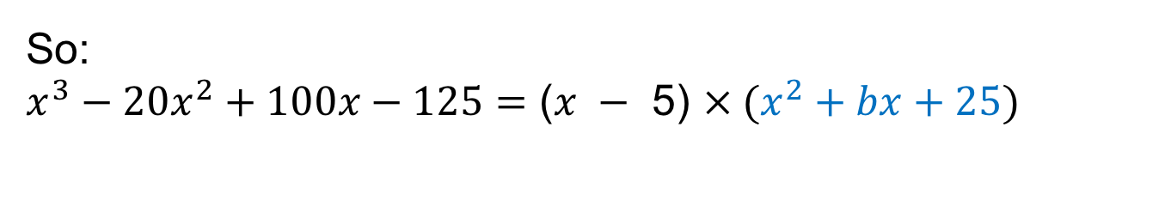

UNIT:
Factorising
Polynomials
Section 1
The Cubic Equation
So:
$$x^{3}−{20x}^{2}+100x−125=\text{(}x −\text{ 5)} × (x^{2}+bx+25)$$
$$−{20x}^{2}$$
5
By inspection we can eventually find:
$b=$ $−15$
So:
$x^{3}−{20x}^{2}+100x−125=\text{(}x −\text{ 5)}$ $× (x^{2}−15x+25)$
The $−{20x}^{2}$ in the cubic is made from
summing the expanded $bx^{2}$ and $−{5x}^{2}$
So: $bx^{2}$ $+$ $−{5x}^{2}$ $=$ $−{20x}^{2}$
$b=$ $−15$
We can now solve the cubic equation$:$
$${ x}^{3}−{20x}^{2}+100x−125=0$$
$\text{(}x −\text{ 5)}$ $(x^{2}−15x+25)=0$
Either $\text{(}x −\text{ 5)}$ $=0$ or $(x^{2}−15x+25)=0$
So $x =5$ and
we can now use the quadratic formula to solve $(x^{2}−15x+25)=0$
We will solve this next…
$$x=\frac{−b±\sqrt{b^{2}−4ac}}{2a}$$

Slide 7
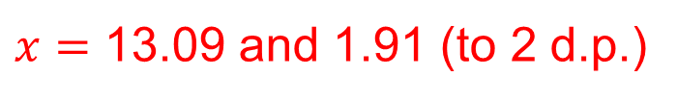
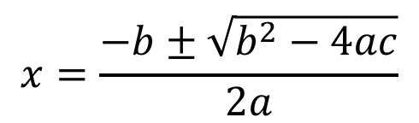
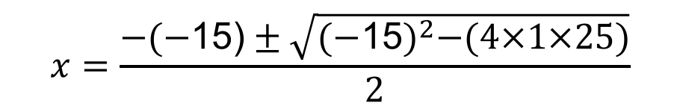
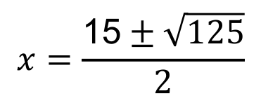
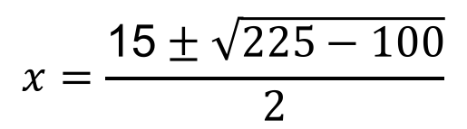
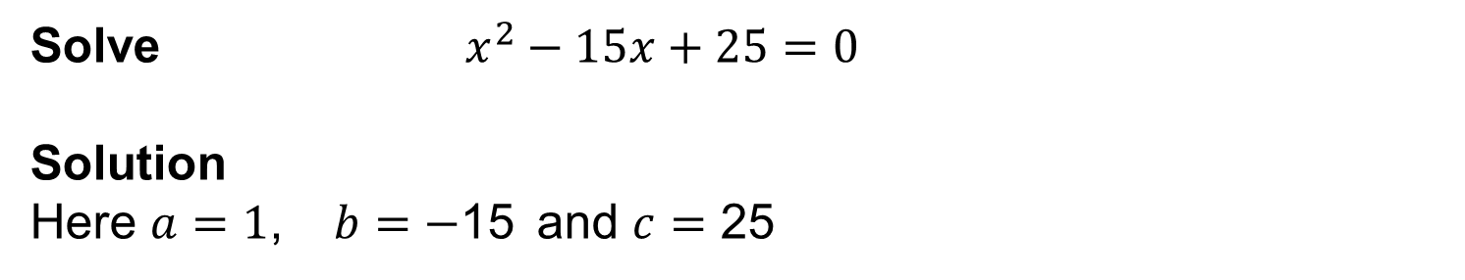
UNIT:
Factorising
Polynomials
Section 1
The Cubic Equation
Solve $x^{2}−15x+25=0$
Solution
Here $a=1$, $b$ $=$ $−$15 and $c$ $=$ 25
$$x=\frac{−b±\sqrt{b^{2}−4ac}}{2a}$$
gives
$$x=\frac{−(−\text{15)}±\sqrt{{(−\text{15})}^{2}−(4×1×25)}}{2}$$
$$x=\frac{\text{15}±\sqrt{225−100}}{2}$$
$$x=\frac{\text{15}±\sqrt{125}}{2}$$
$x=$ 13.09 and 1.91 (to 2 d.p.)

Slide 8


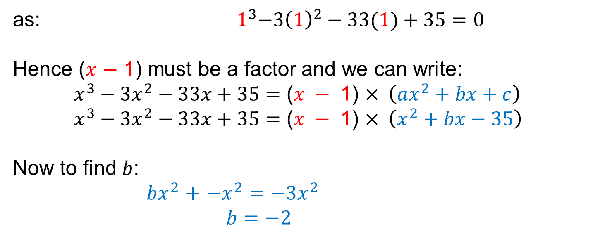

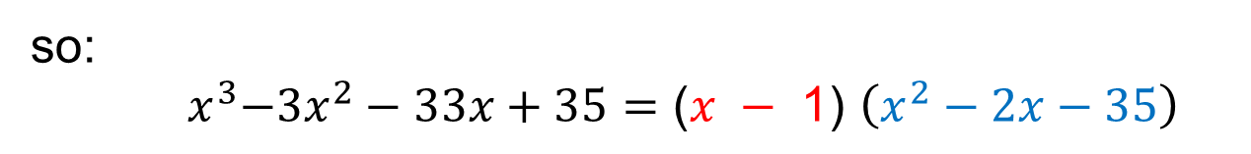
UNIT:
Factorising
Polynomials
Section 1
The Cubic Equation
Worked Example
Find all the solutions for: ${ x}^{3}−{3x}^{2}−33x+35=0$
$$−{3x}^{2}$$
Solution
We can look and see $x=1$ is a solution
as: ${ 1}^{3}−{3\left(1\right)}^{2}−33(1)+35=0$
Hence ($x$ $−$ 1) must be a factor and we can write:
$x^{3}−{3x}^{2}−33x+35=\text{(}x −\text{ 1}\text{)}$ $× \left({ax}^{2}+bx+c\right)$
$x^{3}−{3x}^{2}−33x+35=\text{(}x − \text{1}\text{)}$ $× \left(x^{2}+bx−35\right)$
Now to find $b$:
$bx^{2}$ $+$ $−x^{2}$ $=$ $−{3x}^{2}$
$b=$ $−2$
so:
${ x}^{3}−{3x}^{2}−33x+35=\text{(}x −\text{ 1}\text{)}$ $\left(x^{2}−2x−35\right)$
continued…

Slide 9
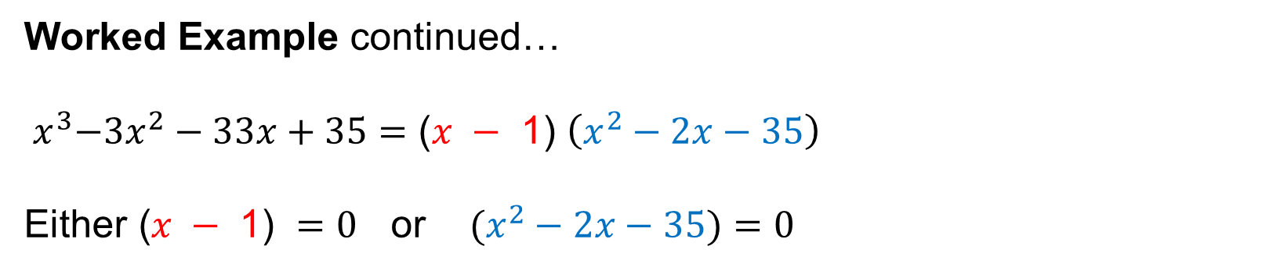

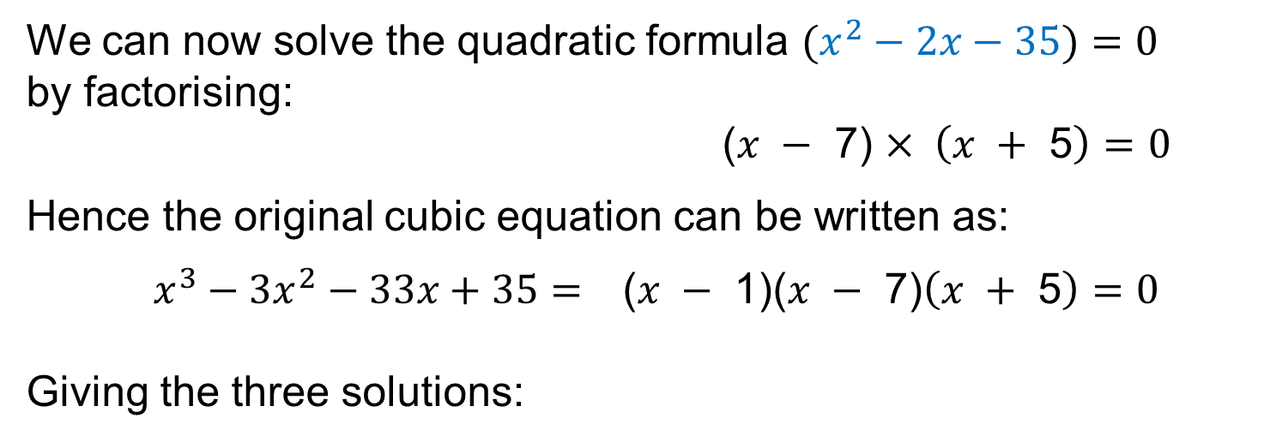
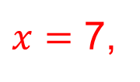

UNIT:
Factorising
Polynomials
Section 1
The Cubic Equation
Worked Example continued…
${ x}^{3}−{3x}^{2}−33x+35=\text{(}x −\text{ 1}\text{)}$ $\left(x^{2}−2x−35\right)$
$$\text{Either} \text{(}x −\text{ 1}\text{)} =0 \text{or} (x^{2}−2x−35)=0$$
We can now solve the quadratic formula $(x^{2}−2x−35)=0$
by factorising:
$\text{(}x − \text{7}\text{)}$ $× \left(x + \text{5}\right)$ $=0$
Hence the original cubic equation can be written as:
$x^{3}−{3x}^{2}−33x+35= \text{(}x − \text{1}\text{)(}x −\text{ 7)}\left(x +\text{ 5}\right)$ $=0$
Giving the three solutions:
$x$ $=$ $1,$
$x$ $=$ 7,
$x$ $=−\text{5}$

Slide 10
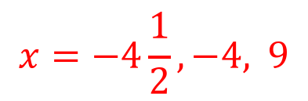

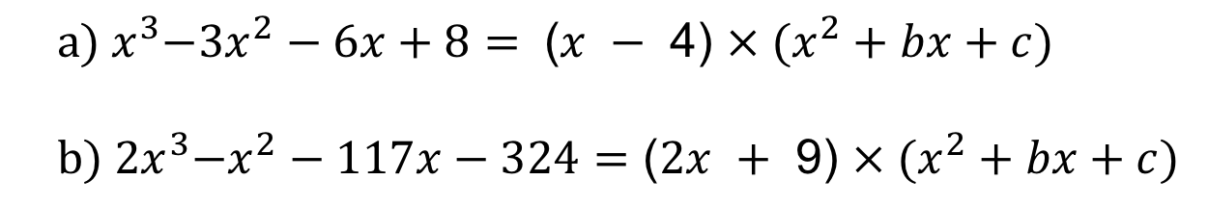
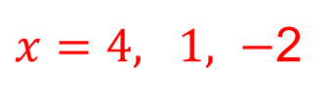

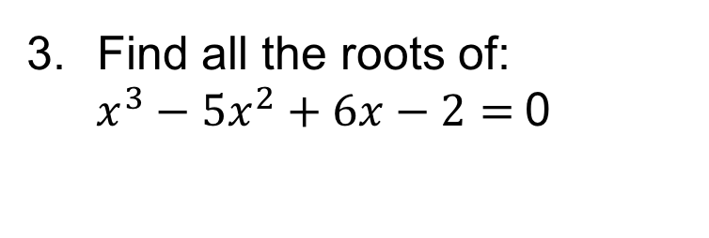

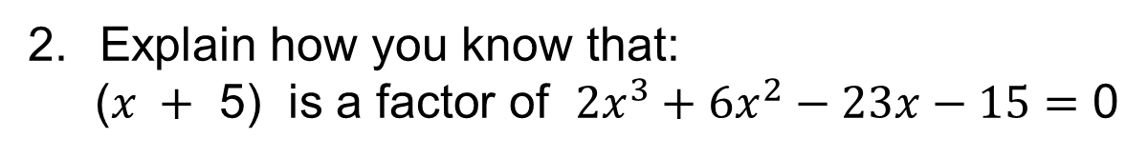


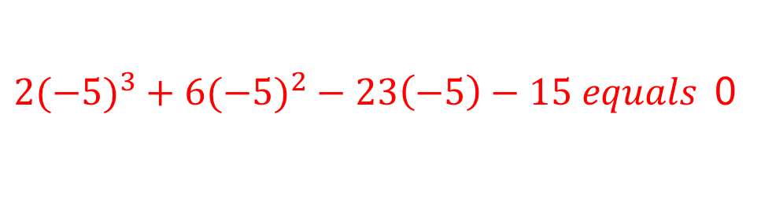


UNIT:
Factorising
Polynomials
Section 1
Section 1: Fitness Check
Here are some questions to check your progress;
there are more practice questions if needed.
Work out the missing quadratic formula
and then find all the roots of:
$${ a) x}^{3}−{3x}^{2}−6x+8= \text{(}x − \text{4}\text{)} × (x^{2}+bx+c)$$
$${ b) 2x}^{3}−x^{2}−117x−324=\text{(}2x + \text{9}\text{)} × (x^{2}+bx+c)$$
$$x^{2}+x−2$$
$x=4, 1,$ $−$2
$$x=−4\frac{1}{2}, −4, 9$$
$$x^{2}−5x−36$$
Explain how you know that:
$\text{(}x + \text{5}\text{)} \text{is} \text{a} \text{factor} \text{of} {2x}^{3}+{6x}^{2}−23x−15=$ 0
${2(−5)}^{3}+{6(−5)}^{2}−23\left(−5\right)−15 equals$0
Find all the roots of:
$x^{3}−{5x}^{2}+6x−2=$0
1, 0.59, 3.41
$1^{3}−{5\left(1\right)}^{2}+6(1)−2=$0
$Hence \text{(}x −\text{ 1)}$is a factor
$$\text{(}x − \text{1}\text{)} × (x^{2}+bx+2)$$
$$b=−4$$
$$\text{(}x −\text{ 1)} (x^{2}−4x+2)=0$$
Now use quadratic formula…

Slide 11
UNIT:
Factorising
Polynomials
Section 1
Section 1: Review
You have completed the first Section.
If you have completed and understood this section,
click to start the next Section
If you need more examples and interactive practice,
press here
You might also find it helpful to look at:
Essential Information: press here

Slide 12
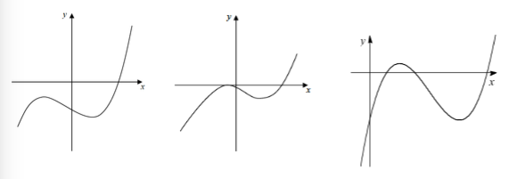
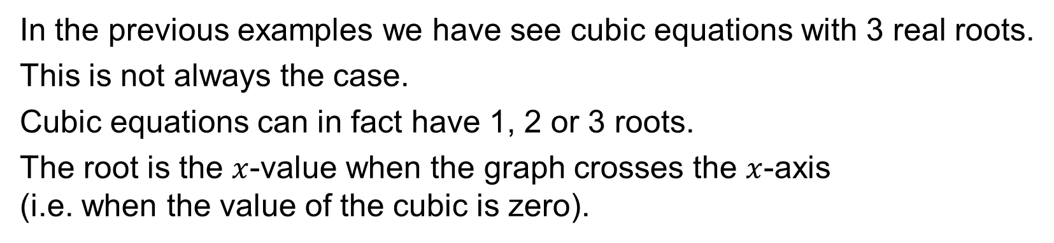



UNIT:
Factorising
Polynomials
Section 2
Cubic Equation: Number of Roots
In the previous examples we have see cubic equations with 3 real roots.
This is not always the case.
Cubic equations can in fact have 1, 2 or 3 roots.
The root is the $x$-value when the graph crosses the $x$-axis
(i.e. when the value of the cubic is zero).
$1$ root
$2$ roots
$3$ roots

Slide 13
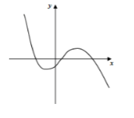
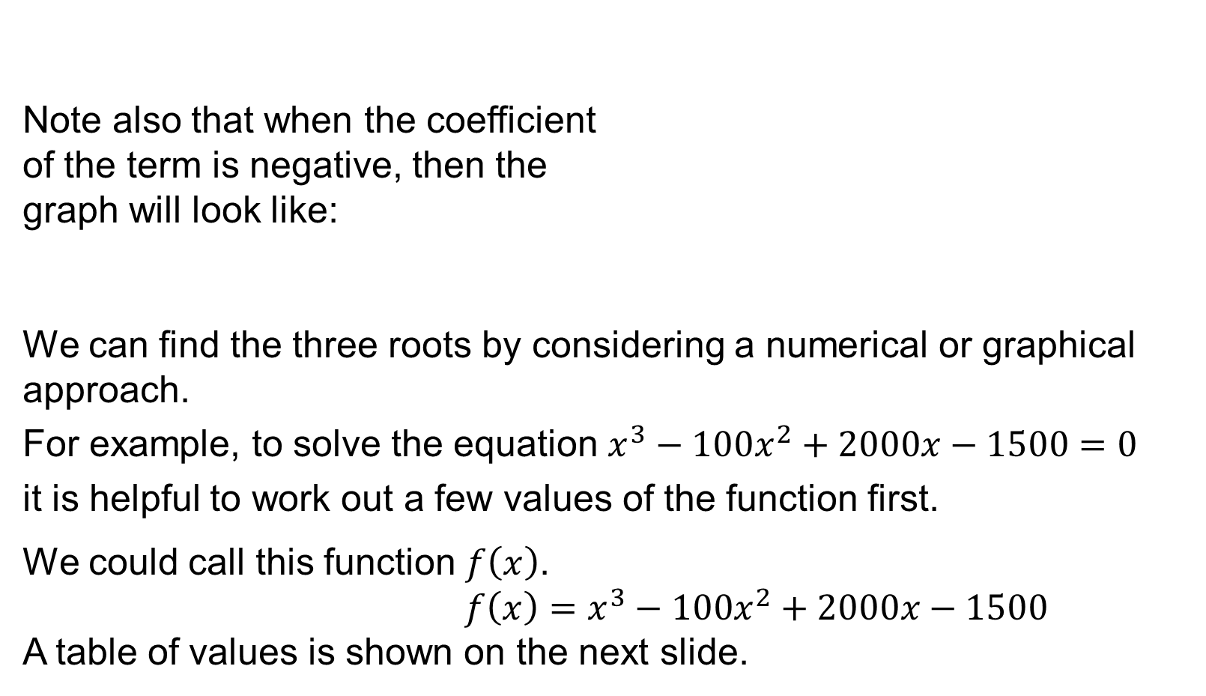
UNIT:
Factorising
Polynomials
Section 2
Cubic Equation: Number of Roots
Note also that when the coefficient
of the term is negative, then the
graph will look like:
We can find the three roots by considering a numerical or graphical approach.
For example, to solve the equation $x^{3}−{100x}^{2}+2000x−1500=0$
it is helpful to work out a few values of the function first.
We could call this function $f\left(x\right)$.
${f\left(x\right)=x}^{3}−{100x}^{2}+2000x−1500$
A table of values is shown on the next slide.

Slide 14
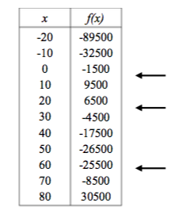
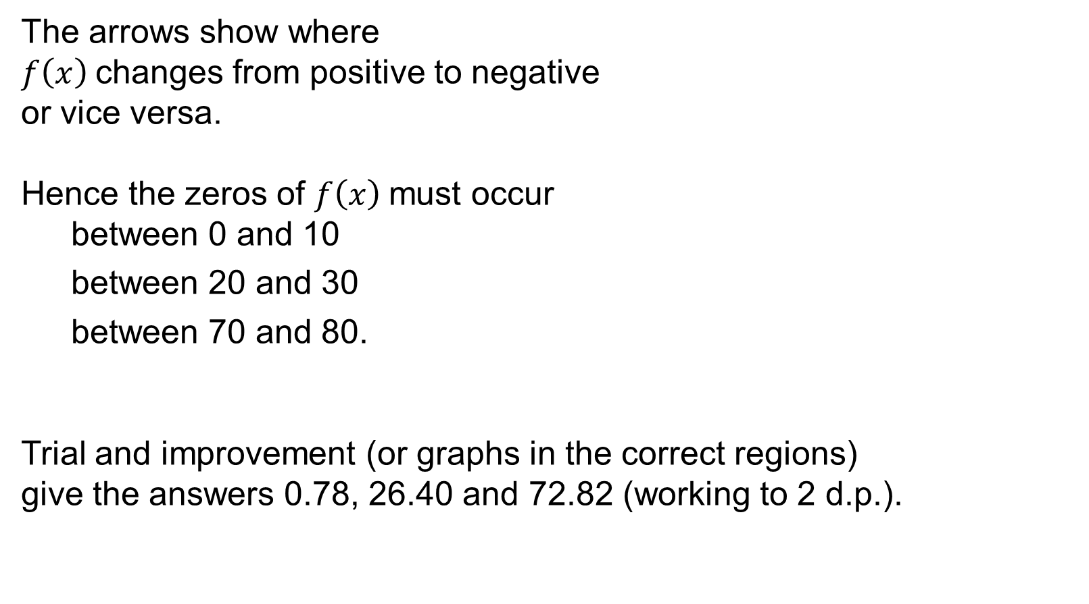
UNIT:
Factorising
Polynomials
Section 2
Cubic Equation: Number of Roots
The arrows show where
$f\left(x\right)$changes from positive to negative
or vice versa.
Hence the zeros of $f\left(x\right)$must occur
between 0 and 10
between 20 and 30
between 70 and 80.
Trial and improvement (or graphs in the correct regions)
give the answers 0.78, 26.40 and 72.82 (working to 2 d.p.).

Slide 15
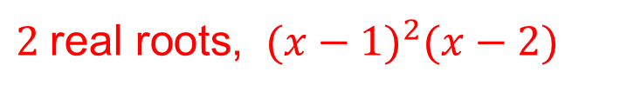

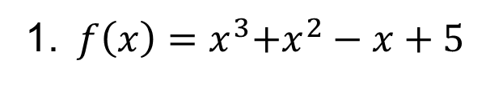
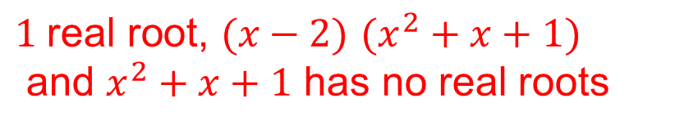

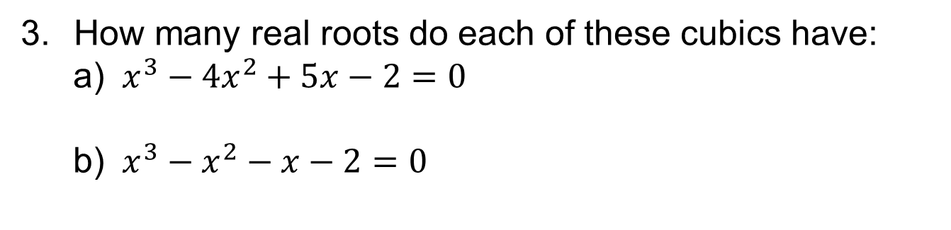
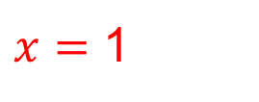
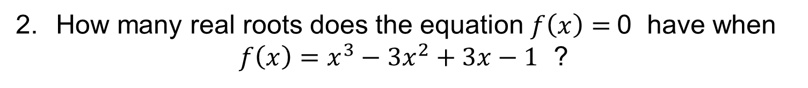

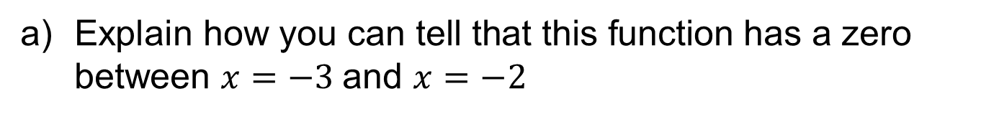
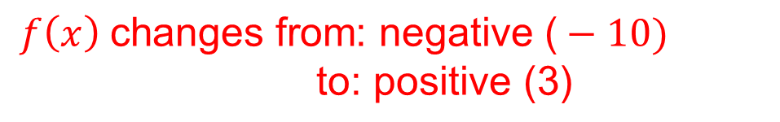
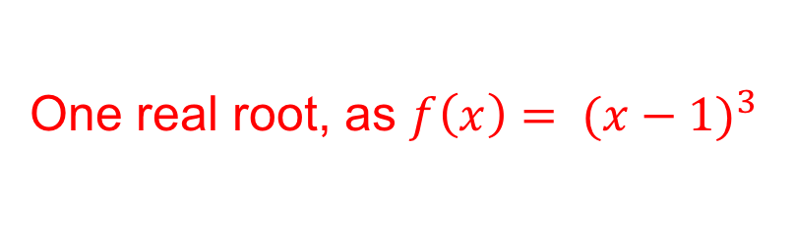
UNIT:
Factorising
Polynomials
Section 2
Section 2: Fitness Check
Here are some questions to check your progress;
there are more practice questions if needed.
1.${ f\left(x\right)=x}^{3}+x^{2}−x+5$
$\text{Explain} \text{how} \text{you} \text{can} \text{tell} \text{that} \text{th}\text{is} \text{function}$has a zero between $x=−3$and $x=−2$
$$f\left(x\right) \text{changes} \text{from}\text{: }\text{negative}\text{ (}−\text{10) }$$
$\text{to}\text{: }\text{positive}\text{ (3)}$
b) Find this value to 3 significant figures.
$$x=−2.34$$
How many real roots does the equation $f\left(x\right)=$0 have when
${f\left(x\right)=x}^{3}−{3x}^{2}+3x−1$ ?
One real root, as $f\left(x\right)=$ ${ (x−1)}^{3}$
$x=$ 1
How many real roots do each of these cubics have:
a) $x^{3}−{4x}^{2}+5x−2=0$
b) $x^{3}−x^{2}−x−2=0$
$2 \text{real} \text{roots}$, ${ (x−1)}^{2}(x−2)$
$$x=\text{ 1}\text{, 2}$$
$1 \text{real} \text{root}\text{, }(x−2)$ $(x^{2}+x+1)$
and $x^{2}+x+1$ has no real roots
$$x= \text{2}$$

Slide 16
UNIT:
Factorising
Polynomials
Section 2
Section 2: Review
You have completed the second Section.
If you have completed and understood this section,
click to start the next Section
If you need more examples and interactive practice,
press here
You might also find it helpful to look at:
Essential Information: press here

Slide 17
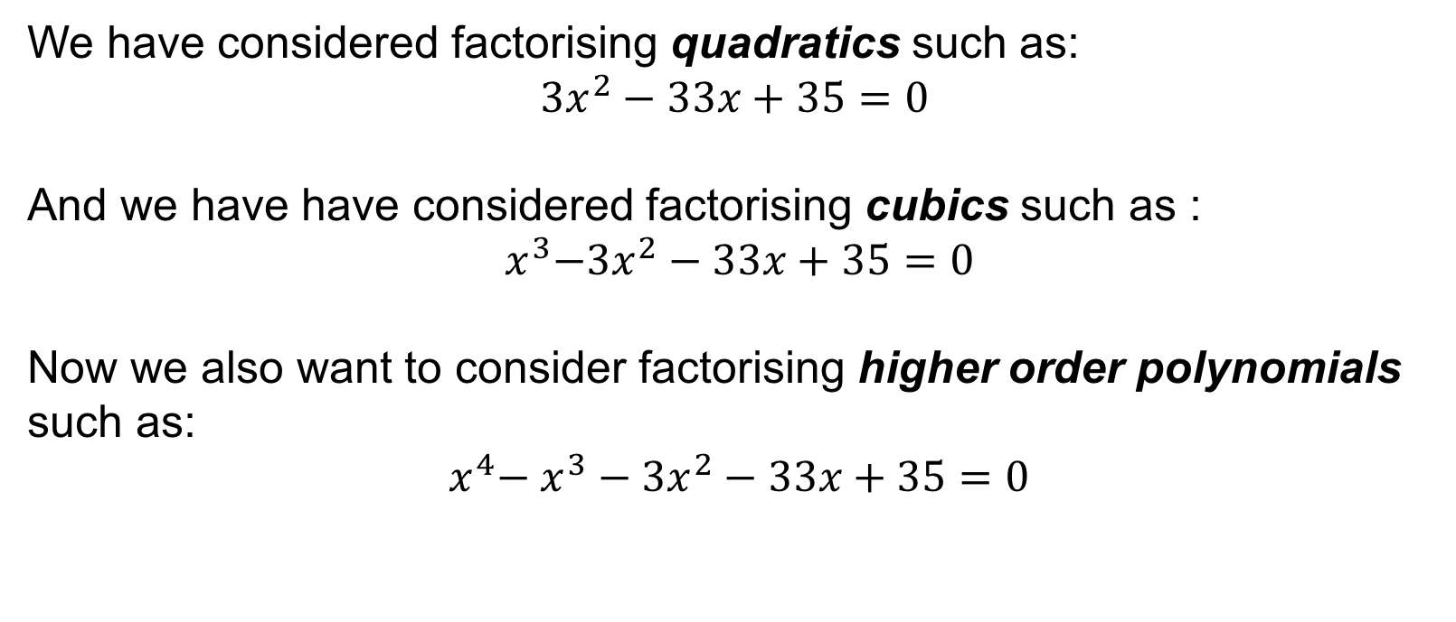
UNIT:
Factorising
Polynomials
Section 3
Factor Theorem
We have considered factorising quadratics such as:
$${3x}^{2}−33x+35=\text{0}$$
And we have have considered factorising cubics such as :
$${ x}^{3}−{3x}^{2}−33x+35=0$$
Now we also want to consider factorising higher order polynomials
such as:
$${{ x}^{4}− x}^{3}−{3x}^{2}−33x+35=0$$
For this, we use the Factor Theorem.

Slide 18
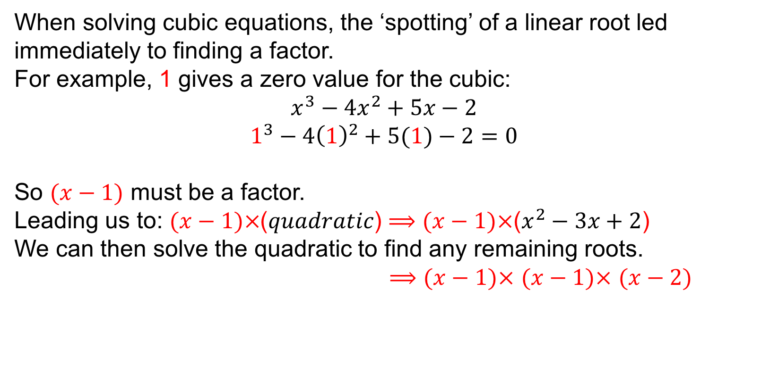

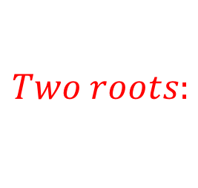
UNIT:
Factorising
Polynomials
Section 3
Factor Theorem
When solving cubic equations, the ‘spotting’ of a linear root led immediately to finding a factor.
For example, 1 gives a zero value for the cubic:
$$x^{3}−{4x}^{2}+5x−2$$
$$1^{3}−{4\left(1\right)}^{2}+5(1)−2=0$$
So $(x−1)$ must be a factor.
Leading us to: $(x−1)×$($quadratic$) $⟹(x−1)×$($x^{2}−3x+2$)
We can then solve the quadratic to find any remaining roots.
$⟹(x−1)×$ $(x−1)×$ $(x−2)$
$$Two roots:$$
$x$ $=$ 1
$x$ $=2$
We can now apply the same technique to polynomials of any order. This is the Factor Theorem.

Slide 19







UNIT:
Factorising
Polynomials
Section 3
Factor Theorem
For example: Find a factor of the quartic:
$$x^{4}+{3x}^{3}−{2x}^{2}+5x−7$$
Using trial and improvement we can ‘spot’ a root.
Try simple values first, for example: 0, 1, $−1$, 2, $−2…$
$$1+{3(1)}^{3}−{2\left(1\right)}^{2}+5\left(1\right)−7=0$$
So $(x−1)$ must be a factor.
Leading us to: $(x−1)×$($cubic$) $⟹\left(x−1\right)×$(${ax}^{3}+{bx}^{2}+cx+d$)
$⟹\left(x−1\right)×$($x^{3}+{bx}^{2}+cx+7$)
$⟹x^{4}+{bx}^{3}+{cx}^{2}+7x$
$− { x}^{3}−{bx}^{2}−cx$ $− 7$
$⟹\left(x−1\right)× \text{(}x^{3}+{4x}^{2}+2x+7\text{)}$
We can easily ‘see’ $a$ and $d$, and substitute in…
$$a=1$$
$$d=7$$
And $c=2$
We can now expand, to find $b$ and $c$
Therefore, $b$ $=4$
$$x^{4}+{3x}^{3}−{2x}^{2}+5x−7$$

Slide 20








UNIT:
Factorising
Polynomials
Section 3
Section 3: Fitness Check
Here are some questions to check your progress;
there are more practice questions if needed.
$\text{Show} \text{that}\text{ (}x+1)$is a factor of ${x^{5}+x}^{4}+{3x}^{3}−{2x}^{2}−4x+1$
$${−1+(−1)}^{4}+{3(−1)}^{3}−{2\left(−1\right)}^{2}−4\left(−1\right)+1=0$$
$\text{Show} \text{that}\text{ (}x−8)$is a factor of ${x^{10}−9x}^{9}+{8x}^{8}−x^{2}+x+56$
$${8^{10}−9(8)}^{9}+{8(8)}^{8}−{(8)}^{2}+8+56=0$$
Find a linear factor for each of these polynomials:
a) $x^{4}−{6x}^{3}−{8x}^{2}+6x+7$
b) $x^{3}+{12x}^{2}−43x−6$
$$(x−1)$$
$$(x−3)$$
Show that $\left(3x−2\right)$is a factor of ${3x}^{3}+{10x}^{2}−11x+2$
${3(\frac{2}{3})}^{3}+{10(\frac{2}{3})}^{2}−11(\frac{2}{3})+2$ $= \text{0}$

Slide 21
UNIT:
Factorising
Polynomials
Section 3
Section 3: Review
You have completed the third Section.
If you have completed and understood this section,
click to start the next Section
If you need more examples and interactive practice,
press here
You might also find it helpful to look at:
Essential Information: press here

Slide 22




UNIT:
Factorising
Polynomials
Section 4
Factors of Higher Order Polynomials
We have seen previously that once we have spotted a linear factor,
we can try and work out the ‘missing’ expression by inspection.
For example:
$x^{3}−{4x}^{2}+5x−2⟹(x−1)×$($x^{2}−3x+2$)
We can then solve the quadratic to find any remaining roots.
$⟹(x−1)×$ $(x−1)×$ $(x−2)$
$$Two roots:$$
$x$ $=$ 1
$x$ $=2$
Another method is long division of polynomials.
Once we have a linear factor, we use this to divide throughout the original polynomial to find what is ‘left’.

Slide 23










UNIT:
Factorising
Polynomials
Section 4
Factors of Higher Order Polynomials
For example:
${x^{4}+5x}^{3}+{7x}^{2}+6x+8⟹(x+2)×$($cubic$)
So we divide ${x^{4}+5x}^{3}+{7x}^{2}+6x+8$ by $(x+2)$.
${x^{4}+5x}^{3}+{7x}^{2}+6x+8$
$x+2$
This division is carried out in a very similar fashion to
regular long division:
${x^{4}+5x}^{3}+{7x}^{2}+6x+8$
Then we multiply $x^{3}$ with ($x+2)$
to give
First, we see how many $x$ ‘go into’ $x^{4}$.
Answer: $x^{3}$
$$x^{3}$$
$$x$$
$$x+2$$
$$x+2$$
$$x^{4}+2x^{3}$$
Then we subtract to see what remains
continued…

Slide 24



























UNIT:
Factorising
Polynomials
Section 4
Factors of Higher Order Polynomials
continued…
${x^{4}+5x}^{3}+{7x}^{2}+6x+8$
$$x^{3}$$
$${+ 3x}^{2}$$
$$+ x$$
$$+ 4$$
$$x+2$$
$$x+2$$
$$x^{4}+2x^{3}$$
Then we subtract to see what remains
$${3x}^{3}$$
$$+{ 7x}^{2}$$
And then ‘bring down’ the next term: ${+7x}^{2}$
$${3x}^{3}+{6x}^{2}$$
A$nd then repeat:$
$How many x$ ‘go into’ ${3x}^{3}$
Answer: ${3x}^{2}$
Then we subtract to see what remains
$$+ 6x$$
$$x^{2}$$
And then ‘bring down’ the next term: +$6x$
Then we multiply ${3x}^{2}$ with ($x+2)$
to give:
$$x^{2}+2x$$
A$nd then:$
$How many x$ ‘go into’ $x^{2}$
Answer: $x$
A$nd:$
$How many x$ ‘go into’ $4x$
Answer: $4$
$$4x$$
$$+ 8$$
Then we subtract to see
what remains
Then we multiply $x$ with ($x+2)$
to give:
$$4x+8$$
And then ‘bring down’ the
final term: $+8$
Then we multiply $4$
with ($x+2)$to give:
0
Then we subtract to see
what remains
So $\left(x^{3}+{3x}^{2}+x+4\right)$ is a factor.
zero
and ${x^{4}+5x}^{3}+{7x}^{2}+6x+8=\left(x+2\right)\left(x^{3}+{3x}^{2}+x+4\right)$

Slide 25




























UNIT:
Factorising
Polynomials
Section 4
Factors of Higher Order Polynomials
Try: ${x^{4}−5x}^{3}−{2x}^{2}+25x−3$ divided by $\left(x−3\right)$
${x^{4}−5x}^{3}−{2x}^{2}+25x−3$
First, we see how many $x$ ‘go into’ $x^{4}$.
Answer: $x^{3}$
$$x^{3}$$
$${−2x}^{2}$$
$$− 8x$$
$$+ 1$$
$$x−3$$
$$x−3$$
Then we multiply $x^{3}$ with ($x−3)$
to give:
$$x^{4}−3x^{3}$$
Then we subtract to see what remains
$${−2x}^{3}$$
$$−{ 2x}^{2}$$
And then ‘bring down’ the next term: ${−2x}^{2}$
$${−2x}^{3}+{6x}^{2}$$
A$nd then repeat:$
$How many x$ ‘go into’ ${−2x}^{3}$
Answer: ${−2x}^{2}$
Then we subtract to see what remains
$$+ 25x$$
$${−8x}^{2}$$
And then ‘bring down’ the next term: $+25x$
Then we multiply ${−2x}^{2}$ with ($x−3)$
to give:
$${−8x}^{2}+24x$$
A$nd then:$
$How many x$ ‘go into’ ${−8x}^{2}$
Answer: $−8x$
A$nd:$
$How many x$ ‘go into’ $x$
Answer: $1$
$$x$$
Then we subtract to see
what remains
$$− 3$$
Then we multiply $−8x$ with ($x−3)$
to give:
$$x−3$$
And then ‘bring down’ the
final term: $−3$
Then we multiply $1$ with
($x−3)$to give:
0
Then we subtract to see
what remains
So $\left(x^{3}−{2x}^{2}−8x+1\right)$ is a factor.
zero
and${{ x}^{4}−5x}^{3}−{2x}^{2}+25x−3=\left(x−3\right)\left(x^{3}−{2x}^{2}−8x+1\right)$

Slide 26






UNIT:
Factorising
Polynomials
Section 4
Section 4: Fitness Check
Here are some questions to check your progress;
there are more practice questions if needed.
Use long division to find the missing factors:
a) $x^{4}+{6x}^{3}+{9x}^{2}+5x+1=(x+1)$
b) $x^{4}+{7x}^{3}−39x−18=(x+6)$
c) ${2x}^{3}−{4x}^{2}−7x+14=(x−2)$
d) ${{9x}^{5}+9x}^{4}−{16x}^{3}+11x+2=(3x+2)$
$$(x^{3}+{5x}^{2}+4x+1)$$
$${(x}^{3}+ x^{2}−6x−3)$$
$$({2x}^{2}−7)$$
$${(3x}^{4}+ x^{3}−{6x}^{2}+4x+1)$$
$\text{Solve} \text{the} \text{quartic} \text{equation}\text{: }x^{4}+{8x}^{3}−{13x}^{2}−32x+36=0$
$$x=1, 2, −2, −9$$
$\text{Solve} \text{the} \text{quintic} \text{equation}\text{: }{x^{5}−8x}^{3}+{6x}^{2}+7x−6=0$
$$x=−3, −1, 1\left(repeated\right), 2$$

Slide 27
UNIT:
Factorising
Polynomials
Section 4
Section 4: Review
You have completed the fourth Section.
If you have completed and understood this section,
click to start the next Section
If you need more examples and interactive practice,
press here
You might also find it helpful to look at:
Essential Information: press here

Slide 28

UNIT:
Factorising
Polynomials
Section 5
Remainders
In the previous section, we found a missing factor by dividing the polynomial by a linear factor.
We could be confident, therefore, that there would be no remainder
(by knowing that the linear factor would definitely ‘go into’ the
original polynomial).
But what happens if we divide a polynomial by an expression that is not a factor?
For example:
$${\left(x+3\right) \text{is} \text{not} \text{a} \text{factor} \text{of} x}^{3}+{6x}^{2}+7x−4$$
In scenarios such as this, there will be a remainder.

Slide 29























UNIT:
Factorising
Polynomials
Section 5
Remainders
${ x}^{3}+{ 6x}^{2}+7x−4$ divided by $\left(x+3\right)$
${x^{3}+6x}^{2}+7x−4$
First, we see how many $x$ ‘go into’ $x^{3}$.
Answer: $x^{2}$
$$x^{2}$$
$$+ 3x$$
$$− 2$$
$$x+3$$
$$x+3$$
Then we multiply $x^{2}$ with ($x+3)$
to give:
$$x^{3}+3x^{2}$$
Then we subtract to see what remains
$${3x}^{2}$$
$$+7x$$
And then ‘bring down’ the next term: $+7x$
$${3x}^{2}+9x$$
A$nd then repeat:$
$How many x$ ‘go into’ ${3x}^{2}$ ?
Answer: $3x$
Then we subtract to see what remains
$$−2x$$
$$− 4$$
and then ‘bring down’ the next term: $−4$
Then we multiply $3x$ with ($x+3)$
to give:
$$−2x−6$$
A$nd then:$
$How many x$ ‘go into’ $−2x ?$
Answer: $−2$
$$2$$
Then we subtract to see
what remains
Then we multiply $−2$ with ($x+3)$
to give:
So there is a remainder of 2.

Slide 30












UNIT:
Factorising
Polynomials
Section 5
Remainders
${ x}^{3}+{6x}^{2}+7x−4$ divided by $\left(x+3\right)$
We can write this as:
${ x}^{3}+{6x}^{2}+7x−4$
$=$
${ x}^{2}+ 3x−2, remainder 2$
$$(x+3)$$
$${ x}^{2}+ 3x$$
$$− 2+$$
$$2$$
or more commonly as:
$$=$$
$$x+3$$
or:
${ x}^{3}+{6x}^{2}+7x−4$
$$=$$
$${ (x}^{2}+ 3x−2)(x+3)+2$$

Slide 31























UNIT:
Factorising
Polynomials
Section 5
Remainders
Try: ${x^{4}−5x}^{3}−{2x}^{2}+25x−8$ divided by $\left(x−2\right)$
${x^{4}−5x}^{3}−{2x}^{2}+25x−8$
First, we see how many $x$ ‘go into’ $x^{4}$.
Answer: $x^{3}$
$$x^{3}$$
$${−3x}^{2}$$
$$− 8x$$
$$+ 9$$
$$x−2$$
$$x−2$$
Then we multiply $x^{3}$ with ($x−2)$
to give:
$$x^{4}−2x^{3}$$
Then we subtract to see what remains
$${−3x}^{3}$$
$$−{ 2x}^{2}$$
And then ‘bring down’ the next term: ${−2x}^{2}$
$${−3x}^{3}+{6x}^{2}$$
A$nd then repeat:$
$How many x$ ‘go into’ ${−3x}^{3}$ ?
Answer: ${−3x}^{2}$
Then we subtract to see what remains
$$+ 25x$$
$${−8x}^{2}$$
and then ‘bring down’ the next term: $+25x$
$${−8x}^{2}+16x$$
Then we multiply ${3x}^{2}$ with ($x−2)$
to give:
A$nd then:$
$How many x$ ‘go into’ ${−8x}^{2}$ ?
Answer: $−8x$
A$nd:$
$How many x$ ‘go into’ $9x ?$
Answer: $9$
$$9x$$
$$− 8$$
Then we subtract to see
what remains
Then we multiply $−8x$ with ($x−2)$
to give:
$$9x−18$$
And then ‘bring down’ the
final term: $−8$
Then we multiply $9$ with
($x−2)$to give:
10
Then we subtract to see
what remains
So there is a remainder of 10.

Slide 32












UNIT:
Factorising
Polynomials
Section 5
Remainders
${x^{4}−5x}^{3}−{2x}^{2}+25x−8$ divided by $\left(x−2\right)$
We can write this as:
${x^{4}−5x}^{3}−{2x}^{2}+25x−8$
$=$
${ x}^{3}− 3x^{2}−8x+9, remainder 10$
$$(x−2)$$
$$=$$
$$+$$
$$10$$
or more commonly as:
$${ x}^{3}− 3x^{2}−8x+9$$
$$x−2$$
or:
$$=$$
${x^{4}−5x}^{3}−{2x}^{2}+25x−8$
$${ (x}^{3}− 3x^{2}−8x+9)(x−2)+10$$

Slide 33








UNIT:
Factorising
Polynomials
Section 5
Section 5: Fitness Check
Here are some questions to check your progress;
there are more practice questions if needed.
What is the remainder when:
a) $x^{4}−{3x}^{2}+7 \text{is} \text{divided} \text{by} \left(x+3\right)$
b) $x^{2}+5x−7 \text{is} \text{divided} \text{by} \left(x−2\right)$
c) ${5x}^{3}+{6x}^{2}+7x−3 \text{is} \text{divided} \text{by} \left(x+5\right)$
d) $x^{3}+{4x}^{2}−7x+10 \text{is} \text{divided} \text{by} \left(x+3\right) ?$
$$61$$
$$7$$
$$−513$$
$$40$$
$\text{Find} \text{the} \text{linear} \text{expressions} \text{which} \text{gives} \text{a} \text{remainder} \text{of}\text{ 6 }\text{when} \text{divided} \text{into}\text{: }x^{2}+10x+22$
$\left(x+2\right),$ $\left(x+8\right)$
Solution: So $x^{2}+10x+16$ can be factorised.
Try $x=−2$ 4 $+(−20)$ $+16=0$ so $\left(x+2\right)$ is a factor.
Now:
Either use polynomial division and divide $x^{2}+10x+22$ by $\left(x+2\right)$
or look for another solution for $x^{2}+10x+16$

Slide 34
UNIT:
Factorising
Polynomials
Section 5
Section 5: Review
You have completed the fifth Section.
If you have completed and mastered this last section,
click here for the Unit audit
If you need more examples and interactive practice,
press here
You might also find it helpful to look at:
Essential Information: press here

