Slide 1
Supporting and Enhancing Mathematics and Statistics
UNIT: Number Sequences

Slide 2
UNIT:
Number
Sequences
Number Sequences
Number Sequences are an important part of algebra work.
You have four sections to work through and there are check up audits and fitness tests for each section.
Simple Number Patterns
Recognising Number Patterns
Extending Number Patterns
Formulae for Number Sequences

Slide 3
Simple Number Patterns
UNIT:
Number
Sequences
Section 1
A list of numbers which form a pattern is called a sequence.
To continue a number sequence, it is often very useful to
look for the difference between numbers.
Sequence
7, 11, 15, 19, 23, …
Difference
4 4 4 4
In this sequence, the difference is 4.
The next two terms are:
27 + 4 = 31, giving
7, 11, 15, 19, 23, 27, 31, …
23 + 4 = 27 and

Slide 4
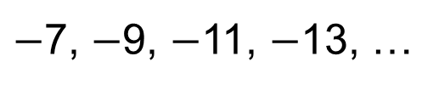
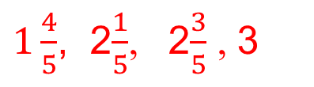
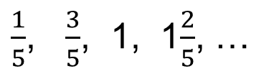
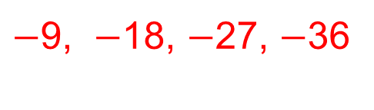
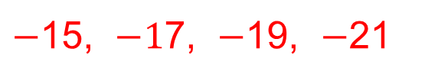
UNIT:
Number
Sequences
Section 1
Section 1: Fitness Check
Here are some questions to check your progress;
there are more practice questions if needed.
Find the next four numbers in each sequence.
4, 9, 14, 19, …
24, 29, 34, 39
3, 20, 37, 54, …
71, 88, 105, 122
$−$7, $−$9, $−$11, $−$13, …
$−$15, $−1$7, $−$19, $−$21
18, 9, 0, …
$−$9, $−$18, $−$27, $−$36
2, 2.25, 2.5, 2.75,…
3, 3.25, 3.5, 3.75
1.9, 3.3, 4.7, 6.1, …
7.5, 8.9, 10.3, 11.7
$\frac{1}{5}$, $\frac{3}{5}$, 1, 1$\frac{2}{5}$, …
$1\frac{4}{5}$, 2$\frac{1}{5}$, 2$\frac{3}{5}$ , 3
0.91, 0.84, 0.77, 0.7, …
0.63, 0.56, 0.49, 0.42

Slide 5
UNIT:
Number
Sequences
Section 1
Section 1: Review
You have completed the first Section.
If you have completed and understood this section,
click to start the next Section
If you need more examples and interactive practice,
press here
You might also find it helpful to look at:
Essential Information: press here

Slide 6
UNIT:
Number
Sequences
Section 2
Recognising Number Patterns
Some number sequences follow different patterns.
Look at the ones below.
Can you spot the patterns?
Fibonacci Sequence:
Square Numbers:
Triangular Numbers:
(Note: Two consecutive Triangular Numbers sum to a Square Number, for example: 10 + 15 = 25)
Cube Numbers:
1, 1, 2, 3, 5, 8, 13, 21, 34,…
1, 4, 9, 16, 25, 36, 49, …
1, 3, 6, 10, 15, 21, 28, 36, ...
1, 8, 27, 64, 125, 216, ...

Slide 7
UNIT:
Number
Sequences
Section 2
Recognising Number Patterns
1, 1, 2, 3, 5, 8, 13, 21, 34,…
Fibonacci Sequence:
is obtained by adding together two consecutive terms to obtain the next term.
Square Numbers sequence:
is obtained by squaring 1, then squaring 2, then squaring 3, then squaring 4, then squaring 5, ...
Triangular Numbers sequence:
the difference increases by 1 each time, starting with +2, then +3, then +4, …
Cube Numbers sequence:
is obtained by cubing 1, then cubing 2, then cubing 3, then cubing 4, then cubing 5, ...
1 + 1 = 2
1 + 2 = 3
2 + 3 = 5
3 + 5 = 8 and so on
1, 4, 9, 16, 25, 36, 49, …
1², 2², 3², 4², 5², 6², 7², …
1, 3, 6, 10, 15, 21, 28, 36, ...
1, 8, 27, 64, 125, 216, ...
1³, 2³, 3³, 4³, 5³, 6³, …

Slide 8
UNIT:
Number
Sequences
Section 2
Recognising Number Patterns
Number sequences sometimes require detective work.
Often they are very similar to ones previously encountered - with just an added tweak or two.
2, 5, 10, 17, 26, 37, 50, …
Look at this one:
What comes next?
This is the square number sequence with one more added to each term.
And this one?
This is the triangular number sequence with each term doubled.
Try this one…
Similar to the Fibonacci sequence, this sequence is obtained by adding together two consecutive terms to obtain the next term.
2, 5, 10, 17, 26, 37, 50, 65, 82, …
2, 6, 12, 20, 30, 42, ...
2, 6, 12, 20, 30, 42, 56, 72, ...
1, 5, 6, 11, 17, 28, …

Slide 9
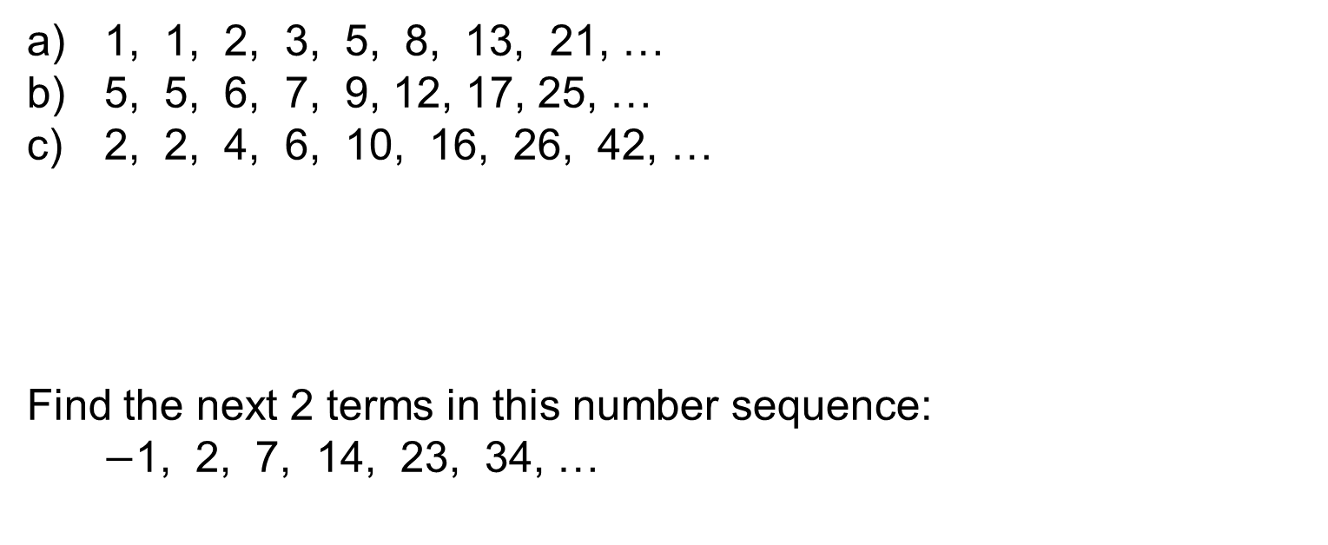
UNIT:
Number
Sequences
Section 2
Recognising Number Patterns
Describe how the following sequences are related, and
find the next term for each:
1, 1, 2, 3, 5, 8, 13, 21, …
5, 5, 6, 7, 9, 12, 17, 25, …
2, 2, 4, 6, 10, 16, 26, 42, …
Find the next 2 terms in this number sequence:
$−$1, 2, 7, 14, 23, 34, …
34
38
68
The first is the Fibonacci sequence;
the second is the Fibonacci sequence with 4 added to each term;
the third is the Fibonacci sequence with each term doubled.
47, 62
This is the square number sequence with 2 subtracted from
each term.

Slide 10
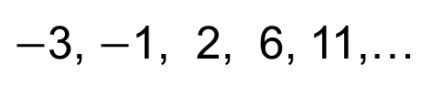
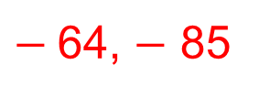
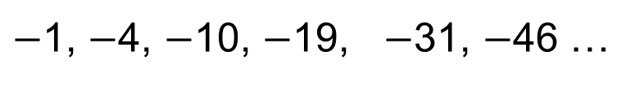
UNIT:
Number
Sequences
Section 2
Section 2: Fitness Check
Here are some questions to check your progress;
there are more practice questions if needed.
Find the next two numbers in each sequence
1, 8, 27, 64, 125, ...
216, 343
5, 6, 11, 17, 28, …
45, 73
$−$3, $−$1, 2, 6, 11,…
17, 24
1, 4, 9, 16, 25, …
36, 49
1, 3, 6, 10, 15, 21,…
28, 36
2, 8, 18, 32, 50, 72, …
98, 128
$−$1, $−$4, $−$10, $−$19, $−$31, $−$46 …
$−$64, $−$ 85

Slide 11
UNIT:
Number
Sequences
Section 2
Section 2: Review
You have completed the second Section.
If you have completed and understood this section,
click to start the next Section
If you need more examples and interactive practice,
press here
You might also find it helpful to look at:
Essential Information: press here

Slide 12
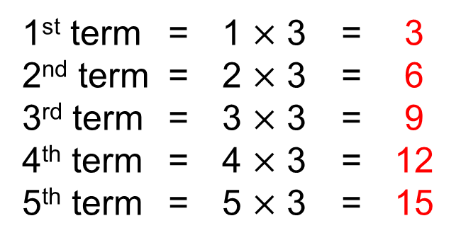
UNIT:
Number
Sequences
Section 3
Extending Number Patterns
A formula or rule can be used to work out any term of a sequence without having to work out all the terms.
For example, we can work out the 100th term of
2, 5, 8, 11, 14,…
without having to work out all the interspersing terms.
Let’s look at this example first: 3, 6, 9, 12, 15, 18,…
The terms of the sequence can be obtained as shown below:
1st term = 1 $×$ 3 = 3
2nd term = 2 $×$ 3 = 6
3rd term = 3 $×$ 3 = 9
4th term = 4 $×$ 3 = 12
5th term = 5 $×$ 3 = 15
This pattern can be extended to give…
Continued on next slide

Slide 13

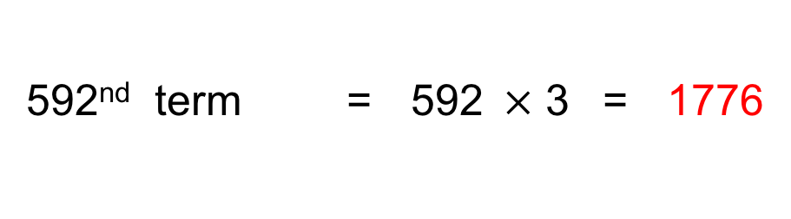
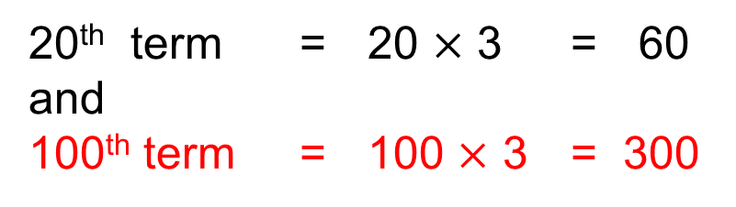
UNIT:
Number
Sequences
Section 3
Extending Number Patterns
Continued
20th term = 20 $×$ 3 = 60
and
100th term = 100 $×$ 3 = 300
In fact, we can find any term we like.
What about the 1000th term? Or the 592nd term? Or the millionth term?
We simply multiply the term number by 3.
592nd term = 592$×$ 3 = 1776
We can generalise this by finding a rule for the n^{th} term
(that is for any term).
n^{th} term = n $×$ 3
n^{th} term = 3n

Slide 14
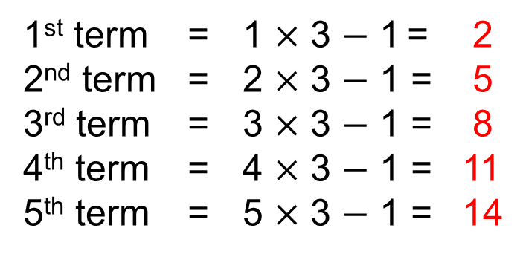
Extending Number Patterns
UNIT:
Number
Sequences
Section 3
Let’s look again at:
Can we work out the 100th term?
2, 5, 8, 11, 14,…
And the n^{th} term?
First we spot the pattern, and notice that there is a
common difference of 3.
So the general term will be based on a multiple of 3.
But something else is happening too.
We also need to subtract 1.
The terms of the sequence are obtained as shown below:
1st term = 1 $×$ 3 $−$ 1 = 2
2nd term = 2 $×$ 3 $−$ 1 = 5
3rd term = 3 $×$ 3 $−$ 1 = 8
4th term = 4 $×$ 3 $−$ 1 = 11
5th term = 5 $×$ 3 $−$ 1 = 14
This pattern can be extended to give…
Continued on next slide

Slide 15
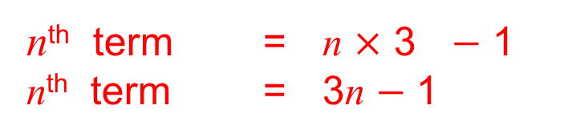
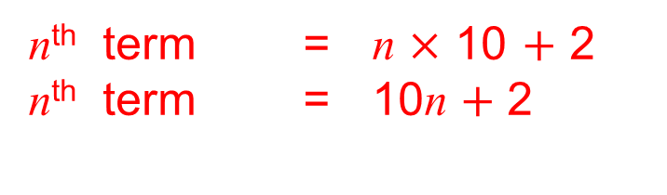
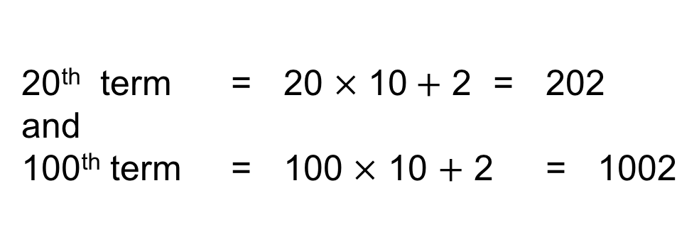
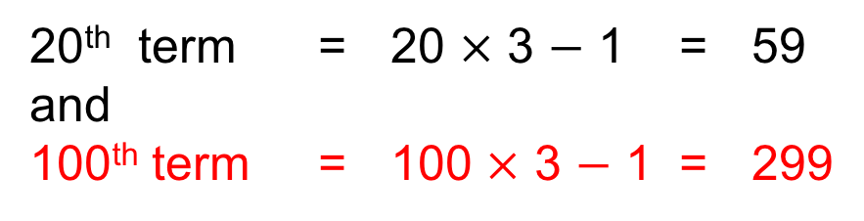
UNIT:
Number
Sequences
Section 3
Extending Number Patterns
Continued
20th term = 20 $×$ 3 $−$ 1 = 59
and
100th term = 100 $×$ 3 $−$ 1 = 299
n^{th} term = n $×$ 3 $−$ 1
n^{th} term = 3n $−$ 1
Find the n^{th} term for this sequence:
12, 22, 32, 42, 52, 62,…
We simply multiply the term number by 10 and add 2.
For example,
20th term = 20 $×$ 10$+$ 2 = 202
and
100th term = 100 $×$ 10 $+$ 2 = 1002
n^{th} term = n $×$ 10 $+$ 2
n^{th} term = 10n $+$ 2

Slide 16
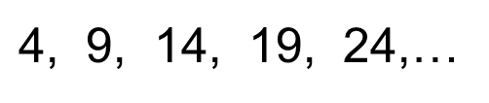
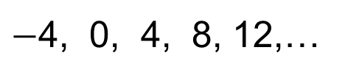
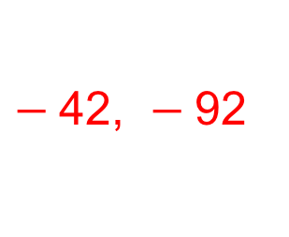
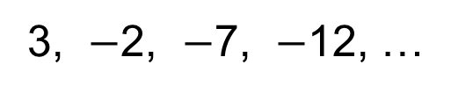
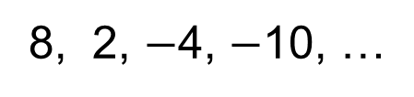
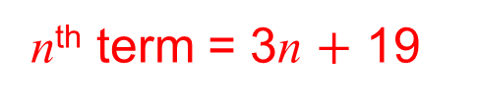
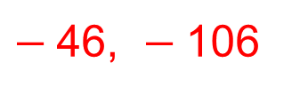
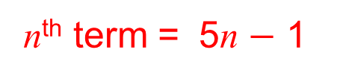
UNIT:
Number
Sequences
Section 3
Section 3: Fitness Check
Here are some questions to check your progress;
there are more practice questions if needed.
Find the 10th and 20th terms of each sequence below:
7, 12, 17, 22, 27, ...
52, 102
8, 2, $−$4, $−$10, …
$−$46, $−$106
$−$4, 0, 4, 8, 12,…
32, 72
3, $−$2, $−$7, $−$12, …
$−$42, $−$92
Find the n^{th} terms of each sequence below:
$\text{4}$, 9, 14, 19, 24,…
n^{th} term = 5n $−$ 1
22, 25, 28, 31, …
n^{th} term = 3n $+$ 19

Slide 17
UNIT:
Number
Sequences
Section 3
Section 3: Review
You have completed the third Section.
If you have completed and mastered this last section,
click here for the Unit audit
If you need more examples and interactive practice,
press here
You might also find it helpful to look at:
Essential Information: press here

Slide 18
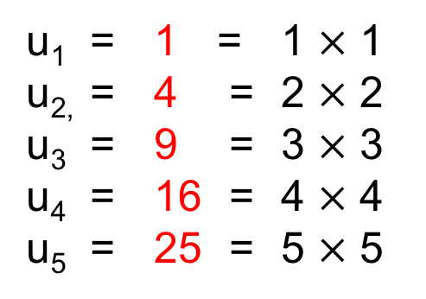
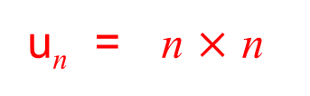
Formulae for Number Sequences
UNIT:
Number
Sequences
Section 4
In the last section we found the n^{th} term for linear sequences,
that is, for sequences which go up or down by a constant amount.
We can also find a formulae for the n^{th} term for other sequences.
For example:
1, 4, 9, 16, 25,…
We can refer to the first term as u_{1,} to the second term as u_{2,}
the third term as u_{3,} and so on
u₁ = 1 = 1 $×$ 1
u_{2,} = 4 = 2 $×$ 2
u₃ = 9 = 3 $×$ 3
u₄ = 16 = 4 $×$ 4
u₅ = 25 = 5 $×$ 5
This sequence can be described by the general formula:
u_{n} = n $×$ n
u_{n} = n ²

Slide 19
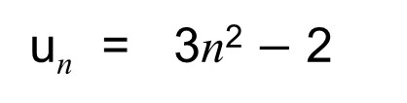
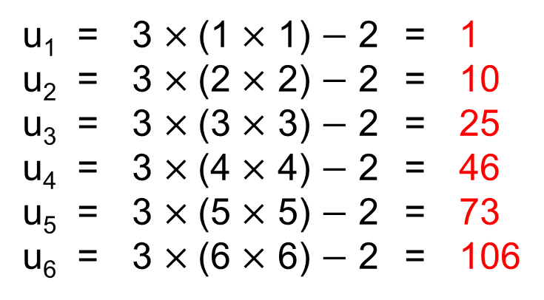
UNIT:
Number
Sequences
Section 4
Formulae for Number Sequences
Example
Use the formula below to find the first 6 terms of the sequence:
u_{n} = 3n² $−$ 2
Solution
We can work out each term in turn:
u₁ = 3 $×$(1 $×$ 1) $−$ 2 = 1
u₂ = 3 $×$(2 $×$ 2) $−$ 2 = 10
u₃ = 3 $×$(3 $×$ 3) $−$ 2 = 25
u₄ = 3 $×$(4 $×$ 4) $−$ 2 = 46
u₅ = 3 $×$(5 $×$ 5) $−$ 2 = 73
u₆ = 3 $×$(6 $×$ 6) $−$ 2 = 106
This sequence is:
1, 10, 25, 46, 73, 106,…

Slide 20
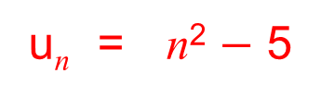
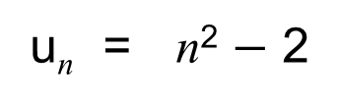
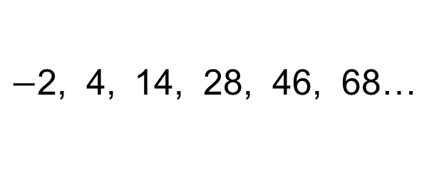
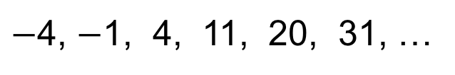
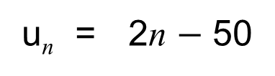
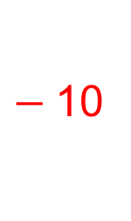
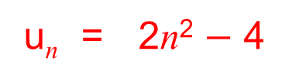
UNIT:
Number
Sequences
Section 4
Section 4: Fitness Check
Here are some questions to check your progress;
there are more practice questions if needed.
1. Find the 20th term of each sequence below:
u_{n} = 5n
100
u_{n} = 2n $−$ 50
$−$10
398
u_{n} = n² $−$ 2
2. List the first 6 terms of u_{n} = n²
3. Use your answer to write down the formula for the
following sequences:
1, 4, 9, 16, 25, 36, …
2, 8, 18, 32, 50, 72, …
u_{n} = 2n²
$−$4, $−$1, 4, 11, 20, 31, …
u_{n} = n² $−$ 5
$−$2, 4, 14, 28, 46, 68…
u_{n} = 2n² $−$ 4

Slide 21
UNIT:
Number
Sequences
Section 4
Section 4: Review
You have completed the fourth and last Section.
If you have completed and mastered this last section,
click here for the Unit audit
If you need more examples and interactive practice,
press here
You might also find it helpful to look at:
Essential Information: press here

