Slide 1
Supporting and Enhancing Mathematics and Statistics
UNIT: Powers

Slide 2
UNIT:
Powers
Powers
Powers play an important in algebraic work.
You have two sections to work through and there are check up audits and fitness tests for each section.
Fractional Indices
Further Problems

Slide 3


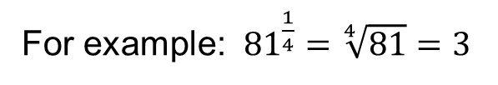













UNIT:
Powers
Section 1
Indices Rules
Previously you will have
seen and used these indices rules:
$a^{m}×{ a}^{n}$ $=$ $a^{m+n}$
For example: 4³ $×$ 4⁵ = 4⁸
$a^{m}÷a^{n}$ $=$ $a^{m−n}$
For example: 6¹⁰ $÷$6³ = 6⁷
$a^{0}$ $=$ 1
For example: $7^{0}$ $=$ 1
${(a^{m})}^{n}=$ $a^{m×n}$
For example: ${(8^{4}\text{)}}^{3}=$ $8^{4×3}=$ $8^{12}$
$a^{−1}$ $=\frac{1}{a}$
For example: $9^{−1}$ $=\frac{1}{9}$
$a^{−n}$ $=\frac{1}{a^{n}}$
For example: $6^{−4}$ $=\frac{1}{6^{4}}$
$$a^{\frac{1}{2}}=\sqrt{a}$$
For example: $9^{\frac{1}{2}}=\sqrt{9} =3$
$$a^{\frac{1}{n}}=\sqrt[n]{a}$$
For example: ${81}^{\frac{1}{4}}=\sqrt[4]{81}=3$

Slide 4
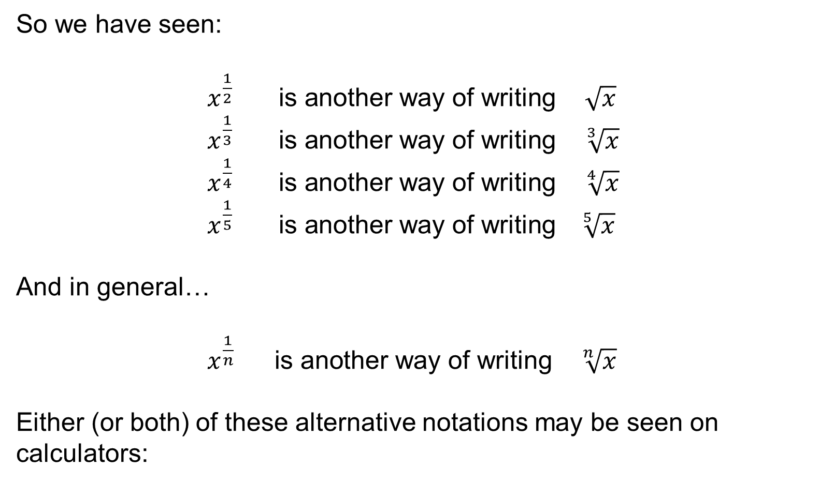

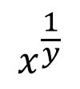
UNIT:
Powers
Section 1
Notation
So we have seen:
$x^{\frac{1}{2}} \text{is} \text{another} \text{way} \text{of} \text{writing} \sqrt{x}$
$x^{\frac{1}{3}} \text{is} \text{another} \text{way} \text{of} \text{writing} \sqrt[3]{x}$
$x^{\frac{1}{4}} \text{is} \text{another} \text{way} \text{of} \text{writing} \sqrt[4]{x}$
$x^{\frac{1}{5}} \text{is} \text{another} \text{way} \text{of} \text{writing} \sqrt[ 5]{x}$
And in general…
$x^{\frac{1}{n}} \text{is} \text{another} \text{way} \text{of} \text{writing} \sqrt[n]{x}$
Either (or both) of these alternative notations may be seen on calculators:
$$x^{\frac{1}{y}}$$
$$\sqrt[y]{x}$$

Slide 5
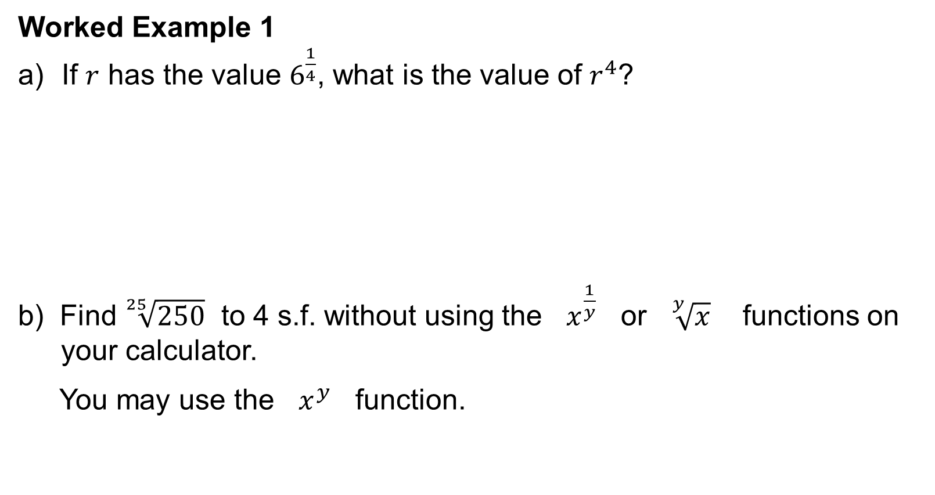
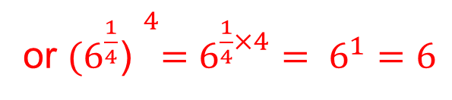
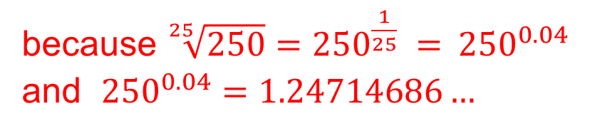
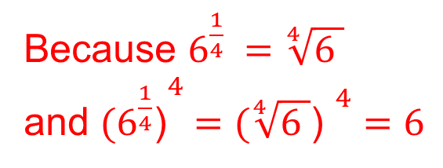
UNIT:
Powers
Section 1
Worked Example 1
Worked Example 1
If $r$ has the value $6^{\frac{1}{4}}$, what is the value of $r^{4}$?
b) Find $\sqrt[25]{250}$ to 4 s.f. without using the $x^{\frac{1}{y}}$ or $\sqrt[y]{x}$ functions on
your calculator.
You may use the $x^{y}$ function.
6
Because $6^{\frac{1}{4}} =\sqrt[4]{6 }$
and ${(6^{\frac{1}{4}}\text{)}}^{4} ={(\sqrt[4]{6 }\text{)} }^{4}$ $=6$
or ${(6^{\frac{1}{4}}\text{)} }^{4}=$ $6^{\frac{1}{4}×4}$ $= 6^{1}$ $=$ $6$
1.247
because ${\sqrt[25]{250}=250}^{\frac{1}{25}} ={ 250}^{0.04}$
and ${250}^{0.04}=1.24714686…$

Slide 6
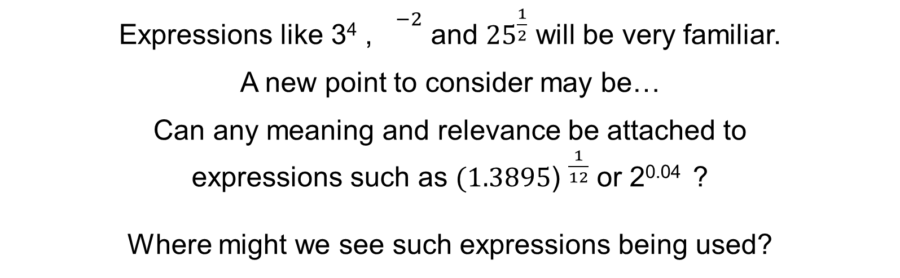
UNIT:
Powers
Section 1
Exponential Growth
Expressions like 3⁴ , ${}^{−2}$ and ${25}^{\frac{1}{2}}$ will be very familiar.
A new point to consider may be…
Can any meaning and relevance be attached to
expressions such as ${(1.3895\text{)} }^{\frac{1}{12}}$ or 2^{0.04} ?
Where might we see such expressions being used?
8
Exponential growth occurs in many situations and
fractional indices are often very useful.
A good example concerns credit card accounts where any
unpaid debt grows exponentially by a certain percentage each month.
Credit cards agreements quote a monthly interest rate
and the equivalent APR (annual percentage rate).

Slide 7
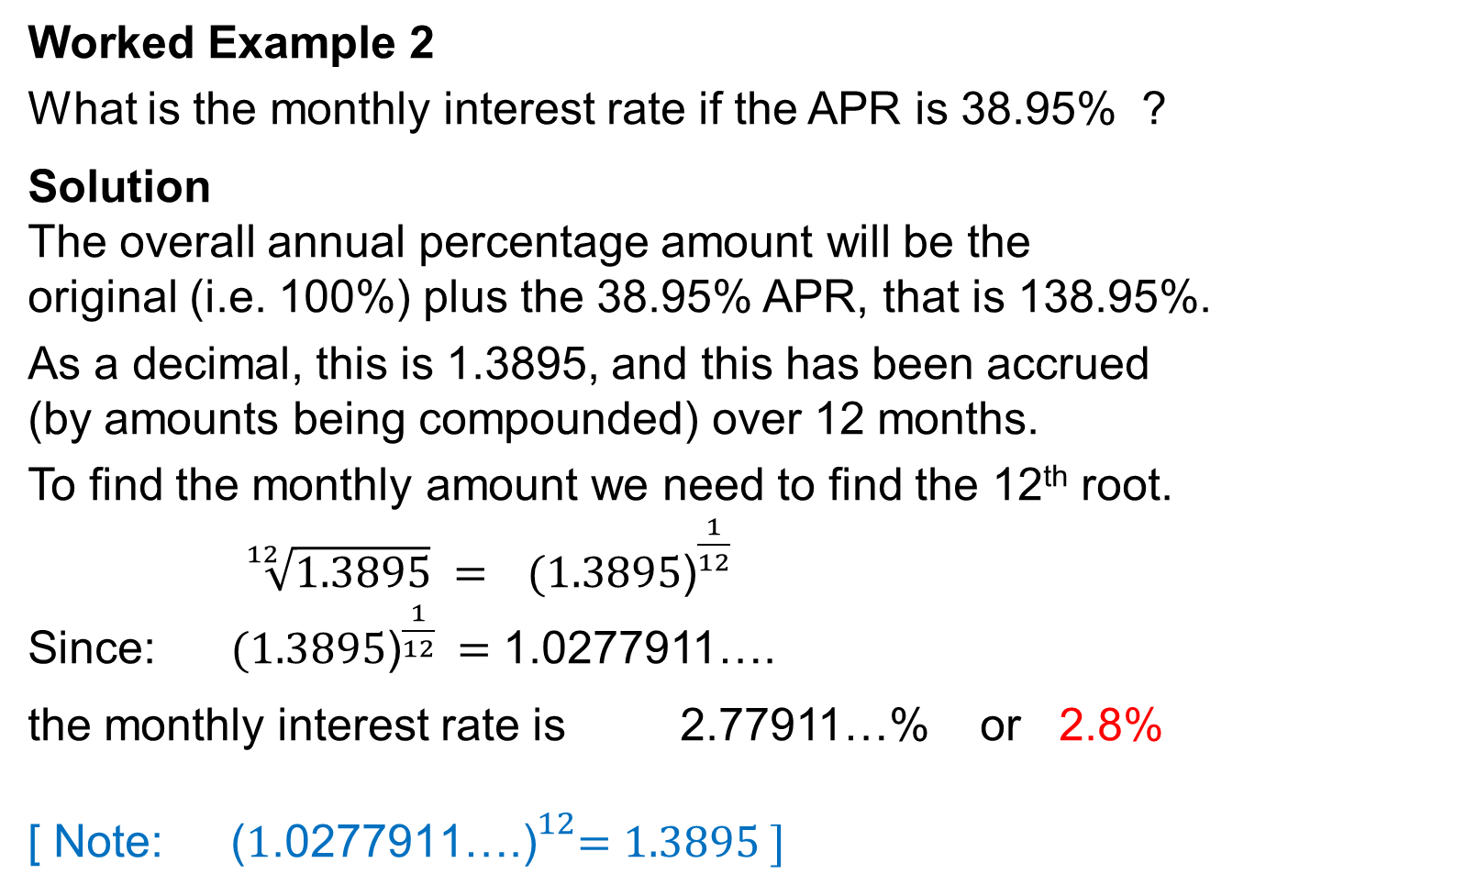
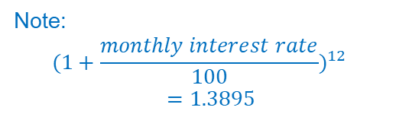
UNIT:
Powers
Section 1
Worked Example 2
Worked Example 2
What is the monthly interest rate if the APR is 38.95% ?
Solution
The overall annual percentage amount will be the
original (i.e. 100%) plus the 38.95% APR, that is 138.95%.
As a decimal, this is 1.3895, and this has been accrued
(by amounts being compounded) over 12 months.
To find the monthly amount we need to find the 12th root.
${\sqrt[12]{1.3895} = (1.3895\text{)}}^{\frac{1}{12}}$
Since: ${(1.3895\text{)}}^{\frac{1}{12}} =$ 1.0277911….
the monthly interest rate is 2.77911…% or 2.8%
[ Note: ${\text{(}1\text{.0277911}\text{….}\text{)}}^{12}=1.3895 ]$
Note:
$${(1+\frac{monthly interest rate}{100})}^{12}=1.3895$$
($1+\frac{monthly interest rate}{100}\text{)}×$($1+\frac{monthly interest rate}{100}$)$×$($1+\frac{monthly interest rate}{100}$) $×$….

Slide 8
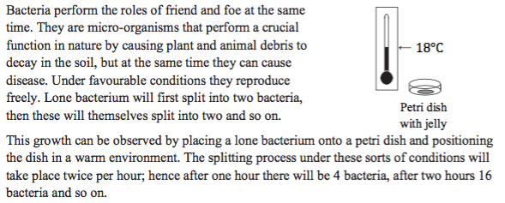
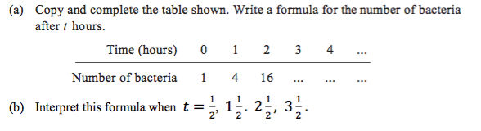
UNIT:
Powers
Section 1
Worked Example 3
Worked Example 3
Solution on next slide

Slide 9

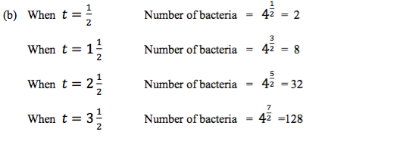
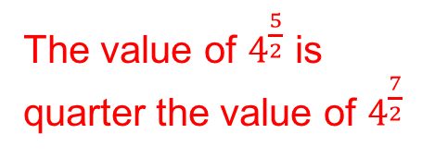
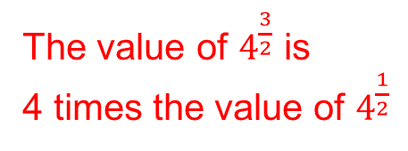

UNIT:
Powers
Section 1
Solution
Solution
Formula is $4^{t}$
The value multiplies by 4,
each time the power
increases by 1
Note: The difference between the powers is 1
The value of $4^{\frac{3}{2}}$ is
4 times the value of $4^{\frac{1}{2}}$
The value of $4^{\frac{5}{2}}$ is
quarter the value of $4^{\frac{7}{2}}$
The value divides by 4,
each time the power
decreases by 1

Slide 10
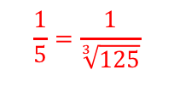
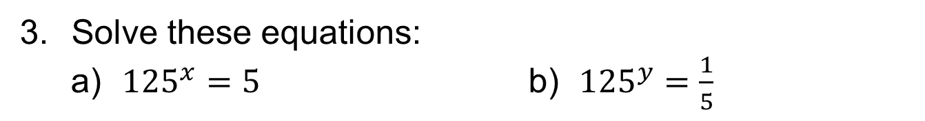

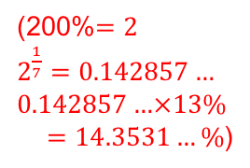
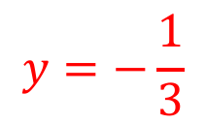
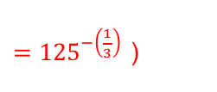
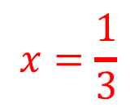
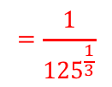
UNIT:
Powers
Section 1
Section 1: Fitness Check
Here are some questions to check your progress;
there are more practice questions if needed.
The APR on a credit card is 26.08% with monthly payments made.
Jamal has an outstanding credit card bill of £365.
How much will this be after 6 months, assuming
no other transactions take place?
£409.84
Anais has a bill for £218. What is her bill after one month?
£222.25
2. Pond plants grow exponentially so that the area they
cover doubles every week. On Saturday they cover 13% of the
surface. What percentage do they cover by Sunday?
(200%$=2$
$2^{\frac{1}{7}}$ $=0.142857…$
$$0.142857…×13\%$$
$=14.3531…\%$)
14.35%
Solve these equations:
a) ${125}^{x}$ $=5$ b) ${125}^{y}$ $=\frac{1}{5}$
$$y=−\frac{1}{3}$$
$$x=\frac{1}{3}$$
$$\frac{1}{5}=\frac{1}{\sqrt[3]{125}}$$
$$=\frac{1}{{125}^{\frac{1}{3}}}$$
$={125}^{−\left(\frac{1}{3}\right) }$)
( $5$ $=\sqrt[3]{125}$

Slide 11
UNIT:
Powers
Section 1
Section 1: Review
You have completed the first Section.
If you have completed and understood this section,
click to start the next Section
If you need more examples and interactive practice, press here
You might also find it helpful to look at:
Essential Information: press here

Slide 12
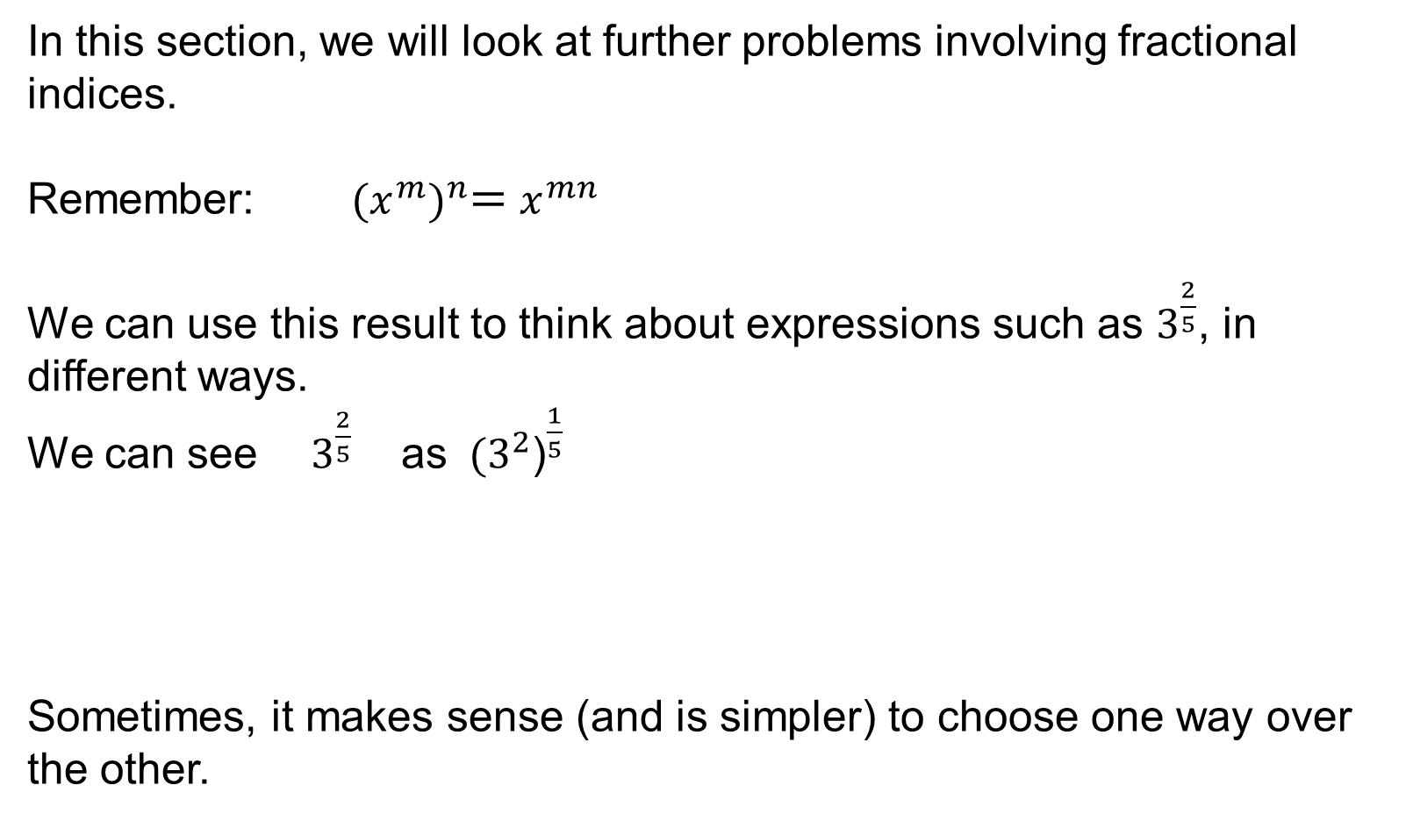
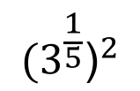

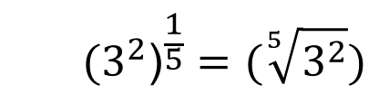

UNIT:
Powers
Section 2
Further Problems
In this section, we will look at further problems involving fractional indices.
Remember: ${(x^{m})}^{n}=$ $x^{mn}$
We can use this result to think about expressions such as $3^{\frac{2}{5}}$, in different ways.
We can see $3^{\frac{2}{5}}$ as ${{ (3}^{2}\text{)}}^{\frac{1}{5}}$
Sometimes, it makes sense (and is simpler) to choose one way over the other.
or as
$${{(3}^{\frac{1}{5}}\text{)}}^{2}$$
$${{ (3}^{2}\text{)}}^{\frac{1}{5}}=(\sqrt[5]{3^{2}})$$
${{(3}^{\frac{1}{5}}\text{)}}^{2}$ ${=(\sqrt[5]{3})}^{2}$
$$=(\sqrt[5]{9})$$

Slide 13
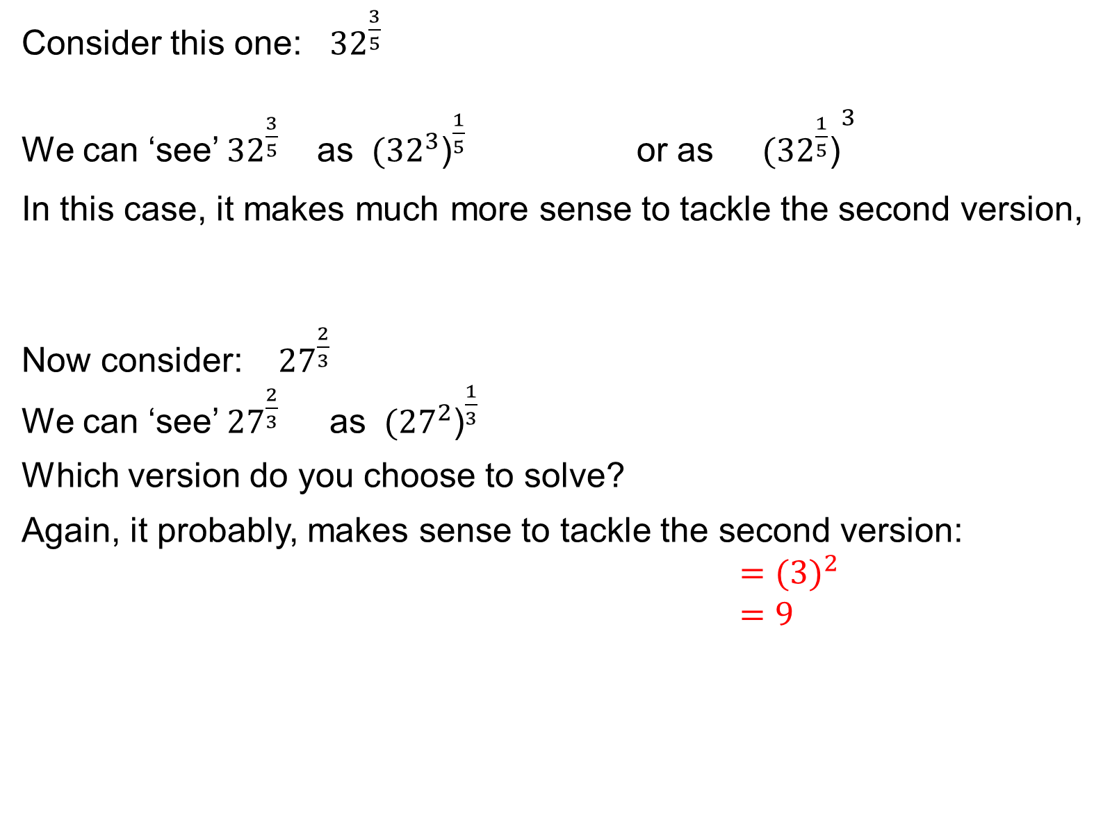
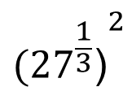
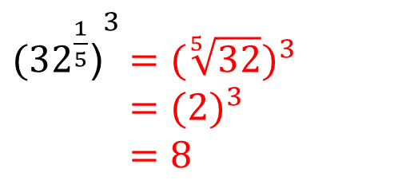
UNIT:
Powers
Section 2
Further Problems
Consider this one: ${32}^{\frac{3}{5}}$
We can ‘see’ ${32}^{\frac{3}{5}}$ as ${{ (32}^{3}\text{)}}^{\frac{1}{5}}$ or as ${{(32}^{\frac{1}{5}}\text{)}}^{3}$
In this case, it makes much more sense to tackle the second version,
Now consider: ${27}^{\frac{2}{3}}$
We can ‘see’ ${27}^{\frac{2}{3}}$ as ${{ (27}^{2}\text{)}}^{\frac{1}{3}}$
Which version do you choose to solve?
Again, it probably, makes sense to tackle the second version:
${=(3)}^{2}$
$=9$
${{(32}^{\frac{1}{5}}\text{)}}^{3}$ ${=(\sqrt[5]{32})}^{3}$
${=(2)}^{3}$
$=8$
$${{(27}^{\frac{1}{3}}\text{)}}^{2}$$
or as

Slide 14

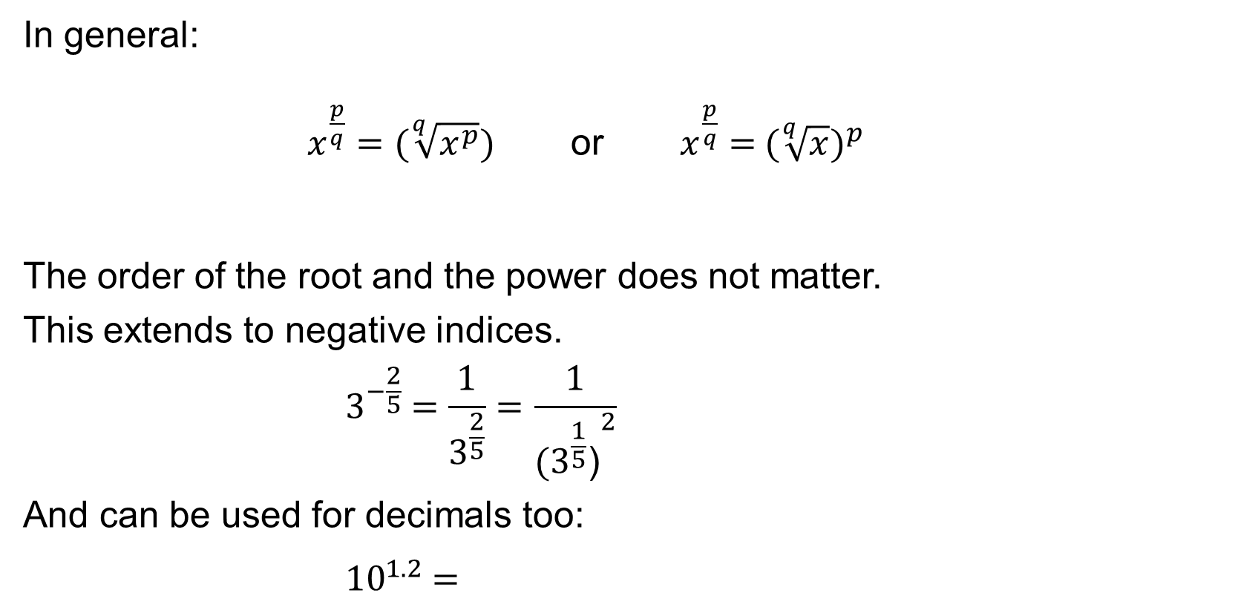
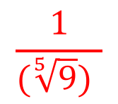
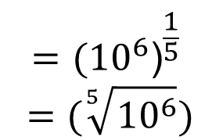
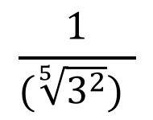
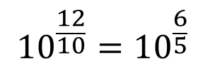
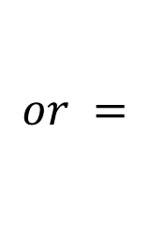
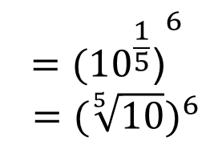
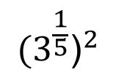
UNIT:
Powers
Section 2
Problems Using Fractional Indices
In general:
$x^{\frac{p}{q}}$ $=(\sqrt[q]{x^{p}})$ or $x^{\frac{p}{q}}$ $={ (\sqrt[q]{x})}^{p}$
The order of the root and the power does not matter.
This extends to negative indices.
$${ 3}^{−\frac{2}{5}} =\frac{1}{3^{\frac{2}{5}}}=\frac{1}{{{(3}^{\frac{1}{5}}\text{)}}^{2}}$$
And can be used for decimals too:
$${ 10}^{1.2} =$$
$$\frac{1}{(\sqrt[5]{3^{2}}) }$$
$$\frac{1}{(\sqrt[5]{9}) }$$
$$or =$$
$$=$$
$${{10}^{\frac{12}{10}}=10}^{\frac{6}{5}}$$
$$={{(10}^{6}\text{)}}^{\frac{1}{5}}$$
$$=(\sqrt[5]{{10}^{6}})$$
$$={{(10}^{\frac{1}{5}}\text{)}}^{6}$$
${ =(\sqrt[5]{10})}^{6}$
or
$${{(3}^{\frac{1}{5}}\text{)}}^{2}$$

Slide 15
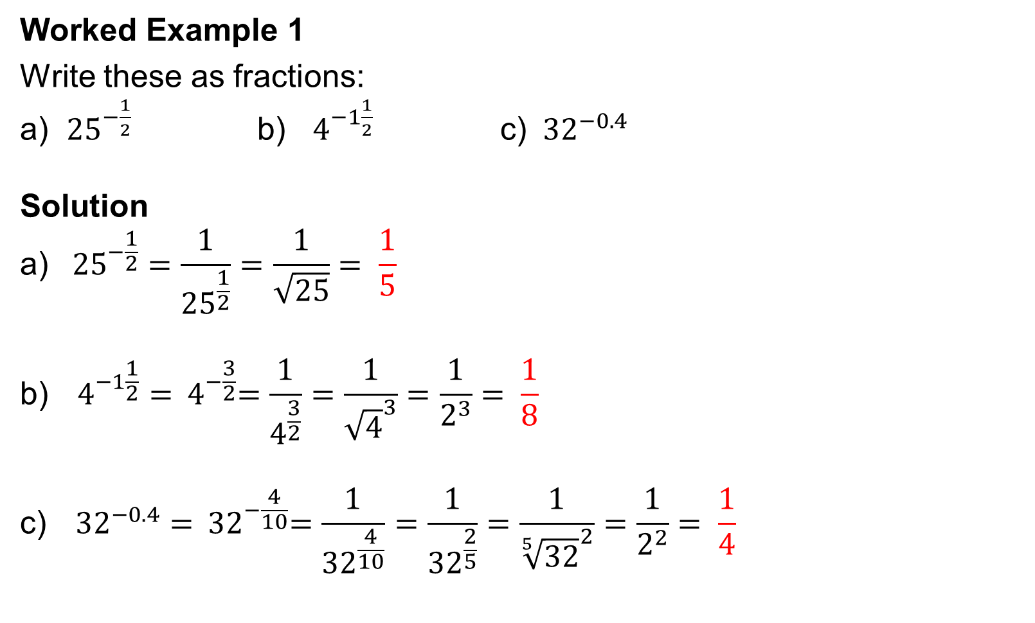
UNIT:
Powers
Section 2
Worked Example
Worked Example 1
Write these as fractions:
a) ${25}^{−\frac{1}{2}}$ b) $4^{−1\frac{1}{2}}$ c) ${ 32}^{−0.4}$
Solution
$${\text{a}\text{)} 25}^{−\frac{1}{2}}=\frac{1}{{25}^{\frac{1}{2}}}=\frac{1}{\sqrt{25}}= \frac{1}{5}$$
$$\text{b}\text{)}{ 4}^{−1\frac{1}{2}}={ 4}^{−\frac{3}{2}}=\frac{1}{4^{\frac{3}{2}}}=\frac{1}{{\sqrt{4}}^{3}}=\frac{1}{2^{3}}= \frac{1}{8}$$
$$\text{c}\text{)}{ 32}^{−0.4}={ 32}^{−\frac{4}{10}}=\frac{1}{{32}^{\frac{4}{10}}}=\frac{1}{{32}^{\frac{2}{5}}}=\frac{1}{{\sqrt[5]{32}}^{2}}=\frac{1}{2^{2}}= \frac{1}{4}$$

Slide 16
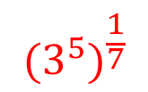
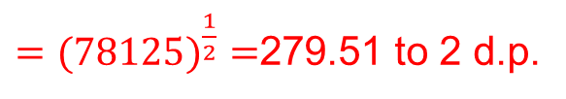
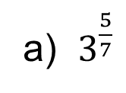
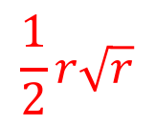
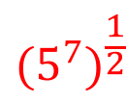
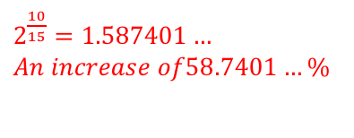
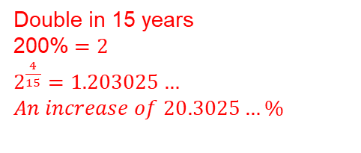
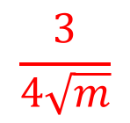
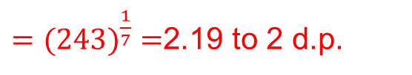
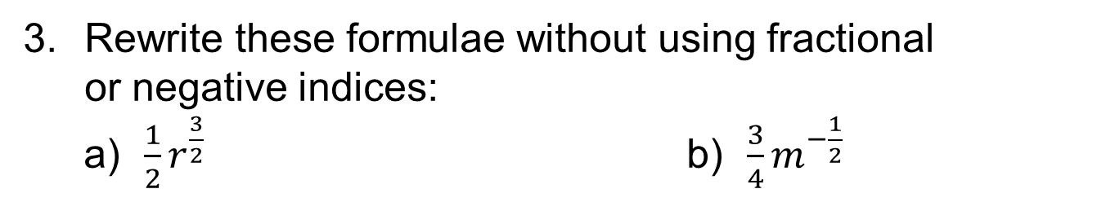
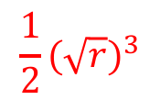
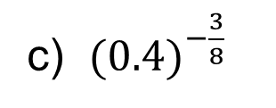
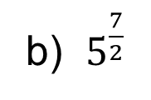


UNIT:
Powers
Section 2
Section 2: Fitness Check
Here are some questions to check your progress;
there are more practice questions if needed.
Calculate the numerical values of:
a) $3^{\frac{5}{7}}$
b) $5^{\frac{7}{2}}$
c) ${(0.4)}^{−\frac{3}{8}}$
${(0.4)}^{\frac{3}{8}}$ $={({0.4}^{3})}^{\frac{1}{8}}$ $=$ 0.7092…
$${(3^{5})}^{\frac{1}{7}}$$
$${(5^{7})}^{\frac{1}{2}}$$
${(0.4)}^{−\frac{3}{8}}$ $=\frac{1}{{(0.4)}^{\frac{3}{8}}}$
${(0.4)}^{−\frac{3}{8}}$ $=\frac{1}{\text{0.7092}\text{…}}$
$=$ 1.41 to 2 d.p.
$={(243)}^{\frac{1}{7}}$ $=$2.19 to 2 d.p.
$={(78125)}^{\frac{1}{2}}$ $=$279.51 to 2 d.p.
The population of a city is expected to grow exponentially
and to double in 15 years. By what percentage would you
expect the population to have risen after
a) four years, b) 10 years?
Double in 15 years
200%$=2$
$2^{\frac{4}{15}}$ $=1.203025…$
$$An increase of 20.3025…\%$$
20.3%
58.7%
Rewrite these formulae without using fractional
or negative indices:
a) ${\frac{1}{2}r}^{\frac{3}{2}}$ b) ${\frac{3}{4}m}^{−\frac{1}{2}}$
$2^{\frac{10}{15}}$ $=1.587401…$
$$An increase of58.7401…\%$$
$$\frac{1}{2}r\sqrt{r}$$
$$\frac{1}{2}{(\sqrt{r})}^{3}$$
$$\frac{3}{4\sqrt{m}}$$
or

Slide 17
UNIT:
Powers
Section 2
Section 2: Review
You have completed the second Section.
If you have completed and mastered this last section,
click here for the Unit audit
If you need more examples and interactive practice,
press here
You might also find it helpful to look at:
Essential Information: press here

