Slide 1
Supporting and Enhancing Mathematics and Statistics
UNIT: Rates of Change

Slide 2
UNIT:
Rates of Change
Rates of Change
This unit is divided into the following seven sections:
Introduction
2. Instantaneous Speed
3. Finding the Gradient
4. Gradient of Quadratics
5. Differentiation
6. Optimisation
7. Real Problems

Slide 3
UNIT:
Rates of Change
Section 1
Introduction
There are countless examples of change: the thickness of the ozone layer is changing with time; the diameter of a metal ring changes with temperature; the air pressure on a mountain changes with altitude. In many cases, however, what is important is not whether things change, but how fast they change.
A very practical problem is in motion where the rate of change of distance with time is speed (velocity) and the rate of change of speed/velocity with time is acceleration.
Example
The town of Dorchester in Dorset is 2 km from end to end, and a
30 mph speed limit is in force throughout. Although the A35 road now by-passes the town, many drivers consider it quicker, late at night when traffic is light, to drive through the centre of town.

Slide 4
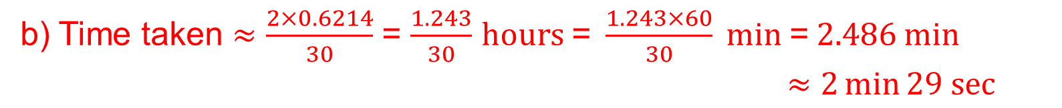
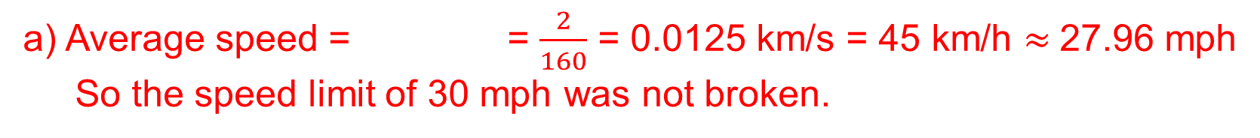
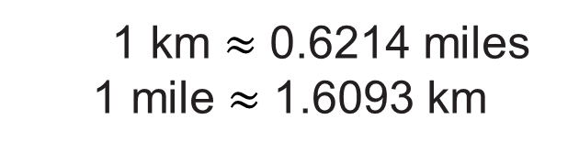
UNIT:
Rates of Change
Section 1
Introduction
Example (continued)
a) A driver took 2 minutes 40 seconds to drive through the town. Assuming the car stayed at a constant speed, was the speed limit broken?
b) What is the shortest time a driver can take to drive through Dorchester and not break the speed limit ?
1 km $≈$ 0.6214 miles
1 mile $≈$ 1.6093 km
Solution
distance
time
a) Average speed = = $\frac{2}{160}$ = 0.0125 km/s = 45 km/h $≈$27.96 mph
So the speed limit of 30 mph was not broken.
b) Time taken $≈$ $\frac{2×0.6214}{30}$ = $\frac{1.243}{30}$ $hours \text{=} \frac{1.243×60}{30} min \text{=} 2.486 min$
$≈2\min{29 sec}$

Slide 5
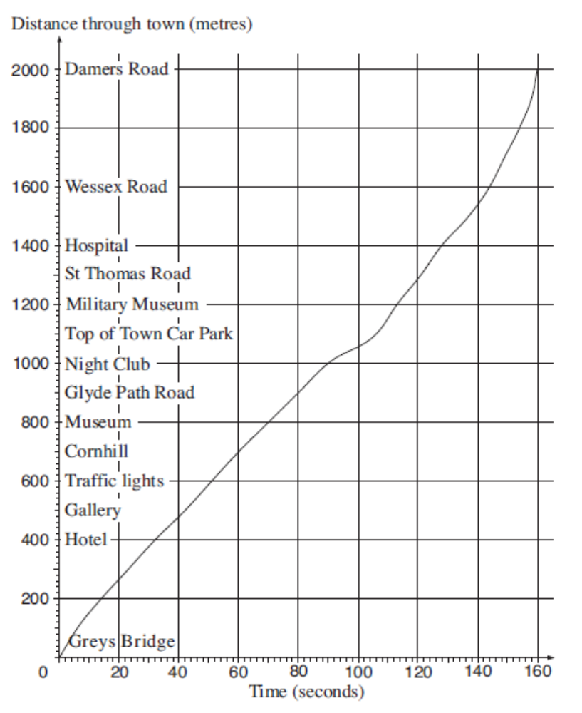
UNIT:
Rates of Change
Section 1
Introduction
Example
The graph opposite is a distance-time graph for a car being driven through Dorchester.
a) Travelling through Dorchester the driver negotiated a major roundabout. Where do you think it is, and how can you tell?
Solution
a) Roundabout is at Top of Town Car Park, as the gradient on the graph (i.e. speed) is reduced at that location.

Slide 6
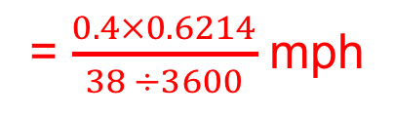
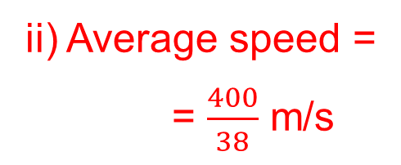
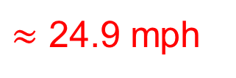
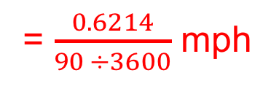
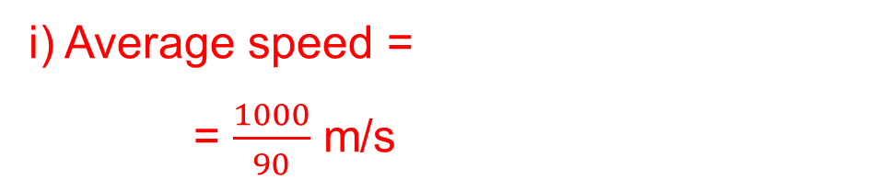
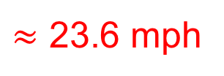
UNIT:
Rates of Change
Section 1
Introduction
Example (continued)
b) What was the car’s average speed, in mph, between
i) Grey’s Bridge and Night Club
ii) Night Club and Hospital?
Solution
distance
time
i) Average speed =
= $\frac{1000}{90}$ m/s
= $\frac{0.6214}{90 ÷3600}$ mph
$≈$ 24.9 mph
ii) Average speed =
= $\frac{400}{38}$ m/s
distance
time
= $\frac{0.4×0.6214}{38 ÷3600}$ mph
$≈$ 23.6 mph

Slide 7
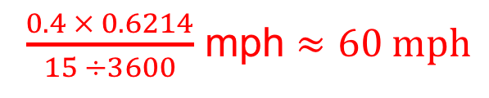
UNIT:
Rates of Change
Section 1
Section 1: Fitness Check
Using the distance-time graph opposite, what was the car’s average speed, in mph, between Wessex Road and Damer’s Road?
Answer
$\frac{0.4 × 0.6214}{15 ÷3600}$ mph $≈60 mph$

Slide 8
UNIT:
Rates of Change
Section 1
Section 1: Review
You have completed the first section.
If you have completed and mastered this section,
click to start the next Section
If you need more examples and interactive practice,
press here
You might also find it helpful to look at:
Essential Information: press here

Slide 9
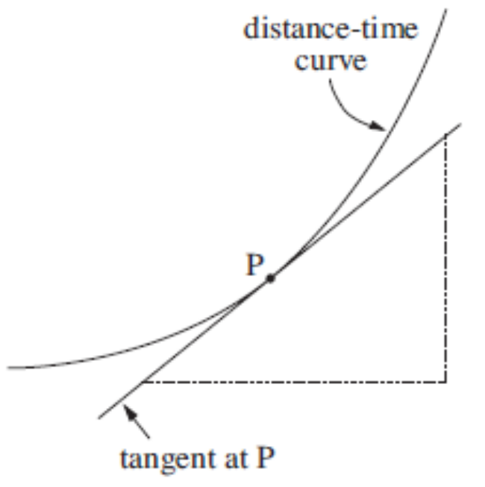
UNIT:
Rates of Change
Section 2
Instantaneous Speed
Another method of finding the speed is to use a ‘radar gun’, which is focused on the car as it passes. This gives the instantaneous speed of the vehicle, similar to that shown on the speedometer of the car.
On a distance-time graph, the instantaneous speed is indicated by the steepness, or gradient, but when the graph is a complicated curve the gradient is difficult to pin down accurately. One way is to draw a tangent to the curve and to work out the gradient.
There are many other examples of a graph where the gradient, or steepness, is useful. This property of the gradient has important applications to all kinds of graphs, as illustrated on the next slide.

Slide 10
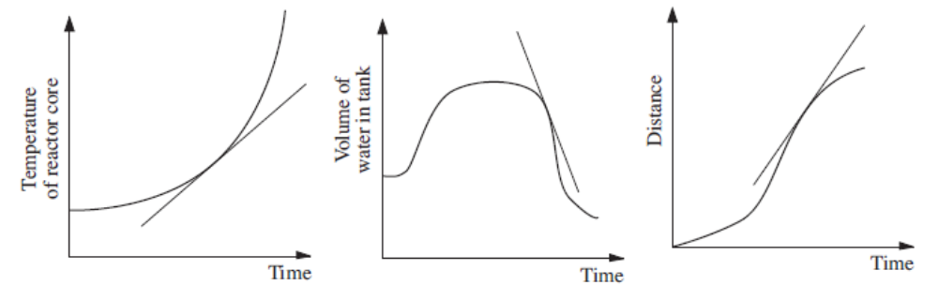
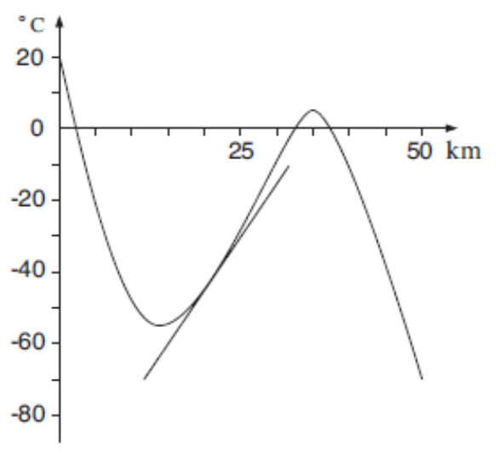
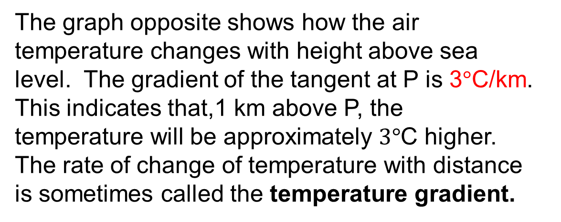
UNIT:
Rates of Change
Section 2
Instantaneous Speed
The graph opposite shows how the air temperature changes with height above sea level. The gradient of the tangent at P is 3$°$C/km. This indicates that,1 km above P, the temperature will be approximately $3°$C higher. The rate of change of temperature with distance is sometimes called the temperature gradient.
P
60°C
20km

Slide 11
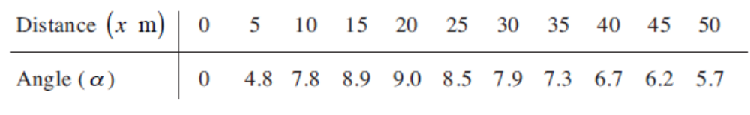
UNIT:
Rates of Change
Section 2
Instantaneous Speed: Example
Example
In a game of rugby, imagine that a try has been scored, the ball being grounded on one side of the in-goal area. A kick at goal now follows.
The angle in which the ball must be kicked is denoted by α ; the smaller the angle, the trickier the kick. The angle depends on how far back the kick is taken. The way it changes is shown in the table.
a) Draw a graph of angle against distance.
b) Estimate the gradient of the graph at x = 5 m, 15 m and 40 m.
Interpret your answers.
c) What is the best point from which to take the kick?
What is the gradient at this point?
Solution on next slide

Slide 12
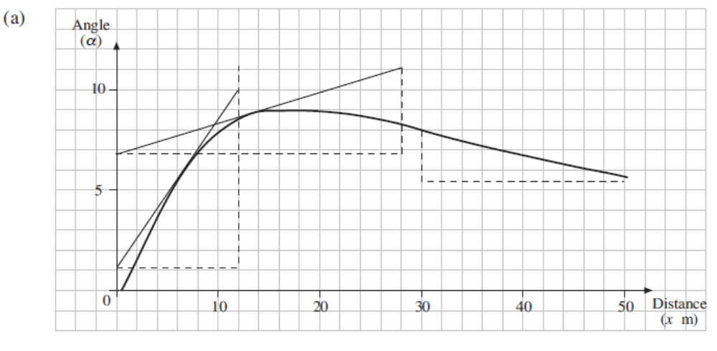
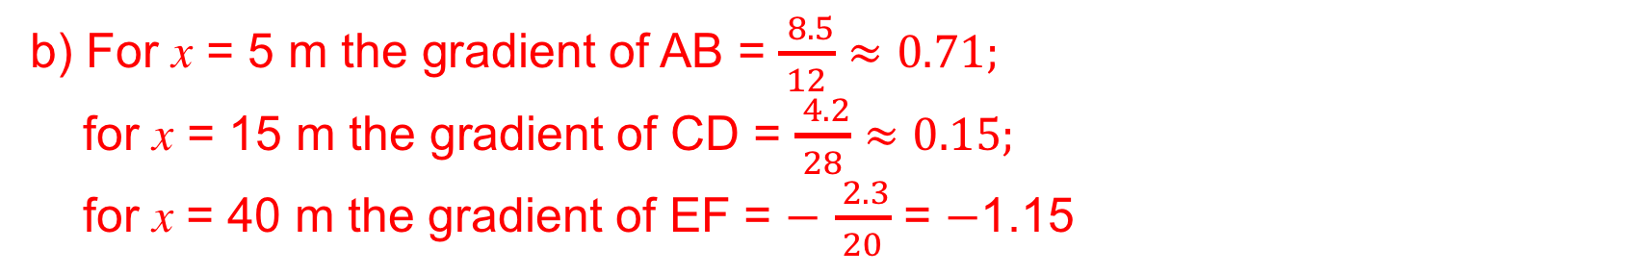
UNIT:
Rates of Change
Section 2
Instantaneous Speed: Example
a)
D
B
4.2
E
C
28
2.3
F
8.5
20
12
A
b) For x = 5 m the gradient of AB = $\frac{ 8.5}{12}$ $≈0.71;$
for x = 15 m the gradient of CD = $\frac{ 4.2}{28}$ $≈0.15;$
for x = 40 m the gradient of EF = $−$ $\frac{ 2.3}{20}$ = $−$1.15
Gradient slowing down and then becoming negative
c) Angle = 9$°$ when gradient = zero so angle is a maximum

Slide 13
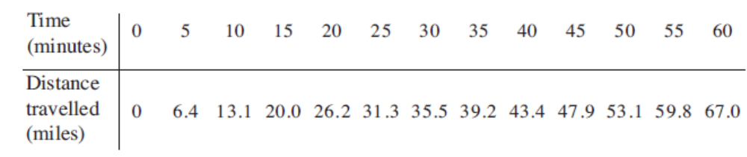
UNIT:
Rates of Change
Section 2
Section 2: Fitness Check
Harriet is a passenger in a car being driven along a motorway.
She monitors the progress of the journey by counting the distance markers at the roadside.
She writes down the distance travelled from the start every 5 minutes.
Draw a distance-time graph.
Estimate the instantaneous speed of the car in mpm* after
i) 20 mins
1.25
(ii) 40 mins
0.91
iii) 55 mins
1.4
b) The speed limit is 70 mph.
When was the car exceeding the speed limit?
*mpm is miles per minute
In the early stage and the last stage.
Solution on next slide

Slide 14
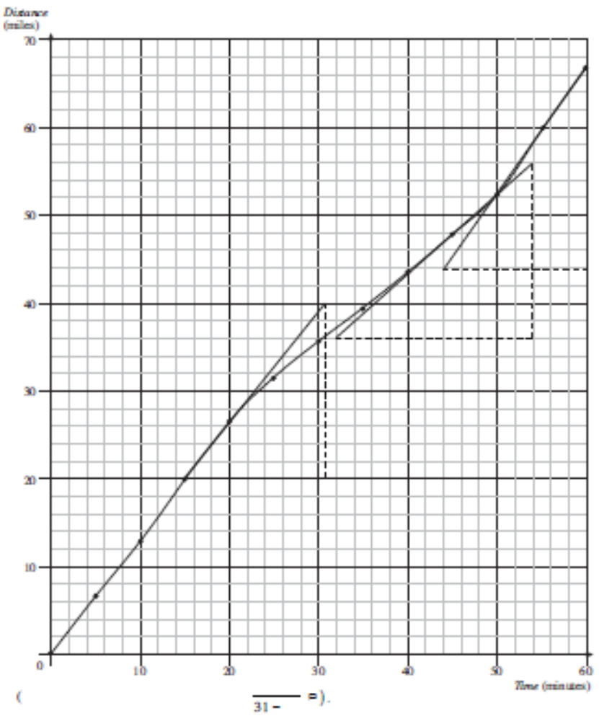
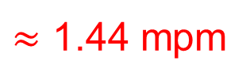
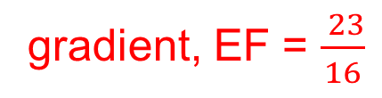
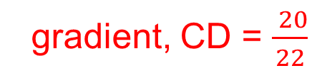
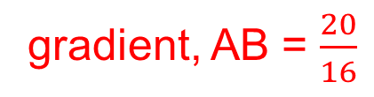
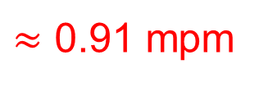
UNIT:
Rates of Change
Section 2
Section 2: Fitness Check
a) At i) x = 20 mins
F
gradient, AB = $\frac{20}{16}$
= 1.25 *mpm
D
ii) x = 40 mins
gradient, CD = $\frac{ 20}{22}$
$≈$ 0.91 mpm
B
E
iii) x = 55 mins
C
gradient, EF = $\frac{ 23}{16}$
$≈$ 1.44 mpm
b) The speed limit is 1.16 mpm (70 mph). Hence speed limit broken from 0 to 20 mins and again in the last stage.
A
*mpm is miles per minute
20
40
55

Slide 15
UNIT:
Rates of Change
Section 2
Section 2 : Review
You have completed the second section.
If you have completed and mastered this section,
click to start the next Section
If you need more examples and interactive practice,
press here
You might also find it helpful to look at:
Essential Information: press here

Slide 16
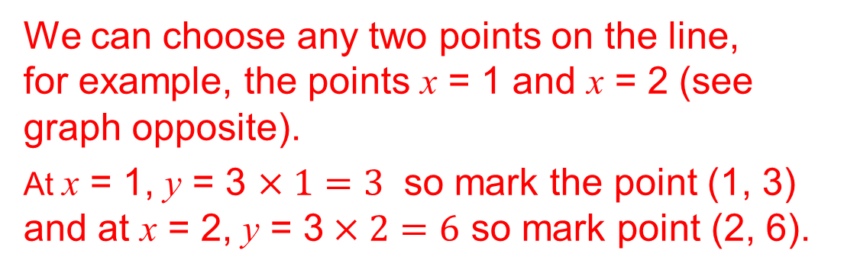
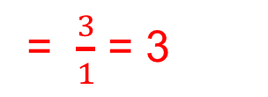
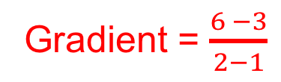
UNIT:
Rates of Change
Section 3
Finding the Gradient
If you know the equation of a line it is possible to calculate the gradient of the line without drawing a diagram.
Example 1
For the function y = 3x find the gradient of the line.
Solution
We can choose any two points on the line,
for example, the points x = 1 and x = 2 (see graph opposite).
At x = 1, y = 3 $×1=3$ so mark the point (1, 3) and at x = 2, y = 3$×2=6$ so mark point (2, 6).
Gradient = $\frac{6 −3}{2−1}$
= $\frac{3}{1}$ = 3
Note:
For the graph of the function y = mx where m is any number, the gradient equals “m”.

Slide 17
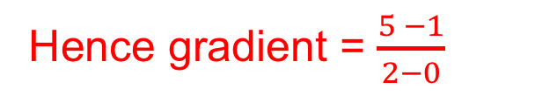
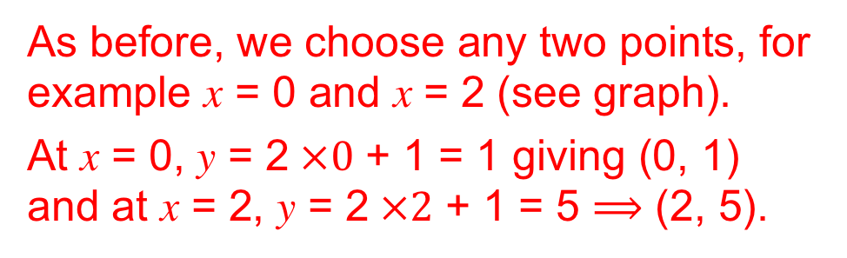
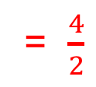
UNIT:
Rates of Change
Section 3
Finding the Gradient
Example 2
For the function y = 2x +1 find the gradient of the line.
Solution
As before, we choose any two points, for example x = 0 and x = 2 (see graph).
At x = 0, y = 2$×0$ + 1 = 1 giving (0, 1)
and at x = 2, y = 2$×2$ + 1 = 5 $⟹$ (2, 5).
Hence gradient = $\frac{5 −1}{2−0}$
= $\frac{4}{2}$
= 2
Note: In the same way, for the equation of any straight line:
y = mx + c
where m and c are constants, the gradient will be m.

Slide 18
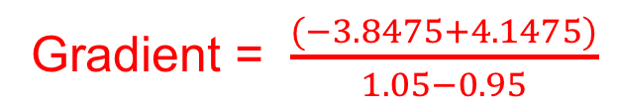
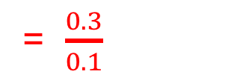
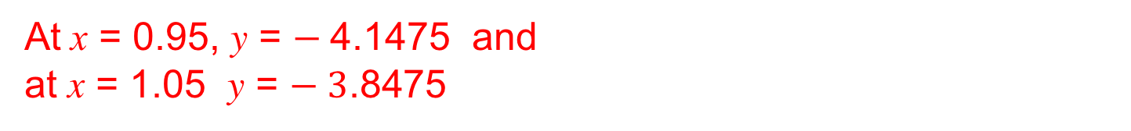
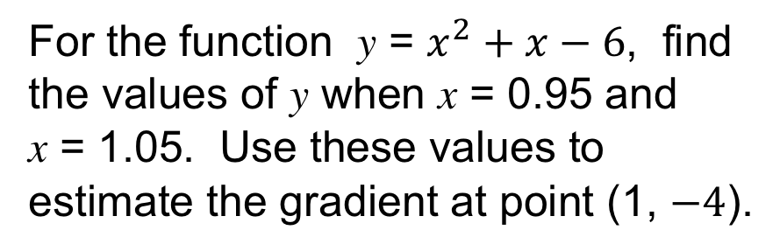
UNIT:
Rates of Change
Section 3
Finding the Gradient
If you know the equation of the curve it is possible to calculate the gradient at a point without having to draw tangents to the curve at that point, by looking at values around the point
Example
For the function y = $x^{2}+x−6$, find the values of y when x = 0.95 and x = 1.05. Use these values to estimate the gradient at point (1, $−4$).
Solution
At x = 0.95, y = $−$4.1475 and
at x = 1.05 y = $− 3$.8475
Gradient = $\frac{(−3.8475+4.1475)}{1.05−0.95}$
= $\frac{0.3}{0.1}$
= 3

Slide 19
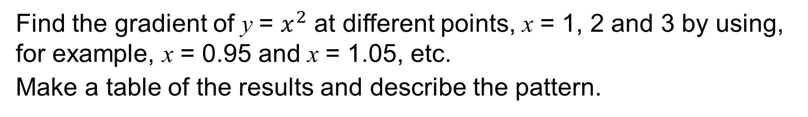

UNIT:
Rates of Change
Section 3
Section 3: Fitness Check
Find the gradient of y = $x^{2}$ at different points, x = 1, 2 and 3 by using, for example, x = 0.95 and x = 1.05, etc.
Make a table of the results and describe the pattern.
Answers
At x = 1, the gradient is estimated as 2
At x = 2, the gradient is estimated as 4
At x = 3, the gradient is estimated as 6
It appears that the gradient is twice the x value,
that is, the gradient of ${ x}^{2}$ is 2x.

Slide 20
UNIT:
Rates of Change
Section 3
Section 3: Review
You have completed the third section.
If you have completed and mastered this section,
click to start the next Section
If you need more examples and interactive practice,
press here
You might also find it helpful to look at:
Essential Information: press here

Slide 21
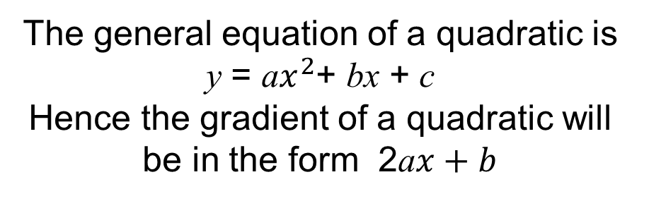
UNIT:
Rates of Change
Section 4
Gradient of Quadratics
Using the results from Section 3 it is possible to draw the
following conclusions:
• the gradient of y = $x^{2}$ is given by 2, so the gradient of y = $x^{2}$ is 2a$x$
the gradient of y = b$x$, a straight line, is just b
• adding a constant, c, merely moves the curve or line up or down
and does not alter the gradient.
The general equation of a quadratic is y = a$x^{2}$+ bx + c
Hence the gradient of a quadratic will be in the form 2a$x+b$

Slide 22
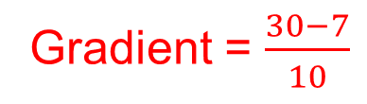
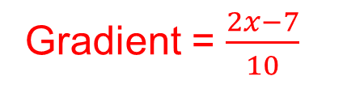
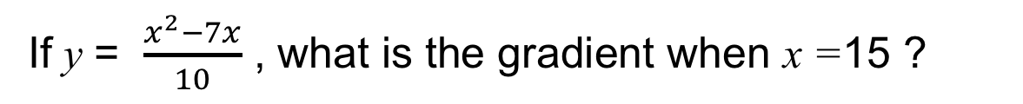

UNIT:
Rates of Change
Section 4
Gradient of Quadratics
Example
Find the formula for the gradient of the curve y = 5$x^{2}$+ 7x + 10
Solution
Gradient = 10x + 7
Example
Find the formula for the gradient of the curve y = (2x+ 4)( 3x+ 2)
Solution
Expand (2x + 4)( 3x + 2) = 6$x^{2}$+16x + 8 Gradient = 12x +16
Example
If y = $\frac{x^{2}−7x}{10}$ , what is the gradient when x =15 ?
Solution
Gradient = $\frac{2x−7}{10}$
when x = 15
Gradient = $\frac{30−7}{10}$
= 2.3
$$⟹$$

Slide 23
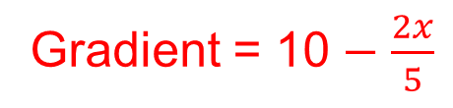
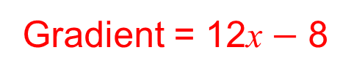
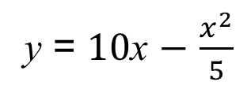
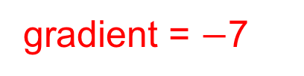
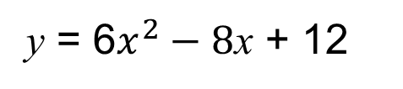
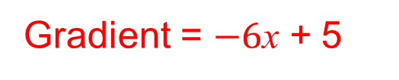
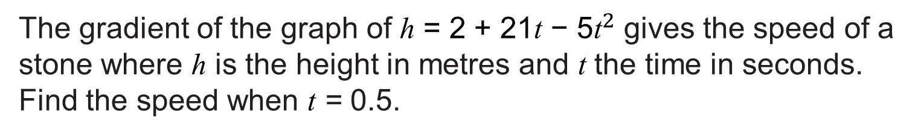
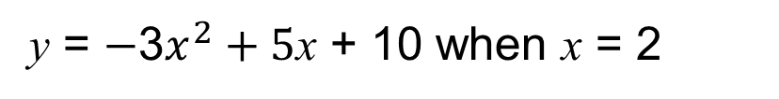
UNIT:
Rates of Change
Section 4
Section 4: Fitness Check
Exercise
Find formulae that give the gradients of these curves.
y = $10$x $−$ $\frac{x^{2}}{5}$
Gradient = 10 $−$ $\frac{2x}{5}$
y = 6$x^{2}−8$x + 12
Gradient = 12x $−$ 8
Exercise
Find the gradient of
y = $−$3$x^{2}+5$x + 10 when x = 2
Gradient = $−6$x + 5
When x = 2,
gradient = $−$7
Exercise
The gradient of the graph of h = 2 + 21t − 5${\text{t}}^{2}$ gives the speed of a stone where h is the height in metres and t the time in seconds. Find the speed when t = 0.5.
Speed = 21 – 10t when t = 0.5
Speed = 21 – 5 = 16 metres per second

Slide 24
UNIT:
Rates of Change
Section 4
Section 4: Review
You have completed the fourth section.
If you have completed and mastered this section,
click to start the next Section
If you need more examples and interactive practice,
press here
You might also find it helpful to look at:
Essential Information: press here

Slide 25
UNIT:
Rates of Change
Section 5
Differentiation
The process of finding ‘gradient functions’ is called differentiation. Another name for the gradient function is the derivative or derived function.
6$x^{2}−8$x + 9 is differentiated to give 12x − 8
12x − 8 is known as the derivative of 6$x^{2}−8$x + 9
The inventor of this technique is generally thought to have been the English physicist and mathematician Sir Isaac Newton (1643-1747), who developed it in order to explain the movement of stars and planets. However, the German mathematician Gottfried Wilhelm Leibniz (1646-1716) ran him close, and it was Leibniz who was the first actually to publish the idea, in the year 1684. Much vigorous and acrimonious discussion ensued as to who discovered the technique first. Today both are saluted for their genius.

Slide 26
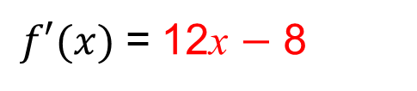
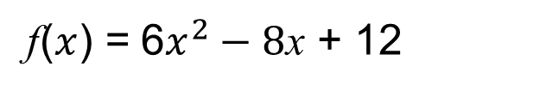




UNIT:
Rates of Change
Section 5
Differentiation
The notation used by Leibniz is still used today. The gradient of a straight line is
change in $y$
change in $x$
which he shortened to $\frac{dy}{dx}$ (read as 'dy by dx').
Hence y = 6$x^{2}−8$x + 12 $\frac{dy}{dx}$ = 12x − 8
or
$\frac{d}{dx}$ (6$x^{2}−8$x + 12) = 12x $−$ 8
$\frac{d}{dx}$ is the derivative with
respect to x
or
f($x$) = 6$x^{2}−8$x + 12
$f′(x)$= 12x $−$ 8
(derived function)

Slide 27


















UNIT:
Rates of Change
Section 5
Differentiation
Examples
d)
e)
y = a$x^{b}$ $\frac{dy}{dx}$= ab$x^{b−1}$
a) y = $x^{2}$
$\frac{dy}{dx}$= ${2x}^{1}$
$\frac{dy}{dx}$= 2x
b) y = $x^{3}$
$\frac{dy}{dx}$= ${3x}^{2}$
c) y = $\frac{1}{x}$
y = $x^{−1}$
$\frac{dy}{dx}$ = ${−x}^{−2}$
$\frac{dy}{dx}$ = $−\frac{1}{x^{2}}$
y = 5$x^{0}$
$\frac{dy}{dx}$= 0 (gradient zero)
d) y = 5
$\frac{dy}{dx}$ = 1$x^{0}$
$\frac{dy}{dx}$ = 1
e) y = x
y = $x^{1}$

Slide 28












UNIT:
Rates of Change
Section 5
Section 5: Fitness Check
Exercise
1. Find the derivative of the following functions:
a) y = $x^{3}+5x^{2}$+ 3x with respect to x
b) r = 6${\text{t}}^{3}−10{\text{t}}^{2}$+ 2t with respect to t
c) f(x)= $−5x^{2}$+ $\frac{1}{x}$ with respect to x.
$\frac{dy}{dx}$ = 3$x^{2}$+10x + 3
$\frac{d\text{t}}{dr}$ = 18${\text{t}}^{2}−20\text{t}$+ 2
f′(x) = $−10x−$ $\frac{1}{x^{2}}$
2. What is the gradient of the curve y = $x^{3}−3x^{2}$+ 6 at the point (3, 6) ?
$\frac{dy}{dx}$ = 3$x^{2}−6$x
when $x$ = 3
$\frac{dy}{dx}$ = 27$−18=9$
3. At what two points is the gradient of y = 2$x^{3}−9x^{2}$+ 36x $−$ 11
equal to 24 ?
6$x^{2}−$18x + 12 = 0
$\frac{dy}{dx}$ = 6$x^{2}−$18x + 36 = 24
$x^{2}−3$x + 2 = 0
(1,18) and (2, 39)
(x $−$ 1)(x $−$ 2) = 0

Slide 29
UNIT:
Rates of Change
Section 5
Section 5: Review
You have completed the fifth section.
If you have completed and mastered this section,
click to start the next Section
If you need more examples and interactive practice,
press here
You might also find it helpful to look at:
Essential Information: press here

Slide 30

UNIT:
Rates of Change
Section 6
Optimisation
Optimisation is the process of finding the
maximum or minimum of a function.
Example
.
The graph opposite shows a sketch of the function f(x). What is the value of f ′(x) at the points A, B and C ?
Solution
Points A, B and C are stationary points where the value of f ′(x) is equal to zero.
Here the gradient of the graph is equal to zero and the tangent is exactly horizontal at this point.

Slide 31





UNIT:
Rates of Change
Section 6
Optimisation
The maximum and minimum points of any function
can be found by working out where the gradient is zero.
It should also be noted that stationary points can also turn out
to be points of inflection; see below.
.
+
$$−$$
+
+
$$−$$
+

Slide 32






UNIT:
Rates of Change
Section 6
Optimisation
Example
A piece of card 20 cm by 20 cm has four identical square pieces of side x removed from the corners so that it forms a net for an open-topped box. The problem is to find the dimensions of a box with the largest (maximum) volume.
Solution
Volume = x(20 $−$ 2x)(20 $−$ 2x)
The maximum volume is produced
when
x = 3.33 cm
${\text{=} 4x}^{3}− 80x^{2}$ + 400x
$\frac{dv}{dx}$ = 12$x^{2}−160$x + 400 = 0
3$x^{2}−40$x + 100 = 0
x = 10 cm or x = 3.33 cm
(10 cm will not create a box)

Slide 33











UNIT:
Rates of Change
Section 6
Optimisation
Example
Find the two stationary points of the function T = 2k + $\frac{ 8}{k}$
and determine which is a maximum and which is a minimum.
Solution
$\frac{dT}{dk}$ = 0
$$⟹$$
$\frac{dT }{dk}$ = 2 $−$ $\frac{8}{k^{2}}$
$$⟹$$
2 $−$ $\frac{8}{k^{2}}$ = 0
$k^{2}$ = 4
k = 2 or k = $−$2
$$⟹$$
$$⟹$$
Minimum
Maximum
To determine which is a maximum and which is a minimum, investigate values around these points.
(2, 8) and ($−$2, $−$8) are the stationary points

Slide 34






UNIT:
Rates of Change
Section 6
Optimisation
Example (continued)
Another way of determining a maximum or minimum is to investigate gradients around the stationary points.
k =
$−$2.1 $−$2 $−$ 1.9 1.9 2 2.1
Solution
The stationary points are where k = 2 or $−$2
$\frac{dT }{dk}$ =
+ $−$ $−$ +
Insert the values of k into
$\frac{dT }{dk}$ = 2 $−$ $\frac{8}{k^{2}}$
(2,8) and ($−$2, $−$8) are the stationary points
(2, 8) is a minimum and ($−$2, $−$8) is a maximum
+
If the stationary point was an inflection, the gradients on either side of the point would both be positive or negative.
+

Slide 35










UNIT:
Rates of Change
Section 6
Section 6: Fitness Check
1. A function $f\left(x\right)$is defined as follows
${f(x)=x}^{3}−6x^{2}−$ 36$x$ + 15
Show that $f^{′}\left(−2\right)=f^{′}\left(6\right)=$ 0, and hence find the coordinates of the maximum and minimum points.
Answers
${f′(x)=3x}^{2}−$ 12x $−$ 36
$f^{′}\left(x\right)=0$ gives
${0 =3x}^{2}−$ 12x $−$ 36
${0 =x}^{2}−$ 4x $−$ 12
$$⟹$$
$0 =$ (x + 2)(x $−$ 6)
Hence x $=$ $−$2 and x $=$ 6

Slide 36







UNIT:
Rates of Change
Section 6
Section 6: Fitness Check
2. The makers of a car use the following polynomial model to express the petrol consumption, M miles per gallon, in terms of the speed, v miles per hour,
M = $\frac{v^{3}−230v^{2}+15100v −145000}{4000}$
Find the speed that maximises the petrol consumption, M.
Answer
$\frac{dM}{dv}$
= $\frac{1}{4000}\left(3v^{2}−460v+15100\right)=0$
$$⟹$$
3$v^{2}−460v+15100=0$
Using the quadratic formulae
$v=\frac{230}{3} +\frac{20}{3}\sqrt{19 }≈105.72$
$or v=\frac{230}{3}−\frac{20}{3}\sqrt{19 }$ $≈47.607$
For maximum, consider the sign of $\frac{dM}{dv}$ each side of these values of v.
For $v=47.5, \frac{dM}{dv}≈0.0047>0$and for $v=47.7, \frac{dM}{dv}=−0.0040<0$
so there is max value at 47.607 (and similarly min value at 105.72).

Slide 37
UNIT:
Rates of Change
Section 6
Section 6: Review
You have completed the sixth section.
If you have completed and mastered this section,
click to start the next Section
If you need more examples and interactive practice,
press here
You might also find it helpful to look at:
Essential Information: press here

Slide 38

UNIT:
Rates of Change
Section 7
Real Problems
Example
You have 120 m of fencing and want to make two enclosures as shown in the diagram. The problem is to maximise the area, A, enclosed.
Use the fact that the total length of fencing is 120 m to write an equation connecting x and y.
Make y the subject of this equation and hence write a formula for A in terms of x.
Now differentiate with respect to x and put it equal to zero to solve the problem.

Slide 39




UNIT:
Rates of Change
Section 7
Real Problems
Solution
The area, A = xy, x and y are connected by 120 = 3y + 2x
Hence 3y $=$120 $−$ 2x and y = $\frac{1}{3}$(120 $−$ 2x)
A = x $\frac{1}{3}$ (120 $−$ 2x) = 40x $−$ $\frac{2}{3}x^{2}$
To find the maximum area, we find the gradient
Gradient = 40 $−$ $\frac{4x}{3}$ = 0
Hence x = 30
As 120 = 3y + 2x when x = 30, y = 20
Area= 30 × 20 = 600${ m}^{2}$
Note: The quantity that needed to be maximised was first expressed in terms of two quantities, x and y. However, x and y were connected by the condition that the total length of fencing had to be 120 m. This sort of condition is known as a constraint. It allowed area A to be expressed in terms of one quantity only, and thus the problem could be solved.

Slide 40







UNIT:
Rates of Change
Section 7
Real Problems
Example
A closed cylindrical can has a volume of 350 ${cm}^{3}$. Find the dimensions of the can that minimise the surface area.
Solution
Let the radius be r cm and the height h cm. Let the surface area be S ${cm}^{2}$ ; then
S = 2π$r^{2}$+ 2πrh
(both ends and curved surface)
We need to find the minimum of S but at present, S involves two variables, r and h. The fact that the volume has to be 350 ${cm}^{3}$ gives a connection between r and h; namely
π$r^{2}h$= 350 (constraint)
$h$=$\frac{350}{\text{π}r^{2}h}$
Hence S = 2π$r^{2}$+ 2πr $\frac{350}{\text{π}r^{2}h}$ S = 2π$r^{2}$+ $\frac{700}{r}$

Slide 41











UNIT:
Rates of Change
Section 7
Real Problems
Solution (continued)
$\frac{dS}{dr}\text{=}$4π $−$ $\frac{700}{r^{2}}$
$\frac{dS}{dr}\text{=}$ 0
0 = 4π $−$ $\frac{700}{r^{2}}$
4π = $\frac{700}{r^{2}}$
$$⟹$$
$$⟹$$
$$⟹$$
$r^{2}$ =$\frac{ 700}{\text{4}\text{π}}$
$r^{2}$ = 55.7
r = 3.82 cm to 3 s.f
$$⟹$$
$$⟹$$
h = $\frac{350}{\text{π}r^{2}}$
= 7.64 cm to 3 s.f (from the equation above)
The dimensions of the can are as follows:
radius = 3.82 cm
diameter = 7.64 cm
height = 7.64 cm
The height of the can is approximately twice the radius.

Slide 42




















UNIT:
Rates of Change
Section 7
Section 7: Fitness Check
A small closed water tank is in the shape of a cuboid with a square base.
The total surface area is 15000 ${cm}^{2}$ .
Find the maximum volume given this constriction
(Let x cm be the side of the square and h cm be the height.)
Answer
Surface area $=$ 4xh + 2$x^{2}$ so
15000 $=$ 4xh + 2$x^{2}$
and h $=$ $\frac{3750}{x}−\frac{x}{2}$
$=$ ${\left(\frac{3750}{x}−\frac{x}{2}\right)x}^{2}$
Volume $=$ h$x^{2}$
$=$ 3750x $−$ $\frac{x^{3}}{2}$
$$\frac{dV}{dx}= 3750−\frac{3x^{2}}{2}$$
$$⟹ \frac{3x^{2}}{2}=3750$$
$$=0$$
$⟹x^{2}$ = 2500
$⟹$x $=$ 50 cm
As h $=$ $\frac{3750}{x}−\frac{x}{2}$
= $\frac{3750}{50}−\frac{50}{2}$
$=$ 50 cm
and volume $=$ h$x^{2}$,
volume $=$ 50 × 50 × 50
$=$ 125000 ${cm}^{3}$
$=$ 125 litres

Slide 43
UNIT:
Rates of Change
Section 7
Section 7: Review
You have completed the seventh section.
If you have completed and mastered this last section,
click here for the Unit audit.
If you need more examples and interactive practice,
press here
You might also find it helpful to look at:
Essential Information: press here

