Slide 1
Supporting and Enhancing Mathematics and Statistics
UNIT: Growth and Decay

Slide 2
UNIT:
Growth and Decay
Growth and Decay
The unit of work on Growth and Decay is divided into the following six sections:
1. Modelling Population
2. Models of Growth and Decay
3. Carbon Dating
4. Rate of Growth
5. Solving Exponential Equations
6. Problems of Logarithms

Slide 3
UNIT:
Growth and Decay
Section 1
Modelling Population
Amoebae reproduce by fission, or splitting in two after a certain time. The "parent" cell divides into two smaller copies of itself. The nucleus also divides into two.
Radioactive substances have 'half lives' which are determined by the time it takes the radioactivity to halve. In 2020 the world was in the grips of a COVID-19 pandemic caused by severe acute respiratory syndrome coronavirus 2.
These are examples of systems which are modelled by what we call 'exponential' functions.
The graph on the next slide shows the growth in total COVID-19 cases day-to-day for several countries.

Slide 4
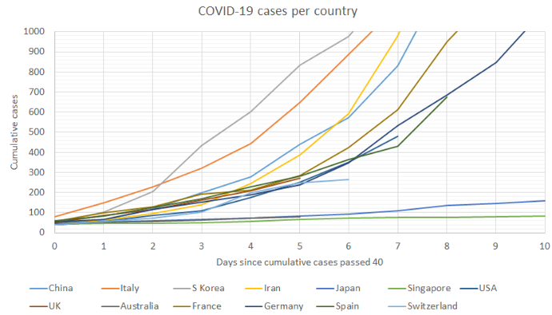
UNIT:
Growth and Decay
Section 1
Modelling Population

Slide 5
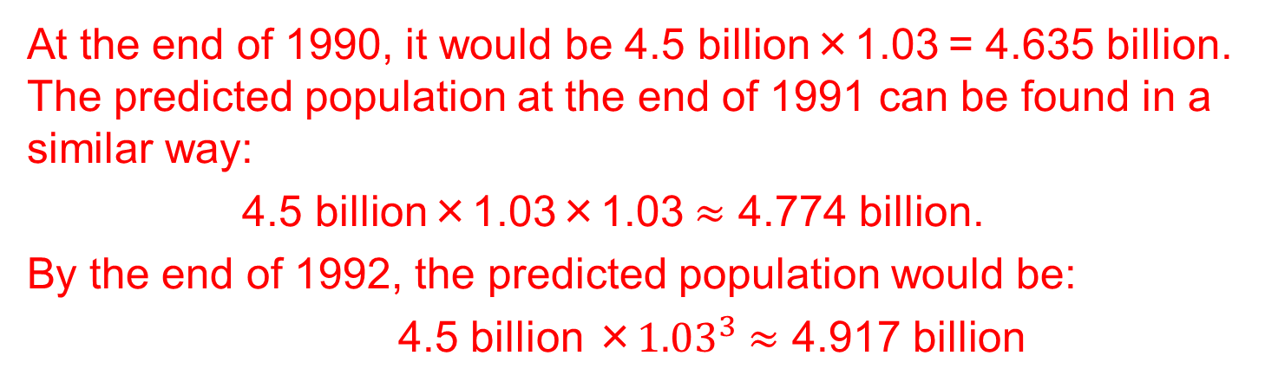
UNIT:
Growth and Decay
Section 1
Modelling Population
We will form a model to describe population growth, and then use it to predict the year when the population would be twice the size it was in 1989.
The world population at the end of 1989 was approximately 4.5 billion. If the population grew each year by 3%, what would be the population at the end of 1990, 1991 and 1992?
Solution
At the end of 1990, it would be 4.5 billion×1.03 = 4.635 billion.
The predicted population at the end of 1991 can be found in a similar way:
4.5 billion×1.03×1.03 $≈$ 4.774 billion.
By the end of 1992, the predicted population would be:
4.5 billion ×${1.03}^{3}$ $≈$ 4.917 billion

Slide 6
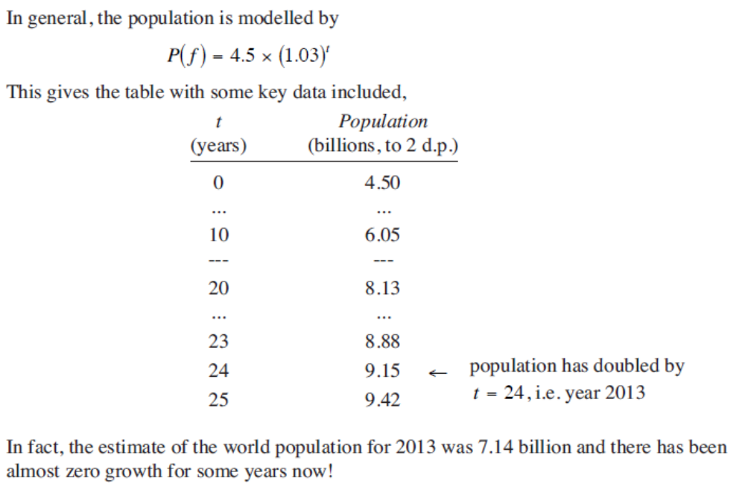
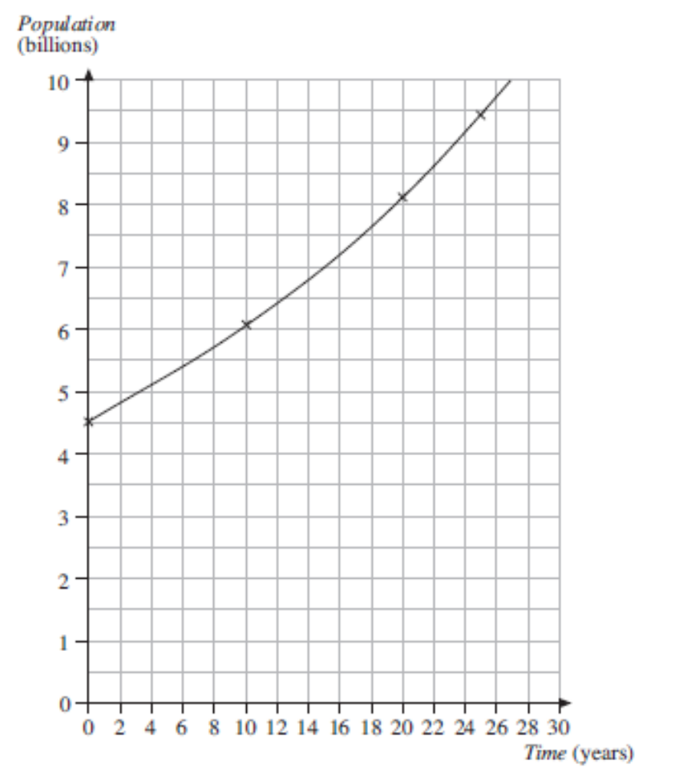
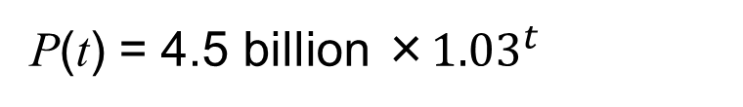
UNIT:
Growth and Decay
Section 1
Modelling Population
Example (Continued)
P(t) = 4.5 billion ×${1.03}^{t}$
In general, the population is modelled by
This gives the following table and graph:
This model estimates that the population would have doubled by
2013 to 7.14 billion. In fact there has been zero growth for some years now!

Slide 7
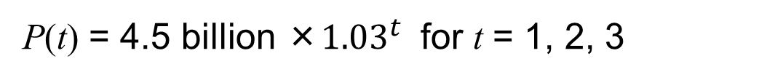
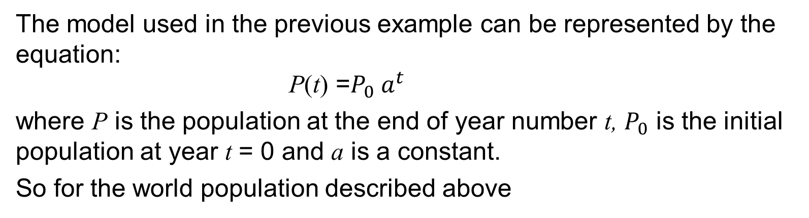
UNIT:
Growth and Decay
Section 1
Modelling Population
The model used in the previous example can be represented by the equation:
P(t) =$P_{0}{ a}^{t}$
where P is the population at the end of year number t, $P_{0}$ is the initial population at year t = 0 and a is a constant.
So for the world population described above
P(t) = 4.5 billion ×${1.03}^{t}$ for t = 1, 2, 3
Equations of the form above can also be used to describe populations that are declining so the constant a would be less than 1.
Some species are endangered because they have declining populations for various reasons such as hunting, habitat destruction, new predators or infertility.
Models are made to help predict future trends in fish stock levels, which take into account many features like fishing techniques and environmental conditions.

Slide 8
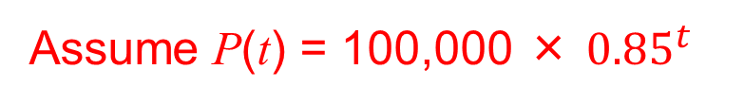
UNIT:
Growth and Decay
Section 1
Section 1: Fitness Check
Produce a model of a fish population based on the assumption that it is declining by 15% each year. Use the model, with initial population 100 000 to find the number of years before the population becomes so low that it is in danger of being unable to sustain itself, say less than 20 000.
Answer
Years Elapsed
Assume P(t) = 100,000 × ${0.85}^{t}$
Population
0
100 000
The “action” level of 20 000 is at 10 years.
1
85 000
2
72 250
9
23 162
10
19 687
More details are shown graphically for information on the next slide.

Slide 9
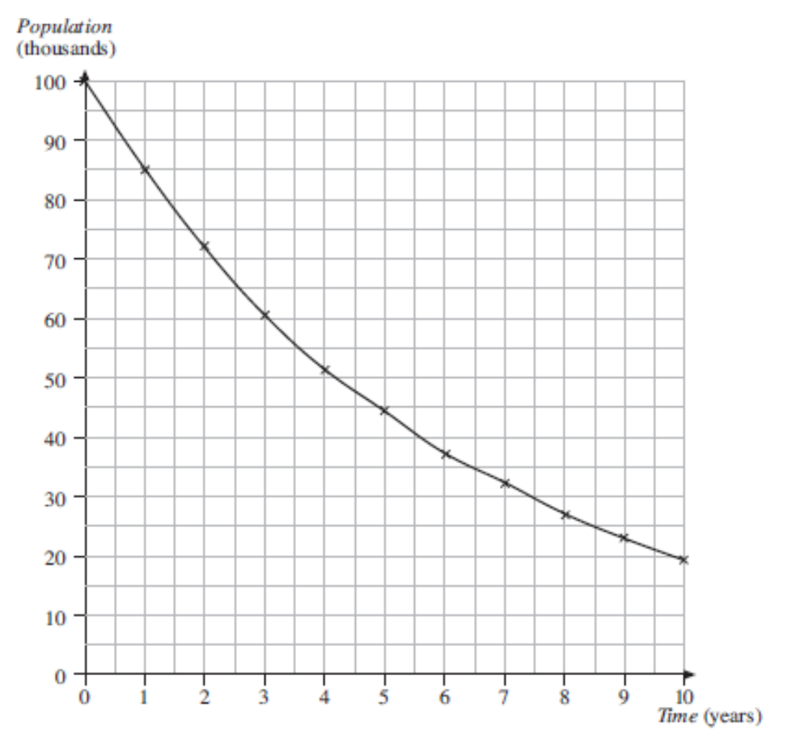
UNIT:
Growth and Decay
Section 1
Section 1: Fitness Check
Note
This graph shows how the level of fish stocks will decline with time.
The “action level” is reached at year 10.

Slide 10
UNIT:
Growth and Decay
Section 1
Section 1: Review
You have completed the first section.
If you have completed and mastered this section,
click to start the next Section
If you need more examples and interactive practice,
press here
You might also find it helpful to look at:
Essential Information: press here

Slide 11
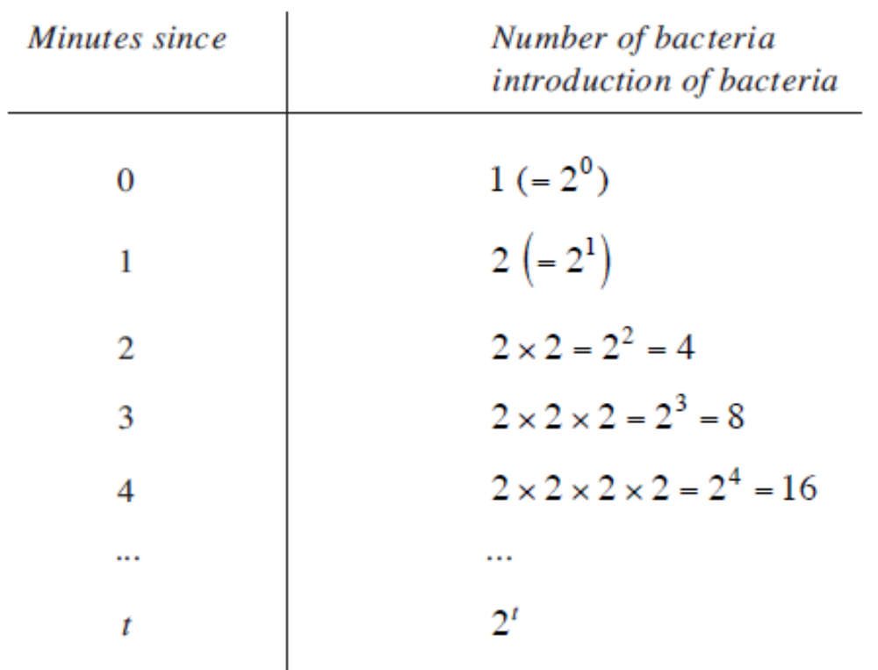
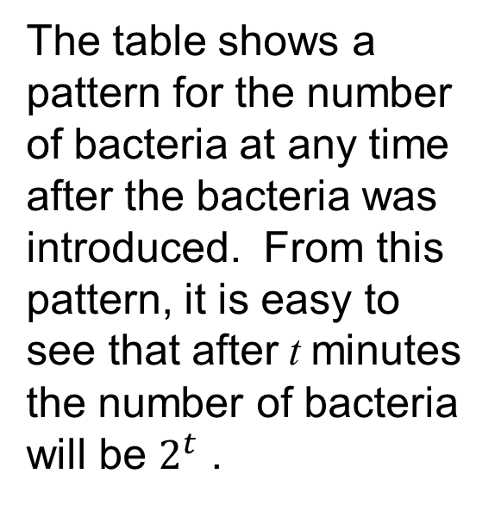
UNIT:
Growth and Decay
Section 2
Models of Growth and Decay
The previous models show how mathematics can be used to model growth and decay of populations. Another example is bacteria, which divide in two every minute. The growth in numbers is illustrated in the table below.
The table shows a pattern for the number of bacteria at any time after the bacteria was introduced. From this pattern, it is easy to see that after t minutes the number of bacteria
will be $2^{t}$ .

Slide 12
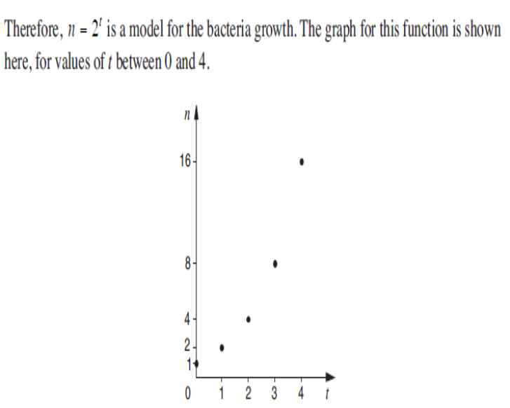
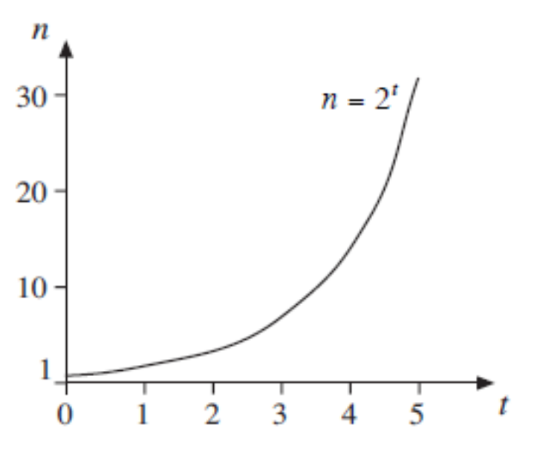
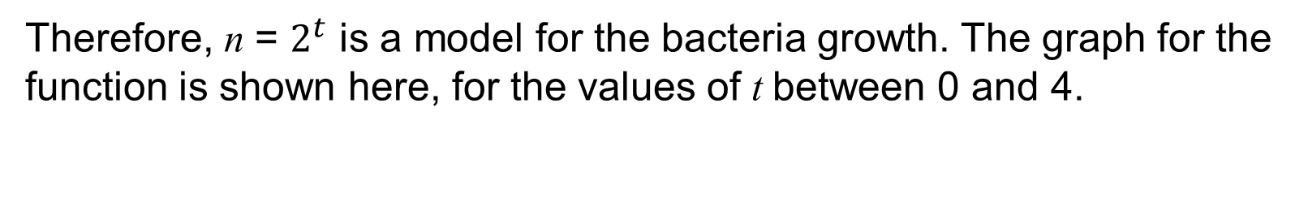
UNIT:
Growth and Decay
Section 2
Models of Growth and Decay
Therefore, n = $2^{t}$ is a model for the bacteria growth. The graph for the function is shown here, for the values of t between 0 and 4.
Drawing a smooth curve through these discrete points gives a continuous model of growth.
Many situations which have models like this have continuous not discrete domains, so the curve is typical of this type of function.

Slide 13
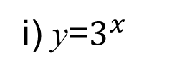
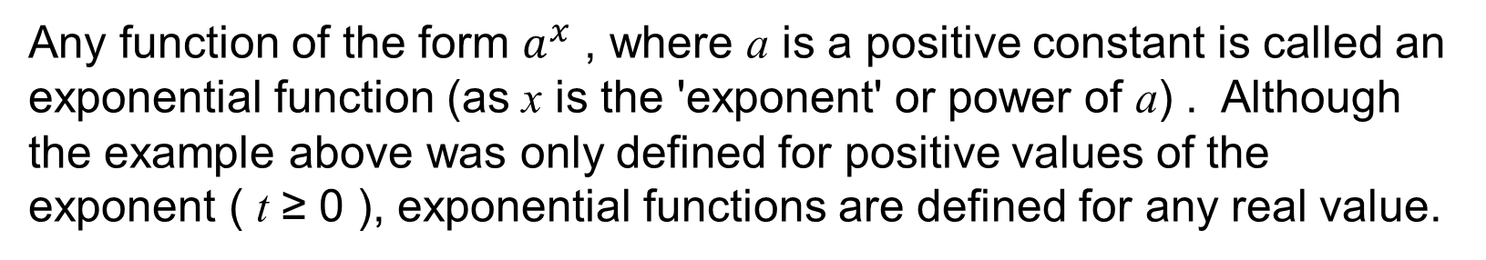
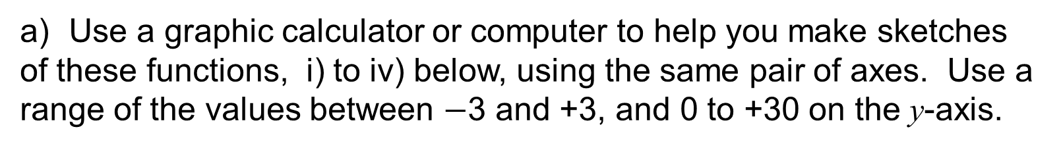
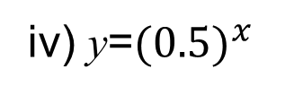
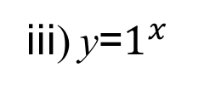
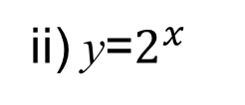
UNIT:
Growth and Decay
Section 2
Models of Growth and Decay
Any function of the form $a^{x}$ , where a is a positive constant is called an exponential function (as x is the 'exponent' or power of a) . Although the example above was only defined for positive values of the exponent ( t ≥ 0 ), exponential functions are defined for any real value.
For instance, if $f\left(x\right)$ = $3^{x}, then f\left(−1\right)=3^{−1}$= $\frac{1}{3}$
Example
a) Use a graphic calculator or computer to help you make sketches of these functions, i) to iv) below, using the same pair of axes. Use a range of the values between $−$3 and +3, and 0 to +30 on the y-axis.
i) y=$3^{x}$
ii) y=$2^{x}$
.
iii) y=$1^{x}$
iv) y=${(0.5)}^{x}$
b) Do the curves have a common point?
c) What is the relationship between $y=2^{x}$and $y={0.5}^{x}$ ?
d) What happens as x becomes large and positive?

Slide 14
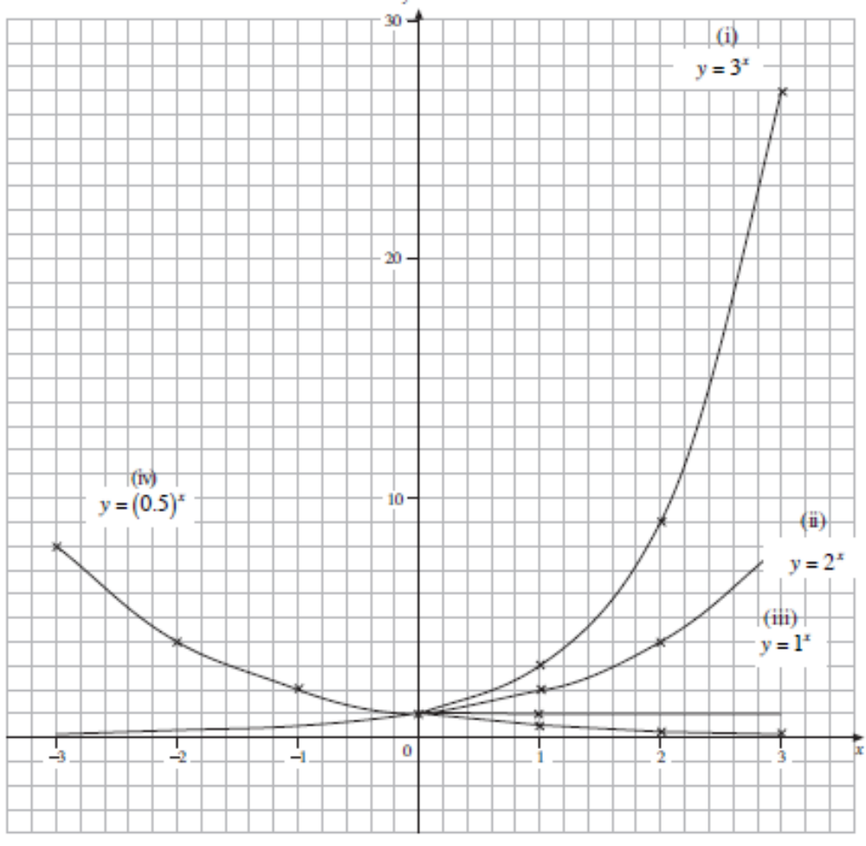




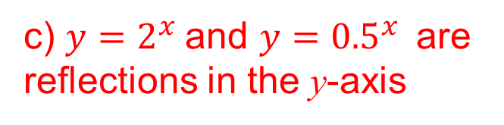
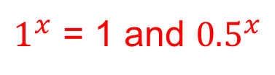

UNIT:
Growth and Decay
Section 2
Models of Growth and Decay
Solution
b) Common point is (0,1)
c) $y=2^{x}$and $y={0.5}^{x}$are reflections in the y-axis
$$∞$$
(d) As x
$$2^{x}$$
$$∞$$
$$3^{x}$$
$$∞$$
$1^{x}$ = 1 and ${0.5}^{x}$
0

Slide 15
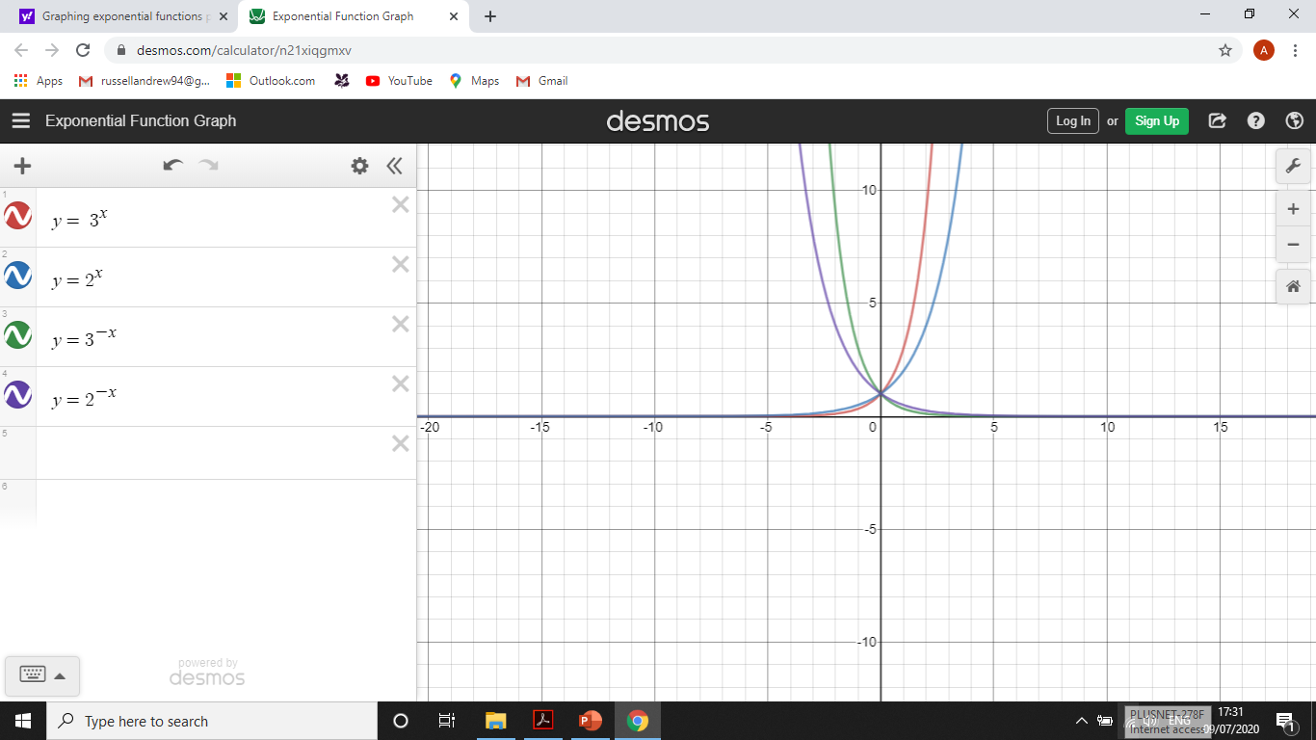


UNIT:
Growth and Decay
Section 2
Models of Growth and Decay
Example
Draw the graphs of y = $3^{−x}$ and y = $2^{−x}$.
Compare them with y =${ 3}^{x}$ and y = $2^{x}$.
Describe the behaviour for large positive values of x.
Solution
From the graph it can be seen that they are reflections of each other in the y axis.
As x
$∞$ the functions
0

Slide 16
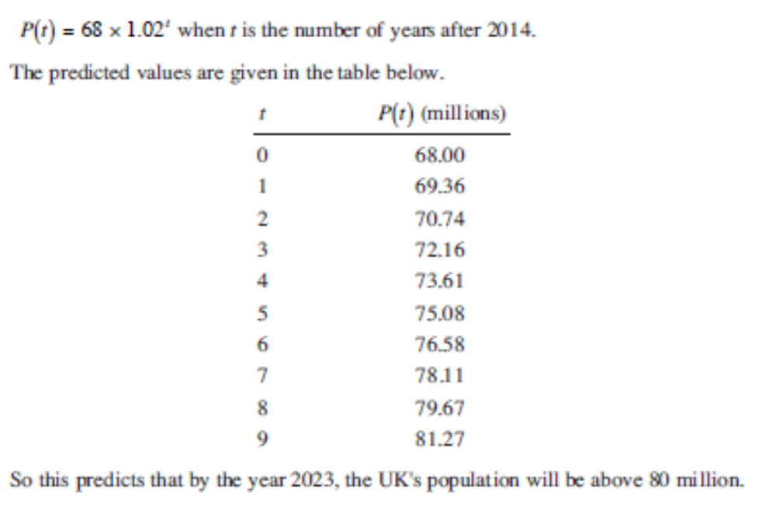
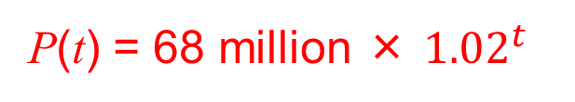
UNIT:
Growth and Decay
Section 2
Models of Growth and Decay
Example
The government’s statistical service made several predictions about the United Kingdom’s population in 2014. One of these was that the population will grow by 2% every year. If the population in 2014 was 68 million, form a model for the UK’s future population. Use it to draw a graph or spreadsheet of the projected population, and from this estimate the year when the population will equal 80 million.
Solution
P(t) = 68 million × ${1.02}^{t}$
when t is the number of years after 2014.
From the table opposite we can predict that the UK’s population will be above 80 million when t is between 8 and 9 years.

Slide 17
UNIT:
Growth and Decay
Section 2
Section 2: Fitness Check
Use the population model P(t) = 68 million $× a^{t}$
with a) a = 1.01 b) a = 1.05 c) a = 1.1 to estimate when the UK’s population will reach 80 million.
In the question above, what factors in the population model have not fully been taken into account?
Answers
a) 17 years b) 14 year c) 2 years
Immigration and migration are not specifically included; government policy could have a dramatic effect; birth and death rates could be unpredictable for various reasons (e.g. extremes of weather, epidemics, etc.).

Slide 18
UNIT:
Growth and Decay
Section 2
Section 2: Review
You have completed the second section.
If you have completed and mastered this section,
click to start the next Section
If you need more examples and interactive practice,
press here
You might also find it helpful to look at:
Essential Information: press here

Slide 19
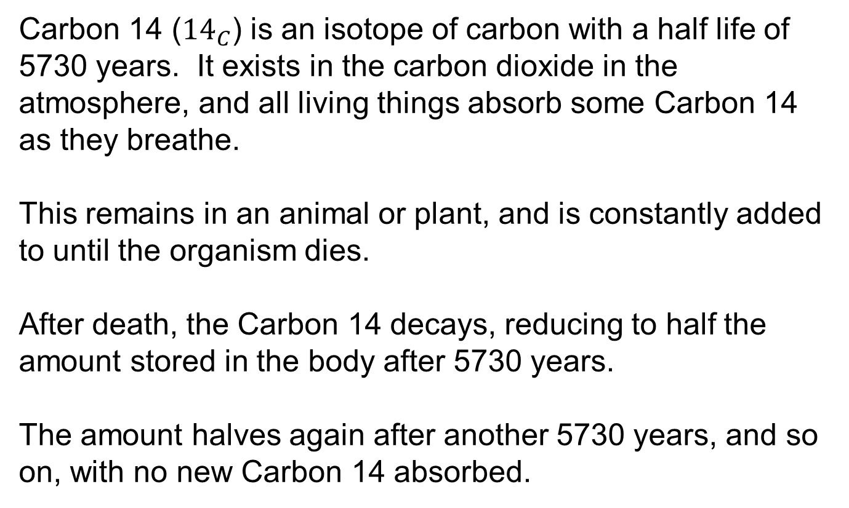
UNIT:
Growth and Decay
Section 3
Carbon Dating
Carbon 14 (${14}_{C}$) is an isotope of carbon with a half life of 5730 years. It exists in the carbon dioxide in the atmosphere, and all living things absorb some Carbon 14 as they breathe.
This remains in an animal or plant, and is constantly added to until the organism dies.
After death, the Carbon 14 decays, reducing to half the amount stored in the body after 5730 years.
The amount halves again after another 5730 years, and so on, with no new Carbon 14 absorbed.

Slide 20
UNIT:
Growth and Decay
Section 3
Carbon Dating
In 1946 an American scientist, Willard Libby, developed a way of 'dating' archaeological objects by measuring the Carbon 14 radiation present in them.
This radioactivity is compared with that found in things living now.
For instance, if bones of recently dead animals produce 10 becquerels per gram of bone carbon (a becquerel ( or bec)) is the unit of radioactivity), and an old bone produces only 5 becquerels, the radioactivity has halved since the animal which had the old bone died.
As the half life of Carbon 14 is 5730 years, this would mean the animal died in 3715 BC approximately, as tested in 2015.

Slide 21
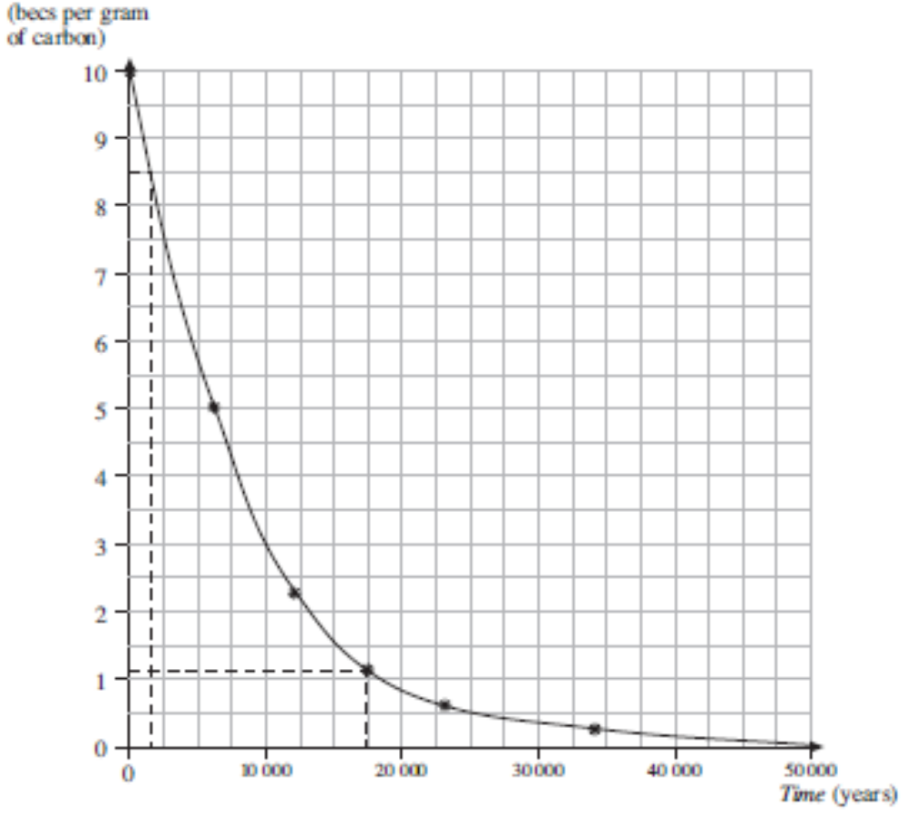
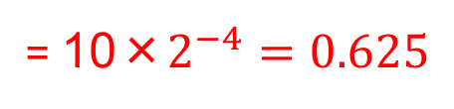
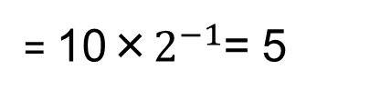
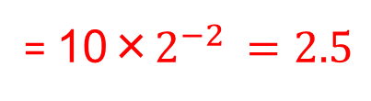
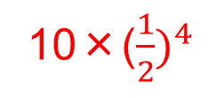
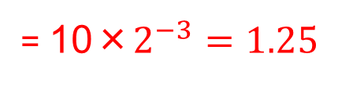
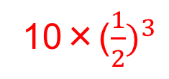
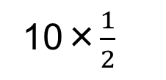
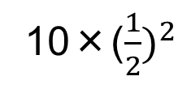
UNIT:
Growth and Decay
Section 3
Section 3: Fitness Check
Complete the results table below and estimate the age of bones with 1.1 becs per gram of carbon by drawing a graph.
Age (years)
Radiation (becs)
0
10
5370
10×$\frac{1}{2}$
= 10×$2^{−1}$= 5
11460
10×(${\frac{1}{2})}^{2}$
= 10×$2^{−2 }=2.5$
17190
10×(${\frac{1}{2})}^{3}$
= 10×$2^{−3}=1.25$
23020
10×(${\frac{1}{2})}^{4}$
= 10×$2^{−4}=0.625$
17500 years

Slide 22
UNIT:
Growth and Decay
Section 3
Section 3: Review
You have completed the third section.
If you have completed and mastered this section,
click to start the next Section
If you need more examples and interactive practice,
press here
You might also find it helpful to look at:
Essential Information: press here

Slide 23
UNIT:
Growth and Decay
Section 4
Rate of Growth
Suppose a colony of bacteria doubles in number every minute as every member of the colony divides in two. So if there are 2 bacteria at the start of the colony, there will be 4 a minute later (an increase of 2 in one minute), 8 two minutes later (an increase of 4 in one minute) and so on.
As the number of bacteria increases, so the rate at which that number increases goes up. So the rate of increase of an exponential function is closely related to the value of the function at any point.
This suggests that exponential functions and their derivatives are closely linked as we will see in the next example.

Slide 24
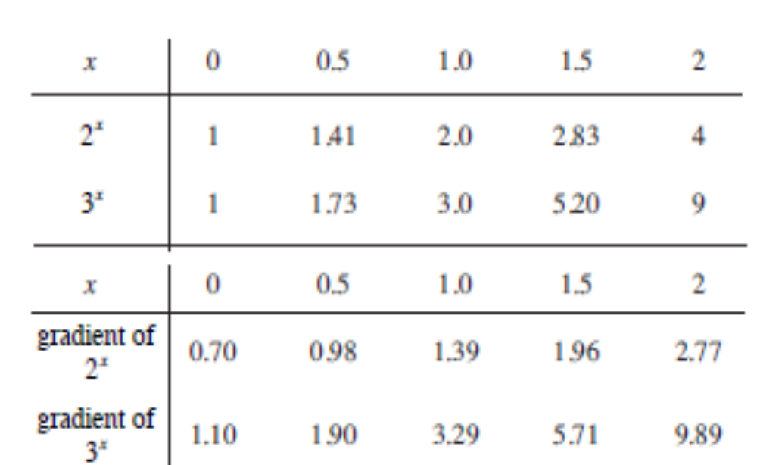
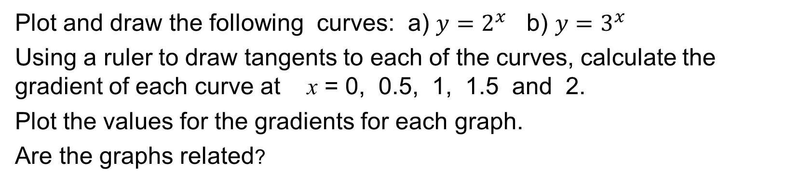
UNIT:
Growth and Decay
Section 4
Rate of Growth
Example
Plot and draw the following curves: a) $y=2^{x}$ b) $y=3^{x}$
Using a ruler to draw tangents to each of the curves, calculate the gradient of each curve at x = 0, 0.5, 1, 1.5 and 2.
Plot the values for the gradients for each graph.
Are the graphs related?
Solution
Here are the calculations for the two functions and estimates of the derivatives.

Slide 25
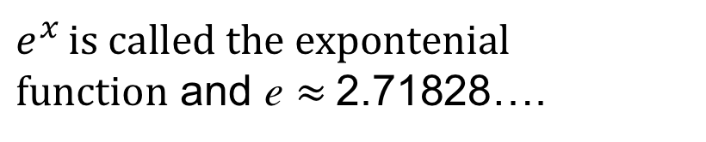
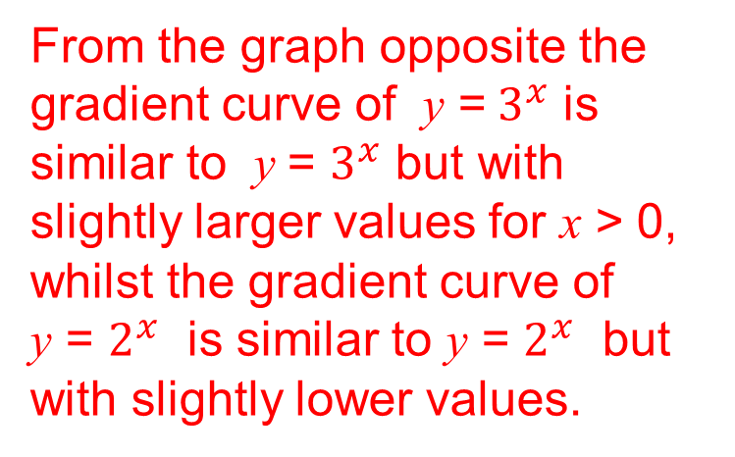
UNIT:
Growth and Decay
Section 4
Rate of Growth
Solution
From the graph opposite the gradient curve of y =${ 3}^{x}$ is similar to y = $3^{x}$ but with slightly larger values for x > 0, whilst the gradient curve of
y = $2^{x}$ is similar to y = $2^{x}$ but with slightly lower values.
Hence there must be a number, call it e such that:
$e^{x }is called the$ expontenial
$function$ and e $≈$2.71828….

Slide 26
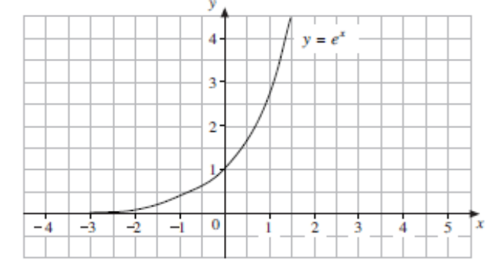
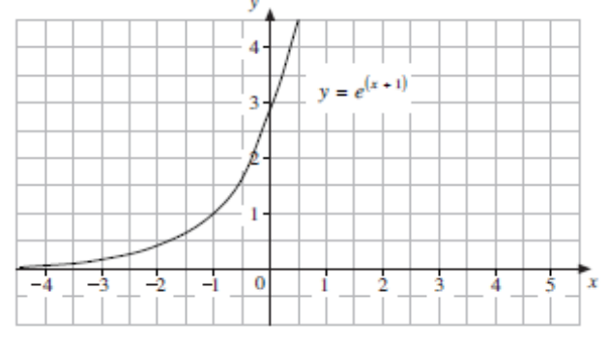
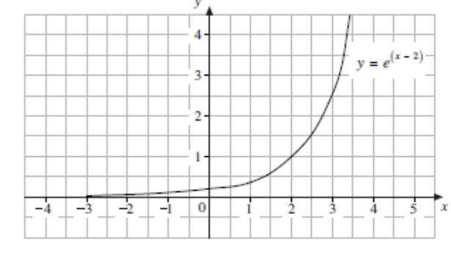
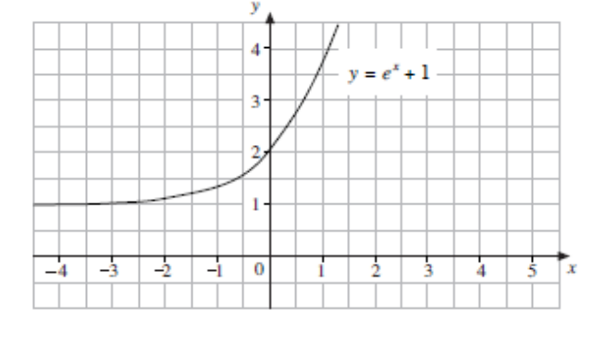
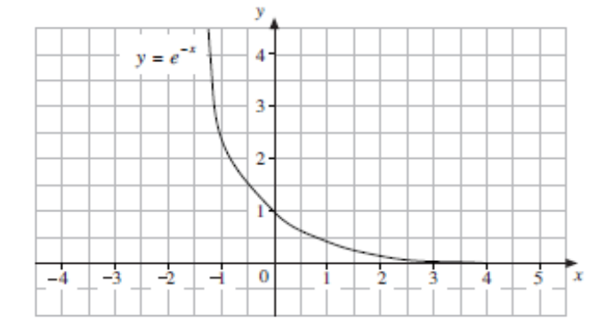
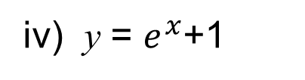
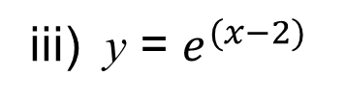
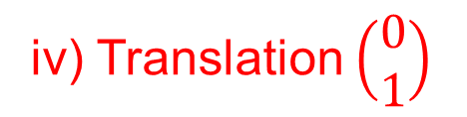
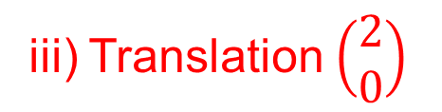
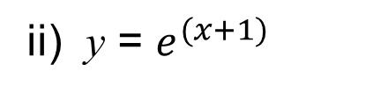



UNIT:
Growth and Decay
Section 4
Rate of Growth
Example
Compare the following graphs with the graph y =${ e}^{x}$.
i) y = $e^{x}$
ii) y = $e^{(x+1)}$
iii) y = $e^{(x−2)}$
Solution
iv) y = $e^{x}$+1
v) y = $e^{−x}$
ii) Translation $\left(\begin{matrix}−1 \\ 0\end{matrix}\right)$
iii) Translation $\left(\begin{matrix}2 \\ 0\end{matrix}\right)$
iv) Translation $\left(\begin{matrix}0 \\ 1\end{matrix}\right)$
v) Reflection in y axis

Slide 27













UNIT:
Growth and Decay
Section 4
Rate of Growth
Example
Use the fact that the derivative of $e^{x}$ is $e^{x}$, to work out the derivatives of each of the other functions.
i) y = $e^{x}$
$\frac{dy}{dx}$ = $e^{x}$
$\frac{dy}{dx}$ = $e^{x+1}$
iii) y = $e^{x+2}$
$\frac{dy}{dx}$ = $e^{x+2}$
ii) y = $e^{(x+1)}$
iv) y = $e^{x}$+1
$\frac{dy}{dx}$ = $e^{x}$
v) y = $e^{−x}$
$\frac{dy}{dx}$ = ${−e}^{−x}$
The function f(x) = $e^{x}$ is a mapping from the set of real numbers, R, to the positive real numbers. Its graph shows that it is a one to one function. This means that
f(x) = $e^{x}$ has an inverse function ln (x),
'the natural logarithm of x' . The graph of this inverse function is a reflection in the line y = x of the graph y = $e^{x}$.

Slide 28








UNIT:
Growth and Decay
Section 4
Rate of Growth
Example
Find x if $e^{x}$ = 100. Give your answer to two decimal places.
Solution
Since $e^{x}$ = 100 and y = ln x is the inverse function of $e^{x}$
x = ln (100) = 4.61 2 d.p.
To summarise, for a > 0
Example
Solve, to 3 significant figures. the equation 3$e^{2x−1}$ = 5.
Solution
Since 3$e^{2x−1}$ = 5, then $e^{2x−1}$ = $\frac{5}{3}$
Since $e^{x}$ and ln x are inverse functions:
2x $−$1 = ln $\frac{5}{3}$
Hence 2x = 1 + ln $\frac{5}{3}$
x = $\frac{1}{2}$ (1 + ln $\frac{5}{3}$)
x = 0.755 to 3.s.f
$$⟹$$
$$⟹$$

Slide 29










UNIT:
Growth and Decay
Section 4
Section 4: Fitness Check
1. Solve $e^{2x}$ =1 to 2 decimal places.
2x = ln1
x = 0
2. Solve 3$e^{\frac{x}{2}}$ = 4 to 3 significant figures.
$\frac{x}{2}$ = ln $\frac{4}{3}$
x = 2 ln $\frac{4}{3}$
x = 0.575
3. Solve $e^{−x}$ =1.5 to 2 decimal places.
$−$ x = ln 1.5
x = 0.41
4. Solve ${4e}^{3x−2}$ = 16 to 1 decimal places.
3x – 2 = ln 4
3x = ln 4 + 2
x = $\frac{1}{3}$ (ln 4 + 2)
x = 1.1
5. Solve ${7e}^{3−x}$ = 2 to 3 significant figures.
3 – x = ln $\frac{2}{7}$
x = 3 $−$ ln $\frac{2}{7}$
x = 4.25

Slide 30
UNIT:
Growth and Decay
Section 4
Section 4: Review
You have completed the fourth section.
If you have completed and mastered this section,
click to start the next Section
If you need more examples and interactive practice,
press here
You might also find it helpful to look at:
Essential Information: press here

Slide 31



UNIT:
Growth and Decay
Section 5
Solving Exponential Equations
Earlier in this unit, we used exponential functions as models, and then graphs to estimate the solution to a problem.
The logarithmic function allows you to calculate rather than estimate these solutions as is shown in the example below.
Example
A bacteria colony doubles in number every minute, from a starting population of one. The population model is P(m) =${ 2}^{m}$ where P is the population and m the number of minutes since the colony was started. Find the time when the population first equals 1000.
Solution
P(m) = 1000 so
${ 2}^{m}$ = 1000
Hence ${ln 2}^{m}$ = ln 1000
and m ln 2 = ln 1000 and m = $\frac{ln 1000}{ln 2}≈9.966 mins$

Slide 32






UNIT:
Growth and Decay
Section 5
Solving Exponential Equations
Example
Solve $3^{2x−1}$= $5^{x}$, giving your answer to 2 decimal places.
Solution
ln ($3^{2x−1}$) = ln $5^{x}$
(2x$−$1) ln 3 = x ln 5
2x ln 3 – ln 3 = x ln 5
2x ln 3 – ln 3 $−$ x ln 5 = 0
x(2 ln 3 $−$ ln 5) – ln 3 = 0
x = $\frac{\ln{3}}{2 ln 3− ln 5}$
= 1.87 to 2 decimal places

Slide 33













UNIT:
Growth and Decay
Section 5
Section 5: Fitness Check
${1. 3}^{x}$ = 5 to 2 d.p.
x ln 3 = ln 5
x = $\frac{\ln{5}}{\ln{3}}$
x = 1.46
$−$x ln 2 = ln 6
x = $−$ $\frac{\ln{6}}{\ln{2}}$
x = $−$2.58
${2. 2}^{−x}$ = 6 to 3 s.f.
x = $\frac{\ln{4}}{2 ln{3}}$
${3. 3}^{2x}$ = 4 to 2 d.p.
2x ln 3 = ln 4
x = 0.63
$4. { 5}^{x−1}$ = 3 to 3 s.f.
(x$−$1) ln 5 = ln 3
x = $\frac{\ln{3+ln 5}}{\ln{5}}$
x = 1.68
$5. { 2}^{2x+1 }$= 4 to 2 d.p.
(2x+1) ln 2 = ln 4
x = $\frac{\ln{4−ln 2}}{2 ln{2}}$
x = 0.5

Slide 34
UNIT:
Growth and Decay
Section 5
Section 5: Review
You have completed the fifth section.
If you have completed and mastered this section,
click to start the next Section
If you need more examples and interactive practice,
press here
You might also find it helpful to look at:
Essential Information: press here

Slide 35

UNIT:
Growth and Decay
Section 6
Properties of Logarithms
As well as obeying the rule
ln ($a^{x}$) = x ln a
logarithms also obey, for any real numbers a, b,
ln (ab) = ln a + ln b
and
ln ($\frac{a}{b})$= ln a − ln b
Example
The relationship between length, l (cm), and frequency, f (hz), can be found experimentally. The next table shows some data collected by experiment for a particular type of string.

Slide 36


UNIT:
Growth and Decay
Section 6
Properties of Logarithms
Example
f =a$l^{b}$
Use logarithms to 'linearise' the relationship.
Plot ln f on a vertical axis and ln l on the horizontal, and draw a line of best fit.
Find the gradient and intercept with the vertical axis of this line, and so determine the values of a and b.

Slide 37





UNIT:
Growth and Decay
Section 6
Properties of Logarithms
Solution
If f = a$l^{b}$ for constants a and b
then
ln f = ln a + b ln l
Gradient = $\frac{5−6.1}{4.75−3.8}$ = $−$1.16 = b
6.02 = ln a – 1.16 × 3.91
ln a = 27.30
and a = 7.2
Hence
f =${7.21}^{−1.16}$

Slide 38







UNIT:
Growth and Decay
Section 6
Properties of Logarithms
Example
For the data above, plot a graph of ln T against ln R, and use it to estimate the values of the
constants a and b.
T = a$R^{b}$
T=a$R^{b}$
Solution
Gradient = $\frac{3.38 − 0}{7.26 −5.01}$ = $\frac{3.38}{2.25}$ =1.5
b = 1.5
Substitute (5.01, 0)
ln T = ln a + b ln R
ln a = $−$1.5 ln (5.01)
a = 2.42
T = a$R^{b}$ becomes
T = 2.42 $×{ R}^{1.5}$

Slide 39









UNIT:
Growth and Decay
Section 6
Section 6: Fitness Check
A physicist conducts an experiment to discover the half life of an element. The radioactivity at one moment from a sample of the element is measured as 30 becquerels. One hour later the radioactivity is just 28 becquerels. Assuming that the radioactivity is governed by a formula of the form
R = a $×$ $2^{−kt}$
where R is the radioactivity in becquerels per gram, t the time in hours, and a and k are constants, find the values of a and k, and hence determine the half life in hours.
Answer
At t = 0 R = 30
$$⟹$$
30 = a × $2^{0}$
$$⟹$$
a = 30
ln (R) = ln (a) – kt ln (2 )
$$⟹$$
now substitute R = 28 and t =1 to give:
ln (28) = ln (30) – k ln (2 )
$$⟹$$
k = $\frac{ln 30−ln 28}{\ln{2}}$
= 0.0995
Half life: R =15
$$⟹$$
15 = 30×$2^{−0.0995t}$
t = 10.05 hours
$$⟹$$

Slide 40
UNIT:
Growth and Decay
Section 6
Section 6: Review
You have completed the sixth section.
If you have completed and mastered the last section,
click here for the Unit audit
If you need more examples and interactive practice,
press here
You might also find it helpful to look at:
Essential Information: press here

