Slide 1
Supporting and Enhancing Mathematics and Statistics
UNIT: Further Calculus

Slide 2
UNIT:
Further Calculus
Section 1
Further Calculus
This unit builds on the earlier work in Calculus and is divided into the following five sections:
1. Rate of Change of the Gradient
2. Stationary Points
3. Differentiating Composite Functions
4. Integration Again
5. Differentiating Products and Quotients

Slide 3
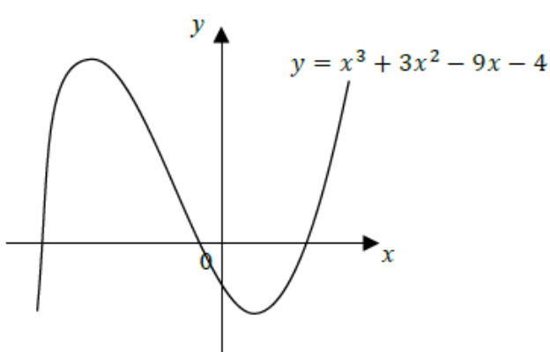
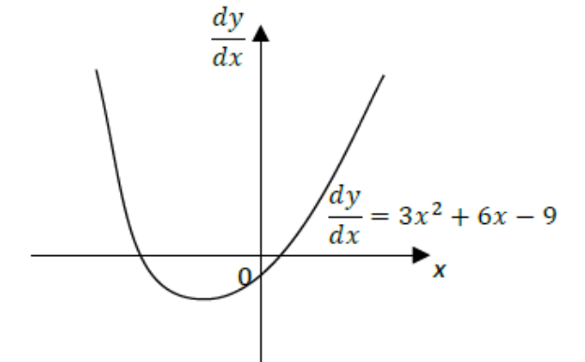
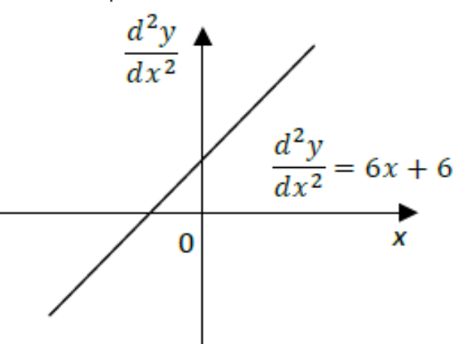
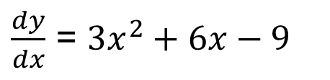
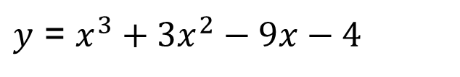
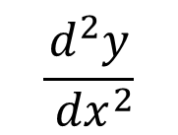
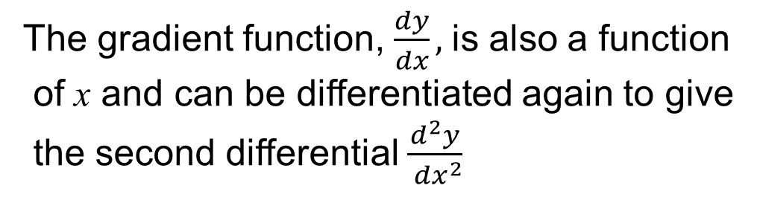
UNIT:
Further Calculus
Section 1
Rate of Change of the Gradient
The sketch opposite shows the graph of
$y$ = $x^{3}+3x^{2}−9x−4$
You have already seen that the derivative of this function is given by
$\frac{dy}{dx}$ = ${3x}^{2}+6x−9$
The gradient function, $\frac{dy}{dx},$is also a function
of x and can be differentiated again to give
the second differential $\frac{d^{2}y}{{ dx}^{2}}$
$$\frac{d^{2}y}{{ dx}^{2}}$$
= 6x + 6

Slide 4
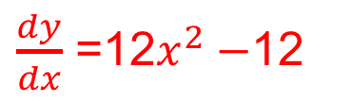
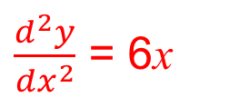
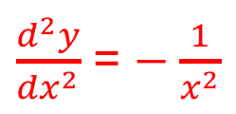
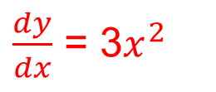
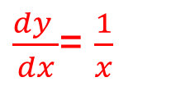
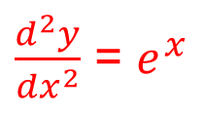
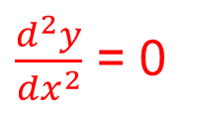
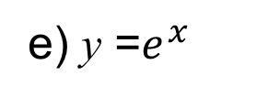
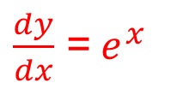
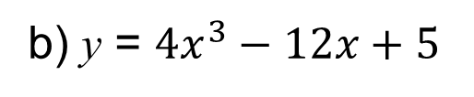
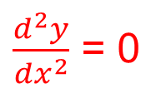
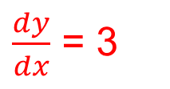
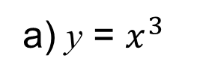
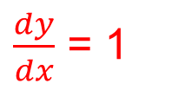
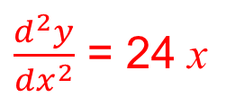
UNIT:
Further Calculus
Section 1
Section 1: Fitness Check
Find the second derivative of these functions
$\frac{dy}{dx}$ = 3$x^{2}$
$\frac{d^{2}y}{{dx}^{2}}$ = 6x
a) y = $x^{3}$
$\frac{dy}{dx}$ =12$x^{2}−$12
$\frac{d^{2}y}{{dx}^{2}}$ = 24 x
b) y = ${4x}^{3}−12x+5$
$\frac{dy}{dx}$ = 1
$\frac{d^{2}y}{{dx}^{2}}$ = 0
c) y = x
$\frac{dy}{dx}$ = 3
$\frac{d^{2}y}{{dx}^{2}}$ = 0
d) y = 3x+1
$\frac{dy}{dx}$ =${ e}^{x}$
$\frac{d^{2}y}{{dx}^{2}}$ = $e^{x}$
e) y =$e^{x}$
f) y = ln x
$\frac{dy }{dx}$= $\frac{1}{x}$
$\frac{d^{2}y}{{dx}^{2}}$ = − $\frac{1}{x^{2}}$

Slide 5
UNIT:
Further Calculus
Section 1
Section 1: Review
You have completed the first section.
If you have completed and mastered this section,
click to start the next Section
If you need more examples and interactive practice,
press here
You might also find it helpful to look at:
Essential Information: press here

Slide 6
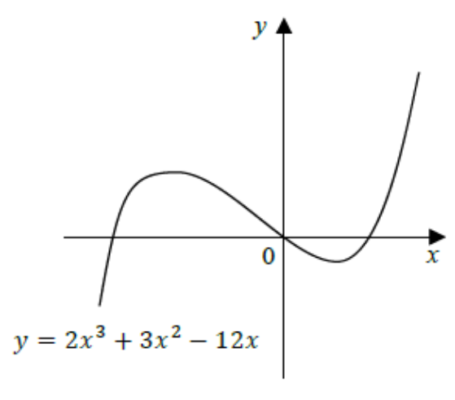
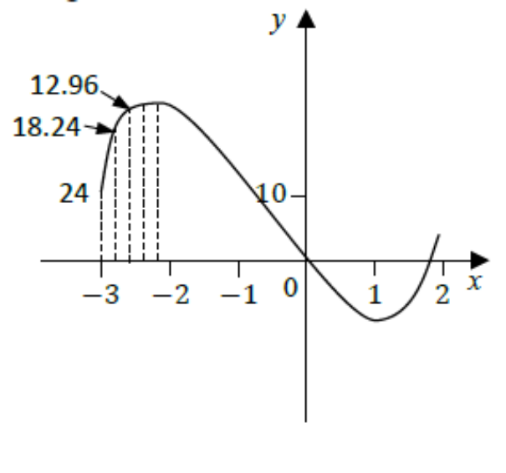
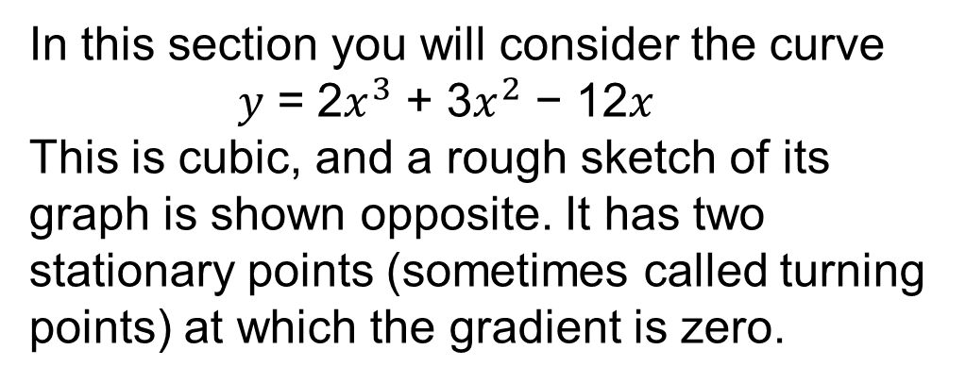
UNIT:
Further Calculus
Section 2
Stationary Points
In this section you will consider the curve
𝑦 = 2$x^{3}$ + 3$x^{2}$ − 12𝑥
This is cubic, and a rough sketch of its graph is shown opposite. It has two stationary points (sometimes called turning points) at which the gradient is zero.
We now need to find the co-ordinates of the stationary points. In the Rates of Change Unit, you saw that the nature of the stationary points can be determined by looking at the gradient on each side of the stationary point. The gradients are shown on the diagram.
You can see above the change in the value of the gradient as it rapidly decreases until it reaches zero at the point of maximum value.

Slide 7
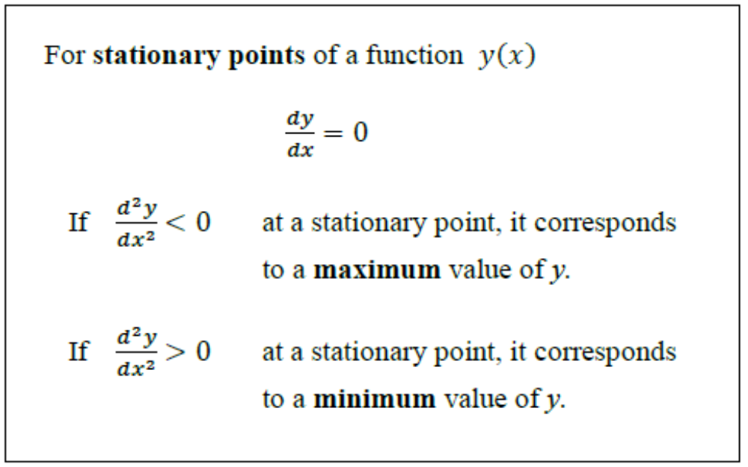
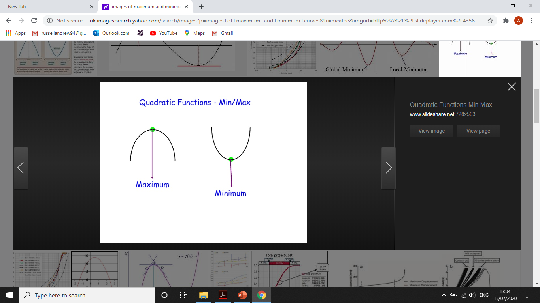
UNIT:
Further Calculus
Section 2
Stationary Points
For a maximum value of a function, note that the gradient is decreasing in value as it passes through the value zero at the stationary point, whereas for a minimum value, this gradient is increasing. Hence:
Note: that there is no need to graph a function to find its max/min values.

Slide 8
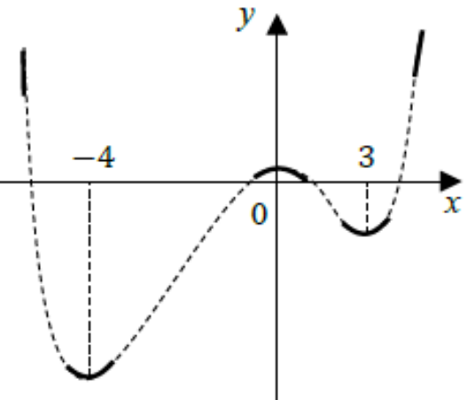
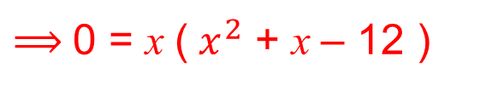
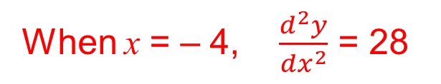
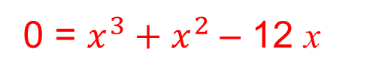
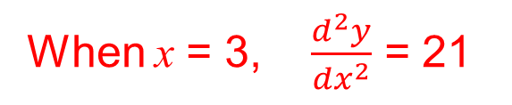
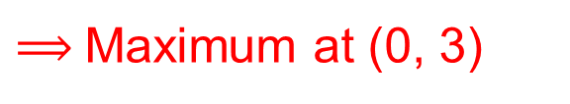
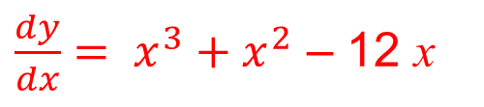
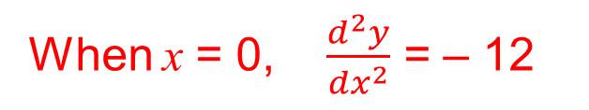
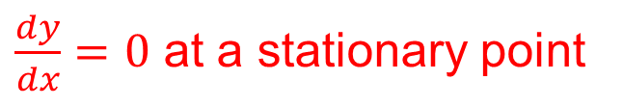
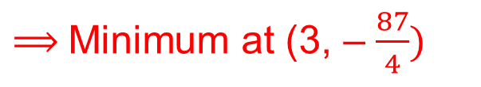
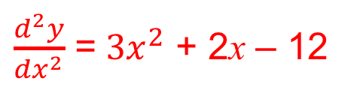
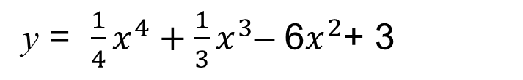
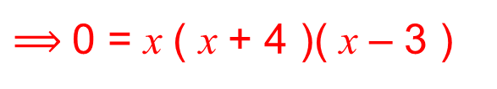
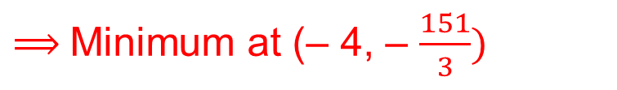
UNIT:
Further Calculus
Section 2
Stationary Points
Example 1
Find the maximum and minimum points of the following curve:
y = $\frac{1}{4}x^{4}+\frac{1}{3}x^{3}$– 6$x^{2}$+ 3
Hence sketch the curve.
Solution
$\frac{dy}{dx}=0$ at a stationary point
$\frac{dy}{dx}= x^{3}+x^{2}$ – 12 x
0 = $x^{3}+x^{2}$ – 12 x
$⟹$0 = x (${ x}^{2}$ + x – 12 )
$⟹$0 = x ( x + 4 )( x – 3 )
$\frac{d^{2}y}{{dx}^{2}}$ =${ 3x}^{2}$ + 2x – 12
When x = 0, $\frac{d^{2}y}{{dx}^{2}}$ = – 12
$⟹$Maximum at (0, 3)
When x = – 4, $\frac{d^{2}y}{{dx}^{2}}$ = 28
$⟹$Minimum at (– 4, – $\frac{151}{3})$
When x = 3, $\frac{d^{2}y}{{dx}^{2}}$ = 21
$⟹$Minimum at (3, – $\frac{87}{4})$
These are shown on the sketch opposite.

Slide 9
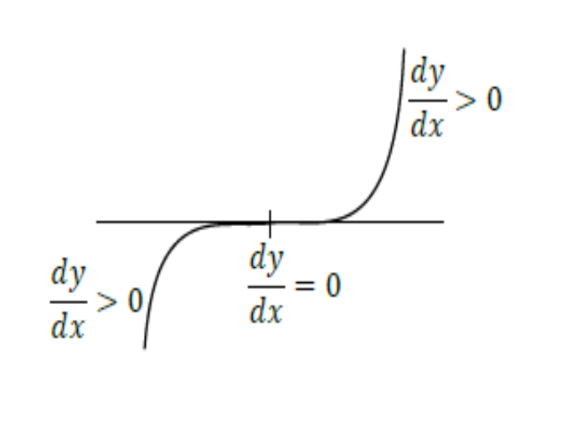
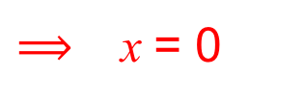
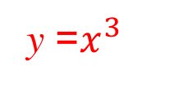
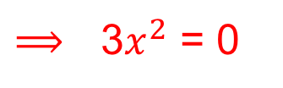
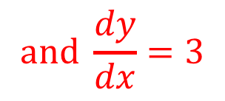
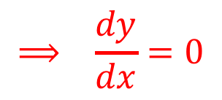
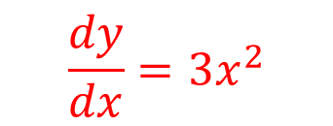
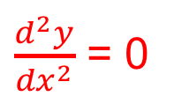
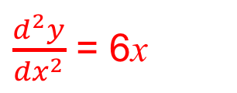

UNIT:
Further Calculus
Section 2
Stationary Points
Example 2
Investigate the stationary points for the graph y =$x^{3}$.
Solution
$$\frac{dy}{dx}=3x^{2}$$
$$⟹ \frac{dy}{dx}=0$$
$⟹$ x = 0
$⟹$3$x^{2}$ = 0
$\frac{d^{2}y}{{dx}^{2}}$ = 6x
$and \frac{d^{3}y}{{dx}^{3}}$ = 6 i.e. ≠ 0
$\frac{d^{2}y}{{dx}^{2}}$ = 0
$$and \frac{dy}{dx}=3$$
Substitute x = 0:
y =$x^{3}$
This is neither a maximum nor minimum but
a point of inflection.

Slide 10





UNIT:
Further Calculus
Section 2
Stationary Points
Example 3
Show that y = $x^{4}$ has a minimum at x = 0 by checking on the values of the derivative on each side of the stationary point.
Solution
For the stationary points, $\frac{dy}{dx}$ = 4$x^{3}$= 0, hence x = 0
$\frac{d^{2}y}{{dx}^{2}}$ = 12 $x^{2}$ When x = 0 $\frac{d^{2}y}{{dx}^{2}}$ = 0 $\frac{d^{3}y}{{dx}^{3}}$ = 24 x When x = 0 $\frac{d^{3}y}{{dx}^{3}}$ = 0
Hence x = 0 is not a
point of inflection.
Substituting values of x around the turning point x = 0
When x = $−$0.1 $\frac{dy}{dx}$ = $−$0.004
-
+
When x = 0.1 $\frac{dy}{dx}$ = 0.004
0
So there is a minimum at x = 0.

Slide 11









UNIT:
Further Calculus
Section 2
Section 2: Fitness Check
Determine any stationary points of the following curve and decide if they correspond to a maximum, minimum or point of infection:
𝑦 = $x^{2}$ − 4𝑥 + 2 ln (𝑥)
Answer
$\frac{dy}{dx}$ = 2x – 4 + $\frac{2}{x}$
$\frac{dy}{dx}$ = 0
$⟹$ 0 = 2x – 4 + $\frac{2}{x}$
⟹ 0 = 2$x^{2}−$ 4x + 2
Hence 0 = 2${(x −1)}^{2}$giving x = 1 as the only stationary point at (1, −3)
$\frac{d^{2}y}{{dx}^{2}}$ = 2 $−$ $\frac{2}{x^{2}}$
$and \frac{d^{3}y}{{dx}^{3}}$ = $\frac{4}{x^{3}}$
When x = 1, $\frac{d^{2}y}{{dx}^{2}}$ = 0 but $\frac{d^{3}y}{{ dx}^{3}}$ ≠ 0
⟹ point of inflection
Note: Alternatively you could check the sign of $\frac{dy}{dx}$either side of x = 1; for example,
when x = 0.9, $\frac{dy}{dx}$ > 0 and when x = 1.1, $\frac{dy}{dx}$ > 0, so it must be a point of inflection.

Slide 12
UNIT:
Further Calculus
Section 2
Section 2: Review
You have completed the second section.
If you have completed and mastered this section,
click to start the next Section
If you need more examples and interactive practice,
press here
You might also find it helpful to look at:
Essential Information: press here

Slide 13


UNIT:
Further Calculus
Section 3
Differentiating Composite Functions
The crucial result needed here is the ‘function of a function’ rule. It can be justified by noting that if y is a function of u, and u is a function of x, that is
𝑦 = 𝑓(𝑢) and 𝑢 = 𝑔(𝑥)
then a small change, 𝛿𝑥 say, in x will result in a small change, say 𝛿𝑢 say in u, which in turn results in a small change, 𝛿𝑦 in y. Now
$\frac{\text{δ}y}{\text{δ}\text{x}}=\frac{\text{δ}y}{\text{δ}u}$ $×$ $\frac{\text{δ}u}{\text{δ}\text{x}}$
and if you let 𝛿𝑥 → 0, then 𝛿𝑢 → 0 and 𝛿𝑦 → 0 and the equation becomes
$$\frac{dy}{dx}=\frac{dy}{du}×\frac{du}{dx}$$

Slide 14















UNIT:
Further Calculus
Section 3
Differentiating Composite Functions
Example 1
$$\frac{dy}{dx}=18x+12$$
Differentiate y = (${\text{3}\text{x} \text{+ 2)}}^{2}$
= 9$x^{2}$+ 12x + 4
Another method, which will be even more useful as the functions get more complicated, is to introduce a new variable u defined by
$$\frac{dy}{dx}=\frac{dy}{du}×\frac{du}{dx}$$
u = 3x + 2
$\frac{du}{dx}$ = 3
y = $u^{2}$
$\frac{dy}{du}$ = 2u = 2(3x + 2) = 6x + 4
$$\frac{dy}{dx}=3\left(6x+4\right)=18x+12$$
Example 2
Differentiate y = $e^{x^{2}}$
$$\frac{dy}{dx}=\frac{dy}{du}×\frac{du}{dx}$$
Let u = $x^{2}$
$\frac{du}{dx}$ = 2x
$$\frac{dy}{dx}={2xe}^{x^{2}}$$
y = $e^{u}$
$\frac{dy}{du}$ = $e^{u}$= $e^{x^{2}}$

Slide 15












UNIT:
Further Calculus
Section 3
Section 3: Fitness Check
1. Differentiate y = (${e^{x}\text{− }\text{x}\text{)}}^{6}$
Answer
Let $u$ = $e^{x}\text{− }\text{x}$
$then \frac{du}{dx}$ = $e^{x}$-1
and using: $\frac{dy}{dx}=\frac{dy}{du}×\frac{du}{dx}$ we let
$y$ = $u^{6}$
$⟹\frac{dy}{du}$ = ${6u}^{5}=6{(e^{x}\text{− }\text{x}\text{)}}^{5}$
$⟹\frac{dy}{dx}=6{(e^{x}\text{− }\text{x}\text{)}}^{5}$ ${(e}^{x}$ $\text{−}$1)
2. Find any stationary points of the curve y = ${\text{(}\text{x}\text{ +}\frac{1}{x}\text{)} }^{4}.$
Answer
Let u = $\text{x}\text{ +}\frac{1}{x}$
$⟹ \frac{du}{dx}$ = 1 $\text{−}$ $\frac{1}{x^{2}}$
and y = $u^{4}$
$so \frac{dy}{du}$ = ${4u}^{3}$= 4${\text{(}\text{x}\text{ +}\frac{1}{x}\text{)}}^{3}$
$⟹ \frac{dy}{dx}=\frac{dy}{du}×\frac{du}{dx}$ = 4${\text{(}\text{x}\text{ +}\frac{1}{x}\text{)}}^{3}$ (1 $−$ $\frac{1}{x^{2}}$)
4${\text{(}\text{x}\text{ +}\frac{1}{x}\text{)}}^{3}$ (1 $−$ $\frac{1}{x^{2}}$) = 0 gives ${\text{(}\text{x}\text{ +}\frac{1}{x}\text{)}}^{3}$= 0 (no solutions) or (1 $−$ $\frac{1}{x^{2}}$) = 0
This gives x =1 or x = $−$1 $⟹$ (1, 16) and ($−$1, 16) as stationary points.

Slide 16
UNIT:
Further Calculus
Section 3
Section 3: Review
You have completed the third section.
If you have completed and mastered this section,
click to start the next Section
If you need more examples and interactive practice,
press here
You might also find it helpful to look at:
Essential Information: press here

Slide 17











UNIT:
Further Calculus
Section 4
Integration Again
The results that have been developed in the last section are, as you will see, very useful in integration. For example,
y ${\text{=} \text{(}\text{x}\text{+}\text{5}\text{)}}^{4}$
In general
$$y{=(ax+b)}^{n}$$
$\frac{dy}{dx}=4 × 1{ × (x+5)}^{3}$
$\frac{dy}{dx}$ ${\text{= }\text{na}\text{(}ax+b\text{)}}^{n−1}$
$\int{4{(x+5)}^{3}{\text{dx} \text{= (}\text{x} \text{+} \text{5)}}^{4}+c}$
$\int{{ \text{an}\text{(}ax+b\text{)}}^{n−1}dx}={\text{ (}\text{ax} \text{+} \text{b}\text{)}}^{n}$ + $c$
$4\int{{(x+5)}^{3}{\text{dx} \text{= (}\text{x} \text{+} \text{5)}}^{4}+c}$
an$\int{{\text{(}\text{a}\text{x}\text{ +} b\text{)} }^{n−1}dx={\text{ (}\text{ax} \text{+} \text{b}\text{)}}^{n}\text{ +} c}$
$\int{{(x+5)}^{3}\text{dx} }$= $\int{\frac{{(x+5)}^{4}}{4}+k}$
$\int{{\text{(}\text{ax} \text{+} \text{b}\text{)} }^{n−1}dx=\frac{{(ax+b)}^{n}}{an}}$ + k
$\int{{\text{(}\text{ax} \text{+} \text{b}\text{)} }^{n}dx=\frac{{(ax+b)}^{n+1}}{a(n+1)}}$ + k
or

Slide 18






UNIT:
Further Calculus
Section 4
Integration Again
Example
Solution
Use the results above to evaluate
a)$\int{\frac{dx}{(x+ 1)}}$
b) $\int{\frac{dx}{1−2x}}$
a)$\int{\frac{dx}{(x+ 1)}=\ln{ \left(x+1\right)}+c}$
b)$\int{\frac{dx}{(1−2x)}}$ = $\frac{1}{−2}ln \left(1 −2\text{x}\right)+c$
Another important method of integration is based on the result that if y = ln f(x) then defining u = f(x), y = ln u and $\frac{dy}{dx}=\frac{dy}{du}×\frac{du}{dx}$
$\frac{dy}{dx}=\frac{1}{u}$ $×$ f(x)
$$\frac{dy}{dx}=\frac{f′(x)}{f(x)}$$

Slide 19





UNIT:
Further Calculus
Section 4
Integration Again
Example
Find $\int{\frac{(3x^{2}+x)}{(2x^{3}+x^{2})}dx}$
Solution
f(x) = ${2x}^{3}$+ $x^{2}$, then f ’(x)= 6$x^{2}$+ 2x, so the integral can be written as
integral = $\int{\frac{(3x^{2}+x)}{(2x^{3}+x^{2})}dx}$
= $\frac{1}{2}\int{\frac{2(3x^{2}+x)}{(2x^{3}+x^{2})}dx}$
$=\frac{1}{2}\int{\frac{f′(x)}{f(x)}dx}$ when $f(x$) = $2x^{3}+x^{2}$
= $\frac{1}{2}$ln f(x)+ c =ln ($2x^{3}+x^{2}$)+ c

Slide 20












UNIT:
Further Calculus
Section 4
Section 4: Fitness Check
1. Find $\int{{(2x+1)}^{4}dx}$
2. Find $\int{\frac{dx}{3x+2}dx}$
Answer
Answer
$$\int{{(2x+1)}^{4}dx}$$
$$\int{\frac{dx}{3x+2}dx}$$
$Use \int{{\text{(}\text{ax}\text{+}\text{b}\text{)} }^{n}dx=\frac{{(ax+b)}^{n+1}}{a(n+1)}}$ + k
$$\int{\frac{dx}{(3x+2)}=\ln{ \left(3x+2\right)}+c}$$
$\int{{(2x+1)}^{4}dx }$= $\frac{{(2x+1)}^{5}}{10}$ + c
3. Find $\int{\frac{x}{x^{2}+1}dx}$
Answer
f(x) = $x^{2}$+ 1, then $f^{′}$(x)= 2x, so the integral can be written as
$\int{\frac{x}{x^{2}+1}dx}$ = $\frac{1}{2}\int{\frac{2x}{x^{2}+1}dx}$
= $\frac{1}{2}$ln f(x)+ c = $\frac{1}{2}$ ln ($x^{2}+1$)+ $c$
4. Find $\int{\sqrt{4x−1} dx }$
$\int{{(4x−1)}^{\frac{1}{2}} dx}$ = $\frac{{(4x−1)}^{\frac{3}{2}}}{6}+c$
Answer

Slide 21









UNIT:
Further Calculus
Section 4
Section 4: Fitness Check
1. Find $\int{{(2x+1)}^{4}dx}$
Answer
$\int{{(2x+1)}^{4}dx }$= $\frac{{(2x+1)}^{5}}{10}$ + c
$$\int{\frac{dx}{(3x+2)}=\ln{ \left(3x+2\right)}+c}$$
2. Find $\int{\frac{dx}{(3x+2)}dx}$
Answer
3. Find $\int{\frac{x}{{(x}^{2}+1)}dx}$
Answer
f(x) = $x^{2}$+ 1, then f ’(x) = 2x, so the integral can be written as:
integral = $\frac{1}{2}\int{\frac{2x}{x^{2}+1}dx}$
= $\frac{1}{2}$ln f(x)+ c = $\frac{1}{2}$ ln ($x^{2}+1$)+ $c$
4. Find $\int{\sqrt{4x−1 }}dx$
Answer
$\int{{(4x−1)}^{\frac{1}{2}} dx}$ = $\frac{{(4x−1)}^{\frac{3}{2}}}{6}+c$

Slide 22
UNIT:
Further Calculus
Section 4
Section 4: Review
You have completed the fourth section.
If you have completed and mastered this section,
click to start the next Section
If you need more examples and interactive practice,
press here
You might also find it helpful to look at:
Essential Information: press here

Slide 23

UNIT:
Further Calculus
Section 5
Differentiating Products and Quotients
There are very useful formulae for differentiating both products and quotients. For example, if y is defined as the product of the functions, u and v of x, then
𝑦(𝑥) = 𝑢(𝑥)𝑣(𝑥) or
Using the basic definition of a derivative, let 𝛿𝑥 be a small change in 𝑥, then consider
𝑦(𝑥 + 𝛿𝑥) − 𝑦(𝑥) = 𝑢(𝑥 + 𝛿𝑥)𝑣(𝑥 + 𝛿𝑥) − 𝑢(𝑥)𝑣(𝑥)
= [𝑢(𝑥 + 𝛿𝑥) − 𝑢(𝑥)] 𝑣(𝑥 + 𝛿𝑥) + 𝑢(𝑥) [𝑣(𝑥 + 𝛿𝑥) − 𝑣(𝑥)]
(the middle two terms cancel out)
Dividing both sides by 𝛿𝑥 gives
y=uv
$$\frac{y(x + δx) − y(x)}{\text{δ}\text{x}}=\frac{(u\left(x + δx\right)− u\left(x\right))}{\text{δ}\text{x}}=(v(x + δx) + u(x))\frac{(v(x + δx) − v(x))}{\text{δ}\text{x}}$$
and taking the limit as 𝛿𝑥 → 0, gives
$$\frac{dy}{dx}=v\frac{du}{dx}+u\frac{dv}{dx}$$
Note: There is no need to fully understand the derivation of this formula but it is an important result that you need to be able to use.

Slide 24













UNIT:
Further Calculus
Section 5
Differentiating Products and Quotients
Example 1
If $y$ =${ x}^{2}{(x−1)}^{2}$use the Product Rule to find $\frac{dy}{dx}.$
Solution
$$\frac{dy}{dx}=v\frac{du}{dx}+u\frac{dv}{dx}$$
$\frac{dy}{dx}$ = ${\text{2}\text{x} (x−1)}^{2}$ + ${ x}^{2}$ 2( x $−$1)
Let u = ${ x}^{2}$, v = ${(x−1)}^{2}$
= 2x ( x $−$ 1)(($x−1$) + x)
$\frac{du}{dx}$ = 2x
$\frac{dv }{dx}$= 2(x $−$1)
= 2x ( x $−$1)(2$x−1$)
Example 2
If $y$ =${ e}^{−x}(x+1)$ find $\frac{dy}{dx}.$
Solution
Let u = ${ e}^{−x}$, v = x + 1
$\frac{dy}{dx}$ = ${\text{−(}\text{x} \text{+ 1)}(e)}^{−x}$ + ${ e}^{−x}$
$\frac{du}{dx}$ = $− e^{−x}$
$\frac{dv }{dx}$ = 1
$\frac{dy}{dx}$ = ${\text{−}\text{x}(e)}^{−x}$

Slide 25










UNIT:
Further Calculus
Section 5
Differentiating Products and Quotients
The equivalent formula for a quotient is given below:
$y$ = $\frac{u}{v}$
$$\frac{dy}{dx}=\frac{(v\frac{du}{dx}−u\frac{dv}{dx} )}{v^{2}}$$
Example 1
Differentiate $y$ = $\frac{x−1}{2x−3}$ with respect to x.
Solution
Let u = x $−$ 1
and v = 2 x $−$ 3,
$so \frac{du}{dx}$ = 1
$and \frac{dv}{dx}$ = 2
$$\frac{dy}{dx}=\frac{(v\frac{du}{dx}−u\frac{dv}{dx} )}{v^{2}}$$
= $\frac{\left(2x−3\right)−2(x−1) }{{(2x−3)}^{2}}$
= $\frac{ −1}{{(2x−3)}^{2}}$

Slide 26








UNIT:
Further Calculus
Section 5
Differentiating Products and Quotients
Example 2
Find the stationary points and sketch the curve of y = $\frac{x^{3}}{(1+x)}$.
Solution
Let u = $x^{3}$
and v = 1+ x,
$so \frac{du}{dx}$ = ${3x}^{2}$
$and \frac{dv}{dx}$ = 1
$$\frac{dy}{dx}=\frac{(v\frac{du}{dx}−u\frac{dv}{dx} )}{v^{2}}$$
= $\frac{{3x}^{2}\left(1+x\right)−x^{3} }{{(1+x)}^{2}}$
= $\frac{x^{2}(2x+3)}{{(1+x)}^{2}}$
$\frac{dy}{dx}=0$ gives
$\frac{x^{2}\left(2x+3\right)}{{(1+x)}^{2}}$ = 0
${Hence x}^{2}\left(2x+3\right)$ = 0 giving stationary points at x = 0 and x = $\text{−}$ $\frac{2}{3}.$
Continued on next slide.

Slide 27







UNIT:
Further Calculus
Section 5
Differentiating Products and Quotients
Example (continued)
To determine if they are maximum or minimum points, we will look at the sign of $\frac{dy}{dx}$ each side of the stationary points.
When x = $\text{−}$0.1, $\frac{dy}{dx}>0$
and when x = 0.1, $\frac{dy}{dx}>0.$
So x = 0 is a point of inflection.
When x = $\text{−}$0.6, $\frac{dy}{dx}$< 0
and when x = $\text{−}$0.7, $\frac{dy}{dx}>0.$
So x = – $\frac{2}{3}$ is a minimum.

Slide 28




UNIT:
Further Calculus
Section 5
Section 5: Fitness Check
1. Differentiate y = $x^{2}l$n(x)
Answer
Use the product rule: $\frac{dy}{dx}=v\frac{du}{dx}+u\frac{dv}{dx}$
Let u =${ x}^{2}$
and v = ln (x)
$giving \frac{du}{dx}$ = 2x and $\frac{dv}{dx}$ = $\frac{1}{x}.$
Hence $\frac{dy}{dx}=\text{2}\text{x} \text{ln} \text{(}\text{x}\text{)}+x$

Slide 29













UNIT:
Further Calculus
Section 5
Section 5: Fitness Check
2. Sketch the curve y = $\frac{ x^{2}}{1−x}$.
Answer
Using the quotient rule $\frac{dy}{dx}=\frac{(v\frac{du}{dx}−u\frac{dv}{dx} )}{v^{2}}$
let u =${ x}^{2}$
and v = 1 – x giving
$\frac{du}{dx}$ = 2x
$and \frac{dv}{dx}$ = – 1
$\frac{dy}{dx}=\frac{(2x\left(1−x\right)+x^{2})}{{(1−x)}^{2}}$ = $\frac{x(2−x)}{{(1−x)}^{2}}$
$\frac{x(2−x)}{{(1−x)}^{2}}$ = 0,
So $\frac{dy}{dx}=0 gives$
stationary points are at x = 0 and x = 2
When x = 0.1, $\frac{dy}{dx}>0$
and when x = – 0.1, $\frac{dy}{dx}>0.$
So there is minimum at x = 0.
When x = 1.9, $\frac{dy}{dx}$ < 0
and when x = 2.1, $\frac{dy}{dx}<0.$
So there is maximum at x = 2.

Slide 30
UNIT:
Further Calculus
Section 5
Section 5: Review
You have completed the final section.
If you have completed and understood this section,
click here for the Unit audit.
If you need more examples and interactive practice,
press here
You might also find it helpful to look at:
Essential Information: press here

