Slide 1
Supporting and Enhancing Mathematics and Statistics
UNIT: Even More Calculus

Slide 2
UNIT:
Even more Calculus
Even More Calculus
The following units of work on calculus bring together extended methods in both Differentiation and Integration. The topic is divided into the following 5 sections:
1. Derivatives of Trig Functions
2. Rates of Change
3. Integration by Substitution
4. Integration by Parts
5. First Order Differential Equations

Slide 3
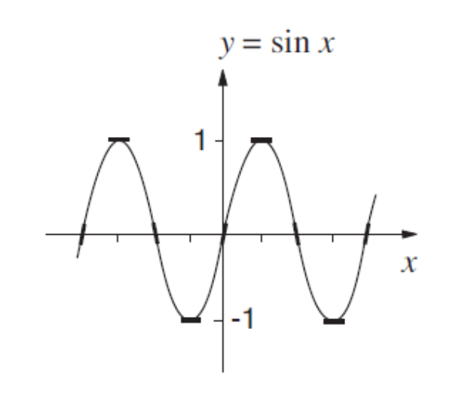
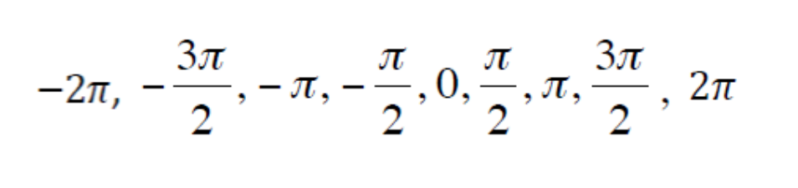
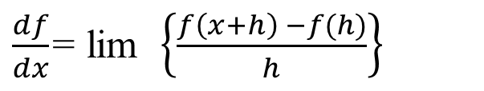
UNIT:
Even more Calculus
Section 1
Derivatives of Trig Functions
The derivative of a general function f(x) is given by
$\frac{df}{dx}$= lim $\left\{\frac{f\left(x+h\right) −f(h)}{h}\right\}$
h
0
You are going to obtain the derivatives of sin x, cos x, and tan x. Remember that the derivative of a function at a given point is given by the gradient of that function at the given point. Suppose you look at a sketch of the graph sin x and sketch in the tangents for values of x,
This is shown opposite.
Continued on next slide

Slide 4
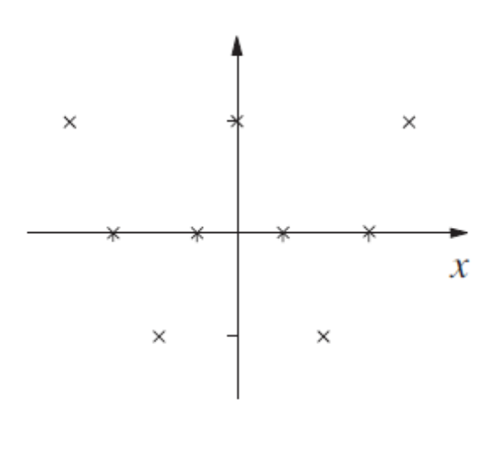
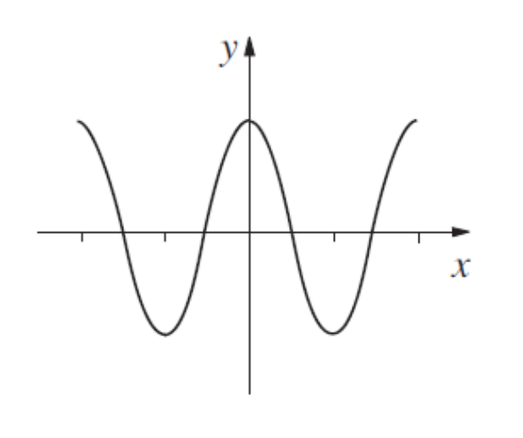
UNIT:
Even more Calculus
Section 1
Graphical Interpretation
Continued
These tangent values when plotted against x will look like the sketch opposite.
This suggests that the graph of the function for the tangent may be something like the sketch opposite which suggests that the derivative of sin x might be cos x, but this illustration is certainly not a proof.

Slide 5
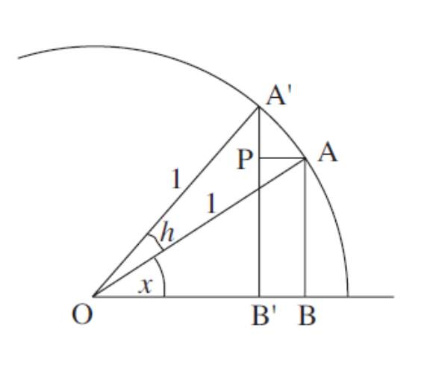
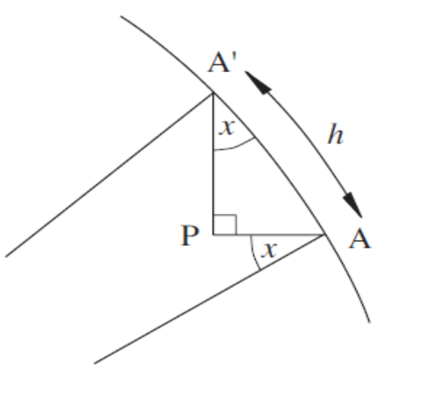
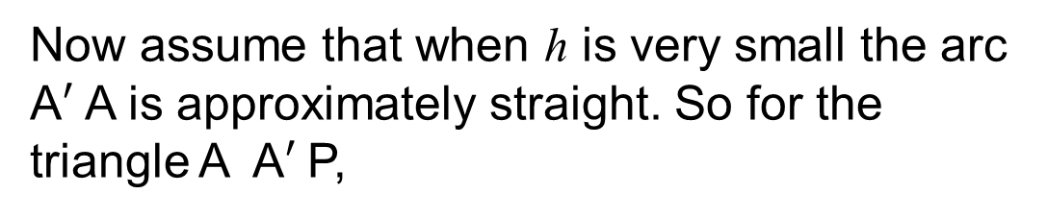
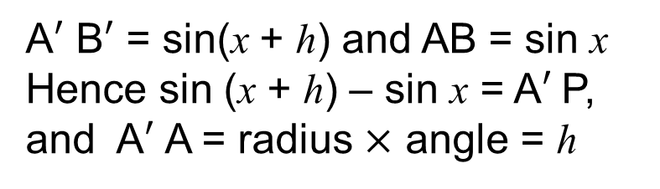
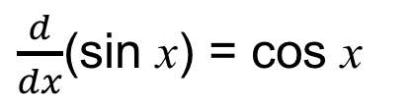
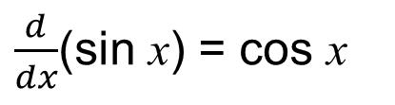
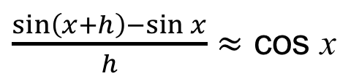
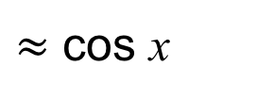
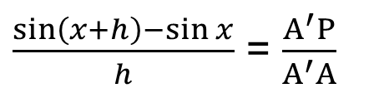
UNIT:
Even more Calculus
Section 1
Derivatives of Trig Functions
Geometric proof
It is also possible to use a circle of unit radius to show that, for example
$\frac{d}{dx}$(sin x) = cos x
In the diagram shown opposite h is small, and
A$′$ B$′$ = sin(x + h) and AB = sin x
Hence sin (x + h) – sin x = A$′$P,
and A$′$ A = radius $×$ angle = h
Now assume that when h is very small the arc A$′$ A is approximately straight. So for the triangle A A$′$P,
$\frac{\sin\left(x+h\right)−\sin{x}}{h}$ = $\frac{A^{′}P}{A^{′}A}$
$≈$ cos x
So, approximately, if h is very small
$\frac{\sin\left(x+h\right)−\sin{x}}{h}$ $≈$ cos x
And taking the limit as h 0,
$\frac{d}{dx}$(sin x) = cos x

Slide 6
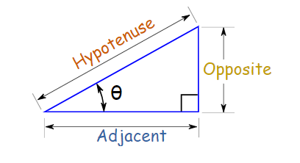
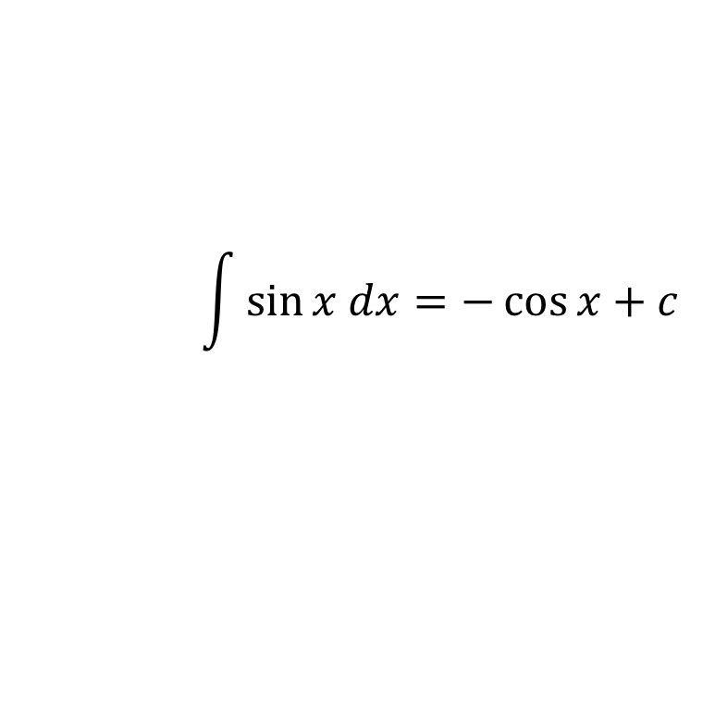
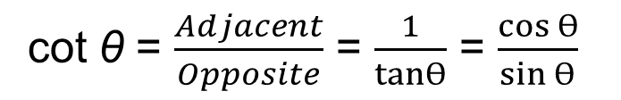
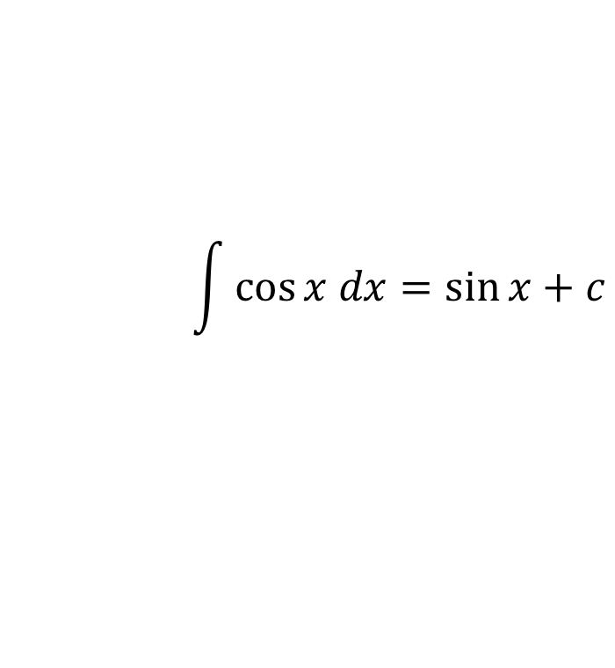
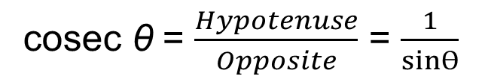
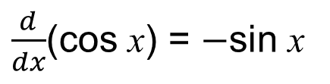
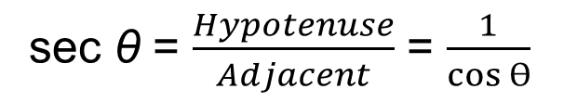
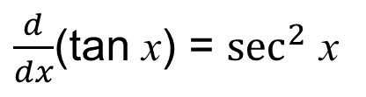
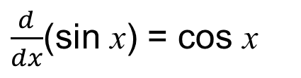
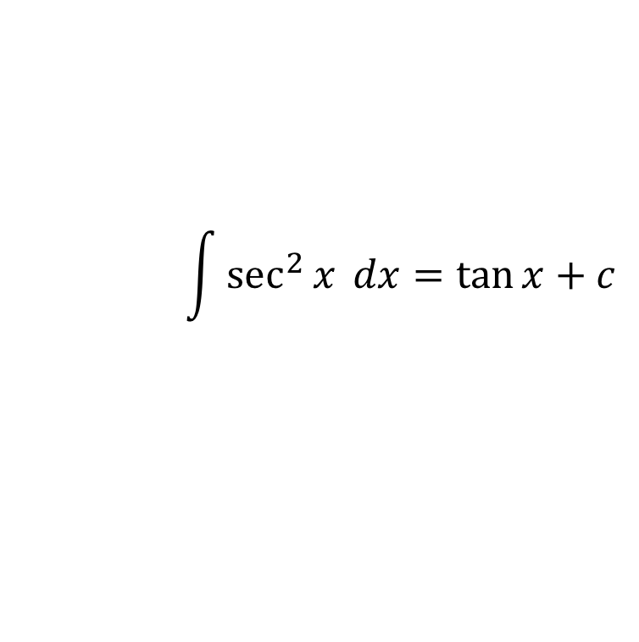
UNIT:
Even more Calculus
Section 1
Derivatives of Trig Functions: Key Results
Below are the three crucial derivatives and their inverse integration:
$\frac{d}{dx}$(sin x) = cos x
$\frac{d}{dx}$(cos x) = $−$sin x
$\frac{d}{dx}$(tan x) = $\sec^{2}$ x
$$\int{\cos{x dx=\sin{x}+c}}$$
$$\int{\sin{x dx=−\cos{x}+c}}$$
$$\int{\sec^{2}x{ dx=\tan{x}+c}}$$
Revision of secant, cotangent and cosecant
sec θ = $\frac{Hypotenuse}{Adjacent}$ = $\frac{1}{cos Ɵ}$
cot θ = $\frac{Adjacent}{Opposite}$ = $\frac{1}{tanƟ}$ = $\frac{cos Ɵ}{sin Ɵ}$
cosec θ = $\frac{Hypotenuse}{Opposite}$ = $\frac{1}{sinƟ}$

Slide 7
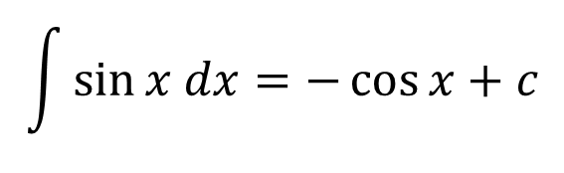
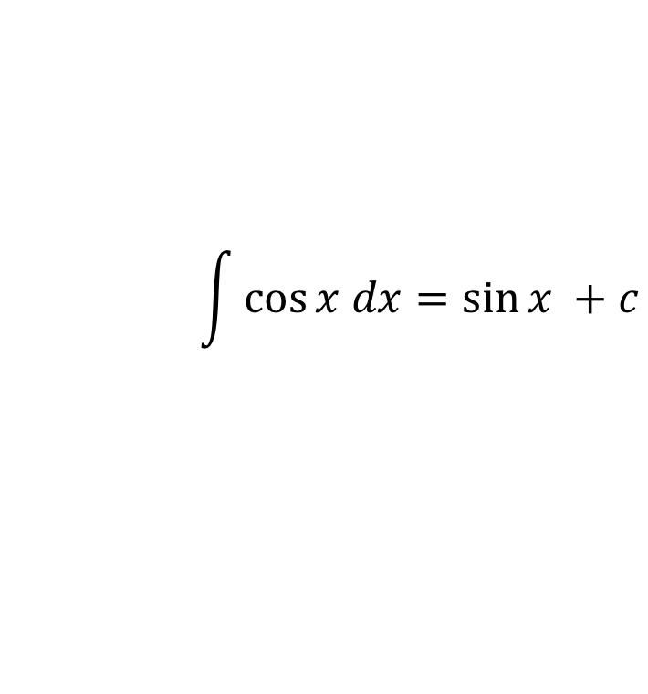
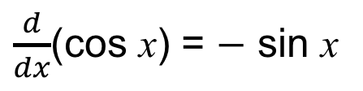
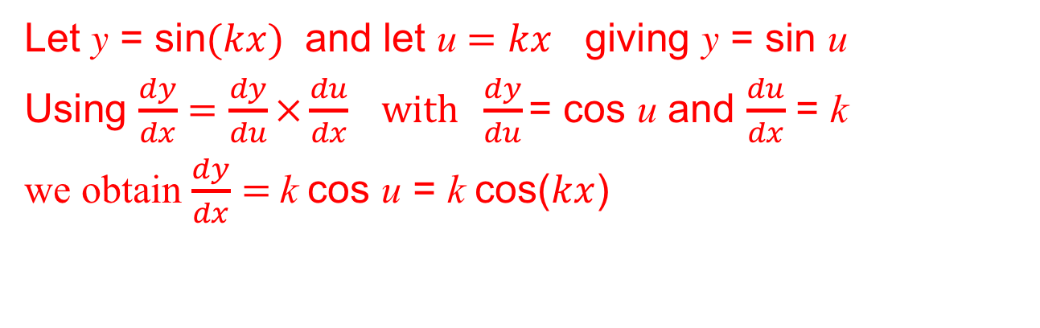
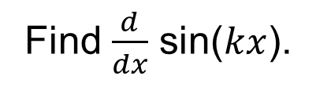
UNIT:
Even more Calculus
Section 1
Derivatives of Trig Functions: Example
$\frac{d}{dx}$(sin x) = cos x
$\frac{d}{dx}$(cos x) = $−$ sin x
$\frac{d}{dx}$(tan x) = $\sec^{2}$ x
$$\int{\cos{x dx=\sin{x }+c}}$$
$$\int{\sin{x dx=−\cos{x}+c}}$$
$$\int{\sec^{2}x{ dx=\tan{x}+c}}$$
Example
Find $\frac{d}{dx}$ sin($kx$).
Solution
Let y = sin($kx$) and let u $=kx$ giving y = sin u
Using $\frac{dy}{dx}=\frac{dy}{du}×\frac{du}{dx} with \frac{dy}{du}\text{= }\text{cos} \text{u}$ and $\frac{du}{dx}$ = k
we obtain $\frac{dy}{dx}=$k cos u = k cos($kx$)

Slide 8
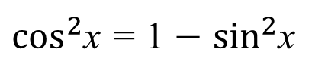
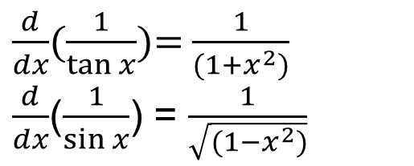
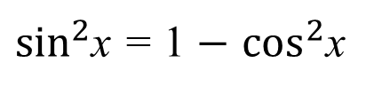
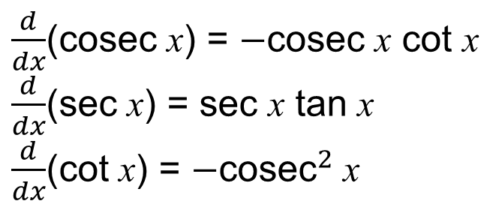

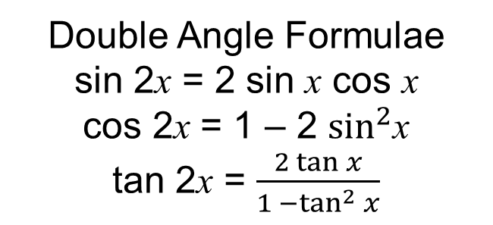
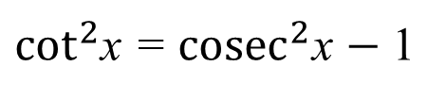
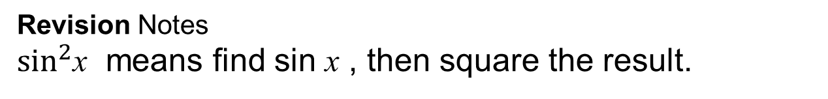
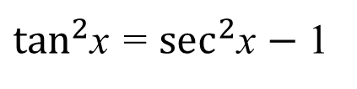
UNIT:
Even more Calculus
Section 1
Trig Revision and Formulae
Revision Notes
$\sin^{2}$x means find sin x , then square the result.
${sin⁡(x}^{2}$) means to square x, then the sine function.
As $\sin^{2}$x + $\cos^{2}$x =1
Double Angle Formulae
sin 2x = 2 sin x cos x
cos 2x = 1 – 2 $\sin^{2}$x
tan 2x = $\frac{2 tan x}{1 −\tan^{2} x}$
$\sin^{2}$x = 1 $−$ $\cos^{2}$x
$\cos^{2}$x = 1 $−$ $\sin^{2}$x
$\tan^{2}$x = $\sec^{2}$x $−$ 1
$\cot^{2}$x = ${cosec}^{2}$x $−$ 1
$\frac{d}{dx}$($\frac{1}{tan x}$)= $\frac{1}{(1+x^{2})}$
$\frac{d}{dx}$($\frac{1}{sin x}$) = $\frac{1}{\sqrt{(1−x^{2})}}$
$\frac{d}{dx}$(cosec x) = $−$cosec x cot x
$\frac{d}{dx}$(sec x) = sec x tan x
$\frac{d}{dx}$(cot x) = $−{\text{cosec}}^{2}$ x

Slide 9
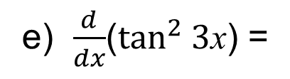
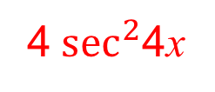
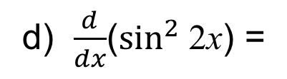
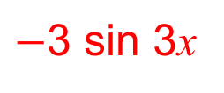
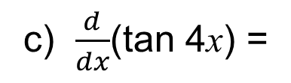
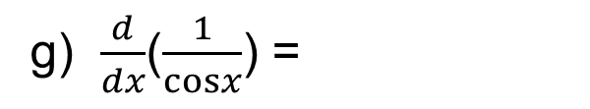
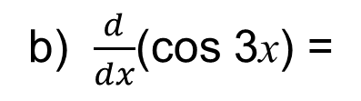
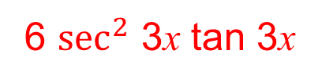
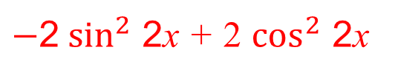
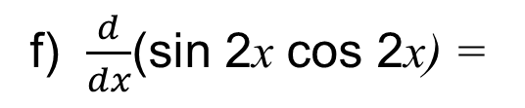

UNIT:
Even more Calculus
Section 1
Section 1: Fitness Check
a) $\frac{d}{dx}$(sin 2x) =
2 cos 2x
b) $\frac{d}{dx}$(cos 3x) =
$−$3 sin 3x
c) $\frac{d}{dx}$(tan 4x) =
4$\sec^{2}$4x
d) $\frac{d}{dx}$($\sin^{2}$ 2x) =
$$4 cos 2x sin 2x$$
e) $\frac{d}{dx}$($\tan^{2} 3$x) =
6 $\sec^{2}$ 3x tan 3x
f) $\frac{d}{dx}$(sin 2x cos 2x) =
$−$2$\sin^{2}$ 2x + 2 $\cos^{2}$ 2x
g) $\frac{d}{dx}$($\frac{1}{cosx}$) =
sec x tan x

Slide 10
UNIT:
Even more Calculus
Section 1
Section 1: Review
You have completed the first Section.
If you have completed and mastered this section,
click to start the next Section
If you need more examples and interactive practice,
press here
You might also find it helpful to look at:
Essential Information: press here

Slide 11
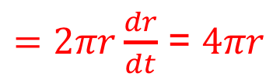
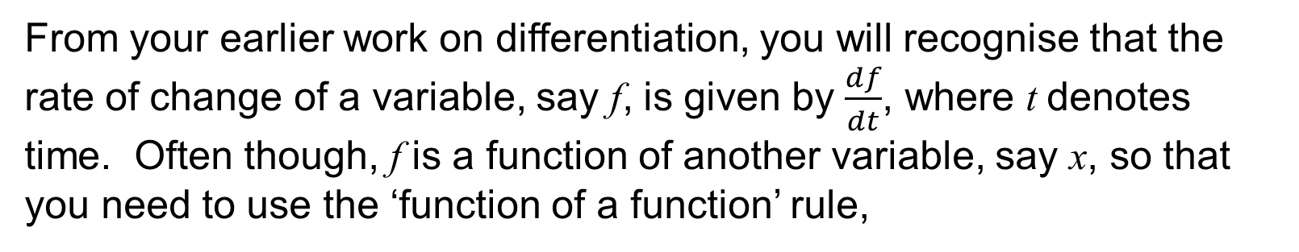
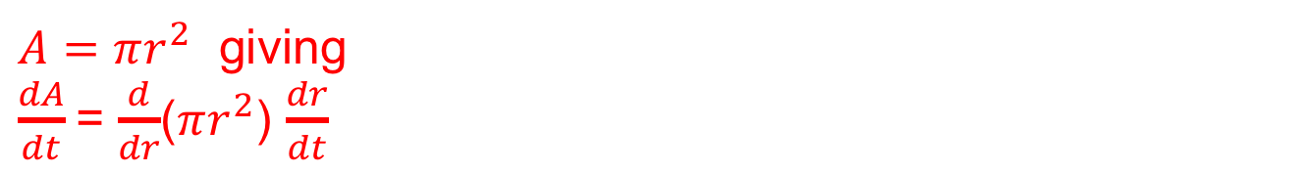




UNIT:
Even more Calculus
Section 2
Rates of Change
From your earlier work on differentiation, you will recognise that the rate of change of a variable, say f, is given by $\frac{df}{dt}$, where t denotes time. Often though, f is a function of another variable, say x, so that you need to use the ‘function of a function’ rule,
$$\frac{df}{dt}=\frac{df}{dx}\frac{dx}{dt}$$
Example 1
The radius of a circular oil slick is increasing at the rate of 2 m/s ($\frac{dr}{dt}$). Find the rate at which the area of the slick is increasing when its radius is a) 10 m, b) 50 m.
Solution
$A=πr^{2}$ giving
$\frac{dA}{dt}$= $\frac{d}{dr}$($πr^{2}$) $\frac{dr}{dt}$
$=2πr\frac{dr}{dt}$ = $4πr$
a) r = 10 m, $\frac{dA}{dt}$= $40π$
b) r = 50 m, $\frac{dA}{dt}$= $200π$

Slide 12















UNIT:
Even more Calculus
Section 2
Rates of Change: Examples
Example 2
A spherical balloon is blown up so that its volume increases at a constant rate of 10 ${cm}^{3}/$s ($\frac{dV}{dt}$). Find the rate of increase of the radius when the volume of the balloon is 1000 ${cm}^{3}$.
Solution
V$=\frac{4}{3} πr^{3}$
$$⟹$$
$\frac{dV}{dt}$= $\frac{d}{dr}$($\frac{4}{3} πr^{3}$) $\frac{dr}{dt}(using function of a function)$
= 4$πr^{2}$ $\frac{dr}{dt}$
$\frac{dV}{dt}$= 10
10 = (4$πr^{2}$) $\frac{dr}{dt}$
$\frac{dr}{dt}$ = $\frac{10}{\text{4}πr^{2}}$
$$⟹$$
$$⟹$$
Using V $=\frac{4}{3} πr^{3}$when volume is 1000 ${cm}^{3}$, the radius is given by
1000 = $\frac{4}{3} πr^{3}$
$r$ =$\sqrt[3]{\frac{3000}{\text{4}π}}$
$r$ =${(\frac{3000}{\text{4}π})}^{\frac{1}{3}}$
$$⟹$$
$$⟹$$
Hence, $\frac{dr}{dt}$ = $\frac{10}{\text{4}π}{(\frac{3000}{\text{4}π})}^{−\frac{2}{3}} ≈0.011 cm$/s

Slide 13













UNIT:
Even more Calculus
Section 2
Section 2: Fitness Check
1. A spherical balloon is inflated by gas being pumped at a constant rate of 200 ${\text{cm}}^{3}$/s. What is the rate of increase of the surface area of the balloon when its radius is 100 cm ?
Answer
$\frac{dv}{dt}$ = 200 ${\text{cm}}^{3}$/s.
$Hence \frac{dv}{dt}$ = $\frac{d}{dr}$ ($\frac{4}{3} πr^{3}$) $\frac{dr}{dt}$
200 = 4$πr^{2}$ $\frac{dr}{dt}$
$$⟹$$
$\frac{dr}{dt}$ = $\frac{200}{\text{4}πr^{2}}$
$$⟹$$
Surface area of a balloon = $\text{4}πr^{2}$.
$\frac{dA}{dt}$ = $\frac{d}{dr}$ ($\text{4}πr^{2}$) $\frac{dr}{dt}$
$\frac{dA}{dt}$ = $\frac{d}{dr}$ ($\text{4}πr^{2}$) $\frac{200}{\text{4}πr^{2}}$
$$⟹$$
$$⟹$$
$\frac{dA}{dt}$ = (8$π$r) $\frac{200}{\text{4}πr^{2}}$ = $\frac{400}{r}$
When r =100, $\frac{dA}{dt}$ = 4 ${\text{cm}}^{2}$/s.

Slide 14









UNIT:
Even more Calculus
Section 2
Section 2: Fitness Check
2. The volume of water in a container is given by ${xe}^{−2x}{\text{cm}}^{3}$where x is the depth of the water in the container.
a) Find the rate of increase of volume when the depth is 0.2 cm and increasing at a rate of 0.1 cm $s^{−1}$.
b) Also determine when the rate of increase of volume is stationary.
Answer
$${a) V=xe}^{−2x}{\text{cm} }^{3}$$
Using the product rule, $\frac{dv}{dx}$ =${ e}^{−2x}−{ 2xe}^{−2x}$
$\frac{dv}{dt}$ = $\frac{d}{dx}$(${xe}^{−2x}$) $\frac{dx}{dt}$
$\text{and} \text{when} \frac{dx}{dt}\text{ = 0.1}, \frac{dv}{dt}$ = (${ e}^{−2x}−{ 2xe}^{−2x}$) $\frac{1}{10}$
With x = 0.2 cm
$\frac{dv}{dt}$ = 0.0402 ${\text{cm}}^{3}$/s.
$b) \frac{dv}{dt}$ = (${ e}^{−2x}−{ 2xe}^{−2x}$) $\frac{1}{10}$ = 0
$$⟹$$
${ e}^{−2x}−{ 2xe}^{−2x}$= 0
$$⟹$$
$${ e}^{−2x}={ 2xe}^{−2x}$$
$$⟹$$
x = 0.5 cm

Slide 15
UNIT:
Even more Calculus
Section 2
Section 2: Review
You have completed the second Section.
If you have completed and mastered this section,
click to start the next Section
If you need more examples and interactive practice,
press here
You might also find it helpful to look at:
Essential Information: press here

Slide 16





UNIT:
Even more Calculus
Section 3
Integration by Substitution
This method is the equivalent to using a change of variable when differentiating composite functions.
In general, if
y $=\int{f(x)dx}$
then $\frac{dy}{ dx}=f\left(x\right).$
If we let x = g(u) for some function g of a new variable u, then y becomes a function of u and
$$\frac{dy}{du}=\frac{dy}{dx}×\frac{dx}{du}$$
$$\frac{dy}{du}=f(x)\frac{dx}{du}=f(g(u))\frac{dx}{du}$$
Then y =$\int{f\left(g\left(u\right)\right)\frac{dx}{du}du.}$

Slide 17






UNIT:
Even more Calculus
Section 3
Integration by Substitution: Examples
Example 1
Find $\int{x{(3x−1)}^{2}dx }$using a suitable substitution.
Solution
If u = 3x $−$1 then $\frac{du}{dx}$ = 3 and $x$ = $\frac{u+1}{3}$and the integral becomes
$\int{x{(3x−1)}^{2} \frac{dx}{du}du}$ = $\int{(\frac{u+1}{3})u^{2}\frac{du}{3}}$
= $\frac{1}{9}\int{{(u}^{3}+u^{2})du}$
= $\frac{1}{9}$ ( $\frac{u^{4}}{4}+\frac{u^{3}}{3} )+c$
= $\frac{1}{9}$ ( $\frac{{(3x−1)}^{4}}{4}+\frac{{(3x−1)}^{3}}{3} )+c$
= $\frac{{(3x−1)}^{4}}{36}+\frac{{(3x−1)}^{3}}{27}$ + c
Note: you could have expanded the bracket in the integral and then integrated term by term; you would, of course, get the same answer but not quite in the same form.

Slide 18







UNIT:
Even more Calculus
Section 3
Integration by Substitution: Examples
Example 2
Find $\int_{0}^{1}{{x(3x^{2}+2)}^{3}dx.}$
Solution
Let u = $3x^{2}+2$ giving $\frac{du}{dx}$ = 6x.
The limits on u for the integration are determined from:
x = 0 ⇒ u = 2
x = 1 ⇒ u = 5
Hence $\int_{0}^{1}{{x(3x^{2}+2)}^{3}dx}$ = $\int_{2}^{5}{{x(3x^{2}+2)}^{3}\frac{dx}{du}du }$
= $\int_{2}^{5}{{xu}^{3}\frac{1}{6x}du }$
= $\int_{2}^{5}{u^{3}\frac{1}{6}du }$
5
= $\left[\frac{1}{24}u^{4}\right]$
= $\frac{1}{24}\left[5^{4}−2^{4}\right]$
= $\frac{1}{24}$ (625 $−$16) = $\frac{609}{24}$
2

Slide 19



UNIT:
Even more Calculus
Section 3
Section 3: Fitness Check
1. Find$\int{e^{x}{(1+e^{x})}^{\frac{1}{2}} dx }\text{using} \text{the} \text{substitution} \text{u} \text{= 1 +}{ e}^{x}.$
$\frac{2{(1+e^{x})}^{\frac{3}{2}}}{3}$ + c
Answer
2. Using the substitution x = 3 tan θ, find $\int_{0}^{3}{\frac{1}{(9+x^{2})}}$ dx.
Answer
$$\frac{π}{12}$$
Note: For the limits, when x = 0, θ = 0 and when x = 3, θ = $\frac{π}{4}.$

Slide 20
UNIT:
Even more Calculus
Section 3
Section 3: Review
You have completed the third Section.
If you have completed and mastered this section,
click to start the next Section
If you need more examples and interactive practice,
press here
You might also find it helpful to look at:
Essential Information: press here

Slide 21






UNIT:
Even more Calculus
Section 4
Integration by Parts
Our second method of integration is a very important one which is particularly useful for a number of different integrals. You can see how it works by first differentiating with respect to x, $\frac{d}{dx}$(x sin x) = x + cos x.
Example
By assuming $\int{xe^{x}dx=\left(ax+b\right)e^{x}+c}$
find the values of the constants a and b so that the result is valid.
Solution
We differentiate both sides of the equation above to give:
$xe^{x}$= $\frac{d}{dx}$((a x + b)$e^{x}$+ c)
= (a x + b)$e^{x}$+a$e^{x}$+ 0 =
(a x + a + b)$e^{x}$
So comparing coefficients, a = 1 and a + b = 0 giving b = $−$1.
Hence, $\int{xe^{x}dx=\left(x−1\right)e^{x}+c.}$

Slide 22



UNIT:
Even more Calculus
Section 4
Integration by Parts
By now you should be wondering if there is a more precise method of evaluating integrals of the type above, where the method requires inspired guesswork to start with. In fact, there is a more formal method.
If u and v are two functions of x then from your work on differentiation, you know that:
$$\frac{d}{dx}\left(uv\right)=v\frac{du}{dx}+u\frac{dv}{dx}$$
If we take the formula above and integrate each side with respect to x, we get
$$uv=\int{v\frac{du}{dx}}dx+\int{u\frac{dv}{dx}dx}$$
$\int{u\frac{dv}{dx}dx}$ = $uv−\int{v\frac{du}{dx}}dx$

Slide 23










UNIT:
Even more Calculus
Section 4
Integration by Parts: Examples
$\int{u\frac{dv}{dx}dx}$ = $uv−\int{v\frac{du}{dx}}dx$
Example 1
Find $\int{x cosx dx.}$
Solution
Here u = x and $\frac{dv}{dx}$ = cos x, so v = sin x
$\int{x cos x dx}$ = x sinx $−$ $\int{sinx .1}dx$
= x sinx $−$ cosx +c
Example 2
Find $\int{xe^{x}dx.}$
Solution
Let u = x and $\frac{dv}{dx }$ = $e^{x}$, giving v = $e^{x}$
$$\int{xe^{x}dx=xe^{x}−\int{e^{x}dx}}$$
= $xe^{x}−e^{x}$+ c
= $e^{x}$(x $−$1)+ c

Slide 24













UNIT:
Even more Calculus
Section 4
Integration by Parts: Examples
Example 3
$\int{u\frac{dv}{dx}dx}$ = $uv−\int{v\frac{du}{dx}}dx$
Find $\int{ln x dx.}$
Solution
Let u = ln x and $\frac{dv}{dx }$ = 1, giving v = x
$\int{ln x dx}$ = x ln x $−$ $\int{x\frac{1}{x}}dx$
= x ln x – x + c
Example 4
Find $\int_{0}^{\frac{π}{2}}{x sinx }$dx.
Solution
Let u = x and $\frac{dv}{dx }$ = $\sin{x}$, giving v = $−$ cos x
$$\frac{π}{2}$$
$$\frac{π}{2}$$
$\int_{0}^{\frac{π}{2}}{x sinx }$= $\left[−x cos x\right]−\int{−cos x}dx$
0
0
$$\frac{π}{2}$$
= (0 $−$ 0)+ $\int{cos x}dx$
0
$$\frac{π}{2}$$
= $\left[sin x\right]$
= 1
0

Slide 25





UNIT:
Even more Calculus
Section 4
Section 4: Fitness Check
$\int{u\frac{dv}{dx}dx}$ = $uv−\int{v\frac{du}{dx}}dx$
1. Find$\int{\ln{x}dx.}$
Answer
$\int{\ln{x}dx=}$ x ln x – x +c
2. Find$\int{x^{2}sin⁡x dx}$.
Answer
$\int{x^{2}\sin{x}dx=}$ $2x sin x$ + $(2{−x}^{2}$) $cos x+c$

Slide 26
UNIT:
Even more Calculus
Section 4
Section 4: Review
You have completed the fourth Section.
If you have completed and mastered this section,
click to start the next Section
If you need more examples and interactive practice,
press here
You might also find it helpful to look at:
Essential Information: press here

Slide 27




UNIT:
Even more Calculus
Section 5
First Order Differential Equations
You might well wonder why you have studied integration in such depth. The main reason is the crucial role it plays in solving what are known as differential equations. Here you will only be dealing with first order differential equations, which can be expressed, in general, in the form
$$\frac{dy}{dx}=f(x,y)$$
when y = y(x) is an unknown function of x, and f is a given function of x and y.
Examples of such equations include
$$\frac{dy}{dx}=xy$$
$$\frac{dy}{dx}=x+y$$
$$\frac{dy}{dx}=\frac{x}{y}$$
(y ≠ 0)

Slide 28








UNIT:
Even more Calculus
Section 5
First Order Differential Equations: Examples
Example 1
For x ≥ 0, solve $\frac{dy}{dx}\text{=} \frac{x}{y}$ given that y = 1 when x = 0.
Solution
You can write this as y $\frac{dy}{dx}$= x
and integrating both sides with respect to x,
$$\int{y\frac{dy}{dx}}dx=\int{xdx}$$
$$\int{y dy}=\int{xdx}$$
$\frac{1}{2}y^{2}=\frac{1}{2}x^{2}$+ k
$$⟹$$
$$⟹$$
Since y = 1 when x = 0,
k = $\frac{1}{2}$
and $y^{2}=x^{2}+1$
hence the solution of the differential equation is y =$\sqrt{1+x^{2}}.$

Slide 29












UNIT:
Even more Calculus
Section 5
First Order Differential Equations: Examples
Example 2
Solve $\frac{dy}{dx}=\frac{y}{x}$
given that y = 1 when x = 1.
Solution
As before, $\frac{1}{y}\frac{dy}{dx}=\frac{1}{x}$
and we integrate both sides with respect to x,
$$\int{\frac{1}{y}\frac{dy}{dx}dx}=\int{\frac{1}{x}dx}$$
$$\int{\frac{1}{y}dy}=\int{\frac{1}{x}dx}$$
$$⟹$$
$$⟹$$
ln y = ln x + c
Writing the constant in the form c $=$ ln k , we have:
ln y $=$ ln x + ln k
$$⟹$$
ln y $=$ ln (k x)
$$⟹$$
y $=$ k x
Since y = 1 when x = 1 then k = 1, the solution is:
y$=$ x

Slide 30


UNIT:
Even more Calculus
Section 5
Section 5: Fitness Check
1. Solve 3y $\frac{dy}{dx}$= 5$x^{2}$ given that y = 1 when x = 0.
y =$\sqrt{(\frac{10x^{3}}{9}+1)}$
Answer
2. Solve $\frac{1}{(y+1)}\frac{dy}{dx}=\frac{1}{(x+1)}$
Answer
y = k x + k $−$ 1 , where k is a constant.

Slide 31
UNIT:
Even more Calculus
Section 5
Section 5: Review
You have completed the fifth Section.
If you have completed and mastered this last section,
click here for the Unit audit.
If you need more examples and interactive practice,
press here
You might also find it helpful to look at:
Essential Information: press here

