Slide 1
Supporting and Enhancing Mathematics and Statistics
UNIT: Data Collection

Slide 2
UNIT:
Data Collection
Section 1
Data Collection
Collecting data is a key part of Data Science.
Here we will introduce the concept and begin to show how data can be recorded.
There are three sections in this Unit, namely:
Questionnaires and Surveys
Sampling
Charts and Tables

Slide 3
UNIT:
Data Collection
Section 1
Questionnaires and Surveys
Key Aspects
What is the purpose of your questionnaire?
Questions must be non biased
Questions must be clear and unambiguous
Questions can result in qualitative or quantitative data
Always pilot any questionnaire

Slide 4
UNIT:
Data Collection
Section 1
Biased Questions
Are the questions on this questionnaire biased?
Are you concerned about the environment?
Are you concerned about the level of pollution caused by vehicles?
Do you think the health of young children is at risk due to exhaust fumes from vehicles?
Is there too much traffic congestion in towns?
Is public transport under-used?
Do you think vehicles should be banned from main shopping streets?
Yes, they are biased as they lead you to answer ‘Yes’ to the last question!

Slide 5
UNIT:
Data Collection
Section 1
Poor Questionnaire?
Why is this a poor questionnaire?
Many ways it could be improved; for example:
Major sports such as Football left off
Participants might have two sports as equal favourites
It might be more interesting to ask for their views of each sport using a scale of interest

Slide 6
UNIT:
Data Collection
Section 1
Sample Likert Scales for Responses
You can use what is termed a Likert scale to get responses to questions: see below
You could have more or less options but note that
for 4 options, there is no middle value.
You often see, for example at Airports, coloured button responses to reflect the service with the results
automatically saved and analysed.

Slide 7
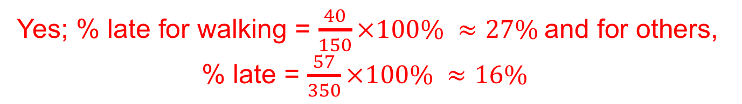
UNIT:
Data Collection
Section 1
Questionnaires and Surveys: Fitness Check
Louis thinks that learners who walk to school are more likely to be late than those who do not walk to school.
To test if his view is correct, he carries out a survey of 100 learners from Year 7 for 5 consecutive Tuesdays.
Here are his results.
1. Do the results support his view?
Yes; % late for walking = $\frac{40}{150}×100\% ≈27\%$and for others, % late = $\frac{57}{350}×100\% ≈16\%$
2. Suggest ways in which Louis could improve his survey.
Survey other days; how late would be useful; sample should be random.

Slide 8
UNIT:
Data Collection
Section 1
Section 1: Review
You have completed the first Section.
If you have completed and understood this section,
click to start the next Section.
If you need more examples and interactive practice,
press here.
You might also find it helpful to look at:
Essential Information: press here

Slide 9
UNIT:
Data Collection
Section 2
Sampling
When conducting a survey it is often impossible to ask every individual who might be concerned or involved. For example, for a political opinion poll it is only possible to ask a sample of the population how they would vote.
Population is used for any group for which information is required.
For example, the following could be populations:
• Plymouth Argyle Football Club supporters,
• Laptops produced in a factory,
• Adult voters in England,
• All students in your school or college
Conclusions are reached by looking at samples taken from a population.
There are many methods for selecting a sample from a population but we will look carefully at 3 of these here:
Random Stratified Systematic

Slide 10
UNIT:
Data Collection
Section 2
Random Sample
The sample is formed by selecting a number of members of the population at random.
It is important to make sure that each member of the population is equally likely to be selected.
Tables of random numbers* can be used to help this process but more mundane methods, such as using numbers from a telephone directory or even choosing a number from a hat of numbers, can be used.
Scientific calculators also provide you with random numbers.
* Note: the next slide has a table of random numbers.

Slide 11
UNIT:
Data Collection
Section 2
Random Numbers
To use this table, you start at a random number and move in any direction.
Example: Find a random sample of size 5 for a group of 60 learners.
Solution:
The learners are numbered:
01, 02, 03……..59, 60
Working from the start of the 7th row, taking the digits in pairs, we get:
14, 95, 40, 52, 34, 96, 60
We reject 95 and 96 as they are more than 60 to give the sample:
14, 40, 52, 34, 60

Slide 12
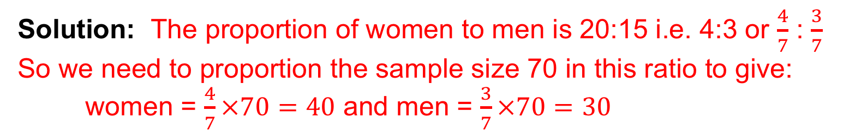
UNIT:
Data Collection
Section 2
Stratified Sample
This is an important method of sampling, particularly when the population under study is split into a number of distinct groups.
Random samples are taken from each group so that the ratio of the sizes of the sample is the same as the ratio of the number of members of the groups in the population.
For example, if a population contains 1000 women and 500 men, a stratified sample of total size 75 would contain 50 women and 25 men.
Example:
A population contains 2000 women and 1500 men. We require a stratified sample of total size 70. How many women and men would be needed?
Solution: The proportion of women to men is 20:15 i.e. 4:3 or $\frac{4}{7}$ : $\frac{3}{7}$
So we need to proportion the sample size 70 in this ratio to give:
women = $\frac{4}{7}×70=40$ and men = $\frac{3}{7}×70=30$

Slide 13
UNIT:
Data Collection
Section 2
Systematic Sample
This type of sample is formed by taking members of the population at regular intervals.
For example, by selecting every 5th or every 10th or every 20th member of the population, depending on the population number and sample size.
1. Mrs Powell
2. Mrs Grant
3. Mrs Clarke
4. Mrs Bailey
5. Mrs Miller
6. Mr Gordon
7. Mr Francis
8. Mr Brown
9. Mr Wright
10. Mr Gray
11. Mr Davis
12. Mr Lawrence
Example: There are 12 teachers in this small primary school. A sample of size 3 is to be selected using systematic sampling.
Solution: Selecting every 4th teacher, starting arbitrary with the third teacher gives:
Mrs Clarke, Mr Francis, Mr Davis
Notes: This is not a unique sample nor random as once the first teacher is chosen, there is not an equal chance for other teachers to be in the sample.

Slide 14
UNIT:
Data Collection
Section 2
Random Sample
In reality with only 12 teachers to sample, it would be easier to survey the complete population; we call this a CENSUS. As an example though, we will use the same data to obtain a random sample of size 3.
Example: Find a random sample of size 3 for this population.
1. Mrs Powell
2. Mrs Grant
3. Mrs Clarke
4. Mrs Bailey
5. Mrs Miller
6. Mr Gordon
7. Mr Francis
8. Mr Brown
9. Mr Wright
10. Mr Gray
11. Mr Davis
12. Mr Lawrence
Solution: We can select the numbers:
01, 02, 03, 04, 05, 06, 07, 08, 09, 10, 11, 12
from our table of random numbers.
The first 28 numbers in third row of the table, taken in pairs reads:
04, 92, 89, 43, 72, 12, 54, 52, 20, 08, 89, 91, 46, 44
giving: Mrs Bailey, Mr Lawrence, Mr Brown
Note: A more efficient use of random number table is to take 01 and every 12th number after it for Mrs Powell, that is the numbers 01, 13, 25, 37, 49, 61, 73, 85, 97, etc.

Slide 15
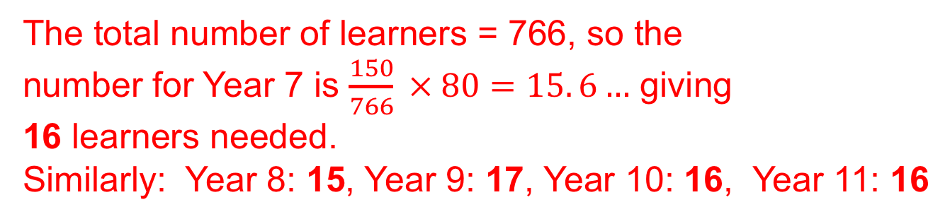
UNIT:
Data Collection
Section 2
Section 2: Fitness Check
1. What is the difference between a census and a sample?
A census consists of the complete population whereas a sample is a subgroup of the population.
2. What are the advantages of taking a sample?
The main advantages are that it is easier to implement, costs less and is easier to analyse.
3. This table shows the number of learners
in each school year. How many learners
should be selected from each year to
create a stratified sample of size 80?
The total number of learners = 766, so the
number for Year 7 is $\frac{150}{766} × 80=15. 6…$ giving
16 learners needed.
Similarly: Year 8: 15, Year 9: 17, Year 10: 16, Year 11: 16

Slide 16
UNIT:
Data Collection
Section 2
Section 2: Fitness Check
1. Mrs Powell
2. Mrs Grant
3. Mrs Clarke
4. Mrs Bailey
5. Mrs Miller
6. Mr Gordon
7. Mr Francis
8. Mr Brown
9. Mr Wright
10. Mr Gray
11. Mr Davis
12. Mr Lawrence
4. For these teachers, use
this following list of random
numbers to find a random
sample of size 4.
Taking pairs and working horizontally, the first 4 numbers needed are:
12, 10, 02, (reject 12), 01;
that is: Mr Lawrence, Mr Gray, Mrs Grant, Mrs Powell

Slide 17
UNIT:
Data Collection
Section 2
Section 2: Review
You have completed the second Section.
If you have completed and understood this section,
click to start the next Section.
If you need more examples and interactive practice,
press here.
You might also find it helpful to look at:
Essential Information: press here

Slide 18
UNIT:
Data Collection
Section 3
Charts and Tables
The chart can be used to show the mileage between some Scottish towns and cities.
What is the distances in miles between:
Fort William and Perth?
Edinburgh and Stranraer?
103
123
Which places are furthest apart?
Inverness and Stranraer: 249 miles

Slide 19
UNIT:
Data Collection
Section 3
Charts and Tables
In a school 37 learners took exams in both Mathematics and Physics.
Their results are given in this table:
a) How many got the same grade in both subjects?
b) How many obtained a higher grade in Physics
than in Mathematics?
c) Which was the most common grade in Physics?
10
11
7 (C)

Slide 20
UNIT:
Data Collection
Section 3
Section 3: Fitness Check
The table gives the distances, in kilometres, between some English towns and cities.
1. Nicole travels from Birmingham to Leeds and then to Manchester.
a) How far does she travel?
b) By how many km would the distance she travels be reduced if she went from Birmingham to Manchester and then to Leeds?
239 kms
43 kms

Slide 21
UNIT:
Data Collection
Section 3
Section 3: Fitness Check
2. The table shows the favourite sports selected by a
sample of learners each year in a secondary school.
In each year, each learner chose just one sport.
a) How many chose basketball in Year 8?
b) How many more chose football in Year 7 than in Year 10?
c) In which year was 'track and field’ the most popular sport?
7
6
Year 10

Slide 22
UNIT:
Data Collection
Section 3
Section 3: Review
You have completed the last Section.
If you have completed and mastered this last section,
click here for the Unit audit.
If you need more examples and interactive practice,
press here.
You might also find it helpful to look at:
Essential Information: press here

