Slide 1
Supporting and Enhancing Mathematics and Statistics
UNIT: Data Presentation

Slide 2
UNIT:
Data
Presentation
Data Presentation
Presenting data is an informative and helpful way is another key aspect of Data Science.
Here we consider some of the ways in which this can be done with aspects of data analysis.
There are five sections in this Unit, namely:
Pictograms and Bar Charts
Pie Charts
Line Graphs
Stem and Leaf Plots
Frequency Graphs: Histograms

Slide 3
UNIT:
Data
Presentation
Section 1
Data Presentation: Bar Charts
Here is some data for Manchester City, the winners of the Premier League in the 2018/19 season.
The table below gives their scoring record in their 38 matches (20 teams in the Premier League; each team plays every other team, at home and away).
4 | 1 | 1 | 2 | 1 | 1 | 2 | 2 | 3 | 1 | 1 | 6 | 2 | 3 | 1 | 3 | 3 | 2 | 3
1 | 2 | 3 | 0 | 2 | 3 | 4 | 3 | 6 | 1 | 5 | 0 | 2 | 5 | 3 | 2 | 1 | 6 | 2
What does this data show?
Overall Manchester City are good at scoring goals!
How can we illustrate this data to show its meaning?
We can make some progress by analysing the data using a tally table to show the frequency of each
number of goals scored in the 38 games played

Slide 4
UNIT:
Data
Presentation
Section 1
Tally Table
In a tally table each data item is shown as a vertical line (I).
Goals per match | Tally | Frequency
0 | II | 2
1 | IIII IIII | 10
2 | IIII IIII | 10
3 | IIII IIII | 9
4 | II | 2
5 | II | 2
6 | I | 3
Total number of matches |  | 38
After four data items, the fifth is indicated by a line drawn through the previous 4 and a space left before starting the next set of lines.
For example the entry IIII III
shows a frequency of 5 + 3 = 8
This gives some summary data; there are many ways of illustrating this.
What is missing though for you to make any useful conclusions?
We need to know not just how many goals were scored but how many were scored by the opposition in the games.

Slide 5
UNIT:
Data
Presentation
Section 1
Bar Chart
Here is a bar chart to illustrate the frequency of goals scored by Manchester City in the 2018/19 Premier League.
Number of goals

Slide 6
UNIT:
Data
Presentation
Section 1
Horizontal Bar Chart
Here is another bar chart but this has been turned round.

Slide 7
UNIT:
Data
Presentation
Section 1
Pictogram: Example
There are many other ways to display data; the aim is for someone to look at the display and have a good idea of what it is showing.
Here is a different type of data. The table below gives the number and colour of cars sold by a garage over a month.
How can this data be illustrated?
A pictograms is one possible way of showing this data.

Slide 8
UNIT:
Data
Presentation
Section 1
Pictogram to Illustrate Data
Here one car picture represents exactly 1 car.
Sometimes it might represent more if the numbers were much larger.
You have to look at the ‘key’ to the pictogram.

Slide 9
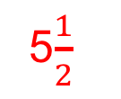
UNIT:
Data
Presentation
Section 1
Section 1: Fitness Check
1. The pictogram shows how many suitcases were sold by a store from 2013 to 2019, with one row missing.
2013
2014
2015
2016
2017
2018
2019
a) How many cases were sold in 2014?
b) What is the smallest number of cases sold in a year?
c) What is the greatest number of cases sold in a year?
d) In 2018 a total of 550 cases were sold.
How many suitcase symbols should be there?
400
250
700
5$\frac{1}{2}$

Slide 10
UNIT:
Data
Presentation
Section 1
Section 1: Fitness Check
2. The bar chart below shows the shoe sizes of a group of 15-year-old boys.
23
a) How many boys are there in the group?
b) Comment on the shape of the bar chart, saying whether or
not this is the shape you would expect.
We would expect there to be many more boys with shoe sizes around 8 and 9 than 5 or 12, so the results are surprising.

Slide 11
UNIT:
Data
Presentation
Section 1
Section 1: Review
You have completed the first Section.
If you have completed and understood this section,
click to start the next Section.
If you need more examples and interactive practice,
press here.
You might also find it helpful to look at:
Essential Information: press here

Slide 12
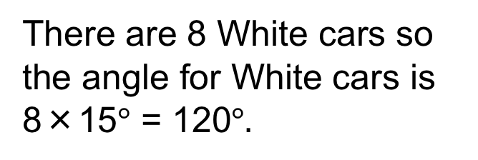

UNIT:
Data
Presentation
Section 2
Data Presentation: Pie Charts
We will use our colour of cars data from the first section.
To construct a pie chart, the angles around the circle must be in proportion to the number of cars of each colour. It is the AREA that represents the size of the data.
There are 24 cars in total and 360$°$ around the circle, so each car is represented by angle: 360$°$ ÷ 24 = 15$°$
There are 8 White cars so the angle for White cars is 8×15$°$ = 120$°.$
Colour | Number | Mutiplier | Angle
White | 8
Silver | 6
Blue | 6
Black | 2
Red | 2
15
15
15
15
15
120
90
90
30
30
We calculate the angles for each colour in the same way as in the table.

Slide 13
UNIT:
Data
Presentation
Section 2
Pie Chart for Colour of Cars
Using the angles calculated, here is the pie chart
This is a straightforward way of illustrating qualitative data (that is, the colour of cars); we will next look at how to illustrate quantitative data.

Slide 14


UNIT:
Data
Presentation
Section 2
Section 2: Fitness Check
This pie chart, not drawn to scale, shows the Saturday morning activities of a group of 120 children.
a) The sector for soccer is represented by an angle of 150°.
How many children play soccer on Saturday mornings?
b) Given that 46 children swim on Saturday mornings,
calculate the value of x.
Number = $\frac{150}{360}$ $× 120=50$
Angle x = $\frac{46}{120}$ $× 360°=138°$

Slide 15
UNIT:
Data
Presentation
Section 2
Section 2: Review
You have completed the second Section.
If you have completed and understood this section,
click to start the next Section.
If you need more examples and interactive practice,
press here.
You might also find it helpful to look at:
Essential Information: press here

Slide 16
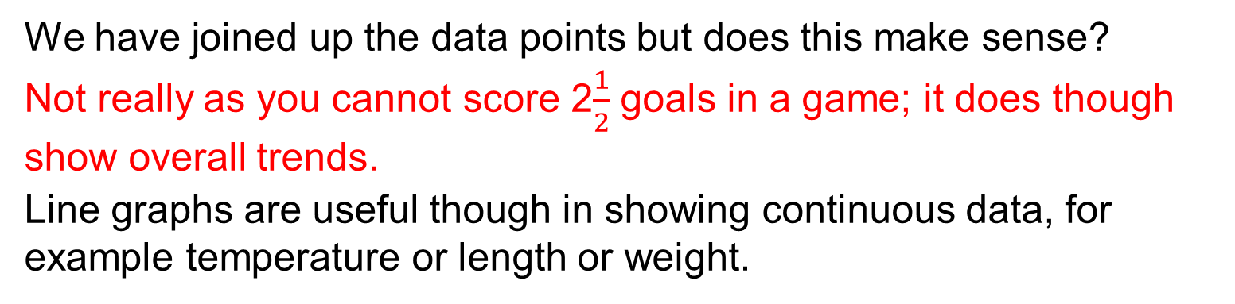
UNIT:
Data
Presentation
Section 3
Data Presentation: Line Graphs
Here is another way to illustrate the goals-scored data.
We have joined up the data points but does this make sense?
Not really as you cannot score 2$\frac{1}{2}$ goals in a game; it does though show overall trends.
Line graphs are useful though in showing continuous data, for example temperature or length or weight.

Slide 17

UNIT:
Data
Presentation
Section 3
Illustrating Temperature Data
Here is the average monthly temperature at Chichester.
$$°C$$
J F M A M J J A S O N D
A line graph does make sense here as the data trend can be seen; that is, increasing from Feb to Aug and then decreasing until the end of the year.

Slide 18



UNIT:
Data
Presentation
Section 3
Line Graphs: Example
Samuel recorded the temperature in his shed at 6 am each day for a week. His records are shown on this line graph.
a) What was the temperature on Wednesday?
b) What was the lowest temperature recorded?
c) What was the highest temperature recorded?
25$°C$
19$°C$
30$°C$

Slide 19
UNIT:
Data
Presentation
Section 3
Section 3: Fitness Check
This line graph shows how the height of a sunflower plant changed in the weeks after it was planted.
a) What was the height of the plant when planted?
b) How much did the plant grow in the first week?
c) What is the greatest height reached so far?
d) How long did it take to go from 54 to 78 cm?
8 cm
22 cm
84 cm
3 weeks

Slide 20
UNIT:
Data
Presentation
Section 3
Section 3: Review
You have completed the third Section.
If you have completed and understood this section,
click to start the next Section.
If you need more examples and interactive practice,
press here.
You might also find it helpful to look at:
Essential Information: press here

Slide 21
UNIT:
Data
Presentation
Section 4
STEM and LEAF Plots
Here is another very simple way which quickly gives an overall view of the general characteristics of the data. This is called a stem and leaf plot and here how it works.
Example:
The marks gained out of 50 by 15 pupils in a Biology test are as given below: 27, 36, 24, 17, 35, 18, 23, 25, 34, 25, 41, 18, 22, 24, 42
The stem and leaf plot uses 'tens' as the stem
and the 'units' as the leaf.
The leaf part is reordered
to give a final plot.
This gives at a glance an impression of the spread
and average of the marks.
STEM LEAF
0
1 7 8 8
2 7 4 3 5 5 2 4
3 6 5 4
4 1 2
STEM LEAF
0
1 7 8 8
2 2 3 4 4 5 5 7
3 4 5 6
4 1 2

Slide 22
UNIT:
Data
Presentation
Section 4
Times for One Mile
Example: Here are the times in minutes for a group of adults to walk or run one mile:
Illustrate the data in a stem and leaf plot; what can you say about the data?
Solution: We first list and secondly reorder
0 7 9 5 5 9
1 7 5 7 9 8 0 7 8 6 7 9
2 1 2 2 3 1 2 1 0
3 1
0 5 5 7 9 9
1 0 5 6 7 7 7 7 8 8 9 9
2 0 1 1 1 2 2 3 3
3 1
It looks as if one group ran (or at least jogged) while the other group just walked at varying speeds!

Slide 23
UNIT:
Data
Presentation
Section 4
Section 4: Fitness Test
Blood samples were taken from 40 blood donors and the lead concentration (mg per 100 ml) recorded.
a) Construct a stem and leaf plot to represent the data.
b) What are the values of the range and the median (middle) value?
a)
STEM LEAF
1 7 7 8 8 9
2 0 2 3 4 4 4 5 5 5 5 8 8 8 8
3 0 0 0 1 1 2 5 6 8 9
4 1 2 3 4 5 5
5 3 3
6 0 4 5
b) Range = 65 – 17= 48 and median = 30

Slide 24
UNIT:
Data
Presentation
Section 4
Section 4: Review
You have completed the fourth Section.
If you have completed and understood this section,
click to start the last Section.
If you need more examples and interactive practice,
press here.
You might also find it helpful to look at:
Essential Information: press here

Slide 25
UNIT:
Data
Presentation
Section 5
Histograms
For continuous data, when any value over a range of values is possible, a frequency graph like the one below can be used to illustrate the data.
This is called a histogram, and is characterised by having a continuous scale along the horizontal axis. Care must be taken about the end points. For example, the interval (in mins) would normally be 30 ≤ time < 35, so that a time of 35 minutes would be in the second interval.

Slide 26
UNIT:
Data
Presentation
Section 5
Using the Histogram
Problems:
How many people completed the Fun Run in
a) between 40 and 45 minutes
b) less than 40 minutes
c) less than one hour?
21
10 + 8 = 18
10 + 8 + 21 + 28 + 7 = 74

Slide 27
UNIT:
Data
Presentation
Section 5
Histogram: Worked Example
A group of students measured the reaction times of 50 other students. The times are given below, correct to the nearest hundredth of a second.
To draw a histogram, we first need to group the data:

Slide 28
UNIT:
Data
Presentation
Section 5
Histogram: Worked Example
Now we can draw the histogram, as below.
Frequency
Reaction Time(s)

Slide 29
UNIT:
Data
Presentation
Section 5
Section 5: Fitness Test
This histogram shows the weights of learners in a school.
Frequency
Weight (kg)
a) How many had a weight greater than 70 kg?
b) How many had a weight between 50 and 65 kg?
c) How many had a weight less than 50 kg?
d) How many learners were there in the school?
5
55
15
81

Slide 30
UNIT:
Data
Presentation
Section 5
Section 5: Review
You have completed the last Section.
If you have completed and mastered this last section,
click here for the Unit audit.
If you need more examples and interactive practice,
press here.
You might also find it helpful to look at:
Essential Information: press here

