Slide 1
Supporting and Enhancing Mathematics and Statistics
UNIT: Extending Probability

Slide 2
UNIT:
Extending
Probability
Extending Probability
This unit of work on probability is divided into the following four sections:
1. Multiplication for Independent Events
2. Mutually Exclusive Events
3. Tree Diagrams and Conditional Probability
4. Using Venn Diagrams to Find Probabilities

Slide 3
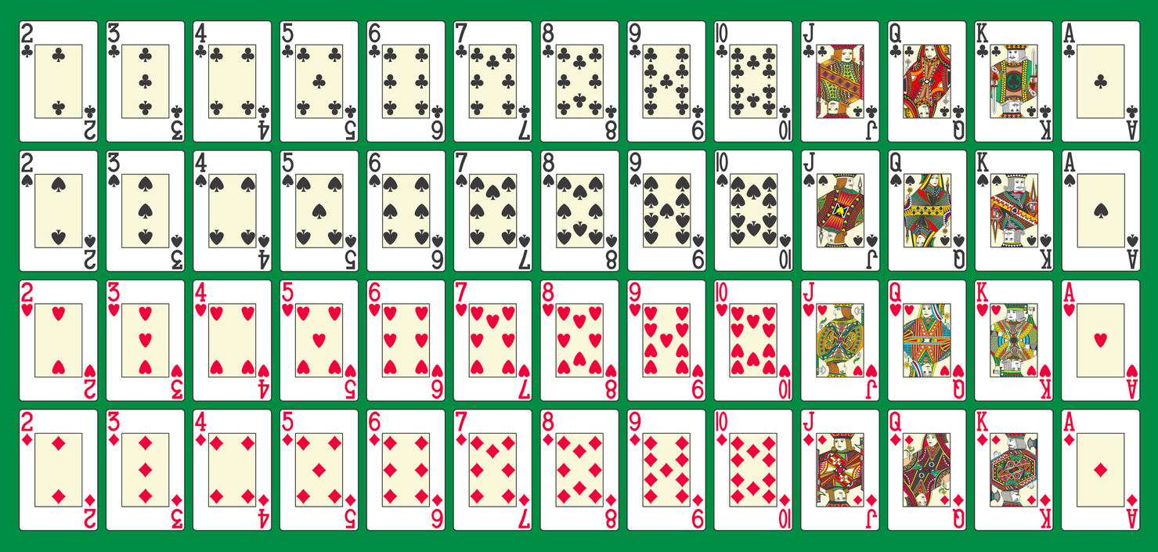
UNIT:
Extending
Probability
Section 4
Useful resource for this Unit
Here is a complete set of playing cards.
There are 13 cards in each of 4 suites and the suites are in 2 colours:
RED: Diamonds & Hearts BLACK: Clubs & Spades

Slide 4
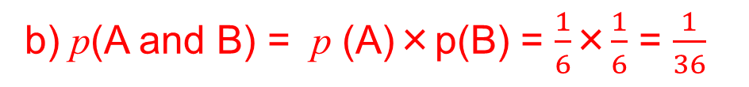
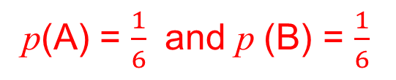
UNIT:
Extending
Probability
Section 1
Multiplication for Independent Events
Two events are independent if one event happening does not affect the probability of the other event. In this case the probability of two events A and B occurring is given by
p (A and B) = p(A) × p(B)
Example
A fair die is rolled twice. Event A is the ‘first roll shows a six’ and event B is ‘the second roll shows a six’.
a) Are events A and B independent?
b) Find p(A and B).
Solution
a) The events are independent as the number obtained on the first roll does not affect the second roll.
p(A) = $\frac{1}{6}$ and p (B) = $\frac{1}{6}$
b) p(A and B) = p (A)×p(B) = $\frac{1}{6}$×$\frac{1}{6}$ = $\frac{1}{36}$

Slide 5
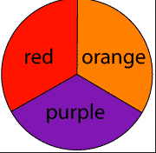

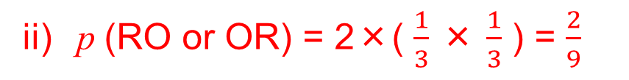
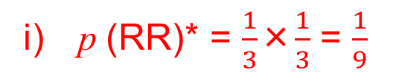
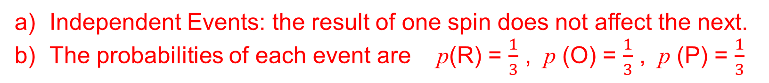
UNIT:
Extending
Probability
Section 1
Multiplication for Independent Events
Example
A spinner in game has 3 sections of equal size that are coloured red (R), orange(O) and purple(P).
a) When the spinner has been spun, are these events
independent?
b) Find the probability that when the spinner is spun twice, the following outcomes are obtained.
i) Red both times. ii) Red and orange in any order.
iii) Both are the same colour.
Solution
a) Independent Events: the result of one spin does not affect the next.
b) The probabilities of each event are p(R) = $\frac{1}{3}$ , p (O) = $\frac{1}{3}$ , p (P) = $\frac{1}{3}$
i) p (RR)* = $\frac{1}{3}$×$\frac{1}{3}$ = $\frac{1}{9}$
ii) p (RO or OR) = 2×( $\frac{1}{3}$ × $\frac{1}{3}$ ) = $\frac{2}{9}$
iii) p(RR or OO or PP) = $\frac{1}{9}$ + $\frac{1}{9}$ + $\frac{1}{9}$ = $\frac{3}{9}$ = $\frac{1}{3}$
* p (RR) means RED 1st time AND RED 2nd time

Slide 6
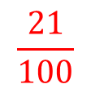
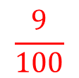
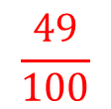

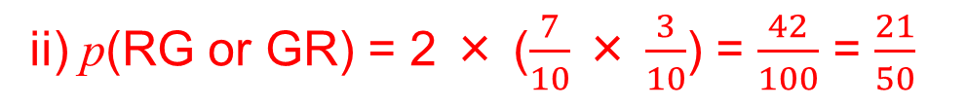

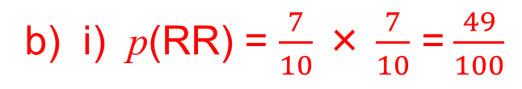
UNIT:
Extending
Probability
Section 1
Section 1: Fitness Check
1. A bag contains 7 red balls and 3 green balls. A ball is taken out and replaced. A second ball is then taken out. R is the event that a Red ball is selected. G is the event that a Green ball is selected.
a) Find the following probabilities:
i) p(R)
$$\frac{7}{10}$$
(ii) p(G)
$$\frac{3}{10}$$
iii) p(GG)
$$\frac{9}{100}$$
iv) p(RR)
$$\frac{49}{100}$$
v) p(GR)
$$\frac{21}{100}$$
b) Find the probability that if two balls are taken out in turn:
i) they are both red,
ii) they are different colours,
iii) they are the same colour.
Answers
b) i) p(RR) = $\frac{7}{10}$ × $\frac{7}{10}$ =$\frac{49}{100}$
ii) p(RG or GR) = 2 × ($\frac{7}{10}$ × $\frac{3}{10}$) = $\frac{42}{100}$ = $\frac{21}{50}$
iii) p(RR or GG) = ($\frac{7}{10}\text{×}\frac{7}{10}$) + ($\frac{3}{10}$ × $\frac{3}{10}$) = $\frac{49}{100}$+ $\frac{9}{100}$ = $\frac{58}{100}$

Slide 7
UNIT:
Extending
Probability
Section 1
Section 1: Fitness Check
2. The probability that Nigel is late for work is 0.2.
The probability that Karen is late for work is 0.3.
Assuming that these events are independent:
a) find the probability that they are both late for work;
b) find the probability that they are both on time;
c) find the probability that only one of them is late:
d) would your answer be the same in (a) if you knew that Karen was going to give Nigel a lift in her car?
Answers
a) 0.2×0.3 = 0.06
b) 0.8×0.7 = 0.56
c) 0.2×0.7 + 0.8 0.3 = 0.38
d) No. We do not know the chance of Karen arriving on time at
Nigel’s and the chance Nigel would be ready for his lift.

Slide 8
UNIT:
Extending
Probability
Section 1
Section 1: Review
You have completed the first section.
If you have completed and mastered this section,
click to start the next Section
If you need more examples and interactive practice,
press here
You might also find it helpful to look at:
Essential Information: press here

Slide 9
UNIT:
Extending
Probability
Section 2
Mutually Exclusive Events
If two events cannot happen or take place at the same time, then they are called mutually exclusive events. For example, when tossing a single coin the events 'heads' and 'tails' are mutually exclusive because they cannot both be obtained at the same time.
If A and B are mutually exclusive events then the probability of obtaining A or B is given by:
p(A or B) = p(A) + p (B)
Example 1
State whether or not the pairs of events described below are mutually exclusive.
a) Yes, they are mutually exclusive as a die CANNOT show a 6 and an odd number at the same time.
Solution
a) A: A die is rolled and shows a 6.
B: A die is rolled and shows an odd number.
b) A: Selecting a child with blue eyes from a class.
B: Selecting a left-handed person from a class.
(b) No, not mutually exclusive as both CAN happen at the same time.

Slide 10
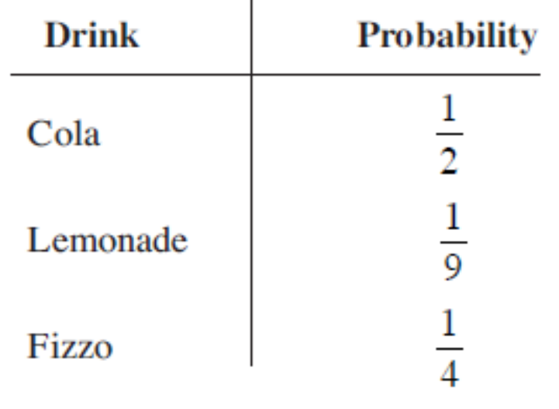
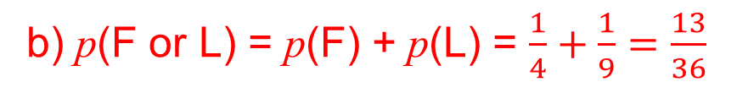
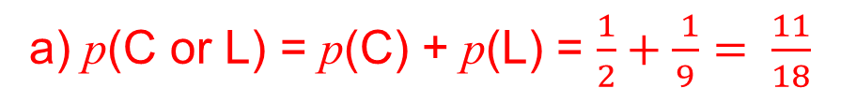
UNIT:
Extending
Probability
Section 2
Mutually Exclusive Events
Example 2
When Andrew buys a can of drink the probabilities of selecting particular brands are given in the table opposite.
Find the probabilities that he selects:
Cola or Lemonade (C or L)
Fizzo or Lemonade (F or L)
None of the drinks listed above.
p(No Events) = 1 – p (Events)
Solution
a) p(C or L) = p(C) + p(L) = $\frac{1}{2}+\frac{ 1}{9}= \frac{11}{18}$
b) p(F or L) = p(F) + p(L) = $\frac{1}{4}+\frac{1}{9}=\frac{13}{36}$
c) 1 – p(C or L or F) = 1 – {p(C) + p(L) + v(F)} = 1 – ( $\frac{1 }{2}+\frac{1}{9}+\frac{1}{4} )=\frac{5}{36}$

Slide 11
UNIT:
Extending
Probability
Section 2
Section 2: Fitness Check
1. When Plymouth Argyle football team play in a league match the probability that they win is 0.4 and the probability that they draw is 0.3. What is the probability that they lose?
Answer
p(lose) = 1 – (p(win ) + p(draw) ) = 1 – ( 0.4 + 0.3 ) = 0.3
2. Decide if each pair of events A and B given below are mutually exclusive:
a) A: Winning a football match.
B: Losing a football match.
b) A: Selecting a diamond from a pack of playing cards.
B: Selecting a King from a pack of playing cards.
Mutually Exclusive
Not Mutually
Exclusive
Note: a full pack of playing cards is shown at the start of this Unit.

Slide 12
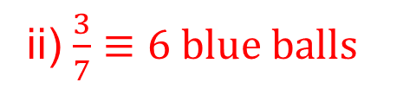

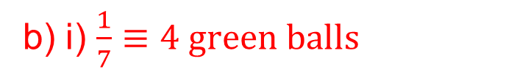
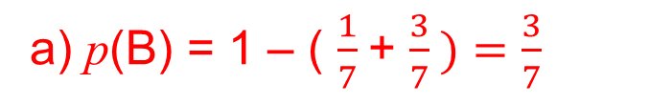

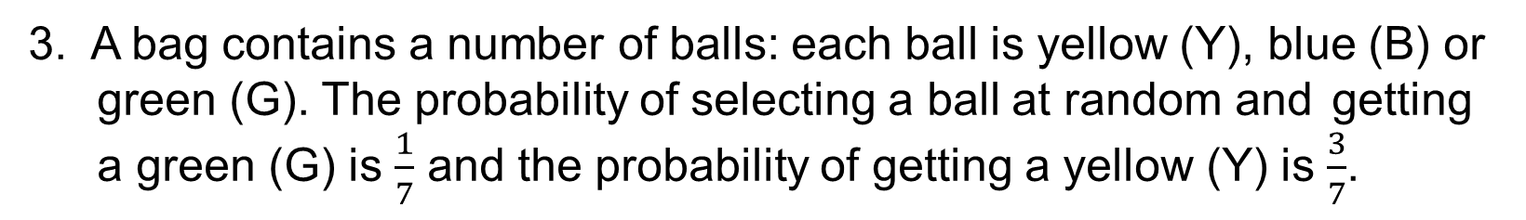

UNIT:
Extending
Probability
Section 2
Section 2: Fitness Check
3. A bag contains a number of balls: each ball is yellow (Y), blue (B) or green (G). The probability of selecting a ball at random and getting a green (G) is $\frac{1}{7}$ and the probability of getting a yellow (Y) is $\frac{3}{7}$.
a) What is the probability of getting a blue ball?
i) If the bag contained 4 green balls, how many yellow balls did
it contain?
ii) If the bag contained 6 blue balls, how many balls did the bag
contain in total?
Answers
a) p(B) = 1 – ( $\frac{1}{7}$+ $\frac{3}{7} )=\frac{3}{7}$
b) i) $\frac{1}{7}≡4 green balls$
Hence $\frac{3}{7} ≡ 3×4 balls =12 yellow balls$
ii) $\frac{3}{7}≡6 blue balls$
Hence $\frac{1}{7} ≡ 2 balls$
and $\frac{7}{7} ≡ 7×2 balls=14 balls$

Slide 13
UNIT:
Extending
Probability
Section 2
Section 2: Review
You have completed the second section.
If you have completed and mastered this section,
click to start the next Section
If you need more examples and interactive practice,
press here
You might also find it helpful to look at:
Essential Information: press here

Slide 14
UNIT:
Extending
Probability
Section 3
Tree Diagrams and Conditional Probability
The probabilities of certain events may change as a result of earlier events.
For example, if it rains today, the probability that it rains tomorrow may be greater than if it was sunny today.
When using a tree diagram, check that the probabilities do not change as a result of the first event.
When probabilities depend on previous events they are called conditional probabilities.

Slide 15
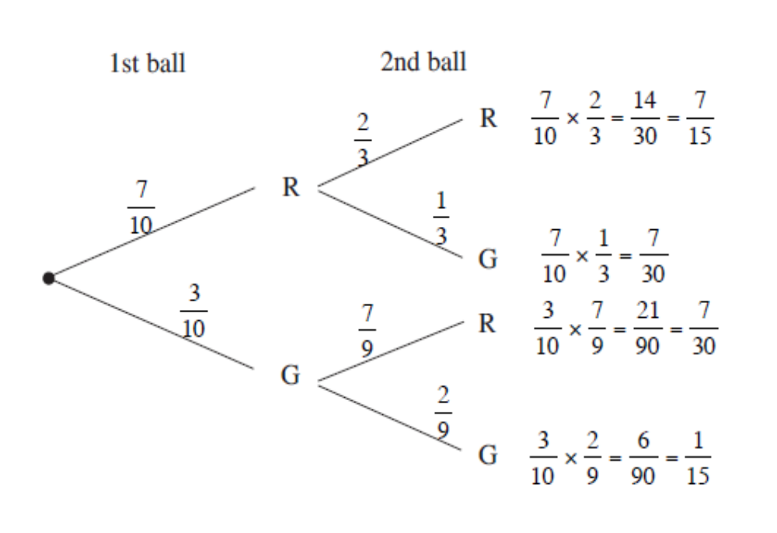
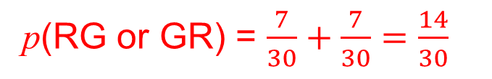
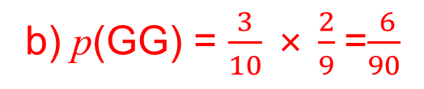
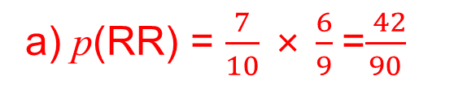
UNIT:
Extending
Probability
Section 3
Tree Diagrams and Conditional Probability
Example 1
A bag contains 7 red balls (R) and 3 green balls (G). Two balls are taken from the bag. Find the probabilities that they are:
a) both red
b) both green
c) one red and one green.
Solution
a) p(RR) = $\frac{7}{10}$ × $\frac{6}{9}$=$\frac{ 42}{90}$
b) p(GG) = $\frac{3}{10}$ × $\frac{2}{9}$=$\frac{ 6}{90}$
c) Using the tree diagram
p(RG or GR) = $\frac{7}{30}+\frac{7}{30}=\frac{14}{30}$

Slide 16
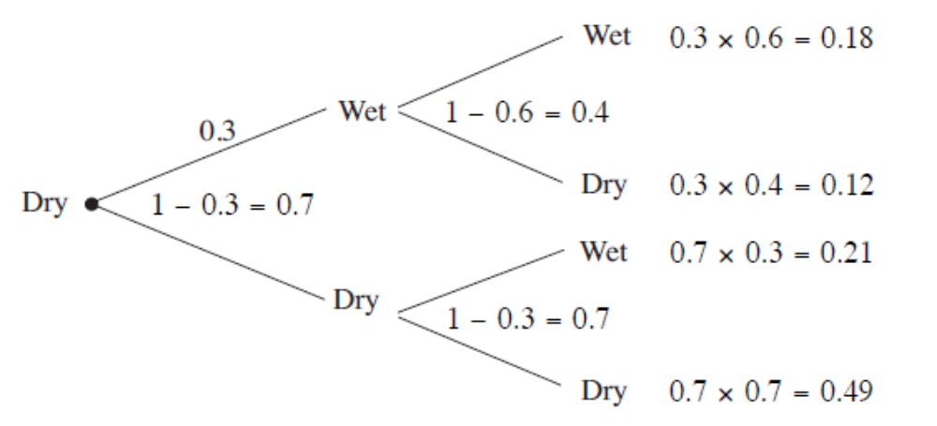
UNIT:
Extending
Probability
Section 3
Tree Diagrams and Conditional Probability
Example 2
Weather experts estimate the probability of rain any day as 0.6 if it rained the previous day and 0.3 if it did not rain the previous day.
Find the probability that a dry day is followed by,
two more dry days, b) two wet days,
c) one wet day and one dry day in either order.
Solution
a) 0.7×0.7 = 0.49
b) 0.3×0.6 = 0.18
c) (0.3×0.4) + (0.7×0.3)
= 0.12 + 0.21 = 0.33

Slide 17
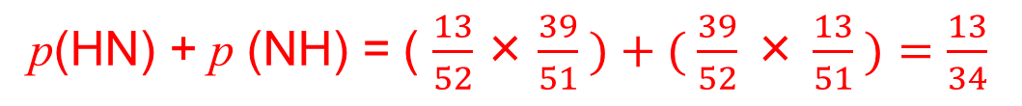
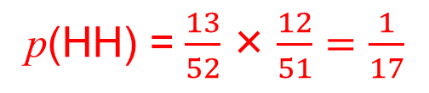
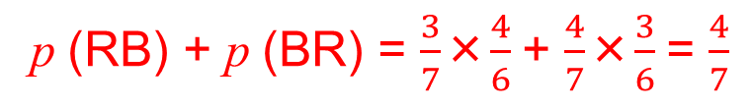
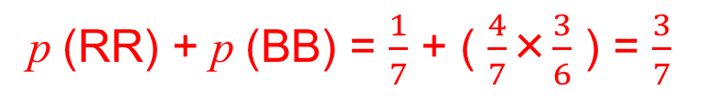
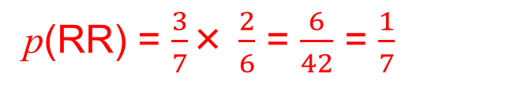
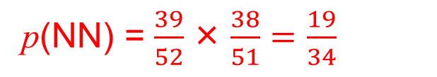
UNIT:
Extending
Probability
Section 3
Section 3: Fitness Check
A bag contains 3 red counters (R) and 4 blue counters (B).
Two counters are taken out of the bag. Find the probability that
a) both are red,
p(RR) = $\frac{3}{7}$× $\frac{2}{6}$ = $\frac{6}{42}$ = $\frac{1}{7}$
b) both counters are the same colour,
p (RR) + p (BB) = $\frac{1}{7}$ + ( $\frac{4}{7}$×$\frac{3}{6}$ ) = $\frac{3}{7}$
c) the counters are different colours.
p (RB) + p (BR) = $\frac{3}{7}$×$\frac{4}{6}$+ $\frac{4}{7}$×$\frac{3}{6}$= $\frac{4}{7}$
A card is drawn at random from a full pack of playing cards.
It is not put back. A second card is then drawn from the same pack.
Find the probability that:
Note: a full pack of
playing cards is
shown at the start
of this Unit.
a) both cards are hearts,
p(HH) = $\frac{13}{52}\text{×}\frac{12}{51}=\frac{1}{17}$
b) only one card is a heart,
p(HN) + p (NH) = ( $\frac{13}{52}\text{×}\frac{39}{51} )+( \frac{39}{52}$ × $\frac{13}{51} )=\frac{13}{34}$
c) neither card is a heart.
p(NN) = $\frac{39}{52}\text{×}\frac{38}{51}=\frac{19}{34}$

Slide 18
UNIT:
Extending
Probability
Section 3
Section 3: Fitness Check
3. The probability that a football team win their next match is:
0.3 if they won their last match
0.8 if they lost their last match.
a) Find the probability that if a match is lost, the next two will be won.
b) Find the probability that if a match is won, the next two will also be won.
a) p(WW) = 0.8×0.3 = 0.24
0.3
W
WW
b) p(WW) = 0.3×0.3 = 0.09
W
0.7
L
WL
0.8
W
LW
L
c) p(WL) = 0.3×0.7 = 0.21
0.2
L
LL
c) Find the probability that if a match is won, the next two will be won and lost in that order.

Slide 19
UNIT:
Extending
Probability
Section 3
Section 3: Review
You have completed the third section.
If you have completed and mastered this section,
click to start the next Section
If you need more examples and interactive practice,
press here
You might also find it helpful to look at:
Essential Information: press here

Slide 20
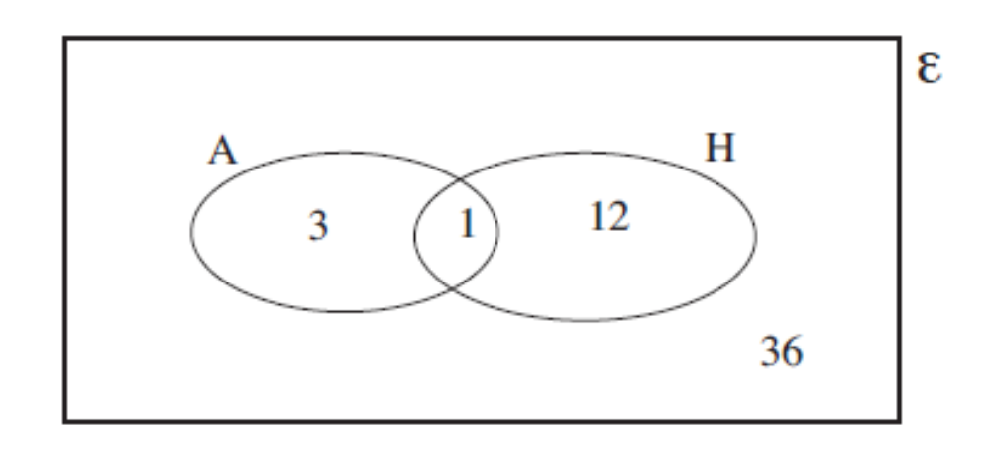
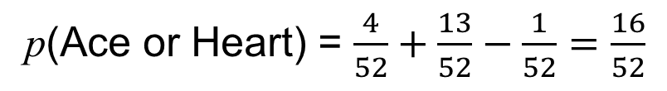
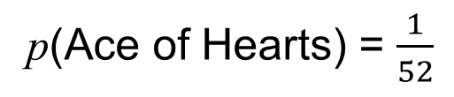
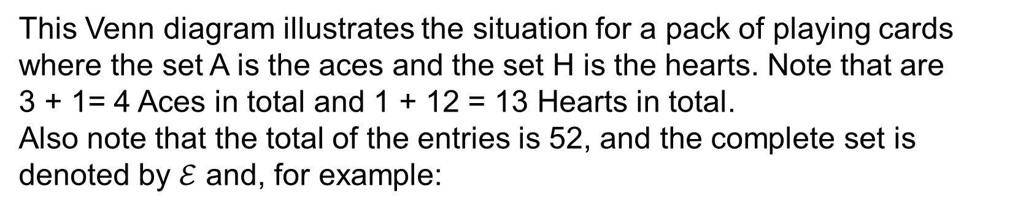
UNIT:
Extending
Probability
Section 4
Using Venn Diagrams to Find Probabilities
Venn diagrams can be used to help find probabilities when events are not mutually exclusive.
Note: a complete
set of playing cards in
shown at the start of
this Unit.
This Venn diagram illustrates the situation for a pack of playing cards where the set A is the aces and the set H is the hearts. Note that are
3 + 1= 4 Aces in total and 1 + 12 = 13 Hearts in total.
Also note that the total of the entries is 52, and the complete set is denoted by $ℰ$ and, for example:
p(Ace of Hearts) = $\frac{1}{52}$
p(Ace or Heart) = $\frac{4}{52}+\frac{13}{52}−\frac{1}{52}=\frac{16}{52}$

Slide 21
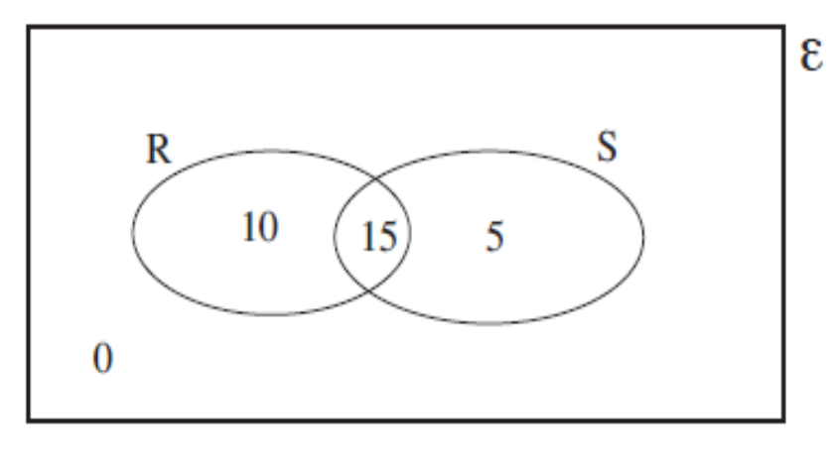
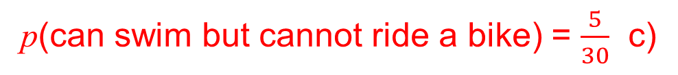
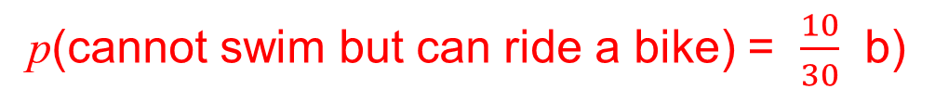
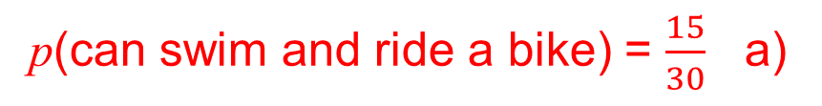
UNIT:
Extending
Probability
Section 4
Using Venn Diagrams to Find Probabilities
Example 1
In a class of 30 children there are 20 who can swim and 25 who can ride a bike. There is no child who cannot swim nor ride a bike.
Draw a Venn diagram and find the probabilities that a child selected at random:
a) can swim and ride a bike,
b) cannot swim but can ride a bike,
c) can swim but cannot ride a bike.
Solution
Let R represent the set of children that can ride a bike and S represent the set of children that can swim.
As 20 + 25 = 45 and 45 – 30 = 15 there must be 15 in the intersection
p(can swim and ride a bike) = $\frac{15}{30}$ a)
p(cannot swim but can ride a bike) = $\frac{10}{30}$ b)
p(can swim but cannot ride a bike) = $\frac{5}{30}$ c)

Slide 22
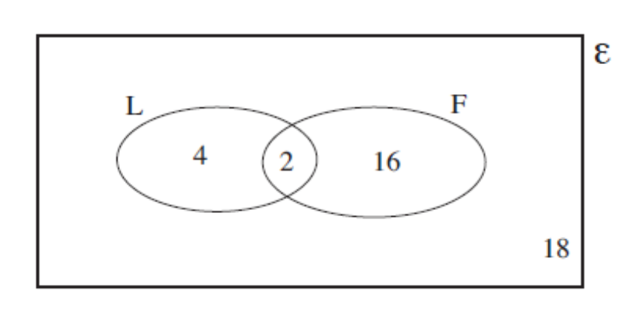
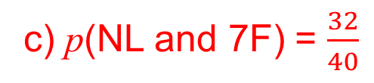
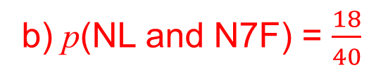
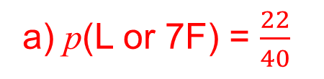
UNIT:
Extending
Probability
Section 4
Using Venn Diagrams to Find Probabilities
Example 2
In a group of 40 students, 6 are left-handed, 18 have size 7 feet and
2 are left-handed with size 7 feet. Draw a Venn diagram and find the probability that a student is:
a) left-handed or has size 7 feet,
b) not left-handed and does not have size 7 feet,
c) not left-handed and has size 7 feet.
Solution
The number 2 is placed in the intersection.
In F we have 18 − 2 = 16 and In L we have 6 − 2 = 4.
Outside we have 40 − (4 + 2 +16) = 18.
a) p(L or 7F) = $\frac{22}{40}$
b) p(NL and N7F) = $\frac{18}{40}$
c) p(NL and 7F) = $\frac{32}{40}$

Slide 23
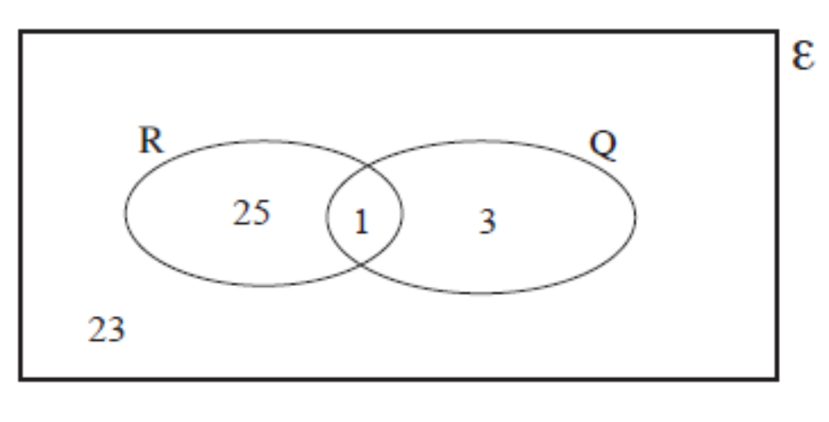
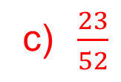
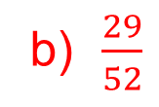
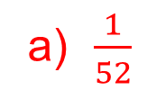
UNIT:
Extending
Probability
Section 4
Section 4: Fitness Check
1. When a card is selected at random from a full pack, two events are:
R: A red card is selected,
Q: A queen is selected.
Draw a Venn diagram and use it to find the probabilities that a card is:
a) a red queen b) red or a queen c) not red and not a queen.
Answers
a) $\frac{1}{52}$
b) $\frac{29}{52}$
c) $\frac{23}{52}$
Note: a full pack of playing cards is shown at the start of this Unit.

Slide 24
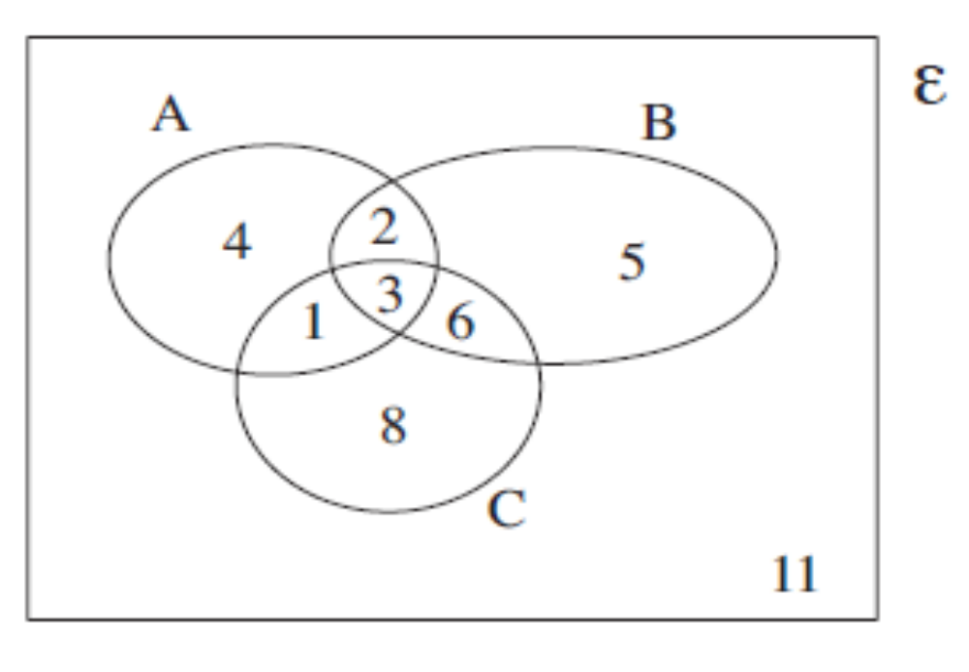


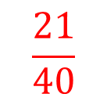


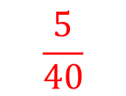
UNIT:
Extending
Probability
Section 4
Section 4: Fitness Check
2. The following Venn diagram shows the number of students taking the modules A, B and C. From the Venn diagram find:
$$\frac{3}{40}$$
a) p(A and B and C)
b) p(A or B)
c) p(A or C)
$$\frac{21}{40}$$
$$\frac{24}{40}$$
d) p(A or B or C)
e) p(A and B)
f) p(A)
$$\frac{29}{40}$$
$$\frac{5}{40}$$
$$\frac{10}{40}$$

Slide 25
UNIT:
Extending
Probability
Section 4
Section 4: Review
You have completed the fourth section.
If you have completed and mastered this last section,
click here for the Unit audit
If you need more examples and interactive practice,
press here
You might also find it helpful to look at:
Essential Information: press here

