Slide 1
Supporting and Enhancing Mathematics and Statistics
UNIT: Probability and Binomial Distributions

Slide 2
UNIT:
Probability and Binomial Distributions
Section 1
Methods of Central Tendency
This gives an introduction to Probability Distributions and gives details of the Binomial Distribution, which is a very important and relevant application in Probability and Statistics.
There are six sections in this unit, namely:
Expectation
Variance
Probability Distributions
The Uniform Distribution
Developing the Binomial Distribution
The Mean and Variance of the Binomial Distribution

Slide 3
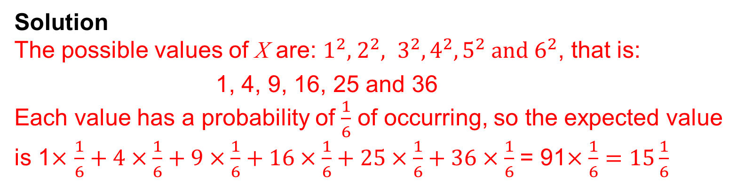
UNIT:
Probability and Binomial Distributions
Section 1
Expectation
You are probably familiar with experiments in probability, for example throwing a dice, and maybe with the concept of expectation. We will use a simple experiment to introduce the concept of expectation.
Example
When throwing a normal dice, let X be the random variable:
X is the “square of the score shown on the dice”.
What is the expected value of X ?
Solution
The possible values of X are: $1^{2}, { 2}^{2}, 3^{2}, 4^{2}, 5^{2} and 6^{2}$, that is:
1, 4, 9, 16, 25 and 36
Each value has a probability of $\frac{1}{6}$ of occurring, so the expected value is 1$×$ $\frac{1}{6}+4×\frac{1}{6}+9×\frac{1}{6}+16×\frac{1}{6}+25×\frac{1}{6}+36×\frac{1}{6}$ = 91$×\frac{1}{6}=15\frac{1}{6}$

Slide 4
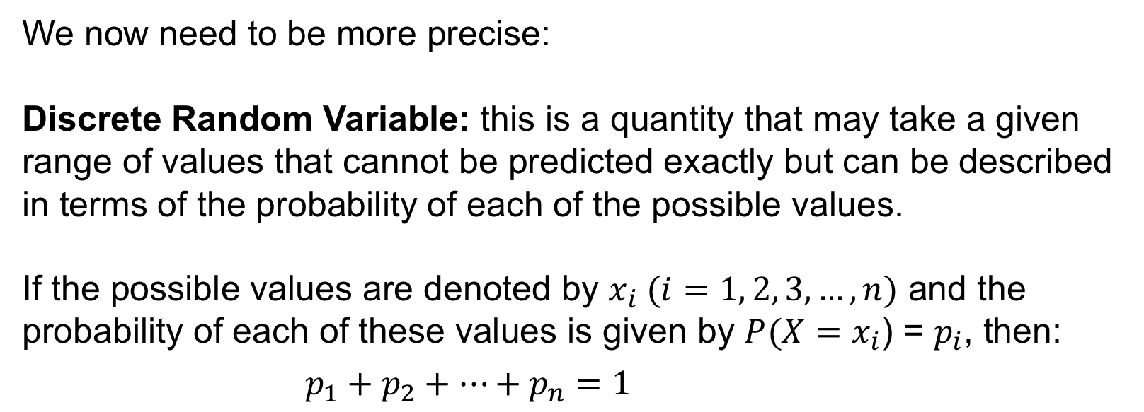
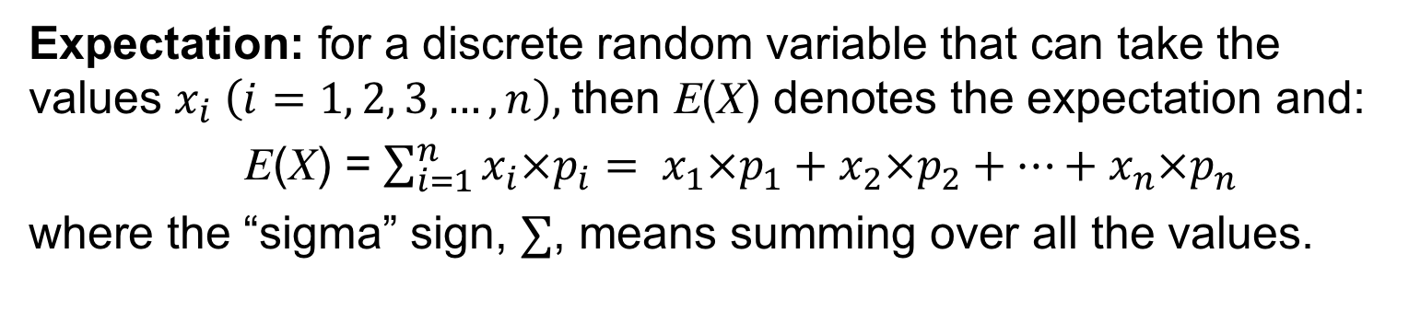
UNIT:
Probability and Binomial Distributions
Section 1
Expectation
We now need to be more precise:
Discrete Random Variable: this is a quantity that may take a given range of values that cannot be predicted exactly but can be described in terms of the probability of each of the possible values.
If the possible values are denoted by $x_{i} (i=1, 2, 3,…,n)$ and the probability of each of these values is given by $P(X=x_{i}$) = $p_{i}$, then:
$p_{1}+p_{2}+…+p_{n}=1$
Expectation: for a discrete random variable that can take the values $x_{i} \left(i=1, 2, 3,…,n\right),$then E(X) denotes the expectation and:
E(X) = $\sum_{i=1}^{n}{x_{i}×p_{i}}= x_{1}×p_{1}+x_{2}×p_{2}+…+x_{n}×p_{n}$
where the “sigma” sign, $∑$, means summing over all the values.

Slide 5
UNIT:
Probability and Binomial Distributions
Section 1
Expectation: Example
Example Let X be the random variable:
“the number of HEADS obtained when tossing a fair coin 3 times”.
a) What are the possible values of X?
b) What are the associated probabilities?
c) Determine the expectation of X.
Solution
The possible values are 0. 1. 2 and 3.
We can calculate the probabilities using a tree diagram
Solution continued on next slide

Slide 6





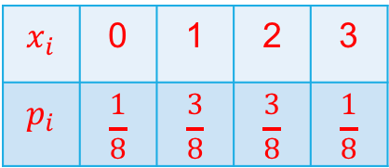
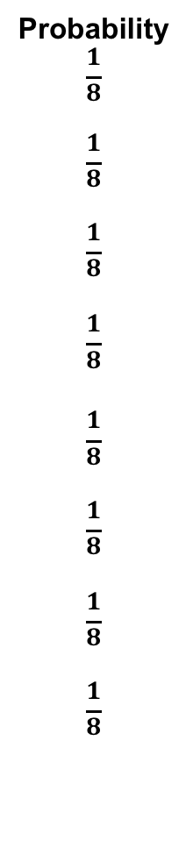








UNIT:
Probability and Binomial Distributions
Section 1
Expectation: Example
Outcome
HHH
HHT
HTH
HTT
THH
THT
TTH
TTT
X
3
2
2
1
2
1
1
0
Probability
$$\frac{1}{8}$$
$$\frac{1}{8}$$
$$\frac{1}{8}$$
$$\frac{1}{8}$$
$$\frac{1}{8}$$
$$\frac{1}{8}$$
$$\frac{1}{8}$$
$$\frac{1}{8}$$
b) Continued
$$\frac{1}{2}$$
$$\frac{1}{2}$$
$$x_{i}$$ | 0 | 1 | 2 | 3
$$p_{i}$$ | $$\frac{1}{8}$$ | $$\frac{3}{8}$$ | $$\frac{3}{8}$$ | $$\frac{1}{8}$$
$$\frac{1}{2}$$
$$\frac{1}{2}$$
$$\frac{1}{2}$$
$$\frac{1}{2}$$
$$\frac{1}{2}$$
$$\frac{1}{2}$$
$$\frac{1}{2}$$
$$\frac{1}{2}$$
$$\frac{1}{2}$$
$$\frac{1}{2}$$
$$\frac{1}{2}$$
$$\frac{1}{2}$$
c) Expectation = 0$×\frac{1}{8}+1×\frac{3}{8}+2×\frac{3}{8}+3×\frac{1}{8}= \frac{12}{8}=1.5$

Slide 7
UNIT:
Probability and Binomial Distributions
Section 1
Section 1: Fitness Check
Let X be the random variable “total score when two fair dice are rolled”.
a) Find the possible values of the random variable X and determine the associated possibilities.
b) Determine the expectation of X.
Answers
a)
b) 7 (Note: you could deduce without calculation from the symmetry of the distribution)

Slide 8
UNIT:
Probability and Binomial Distributions
Section 1
Section 1: Review
You have completed the first section.
If you have completed and mastered this section,
click to start the next Section
If you need more examples and interactive practice,
press here
You might also find it helpful to look at:
Essential Information: press here

Slide 9

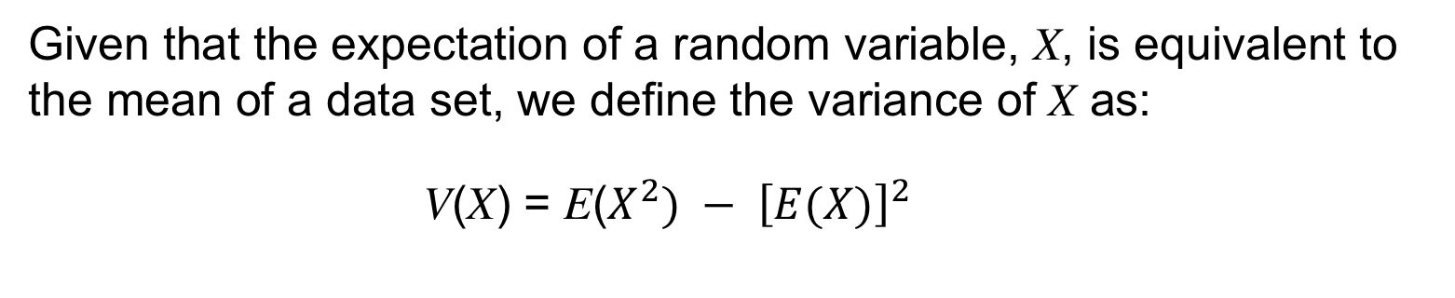
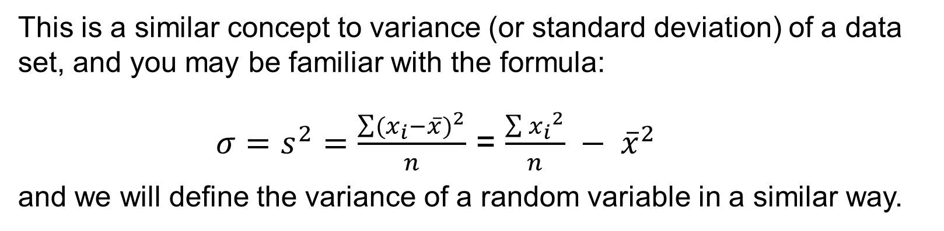
$$×$$
UNIT:
Probability and Binomial Distributions
Section 2
Variance
This is a similar concept to variance (or standard deviation) of a data set, and you may be familiar with the formula:
$σ=s^{2}=\frac{\sum{{(x_{i}−\overline{x})}^{2}}}{n}$ = $\frac{\sum{{x_{i}}^{2}}}{n} − {\overline{x}}^{2}$
and we will define the variance of a random variable in a similar way.
Given that the expectation of a random variable, X, is equivalent to the mean of a data set, we define the variance of X as:
V(X) = E($X^{2}) − {\left[E(X)\right]}^{2}$
We will see how this works in the Example on the next slide.

Slide 10
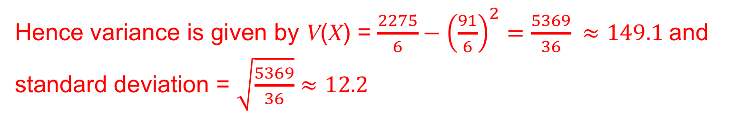
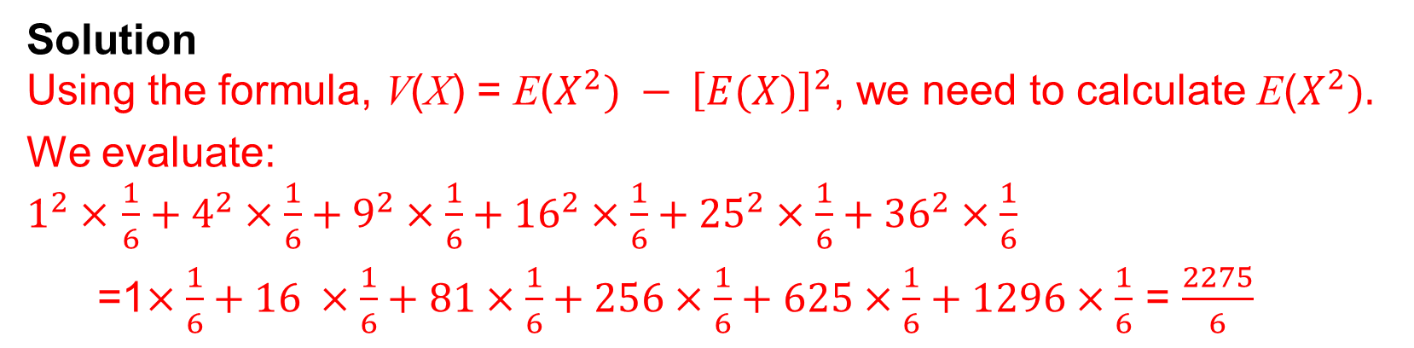
$$×$$
UNIT:
Probability and Binomial Distributions
Section 2
Variance: Example
Example
Let X be the random variable
“square of the score shown on the dice”.
We have already seen in Section 1 that the expectation, E(X) = 7.
Find the variance and standard deviation of the random variable, X.
Solution
Using the formula, V(X) = E($X^{2}) − {\left[E(X)\right]}^{2}$, we need to calculate E($X^{2}).$
We evaluate:
$1^{2}×$ $\frac{1}{6}+4^{2}×\frac{1}{6}+9^{2}×\frac{1}{6}+{16}^{2}×\frac{1}{6}+{25}^{2}×\frac{1}{6}+{36}^{2}×\frac{1}{6}$
=1$×\frac{1}{6}+16 ×\frac{1}{6}+81×\frac{1}{6}+256×\frac{1}{6}+625×\frac{1}{6}+1296×\frac{1}{6}$ = $\frac{2275}{6}$
Hence variance is given by V(X) = $\frac{2275}{6}−{\left(\frac{91}{6}\right)}^{2}=\frac{5369}{36} ≈149.1$and
standard deviation = $\sqrt{\frac{5369}{36}}$ $≈12.2$

Slide 11
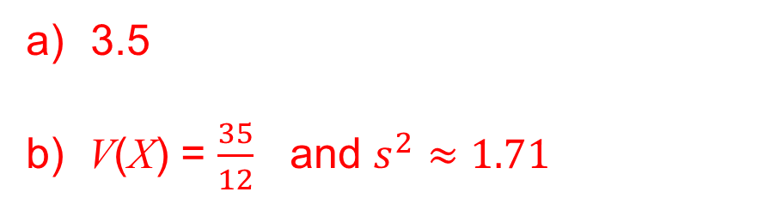
$$×$$
UNIT:
Probability and Binomial Distributions
Section 2
Section 2: Fitness Check
If X is the “score on a fair die”, find the
expectation of X,
variance and standard deviation of X.
Answers
3.5
b) V(X) = $\frac{35}{12}$ and $s^{2}≈1.71$

Slide 12
UNIT:
Probability and Binomial Distributions
Section 2
Section 2: Review
You have completed the second section.
If you have completed and mastered this section,
click to start the next Section
If you need more examples and interactive practice,
press here
You might also find it helpful to look at:
Essential Information: press here

Slide 13
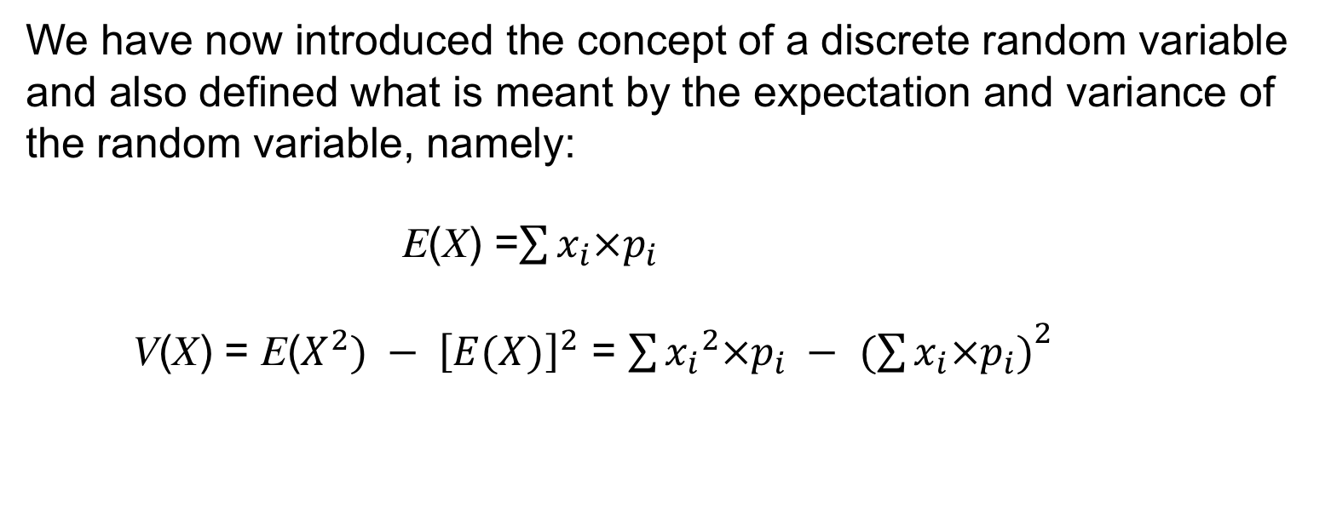
UNIT:
Probability and Binomial Distributions
Section 3
Probability Distributions
We have now introduced the concept of a discrete random variable and also defined what is meant by the expectation and variance of the random variable, namely:
E(X) =$\sum{x_{i}×p_{i}}$
V(X) = E($X^{2}) − {\left[E(X)\right]}^{2}$ = $\sum{{x_{i}}^{2}×p_{i} − }$ ${(\sum{x_{i}×p_{i})}}^{2}$
We will consider one more random distribution before moving on to the the Uniform distribution and the important Binomial distribution, which is fundamental to much of statistical analysis.

Slide 14
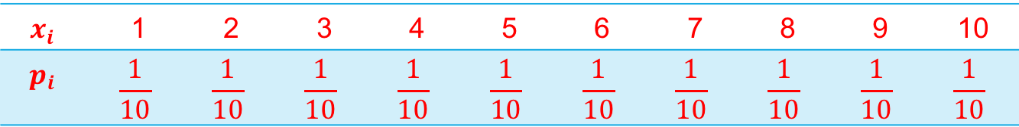
UNIT:
Probability and Binomial Distributions
Section 3
Probability Distributions: Example
Example
For a fair 10-sided spinner, marked 1, 2, 3, ….,10 with S the random variable “the score on the spinner”, find:
a) The probability distribution of S,
b) Expected value of S,
c) Standard deviation of S.
Solution
a) The probability distribution is given the table below:
$$x_{i}$$ | 1 | 2 | 3 | 4 | 5 | 6 | 7 | 8 | 9 | 10
$$p_{i}$$ | $$\frac{1}{10}$$ | $$\frac{1}{10}$$ | $$\frac{1}{10}$$ | $$\frac{1}{10}$$ | $$\frac{1}{10}$$ | $$\frac{1}{10}$$ | $$\frac{1}{10}$$ | $$\frac{1}{10}$$ | $$\frac{1}{10}$$ | $$\frac{1}{10}$$
Solution continued on next slide

Slide 15
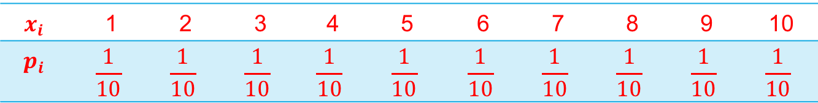
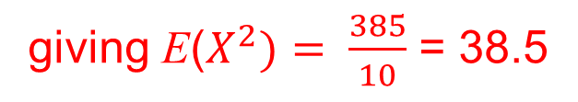

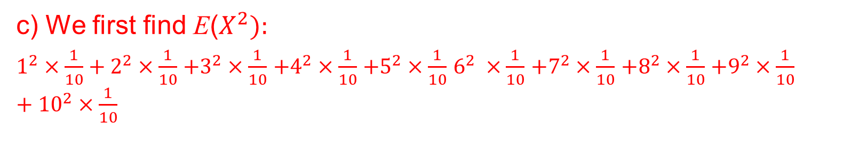
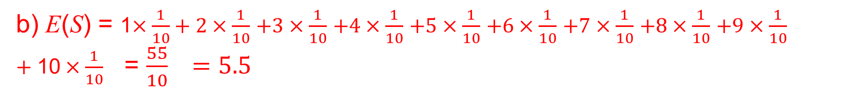
UNIT:
Probability and Binomial Distributions
Section 3
Probability Distributions: Example
$$x_{i}$$ | 1 | 2 | 3 | 4 | 5 | 6 | 7 | 8 | 9 | 10
$$p_{i}$$ | $$\frac{1}{10}$$ | $$\frac{1}{10}$$ | $$\frac{1}{10}$$ | $$\frac{1}{10}$$ | $$\frac{1}{10}$$ | $$\frac{1}{10}$$ | $$\frac{1}{10}$$ | $$\frac{1}{10}$$ | $$\frac{1}{10}$$ | $$\frac{1}{10}$$
b) E(S) = 1$×\frac{1}{10}+\text{2}×\frac{1}{10}$ $+\text{3}×\frac{1}{10}$ $+\text{4}×\frac{1}{10}$ $+\text{5}×\frac{1}{10}$ $+\text{6}×\frac{1}{10}$ $+\text{7}×\frac{1}{10}$ $+\text{8}×\frac{1}{10}$ $+\text{9}×\frac{1}{10}$ $+\text{1}\text{0}×\frac{1}{10}$ = $\frac{55}{10} =5.5$
Note: This is as expected due to the symmetry
c) We first find E($X^{2}):$
$1^{2}×\frac{1}{10}+2^{2}×\frac{1}{10}$ $+3^{2}×\frac{1}{10}$ $+4^{2}×\frac{1}{10}$ $+5^{2}×\frac{1}{10}$ $6^{2} ×\frac{1}{10}$ $+7^{2}×\frac{1}{10}$ $+8^{2}×\frac{1}{10}$ $+9^{2}×\frac{1}{10}$ $+{10}^{2}×\frac{1}{10}$
giving E($X^{2})= \frac{385}{10}$ = 38.5
Using the formula, V(X) = E($X^{2}) − {\left[E(X)\right]}^{2}$, we have:
V(S) = 38.5 $−{5.5}^{2}$ = 8.25
and the standard deviation = $\sqrt{8.25} ≈2.87$

Slide 16
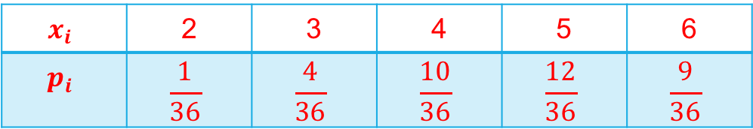
UNIT:
Probability and Binomial Distributions
Section 3
Section 3: Fitness Check
A fair six-sided die has:
'1' on one face, '2' on two of its faces and '3' on the other three faces.
The die is thrown twice. X is the random variable “total score thrown”.
Find:
a) the probability distribution,
b) the probability that the total score is more than 4,
c) E(X) and V(X).
Answers
$$x_{i}$$ | 2 | 3 | 4 | 5 | 6
$$p_{i}$$ | $$\frac{1}{36}$$ | $$\frac{4}{36}$$ | $$\frac{10}{36}$$ | $$\frac{12}{36}$$ | $$\frac{9}{36}$$
a)
b) P(more than 4) = $\frac{12}{36}+ \frac{9}{36}= \frac{21}{36} \left(=\frac{7}{12}\right)$
c) E(X) = $\frac{14}{3} and V\left(X\right)=\frac{10}{9}$

Slide 17
UNIT:
Probability and Binomial Distributions
Section 3
Section 3: Review
You have completed the third section.
If you have completed and mastered this section,
click to start the next Section
If you need more examples and interactive practice,
press here
You might also find it helpful to look at:
Essential Information: press here

Slide 18
UNIT:
Probability and Binomial Distributions
Section 4
The Uniform Distribution
One important distribution is the uniform one in which all possible outcomes have equal possibilities.
The random variable X is said to follow a uniform distribution when all its outcomes are equally likely.
A very simple example is given by the random variable
H: “the number of heads seen when a single coin is tossed”.
Here the probability distribution is given by:
E(H) = $0×\frac{1}{2}$ + 1$×\frac{1}{2}$ = $\frac{1}{2}$ (as expected)
V(H) = $0^{2}×\frac{1}{2}$ + $1^{2}×\frac{1}{2} −{\left(\frac{1}{2}\right)}^{2}= \frac{1}{2} and standard deviation=\sqrt{\frac{1}{2}}=\frac{1}{4}$

Slide 19
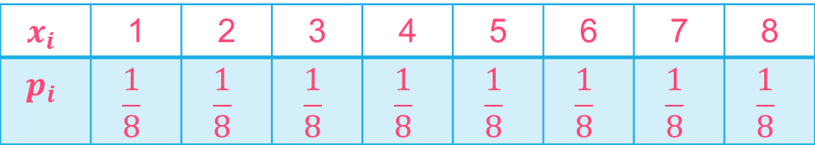
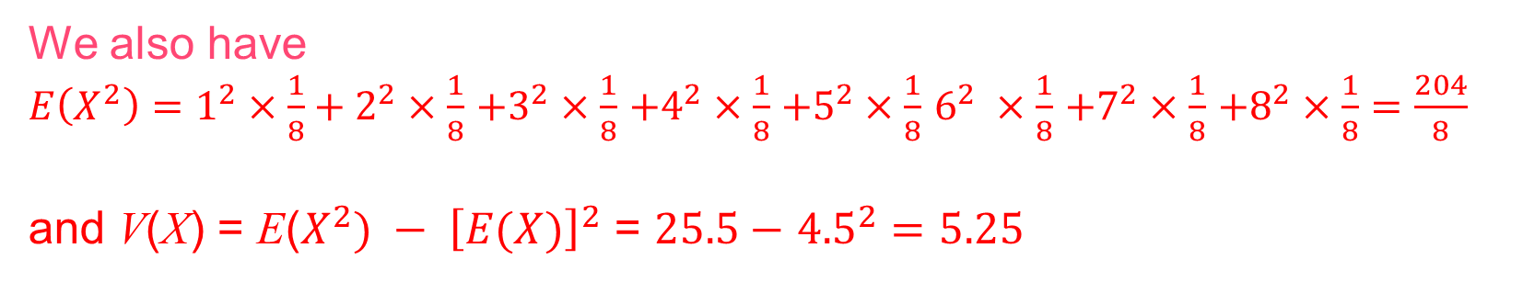
UNIT:
Probability and Binomial Distributions
Section 4
Uniform Distribution: Example
Example
A fair 8-sided spinner has numbers 1, 2, 3, 4, 5, 6, 7 and 8 on its sides. If X is the random variable 'score on the spinner', determine both E(X) and V(X) from first principles.
Solution
The probability distribution is given by:
$$x_{i}$$ | 1 | 2 | 3 | 4 | 5 | 6 | 7 | 8
$$p_{i}$$ | $$\frac{1}{8}$$ | $$\frac{1}{8}$$ | $$\frac{1}{8}$$ | $$\frac{1}{8}$$ | $$\frac{1}{8}$$ | $$\frac{1}{8}$$ | $$\frac{1}{8}$$ | $$\frac{1}{8}$$
Hence E(X) = 1$×\frac{1}{8}+\text{2}×\frac{1}{8}$ $+\text{3}×\frac{1}{8}$ $+\text{4}×\frac{1}{8}$ $+\text{5}×\frac{1}{8}$ $+\text{6}×\frac{1}{8}$ $+\text{7}×\frac{1}{8}$ $+\text{8}×\frac{1}{8}=\frac{36}{8}$
= 4.5
We also have
$E\left(X^{2}\right)=1^{2}×\frac{1}{8}+2^{2}×\frac{1}{8}$ $+3^{2}×\frac{1}{8}$ $+4^{2}×\frac{1}{8}$ $+5^{2}×\frac{1}{8}$ $6^{2} ×\frac{1}{8}$ $+7^{2}×\frac{1}{8}$ $+8^{2}×\frac{1}{8}=\frac{204}{8}$
and V(X) = E($X^{2}) − {\left[E(X)\right]}^{2}$ = $25.5−$ ${4.5}^{2}=5.25$
= 25.5

Slide 20
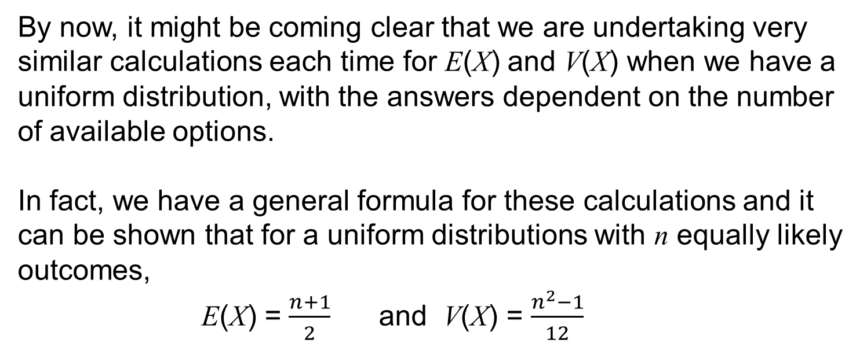
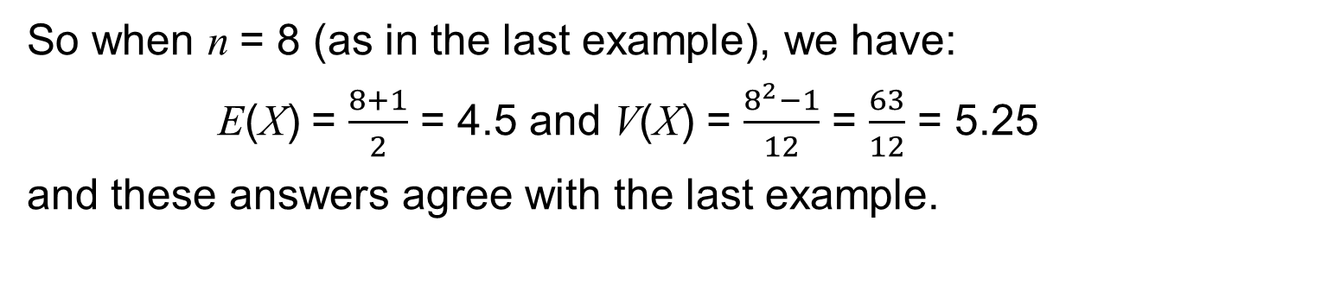
UNIT:
Probability and Binomial Distributions
Section 4
Section 4: General Formula
By now, it might be coming clear that we are undertaking very similar calculations each time for E(X) and V(X) when we have a uniform distribution, with the answers dependent on the number of available options.
In fact, we have a general formula for these calculations and it can be shown that for a uniform distributions with n equally likely outcomes,
E(X) = $\frac{n+1}{2}$ and V(X) = $\frac{n^{2}−1}{12}$
So when n = 8 (as in the last example), we have:
E(X) = $\frac{8+1}{2}$ = 4.5 and V(X) = $\frac{8^{2}−1}{12}$ = $\frac{63}{12}$ = 5.25
and these answers agree with the last example.

Slide 21
UNIT:
Probability and Binomial Distributions
Section 4
Section 4: Fitness Check
A fair 5-sided spinner has numbers 1, 2, 3, 4 and 5 on its sides.
a) If X is the random variable “score on the spinner”, determine both E(X) and V(X) from first principles.
b) Do these values agree with the general formula?
Answers
a) E(X) = 3 and V(X) = 2
b) Yes, they are in agreement with the general formula.

Slide 22
UNIT:
Probability and Binomial Distributions
Section 4
Section 4: Review
You have completed the fourth section.
If you have completed and mastered this section,
click to start the next Section
If you need more examples and interactive practice,
press here
You might also find it helpful to look at:
Essential Information: press here

Slide 23
UNIT:
Probability and Binomial Distributions
Section 5
Binomial Distribution
We will use a worked example to introduce this distribution.
Example
Ashoke, Theo and Sadie will each visit the local leisure centre to swim on one evening next week but have made no arrangement between themselves to meet or go on any particular day.
The random variable X is:
“the number of the three who go to the leisure centre on Wednesday”.
Find the probability distribution for X, that is, the probabilities for each value of X.
Solution
The probabilities of 0, 1, 2 or 3 people going on Wednesday can be found by using the tree diagram method covered in the unit Probability of Two or More Events.

Slide 24
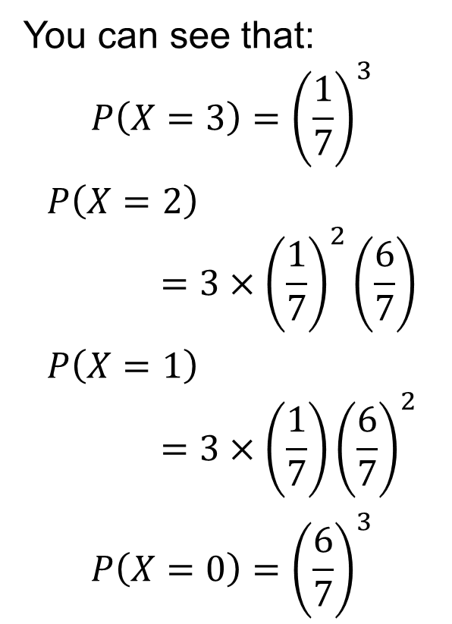
UNIT:
Probability and Binomial Distributions
Section 5
Binomial Distribution
The tree diagram below shows probabilities for how many go on Wednesday.
You can see that:
$$P\left(X=3\right)={\left(\frac{1}{7}\right)}^{3}$$
$$P\left(X=2\right)=3×{\left(\frac{1}{7}\right)}^{2}\left(\frac{6}{7}\right)$$
$$P\left(X=1\right)=3×\left(\frac{1}{7}\right){\left(\frac{6}{7}\right)}^{2}$$
$$P\left(X=0\right)={\left(\frac{6}{7}\right)}^{3}$$

Slide 25
UNIT:
Probability and Binomial Distributions
Section 5
Finding the Distribution
We can summarise the distribution in this table:
We can easily extend this to having a fourth person with X now
“the number if the four people who go on Wednesday”:
You may recognize the coefficients in each table, that is 1, 3, 3, 1 and 1, 4, 6, 4, 1 from Pascal’s Triangle or from the Binomial Theorem.

Slide 26
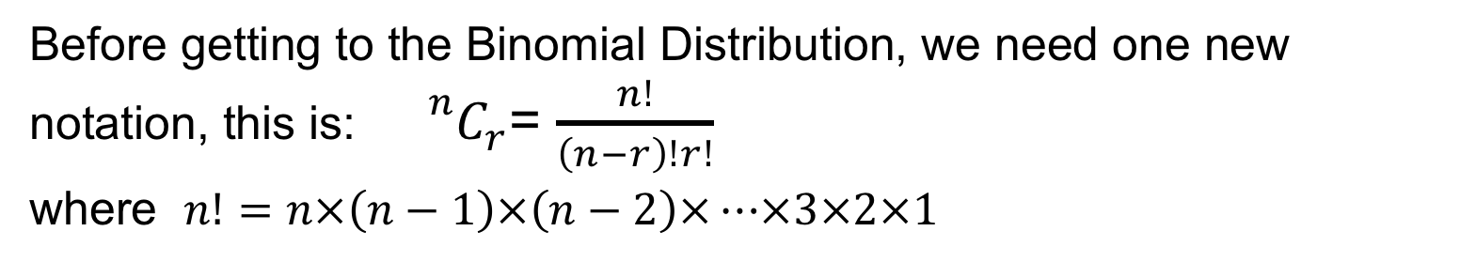
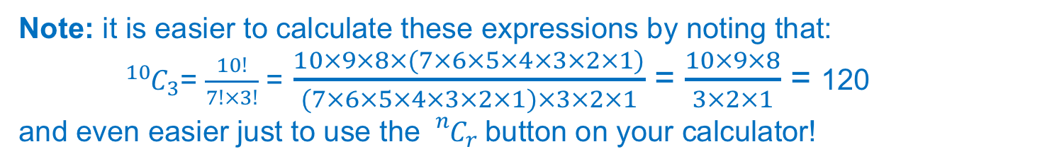
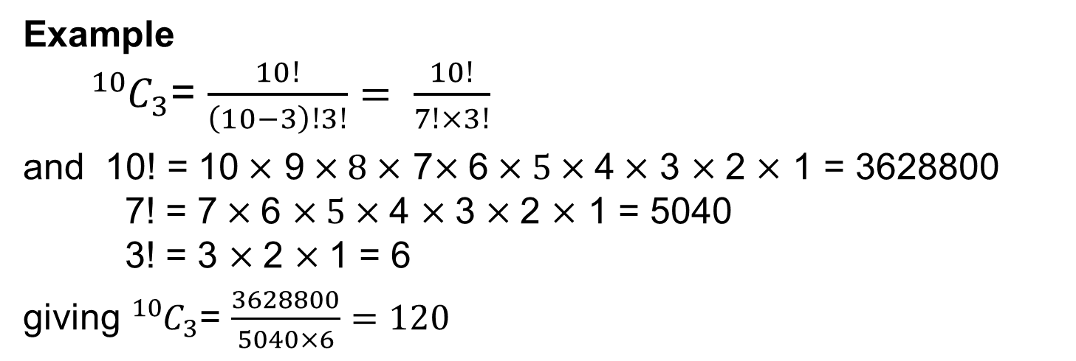
UNIT:
Probability and Binomial Distributions
Section 5
Notation
Before getting to the Binomial Distribution, we need one new notation, this is: ${}_{}^{n}{C_{r}}$= $\frac{n!}{\left(n−r\right)!r!}$
where $n!=n×\left(n−1\right)×\left(n−2\right)×…×3×2×1$
Example
${}_{}^{10}{C_{3}}$= $\frac{10!}{\left(10−3\right)!3!}= \frac{10!}{7!×3!}$
and 10! = 10$×$ 9$×8×$ 7$×$6$×5×$4$×$ 3 $×$2 $×$ 1 = 3628800
7! = 7$×$6 $×5×$4 $×$3 $×$2 $×$ 1 = 5040
3! = 3 $×$2 $×$1 = 6
giving ${}_{}^{10}{C_{3}}$= $\frac{3628800}{5040×6}=120$
Note: it is easier to calculate these expressions by noting that:
${}_{ }^{10}{C_{3}}$= $\frac{10!}{7!×3!}$ = $\frac{10×9×8×(7×6×5×4×3×2×1)}{(7×6×5×4×3×2×1)×3×2×1}$ = $\frac{10×9×8}{3×2×1}$ = 120
and even easier just to use the ${}_{}^{n}{C_{r}}$button on your calculator!

Slide 27
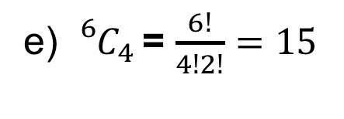
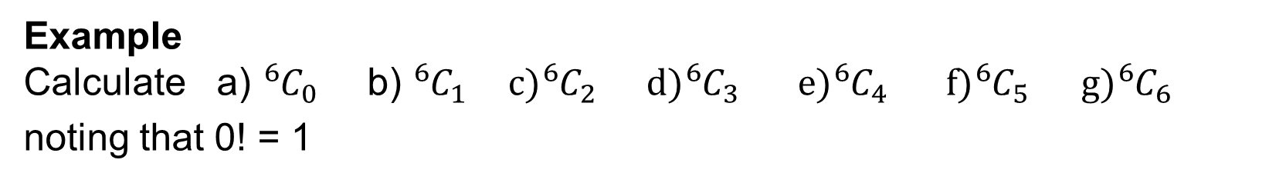
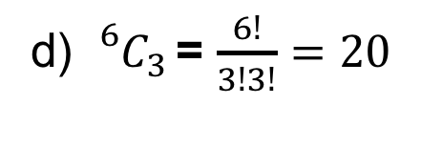
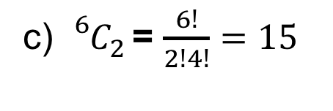
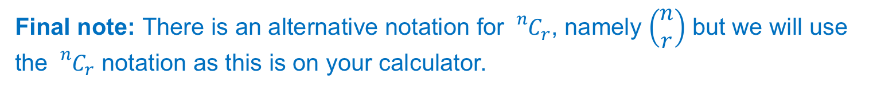
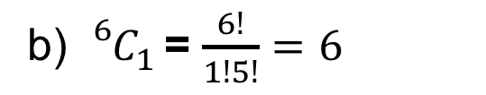
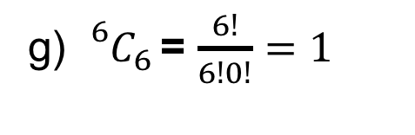
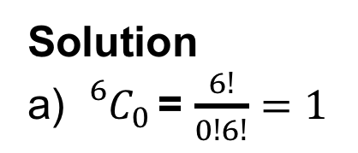
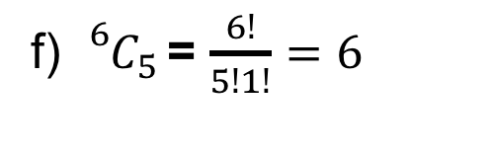
UNIT:
Probability and Binomial Distributions
Section 5
Example
Example
Calculate a) ${}_{}^{6}{C_{0 }}$ b) ${}_{}^{6}{C_{1 } c){}_{}^{6}{C_{2 }} d){}_{}^{6}{C_{3 }} e){}_{}^{6}{C_{4 }} f){}_{}^{6}{C_{5} g){}_{}^{6}{C_{6 }}} }$
noting that 0! = 1
Solution
a) ${}_{}^{6}{C_{0 }}$= $\frac{6!}{0!6!}=1$
b) ${}_{}^{6}{C_{1 }}$= $\frac{6!}{1!5!}=6$
c) ${}_{}^{6}{C_{2 }}$= $\frac{6!}{2!4!}=15$
d) ${}_{}^{6}{C_{3 }}$= $\frac{6!}{3!3!}=20$
e) ${}_{}^{6}{C_{4 }}$= $\frac{6!}{4!2!}=15$
f) ${}_{}^{6}{C_{5 }}$= $\frac{6!}{5!1!}=6$
g) ${}_{}^{6}{C_{6 }}$= $\frac{6!}{6!0!}=1$
Note: this gives the coefficients 1, 6, 15, 20, 15, 10, 6, 1
Final note: There is an alternative notation for ${}_{}^{n}{C_{r}}$, namely $\left(\begin{aligned}n \\ r\end{aligned}\right)$ but we will use the ${}_{}^{n}{C_{r}}$ notation as this is on your calculator.

Slide 28
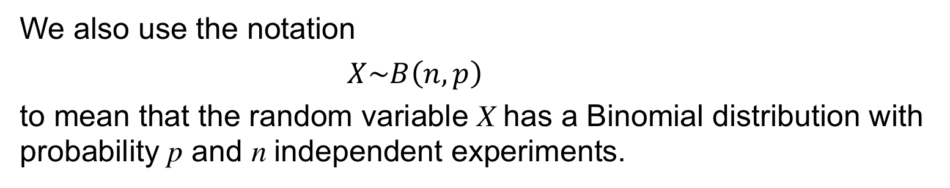
UNIT:
Probability and Binomial Distributions
Section 5
Binomial Distribution
We can summarise and extend our earlier work with this formula.
If the probability of success is p and the “experiment” is repeated n independent times with the probability remaining constant, and X is the random variable “number of successes”, then its probability distribution is given by this formula:
$P\left(X=r\right)=$ ${}_{}^{n}{C_{r}}p^{r}{(1−p)}^{n−r}$ for $r=0, 1. 2, …. ,n$
We also use the notation
$X\sim B\left(n, p\right)$
to mean that the random variable X has a Binomial distribution with probability p and n independent experiments.

Slide 29
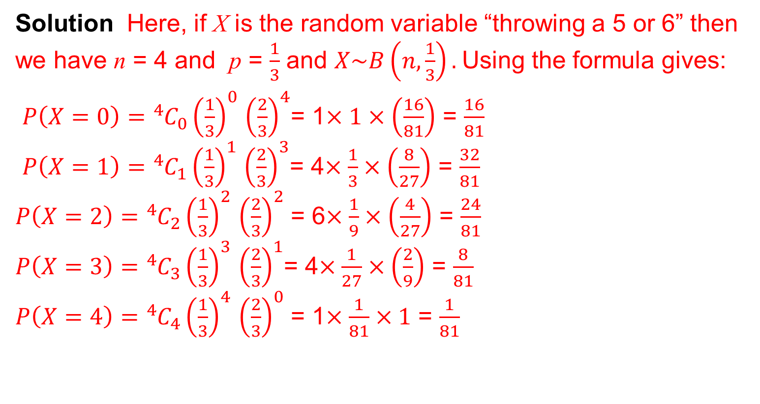
UNIT:
Probability and Binomial Distributions
Section 5
Binomial Distribution: Examples
$P\left(X=r\right)=$ ${}_{}^{n}{C_{r}}p^{r}{(1−p)}^{n−r}$ for $r=0, 1. 2, …. ,n$
Example 1 You throw a fair dice 4 times.
What is the probability distribution of throwing a 5 or 6?
Solution Here, if X is the random variable “throwing a 5 or 6” then we have n = 4 and p = $\frac{1}{3}$ and $X\sim B\left(n,\frac{1}{3}\right).$Using the formula gives:
$P\left(X=0\right)=$ ${}_{}^{4}{C_{0}}{\left(\frac{1}{3}\right)}^{0}$ ${\left(\frac{2}{3}\right)}^{4}$= 1$×1×\left(\frac{16}{81}\right)$ = $\frac{16}{81}$
$P\left(X=1\right)=$ ${}_{}^{4}{C_{1}}{\left(\frac{1}{3}\right)}^{1}$ ${\left(\frac{2}{3}\right)}^{3}$= 4$×\frac{1}{3}×\left(\frac{8}{27}\right)$ = $\frac{32}{81}$
$P\left(X=2\right)=$ ${}_{}^{4}{C_{2}}{\left(\frac{1}{3}\right)}^{2}$ ${\left(\frac{2}{3}\right)}^{2}$ = 6$×\frac{1}{9}×\left(\frac{4}{27}\right)$ = $\frac{24}{81}$
$P\left(X=3\right)=$ ${}_{}^{4}{C_{3}}{\left(\frac{1}{3}\right)}^{3}$ ${\left(\frac{2}{3}\right)}^{1}$= 4$×\frac{1}{27}×\left(\frac{2}{9}\right)$ = $\frac{8}{81}$
$P\left(X=4\right)=$ ${}_{}^{4}{C_{4}}{\left(\frac{1}{3}\right)}^{4}$ ${\left(\frac{2}{3}\right)}^{0}$ = 1$×\frac{1}{81}×1$ = $\frac{1}{81}$
Note that the total probabilities add to 1, as expected.
Note also that the value with the highest probability is X = 1.
Note: try this out in practice and record the outcomes.

Slide 30
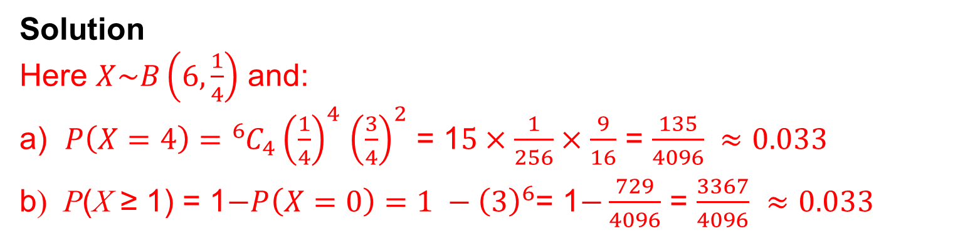
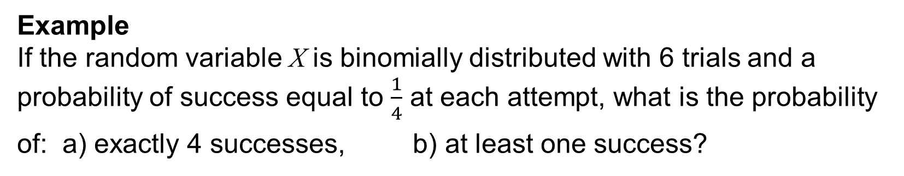
UNIT:
Probability and Binomial Distributions
Section 5
Binomial Distribution: Example
$P\left(X=r\right)=$ ${}_{}^{n}{C_{r}}p^{r}{(1−p)}^{n−r}$ for $r=0, 1. 2, …. ,n$
Example
If the random variable X is binomially distributed with 6 trials and a probability of success equal to $\frac{1}{4}$ at each attempt, what is the probability
of: a) exactly 4 successes, b) at least one success?
Solution
Here $X\sim B\left(6,\frac{1}{4}\right)$ and:
a) $P\left(X=4\right)=$ ${}_{}^{6}{C_{4}}{\left(\frac{1}{4}\right)}^{4}$ ${\left(\frac{3}{4}\right)}^{2}$ = 1$5×\frac{1}{256}×\frac{9}{16}$ = $\frac{135}{4096} ≈0.033$
b) P(X ≥ 1) = 1$−P\left(X=0\right)=1 −{\left(3\right)}^{6}$= 1$−\frac{729}{4096}$ = $\frac{3367}{4096}$ $≈0.033$
Note: Calculators used for A-level courses now have binomial tables available.

Slide 31
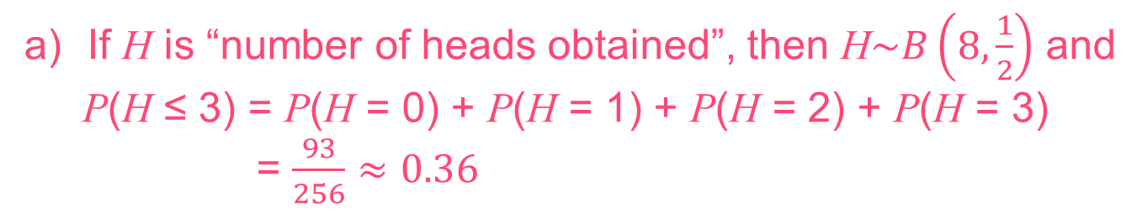
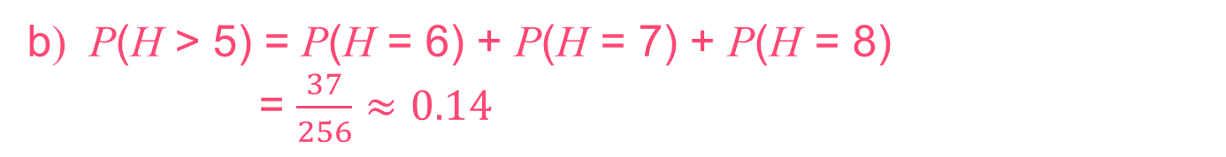
UNIT:
Probability and Binomial Distributions
Section 5
Section 5: Fitness Check
When an unbiased coin is tossed eight times what is the probability, to 2 decimal places, of obtaining:
a) less than 4 heads,
b) more than five heads?
Answers
If H is “number of heads obtained”, then H$\sim B\left(8, \frac{1}{2}\right)$ and
P(H ≤ 3) = P(H = 0) + P(H = 1) + P(H = 2) + P(H = 3)
= $\frac{93}{256}$ $≈0.36$
b) P(H > 5) = P(H = 6) + P(H = 7) + P(H = 8)
= $\frac{37}{256}$ $≈0.14$

Slide 32
UNIT:
Probability and Binomial Distributions
Section 5
Section 5: Review
You have completed the fifth section.
If you have completed and mastered this section,
click to start the next Section
If you need more examples and interactive practice,
press here
You might also find it helpful to look at:
Essential Information: press here

Slide 33
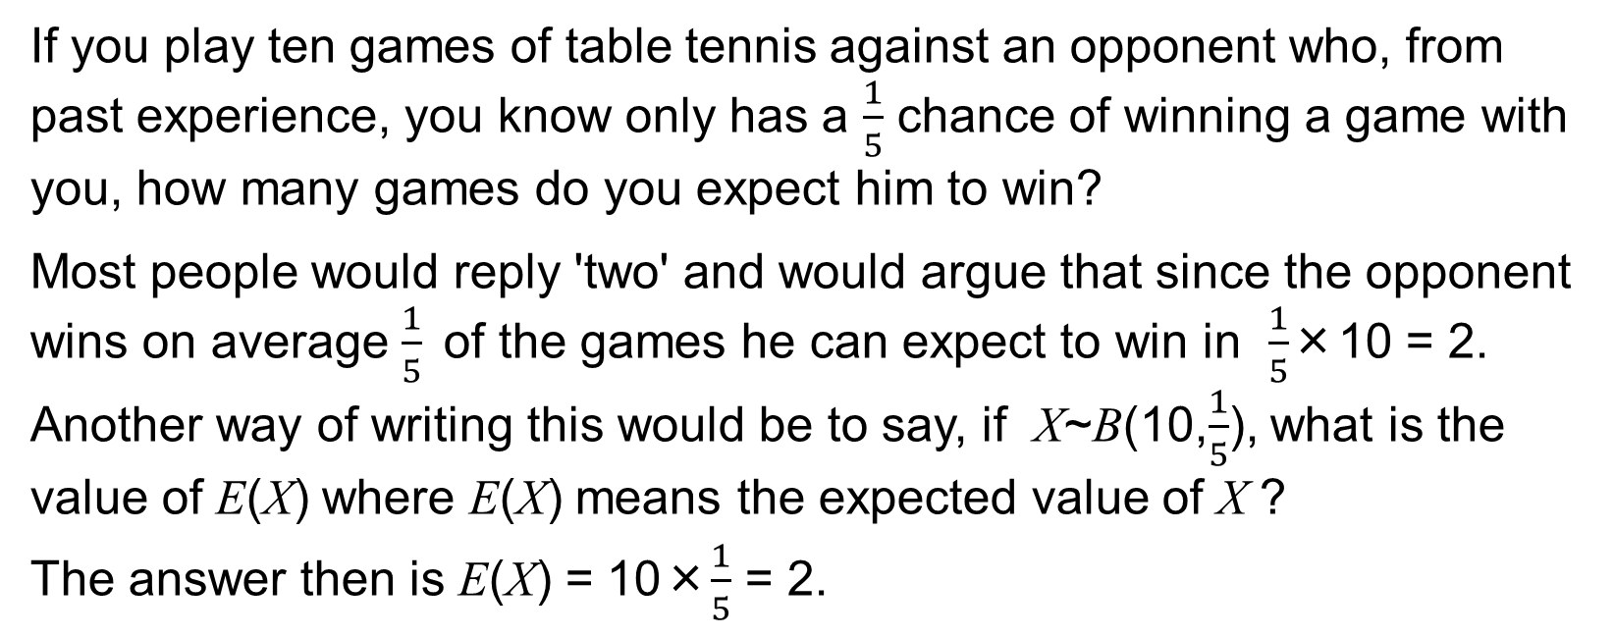
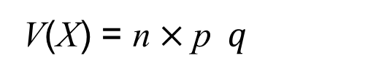
UNIT:
Probability and Binomial Distributions
Section 6
Mean and Variance
If you play ten games of table tennis against an opponent who, from past experience, you know only has a $\frac{1}{5}$ chance of winning a game with you, how many games do you expect him to win?
Most people would reply 'two' and would argue that since the opponent wins on average $\frac{1}{5}$of the games he can expect to win in $\frac{1}{5}$×10 = 2.
Another way of writing this would be to say, if X~B(10,$\frac{1}{5}$), what is the value of E(X) where E(X) means the expected value of X ?
The answer then is E(X) = 10×$\frac{1}{5}$ = 2.
In general, for $X\sim B\left(n, p\right)$, we have: E(X) = n$×$p
Following the analysis in Section 2, we also can show that:
V(X) = n$×$p$q$

Slide 34
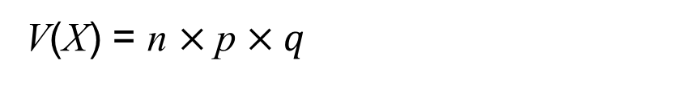
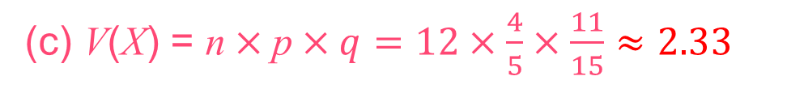
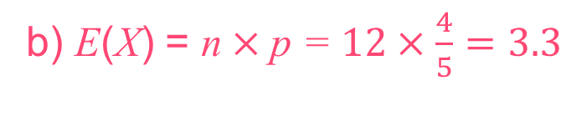
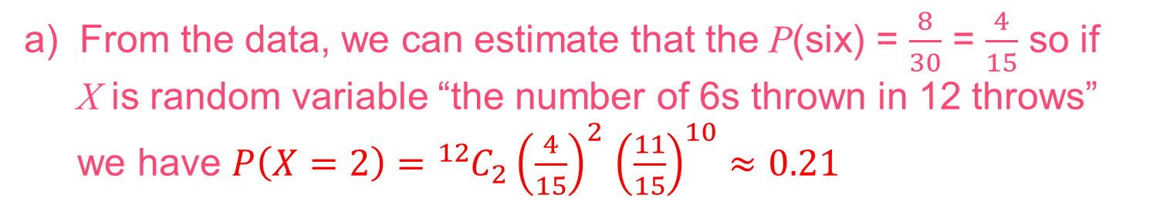
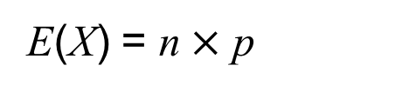
UNIT:
Probability and Binomial Distributions
Section 6
Mean and Variance
E(X) = n$×$ p
V(X) = n $×$p $×q$
A biased die is thrown thirty times and the number of sixes seen is eight. If the die is thrown a further twelve times find:
a) the probability that a six will occur exactly twice,
b) the expected number of sixes,
c) the variance of the number of sixes.
Solution
a) From the data, we can estimate that the P(six) = $\frac{8}{30}$ = $\frac{4}{15}$ so if
X is random variable “the number of 6s thrown in 12 throws”
we have $P\left(X=2\right)=$ ${}_{}^{12}{C_{2}}{\left(\frac{4}{15}\right)}^{2}$ ${\left(\frac{11}{15}\right)}^{10}$ $≈0.21$
b) E(X) = n$×$p = $12×\frac{4}{5}=3.3$
(c) V(X) = n$×$p$×q=12×\frac{4}{5}×\frac{11}{15}≈2.33$

Slide 35
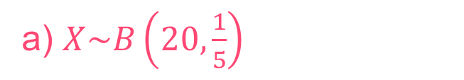
UNIT:
Probability and Binomial Distributions
Section 6
Section 6: Fitness Check
A multiple choice test has twenty questions and five possible answers for each one with only one correct per question.
If X is “the number of questions answered correctly by guessing”, give:
a) the distribution of X,
b) the mean and variance of X,
c) the probability that a student will achieve a pass mark of 10 or
more purely by guessing.
Answers
a) $X\sim B\left(20,\frac{1}{5}\right)$
b) 4, 3.2
c) 0.0026

Slide 36
UNIT:
Probability and Binomial Distributions
Section 6
Section 6: Review
You have completed the sixth and last section.
If you have completed and mastered this last section,
click here for the Unit audit.
If you need more examples and interactive practice,
press here
You might also find it helpful to look at:
Essential Information: press here

