Slide 1
Supporting and Enhancing Mathematics and Statistics
UNIT: Bearings

Slide 2
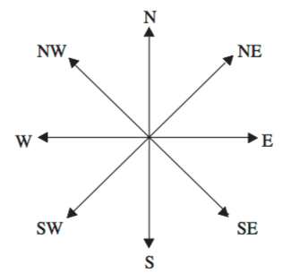
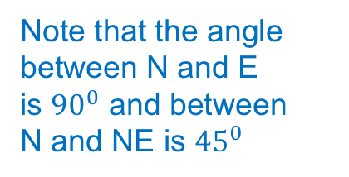
UNIT:
Bearings
Bearings
A compass bearing tells us direction.
The 4 main directions are North, South, East and West.
We can remember the order (starting from north, and going clockwise)
as ‘Never Eat Shredded Wheat’:
N
NW
NE
Note that the angle between N and E is ${90}^{0}$ and between N and NE is ${45}^{0}$
W
E
SW
SE
S
Notice that the bearings in between start with either North or South:
North-East, South-East, South-West, North-West.

Slide 3
UNIT:
Bearings
Bearings
In between these bearings we have:
North-North-East (NNE)*
East-North-East (ENE)
East-South-East (ESE)
South-South-East (SSE)
South-South-West (SSW)
West-South-West (WSW)
West-North-West (WNW)
North-North-West (NNW)
Notice the bearings in between start with:
North, East, South or West:
NNE, ENE, ESE, SSE, SSW, WSW, WNW, NNW
NNW
NNE
WNW
ENE
WSW
ESE
SSW
SSE
* NNE can be read as North of North-East

Slide 4
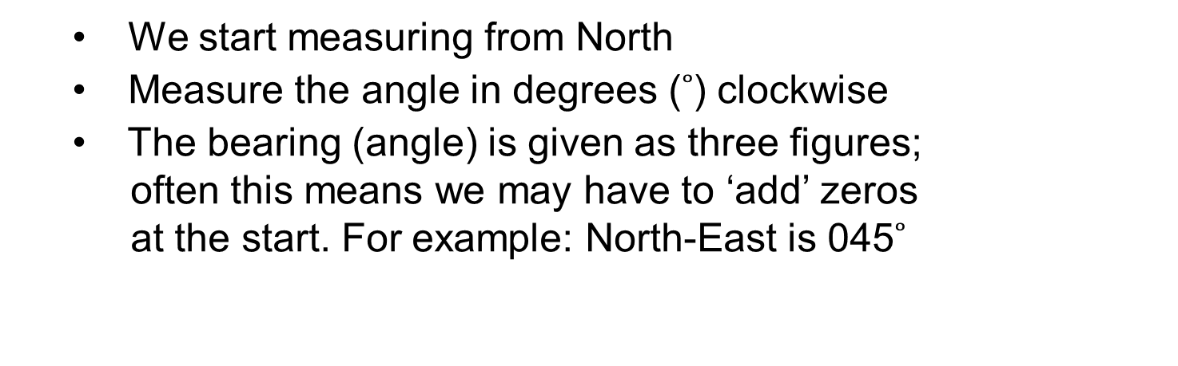
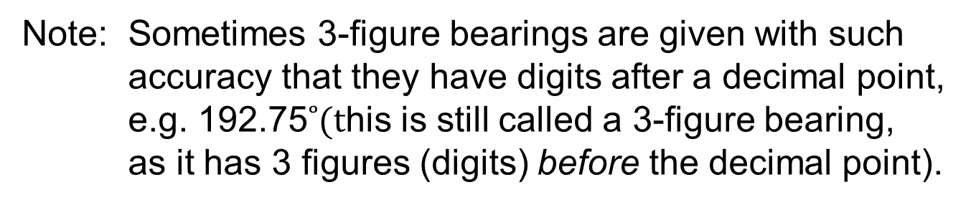
UNIT:
Bearings
Bearings
Three figure bearings can also be used as an
alternative to compass bearings.
They are measured in a particular way:
  We start measuring from North
  Measure the angle in degrees ($˚$) clockwise
  The bearing (angle) is given as three figures;
  often this means we may have to ‘add’ zeros
  at the start. For example: North-East is 045$˚$
The advantage of 3-figure bearings is that they
can describe direction uniquely.
Note: Sometimes 3-figure bearings are given with such
accuracy that they have digits after a decimal point,
e.g. 192.75$˚(t$his is still called a 3-figure bearing,
as it has 3 figures (digits) before the decimal point).

Slide 5
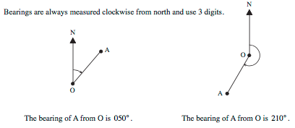
UNIT:
Bearings
Bearings
Examples of 3-figure bearings:
Bearings can be especially useful in navigation, be it at sea or for people walking in the wild, on open moorland or hills.

Slide 6
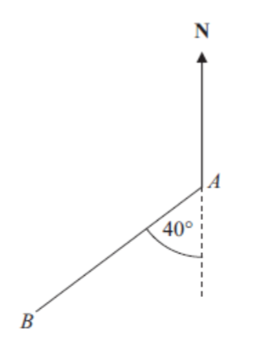

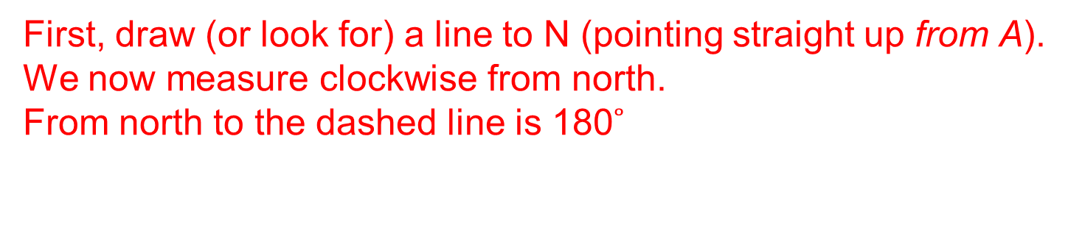
UNIT:
Bearings
Bearings
Example 1:
Work out the bearing of B from A.
Top tip: Always look for the word:
‘from’. It is from this point
your draw the arrow to N
Solution
First, draw (or look for) a line to N (pointing straight up from A).
We now measure clockwise from north.
  From north to the dashed line is 180$˚$
(angles on a straight line).
  We now simply add on the extra 40$˚.$
  Answer: Bearing of B from A is: 180$˚+\text{40}˚=$ 220$˚$

Slide 7
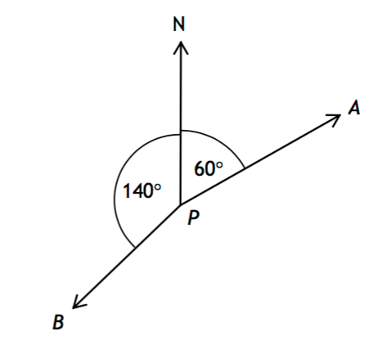
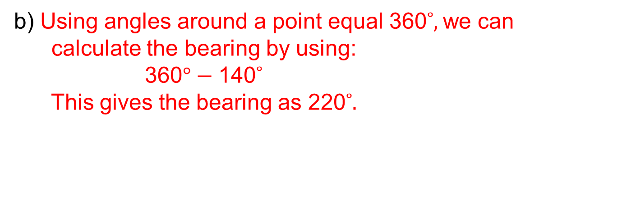
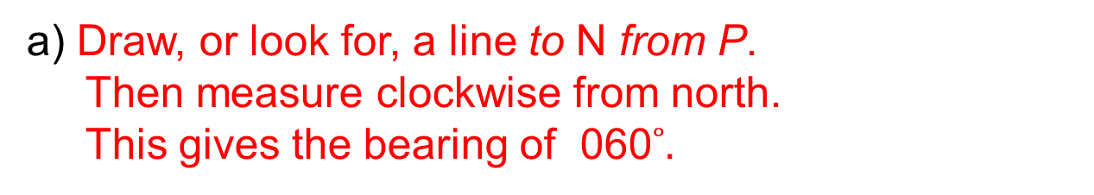
UNIT:
Bearings
Bearings
Example 2:
Write down the bearing of A from P.
b) Work out the bearing of B from P.
  a) Draw, or look for, a line to N from P.
  Then measure clockwise from north.
  This gives the bearing of 060$˚.$
  b) Using angles around a point equal 360$˚,$we can
  calculate the bearing by using:
  360$°−\text{140}˚$
  This gives the bearing as 220$˚.$

Slide 8

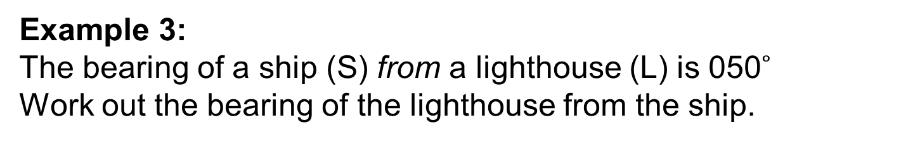

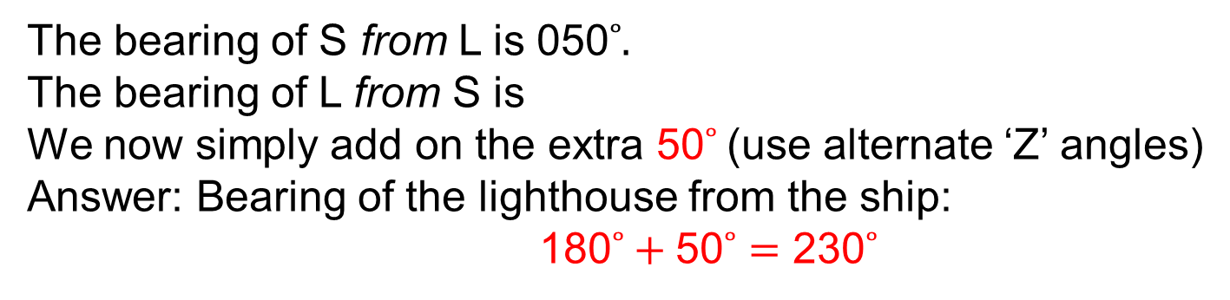

UNIT:
Bearings
Bearings
Example 3:
The bearing of a ship (S) from a lighthouse (L) is 050$˚$
Work out the bearing of the lighthouse from the ship.
N
N
S
50$°$
50$°$
Solution
L
The bearing of S from L is 050$˚.$
The bearing of L from S is
We now simply add on the extra 50$˚$(use alternate ‘Z’ angles)
  Answer: Bearing of the lighthouse from the ship:
  180$˚+\text{5}\text{0}˚=$ 230$˚$
180$˚$plus …

Slide 9
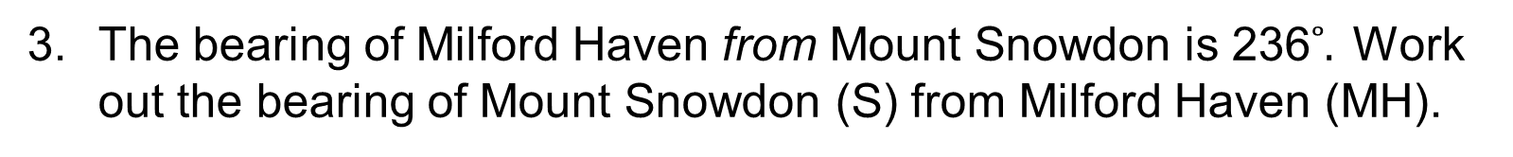

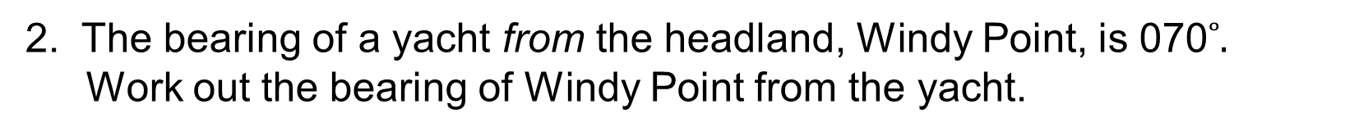


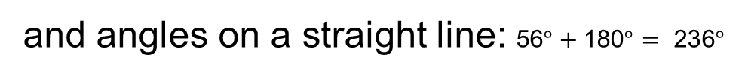




UNIT:
Bearings
Section 1: Fitness Check
Here are some questions to check your progress;
there are more practice questions if needed.
1. What 3-figure bearing is equivalent to the compass bearings:
NE
  $$\text{04}\text{5}˚$$
NW
  $$\text{31}\text{5}˚$$
ESE ?
  $$\text{1}\text{1}\text{2.}\text{5}˚$$
2. The bearing of a yacht from the headland, Windy Point, is 070$˚.$
Work out the bearing of Windy Point from the yacht.
Answer:
  $$\text{180}˚+\text{70}˚=\text{ 2}\text{5}\text{0}˚$$
The bearing of Milford Haven from Mount Snowdon is 236$˚.$ Work out the bearing of Mount Snowdon (S) from Milford Haven (MH).
Tips: Use corresponding angles
N
  and angles on a straight line: $\text{5}\text{6}°+\text{180}°= \text{23}\text{6}°$
N
  56$°$
Answer:
  $$\text{236}˚−\text{180}˚= \text{5}\text{6}˚$$
  56$°$
S
MH
$$\text{180}°$$

Slide 10
UNIT:
Bearings
Section 1: Review
You have completed this Unit.
If you have completed and mastered this section,
click here for the Unit audit
If you need more examples and interactive practice,
press here
You might also find it helpful to look at:
Essential Information: press here

