Slide 1
Supporting and Enhancing Mathematics and Statistics
UNIT: Area

Slide 2
UNIT:
Area
Area
This Unit will explain how to find the areas of a number of common
shapes, along with some applications.
You have five sections to work through and there are check up audits
through fitness tests for each section.
Squares, Rectangles and Triangles
Area and Circumference of Circles
Sector Areas and Arc Lengths
Areas of Parallelograms, Trapeziums, Kites and Rhombuses
5 Surface Area

Slide 3
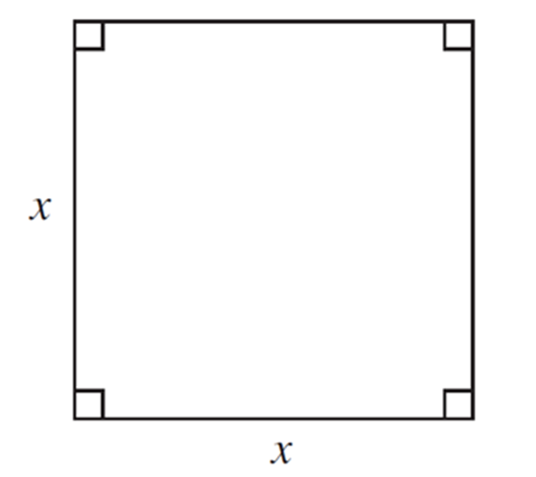
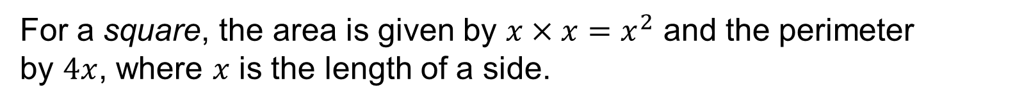
UNIT:
Area
Section 1
Squares, Rectangles and Triangles
Area of a Square
Area of a Square
For a square, the area is given by $x×x=x^{2}$ and the perimeter
by $4x$, where $x$ is the length of a side.

Slide 4
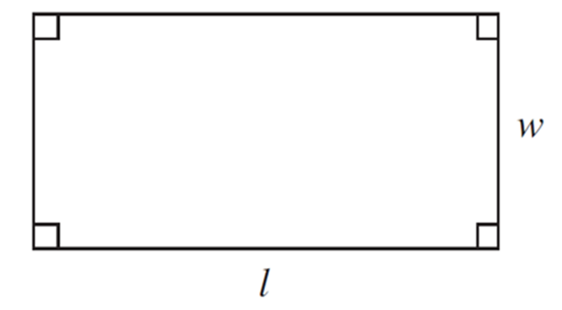
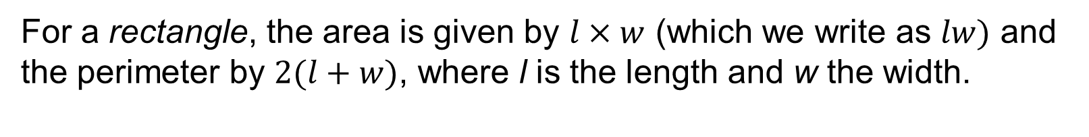
UNIT:
Area
Section 1
Squares, Rectangles and Triangles
Area of Rectangle
Area of a Rectangle
For a rectangle, the area is given by $l×w$ (which we write as $lw)$ and the perimeter by $2(l+w)$, where l is the length and w the width.

Slide 5
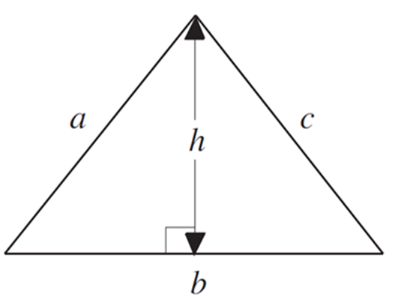
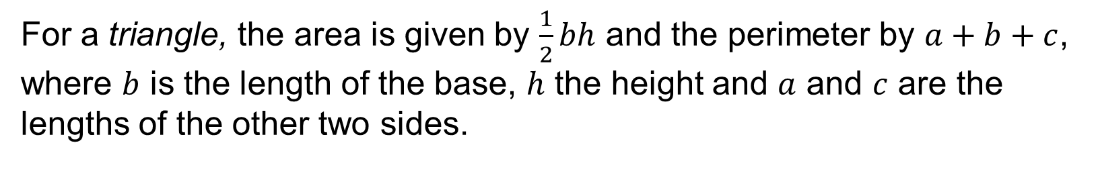
UNIT:
Area
Section 1
Squares, Rectangles and Triangles
Area of a Triangle
Area of a Triangle
For a triangle, the area is given by $\frac{1}{2}bh$ and the perimeter by $a+b+c$, where $b$ is the length of the base, $h$ the height and $a$ and $c$ are the lengths of the other two sides.

Slide 6
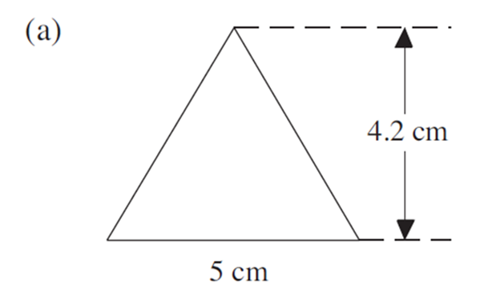
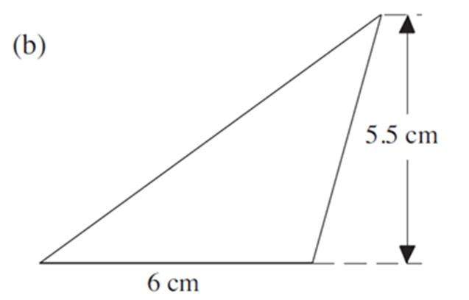
UNIT:
Area
Section 1
Squares, Rectangles and Triangles
Area: Examples
Example 1
Find the area of the following triangles.
You can try this question and check your answer on the next slides.

Slide 7
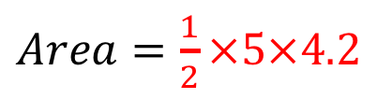
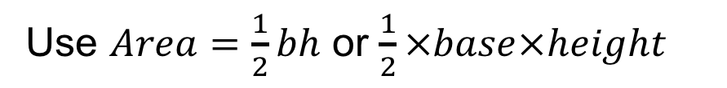
UNIT:
Area
Section 1
Squares, Rectangles and Triangles
Area: Examples
Solution
Use $Area=\frac{1}{2}bh$ or $\frac{1}{2}×base×height$
$Area=\frac{1}{2}×5×4.2$
= 10.5 cm²

Slide 8
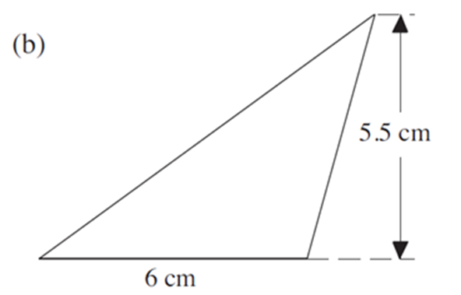
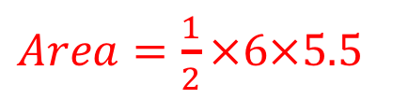
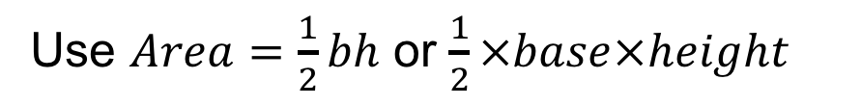
UNIT:
Area
Section 1
Squares, Rectangles and Triangles
Area: Examples
Solution
Use $Area=\frac{1}{2}bh$ or $\frac{1}{2}×base×height$
$Area=\frac{1}{2}×6×5.5$
= 16.5 cm²

Slide 9
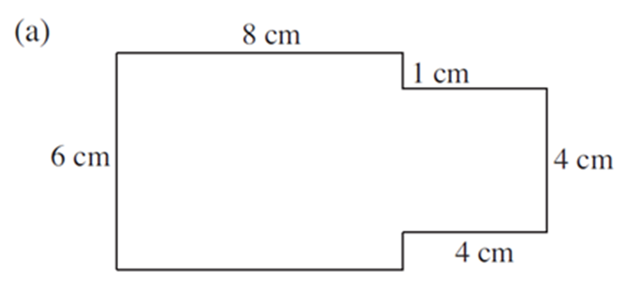
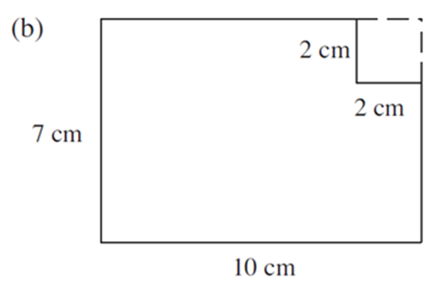
UNIT:
Area
Section 1
Squares, Rectangles and Triangles
Area: Examples
Example 2
Find the perimeter and area of each shape below.
You can try this question and check your answer on the next slides.

Slide 10
UNIT:
Area
Section 1
Squares, Rectangles and Triangles
Area: Examples
Solution
The perimeter is found by adding the lengths of all the sides.
P = 6 + 8 + 1 + 4 + 4 + 4 + 1 + 8 = 36 cm
To find the area, consider the shape split into a rectangle and a square.
Area = Area of rectangle + Area of square
= 6 × 8 + 4²
= 48 + 16
= 64 cm²

Slide 11
UNIT:
Area
Section 1
Squares, Rectangles and Triangles
Area: Examples
Solution
b) The perimeter is found by adding the lengths of all the sides.
P = 10 + 7 + 8 + 2 + 2 + 5 = 34 cm
The area can be found by considering the shape to be a rectangle with a square removed from it.
Area = Area of rectangle − Area of square
= 7 × 10 − 2²
= 70 − 4 = 66 cm²

Slide 12
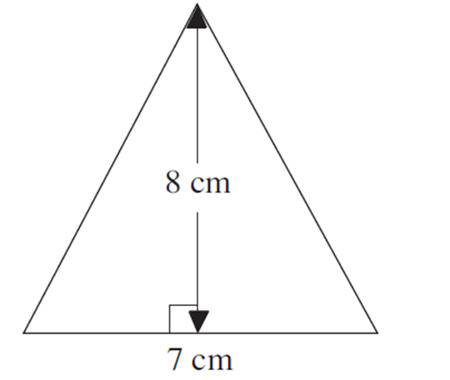
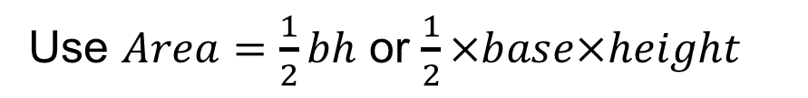
UNIT:
Area
Section 1
Squares, Rectangles and Triangles
Section 1: Fitness Check
Here are some questions to check your progress; there are more practice questions if needed.
1. Find the area of the triangle.
Use $Area=\frac{1}{2}bh$ or $\frac{1}{2}×base×height$
= 28 cm²

Slide 13
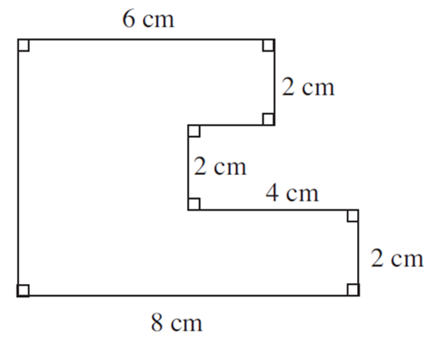
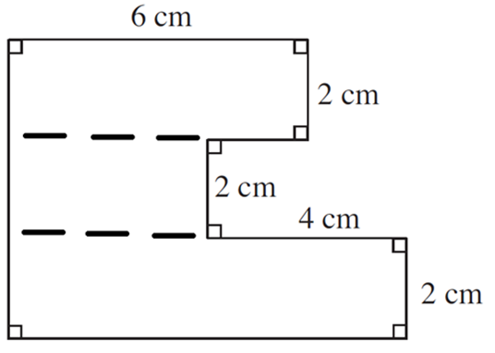
UNIT:
Area
Section 1
Squares, Rectangles and Triangles
Section 1: Fitness Check
2. Find the area and perimeter of the shape.
Answers
Perimeter = 32 cm
Area = 36 cm²
Note that the area can be found, for example, by splitting the shape into three rectangles as opposite.

Slide 14
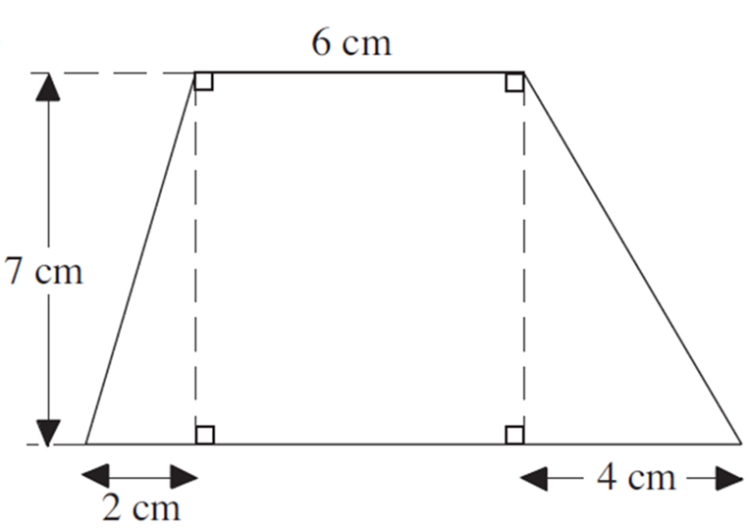

UNIT:
Area
Section 1
Squares, Rectangles and Triangles
Section 1: Fitness Check
3. Find the area of the shape.
Answer
Area = $\frac{1}{2}×2×7$ + $6×7$ + $\frac{1}{2}×4×7=$
63 cm²

Slide 15
UNIT:
Area
Section 1
Squares, Rectangles and Triangles
Section 1: Review
You have completed the first Section.
If you have completed and understood this section, click to start the next Section
If you need more examples and interactive practice, press here
You might also find it helpful to look at:
Essential Information: press here

Slide 16
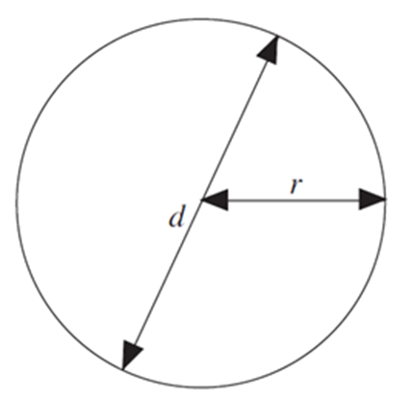

UNIT:
Area
Section 2
Area and Circumference
of Circles
Parts of a Circle
The lengths on a circle are shown on the diagram below, where r is the radius and d is the diameter. Also, we have the length around the outside of the circle which is called the circumference, C.

Slide 17
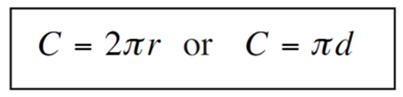
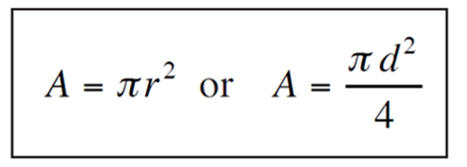
UNIT:
Area
Section 2
Area and Circumference
of Circles
Area and Circumference of a Circle
The circumference of a circle can be calculated using
where r is the radius and d the diameter of the circle. π represents the number 3.14
The area of a circle is found using

Slide 18
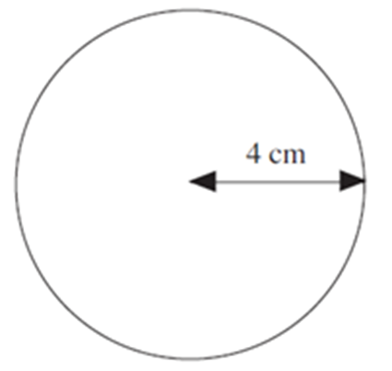
UNIT:
Area
Section 2
Area and Circumference
of Circles
Area and Circumference: Examples
Example 1
Find the circumference and area of this circle.
Solution
The circumference is found using C = 2πr , which in this case gives
C = 2 ×3.14×4
= 25.1 cm (to one decimal place)
The area is found using A = πr², which gives
= 3.14×16
A = 3.14×4²
= 50.3 cm² (to one decimal place)

Slide 19
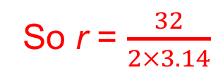
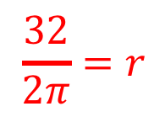
UNIT:
Area
Section 2
Area and Circumference
of Circles
Area and Circumference: Examples
Example 2
Find the radius of a circle if:
a) its circumference is 32 cm, b) its area is 14.3 cm²
Solution
Using C = 2πr
gives 32 = 2πr
and dividing both sides by 2π gives
$$\frac{32}{2π}=r$$
So r = $\frac{32}{2×3.14}$
= 5.09 cm (to 2 decimal places)

Slide 20
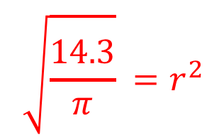
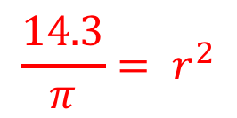
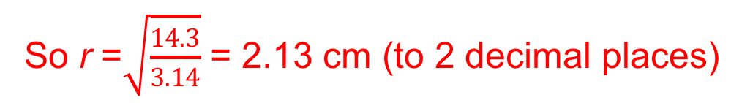
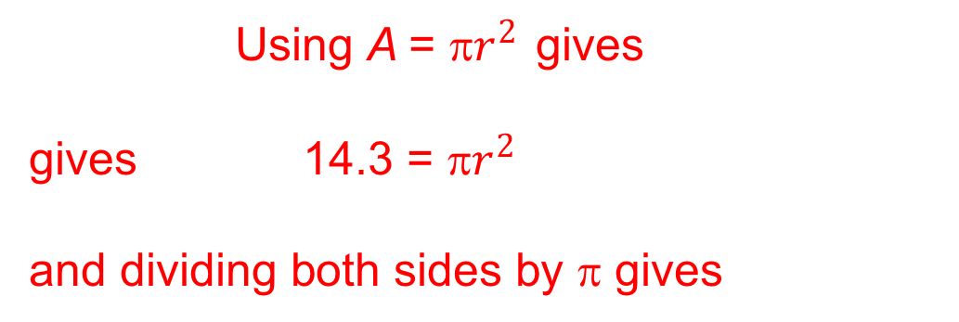
UNIT:
Area
Section 2
Area and Circumference
of Circles
Area and Circumference: Examples
Solution
Using A =${ \text{}r}^{2}$ gives
gives 14.3 = π$r^{2}$
and dividing both sides by π gives
$$\frac{14.3}{π}{= r}^{2}$$
then taking the square root of both sides gives
$$\sqrt{\frac{14.3}{π}} {=r}^{2}$$
So r =$\sqrt{\frac{14.3}{3.14}}$ = 2.13 cm (to 2 decimal places)

Slide 21
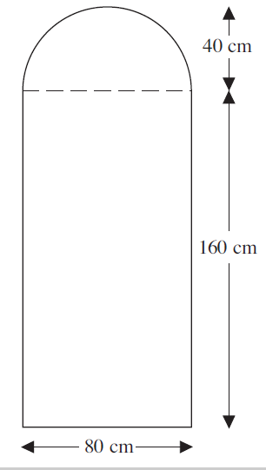
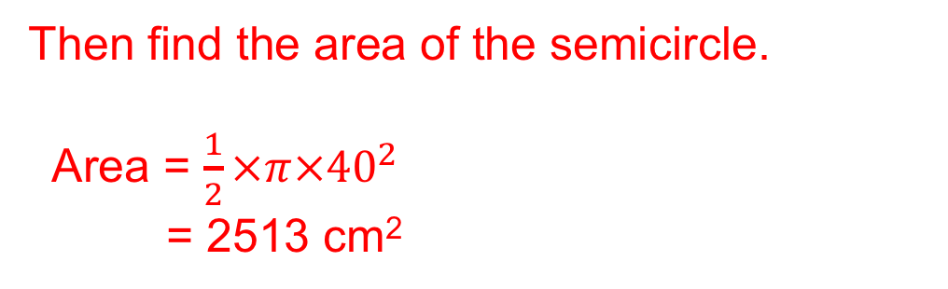
UNIT:
Area
Section 2
Area and Circumference
of Circles
Area of Combined Shapes
Example 3
Find the area of the door shown in the diagram. The top part of the door is a semicircle.
Solution
First find the area of the rectangle.
Area = 80 × 160
= 12800 cm²
Then find the area of the semicircle.
Area = $\frac{1}{2}×π×{40}^{2}$
= 2513 cm²
Total area = 12800 + 2513
= 15313 cm² (to the nearest cm²)

Slide 22
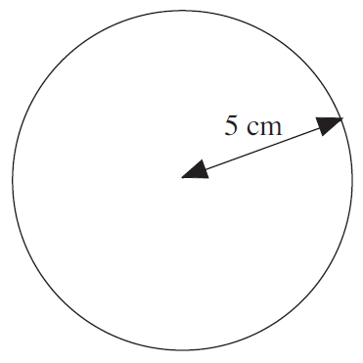
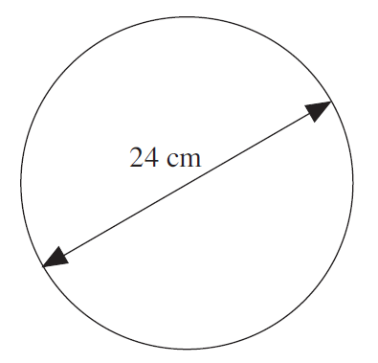
UNIT:
Area
Section 2
Fitness Check
Section 2: Fitness Check
Here are some questions to check your progress; there are more practice questions if needed.
1. Find the circumference and area of this circle.
Answers
C = 2 ×3.14×5
= 31.4 cm (to one decimal place)
A = 3.14×5²
= 78.5 cm² (to one decimal place)
2. Find the circumference and area of this circle.
Answers
C = 75.4 cm (to one decimal place)
A = 452.2 cm² (to one decimal place)
NOTE: The diameter is given in the diagram and you need to half this to get the radius.

Slide 23
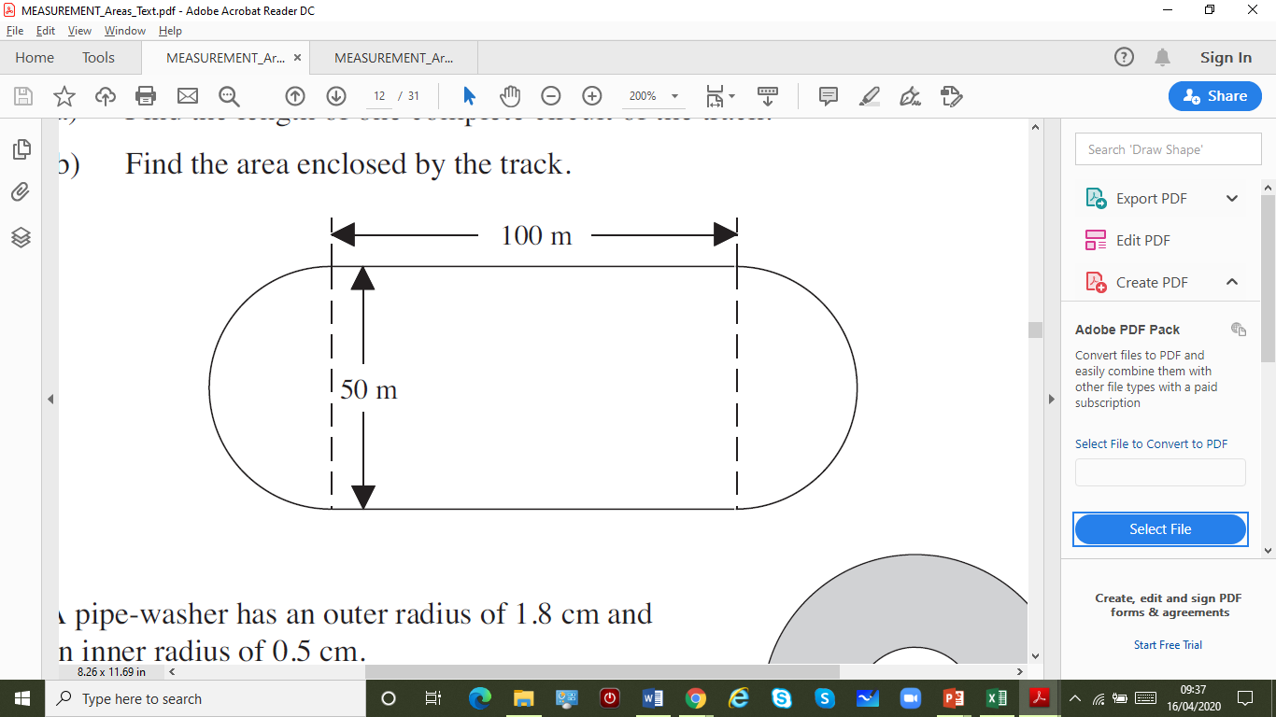
UNIT:
Area
Section 2
Fitness Check
Section 2: Fitness Check
Check your progress; there are more practice questions if needed.
3. Find the radius of a circle if:
a) its circumference is 18 cm, (b) its area is 69.4 cm²
Answers
a) 2.87 cm (to 2 decimal places)
b) 4.70 cm (to 2 decimal places)
4. Here is a running track.
a) Find the length of one
complete circuit of the track.
b) Find the area enclosed
by the track.
Answers
a) 357.1 cm (to 1 decimal place)
b) 6963 cm² (to nearest cm²)

Slide 24
UNIT:
Area
Section 2
Review
Section 2: Review
You have completed the second Section.
If you have completed and understood this section, click to start the next Section
If you need more examples and interactive practice, press here
You might also find it helpful to look at:
Essential Information: press here

Slide 25
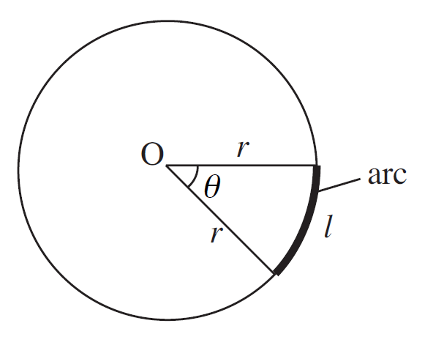
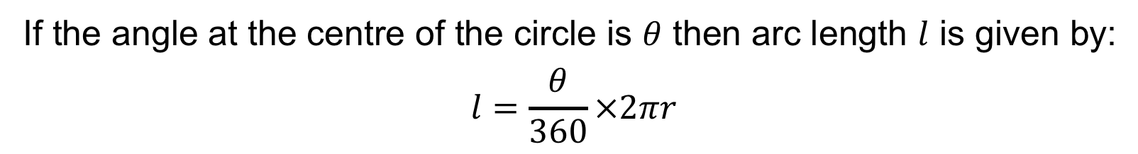
UNIT:
Area
Section 3
Sector Areas
and
Arc Lengths
Definitions and Formula
Sectors and Arc Length
A sector is a slice of a circle, like a slice of a cake. Part of the circumference of a circle is called an arc, as shown in the diagram.
If the angle at the centre of the circle is $θ$ then arc length $l$ is given by:
$$l=\frac{θ}{360}×2πr$$

Slide 26
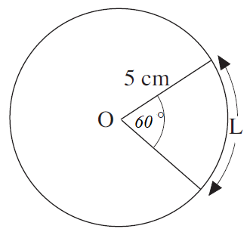
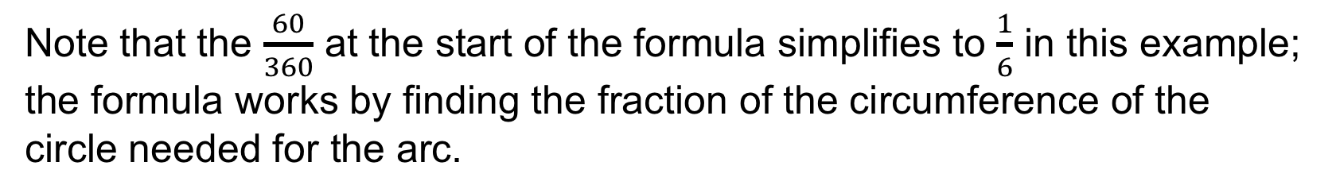
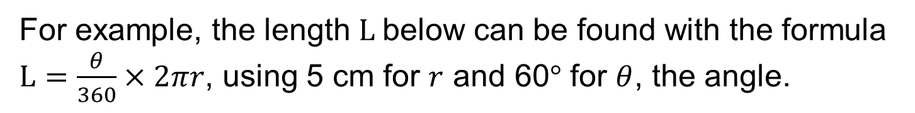
UNIT:
Area
Section 3
Sector Areas
and
Arc Lengths
Example
Sectors and Arc Length
For example, the length L below can be found with the formula $L=\frac{θ}{360}×2πr$, using 5 cm for $r$ and 60° for $θ$, the angle.
$$L=\frac{θ}{360}×2πr =\frac{60}{360}×2×3.14×5 cm=5.23 cm (to 2 d.p.)$$
Note that the $\frac{60}{360}$ at the start of the formula simplifies to $\frac{1}{6}$ in this example; the formula works by finding the fraction of the circumference of the circle needed for the arc.

Slide 27
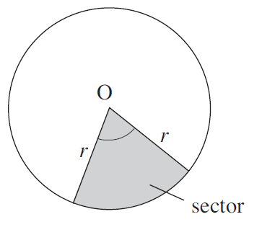
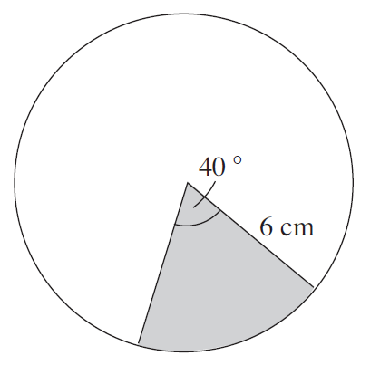
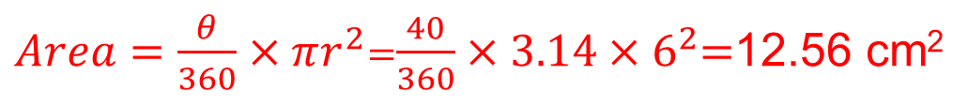
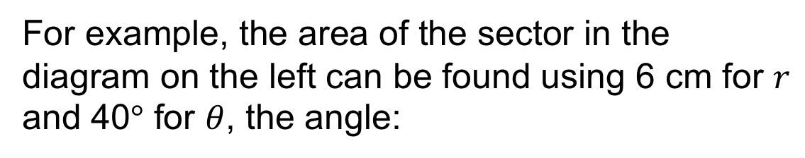
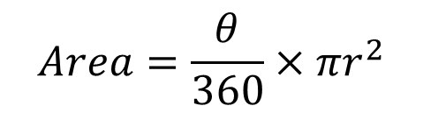
UNIT:
Area
Section 3
Sector Areas
and
Arc Lengths
Formula for Sector Area
Area of a Sector
The area of the sector, as shown in the diagram below, can be found using the formula
$$Area=\frac{θ}{360}×πr^{2}$$
For example, the area of the sector in the diagram on the left can be found using 6 cm for $r$ and 40° for $θ$, the angle:
$Area=\frac{θ}{360}×πr^{2}$=$\frac{40}{360}×3.14{×6}^{2}$=12.56 cm²

Slide 28
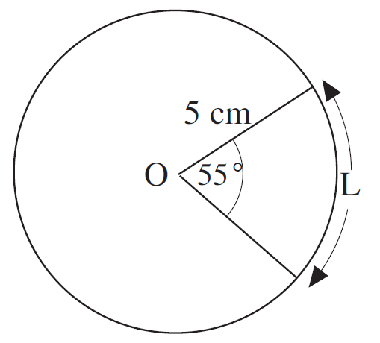
UNIT:
Area
Section 3
Fitness Check
Section 3: Fitness Check
Here are some questions to check your progress; there are more practice questions if needed.
1. Find the length L shown in the diagram below.
Answer
4.80 cm (to 2 decimal places)

Slide 29
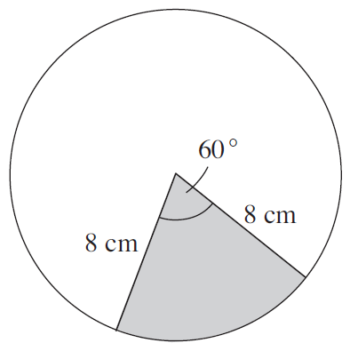
UNIT:
Area
Section 3
Fitness Check
Section 2: Fitness Check
Check your progress; there are more practice questions if needed.
2. Find the area of the sector shown below.
Answer
33.5 cm² (to 1 decimal place)

Slide 30
UNIT:
Area
Section 3
Review
Section 3: Review
You have completed the third Section.
If you have completed and understood this section, click to start the next Section
If you need more examples and interactive practice, press here
You might also find it helpful to look at:
Essential Information: press here

Slide 31
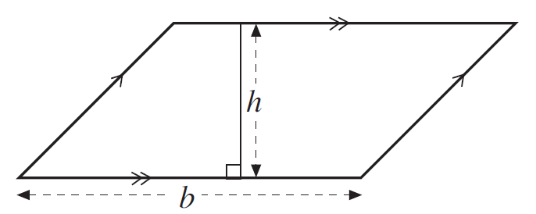
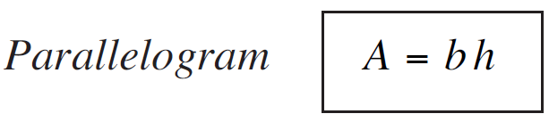
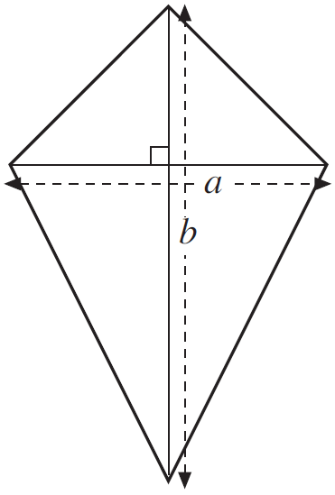



UNIT:
Area
Section 4
Areas of Parallelograms, Trapeziums,
Kites
and
Rhombuses
Area
Parallelograms, Trapeziums, Kites and Rhombuses are all four sided shapes, known as quadrilaterals. Their areas can be found using the following formulae:
The area of a rhombus, a diamond shape, can be found using either the formula for a kite or the formula for a parallelogram.

Slide 32




UNIT:
Area
Section 4
Areas of Parallelograms, Trapeziums,
Kites
and
Rhombuses
Examples
Example 1
Find the area of this kite.
Solution
Using the formula $A=\frac{1}{2}ab$
with $a$ = 5 and $b$ = 8 gives
$$A=\frac{1}{2}×5×8$$
$=$ 20 cm²

Slide 33





UNIT:
Area
Section 4
Areas of Parallelograms, Trapeziums,
Kites
and
Rhombuses
Area
Example 2
Find the area of this trapezium.
Solution
Using the formula $A=\frac{1}{2}h(a+b)$
with $a$ = 6, $b$ = 12 and $h$ = 8 gives
$$A=\frac{1}{2}×8×(6+12)$$
$$=\frac{1}{2}×8×18$$
$=$ 72 cm² (to one decimal place)

Slide 34


UNIT:
Area
Section 4
Fitness Check
Section 4: Fitness Check
Here are some questions to check your progress; there are more practice questions if needed.
1) The diagram shows the end wall of a wooden shed. Find the area of this end of the shed.
Answer
3.5 m²
2) Find the area of the shape below.
Answer
10.2 cm²

Slide 35
UNIT:
Area
Section 4
Review
Section 4: Review
You have completed the fourth Section.
If you have completed and understood this section, click to start the next Section
If you need more examples and interactive practice, press here
You might also find it helpful to look at:
Essential Information: press here

Slide 36


UNIT:
Area
Section 5
Surface Area
Surface Area: Cuboids
Three dimensional shapes, like the cuboid shown on the right, have a surface area which can be found by adding up the areas of all the faces of the shape.
This diagram shows the net for a cuboid. To find the surface area the area of each of the 6 rectangles must be found and then added to give the total surface area.

Slide 37


UNIT:
Area
Section 5
Surface Area
Surface Area: Formula for Cuboid
If x, y and z are the lengths of the sides of the cuboid, then the area of the rectangles in the net are as shown on the right.
The total surface area of the cuboid is then
given by:
$A=xy+yz+xz+$ $xy+yz+xz$
This can be written more simply as
$A=2xy+2yz+$ $2xz$
This is the formula for the surface area of a cuboid.

Slide 38


UNIT:
Area
Section 5
Surface Area
Surface Area: Cylinder
To find the surface area of a cylinder, consider how a cylinder can be broken up into three parts, the top, bottom and curved surface, as in the diagram on the right.
The areas of the top and bottom are
the same: they are circles, and each is given by $πr^{2}$.
The curved surface is a rectangle when rolled out: the next slide shows you how to find the area of this part of the surface.

Slide 39



UNIT:
Area
Section 5
Surface Area
Surface Area of Cylinder: Formula
For the curved surface, the length of one side is the same as the circumference of the circles, $2πr$, and the other side is simply the height of the cylinder, h. So the area is $2πrh$.
The total surface area of the cylinder is found by adding the area of two circles to the area of this rectangle
$A= πr^{2}+πr^{2}+2πrh$
This can be written more simply as
$A= 2πr^{2}+2πrh$
This is the formula for the surface area of a cylinder.

Slide 40


UNIT:
Area
Section 5
Surface Area
Surface Area: Sphere
Another important result is the surface area of a sphere.
For a sphere with radius r, the surface area is given by the formula
$$A=4πr^{2}$$

Slide 41




UNIT:
Area
Section 5
Surface Area
Surface Areas: Examples
Example 1
Find the surface area of this cuboid
Solution
Here is the net of the cuboid and the areas of the rectangles that it contains.
So the total surface area is
$A=2×20+2×30+2×24$
$=$ 148 cm²

Slide 42




UNIT:
Area
Section 5
Surface Area
Surface Area: Examples
Example 2
Cans are made out of aluminium sheets, and are cylinders of radius 3 cm and height 10 cm. Find the area of aluminium needed to make one can.
Solution
Using the formula
$A= 2πr^{2}+2πrh$
The total surface area is
$A= 2×3.14×3^{2}+2×3.14×3×10$
$=$ 245.04 cm² (to 2 d.p.)

Slide 43

UNIT:
Area
Section 5
Surface Area
Surface Area: Examples
Example 3
A ball has radius 4 cm. What is its surface area, to the nearest cm² ?
Solution
The area is found using the formula for the surface area of a sphere
$$A=4πr^{2}$$
$=4×3.14×4^{2}$
$=201$ cm² (to the nearest cm²)

Slide 44


UNIT:
Area
Section 5
Fitness Check
Section 5: Fitness Check
Here are some questions to check your progress; there are more practice questions if needed.
Find the surface area of the
the cuboid opposite.
Answer
136 cm²
2. Find the surface area of the
cylinder opposite.
Answer
114.5 cm²

Slide 45
UNIT:
Area
Section 5
Review
Area
You have completed the fifth Section.
If you have completed and mastered this last section, click here for the Unit audit
If you need more examples and interactive practice, press here
You might also find it helpful to look at:
Essential Information: press here

