Slide 1
Supporting and Enhancing Mathematics and Statistics
UNIT: Solids

Slide 2
UNIT:
Solids
Solids
This Unit focuses on Solids, 3-dimensional shapes, how they can
be described and constructed.
You have four sections to work through and there are check up audits
and fitness tests for each section.
Making Solids Using Nets
Constructing Nets
Plans and Elevations
Using Isometric Paper

Slide 3
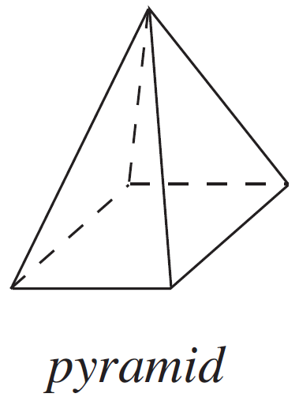
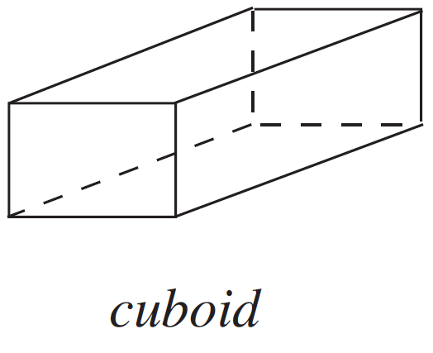
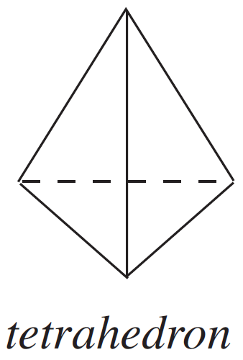
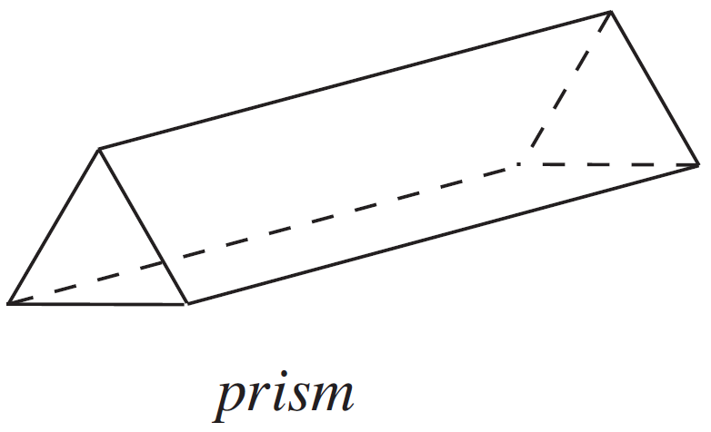
UNIT:
Solids
Section 1
3-Dimensional Shapes
In this unit, you will be dealing with 3-dimensional shapes such as:

Slide 4
UNIT:
Solids
Section 1
Prisms
Prisms are a common 3 dimensional shape. They can be formed
by taking any two dimensional shape and extending (‘extruding’) it
to create a 3 dimensional shape with a cross section of the original
2D shape. The prism can be named after the 2D shape, for
example, the prism below could be named a triangular prism.

Slide 5
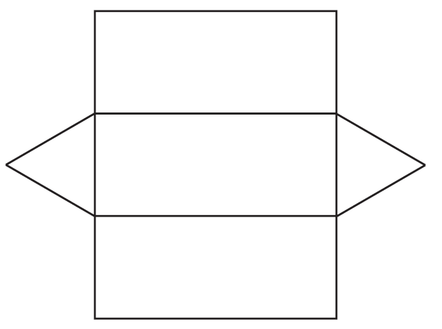
UNIT:
Solids
Section 1
Making Solids Using Nets
Example 1
A net can be cut out, folded and glued to make a hollow shape.
What solid is made when the net shown is folded and glued?
You can try this question and check your answer on the next slides

Slide 6

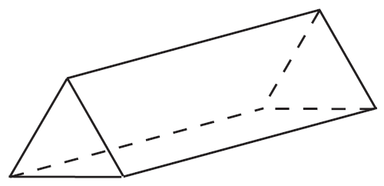
UNIT:
Solids
Section 1
Making Solids Using Nets
Solution
It is important to add tabs to the net so that it can be glued. You could put tabs on every edge, but this would mean gluing tabs to tabs. The first diagram shows one possible position of the tabs.
The final solid is a triangular prism.

Slide 7
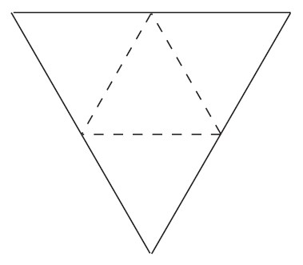

UNIT:
Solids
Section 1
Section 1: Fitness Check
Here are some questions to check your progress; there are more practice questions if needed.
Copy and cut out larger versions of the following nets. What is the name of the solid you make?

Slide 8
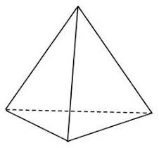
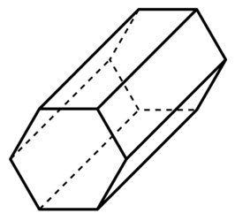
UNIT:
Solids
Section 1
Section 1: Fitness Check
Answers
The first shape is a pyramid, with a triangular base. The second shape is a prism, with a hexagon cross section, which can be named a hexagonal prism.

Slide 9
UNIT:
Solids
Section 1
Section 1: Review
You have completed the first Section.
If you have completed and mastered this section,
click to start the next Section
If you need more examples and interactive practice,
press here
You might also find it helpful to look at:
Essential Information: press here

Slide 10
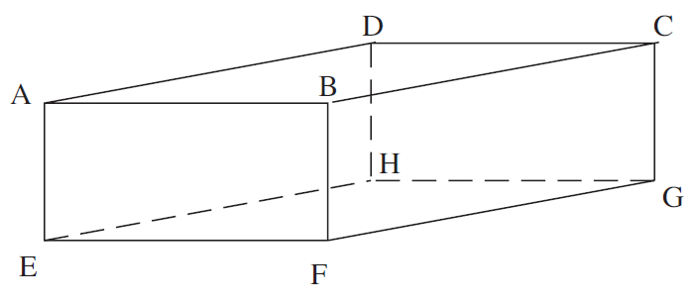
UNIT:
Solids
Section 2
Constructing Nets
A net for a solid can be visualised by imagining that the shape is cut along its edges until it can be laid flat.
Example 1
Draw the net for the cuboid shown in the diagram.

Slide 11

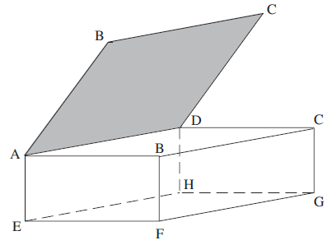
UNIT:
Solids
Section 2
Constructing Nets
Solution
A possible solution is
shown on the left.
It then can be folded together to make the cuboid, as below.

Slide 12
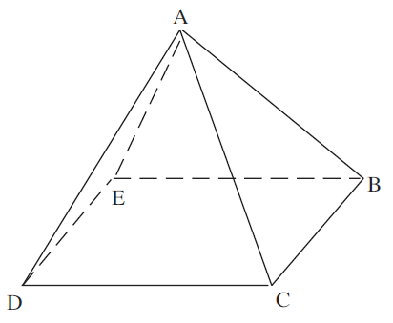
UNIT:
Solids
Section 2
Constructing Nets
Example 2
Draw the net for this square-based pyramid.

Slide 13
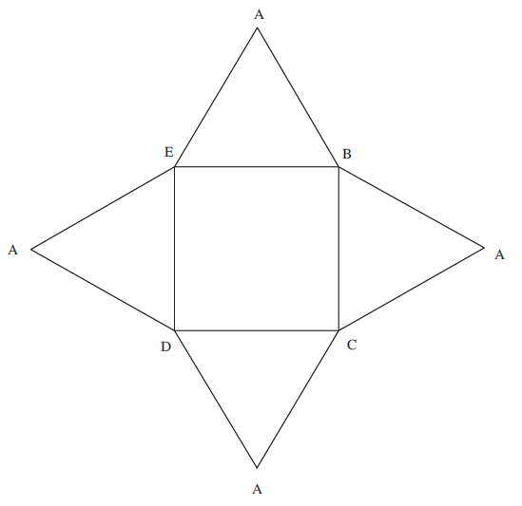
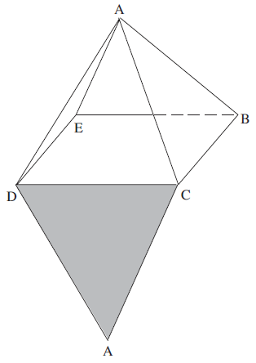
UNIT:
Solids
Section 2
Constructing Nets
Solution
A possible solution is
shown on the left.
It then can be folded together to make the shape, as below.

Slide 14
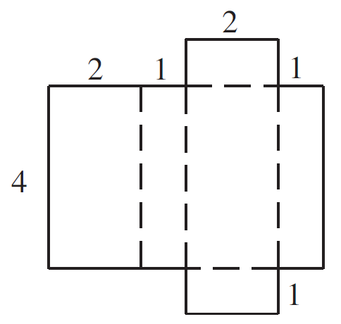
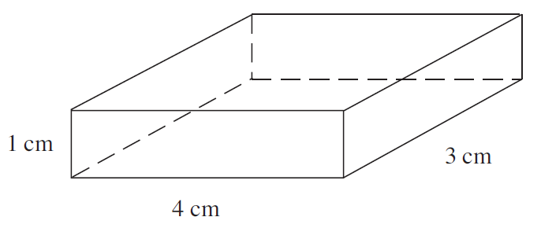
UNIT:
Solids
Section 2
Section 2: Fitness Check
Here are some questions to check your progress; there are more practice questions if needed.
1. Draw an accurate net for the cuboid below.
Answer
One possible answer
is shown above

Slide 15
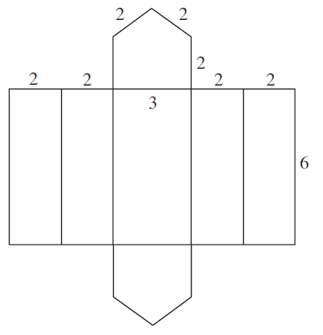
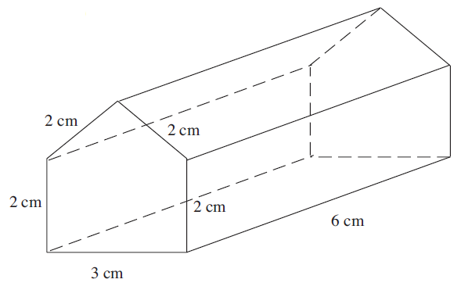
UNIT:
Solids
Section 2
Section 2: Fitness Check
2. Draw an accurate net for the prism below.
Answer
Note: this is just one possible answer

Slide 16
UNIT:
Solids
Section 2
Section 2: Review
You have completed the second Section.
If you have completed and mastered this section,
click to start the next Section
If you need more examples and interactive practice,
press here
You might also find it helpful to look at:
Essential Information: press here

Slide 17
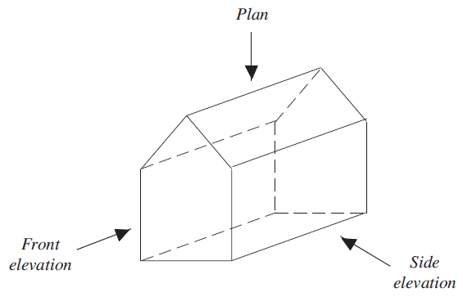
UNIT:
Solids
Section 3
Plans and Elevations
The plan of a solid is the view from above, as in the diagram below.
The elevation of a solid is the view from a side.
We often use the terms front elevation and side elevation.

Slide 18
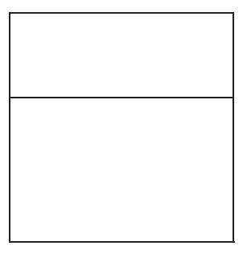
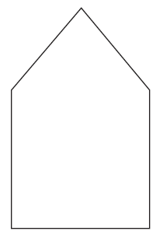
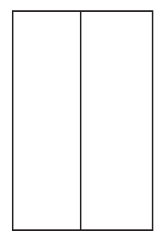
UNIT:
Solids
Section 3
Plans and Elevations
Looking from the side gives the
Side elevation
Looking from the front gives the
Front elevation
Looking from above gives the
Plan

Slide 19
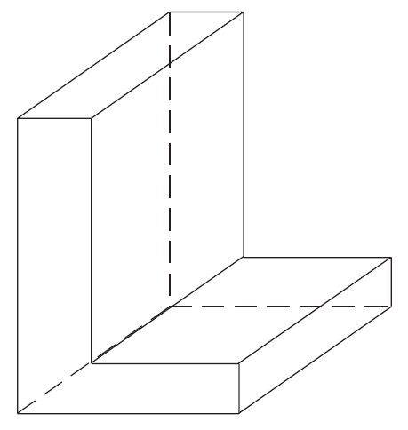
UNIT:
Solids
Section 3
Plans and Elevations
Example
Draw the front elevation, side elevation and plan of this shape, taking the L face to be the ‘front’ of the shape.

Slide 20
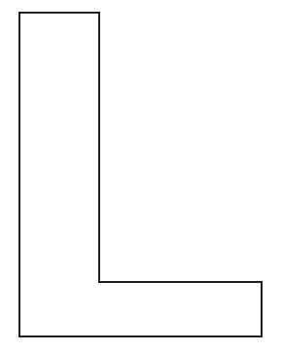
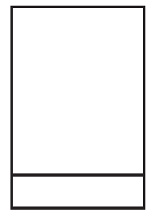

UNIT:
Solids
Section 3
Plans and Elevations
Solution
Looking from the front gives the
Front elevation
Looking from the side gives the
Side elevation
Looking from above gives the
Plan

Slide 21
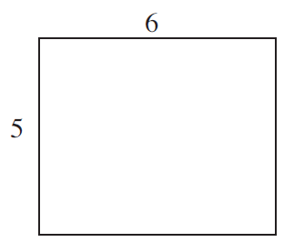
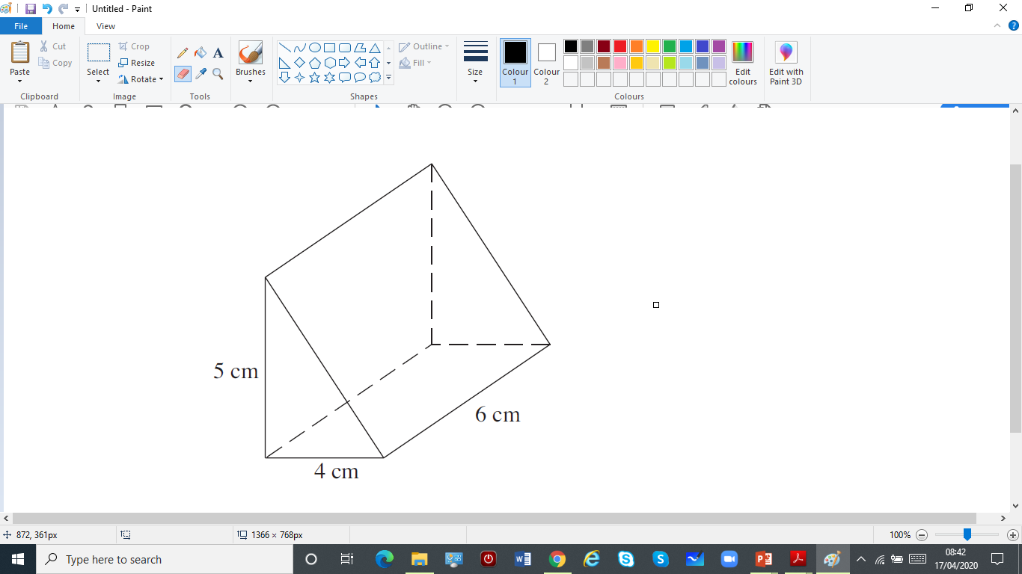
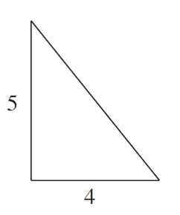

UNIT:
Solids
Section 3
Section 3: Fitness Check
Here is a question, to check your progress; there are more practice questions if needed.
Side elevation
Draw the front elevation, side elevation and plan
of this shape, taking the triangular face to be the
‘front’ of the shape.
Front elevation
Plan

Slide 22
UNIT:
Solids
Section 3
Section 3: Review
You have completed the third Section.
If you have completed and mastered this section,
click to start the next Section
If you need more examples and interactive practice,
press here
You might also find it helpful to look at:
Essential Information: press here

Slide 23
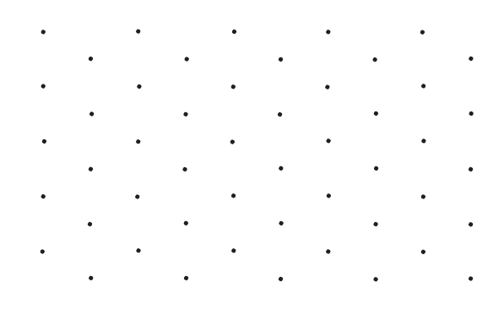
UNIT:
Solids
Section 4
Isometric Paper
The spots on isometric paper are arranged
at the corners of equilateral triangles.
Isometric
paper

Slide 24
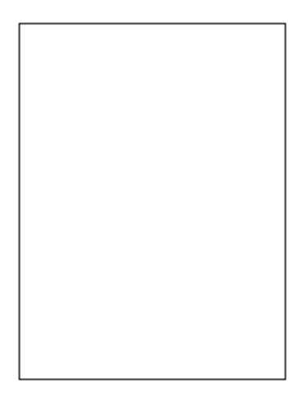

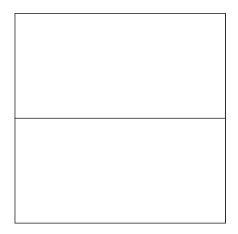
UNIT:
Solids
Section 4
Using Isometric Paper
Example
The diagrams below show the plan and elevations of a solid object.
Plan Front elevation Side elevation
Draw the object on isometric paper.

Slide 25
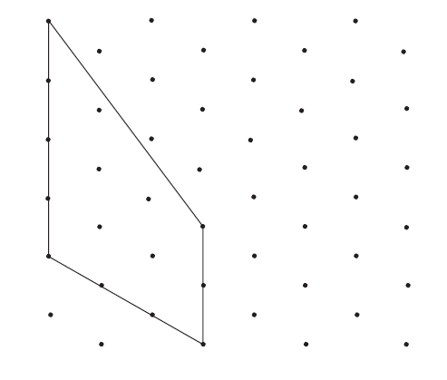

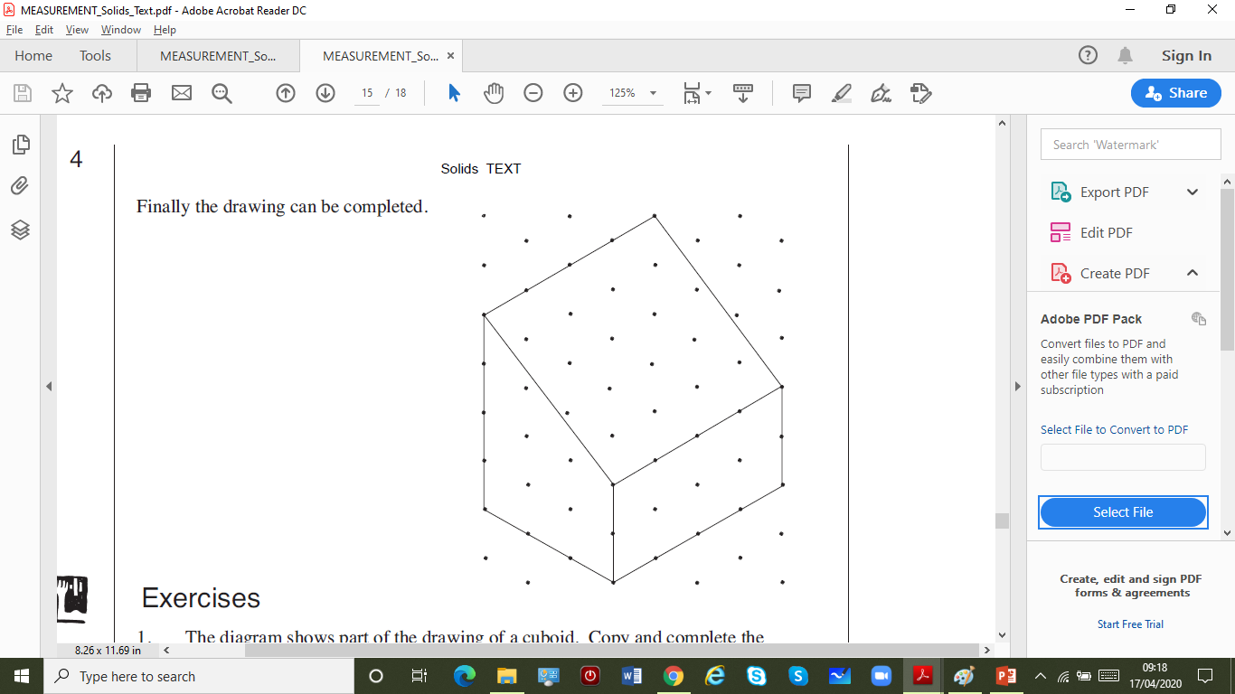
UNIT:
Solids
Section 4
Using Isometric Paper
Solution
From the front elevation
the front can be drawn.
Then using the side elevation the lower part of the side can be drawn.
Finally the drawing can be completed.

Slide 26
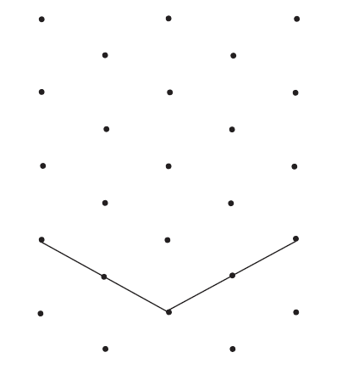
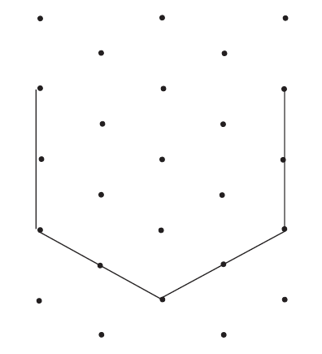
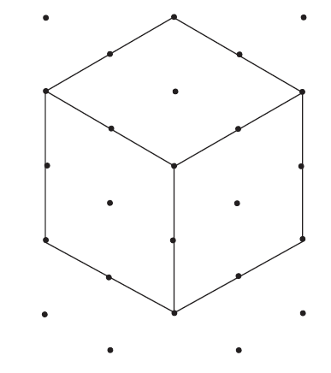
UNIT:
Solids
Section 4
Section 4: Fitness Check
Here is a question, to check your progress; there are more practice questions if needed.
Draw a cube with sides of 2 cm on isometric paper.
Answer (note that you may draw the sides in a different order, but the end result will be the same)

Slide 27
UNIT:
Solids
Section 4
Section 4: Review
You have completed the fourth Section.
If you have completed and mastered this last section,
click here for the Unit audit
If you need more examples and interactive practice,
press here
You might also find it helpful to look at:
Essential Information: press here

