Slide 1
Supporting and Enhancing Mathematics and Statistics
UNIT: Mechanics Introduction

Slide 2
Mechanics Introduction
UNIT:
Mechanics Introduction
This Unit is an introduction to mechanics, including mathematical
modelling, forces & motion and units & dimensions.
You have six sections to work through and there are check up audits
and fitness tests for most sections.
Mathematical Modelling
Modelling from Data
Motion and Force
Newton’s Law of Gravitation
Further Mathematical Modelling
Units and Dimensions

Slide 3
Mathematical Modelling
UNIT:
Mechanics Introduction
Section 1
This Unit is about the use of mathematics in solving realistic
problems. Mathematics occurs in many subjects: engineering and
physics in particular, but also in economics, biology, epidemiology,
and transport, making it vital to industry, commerce, government
and health. Applying mathematics to such a wide range of subjects
requires not only good mathematical problem solving skills but also
the ability of the mathematician to start with a problem in non-
mathematical form and to give the results of any mathematical
analysis in non-mathematical form. In between these start and end
points, the mathematician must:
formulate the problem to allow the use of mathematical analysis,
solve any mathematical problems that have been set up,
interpret the solution in the context of the original setting.

Slide 4
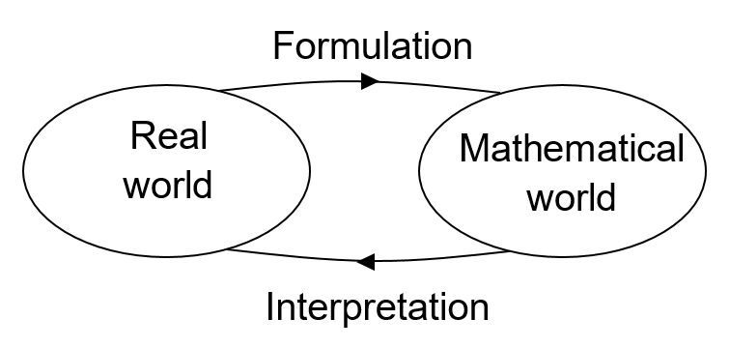
Mathematical Modelling
UNIT:
Mechanics Introduction
Section 1
This process is called mathematical modelling and is illustrated by
the diagram below.

Slide 5
Mathematical Modelling
UNIT:
Mechanics Introduction
Section 1
Central to mathematical modelling is the representation of the real
world problem mathematically. In mechanics the real world problem is
commonly represented with a formula. Such a representation is what
is meant by a mathematical model. The mathematical model could
also come in other forms such as a graph, a spreadsheet, a flow
chart, and many others.
For example, the formula s = 15t describes distance travelled s (in metres) in terms of time t (in seconds) when travelling at a speed of 15 ms⁻¹. The formula s = 15t is a simple example of a mathematical model.
Broadly speaking, a mathematical model is a relation between two
or more variables. The challenge to the applied mathematician is
to formulate a good model which accurately describes or
represents a given situation. A good model, importantly, can be
used to make predictions about future behaviour.

Slide 6
Mathematical Modelling
UNIT:
Mechanics Introduction
Section 1
The first step in trying to devise a mathematical model for a given
situation is to identify the quantities which can be measured and
whose values will describe the real situation.
In mechanics these quantities might be position, velocity, mass, etc. More generally you might be interested in mortality rates, inflation, interest rates, infection rate of a virus, etc.
Such quantities are called variables. In the previous example the variables are distance (s) and time (t).

Slide 7
Section 1: Review
UNIT:
Mechanics Introduction
Section 1
You have completed the first Section.
If you have completed and understood this section, click to start the next Section
If you need more examples and interactive practice,
press here.
You might also find it helpful to look at:
Essential Information: press here

Slide 8
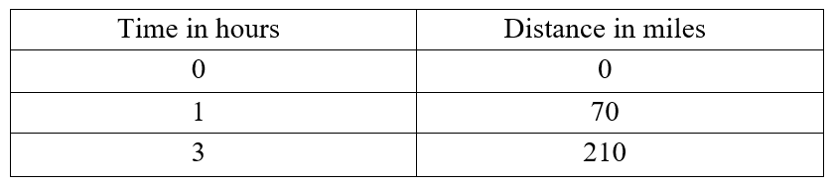
Modelling from Data
UNIT:
Mechanics Introduction
Section 2
One of the simplest methods for finding a mathematical model for a given situation is to carry out an appropriate experiment to collect relevant data: from this data a formula relating the variables can be found. This is called Empirical Modelling.
Example 1
A motorist records the distance they travel along a motorway at various times. The data are recorded in the table below:
Produce a model for this data represented by a formula, using the variables s for distance travelled and t for time.

Slide 9
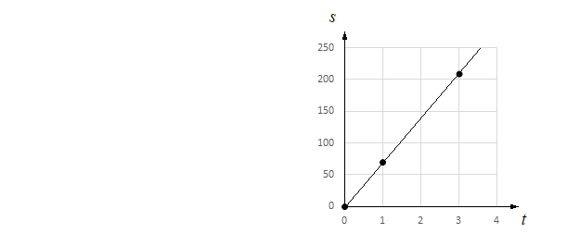
Modelling from Data
UNIT:
Mechanics Introduction
Section 2
Solution
The data suggest that for every hour travelled, the car covers a distance of 70 miles on average, so you can multiply the number of hours travelled by 70 to obtain the distance travelled in miles. An appropriate formula, therefore, would be s = 70t where t is the time in hours and s is the distance in miles.
The above example is a simple and familiar one, but it illustrates the procedure of taking data and producing a formula from it, going from the real world to the mathematical world. Here the formula is fairly easy to identify, but usually the process of finding a model is much more difficult. Commonly a graph is helpful as shown here, with a line of best fit being used to identify the formula.

Slide 10
Modelling from Data
UNIT:
Mechanics Introduction
Section 2
Solution (continued)
The graph, table and the formula are all mathematical models and can be used to describe the given situation and to predict what might happen for other variable values.
For example, the formula and graph predict that about 245 miles will be travelled in 3.5 hours.
Also note that in reality the data will not be so tidy, not following a perfect straight line; in practise, with real data, a line of best fit can be plotted and the formula produced from that. This is a common technique used in mathematical modelling.

Slide 11
Modelling from Data
UNIT:
Mechanics Introduction
Section 2
Example 2
A ball is dropped onto a hard floor. A model for the motion of the ball is investigated. Sketch a graph of Height against Time for a ball dropped from 5 metres. You can produce this sketch by doing your own experiment, or you can find videos online which show practical demonstrations of experiments with a bouncing ball.
Solution
A simple experiment of dropping a ball onto a hard surface will illustrate the relationship between the maximum height before each bounce and the maximum height after each bounce. The first rebound height will be less than the original height from which the ball was dropped and then this cycle repeats itself.

Slide 12
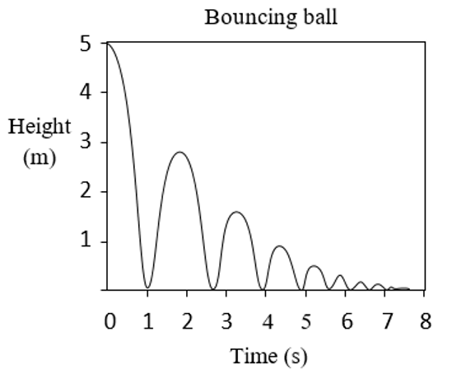
Modelling from Data
UNIT:
Mechanics Introduction
Section 2
Solution (continued)
The graph you produce should look something like this:
The times may be different on your graph, the heights may also be different, but the pattern will be the same: each successive height is less than the previous. A formula for this behaviour is much more advanced than the previous example, so here the sketch will suffice, but it is possible to produce such a formula when you have further knowledge of mathematics, mechanics and mathematical modelling.

Slide 13
Section 2: Fitness Check
UNIT:
Mechanics Introduction
Section 2
Here is a question to check your progress; there are more practice questions if needed.
A simple pendulum consists of a small object attached to a fixed point by a string of length l. As the object swings back and forth the period of the pendulum is the time taken for one complete cycle.
a) Does the length of the pendulum affect the period?
Does the mass of the object affect the period?
Have a guess at the behaviour first, but you can then experiment or find videos online to answer these questions. Finally, research online or use books to find the formula for the period, T, in terms of the length, l, and mass, m.
l

Slide 14
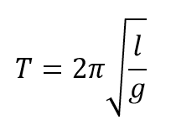
Section 2: Fitness Check
UNIT:
Mechanics Introduction
Section 2
Answers
The period is affected by the length of the pendulum.
The period is not affected by the mass.
The above relationships are confirmed by experiment.
The formula for the Period T is

Slide 15
Section 2: Review
UNIT:
Mechanics Introduction
Section 2
You have completed the second Section.
If you have completed and understood this section, click to start the next Section
If you need more examples and interactive practice, press here
You might also find it helpful to look at:
Essential Information: press here

Slide 16
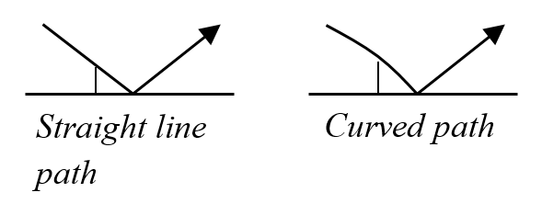
Motion
UNIT:
Mechanics Introduction
Section 3
Mechanics is concerned with the motion of objects and what influences motion. Motion is the change in position and orientation of an object with time. An object’s motion can be described simply by its path: the route it follows on its journey.
In many cases motion is complicated; take for example the motion of a tennis ball from server to receiver. At first sight it might be thought that the ball moves in a straight line from the server’s racket to the ground, before bouncing to the receiver. However, on closer observation the tennis ball is seen to move in a curved path. In fact, the motion of the ball could also involve a swerve and/or a dipping in its path.

Slide 17
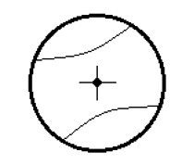
Motion
UNIT:
Mechanics Introduction
Section 3
In this section the paths of objects in simple scenarios are considered. To do this an object will be treated as a particle. This means that the size of the object is ignored and the path of the object is modelled by following some point on the object, as shown with the tennis ball below; it also allows the spin/rotation of the object to be ignored.
The examples here will only go as far as describing and sketching the path of an object, but later it will be possible to describe the motion mathematically, even producing a formula, thereby being able to predict where an object will be in the future. The mathematical description of motion considers variables of position, velocity, acceleration and time.

Slide 18
Motion
UNIT:
Mechanics Introduction
Section 3
Example 1
In each of the situations below sketch, or describe, the path of the object:
a) A tennis ball is dropped and falls to the ground.
b) A golf ball is rolled along a table and falls to the ground from the table’s end.
c) A tennis ball is thrown away from a spacecraft, into the blackness of space.
d) A satellite orbits the Earth.
e) A golf ball is struck into the air and lands a long distance away.

Slide 19
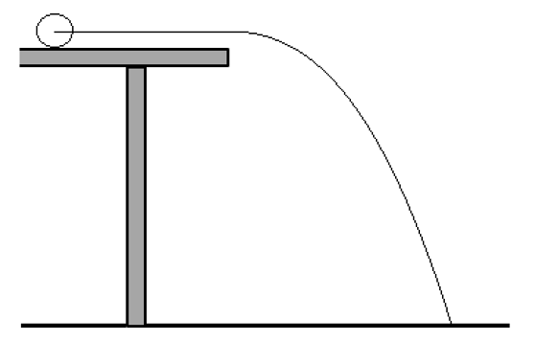
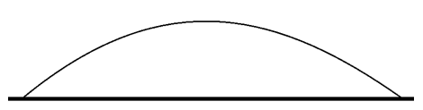
Motion
UNIT:
Mechanics Introduction
Section 3
Solutions
a) A straight line, from the point where the ball starts, to the ground.
b) A straight line along the table then a curved
path to the ground, as shown
c) A straight line away from the astronaut, not
ever stopping unless it interacts with
another object.
d) A circle (or ellipse) around planet Earth.
e) A curve through the air, a parabola models this behaviour well:

Slide 20
Force
UNIT:
Mechanics Introduction
Section 3
Force causes a change in motion. If an object which is initially at rest (not moving) suddenly starts to move, then something must have caused the motion to begin: it is force which has this effect.
You are familiar with forces, and know that if you apply a force to an object it will move. If you ‘push’ an object, such as a pen on a table, then let go, you have applied a force to it, so you will see it continue to slide along the table. Note that it can continue to move even after you let go, and have stopped applying the force.

Slide 21
Force
UNIT:
Mechanics Introduction
Section 3
The principles of force and its effect on motion can be seen more easily in space, where an object is free to move without strong effects of gravity, friction and air resistance. If you apply a force to an object in space it will move, and continue to move, in a straight line away from you, unless something else interacts with it. There are some good films which show the effects of forces in space, such as ‘Gravity’, ‘Apollo 13’ and ‘2001: A Space Odyssey’; there are also relevant videos online showing real footage from space missions.
A force can also stop an object from moving. When you slide a pen across a table, it is the force of friction which slows down and eventually stops the pen from moving. On an ice rink there is much less friction and an ice puck will continue to move for longer. You could also apply a force to change its direction, changing its path to the left or the right. Finally, you can apply a force to speed it up a little, or you can apply a force to slow it down a little.

Slide 22
Force
UNIT:
Mechanics Introduction
Section 3
So, in summary, a force can
• start motion
• stop motion
• change the direction of motion
• make an object move faster or more slowly.
These are all examples of forces changing the motion of an object.
When there are no forces acting on an object, it will remain at rest or it will continue in a straight line at a constant velocity. This hints at Newton’s laws, to be covered in detail in the another Unit.

Slide 23
Force
UNIT:
Mechanics Introduction
Section 3
Note
It may be counter-intuitive, but force is not required to maintain motion. If you are floating freely in space and you shoot a fire extinguisher, to create a force of thrust, you will begin to move. You will then continue to move, even after you release the fire extinguisher. You will continue to move at a fixed, constant velocity, unless another force is applied to you.
The spacecraft Voyager 2 was launched in 1977: it is travelling at over
9 miles per second, is over 11 billion miles from Earth and counting (you can use the NASA website to see how far from us it is now). But this spacecraft is no longer using jets to propel itself; once it was given an initial force of thrust to start its motion, it did not require further force to continue on its path.

Slide 24
Motion
UNIT:
Mechanics Introduction
Section 3
Example 2
For the following scenarios, state the effect on the motion of the force being applied.
An apple falls off a tree and the force of gravity acts upon it.
2. A biro slides along a long desk, with the force of friction acting on it.
A force of thrust on a rocket fires backwards at the rear of the rocket.
A person falling to the ground from a great height releases their parachute, producing a force of drag upwards.

Slide 25
Motion
UNIT:
Mechanics Introduction
Section 3
Solutions
It speeds up as it falls to the ground.
2. The force of friction acts against the direction the biro is sliding in, slowing it down.
The rocket’s speed increases in the forward direction.
The person’s speed towards the ground begins to reduce, slowing them down.

Slide 26
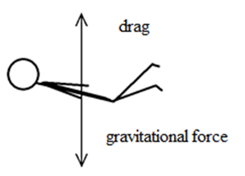
Multiple Forces and Net Force
UNIT:
Mechanics Introduction
Section 3
When solving Earth-based problems you will usually be dealing with more than one force. When multiple forces act upon an object, the forces combine and can be treated as a single resultant force, called a net force.
For example, when a skydiver is falling to the ground from a high altitude, they can obtain a terminal velocity, where they fall at a constant speed towards the ground. From what we know already, this tells us that the net force on the skydiver must be zero, as if it was not, the skydiver would be speeding up or slowing down. This is because the skydiver is subject to two forces: gravity and drag.

Slide 27
Multiple Forces and Net Force
UNIT:
Mechanics Introduction
Section 3
The skydiver is subject to two forces: gravity and drag, shown below.
Drag is a force that acts upon the skydiver upwards, against the direction they are travelling in. This is directly opposite to the direction that gravity is acting, which is towards the ground.
When the skydiver is falling at terminal velocity, the forces of gravity and drag are equal and opposite, cancelling one another out, resulting in a net force of zero. Typically this constant velocity is around 120 miles per hour.

Slide 28

Units of Force
UNIT:
Mechanics Introduction
Section 3
The mathematical description of forces leads to a measure for force:
The unit is named after Isaac Newton, whose laws will be used in the another of the Mechanics Units to solve mechanics problems in a more mathematical way. When you hold a typical smartphone in your hand you will feel a force of a little over 1 Newton from the weight of the phone. Weight is the first type of force described in the next section.

Slide 29
Types of Force
UNIT:
Mechanics Introduction
Section 3
A number of forces have been mentioned so far: friction, thrust, drag and gravitational force. This section will describe the most common forces that will be encountered in the material that follows. It can be helpful to categorise them as contact forces and non-contact forces.
Weight (gravitational force)
The gravitational force between two objects is the most familiar non-contact force. If you hold a pen in front of you and let it go, it falls to the ground. The force which produced this motion is the force of gravity. Even while an object is in the air and not in contact with any other object, gravity still acts upon it and it continues to speed up. This is why gravitational force is described as a non-contact force.
The gravitational force an object feels is called its weight. You can roughly work out the weight of an object on the surface of the Earth, in Newtons, by multiplying its mass in kilograms by ten.

Slide 30
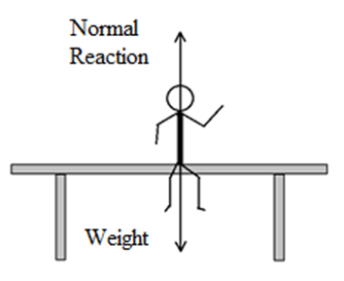
Types of Force
UNIT:
Mechanics Introduction
Section 3
All other forces you come across in this section are contact forces in which there must be contact between two surfaces for the force to exist. Words such as push, pull, tension, hit, knock, load and friction are used to describe contact forces.
Normal Reaction force
Consider the forces acting on you when you sit on a horizontal table. You have your weight acting on you in a downwards direction. But you are not moving, so there must be another force acting upwards to balance your weight. This force comes from the table and is called the Normal Reaction force. These two forces are shown in the diagram on the right.

Slide 31
Types of Force
UNIT:
Mechanics Introduction
Section 3
Normal Reaction force
The normal reaction force is a contact force and its direction is at a right angle to (or is ‘normal’ to) the table.
Note that whenever two objects are in contact there is a contact force between them. The table exerts a force upwards on you and you exert a force downwards on the table. If the table is not strong enough, it is possible for you to break it.

Slide 32
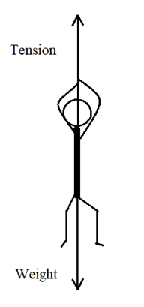
Types of Force
UNIT:
Mechanics Introduction
Section 3
Tension and Thrust
Consider the forces acting on you when you are hanging from a rope. You have your weight acting on you in a downwards direction. But, again, you are not moving, so there must be another force acting upwards to balance your weight. This force comes from the rope and is called tension. These two forces are shown in the diagram on the right.
Similar to tension is thrust. Whereas tension relates to a material exerting force by pulling you, thrust is a force which pushes you, such as a pogo stick, which pushes you up.

Slide 33
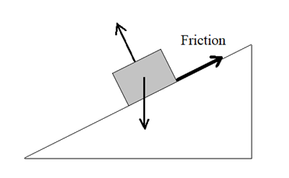
Types of Force
UNIT:
Mechanics Introduction
Section 3
Friction
When an object is sliding along a surface, it will tend to slow down. This implies that there is a force acting against it. This force is friction.
It is another contact force. Friction acts parallel to the surface of contact.
If an object is on a slope, friction acts along the line of the slope, as shown in the diagram above. Friction can prevent an object from sliding, or just slow its progress if it is already sliding. The Normal Reaction force and Weight are also shown on the diagram.

Slide 34
Types of Force
UNIT:
Mechanics Introduction
Section 3
Example 3
A book is on a table and is not moving.
Which forces are acting on the book?
The table is now lifted at one end so that it is tilted, the book is now on a slope. The book still does not move.
b) Which forces are now acting on the book?
Solutions
a) The book has weight acting on it, in a downwards direction, and the normal reaction force, which is equal and acting upwards.
b) The book still has weight acting on it, in a downwards direction, with the normal reaction force now acting perpendicular to the table, but now there must be a force of friction too. This frictional force acts along the table, in a direction which points away from the direction that the book is about to slide. This is shown in the diagram on the next page.

Slide 35
Section 3: Fitness Check
UNIT:
Mechanics Introduction
Section 3
Here is a question, to check your progress; there are more practice questions if needed.
Two teams are involved in a tug of war contest.
Draw a diagram of the situation using arrows to represent the forces.
If the teams are equally balanced how do you think that these forces compare
a) in magnitude
b) in direction?

Slide 36
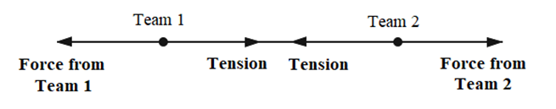
Section 3: Fitness Check
UNIT:
Mechanics Introduction
Section 3
Answers
Your diagram should look something like this:
a) All four forces are equal in magnitude.
b) They all act in the same line, forming two pairs opposite in direction.

Slide 37
Section 3: Review
UNIT:
Mechanics Introduction
Section 3
You have completed the third Section.
If you have completed and understood this section, click to start the next Section
If you need more examples and interactive practice, press here
You might also find it helpful to look at:
Essential Information: press here

Slide 38

Newton’s Universal Law of Gravitation
UNIT:
Mechanics Introduction
Section 4
In the last section a rough formula was given to find weight on the Earth’s surface, the force applicable to an object due to its mass: you can multiply the mass of the object in kg by ten to obtain its weight in Newtons.
As a formula this can be written as

Slide 39
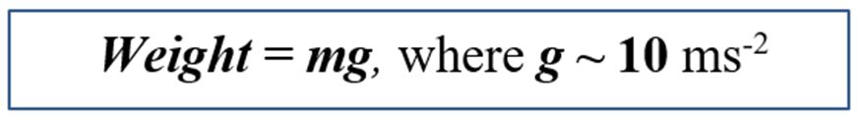
Mass and Weight
UNIT:
Mechanics Introduction
Section 4
Experience confirms this result. A bowling ball has a larger mass
(~7 kg) than a golf ball (~0.05 kg). If you hold a golf ball in one hand and a bowling ball in the other hand you will feel the gravitational force of attraction, the weight, of each object, pressing down on your hands. The force from the bowling ball, however, is far stronger. So the force of gravity on an object depends on the mass of the object.
This section will give a further example of a well-established mathematical model and through it an improved model for gravity. The model will show that a more accurate value for calculating weight on the Earth’s surface is obtained by multiplying the mass by the value 9.81 rather than 10. This section will also introduce a general law for gravity which can be used in problems that are not Earth-based. It will explain why the figure 9.81 is used in more accurate calculations on the surface of the Earth.

Slide 40
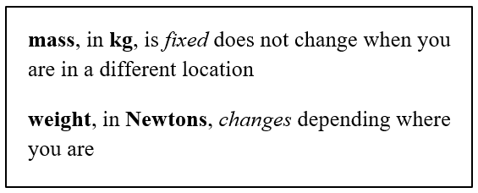
Mass and Weight
UNIT:
Mechanics Introduction
Section 4
You are probably aware that if you were not on the Earth’s surface, on a space station, or on the Moon, the force of gravity would be different. At this point it is important to understand the difference between mass and weight, since the words are often interchanged and confused in everyday language.
Your mass, in kg, does not change, whether you are on the Earth or on the Moon, or elsewhere in space, but your weight in Newtons, does change depending where you are.
This applies to any object, so if you are standing on the Moon rather than on the Earth and you are holding the golf ball and the bowling ball, you will find that the weights of the objects are far less; little weight is felt from the golf ball and much less weight from the bowling ball.

Slide 41
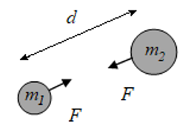
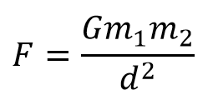
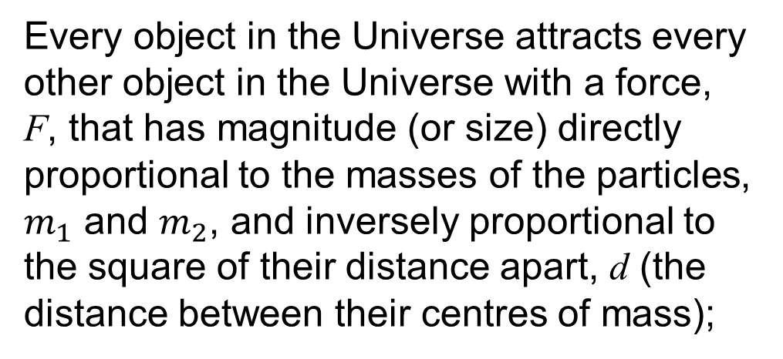
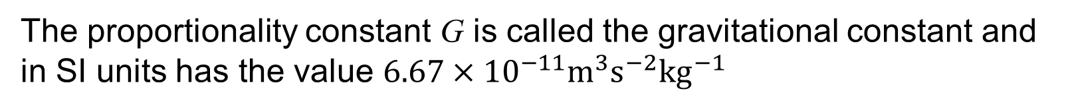
Newton’s Universal Law of Gravitation
UNIT:
Mechanics Introduction
Section 4
Every object in the Universe attracts every other object in the Universe with a force, F, that has magnitude (or size) directly proportional to the masses of the particles, $m_{1}$ and $m_{2}$, and inversely proportional to the square of their distance apart, d (the distance between their centres of mass);
The proportionality constant G is called the gravitational constant and in SI units has the value $6.67×{10}^{−11}m^{3}s^{−2}{kg}^{−1}$

Slide 42
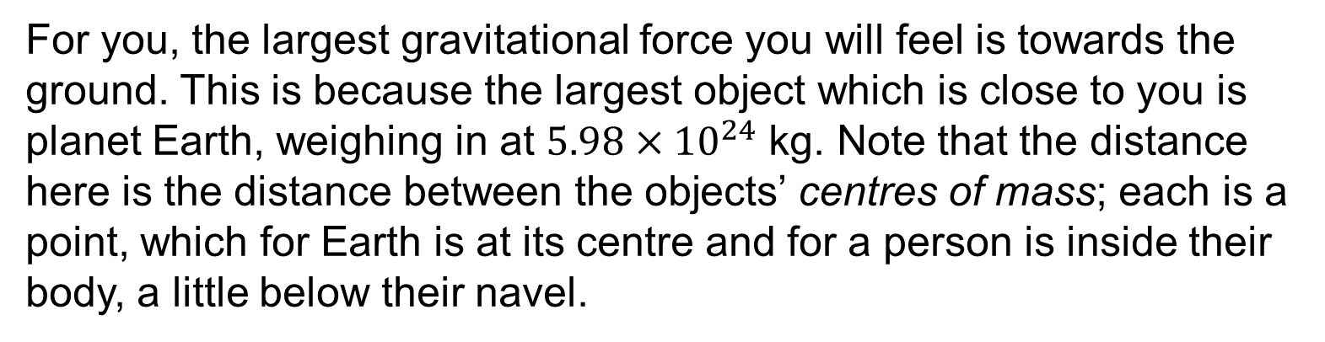
Newton’s Universal Law of Gravitation
UNIT:
Mechanics Introduction
Section 4
This is a general law, which tells you that any two objects anywhere in the universe will attract one another. It tells you that the gravitational force between two objects is bigger if the objects have a larger mass, and is also dependent on how close the objects are to one another, becoming weaker when the objects are further apart.
For you, the largest gravitational force you will feel is towards the ground. This is because the largest object which is close to you is planet Earth, weighing in at $5.98×{10}^{24}$ kg. Note that the distance here is the distance between the objects’ centres of mass; each is a point, which for Earth is at its centre and for a person is inside their body, a little below their navel.

Slide 43
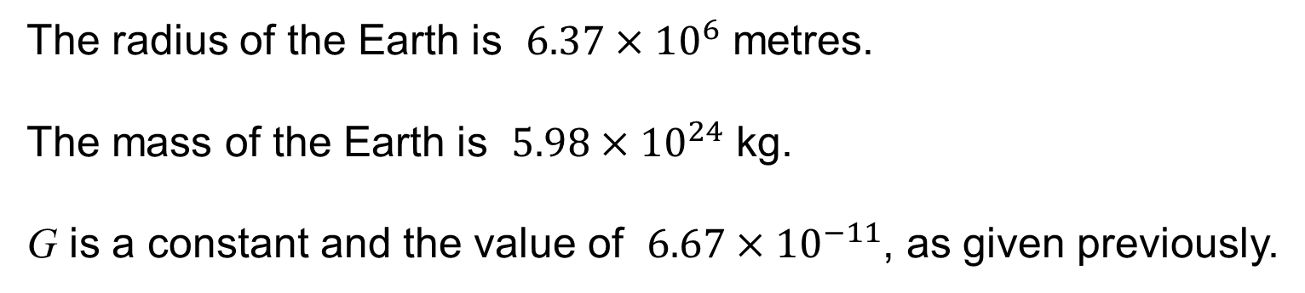
Newton’s Universal Law of Gravitation
UNIT:
Mechanics Introduction
Section 4
Example
Apply this formula to an object of mass m on the Earth's surface.
The radius of the Earth is $6.37×{10}^{6}$ metres.
The mass of the Earth is $5.98×{10}^{24}$ kg.
G is a constant and the value of $6.67×{10}^{−11}$, as given previously.

Slide 44
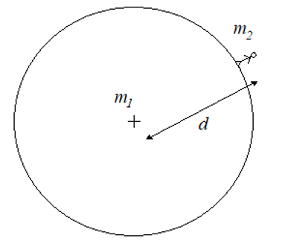
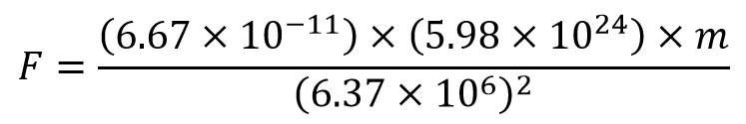

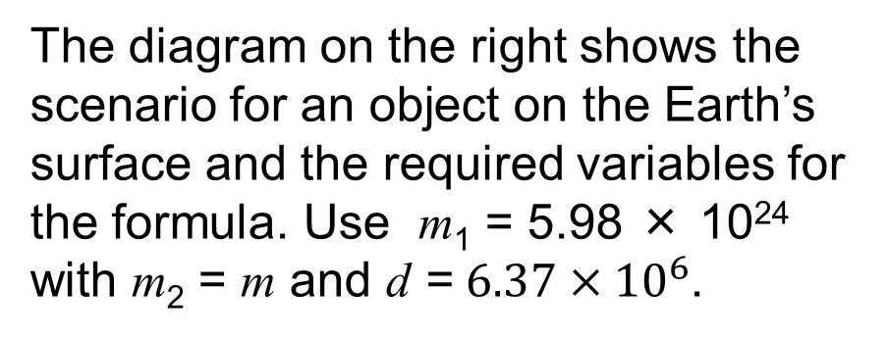
Newton’s Universal Law of Gravitation
UNIT:
Mechanics Introduction
Section 4
Solution
The diagram on the right shows the
scenario for an object on the Earth’s surface and the required variables for the formula. Use m₁ = 5.98 × 10²⁴ with m₂ = m and d = $6.37×{10}^{6}$.
This gives
So the weight is equal to 9.81 × mass, or roughly 10 × mass, as previously established.

Slide 45
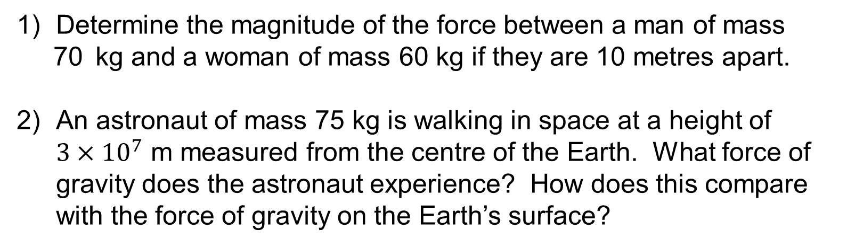
Section 4: Fitness Check
UNIT:
Mechanics Introduction
Section 4
Here are some questions, to check your progress; there are more practice questions if needed.
1) Determine the magnitude of the force between a man of mass
70 kg and a woman of mass 60 kg if they are 10 metres apart.
2) An astronaut of mass 75 kg is walking in space at a height of
$3×{10}^{7}$ m measured from the centre of the Earth. What force of gravity does the astronaut experience? How does this compare with the force of gravity on the Earth’s surface?
Answers
1) 2.8 × 10⁻⁹ N
2) 33.2 N, which is 4.4% of their weight on the Earth's surface.

Slide 46
Section 4: Review
UNIT:
Mechanics Introduction
Section 4
You have completed the fourth Section.
If you have completed and understood this section, click to start the next Section
If you need more examples and interactive practice, press here
You might also find it helpful to look at:
Essential Information: press here

Slide 47
Further Mathematical Modelling
UNIT:
Mechanics Introduction
Section 5
The formulation of the law of gravitation demonstrates another form of mathematical modelling. In the previous section models were formulated by doing experiments and collecting data. From this data the model in the form of a graph and/or an equation takes shape: this is called empirical modelling.
Newton’s work demonstrates a type of modelling called theoretical modelling. You can formulate a model based on an understanding of the physical situation and the important features that affect the situation. Newton proposed that the force between two objects depends on the masses of the objects and the distance between them. He then made three important assumptions:
the force is an attractive force;
the force is directly proportional to each mass;
the force is inversely proportional to the square of the distance.

Slide 48
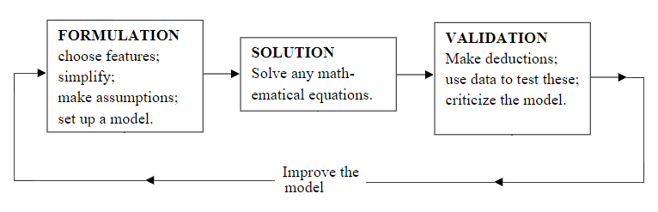
Further Mathematical Modelling
UNIT:
Mechanics Introduction
Section 5
From these assumptions the model follows. Appropriate data or experimental activities are then used to validate the model. Notice how this approach uses the data at the end of the activity to test the model and not at the beginning to formulate the model. The diagram below summarises this type of modelling.

Slide 49
Section 5: Review
UNIT:
Mechanics Introduction
Section 5
You have completed the fifth Section.
If you have completed and understood this section, click to start the next Section
If you need more examples and interactive practice, press here
You might also find it helpful to look at:
Essential Information: press here

Slide 50
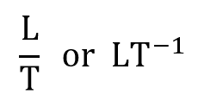
Units and Dimensions
UNIT:
Mechanics Introduction
Section 6
Throughout this unit physical quantities will be measured in an agreed international system of units called SI units. In this system distances, displacements and positions are measured in metres (m), time in seconds (s) and mass in kilograms (kg).
In mechanics, nearly all quantities, somewhat surprisingly, are expressed in terms of basic units of mass, length and time, denoted by the symbols M, L and T.
For example, velocity can be expressed as

Slide 51
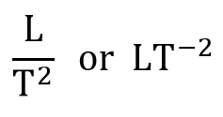
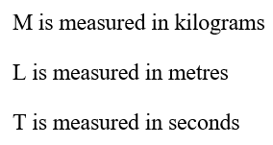
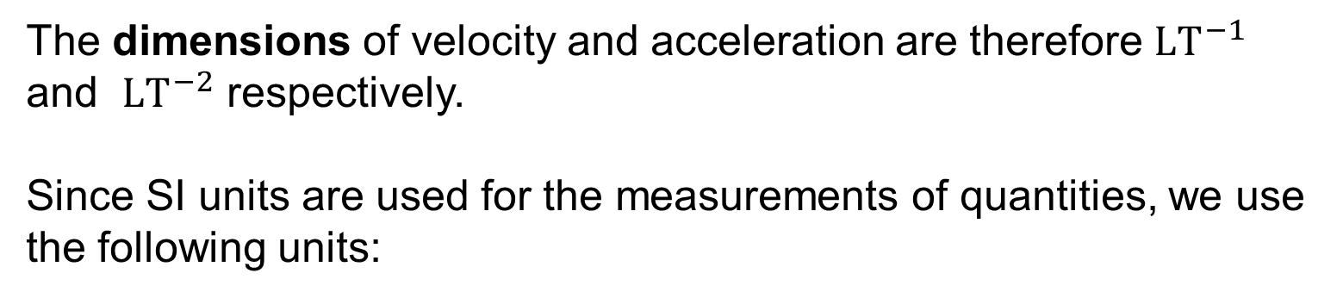
Units and Dimensions
UNIT:
Mechanics Introduction
Section 6
Similarly, acceleration (${ms}^{−2}$) can be expressed as
The dimensions of velocity and acceleration are therefore ${LT}^{−1}$ and ${LT}^{−2}$ respectively.
Since SI units are used for the measurements of quantities, we use the following units:

Slide 52
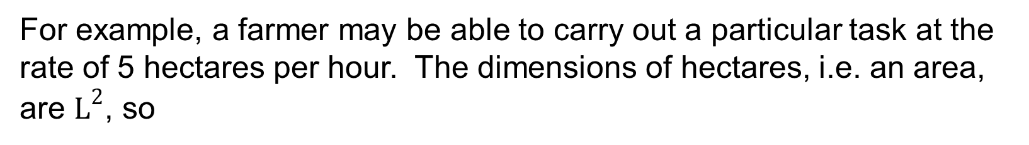
Units and Dimensions
UNIT:
Mechanics Introduction
Section 6
For example, a farmer may be able to carry out a particular task at the rate of 5 hectares per hour. The dimensions of hectares, i.e. an area, are $L^{2}$, so
dimensions of hectares per hour are $L^{2} T^{−1}$
Note that numbers like 2, π, 3, etc. have no units: they are said to be dimensionless. Some quantities such as force (in Newtons) are not expressed in terms of the common SI units; however, the dimensions can be established.

Slide 53
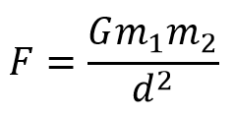
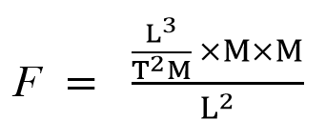
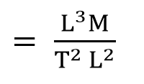

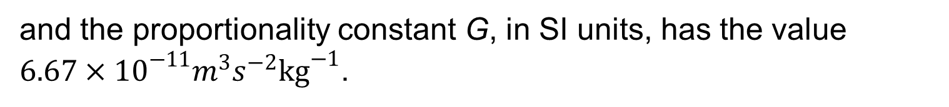
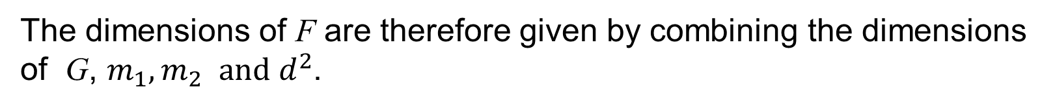
Units and Dimensions
UNIT:
Mechanics Introduction
Section 6
As another example, the Universal Law of Gravitation met in the previous section is given as
and the proportionality constant G, in SI units, has the value $6.67×{10}^{−11}m^{3}s^{−2}{kg}^{−1}$.
The dimensions of F are therefore given by combining the dimensions of G, $m_{1},m_{2}$ $and d^{2}$.
So dimensions of F are:

Slide 54
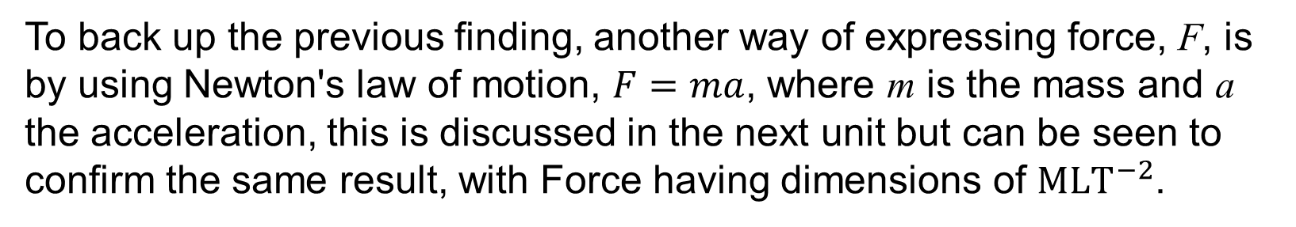
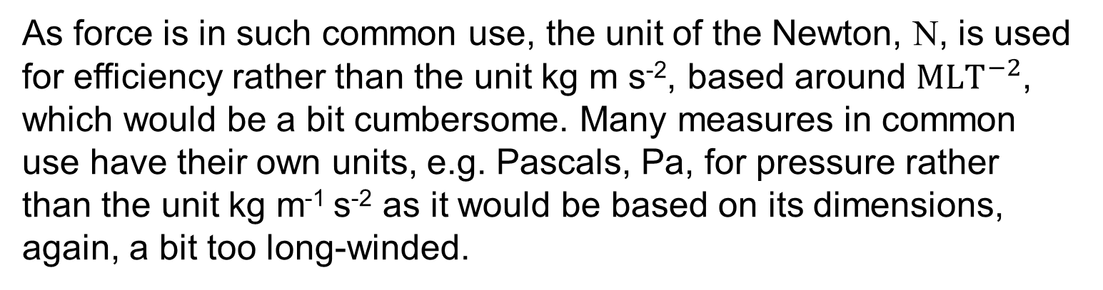
Units and Dimensions
UNIT:
Mechanics Introduction
Section 6
To back up the previous finding, another way of expressing force, F, is by using Newton's law of motion, $F=ma$, where m is the mass and a the acceleration, this is discussed in the next unit but can be seen to confirm the same result, with Force having dimensions of ${MLT}^{−2}$.
As force is in such common use, the unit of the Newton, N, is used for efficiency rather than the unit kg m s⁻², based around ${MLT}^{−2}$, which would be a bit cumbersome. Many measures in common use have their own units, e.g. Pascals, Pa, for pressure rather than the unit kg m⁻¹ s⁻² as it would be based on its dimensions, again, a bit too long-winded.

Slide 55
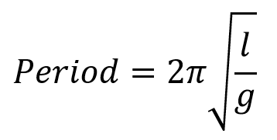
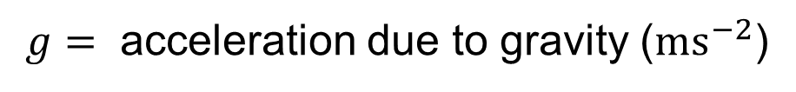
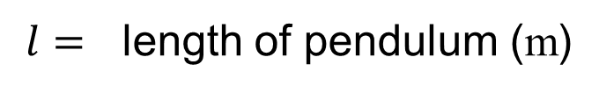
Dimensional Consistency
UNIT:
Mechanics Introduction
Section 6
Equations can be checked for dimensional consistency. In other words, the dimensions on both sides of an equation should be the same.
Example 1
The equation for the period of oscillation (the time for one complete swing) of a simple pendulum is
where $Period=$ period of oscillation (seconds)
$g=$ acceleration due to gravity (${ms}^{−2}$)
$l=$ length of pendulum (m)
Check that the equation is dimensionally consistent.

Slide 56

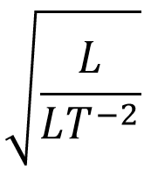
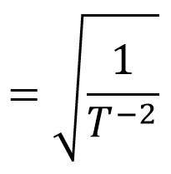
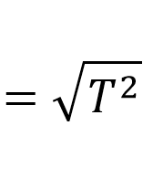
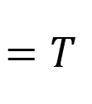
Dimensional Consistency
UNIT:
Mechanics Introduction
Section 6
Solution
The dimension of Period (i.e. the left hand side of the equation) is time, T.
The dimensions of the right hand side of the equation are
So the equation is dimensionally consistent.

Slide 57
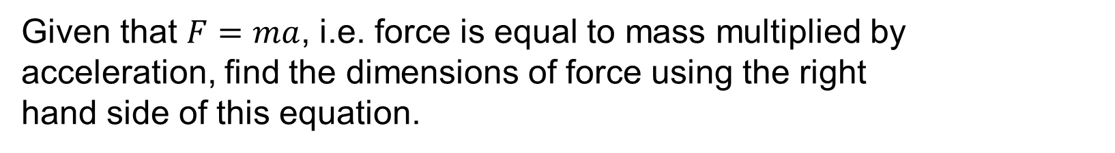
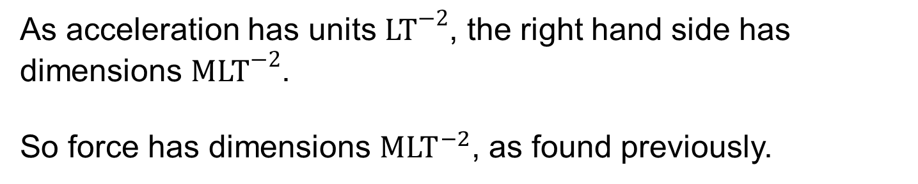
Dimensional Consistency
UNIT:
Mechanics Introduction
Section 6
Example 2
Given that $F=ma$, i.e. force is equal to mass multiplied by acceleration, find the dimensions of force using the right
hand side of this equation.
Solution
As acceleration has units ${LT}^{−2}$, the right hand side has dimensions ${MLT}^{−2}$.
So force has dimensions ${MLT}^{−2}$, as found previously.

Slide 58

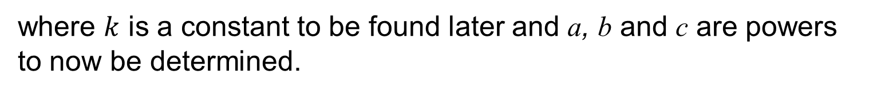
Using Dimensions to Produce Formulae
UNIT:
Mechanics Introduction
Section 6
Experimenters sometimes use dimensions to evolve formulae. They create a formula by beginning with an educated guess at it, using measures which would be expected to be related, then they use the principles of balancing dimensions to produce the final formula.
For example, it is known that the frequency, f, of a stretched wire depends on the mass per unit length, m, the length of the vibrating wire, l, and the force, F, used to stretch the wire. The problem is, therefore, to find the relationship between these quantities.
An initial formula is proposed,
where $k$ is a constant to be found later and a, b and c are powers to now be determined.

Slide 59
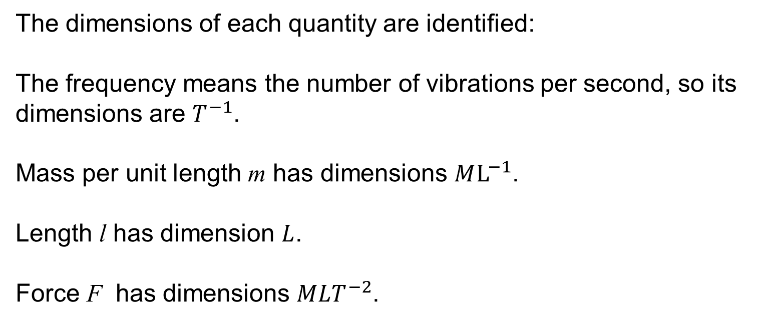
Using Dimensions to Produce Formulae
UNIT:
Mechanics Introduction
Section 6
The dimensions of f must be the same as the dimensions of $m^{a} l^{b} F^{c}$.
The dimensions of each quantity are identified:
The frequency means the number of vibrations per second, so its dimensions are $T^{−1}$.
Mass per unit length m has dimensions $ML^{−1}$.
Length l has dimension $L$.
Force F has dimensions $MLT^{−2}$.

Slide 60


Using Dimensions to Produce Formulae
UNIT:
Mechanics Introduction
Section 6
So the dimensions of the proposed formula can be substituted in:
$T^{−1}$ $={(ML^{−1})}^{a} L^{b}{(MLT^{−2})}^{c}$
Remove brackets
$T^{−1}$ $=M^{a}L^{−a} L^{b}M^{c}L^{c}T^{−2c}$
Collect powers of each dimension
$T^{−1}$ $=M^{a+c}×L^{−a+b+c} ×T^{−2c}$

Slide 61






Using Dimensions to Produce Formulae
UNIT:
Mechanics Introduction
Section 6
$T^{−1}$ $=M^{a+c}×L^{−a+b+c} ×T^{−2c}$
Equating the indices for M, L and T on both sides of the equation gives
$a+c$ $=0$
$−a+b+c$ $=0$
$−2c$ $=−1$
Solving these equations gives $a=−\frac{1}{2}, b=−1 and c=\frac{1}{2}$.
So the formula becomes
or $f=\frac{k}{l}\sqrt{\frac{F}{m}}$
$f$ $=km^{−\frac{1}{2}} l^{−1} F^{\frac{1}{2}}$
where k is a constant whose value could be found from experimentation.

Slide 62



Section 6: Fitness Check
UNIT:
Mechanics Introduction
Section 6
Here are some questions to check your progress; there are more practice questions if needed.
1) Find the dimensions of each of these quantities which are commonly used in mechanics. Mass is represented by m, velocity by v, acceleration by g and length by h.
a) Kinetic energy E, given by $E=\frac{1}{2}{mv}^{2}$
b) Potential energy P, given by $P=mgh$
Answer
a) ML²T⁻² b) ML²T⁻²
The height h, at which a hover-mower moves over the ground is thought to depend on the volume of air F which is pumped per second through the fan and on the speed u at which the air escapes from under the mower apron.
Show that h, F and v could be related by the equation $h=k\sqrt{\frac{F}{v}}$ .
$h=k×F^{\frac{1}{2}}×v^{−\frac{1}{2}}$ hence $h=k\sqrt{\frac{F}{v}}$
Answer

Slide 63
Section 6: Review
UNIT:
Mechanics Introduction
Section 6
You have completed the sixth Section.
If you have completed and mastered this last section, click here for the Unit audit
If you need more examples and interactive practice, press here
You might also find it helpful to look at:
Essential Information: press here

