Slide 1
Supporting and Enhancing Mathematics and Statistics
UNIT: Projectiles

Slide 2
Projectiles
UNIT:
Projectiles
This Unit applies the material learnt in the other Mechanics units to projectiles. The suvat equations can be applied to this scenario, which becomes a problem based in two dimensions.
You have two sections to work through and there are check up audits and fitness tests for each section.
Projectiles and 2D problems
Further Projectile Problems

Slide 3
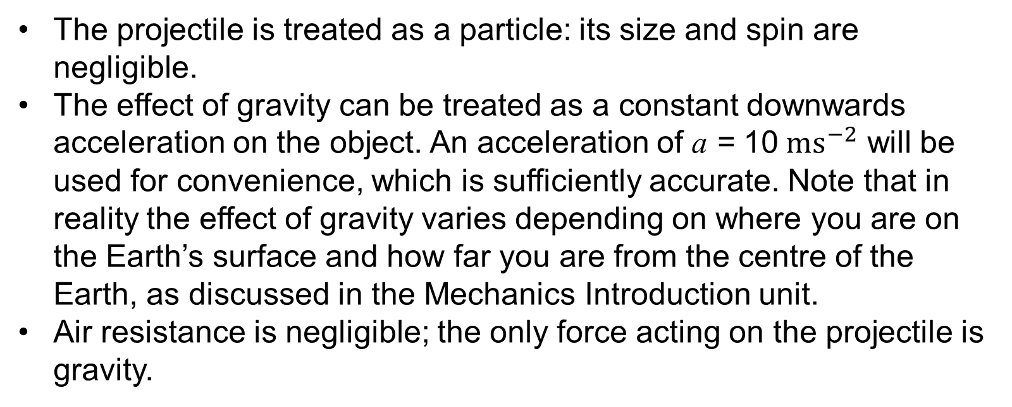
Projectiles
UNIT:
Projectiles
Section 1
A projectile is an object which has been given an initial velocity and travels under the influence of gravity along a curved path; examples are a cannonball, or a stone that has been thrown into the air. A number of assumptions will be used to model projectile motion:
The projectile is treated as a particle: its size and spin are negligible.
The effect of gravity can be treated as a constant downwards acceleration on the object. An acceleration of a = 10${ ms}^{−2}$ will be used for convenience, which is sufficiently accurate. Note that in reality the effect of gravity varies depending on where you are on the Earth’s surface and how far you are from the centre of the Earth, as discussed in the Mechanics Introduction unit.
Air resistance is negligible; the only force acting on the projectile is gravity.

Slide 4
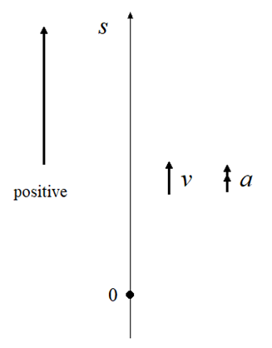
Motion under Gravity
UNIT:
Projectiles
Section 1
To begin, the motion of an object under gravity which has been thrown into the air directly upwards can be considered. This motion is addressed in the unit on One Dimensional Motion. If an object is given an initial velocity upwards, it travels up, with gravity acting downwards, directly against it.
A reminder of the sign convention for this scenario is shown on the left, with positive being the ‘up’ direction. Using this convention, s, v and a will all have positive signs when directed upwards and a negative sign when directed downwards.

Slide 5
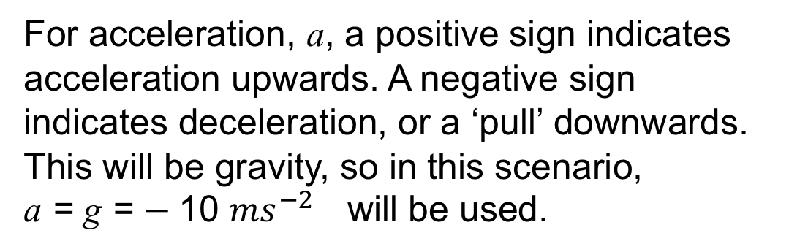
Motion under Gravity
UNIT:
Projectiles
Section 1
For acceleration, a, a positive sign indicates acceleration upwards. A negative sign indicates deceleration, or a ‘pull’ downwards. This will be gravity, so in this scenario,
a = g = $−$10 ${ms}^{−2}$ will be used.
For s, a position of zero is set as the starting position, then positive s is above this position (height) and negative s is below it.
For v, a positive sign indicates that the direction of travel is upwards, a negative sign indicates that the direction of travel is downwards.
For this scenario the suvat equations can be easily applied, with gravity as the constant acceleration acting upon the motion of the object.

Slide 6
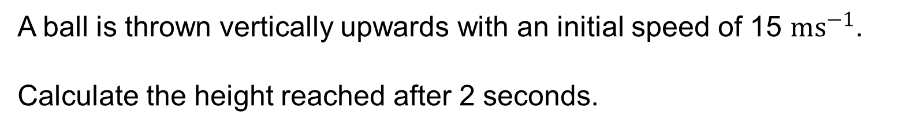

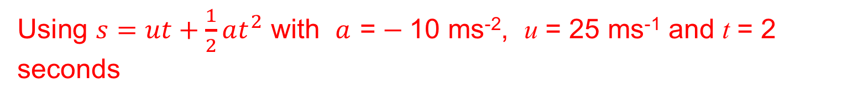

Motion under Gravity
UNIT:
Projectiles
Section 1
Example 1
A ball is thrown vertically upwards with an initial speed of 15 ${ms}^{−1}$.
Calculate the height reached after 2 seconds.
Solution
Using $s=ut+\frac{1}{2}at^{2}$ with $a$ = $−$10 ms⁻², u = 25 ms⁻¹ and t = 2 seconds
$$s=15×2+\frac{1}{2}×−10×2^{2}$$
$$s=10 \text{metres}$$
So after 2 seconds the ball is at a height of 10 metres.

Slide 7
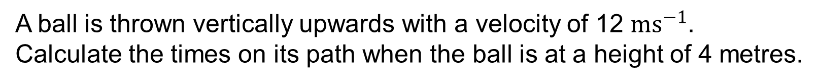


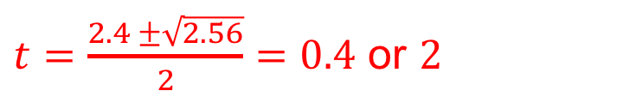
Motion under Gravity
UNIT:
Projectiles
Section 1
Example 2
A ball is thrown vertically upwards with a velocity of 12 ${ms}^{−1}$.
Calculate the times on its path when the ball is at a height of 4 metres.
Solution
Using $s=ut+\frac{1}{2}at^{2}$ with a = $−$10 ms⁻², u = 12 ms⁻¹ and s = 4 m gives
$$4=12t+0.5×−10×t^{2}$$
$$\text{This} \text{rearranges} \text{to}$$
$$5t^{2}−12t+4=0$$
$$t^{2}−2.4t+0.8=0$$
$t=\frac{2.4 ±\sqrt{2.56}}{2}=0.4$ or $2$
Using the quadratic formula
The ball is 4 m above the point of release twice, at $t=0.4$s (on way up) and at$t=2$s (on way down).

Slide 8
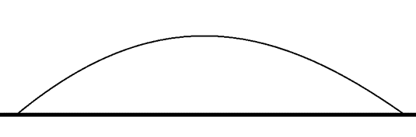
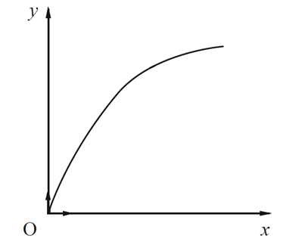
Working in Two Dimensions
UNIT:
Projectiles
Section 1
Following the recap on motion of an object under the influence of gravity in one dimension, the extension can be made to two dimensions, which allows for the general motion of a projectile to be modelled.
It will be demonstrated that projectiles, under the assumptions used here, will travel along a parabolic path as shown below.
To show this the progression needs to be made to two dimensions. The position in the upwards direction, the vertical position described earlier, will be labelled as y and the horizontal position will be labelled as x. This is shown in the diagram on the right.

Slide 9

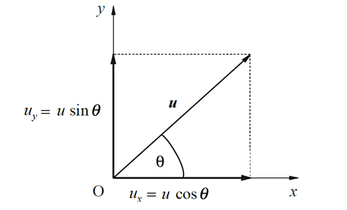
Working in Two Dimensions
UNIT:
Projectiles
Section 1
The horizontal position x and the vertical position y can be handled independently from one another. So for a given time the horizontal position and the vertical position can be calculated using the suvat equations.
For a given initial velocity u of magnitude u at an angle of θ to the horizontal, the horizontal and vertical components can be calculated using some basic trigonometry. This is illustrated in the diagram on the right.

Slide 10
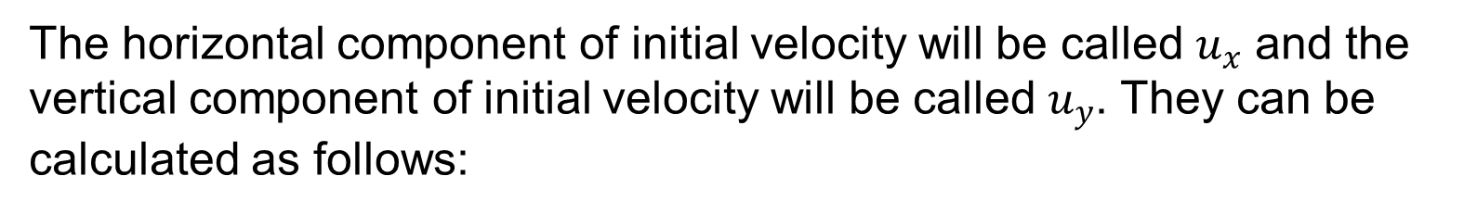

Working in Two Dimensions
UNIT:
Projectiles
Section 1
The horizontal component of initial velocity will be called $u_{x}$ and the vertical component of initial velocity will be called $u_{y}$. They can be calculated as follows:
Initial horizontal velocity $u_{x}=u\cos{θ}$
Initial vertical velocity $u_{y}=u\sin{θ}$

Slide 11

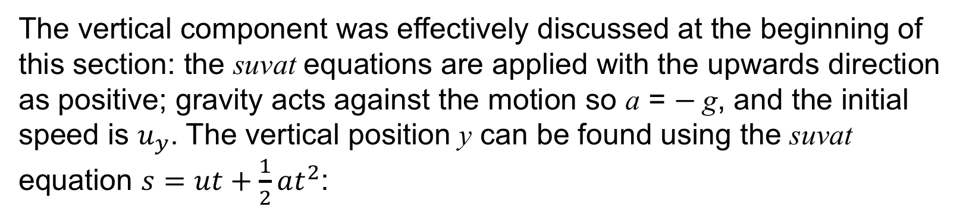

Working in Two Dimensions
UNIT:
Projectiles
Section 1
The suvat equations can now be applied to horizontal and vertical directions for a projectile which has initial speed u at an angle of θ to the horizontal and the position of the projectile can be found at a given time.
The vertical component was effectively discussed at the beginning of this section: the suvat equations are applied with the upwards direction as positive; gravity acts against the motion so a = $−$g, and the initial speed is $u_{y}$. The vertical position y can be found using the suvat equation $s=ut+\frac{1}{2}at^{2}$:
$$y=u_{y}t+\frac{1}{2}at^{2}$$
With a set as $−$10, this equation becomes:

Slide 12

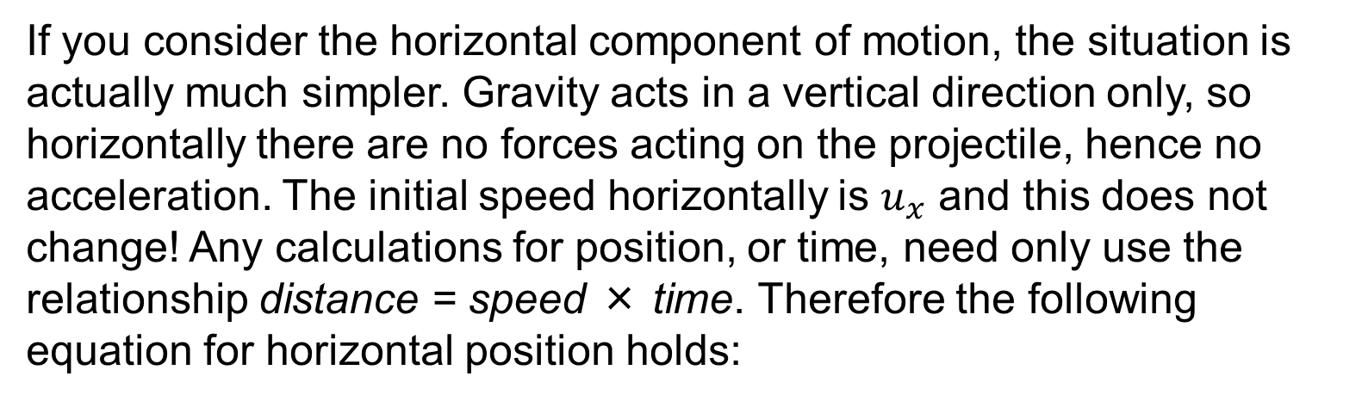
Working in Two Dimensions
UNIT:
Projectiles
Section 1
If you consider the horizontal component of motion, the situation is actually much simpler. Gravity acts in a vertical direction only, so horizontally there are no forces acting on the projectile, hence no acceleration. The initial speed horizontally is $u_{x}$ and this does not change! Any calculations for position, or time, need only use the relationship distance = speed × time. Therefore the following equation for horizontal position holds:
So given the initial velocity in terms of speed u and angle to the horizontal θ, problems involving the position both vertically and horizontally are easily tackled. The suvat equations can also provide information on the final velocity of the projectile at a given time.
These are just applications of the suvat equations to the projectile scenario. g is often given the more accurate value of 9.81, or can be left in solutions as ‘g’, and other resources will vary on this matter.

Slide 13
Working in Two Dimensions
UNIT:
Projectiles
Section 1
Example 3
A stone is thrown at a speed of 15 ms⁻¹ at an angle of 60˚ to the horizontal. Find its position horizontally and vertically at the following times:
a) 0.5 seconds
b) 1 second
c) 2 seconds
Solutions
a) First the horizontal and vertical components of initial velocity need to be found.
Horizontal speed is, $u_{x}=15\cos{60}=7.5 ms^{−1}$
$$\text{Vertical} \text{speed} \text{is}\text{, }u_{y}=15\sin{60}=13.0 ms^{−1}$$

Slide 14



Working in Two Dimensions
UNIT:
Projectiles
Section 1
Solutions (continued)
$u_{x}=7.5 ms^{−1}$
$u_{y}=13.0 ms^{−1}$
Then the horizontal position, x, after 0.5 seconds is
$$x=u_{x}×t=7.5×0.5=3.75 m$$
The vertical position, y, after 0.5 seconds is
$$y=13.0×0.5+\frac{1}{2}×−10×{0.5}^{2}=5.25 m$$
So after 0.5 seconds the stone has travelled 3.75 metres horizontally and 5.25 metres vertically (up!). The positions for the other two times can be calculated in the same way.

Slide 15



Working in Two Dimensions
UNIT:
Projectiles
Section 1
Solutions (continued)
b) $u_{x}=7.5 ms^{−1}$
$u_{y}=13.0 ms^{−1}$
The horizontal position, x, after 1 second is
$$x=u_{x}×t=7.5×1=7.5 m$$
The vertical position, y, after 1 second is
$$y=13.0×1+\frac{1}{2}×−10×1^{2}=8 m$$
So after 1 second the stone has travelled 7.5 metres horizontally and 8 metres vertically. Comparing this to the previous answer, it continues to travel upwards, but is slowing down.

Slide 16
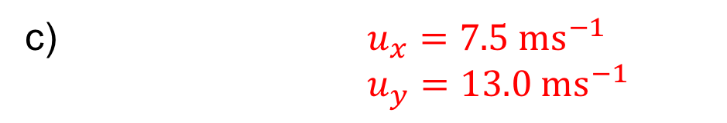


Working in Two Dimensions
UNIT:
Projectiles
Section 1
Solutions (continued)
c) $u_{x}=7.5 ms^{−1}$
$u_{y}=13.0 ms^{−1}$
The horizontal position, x, after 2 seconds is
$$x=u_{x}×t=7.5×2=15 m$$
The vertical position, y, after 0.5 seconds is
$$y=13.0×2+\frac{1}{2}×−10×2^{2}=6.0 m$$
So after 2 seconds the stone has travelled 15 metres horizontally and 6 metres vertically. Comparing this to the previous answer tells you that the stone is now travelling back towards the ground.

Slide 17
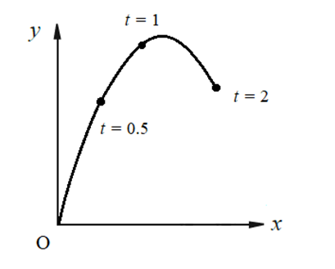
Working in Two Dimensions
UNIT:
Projectiles
Section 1
The diagram below shows the position of the stone horizontally and vertically at these three times.
The stone in this example can be seen to follow a parabolic path for the positional values of t used, as expected

Slide 18
Working in Two Dimensions
UNIT:
Projectiles
Section 1
Example 4
A ball is thrown with a speed of 8 ms^{–1} at an angle of 30˚ to the horizontal. How high above its point of projection is it when it has travelled 2 m horizontally?
Solutions
First the horizontal and vertical components of initial velocity need to be found.
Horizontal speed is, $u_{x}=8\cos{30}=6.928 ms^{−1}$
$$\text{Vertical} \text{speed} \text{is}\text{, }u_{y}=8\sin{30}=4 ms^{−1}$$
The time for the ball to travel 2 m horizontally can be found, then used to find the height, i.e. the vertical position y.

Slide 19



Working in Two Dimensions
UNIT:
Projectiles
Section 1
Solutions (continued)
$u_{x}=6.928 ms^{−1}$
$u_{y}=4 ms^{−1}$
The time is found using $x=u_{x}t$ with x = 2 as the question states:
$$2=6.928t$$
This solves to give t = 0.289 seconds.
Then this value of t can be used to find the height y:
$$y=u_{y}t+\frac{1}{2}at^{2}=4×0.289+\frac{1}{2}×−10×{0.289}^{2}=0.74 m$$
So when the ball has travelled 2 metres horizontally it is at a height of 0.74 metres.

Slide 20

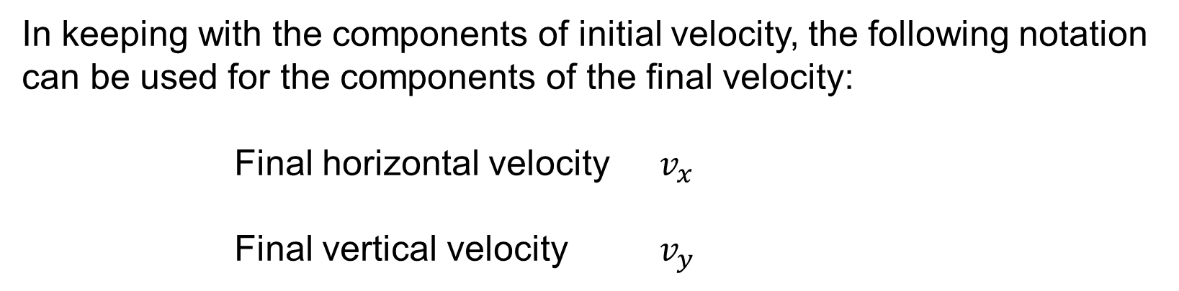
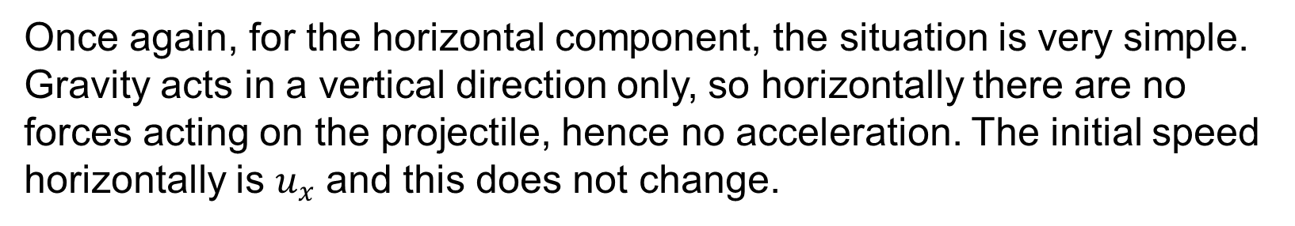
Final Velocity and Speed
UNIT:
Projectiles
Section 1
The suvat equations can also be applied to find the horizontal speed and vertical speed at a given time, for a projectile which has initial speed u at an angle of θ to the horizontal.
In keeping with the components of initial velocity, the following notation can be used for the components of the final velocity:
Final horizontal velocity $v_{x}$
Final vertical velocity $v_{y}$
Once again, for the horizontal component, the situation is very simple. Gravity acts in a vertical direction only, so horizontally there are no forces acting on the projectile, hence no acceleration. The initial speed horizontally is $u_{x}$ and this does not change.
So

Slide 21

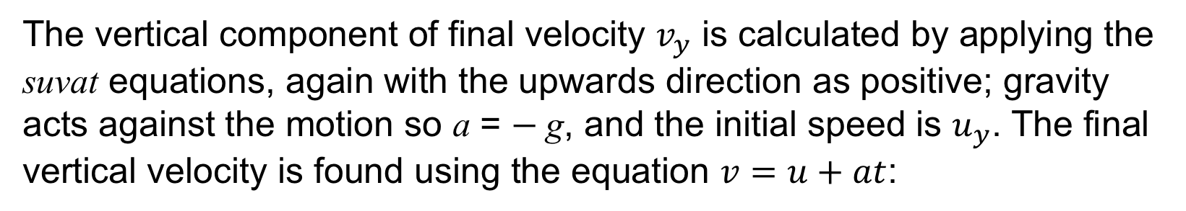

Final Velocity and Speed
UNIT:
Projectiles
Section 1
The vertical component of final velocity $v_{y}$ is calculated by applying the suvat equations, again with the upwards direction as positive; gravity acts against the motion so a = $−$g, and the initial speed is $u_{y}$. The final vertical velocity is found using the equation $v=u+at$:
$$v_{y}=u_{y}+\left(−g\right)t$$
So
$$v_{y}=u_{y}−gt$$
With a set as -10, this equation becomes:
So given the initial velocity in terms of speed u and angle to the horizontal θ, the horizontal and vertical components of final velocity are easily found.

Slide 22
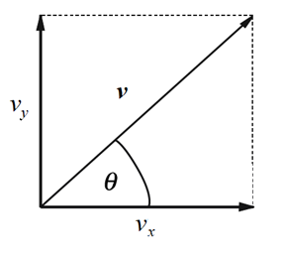


Final Velocity and Speed
UNIT:
Projectiles
Section 1
The speed of the projectile and its angle to the horizontal can be found from these two components. The diagram below shows the final horizontal and vertical components of velocity as a vector v.
From the diagram some basic trigonometry tells you that the final speed $v$ is calculated by finding the magnitude of the vector v:
$$v=\sqrt{v_{x}^{2}+v_{y}^{2}}$$

Slide 23

Final Velocity and Speed
UNIT:
Projectiles
Section 1
The angle with the horizontal is also found using basic trigonometry:
$$θ=\tan^{−1}\left(\frac{v_{y}}{v_{x}}\right)$$
Now the scenario from Worked Example 3 is returned to and will demonstrate these results.

Slide 24
Final Velocity and Speed
UNIT:
Projectiles
Section 1
Example 5
A stone is thrown at a speed of 15 ms⁻¹ at an angle of 60˚ to the horizontal. Find the horizontal and vertical components of velocity at the following times, along with the speed and the angle to the horizontal:
a) 0.5 seconds
b) 1 second
c) 2 seconds
Solutions
a) The horizontal and vertical components of initial velocity were found previously:
Horizontal speed is, $u_{x}=15\cos{60}=7.5 ms^{−1}$
$$\text{Vertical} \text{speed} \text{is}\text{, }u_{y}=15\sin{60}=13.0 ms^{−1}$$

Slide 25


Final Velocity and Speed
UNIT:
Projectiles
Section 1
Solutions (continued)
$u_{x}=15\cos{60}=7.5 ms^{−1}$
$u_{y}=15\sin{60}=13.0 ms^{−1}$
Then the horizontal component of final velocity after 0.5 seconds is
$$v_{x}=u_{x}=7.5 ms^{−1}$$
The vertical component of final velocity after 0.5 seconds is
$$v_{y}=u_{y}+\left(−10\right)t=13.0−10×0.5=8 ms^{−1}$$
These horizontal and vertical components of velocity can be used to find the speed v and the angle with the horizontal θ.

Slide 26



Final Velocity and Speed
UNIT:
Projectiles
Section 1
Solutions (continued)
$v_{x}=7.5 ms^{−1}$
$v_{y}=8 ms^{−1}$
The speed at 0.5 seconds is calculated from the horizontal and vertical components of final velocity as follows:
$$v=\sqrt{v_{x}^{2}+v_{y}^{2}}=\sqrt{{7.5}^{2}+8^{2}}=11.0 ms^{−1}$$
The angle to the horizontal is also calculated:
$$θ=\tan^{−1}\left(\frac{v_{y}}{v_{x}}\right)=\tan^{−1}\left(\frac{8}{7.5}\right)=46.8°$$

Slide 27



Final Velocity and Speed
UNIT:
Projectiles
Section 1
Solutions (continued)
b) $u_{x}=15\cos{60}=7.5 ms^{−1}$
$u_{y}=15\sin{60}=13.0 ms^{−1}$
The horizontal component of final velocity after 1 second is
$$v_{x}=u_{x}=7.5 ms^{−1}$$
The vertical component of final velocity after 1 second is
$$v_{y}=u_{y}+\left(−10\right)t=13.0−10×1=3 ms^{−1}$$
These horizontal and vertical components of velocity can again be used to find the speed v and the angle with the horizontal θ.

Slide 28



Final Velocity and Speed
UNIT:
Projectiles
Section 1
Solutions (continued)
b) $v_{x}=7.5 ms^{−1}$
$v_{y}=3 ms^{−1}$
The speed at 1 second can then be calculated as follows:
$$v=\sqrt{v_{x}^{2}+v_{y}^{2}}=\sqrt{{7.5}^{2}+3^{2}}=8.1 ms^{−1}$$
The angle to the horizontal is also calculated:
$$θ=\tan^{−1}\left(\frac{v_{y}}{v_{x}}\right)=\tan^{−1}\left(\frac{3}{7.5}\right)=21.8°$$
Note that this angle is less than the angle at 0.5 seconds.

Slide 29



Final Velocity and Speed
UNIT:
Projectiles
Section 1
Solutions (continued)
c) $u_{x}=15\cos{60}=7.5 ms^{−1}$
$u_{y}=15\sin{60}=13.0 ms^{−1}$
The horizontal component of final velocity after 2 seconds is:
$$v_{x}=u_{x}=7.5 ms^{−1}$$
The vertical component of final velocity after 2 seconds is:
$$v_{y}=u_{y}+\left(−10\right)t=13.0−10×2=−7 ms^{−1}$$
These horizontal and vertical components of velocity can again be used to find the speed v and the angle with the horizontal θ.

Slide 30


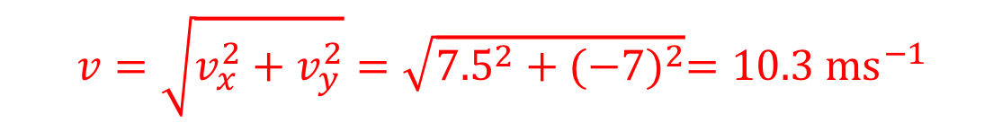
Final Velocity and Speed
UNIT:
Projectiles
Section 1
Solutions (continued)
c) $v_{x}=7.5 ms^{−1}$
$v_{y}=−7 ms^{−1}$
The speed at 2 seconds can then be calculated as follows:
$$v=\sqrt{v_{x}^{2}+v_{y}^{2}}=\sqrt{{7.5}^{2}+{(−7)}^{2}}=10.3 ms^{−1}$$
The angle to the horizontal is also calculated:
$$θ=\tan^{−1}\left(\frac{v_{y}}{v_{x}}\right)=\tan^{−1}\left(\frac{−7}{7.5}\right)=−43.0°$$
Comparing this to the previous answers, the angle has changed sign, it is now below the horizontal, pointing down.

Slide 31
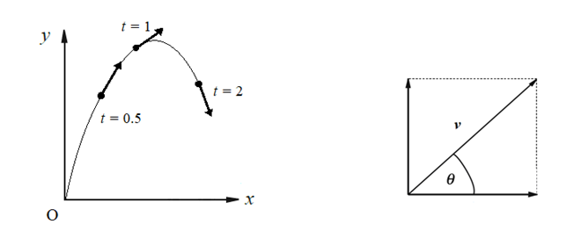
Final Velocity and Speed
UNIT:
Projectiles
Section 1
The diagram below shows the velocity of the stone at these three times. The angle of the velocity θ can be seen to reduce from t = 0.5 to t = 1, then at t = 2 it has become negative and the angle is below the horizontal.
The stone in this example can again be seen to follow a parabolic path and here the velocities illustrate the direction of travel.

Slide 32
Section 1: Fitness Check
UNIT:
Projectiles
Section 1
Here are some questions to check your progress; there are more practice questions if needed.
1) A stone is thrown at a speed of 20 ms⁻¹ at an angle of 60˚ to the horizontal. Find its position horizontally and vertically after the following times:
a) 0.8 seconds
b) 1 second
c) 3 seconds
Answers
a) x = 8m, y = 10.7m b) x = 10m, y = 12.3m c) x = 30m, y = 6.96m
2) An arrow is fired from a bow with a speed of 50 ms⁻¹ at an angle of 5˚ to the horizontal. What is its speed and the angle its velocity makes with the horizontal after 0.6 s?
Answer
49.8 ms⁻¹, 1.9° (below)

Slide 33
Section 1: Review
UNIT:
Projectiles
Section 1
You have completed the first Section.
If you have completed and understood this section, click to start the next Section
If you need more examples and interactive practice, press here
You might also find it helpful to look at:
Essential Information: press here

Slide 34
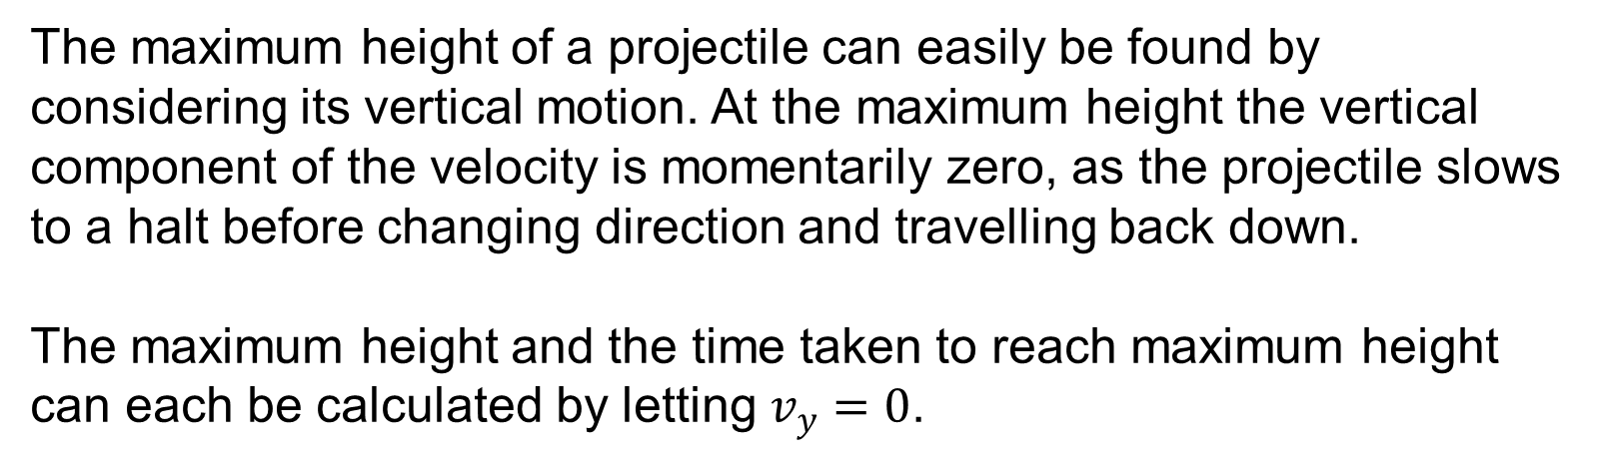
Further Projectile Problems - Maximum Height
UNIT:
Projectiles
Section 2
The first section introduced a technique for solving problems based around projectiles, by simply applying the suvat equations. This section continues to use this approach to find significant attributes in the motion of a projectile such as the maximum height and the range, then addresses the possibility of starting the motion from a different height.
The maximum height of a projectile can easily be found by considering its vertical motion. At the maximum height the vertical component of the velocity is momentarily zero, as the projectile slows to a halt before changing direction and travelling back down.
The maximum height and the time taken to reach maximum height can each be calculated by letting $v_{y}=0$.

Slide 35
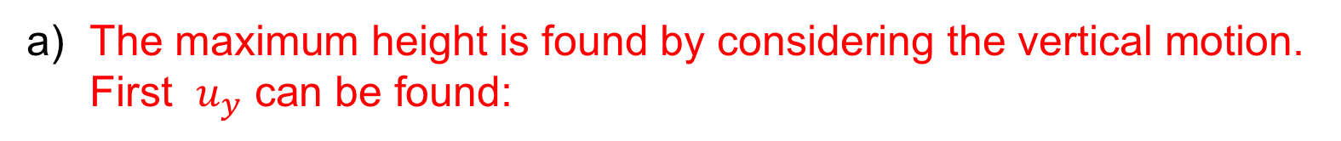

Maximum Height
UNIT:
Projectiles
Section 1
Example 1
A ball is thrown with initial speed 20 ms⁻¹ at an angle of 60˚ to the horizontal.
a) How high does it rise?
b) How long does it take to reach this maximum height?
c) How far has it travelled horizontally at its maximum height?
Solutions
a) The maximum height is found by considering the vertical motion. First $u_{y}$ can be found:
$$\text{Vertical} \text{speed} \text{is}\text{, }u_{y}=20\sin{60}=17.32 ms^{−1}$$
Then $v^{2}=u^{2}+2as$ can be used by letting $v_{y}=v=0$ and solving to find s:
$$0^{2}={17.32}^{2}+2×−10×s$$
Re-arrange to −300 = −20𝑠
Then solve to obtain s = 15 metres as the maximum height.

Slide 36
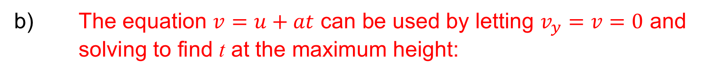



Maximum Height
UNIT:
Projectiles
Section 1
Solutions (continued)
b) The equation $v=u+at$ can be used by letting $v_{y}=v=0$ and solving to find t at the maximum height:
$$0=17.32+−10×t$$
Re-arrange to $−17.32=−10t$
Then solve to obtain t = 1.732 seconds as the time at maximum height.
First find the horizontal component of initial velocity:
$$u_{x}=u\cos{θ=20\cos{60=10 ms^{−1}}}$$
The time at maximum height can be applied to the formula for horizontal position x:
$$x=u_{x}t=10×1.732=17.32 m$$

Slide 37
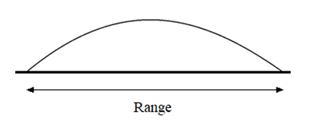
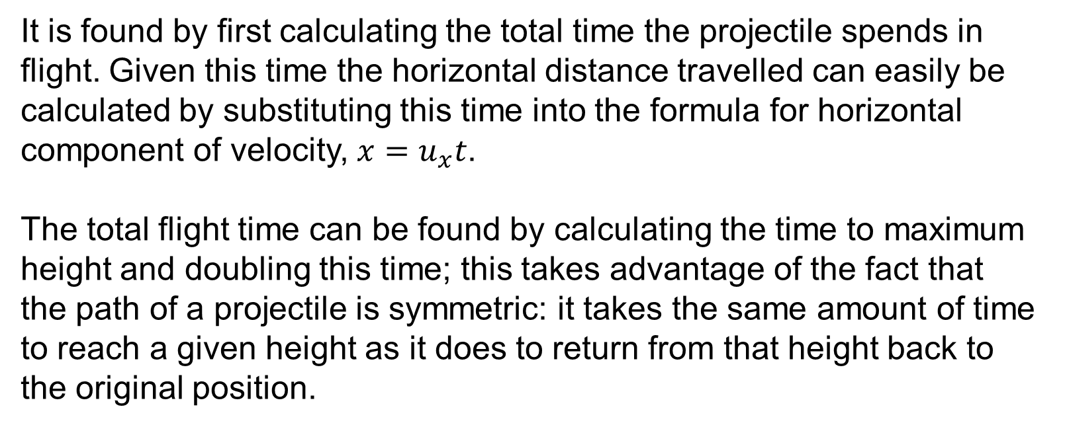
Range of a Projectile
UNIT:
Projectiles
Section 2
The range of a projectile is the total distance it travels horizontally, as shown below.
It is found by first calculating the total time the projectile spends in flight. Given this time the horizontal distance travelled can easily be calculated by substituting this time into the formula for horizontal component of velocity, $x=u_{x}t$.
The total flight time can be found by calculating the time to maximum height and doubling this time; this takes advantage of the fact that the path of a projectile is symmetric: it takes the same amount of time to reach a given height as it does to return from that height back to the original position.

Slide 38
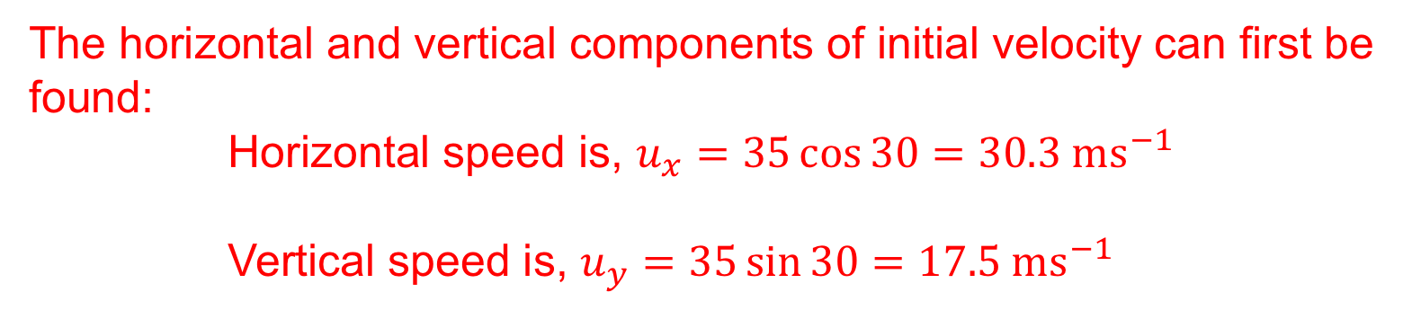
Maximum Height
UNIT:
Projectiles
Section 1
Example 2
A stunt motorcyclist takes off at a speed of 35 ms⁻¹ up a ramp of 30˚ to the horizontal to clear a river 50 m wide. Does the cyclist succeed in doing this?
Solution
The cyclist clears the river if the horizontal distance travelled, the range, is greater than 50 m. To find this distance it is necessary to first find the time of flight. This can be done by doubling the time to the maximum height, as found in the previous example.
The horizontal and vertical components of initial velocity can first be found:
Horizontal speed is, $u_{x}=35\cos{30}=30.3 ms^{−1}$
Vertical speed is, $u_{y}=35\sin{30}=17.5 ms^{−1}$

Slide 39

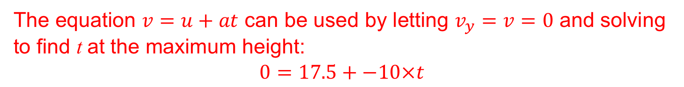
Maximum Height
UNIT:
Projectiles
Section 1
Solutions (continued)
Horizontal speed $u_{x}=30.3 ms^{−1}$
Vertical speed $u_{y}=17.5 ms^{−1}$
The equation $v=u+at$ can be used by letting $v_{y}=v=0$ and solving to find t at the maximum height:
$$0=17.5+−10×t$$
Then solve to obtain t = 1.75 seconds as the time at maximum height.
The time taken to return back to the vertical starting position is equal to this time due to the symmetry of projectile motion, so doubling this time will give you the total flight time.
Total flight time is 2 × 1.75 = 3.5 seconds.
Now the horizontal distance travelled, the range, can be found using this time.
$x=u_{x}t=30.3×3.5=106 m$ (the cyclist clears the 50 metre river)

Slide 40
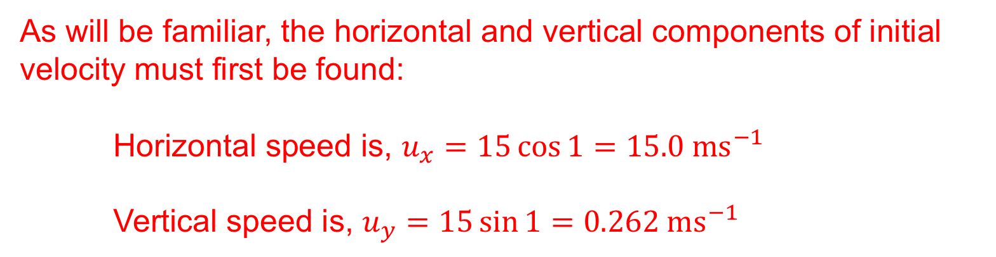
Initial Height
UNIT:
Projectiles
Section 1
Some problems require more consideration of the initial height of the projectile. The same equations used so far are still applicable, with the understanding that they are based around the position of the projectile as relative to its starting position.
Example 3
A tennis player makes a return at a speed of 15 ms⁻¹ and at a height of 3 m to land in the opposite court. If she hits the ball at an angle of 1˚ above the horizontal, how far does the ball travel horizontally?
Solution
As will be familiar, the horizontal and vertical components of initial velocity must first be found:
Horizontal speed is, $u_{x}=15\cos{1}=15.0 ms^{−1}$
Vertical speed is, $u_{y}=15\sin{1}=0.262 ms^{−1}$

Slide 41


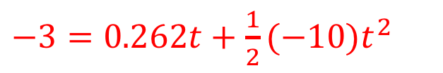
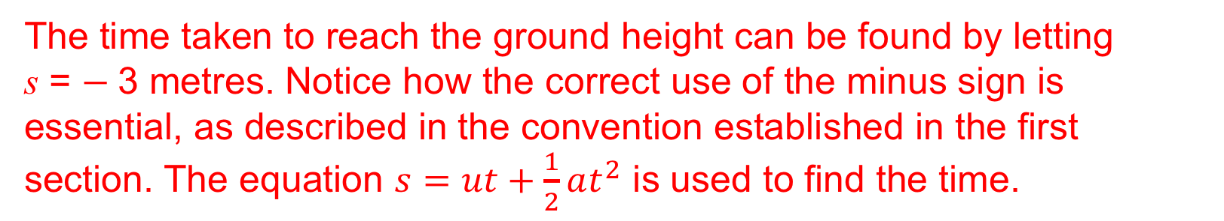
Initial Height
UNIT:
Projectiles
Section 1
Solutions (continued)
Horizontal speed $u_{x}=15.0 ms^{−1}$
Vertical speed $u_{y}=0.262 ms^{−1}$
The time taken to reach the ground height can be found by letting
s = $−$3 metres. Notice how the correct use of the minus sign is essential, as described in the convention established in the first section. The equation $s=ut+\frac{1}{2}at^{2}$ is used to find the time.
$−3=0.262t+\frac{1}{2}(−10)t^{2}$
This rearranges to $t^{2}−0.0873t−0.6=0$
Using the quadratic formula $t=\frac{0.0873 ±\sqrt{2.41}}{2}=0.4$ or $2$
Solutions are t = 0.801 and t = -0.749. (discard negative solution)
$$x=u_{x}t=15.0×0.801=12 m$$
So the ball travels 12 metres horizontally, into the opposite court.

Slide 42
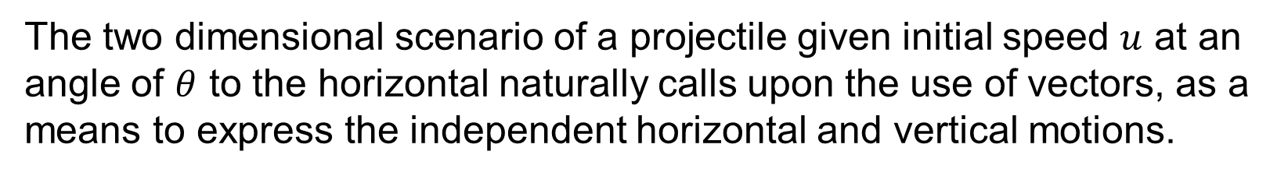


Vector Representation of Projectiles
UNIT:
Projectiles
Section 2
The two dimensional scenario of a projectile given initial speed $u$ at an angle of $θ$ to the horizontal naturally calls upon the use of vectors, as a means to express the independent horizontal and vertical motions.
The components of initial velocity are
$$u=\left({u_{x} \atop u_{y}}\right)=\left({u\cos{θ} \atop u\sin{θ}}\right)$$
The velocity at a later time t is given by
$$v(t)=\left({u_{x} \atop u_{y}−gt}\right)$$

Slide 43

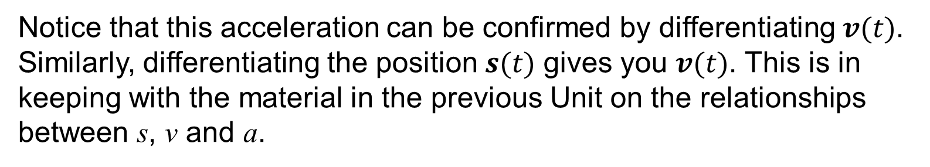
Vector Representation of Projectiles
UNIT:
Projectiles
Section 2
The acceleration is simply
$$a\left(t\right)=\left({0 \atop −g}\right)$$
Notice that this acceleration can be confirmed by differentiating $v(t)$. Similarly, differentiating the position $s(t)$ gives you $v(t)$. This is in keeping with the material in the previous Unit on the relationships between s, v and a.
The techniques used here can be applied to other scenarios in mechanics, other than projectiles. They extend easily to three dimensions, providing a modelling technique which is extremely powerful and has allowed a deep understanding of the world around us.

Slide 44
Section 2: Fitness Check
UNIT:
Projectiles
Section 2
Here are some questions to check your progress; there are more practice questions if needed.
David kicks a ball with a speed of 20 ms⁻¹ at an angle of 30˚ to the horizontal. How far away from him does the ball land?
Answer
34.6 m
2) Karen is standing 4 m away from a wall which is 2.5 m high. She throws a ball at 10 ms⁻¹ at an angle of 40˚ to the horizontal at a height of 1 m above the ground. Will the ball pass over the wall?
Answer
Yes; with 50 cm to spare.

Slide 45
Section 2: Review
UNIT:
Projectiles
Section 2
You have completed the second Section.
If you have completed and mastered this last section, click here for the Unit audit
If you need more examples and interactive practice, press here
You might also find it helpful to look at:
Essential Information: press here

