Slide 1
Supporting and Enhancing Mathematics and Statistics
UNIT: Decimal Calculations

Slide 2
UNIT:
Decimal Calculations
Section 1
Decimal Calculations
It is important to be able to complete
Decimal Calculations.
There are four sections in this Unit, namely:
A Recap of BODMAS
Addition and Subtraction of Decimals
Multiplication with Decimals
Division with Decimals

Slide 3
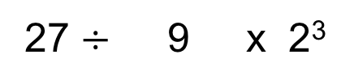
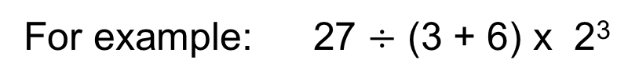
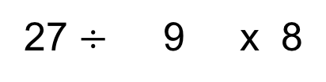
UNIT:
Decimal Calculations
Section 1
Recap of BODMAS
We start with a quick review of key facts:
B Brackets first
O Of (Powers Of, Indices)
D M Division and Multiplication
A S Addition and Subtraction
In any calculation, operations are carried out in a specific order, above.
If both Division and Multiplication occur - then:
these operations are carried out in order, working from left to right.
Likewise, for Addition and Subtraction.
For example: 27 $÷$ (3 + 6) x 2³
Brackets first
27 $÷$ 9 x 2³
Powers Of
27 $÷$ 9 x 8
Division then Multiplication
3 x 8
= 24

Slide 4
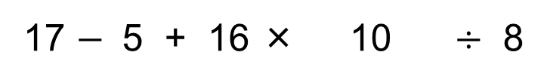
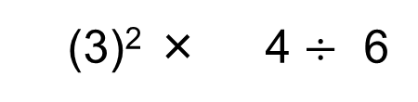
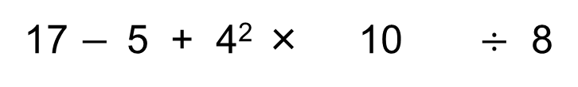
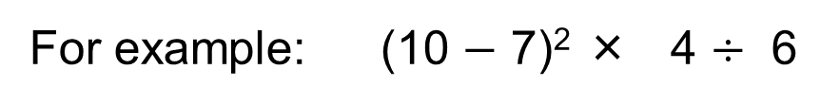
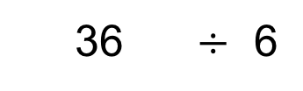
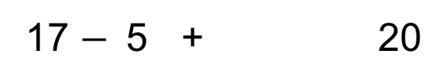
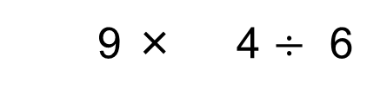
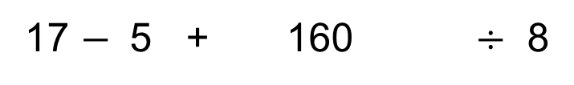
UNIT:
Decimal Calculations
Section 1
Using BODMAS
For example: (10 $−$ 7)² × 4 $÷$ 6
Brackets first
(3)² × 4 $÷$ 6
Powers Of
9 × 4 $÷$ 6
Multiplication
36 $÷$ 6
…then Division
= 6
For example: 17 $−$ 5 + 4² × (9 + 1) $÷$ 8
Brackets first
17 $−$5 + 4² × 10 $÷$ 8
Powers Of
17 $−$ 5 + 16 × 10 $÷$ 8
Multiplication
17 $−$ 5 + 160 $÷$ 8
…then Division
17 $−$5 + 20
Subtraction
12 + 20
…then Addition
= 32

Slide 5
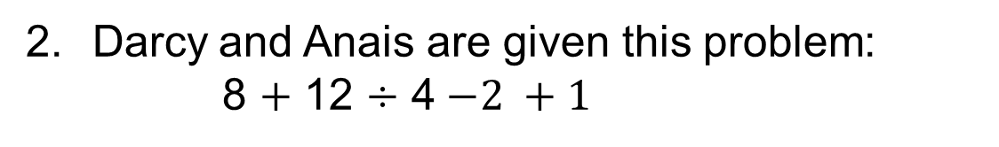
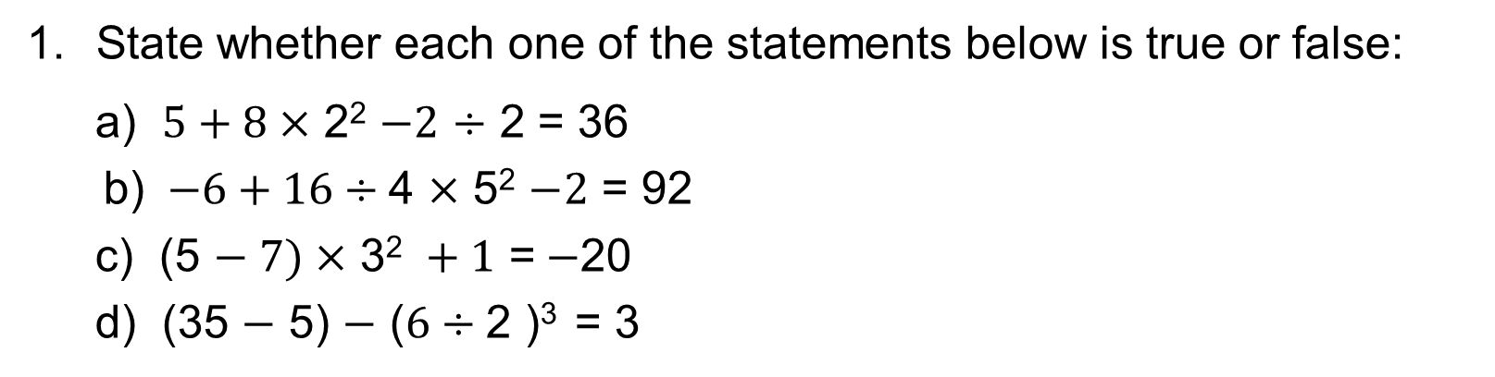
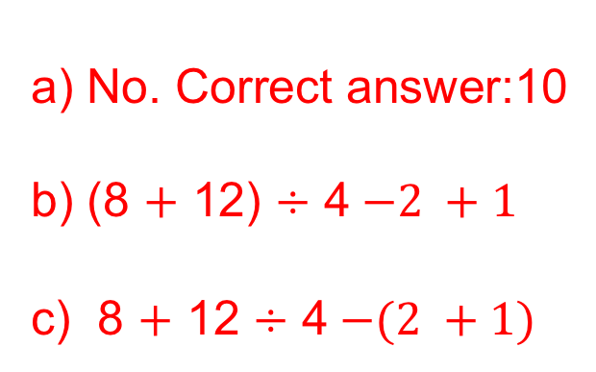
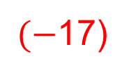
UNIT:
Decimal Calculations
Section 1
Section 1: Fitness Check
State whether each one of the statements below is true or false:
a) $5+8\text{ ×}$ 2² $−2$ $÷$ 2 = 36
b) $−6+16÷\text{4} \text{×}$ 5² $−2$ = 92
c) (5 $− 7)\text{ ×} \text{3}\text{2} +1\text{ =}−$20
d) (35 $−$ 5) $−$ ($6÷\text{2}$ )³ = 3
Answers:
T
T
F
T
$(−$17)
Darcy and Anais are given this problem:
8 $+$ 12 $÷$ 4$−2 +1$
Darcy says the answer is 4. Anais says the answer is 8.
Is either of them correct?
Show how Darcy could insert brackets
to give her answer.
Show how Anais could insert brackets
to give her answer.
a) No. Correct answer:10
b) (8 $+$ 12) $÷$ 4$−2 +1$
c) 8 $+$ 12 $÷$ 4$−(2 +1)$

Slide 6
UNIT:
Decimal Calculations
Section 1
Section 1: Review
You have completed the first Section.
If you have completed and understood this section,
click to start the next Section.
If you need more examples and interactive practice,
press here.
You might also find it helpful to look at:
Essential Information: press here

Slide 7
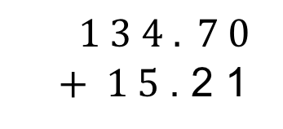
UNIT:
Decimal Calculations
Section 2
Addition and Subtraction of Decimals
We start with a quick review of key facts:
To add or subtract decimal numbers, line up the decimal points.
Line up all digits, in their correct place value columns: Hundreds beneath Hundreds, Tens beneath Tens, etc.
Use zeros as place holders, where needed, to ensure a digit in each column.
Complete column addition, as normal.
For example:
Calculate: 134.7 + 15.21
$1 3 4 . 7 0$
$+ 1 5$. 2 1
1 4 9 . 9 1
Note: Always take care to line up the decimal points.

Slide 8
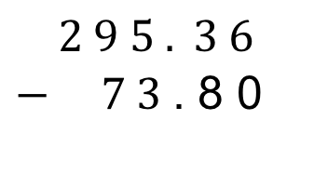
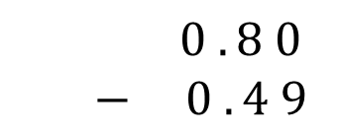
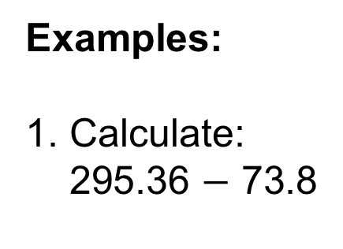
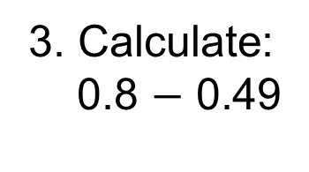


UNIT:
Decimal Calculations
Section 2
Addition and Subtraction of Decimals
Examples:
1. Calculate:
295.36 $−$ 73.8
$2 9 5 . 3 6$
$− 7 3$. 8 0
_________
2 2 1 . 5 6
$$\text{_________}$$
2. Calculate:
0.0107 + 100.2
$$0 . 0 1 0 7$$
+ $1 0 0$. 2 0 0 0
1 0 0 . 2 1 0 7
3. Calculate:
0.8 $−$ 0.49
$$0 . 8 0$$
$− 0 . 4 9$
0 . 3 1

Slide 9
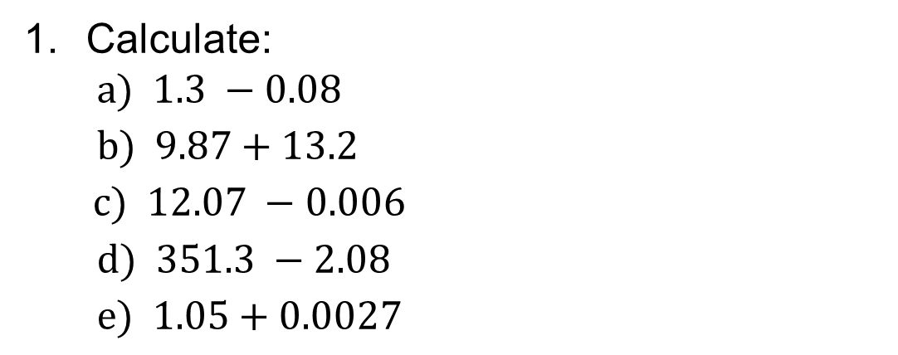
UNIT:
Decimal Calculations
Section 2
Section 2: Fitness Check
Calculate:
$$a) 1.3 −0.08$$
$b) 9.87+13.2$
$c) 12.07 −0.006$
$$d) 351.3 −2.08$$
$$e) 1.05+0.0027$$
1.22
23.07
12.064
349.22
1.0527
2. Ben buys a train ticket that costs £16.48.
How much change does Ben get from a £20 note?
£3.52
Pritti spends £3.74 on Monday, £6.72 on Tuesday and
£5.56 on Wednesday.
How much does she spend altogether?
She had £50 to start with; how much has she got left?
£16.02
£33.98

Slide 10
UNIT:
Decimal Calculations
Section 2
Section 2: Review
You have completed the second Section.
If you have completed and understood this section,
click to start the next Section.
If you need more examples and interactive practice,
press here.
You might also find it helpful to look at:
Essential Information: press here

Slide 11
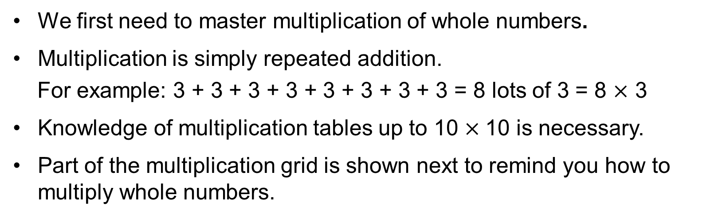
UNIT:
Decimal Calculations
Section 3
Multiplication with Decimals
We start with a quick review of key facts:
We first need to master multiplication of whole numbers.
Multiplication is simply repeated addition.
For example: 3 + 3 + 3 + 3 + 3 + 3 + 3 + 3 = 8 lots of 3 = 8 $×$ 3
Knowledge of multiplication tables up to 10 $×$10 is necessary.
Part of the multiplication grid is shown next to remind you how to multiply whole numbers.

Slide 12
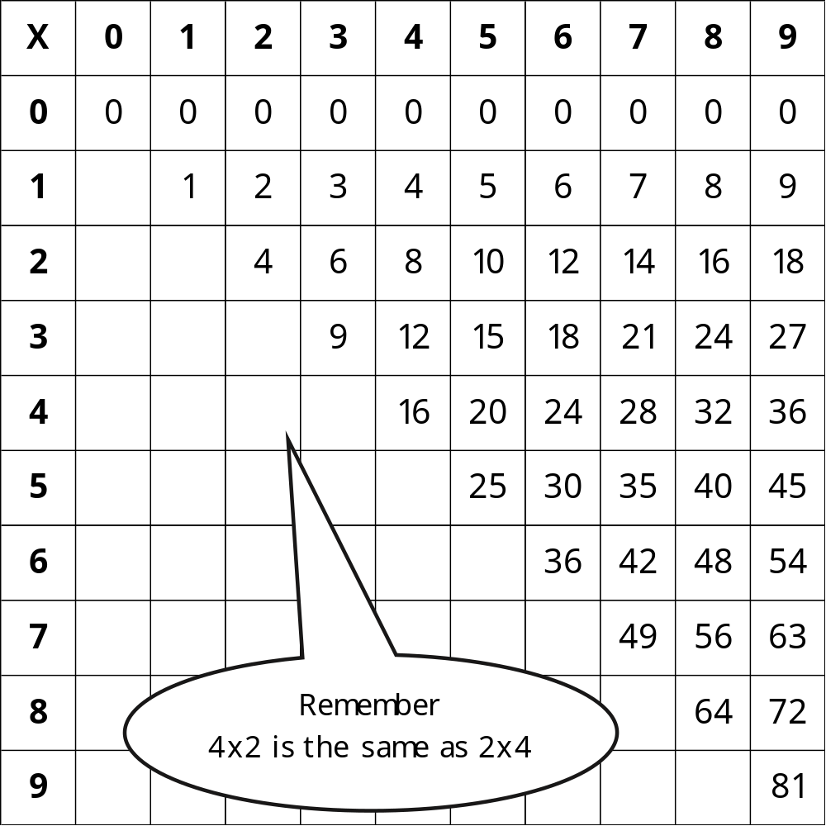
UNIT:
Decimal Calculations
Section 3
Multiplication Grid

Slide 13
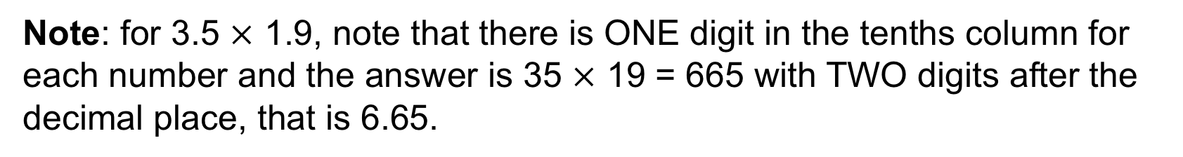
$$×$$
UNIT:
Decimal Calculations
Section 3
Multiplication with Decimals
We now extend our multiplication to decimals.
Example
You know that 35 $×$19 = 665. Deduce the value of :
a) 3.5 $×$19 b) 3.5 $×$ 1.9 c) 350 $×$ 1.9 d) 350 $×$ 190
Solution
3.5 $×$19 = $\frac{35}{10}×$19 = $\frac{35 × 19}{10}$ = $\frac{665}{10}= 66.5$
3.5 $× 1.$9 = $\frac{35}{10}× \frac{19}{10}$ = $\frac{35×19}{10×10}$ = $\frac{665}{100}= 6.65$
350 $× 1.$9 = $350 × \frac{19}{10}$ = $\frac{350×19}{10}$ = $\frac{10×35×19}{10}=35×19=665$
350 $×$ 190 = 35$×$10$×$19$×$10 = 35$×$19$×$10$×$10 = 665$×$100 = 66500
Note: for 3.5 $×$ 1.9, note that there is ONE digit in the tenths column for each number and the answer is 35 $×$ 19 = 665 with TWO digits after the decimal place, that is 6.65.

Slide 14
$$×$$
UNIT:
Decimal Calculations
Section 3
Multiplication Problems in Context
Example
A meal for an adult costs £4.99 and a meal for a child costs £2.25. Find the total cost of 2 adult and 4 child meals.
Solution
Total cost = 2$× £4.99+4$ $× £2.25$ = £9.98 + £9.00 = £18.98
Example
Chain is sold for £2.44 per metre. Find the cost of 3.2 metres of chain.
Solution
Cost = £2.44 $× 3.2$ = £$\frac{244}{100}$ $× \frac{32}{10}=£\frac{244×32}{1000}=£\frac{7808}{1000}=£7.808 ≈£7.81$
Example
Apples are sold for £1.06 per kilogram. Find the cost of 2.4 kg of apples.
Cost = £1.06 $× 2.4$ = £$\frac{106}{100}$ $× \frac{24}{10}=£\frac{106×24}{1000}=£\frac{2544}{1000}=£2.544 ≈£2.54$

Slide 15
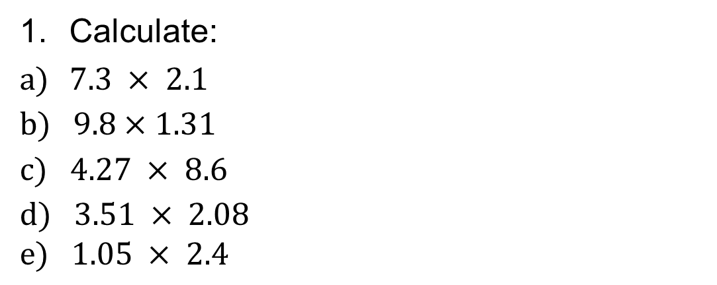
UNIT:
Decimal Calculations
Section 3
Section 3: Fitness Check
Calculate:
$7.3 × 2.1$
$b) 9.8×1.31$
$$c) 4.27 × 8.6$$
$$d) 3.51 × 2.08$$
$$e) 1.05 × 2.4$$
15.33
12.838
36.722
7.3008
2.52
Find the cost of 7 sandwiches, each costing £3.79.
£26.53
Apples are sold for £3.04 per kilogram.
Find the cost of 2.25 kilograms of apples.
Find the cost of 6.7 kilograms of apples.
£6.84
£20.37

Slide 16
UNIT:
Decimal Calculations
Section 3
Section 3: Review
You have completed the third Section.
If you have completed and understood this section,
click to start the next Section.
If you need more examples and interactive practice,
press here.
You might also find it helpful to look at:
Essential Information: press here

Slide 17
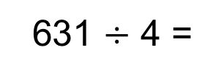
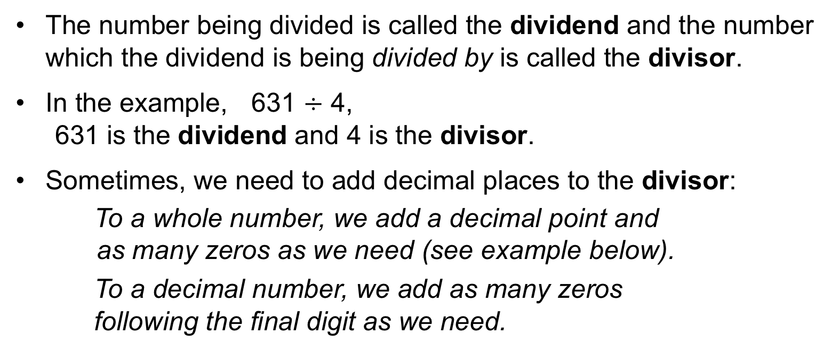
UNIT:
Decimal Calculations
Section 4
Division with Decimals
We start with a quick review of key facts:
The number being divided is called the dividend and the number which the dividend is being divided by is called the divisor.
In the example, 631 $÷$ 4,
631 is the dividend and 4 is the divisor.
Sometimes, we need to add decimal places to the divisor:
To a whole number, we add a decimal point and
as many zeros as we need (see example below).
To a decimal number, we add as many zeros
following the final digit as we need.
1 5 7 . 7 5
631 $÷$ 4 =
6 3 1 . 0 0
Answer: 157.75
4
Note: Take care to line up the decimal points.

Slide 18
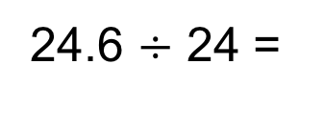
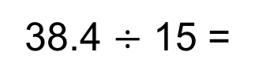
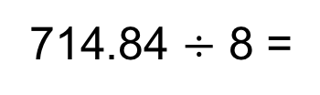
UNIT:
Decimal Calculations
Section 4
Division with Decimals
Further examples:
2. 5 6
38.4 $÷$ 15 =
15 3 8.⁸4⁹0
Answer: 2.56
1 . 0 2 5
24.6 $÷$ 24 =
24
2 4 . 6⁶0¹²0
Answer: 1.025
8 9 . 3 5 5
714.84 $÷$ 8 =
8
7⁷1⁷4 .²8⁴4⁴0
Answer: 89.0355

Slide 19
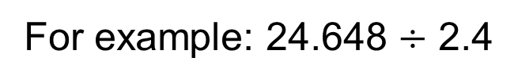
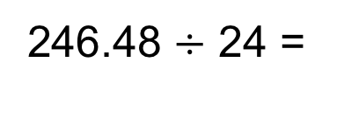
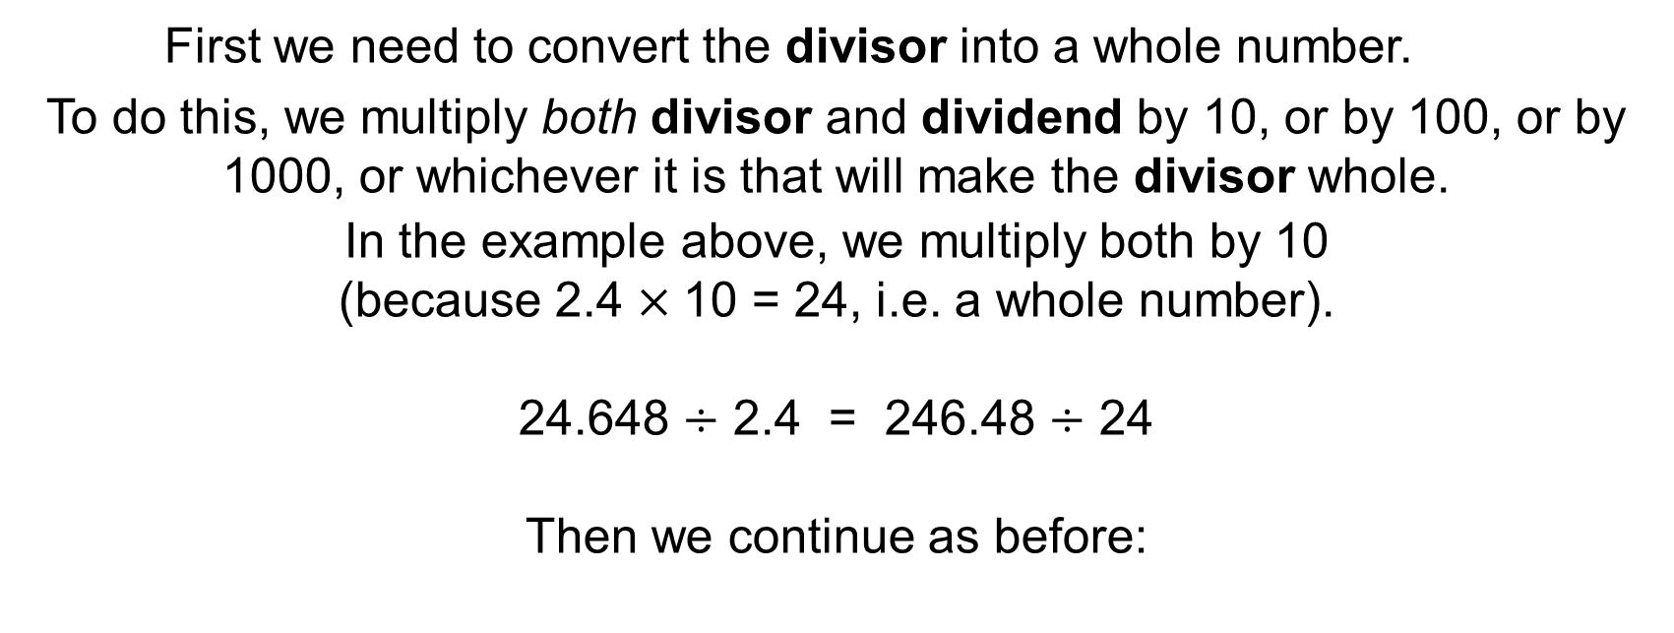
UNIT:
Decimal Calculations
Section 4
Division with Decimals
What happens when we divide a decimal number by a decimal number?
For example: 24.648 $÷$ 2.4
First we need to convert the divisor into a whole number.
To do this, we multiply both divisor and dividend by 10, or by 100, or by 1000, or whichever it is that will make the divisor whole.
In the example above, we multiply both by 10
(because 2.4 $×$10 = 24, i.e. a whole number).
24.648 $÷$ 2.4 = 246.48 $÷$ 24
Then we continue as before:
1 0 . 2 7
246.48 $÷$ 24 =
24
2 4 6 . ⁶4¹⁶8
Answer: 10.27

Slide 20
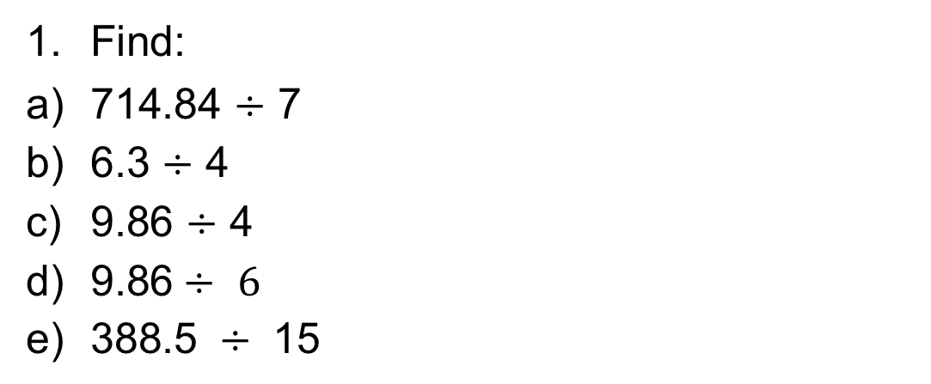
UNIT:
Decimal Calculations
Section 4
Section 4: Fitness Check
Find:
714.84 $÷$ 7
6.3 $÷$ 4
9.86 $÷$ 4
$\text{9.8}\text{6}÷ 6$
$\text{3}\text{88.5} ÷ \text{15}$
102.12
1.575
2.465
1.64333….
25.9
Doing odd-jobs, Oliver and his 3 siblings earn a total of £51.12. They share this amount equally. How much do they each receive?
£12.78
A rope is 38.52 metres long.
It is cut into 4 equal lengths. How long is each length?
It is cut into 15 equal lengths. How long is each length?
9.63 m
2.568 m

Slide 21
UNIT:
Decimal Calculations
Section 4
Section 4: Review
You have completed the fourth Section.
If you have completed and understood this section,
click here for the Unit audit.
If you need more examples and interactive practice,
press here.
You might also find it helpful to look at:
Essential Information: press here

