Slide 1
Supporting and Enhancing Mathematics and Statistics
UNIT: Scientific Notation

Slide 2
UNIT:
Scientific
Notation
Section 1
Scientific Notation
Scientific notation (standard form) is an important part of number work because it enables very large and very small numbers to be expressed in concise ways.
You have two sections to work through and there are check up audits and fitness tests for each section.
Standard (or Scientific) Form
Calculations with Standard Form

Slide 3
UNIT:
Scientific Notation
Section 1
Numbers expressed in Standard Form
Powers of 10 are used in Standard Form, so it is
useful to remember that:
10⁴ = 10 000
10³ = 1000
10² = 100
10¹ = 10
10⁰ = 1
It might be helpful to see this as a pattern which
can be continued...
10⁻¹ = 0.1
10⁻² = 0.01
10⁻³ = 0.001
10⁻⁴ = 0.0001
10⁻⁵ = 0.00001

Slide 4
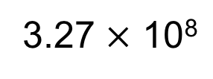
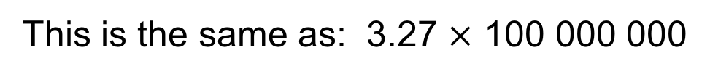
UNIT:
Scientific Notation
Section 1
Standard Form
Standard form is a convenient way to write very large
or very small numbers, and to carry out calculations with
these very large or very small numbers.
An example of a large number written in standard form is:
3
3.27 $×$ 10⁸
This is the same as: 3.27 $×$ 100 000 000
Which equals:
327 000 000
in normal decimal form
Note: in standard form, we write one single non-zero digit
to the left of the decimal point.

Slide 5
UNIT:
Scientific
Notation
Section 1
Standard Form
You may like to remind yourself how to multiply by powers of 10:
To multiply by 10, 100, 1000, 10 000 100 000 etc.,
slide all the digits to the left by 1 place, 2 places,
3 places, 4 places, 5 places, etc. respectively
Empty columns are filled with zeros;
these act as placeholders.

Slide 6
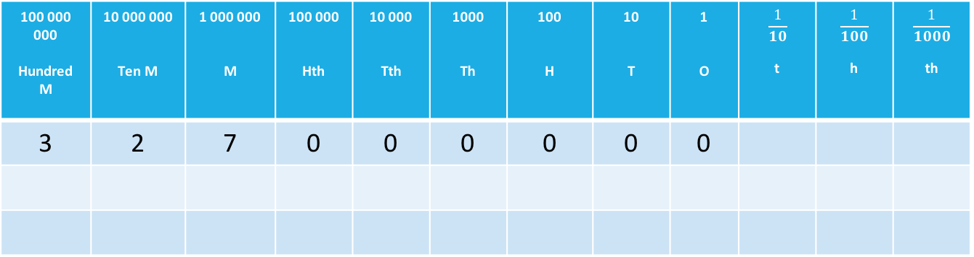
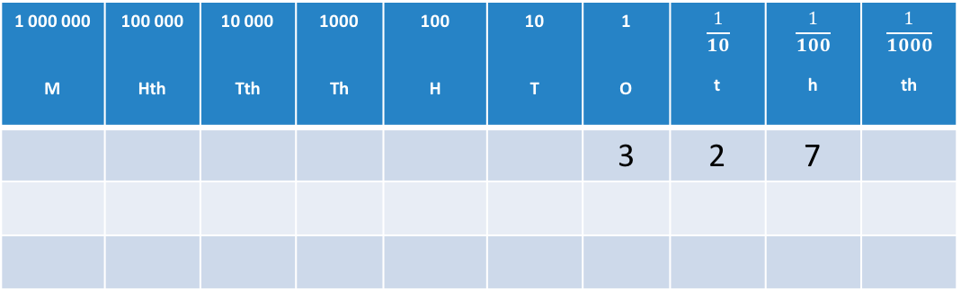
UNIT:
Scientific
Notation
Section 1
Standard Form
1 000 000 M | 100 000 Hth | 10 000 Tth | 1000 Th | 100 H | 10 T | 1 O | $$\frac{1}{10}$$ t | $$\frac{1}{100}$$ h | $$\frac{1}{1000}$$ th
 |  |  |  |  |  | 3 | 2 | 7
3.27 × 10⁸ = 3.27 × 100 000 000
3.27 slides 8 places to the left
100 000 000 Hundred M | 10 000 000 Ten M | 1 000 000 M | 100 000 Hth | 10 000 Tth | 1000 Th | 100 H | 10 T | 1 O | $$\frac{1}{10}$$ t | $$\frac{1}{100}$$ h | $$\frac{1}{1000}$$ th
3 | 2 | 7 | 0 | 0 | 0 | 0 | 0 | 0

Slide 7
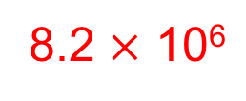
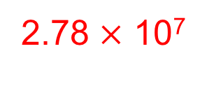
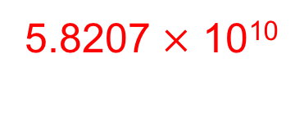
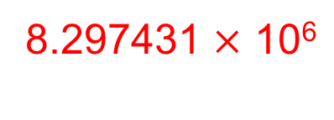
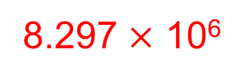
UNIT:
Scientific
Notation
Section 1
Standard Form
Examples for very large numbers:
Write 8 200 000 in standard form
8.2 $×$ 10⁶
Write 8 297 000 in standard form
8.297 $×$ 10⁶
Write 8 297 431 in standard form
8.297431 $×$ 10⁶
Write 58 207 000 000 in standard form
5.8207 $×$ 10¹⁰
Write 27.8 million in standard form
2.78 $×$ 10⁷

Slide 8
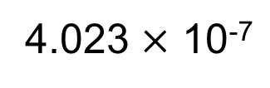
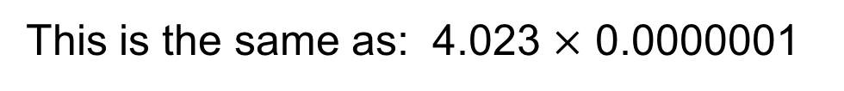
UNIT:
Scientific
Notation
Section 1
Standard Form
An example of a very small number written in
standard form a number:
4.023 $×$ 10⁻⁷
4
This is the same as: 4.023 $×$ 0.0000001
Which equals:
0.0000004023
in normal decimal form
Note: in standard form, we write one single non-zero digit
to the left of the decimal point.

Slide 9
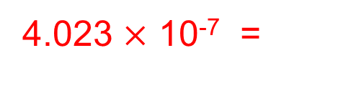
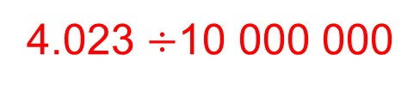
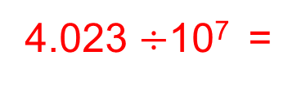
UNIT:
Scientific Notation
Section 1
Standard Form
You may like to remind yourself how to multiply by
negative powers of 10:
Multiplying by 10⁻¹ is the same as dividing by 10
Multiplying by 10⁻² is the same as dividing by 100
Multiplying by 10⁻³ is the same as dividing by 1000
Multiplying by 10⁻⁴ is the same as dividing by 10 000
Multiplying by 10⁻⁵ is the same as dividing by 100 000
and so on…
To divide by 10, 100, 1000, 10 000, 100 000, etc.,
slide all the digits to the right by 1 place, 2 places,
3 places, 4 places, 5 places, etc. respectively
Empty columns are filled with zeros;
these act as placeholders.
4.023 $×$ 10⁻⁷ =
4.023 $÷$10⁷ =
4.023 $÷$10 000 000

Slide 10
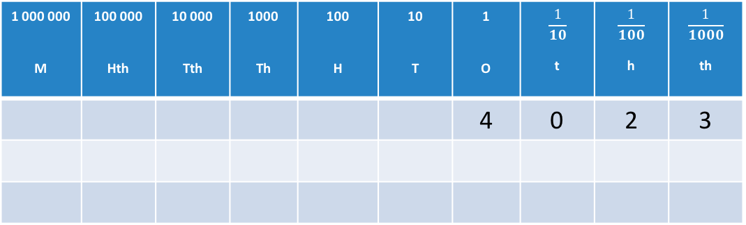

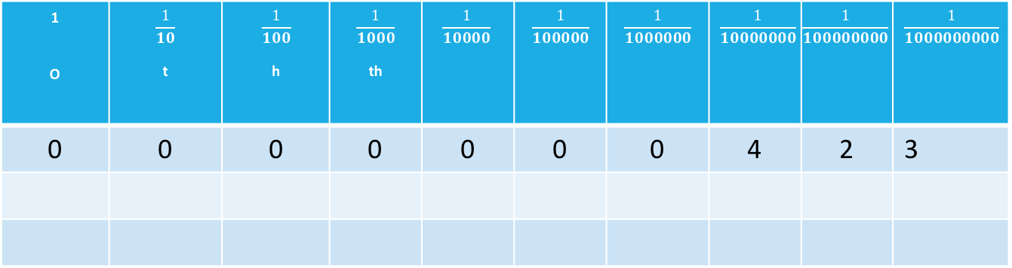

UNIT:
Scientific
Notation
Section 1
Standard Form
1 000 000 M | 100 000 Hth | 10 000 Tth | 1000 Th | 100 H | 10 T | 1 O | $$\frac{1}{10}$$ t | $$\frac{1}{100}$$ h | $$\frac{1}{1000}$$ th
 |  |  |  |  |  | 4 | 0 | 2 | 3
4.023 $×$ 10⁻⁷ = 4.023 $×$ 0.0000001 =
4.023$÷$ 10 000 000
4.23 slides 7 places to the right
1 O | $$\frac{1}{10}$$ t | $$\frac{1}{100}$$ h | $$\frac{1}{1000}$$ th | $$\frac{1}{10000}$$ | $$\frac{1}{100000}$$ | $$\frac{1}{1000000}$$ | $$\frac{1}{10000000}$$ | $$\frac{1}{100000000}$$ | $$\frac{1}{1000000000}$$
0 | 0 | 0 | 0 | 0 | 0 | 0 | 4 | 2 | 3

Slide 11
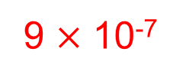
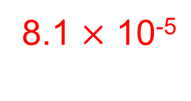
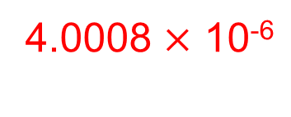
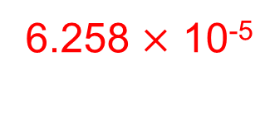
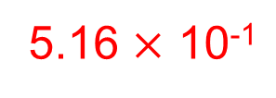
UNIT:
Scientific Notation
Section 1
Standard Form
Examples for very small numbers:
Write 0.0000009 in standard form
9 $×$ 10⁻⁷
Write 0.516 in standard form
5.16 $×$ 10⁻¹
Write 0.00006258 in standard form
6.258 $×$ 10⁻⁵
Write 0.0000040008 in standard form
4.0008 $×$ 10⁻⁶
Write 0.009² in standard form
8.1 $×$ 10⁻⁵

Slide 12
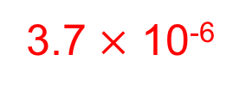
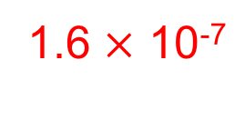


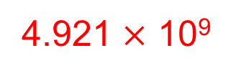
UNIT:
Scientific Notation
Section 1
Section 1: Fitness Check
Here are some questions to check your progress;
there are more practice questions if needed.
Write 0.0000037 in standard form
3.7 $×$ 10⁻⁶
Write 4 921 000 000 in standard form
4.921 $×$ 10⁹
Write 7.531 $×$ 10¹¹ in normal decimal form
753 100 000 000
Write 1.275 $×$ 10⁻⁷ in normal decimal form
0.0000001275
Write 0.0004² in standard form
1.6 $×$ 10⁻⁷

Slide 13
UNIT:
Scientific
Notation
Section 1
Section 1: Review
You have completed the first Section.
If you have completed and understood this section,
click to start the next Section
If you need more examples and interactive practice,
press here
You might also find it helpful to look at:
Essential Information: press here

Slide 14
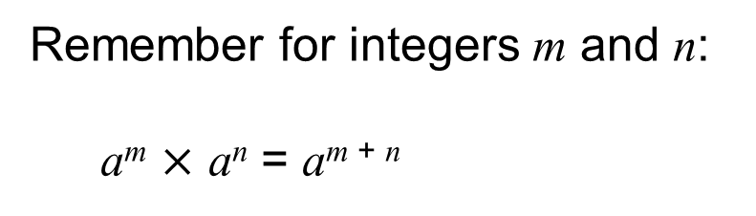
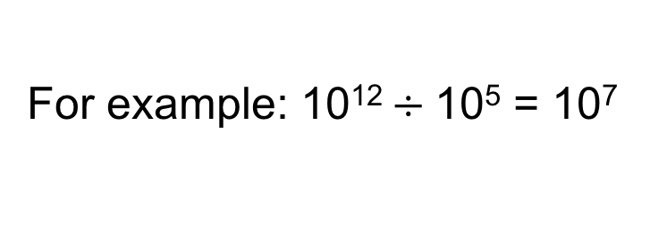
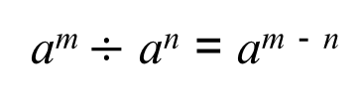
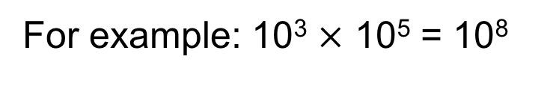
UNIT:
Scientific Notation
Section 2
Calculation with Standard Form
We can multiply and divide standard form numbers,
taking advantage of the form in which they are written and
using the rules of indices.
Remember for integers m and n:
a^{m} $×$ a^{n} = a^{m + n}
For example: 10³ $×$ 10⁵ = 10⁸
a^{m} $÷$ a^{n} = a^{m} ⁻ ^{n}
For example: 10¹² $÷$10⁵ = 10⁷

Slide 15
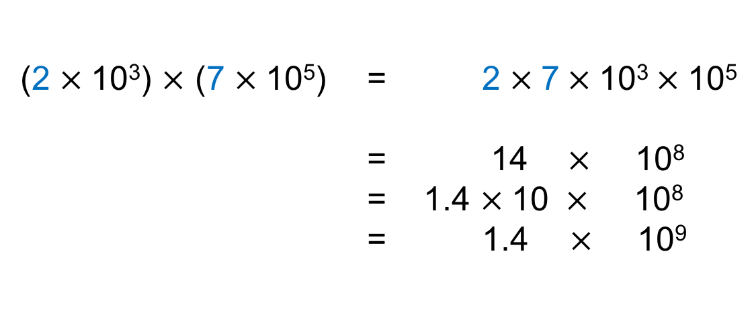
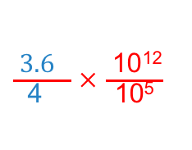
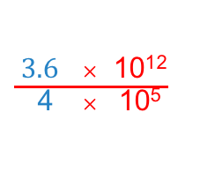
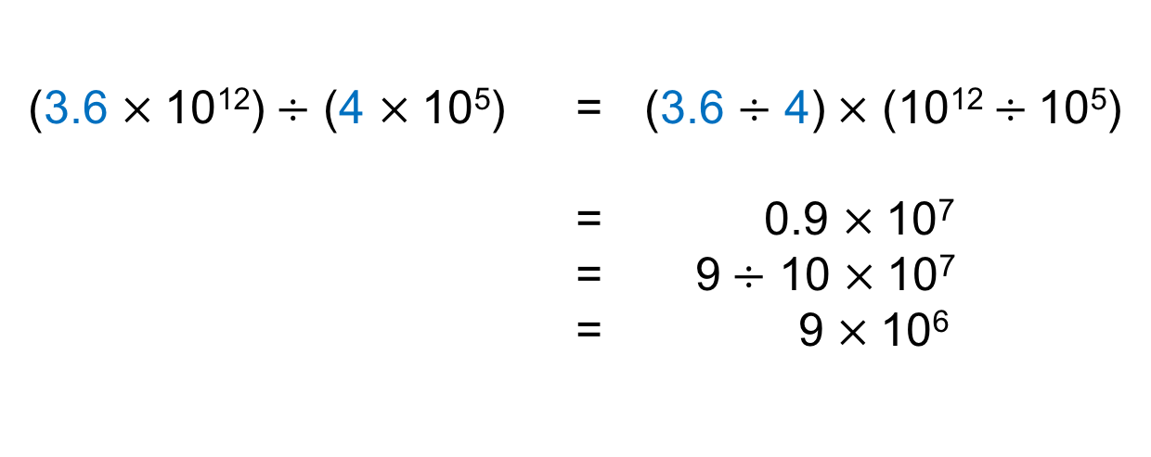
UNIT:
Scientific Notation
Section 2
Calculation with Standard Form
Worked example:
(2 $×$10³) $×$ (7 $×$10⁵) = 2 $×$7$×$10³$×$10⁵
= 14 $×$ 10⁸
= 1.4 $×$10 $×$ 10⁸
= 1.4 $×$ 10⁹
using the rules of indices
converting to standard form
Worked example:
This can also be
written as:
(3.6 $×$10¹²)$÷$ (4 $×$10⁵) = (3.6 $÷$ 4)$×$ (10¹²$÷$10⁵)
= 0.9 $×$10⁷
= 9$÷$ 10 $×$10⁷
= 9 $×$10⁶
$\frac{ \text{3.6} × \text{10}\text{1}\text{2}}{ \text{4} × \text{10}\text{5}}$
which equals
using the rules of indices
$\frac{ \text{3.6} }{\text{4} }$ $×$ $\frac{ \text{10}\text{12}}{\text{10}\text{5}}$
converting to standard form

Slide 16
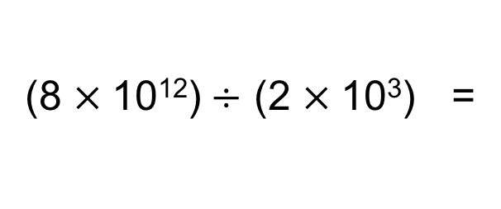
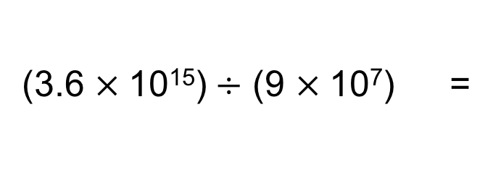
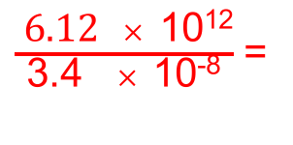
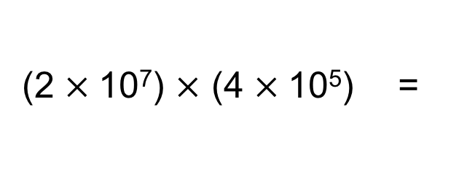
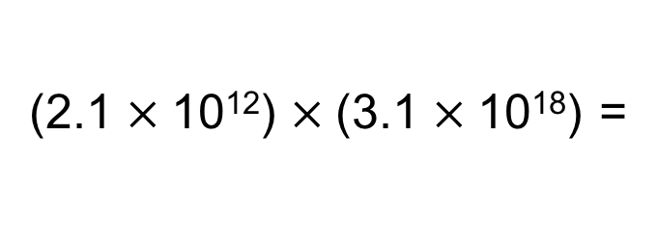
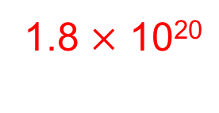
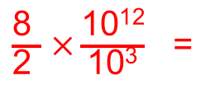
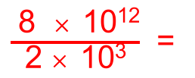
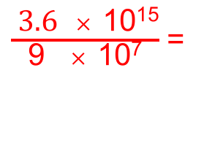
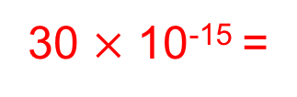
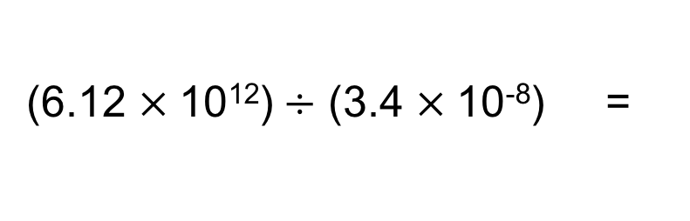
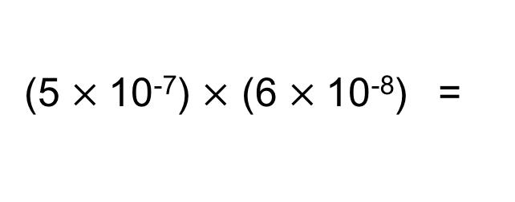
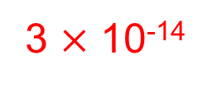
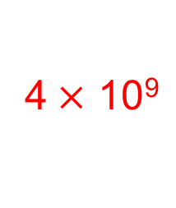
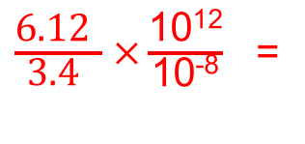
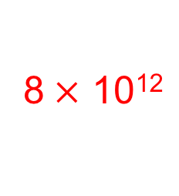
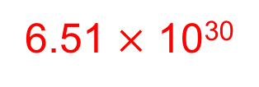
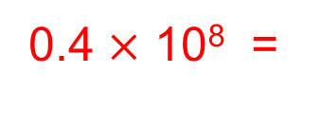
UNIT:
Scientific Notation
Section 2
Calculation with Standard Form
Here are some worked examples, the final answers
are in standard form:
(2 $×$10⁷) $×$ (4 $×$10⁵) =
8$×$ 10¹²
(5 $×$10⁻⁷) $×$ (6 $×$10⁻⁸) =
30 $×$ 10⁻¹⁵ =
3 $×$ 10⁻¹⁴
(2.1 $×$10¹²) $×$(3.1 $×$10¹⁸) =
6.51 $×$ 10³⁰
(8 $×$10¹²)$÷$ (2 $×$10³) =
$\frac{ \text{8 } × \text{10}\text{12}}{\text{2} × \text{10}\text{3}}$ =
$\frac{\text{8 }}{\text{2 }}$ $×\frac{\text{10}\text{12}}{\text{10}\text{3}}$ =
4$×$ 10⁹
(6.12 $×$10¹²)$÷$ (3.4 $×$10⁻⁸) =
$\frac{ \text{6.12} × \text{10}\text{12}}{\text{3.4} × \text{10}\text{−8}}$ =
$\frac{\text{6.12} }{\text{3.4} }$ $×\frac{\text{10}\text{12}}{\text{10}\text{−8}}$ =
1.8 $×$ 10²⁰
(3.6 $×$10¹⁵)$÷$ (9 $×$10⁷) =
$\frac{ \text{3.6} × \text{10}\text{15}}{\text{9} × \text{10}\text{7}}$ =
0.4 $×$ 10⁸ =
4 × 10⁷

Slide 17














UNIT:
Scientific Notation
Section 2
Section 2: Fitness Check
Here are some questions to check your progress;
there are more practice questions if needed.
Do the following calculations, making sure your answer
is in standard form:
(3 $×$10³) $×$ (2 $×$10⁵) =
6$×$ 10⁸
(5 $×$10⁻⁷) $×$ (3 $×$10¹¹) =
15 $×$ 10⁴ =
1.5 $×$ 10⁵
(3.6 $×$10¹²) $×$(4.1 $×$10⁹) =
14.76 $×$ 10²¹ =
1.476 $×$ 10²²
(9 $×$10¹²)$÷$ (3 $×$10⁷) =
3$×$ 10⁵
(5.74 $×$10¹²)$÷$ (1.4 $×$10⁻⁵) =
4.1 $×$ 10¹⁷
(1.62 $×$10²⁰)$÷$ (1.8 $×$10⁸) =
0.9 $×$ 10¹² =
9 × 10¹¹

Slide 18
UNIT:
Scientific Notation
Section 2
Section 2: Review
You have completed this second and last Section.
If you have completed and mastered this last section,
click here for the Unit audit
If you need more examples and interactive practice,
press here
You might also find it helpful to look at:
Essential Information: press here

