Slide 1
Supporting and Enhancing Mathematics and Statistics
UNIT: Decimals and Fractions

Slide 2
Decimals and Fractions
UNIT:
Decimals and Fractions
Decimals and Fractions are two ways of representing the same amount.
You have five sections to work through and there are check up audits and fitness tests for each section.
Decimals
Multiplying and Dividing with Decimals
Fractions and Decimals
Estimating Answers
Using Brackets and Memory on a Calculator

Slide 3
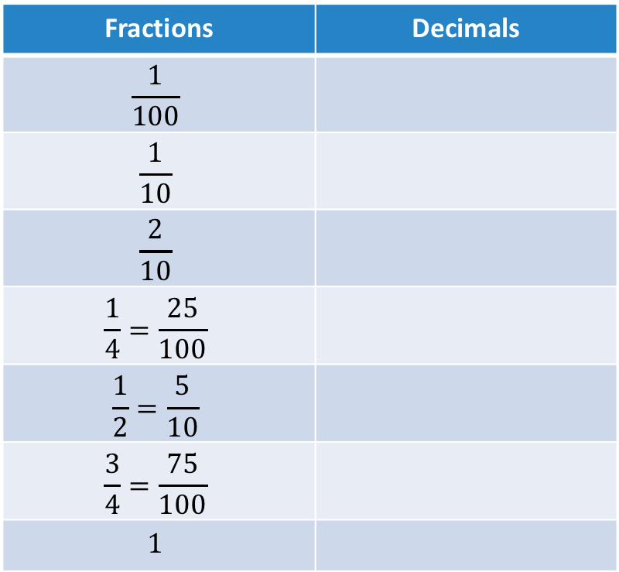
UNIT:
Decimals and Fractions
Section 1
Equivalence of Decimals and Fractions
The table below shows some common fractions and their equivalent decimals.
Fractions | Decimals
$$\frac{1}{100}$$
$$\frac{1}{10}$$
$$\frac{2}{10}$$
$$\frac{1}{4}=\frac{25}{100}$$
$$\frac{1}{2}=\frac{5}{10}$$
$$\frac{3}{4}=\frac{75}{100}$$
$$1$$
0.01
0.1
0.2
0.25
0.5
0.75
1

Slide 4
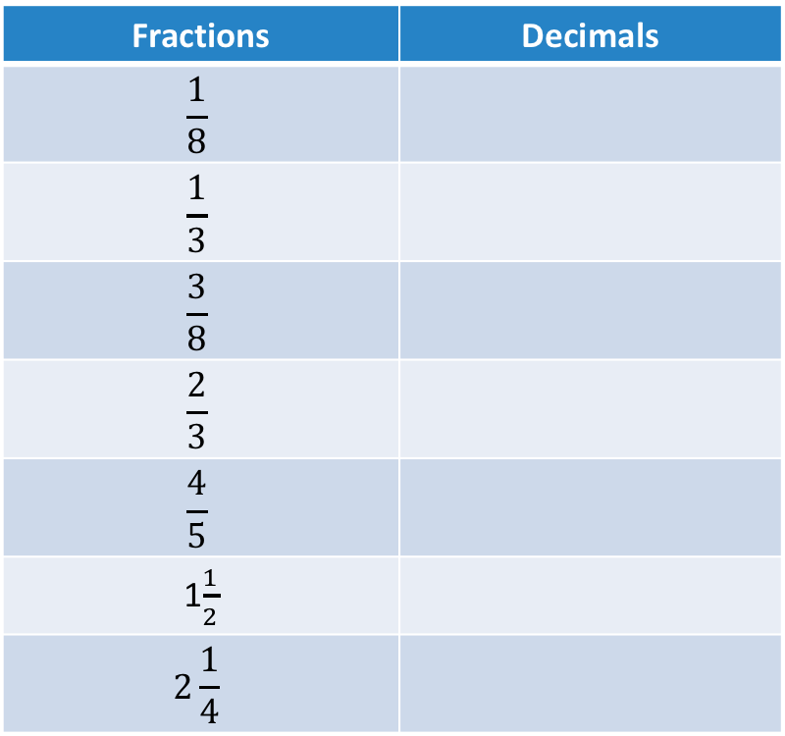
UNIT:
Decimals and Fractions
Section 1
Equivalence of Decimals and Fractions
Here are more common fractions and decimals:
Fractions | Decimals
$$\frac{1}{8}$$
$$\frac{1}{3}$$
$$\frac{3}{8}$$
$$\frac{2}{3}$$
$$\frac{4}{5}$$
1$\frac{1}{2}$
$$\text{2}\frac{1}{4}$$
0.125
0.33333…
0.375
0.66666…
0.8
1.5
2.25

Slide 5

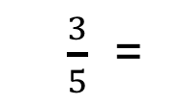

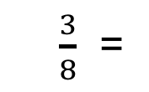
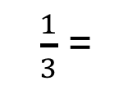
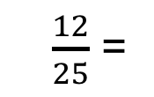
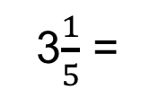

Section 1: Fitness Check
UNIT:
Decimals and Fractions
Section 1
1. Convert between fractions and decimals
a)
b)
c)
d)
e)
f)
g)
h)
$\frac{3}{8}$ =
0.375
$\frac{3}{5}$ =
0.4
$$\frac{3}{4}$$
0.75 =
1.25 =
1$\frac{1}{4}$
$\frac{12}{25}$ =
0.48
3$\frac{1}{5}$ =
3.2
0.7 =
$$\frac{7}{10}$$
$\frac{1}{3}$ =
0.33333…

Slide 6
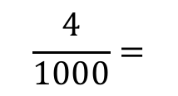

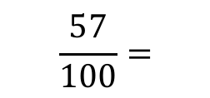
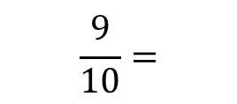
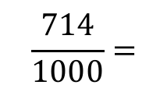



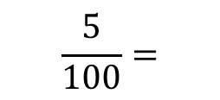

Section 1: Fitness Check
UNIT:
Decimals and Fractions
Section 1
2. Convert to decimals
$$\frac{57}{100}=$$
a)
b)
c)
d)
e)
$$0.57$$
$$\frac{5}{100}=$$
$$0.05$$
$$\frac{714}{1000}=$$
$$0.714$$
$$\frac{4}{1000}=$$
$$0.004$$
$$\frac{9}{10}=$$
$$0.9$$

Slide 7
UNIT:
Decimals and Fractions
Section 1
Section 1: Review
You have completed the first Section.
If you have completed and understood this section,
click to start the next Section.
If you need more examples and interactive practice,
press here.
You might also find it helpful to look at:
Essential Information: press here

Slide 8
Multiplying and Dividing Decimals
UNIT:
Decimals and Fractions
Section 2
Multiplying
To multiply by 10, 100, 1000, 10 000, etc.,
slide all the digits to the LEFT by 1 place, 2 places,
3 places, 4 places, etc. respectively
Empty columns are filled with zeros;
these act as placeholders.
Dividing
To divide by 10, 100, 1000, 10 000, etc.,
slide all the digits to the RIGHT by 1 place, 2 places,
3 places, 4 places, etc. respectively
Empty columns are filled with zeros;
these act as placeholders.
The following slides show some examples.

Slide 9
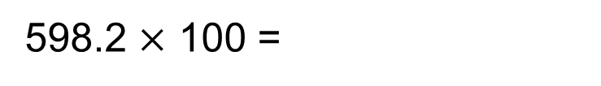
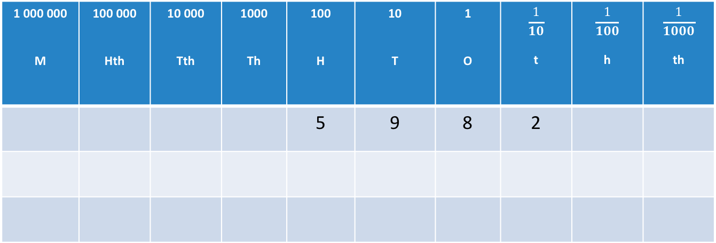
Multiplying with Decimals: Examples
UNIT:
Decimals and Fractions
Section 2
1 000 000 M | 100 000 Hth | 10 000 Tth | 1000 Th | 100 H | 10 T | 1 O | $$\frac{1}{10}$$ t | $$\frac{1}{100}$$ h | $$\frac{1}{1000}$$ th
 |  |  |  | 5 | 9 | 8 | 2
598.2 $×$ 100 =

Slide 10
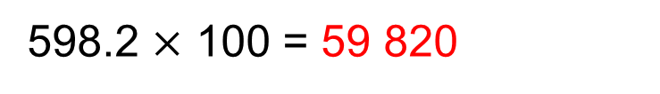
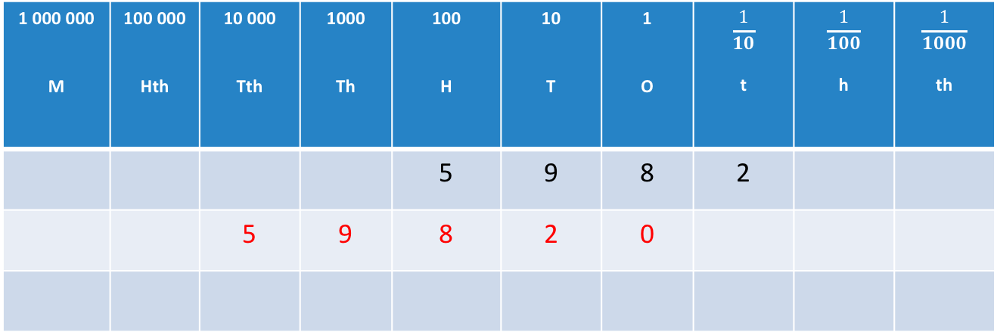
UNIT:
Decimals and Fractions
Section 2
Multiplying with Decimals: Examples
1 000 000 M | 100 000 Hth | 10 000 Tth | 1000 Th | 100 H | 10 T | 1 O | $$\frac{1}{10}$$ t | $$\frac{1}{100}$$ h | $$\frac{1}{1000}$$ th
 |  |  |  | 5 | 9 | 8 | 2
 |  | 5 | 9 | 8 | 2 | 0
598.2 $×$ 100 = 59 820
To multiply by 100, slide all digits 2 places to the LEFT.
Fill empty columns with zeros; these act as placeholders.

Slide 11
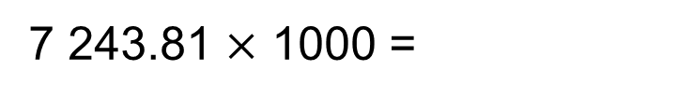
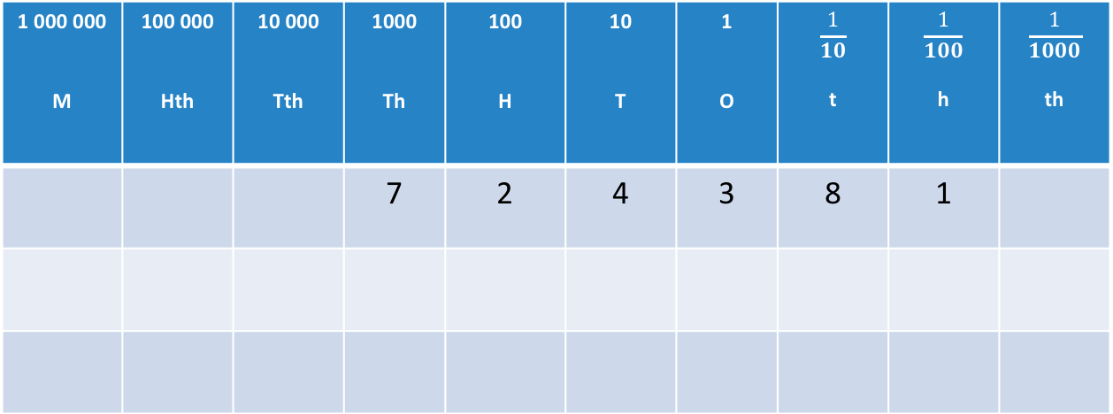
UNIT:
Decimals and Fractions
Section 2
Multiplying with Decimals: Examples
1 000 000 M | 100 000 Hth | 10 000 Tth | 1000 Th | 100 H | 10 T | 1 O | $$\frac{1}{10}$$ t | $$\frac{1}{100}$$ h | $$\frac{1}{1000}$$ th
 |  |  | 7 | 2 | 4 | 3 | 8 | 1
7 243.81 $×$ 1000 =

Slide 12
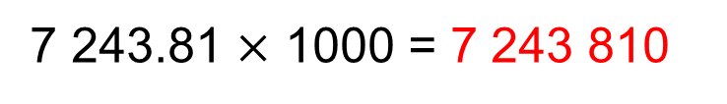
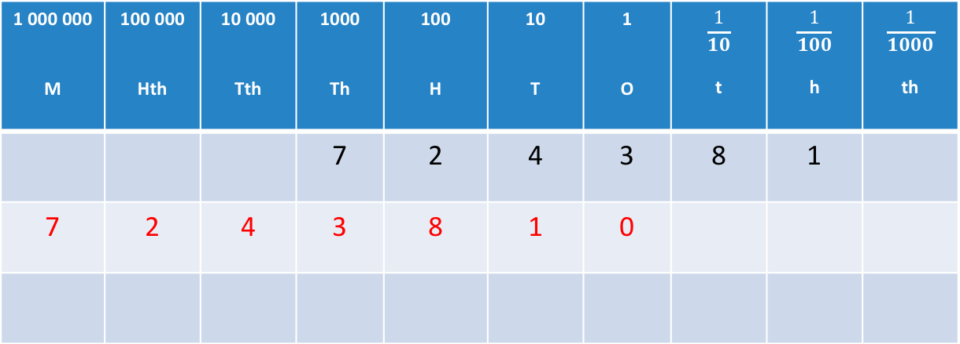
UNIT:
Decimals and Fractions
Section 2
Multiplying with Decimals: Examples
1 000 000 M | 100 000 Hth | 10 000 Tth | 1000 Th | 100 H | 10 T | 1 O | $$\frac{1}{10}$$ t | $$\frac{1}{100}$$ h | $$\frac{1}{1000}$$ th
 |  |  | 7 | 2 | 4 | 3 | 8 | 1
7 | 2 | 4 | 3 | 8 | 1 | 0
7 243.81 $×$ 1000 = 7 243 810
To multiply by 1000, slide all digits 3 places to the LEFT.
Fill empty columns with zeros; these act as placeholders.

Slide 13
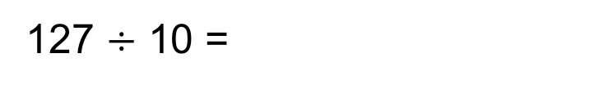
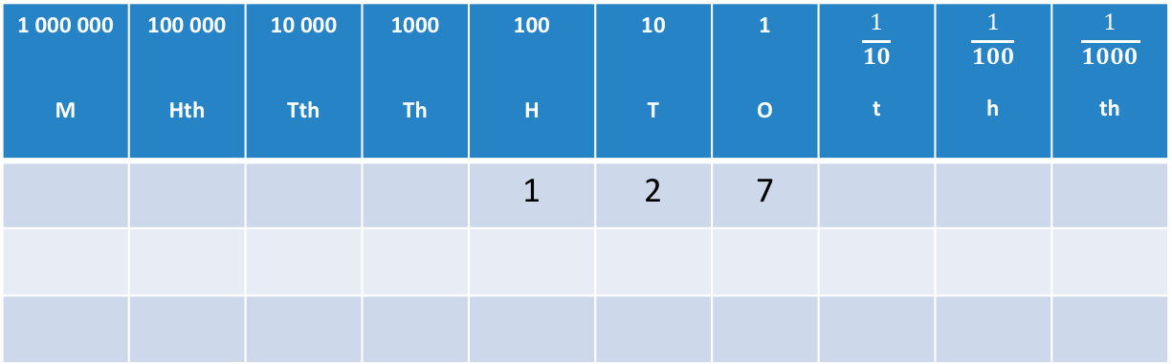
Dividing with Decimals: Examples
UNIT:
Decimals and Fractions
Section 2
1 000 000 M | 100 000 Hth | 10 000 Tth | 1000 Th | 100 H | 10 T | 1 O | $$\frac{1}{10}$$ t | $$\frac{1}{100}$$ h | $$\frac{1}{1000}$$ th
 |  |  |  | 1 | 2 | 7
127 $÷$ 10 =

Slide 14
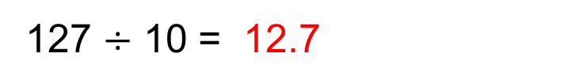
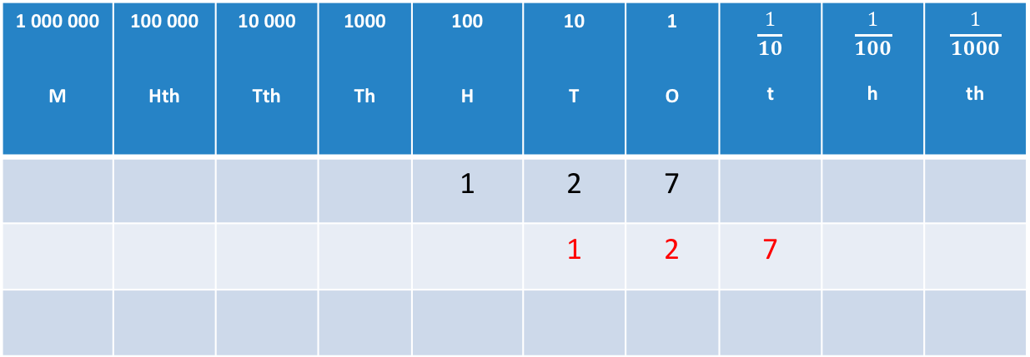
Dividing with Decimals: Examples
UNIT:
Decimals and Fractions
Section 2
1 000 000 M | 100 000 Hth | 10 000 Tth | 1000 Th | 100 H | 10 T | 1 O | $$\frac{1}{10}$$ t | $$\frac{1}{100}$$ h | $$\frac{1}{1000}$$ th
 |  |  |  | 1 | 2 | 7
 |  |  |  |  | 1 | 2 | 7
127 $÷$ 10 = 12.7
To divide by 10, slide all digits 1 place to the RIGHT.
Fill empty columns with zeros; these act as placeholders.

Slide 15
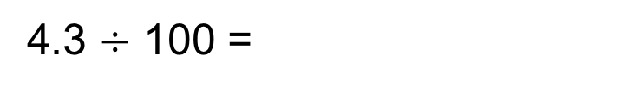
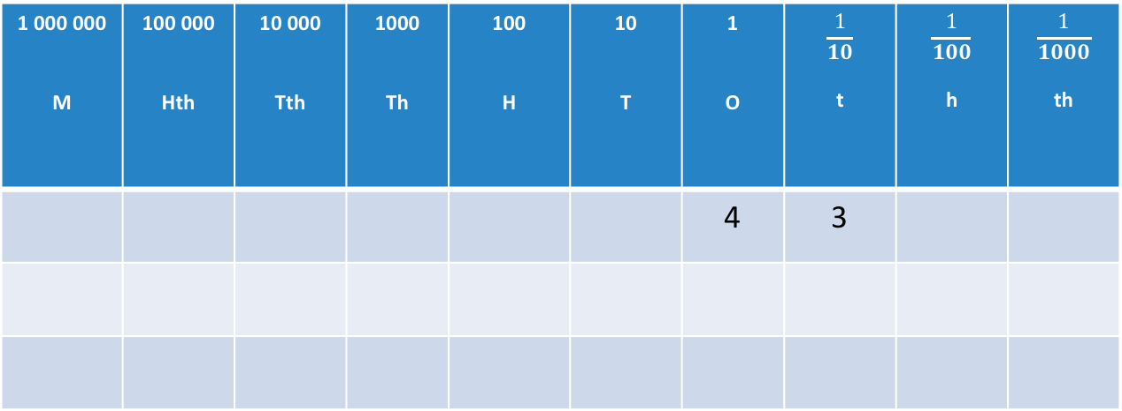
Dividing with Decimals: Examples
UNIT:
Decimals and Fractions
Section 2
1 000 000 M | 100 000 Hth | 10 000 Tth | 1000 Th | 100 H | 10 T | 1 O | $$\frac{1}{10}$$ t | $$\frac{1}{100}$$ h | $$\frac{1}{1000}$$ th
 |  |  |  |  |  | 4 | 3
4.3 $÷$ 100 =

Slide 16
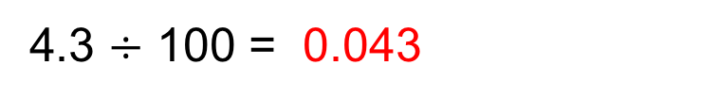
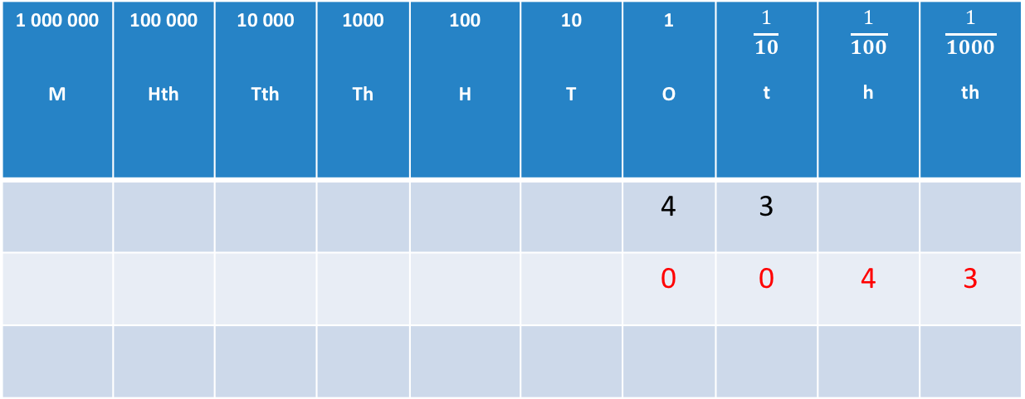
UNIT:
Decimals and Fractions
Section 2
Dividing with Decimals: Examples
1 000 000 M | 100 000 Hth | 10 000 Tth | 1000 Th | 100 H | 10 T | 1 O | $$\frac{1}{10}$$ t | $$\frac{1}{100}$$ h | $$\frac{1}{1000}$$ th
 |  |  |  |  |  | 4 | 3
 |  |  |  |  |  | 0 | 0 | 4 | 3
4.3 $÷$ 100 = 0.043
To divide by 100, slide all digits 2 places to the RIGHT.
Fill empty columns with zeros; these act as placeholders.

Slide 17
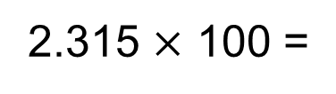
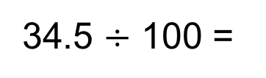
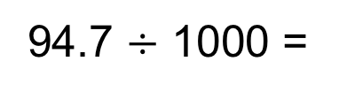
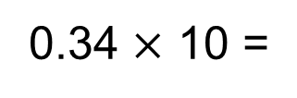
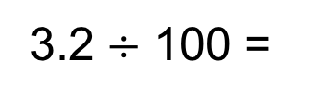
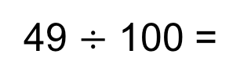
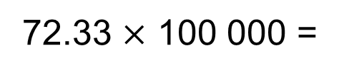
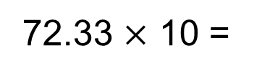
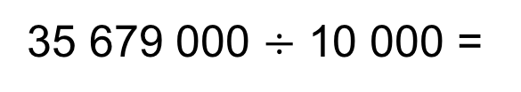
UNIT:
Decimals and Fractions
Section 2
Section 2: Fitness Check
1.
2.
3.
4.
5.
6.
7.
8.
9.
0.34 $×$ 10 =
3.4
49 $÷$ 100 =
0.49
34.5 $÷$ 100 =
0.345
72.33 $×$ 10 =
723.3
2.315 $×$ 100 =
231.5
94.7 $÷$ 1000 =
0.0947
3.2 $÷$ 100 =
0.032
35 679 000 $÷$ 10 000 =
3567.9
72.33 $×$ 100 000 =
7 233 000

Slide 18
Section 2: Review
UNIT:
Decimals and Fractions
Section 2
You have completed the second Section.
If you have completed and understood this section,
click to start the next Section.
If you need more examples and interactive practice,
press here.
You might also find it helpful to look at:
Essential Information: press here

Slide 19
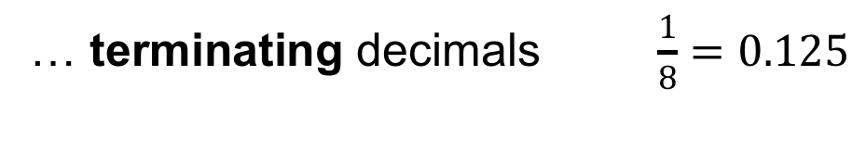
UNIT:
Decimals and Fractions
Section 3
Fractions and Decimals
All fractions can be converted to decimals.
Simply divide the numerator by the denominator.
Some fractions can be written as decimals with a
fixed number of decimal places.
These are called…
… terminating decimals $\frac{1}{8}=0.125$
Some fractions can be written as decimals with
an infinite repeating pattern of decimal places.
These are called…
… recurring decimals $\frac{5}{7}=0.714285714285714285…$

Slide 20
Significant Figures and Decimal Places
UNIT:
Decimals and Fractions
Section 3
Numbers with an infinite number of decimal places are rounded to a specified number of
significant figures (s.f.) or decimal places (d.p.).
Remember the rounding rules: if the following digit after the ‘cut-off’ is 5 or more, you round ‘up’.
Significant figures are counted from left to right, starting from the first non-zero digit.
Decimal places are counted starting from after the decimal point.
Round 37 185.5912… to
37 200
3 significant figures
2 decimal places
37 185.59

Slide 21
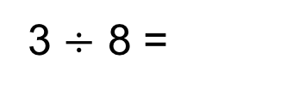
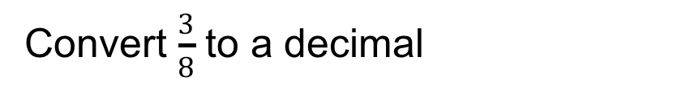
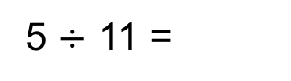

Converting Fractions to Decimals
UNIT:
Decimals and Fractions
Section 3
Simply divide the numerator by the denominator.
Often this is possible to do by pen and paper.
But sometimes a calculator may be helpful!
Convert $\frac{3}{8}$ to a decimal
0.375
3 $÷$ 8 =
Convert $\frac{5}{11}$ to a decimal
5 $÷$ 11 =
0.45454545… = 0.455 (to 3 dp)

Slide 22

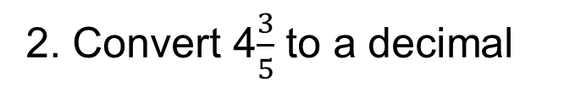

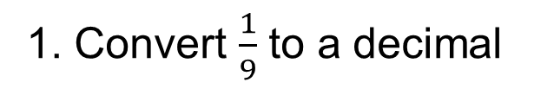
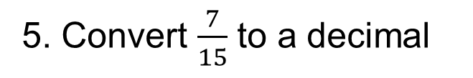
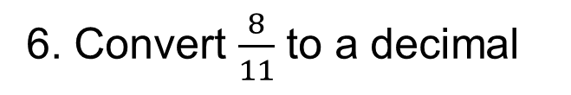
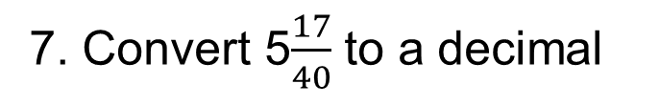
Conversion: Practice
UNIT:
Decimals and Fractions
Section 3
1. Convert $\frac{1}{9}$ to a decimal
0.111111…
2. Convert 4$\frac{3}{5}$ to a decimal
4.6
$$\frac{9}{20}$$
3. Convert 0.45 to a fraction
4. Convert 0.125 to a fraction
$$\frac{1}{8}$$
5. Convert $\frac{7}{15}$ to a decimal
0.466666…
6. Convert $\frac{8}{11}$ to a decimal
0.727272…
7. Convert 5$\frac{17}{40}$ to a decimal
5.425

Slide 23
Section 3: Fitness Check
UNIT:
Decimals and Fractions
Section 3
1. Round 3.2918 to 1 d.p.
3.3
2. Round 345 756 to 2 s.f.
350 000
3. Round 256.761918 to 3 d.p.
256.762
4. Round 9 745 256 to 1 s.f.
10 000 000
5. Round 413 196 to 3 s.f.
413 000
6. Round 9.9918 to 1 d.p.
10.0
7. Round 6.5790918 to 4 d.p.
6.5791
8. Round 0.000056825 to 2 s.f.
0.000057
9. Round 0.0092356 to 2 d.p.
0.01

Slide 24
Section 3: Review
UNIT:
Decimals and Fractions
Section 3
You have completed the third Section.
If you have completed and understood this section,
click to start the next Section.
If you need more examples and interactive practice,
press here.
You might also find it helpful to look at:
Essential Information: press here

Slide 25
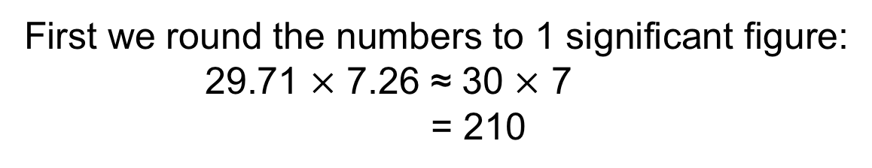
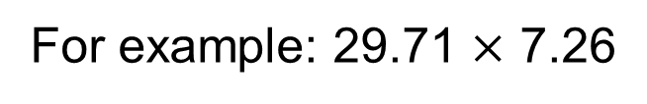
Estimating Answers
UNIT:
Decimals and Fractions
Section 4
Often it is useful to have an approximate solution to a calculation.
We can estimate answers by first rounding the numbers within the calculation.
We may choose to round the numbers to a certain number of significant figures or decimal places (see earlier slides).
For example: 29.71 $×$ 7.26
First we round the numbers to 1 significant figure:
29.71 $×$ 7.26 ≈ 30 $×$ 7
= 210

Slide 26
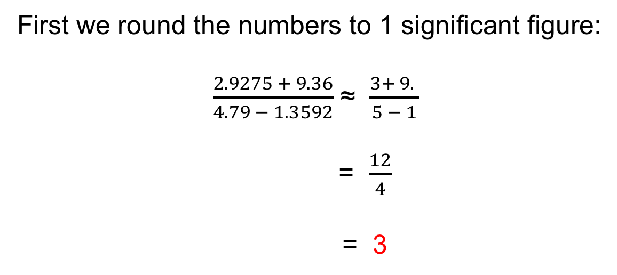
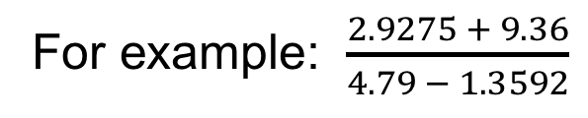

Estimating Answers: Examples
UNIT:
Decimals and Fractions
Section 4
For example: $\frac{2.9275 + 9.36}{4.79 − 1.3592}$
First we round the numbers to 1 significant figure:
$\frac{2.9275 + 9.36}{4.79 − 1.3592}$ ≈ $\frac{3+ 9. }{5 − 1}$
= $\frac{12}{4}$
= 3
Try estimating this one, by rounding to 2 significant figures:
$$\frac{23.6371}{8.193 −2.15}$$

Slide 27






UNIT:
Decimals and Fractions
Section 4
Estimating Answers: Examples
Estimating answer:
$$\frac{23.6371}{8.193 −2.15}$$
$$\frac{24}{8.2 −2.2}$$
$$\frac{24}{6}$$
≈
=
=
4
One more. This time you decide how to round.
$$\frac{48.681+1.3112}{10.81 −0.75}$$
≈
$$\frac{48.7+1.3}{10.8 −0.8}$$
(Rounding to 1 dp)
$$\frac{50}{10 }$$
=
=
5

Slide 28












Section 4: Fitness Check
UNIT:
Decimals and Fractions
Section 4
Estimate the answers to the following by rounding the numbers appropriately:
1. $\frac{6.275 + 24.145}{7.95 − 6.65}≈$
$\frac{6+24 }{8 −7}≈$
$\frac{30 }{1}=$
30
$$\frac{43 −38}{90 −85}≈$$
$$\frac{5}{5}=$$
2. $\frac{42.835 −37.8702}{89.825 − 85.425}≈$
1
3. $\frac{72.3335 +184.893}{134.19 + 1.3592} ≈$
$$\frac{70 +200}{135} ≈$$
$$\frac{270}{135}=$$
2
4. $\frac{99.78− 9.36}{25.91 +4.41882} ≈$
$$\frac{100−10}{26+4} ≈$$
$$\frac{90}{30}=$$
3

Slide 29
Section 4: Review
UNIT:
Decimals and Fractions
Section 4
You have completed the fourth Section.
If you have completed and understood this section,
click to start the next Section.
If you need more examples and interactive practice,
press here.
You might also find it helpful to look at:
Essential Information: press here

Slide 30


Using Brackets and Memory on a Calculator
UNIT:
Decimals and Fractions
Section 5
Brackets and memory functions can help you
carry out some calculations more easily.
Let’s look at $\frac{2.9275 + 9.36}{4.79 − 1.3592}$
This actually means $(2.9275+9.36$) $÷$ $(4.79 −1.3592$)
So we need to divide the solution of $(2.9275+9.36$)
by the solution of $(4.79 −1.3592$)
We can do this by either
using Brackets or
using the the Memory function

Slide 31




Using Brackets on a Calculator
UNIT:
Decimals and Fractions
Section 5
Looking at $\frac{2.9275 + 9.36}{4.79 − 1.3592}$
First open brackets and then input the
numerator calculation (remember to close brackets).
That is $( 2.9275+9.36 )$
$Then type ÷$ and open a second bracket
and input the denominator calculation
(remember to close brackets).
That is $( 4.79 −1.3592)$
Then type $=$
You will have typed:
( | 2 | . | 9 | 2 | 7 | 5 | + | 9 | . | 3 | 6 | ) | $$÷$$ | ( | 4 | . | 7 | 9 | - | 1 | . | 3 | 5 | 9 | 2 | )

Slide 32


Using Memory on a Calculator
UNIT:
Decimals and Fractions
Section 5
Again we look at $\frac{2.9275 + 9.36}{4.79 − 1.3592}$
In other words we need to have the solution to the
denominator $(4.79 −1.3592$) sorted and saved
before we start tackling the numerator (top line).
So we first calculate the denominator and input this
solution into the memory, using the appropriate keys
on your calculator. Some useful keys are:
MC Clears the memory
Min Places the current number into the memory
M+ Adds the number displayed to the memory
MR Recalls the number that is currently in the memory

Slide 33



Using Memory on a Calculator
UNIT:
Decimals and Fractions
Section 5
Press MC to clear the memory
Input the denominator calculation, i.e. $4.79 −1.359\text{2}$
Then type $=$
Press Min to place the value displayed in the memory
Now input the numerator calculation, i.e. $2.9275+9.36$
Then type $=$
Now leaving this solution on the screen, type
$÷$ MR =
This will divide the displayed value by the number in the memory

Slide 34




Section 5: Fitness Test
UNIT:
Decimals and Fractions
Section 5
Use brackets or the memory function to calculate:
$1. \frac{6.275+24.145}{7.95 − 6.65}$=
23.4
$2. \frac{42.835 −37.8702}{89.825 −85.425}$=
1.128363636…
$3. \frac{72.3335 +184.893}{134.79 + 1.3592}$=
1.889298652
$4. \frac{99.78− 9.36}{25.91 + 6.41882}$=
2.796885256

Slide 35
UNIT:
Decimals and Fractions
Section 5
Section 5: Review
You have completed the fifth Section.
If you have completed and mastered this last section,
click here for the Unit audit
If you need more examples and interactive practice,
press here
You might also find it helpful to look at:
Essential Information: press here

