Slide 1
Supporting and Enhancing Mathematics and Statistics
UNIT: Fractions

Slide 2
UNIT:
Fractions
Fractions
Fractions are an important part of number work
as we move on from using whole numbers.
You have four sections to work through and there are check up audits and fitness tests for each section.
Fractions
Equivalent Fractions
Fractions of Quantities
Mixed Numbers and Vulgar Fractions

Slide 3
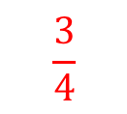
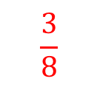
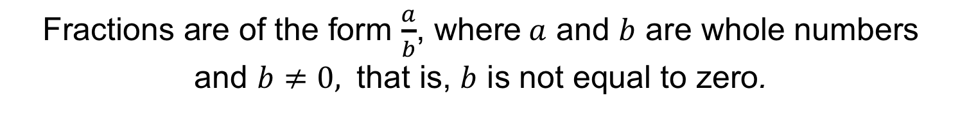
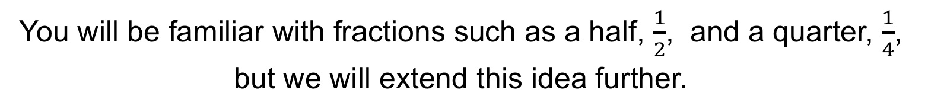
UNIT:
Fractions
Section 1
Shading Fractions
You will be familiar with fractions such as a half, $\frac{1}{2}$, and a quarter, $\frac{1}{4}$,
but we will extend this idea further.
Fractions are of the form $\frac{a}{b}$, where$a$ and $b$ are whole numbers
and $b$ $≠0,$ that is, $b$ is not equal to zero.
Note: a is called the numerator and b the denominator
Now try these questions and check your answers .
What fractions of these shapes are shaded?

Slide 4
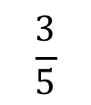
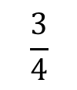
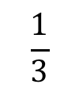
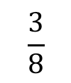
UNIT:
Fractions
Section 1
Identify Fractions
Here are some more questions for you to answer.
Copy each of these shapes and shade the fraction stated.
$$\frac{1}{3}$$
$$\frac{3}{4}$$
$$\frac{3}{5}$$
$$\frac{3}{8}$$
These are examples of the correct answers;
there are many more possible shadings for each question.

Slide 5
UNIT:
Fractions
Section 1
Problem Solving with Fractions
A cake is divided into 12 equal parts, as shown opposite.
John eats 3 slices of cake and Kate eats 2 slices.
What fraction of the cake is now left?
There are 7 slices left out of 12 so the fraction left is $\frac{7}{12}$ .

Slide 6


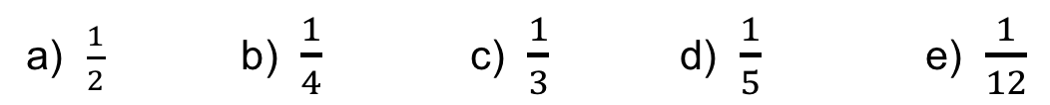

UNIT:
Fractions
Section 1
Section 1: Fitness Check
Here are some questions to check your progress;
there are more practice questions if needed.
1. What fraction is shaded in each of these diagrams?
a)
b)
c)
Answers:
$$\frac{7}{8}$$
$$\frac{2}{5}$$
$$\frac{3}{16}$$
2. Draw this shape 5 times and shade the given fraction.
a) $\frac{1}{2}$ b) $\frac{1}{4}$ c) $\frac{1}{3}$ d) $\frac{1}{5}$ e) $\frac{1}{12}$
NOTE: these are sample answers; there are many others.

Slide 7
UNIT:
Fractions
Section 1
Section 1: Review
You have completed the first Section.
If you have completed and understood this section,
click to start the next Section
If you need more examples and interactive practice,
press here
You might also find it helpful to look at:
Essential Information: press here

Slide 8
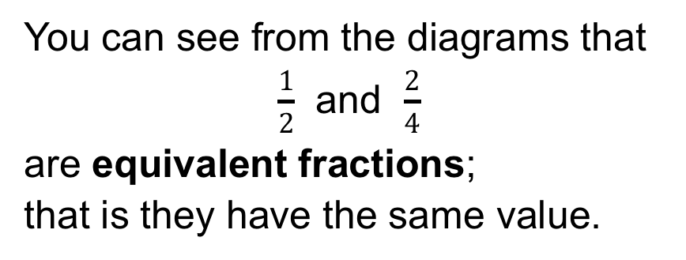
UNIT:
Fractions
Section 2
Equivalent Fractions
You can see from the diagrams that
$\frac{1}{2}$ and $\frac{2}{4}$
are equivalent fractions;
that is they have the same value.
Another way of showing this is to use a number line, as shown below.
= 1

Slide 9
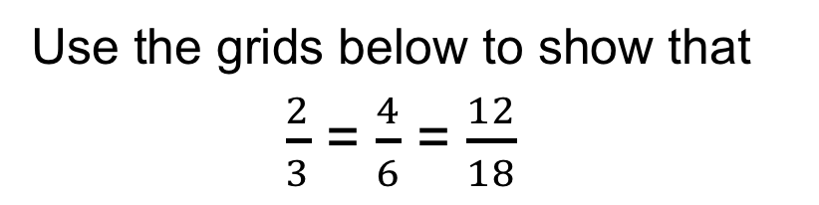
UNIT:
Fractions
Section 2
Showing Equivalence
Use the grids below to show that
$\frac{2}{3}$ = $\frac{4}{6}$ = $\frac{12}{18}$
We can see that these three fractions are equal.
We call these equivalent fractions.

Slide 10
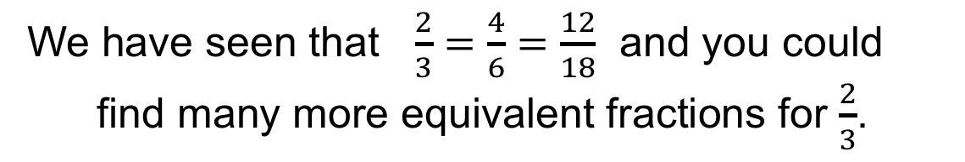
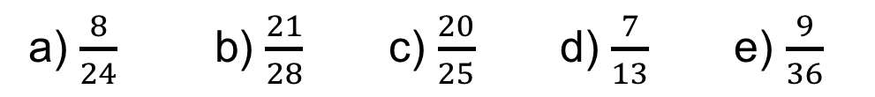
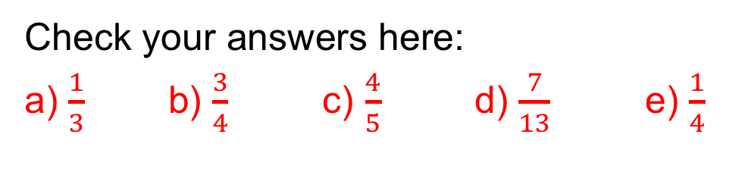
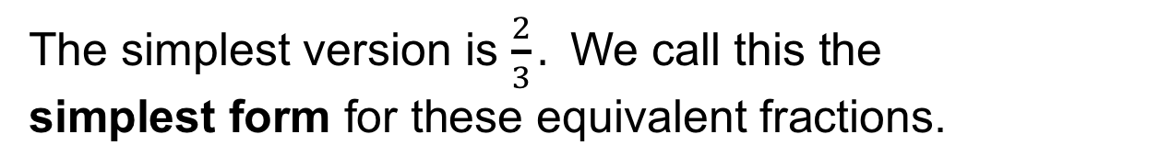
UNIT:
Fractions
Section 2
Simplest Form
We have seen that $\frac{2}{3}=\frac{4}{6}=$ $\frac{12}{18}$ and you could
find many more equivalent fractions for $\frac{2}{3}$.
The simplest version is $\frac{2}{3}.$ We call this the
simplest form for these equivalent fractions.
Find the simplest form for each of these fractions:
a) $\frac{8}{24}$ b) $\frac{21}{28}$ c) $\frac{20}{25}$ d) $\frac{7}{13}$ e) $\frac{9}{36}$
Check your answers here:
a) $\frac{1}{3}$ b) $\frac{3}{4}$ c) $\frac{4}{5}$ d) $\frac{7}{13}$ e) $\frac{1}{4}$

Slide 11
UNIT:
Fractions
Section 2
Fraction Wall

Slide 12
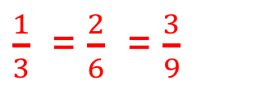
UNIT:
Fractions
Section 2
Fraction Wall for Equivalent Fractions
The Blue arrows show that $\frac{1}{2}$ = $\frac{2}{4}$ = $\frac{3}{6}$ = $\frac{4}{8}$ = $\frac{5}{10}$
What do the RED arrows show?
$\frac{1}{3}$ = $\frac{2}{6}$ = $\frac{3}{9}$

Slide 13
UNIT:
Fractions
Section 2
Examples
Use the fraction wall to complete these equations.
2
2
2
3
2
$a) \frac{1}{2}$ = $\frac{?}{4}$ $b) \frac{1}{5}$ = $\frac{?}{10}$ $c) \frac{?}{4}$ = $\frac{6}{8}$
Now using the fraction wall, put these fractions in increasing order.
$\frac{2}{7}$ $\frac{1}{9}$ $\frac{1}{3}$ $\frac{1}{10}$ $\frac{3}{10}$
Here is the solution:
$\frac{1}{10}$ $\frac{1}{9}$ $\frac{2}{7}$ $\frac{3}{10}$ $\frac{1}{3}$

Slide 14
UNIT:
Fractions
Section 2
Section 2: Fitness Check
Here are some questions to check your progress;
there are more practice questions if needed.
1. What are the missing numbers for these fractions?
2
3
4
5
6
7
8
$\frac{1}{2}$ = $\frac{?}{4}$ $=\frac{?}{6}$ = $\frac{?}{8}$ = $\frac{?}{10}$ = $\frac{?}{12}$ = $\frac{?}{14}$ = $\frac{?}{16}$
2. Find the missing numbers for the equivalent fractions.
1
3
1
a) $\frac{15}{30}=\frac{?}{2}$ b) $\frac{9}{12}=\frac{?}{4} \text{c}\text{)} \frac{17}{51}=\frac{?}{3}$
3. Write these fractions in increasing order.
$\frac{2}{3}$ $\frac{3}{5} \frac{5}{7} \frac{5}{9}$
$\frac{5}{9}$ $\frac{5}{7} \frac{3}{5} \frac{2}{3}$

Slide 15
UNIT:
Fractions
Section 2
Section 2: Review
You have completed the second Section.
If you have completed and understood this section,
click to start the next Section
If you need more examples and interactive practice,
press here
You might also find it helpful to look at:
Essential Information: press here

Slide 16
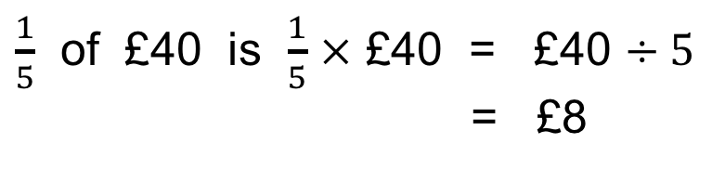
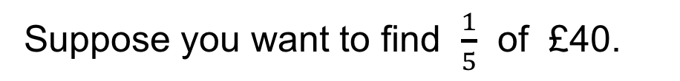
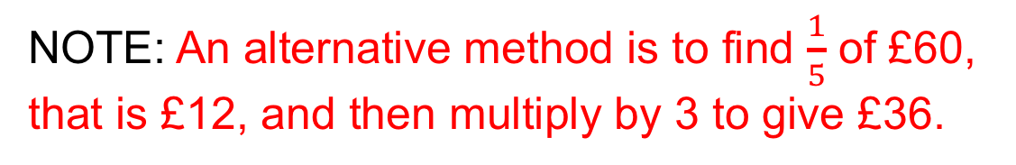
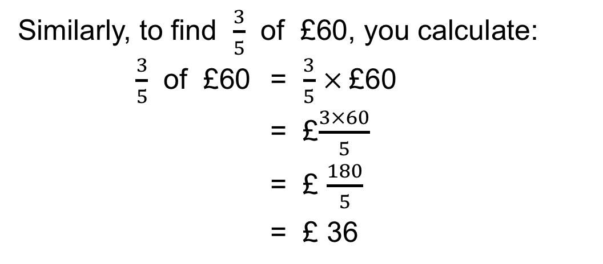
UNIT:
Fractions
Section 3
Section 3: Fractions of Quantities
Now you are ready to use fractions in a practical way.
Suppose you want to find $\frac{1}{5}$ of £40.
$\frac{1}{5}$ of £40 is $\frac{1}{5}$ $×$ £40 = £40 $÷5$
= £8
Similarly, to find $\frac{3}{5}$ of £60, you calculate:
$\frac{3}{5}$ of £60 = $\frac{3}{5}$ $×$£60
= £$\frac{3×60}{5}$
= £ $\frac{180}{5}$
= £ 36
NOTE: An alternative method is to find $\frac{1}{5}$ of £60,
that is £12, and then multiply by 3 to give £36.

Slide 17
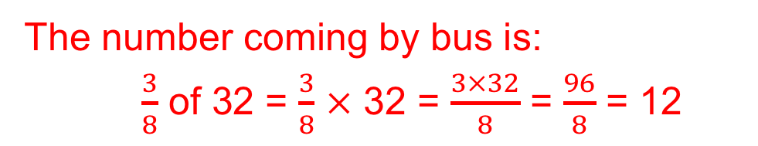
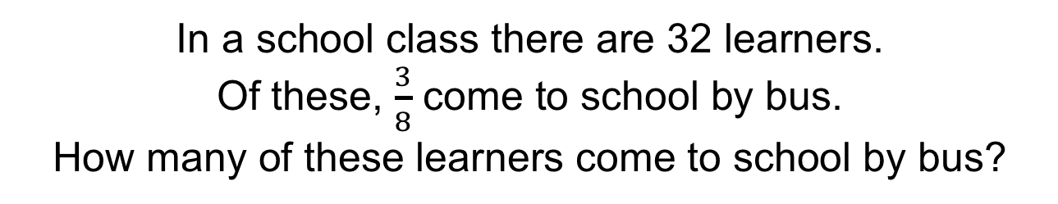
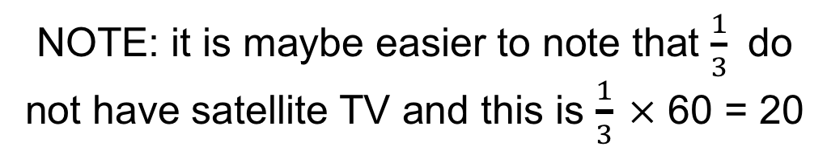
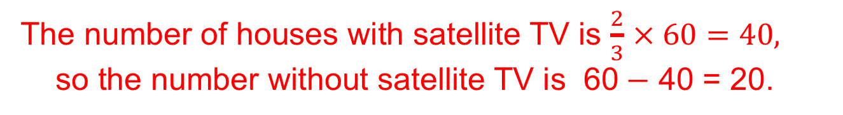
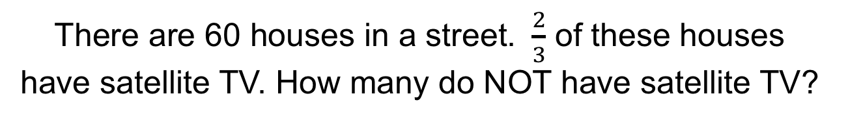
UNIT:
Fractions
Section 3
Fractions in Context
In a school class there are 32 learners.
Of these, $\frac{3}{8}$ come to school by bus.
How many of these learners come to school by bus?
The number coming by bus is:
$\frac{3}{8}$ of 32 = $\frac{3}{8}$ $×$ 32 = $\frac{3×32}{8}$ = $\frac{96}{8}$ = 12
There are 60 houses in a street. $\frac{2}{3}$ of these houses have satellite TV. How many do NOT have satellite TV?
The number of houses with satellite TV is $\frac{2}{3}$ $× 60=40,$
so the number without satellite TV is 60$−$ 40 = 20.
NOTE: it is maybe easier to note that $\frac{1}{3}$ do not have satellite TV and this is $\frac{1}{3} ×$ 60 = 20

Slide 18
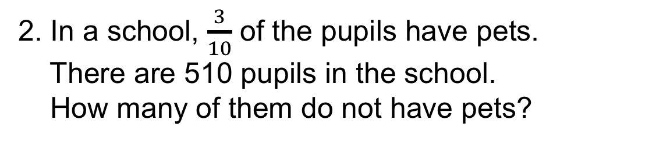
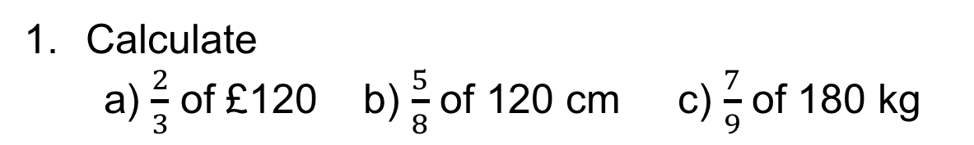
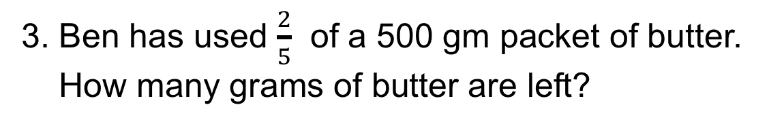
UNIT:
Fractions
Section 3
Section 3: Fitness Check
Here are some questions to check your progress;
there are more practice questions if needed.
Calculate
a) $\frac{2}{3}$ of £120 b) $\frac{5}{8}$ of 120 cm c) $\frac{7}{9}$ of 180 kg
£80 75 cm 140 kg
2. In a school, $\frac{3}{10}$ of the pupils have pets.
There are 510 pupils in the school.
How many of them do not have pets?
357 pupils do not have pets.
3. Ben has used $\frac{2}{5}$ of a 500 gm packet of butter.
How many grams of butter are left?
There are 300 grams left.

Slide 19
UNIT:
Fractions
Section 3
Section 3: Review
You have completed the third Section.
If you have completed and understood this section,
click to start the next Section
If you need more examples and interactive practice,
press here
You might also find it helpful to look at:
Essential Information: press here

Slide 20

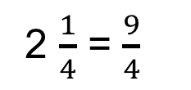

UNIT:
Fractions
Section 4
Section 4: Improper Fractions
The diagram below represents the number two and one quarter.
We write this as 2 $\frac{1}{4}$. This is called a mixed number.
Each small RED square is $\frac{1}{4}$. There are 9 red squares so we write
2 $\frac{1}{4}$ = $\frac{9}{4}$
this as 9 quarters, that is $\frac{9}{4}$ and we see that
We call fractions like $\frac{9}{4}$ improper (or vulgar) fractions
as the numerator is more than the denominator.
Note that 2 $× 4$+ 1 = 9; you can easily change mixed numbers into improper fractions, for example: 3 $\frac{2}{5}$ = $\frac{17}{5}$ as 3 $×$ 5 + 2 = 17

Slide 21
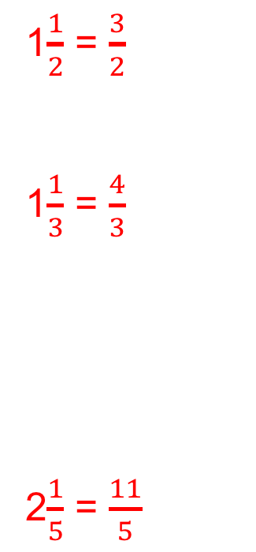
UNIT:
Fractions
Section 4
Section 4: Examples
Write each of the numbers shown below as a mixed number and as an improper fraction.
a)
b)
c)
1$\frac{1}{2}$ = $\frac{3}{2}$
1$\frac{1}{3}$ = $\frac{4}{3}$
2$\frac{1}{5}$ = $\frac{11}{5}$

Slide 22

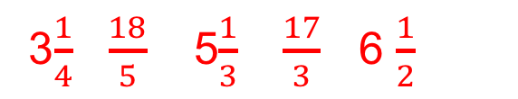
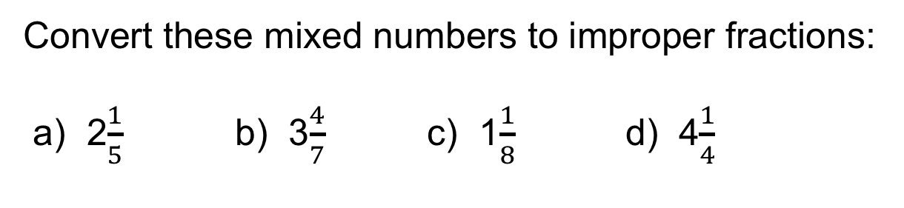


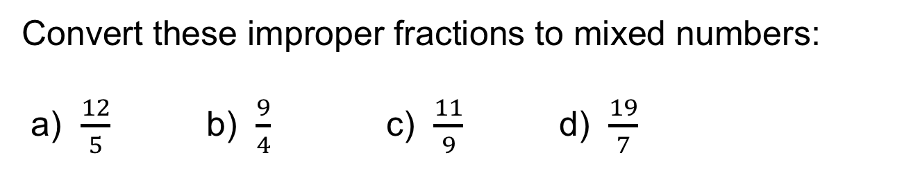




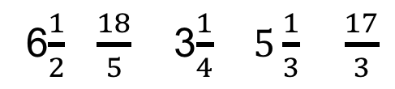
UNIT:
Fractions
Section 4
Examples
Convert these improper fractions to mixed numbers:
a) $\frac{12}{5}$ b) $\frac{9}{4}$ c) $\frac{11}{ 9 }$ d) $\frac{19}{7}$
2$\frac{2}{5}$
2$\frac{1}{4}$
1$\frac{2}{9}$
2$\frac{5}{7}$
Convert these mixed numbers to improper fractions:
a) 2$\frac{1}{5}$ b) 3$\frac{4}{7}$ c) 1$\frac{1}{8}$ d) 4$\frac{1}{4}$
$$\frac{11}{5}$$
$$\frac{25}{7}$$
$$\frac{9}{8}$$
$$\frac{17}{4}$$
Write these fractions in increasing order:
6$\frac{1}{2}$ $\frac{18}{5}$ 3$\frac{1}{4}$ $5\frac{1}{3}$ $\frac{17}{3}$
3$\frac{1}{4}$ $\frac{18}{5}$ 5$\frac{1}{3}$ $\frac{17}{3}$ 6 $\frac{1}{2}$

Slide 23
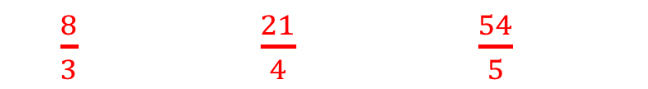
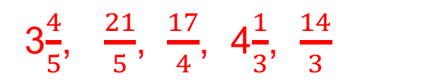
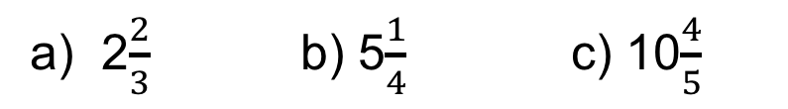

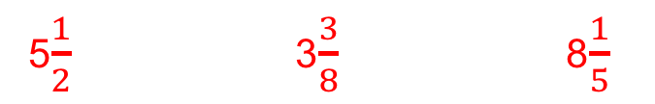
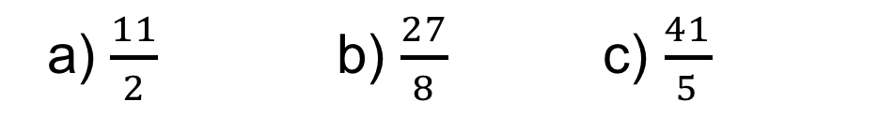
UNIT:
Fractions
Section 4
FRACTIONS: Fitness Check
Here are some questions to check your progress;
there are more practice questions if needed.
1. Convert these mixed numbers to improper fractions:
a) 2$\frac{2}{3}$ b) 5$\frac{1}{4}$ c) 10$\frac{4}{5}$
$\frac{8}{3}$ $\frac{21}{4}$ $\frac{54}{5}$
2. Convert these improper fractions to mixed numbers:
a) $\frac{11}{2}$ b) $\frac{27}{8}$ c) $\frac{41}{5}$
5$\frac{1}{2}$ 3$\frac{3}{8}$ 8$\frac{1}{5}$
3. Write these fractions in increasing order:
4$\frac{1}{3}$, $\frac{14}{3}$, $\frac{17}{4},$ 3$\frac{4}{5}, \frac{21}{5}$
3$\frac{4}{5}$, $\frac{21}{5}$, $\frac{17}{4}$, 4$\frac{1}{3}$, $\frac{14}{3}$

Slide 24
UNIT:
Fractions
Section 4
Section 4: Review
You have completed the fourth and last Section.
If you have completed and mastered this last section,
click here for the Unit audit
If you need more examples and interactive practice,
press here
You might also find it helpful to look at:
Essential Information: press here

