Slide 1
Supporting and Enhancing Mathematics and Statistics
UNIT: Indices and Factors

Slide 2
UNIT:
Indices
and
Factors
Section 1
Indices and Factors
Indices and Factors are an important part of number work.
You have five sections to work through and there are
check up audits and fitness tests for each section.
Squares, Cubes, Square Roots and Cube Roots
Index Notation
Factors
Prime Factors, Highest Common Factor (HCF) and Lowest Common Multiple (LCM)
Further Index Notation

Slide 3
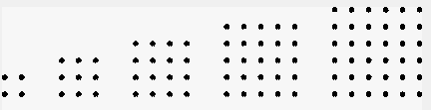
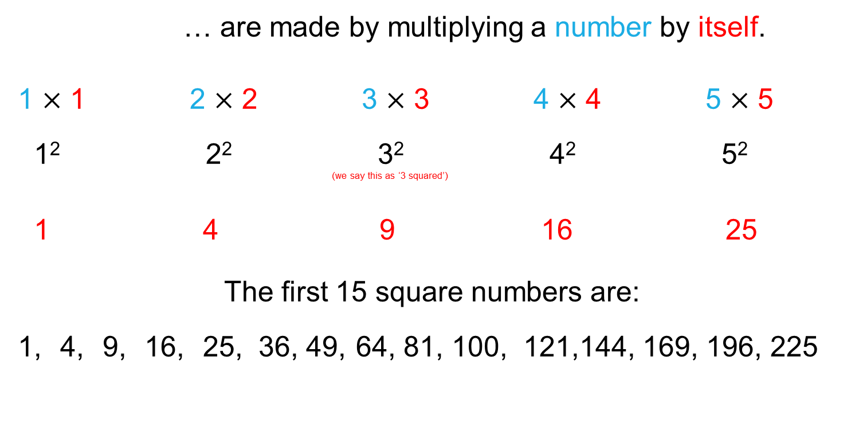
Square Numbers
UNIT:
Indices
and
Factors
Section 1
Squares, Cubes, Square Roots and Cube Roots
… are made by multiplying a number by itself.
1 $×$ 1 2 $×$ 2 3 $×$ 3 4 $×$ 4 5 $×$ 5
1² 2² 3² 4² 5² ^{(we say this as ‘3 squared’)}
1 4 9 16 25
The first 15 square numbers are:
1, 4, 9, 16, 25, 36, 49, 64, 81, 100, 121,144, 169, 196, 225

Slide 4
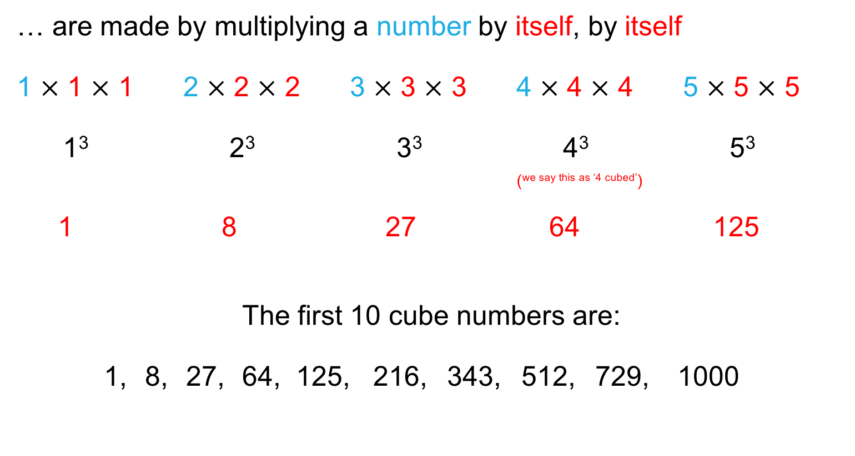
UNIT:
Indices
and
Factors
Section 1
Squares, Cubes, Square Roots and Cube Roots
Cube Numbers
… are made by multiplying a number by itself, by itself
1 $×$ 1 $×$ 1 2 $×$ 2 $×$ 2 3 $×$ 3 × 3 4 $×$ 4 $×$ 4 5 $×$ 5 $×$ 5
1³ 2³ 3³ 4³ 5³ (^{we say this as ‘4 cubed’})
1 8 27 64 125
The first 10 cube numbers are:
1, 8, 27, 64, 125, 216, 343, 512, 729, 1000

Slide 5

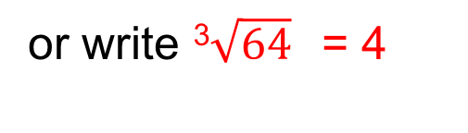
UNIT:
Indices
and
Factors
Section 1
Squares, Cubes, Square Roots and Cube Roots
The reverse process to squaring a number is to
square root a number.
What number squared gives the answer 16?
The number is 4
We say that 4 is the square root of 16,
or write $\sqrt{16}$= 4
The reverse process to cubing a number is to
cube root a number.
What number cubed gives the answer 64?
The number is 4
We say that 4 is the cube root of 64,
or write ³$\sqrt{64}$= 4

Slide 6

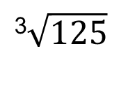
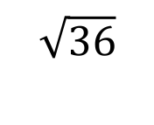




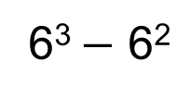

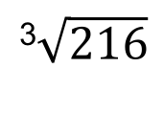

UNIT:
Indices
and
Factors
Section 1
Section 1: Fitness Check
Here are some questions to check your progress;
there are more practice questions if needed.
Find:
Find:
$$\sqrt{100}$$
10
5²
25
$$\sqrt{36}$$
6
$$\sqrt{400}$$
20
10³
1000
$$\sqrt{196}$$
14
³$\sqrt{216}$
6
$$\sqrt{225}$$
15
Calculate:
Find:
³$\sqrt{729}$
9
6² + 7²
85
³$\sqrt{64}$
4
5³ + 10³
1125
³$\sqrt{8}$
2
6³ $−$ 6²
180
³$\sqrt{125}$
5

Slide 7
UNIT:
Indices
and
Factors
Section 1
Section 1: Review
You have completed the first Section.
If you have completed and understood this section,
click to start the next Section
If you need more examples and interactive practice,
press here
You might also find it helpful to look at:
Essential Information: press here

Slide 8
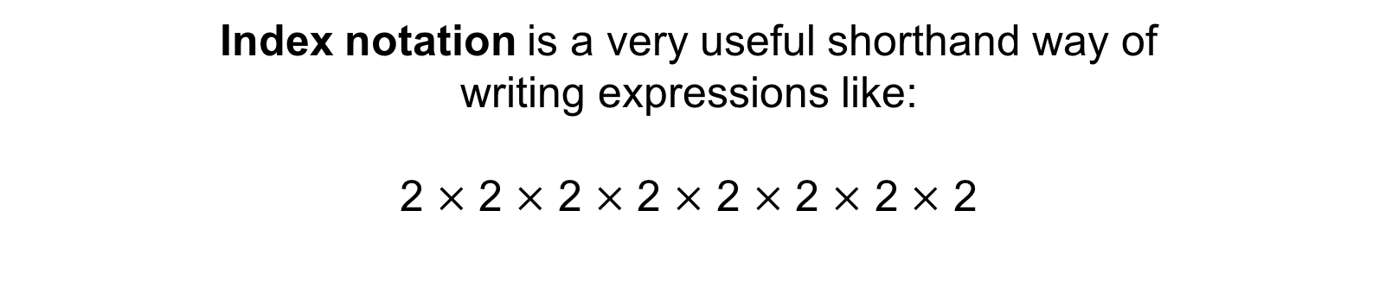
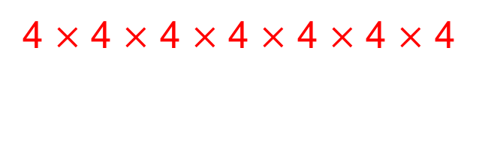
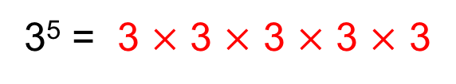
UNIT:
Indices
and
Factors
Section 2
Index Notation
Index notation is a very useful shorthand way of
writing expressions like:
2 $×$ 2 $×$ 2 $×$ 2 $×$ 2 $×$ 2 $×$ 2 $×$ 2
The above could be written as
2⁸
The small number, the 8, is the index (or power)
8
8
For example:
3⁵ = 3 $×$ 3 $×$ 3 $×$ 3 $×$ 3
For example:
4⁷ =
4 $×$ 4 $×$ 4 $×$ 4 $×$ 4 $×$ 4 $×$ 4

Slide 9
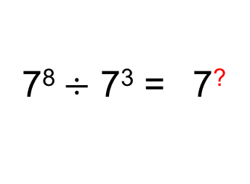
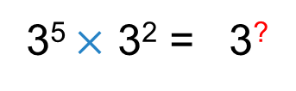
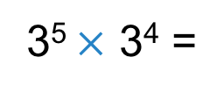
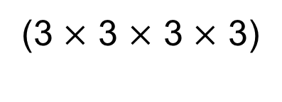
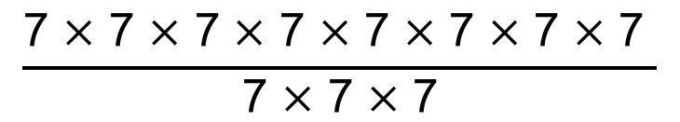

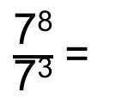
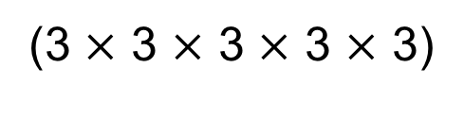
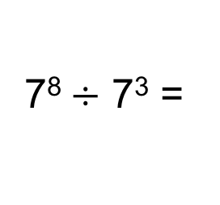
UNIT:
Indices
and
Factors
Section 2
Index Notation
For example, find the missing number:
3⁵ $×$ 3² = 3?
3⁵ $×$ 3⁴ =
(3 $×$ 3 $×$ 3 $×$ 3 $×$ 3)
$$×$$
(3 $×$ 3 $×$ 3 $×$ 3)
= 3⁹
Can you see a rule?
For example, find the missing number:
7⁸$÷$ 7³ = 7?
7⁸$÷$ 7³ =
$\frac{\text{7}\text{8}}{\text{7}\text{3}}$ =
$$\frac{\text{7} ×\text{ 7} ×\text{ 7} ×\text{ 7} ×\text{ 7} ×\text{ 7} ×\text{ 7} ×\text{ 7 }}{\text{7} ×\text{ 7} ×\text{ 7}}$$
= 7⁵
Can you see a rule?

Slide 10
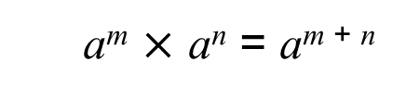
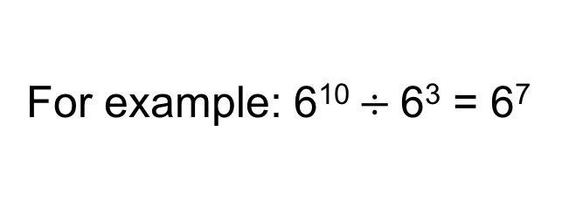
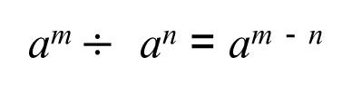
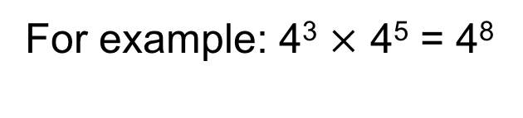
UNIT:
Indices
and
Factors
Section 2
Index Notation
Below are two of the rules of indices.
a^{m} $×$ a^{n} = a^{m + n}
For example: 4³ $×$ 4⁵ = 4⁸
a^{m} $÷$ a^{n} = a^{m} ⁻ ^{n}
For example: 6¹⁰ $÷$6³ = 6⁷
NOTE: Here a, m and n are integers.

Slide 11
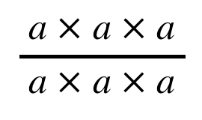
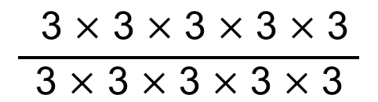
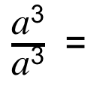
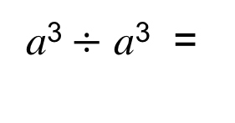
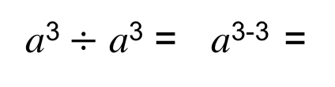
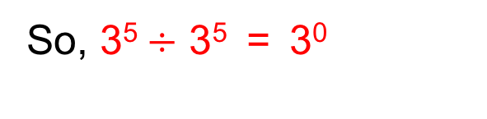
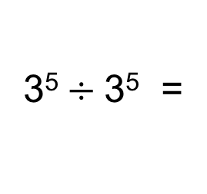
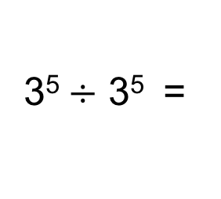
UNIT:
Indices
and
Factors
Section 2
Index Notation
Using the rules of indices,
$$\frac{ \text{3} × \text{3} × \text{3} × \text{3} × \text{3} }{\text{3} × \text{3} × \text{3} × \text{3} × \text{3}}$$
3⁵$÷$ 3⁵ =
3⁵⁻⁵ =
3⁰
or
3⁵$÷$3⁵ =
= 1
So, 3⁵$÷$ 3⁵ = 3⁰
= 1
This shows the rule:
a⁰ = 1
This is shown in a general case below:
$\frac{\text{a}\text{3}}{\text{a}\text{3}}$ =
$$\frac{ \text{a} × \text{a} × \text{a} }{\text{a} × \text{a} × \text{a}}$$
a³$÷$ a³ = a³⁻³ =
a⁰
a³$÷$ a³ =
a⁰
= 1

Slide 12
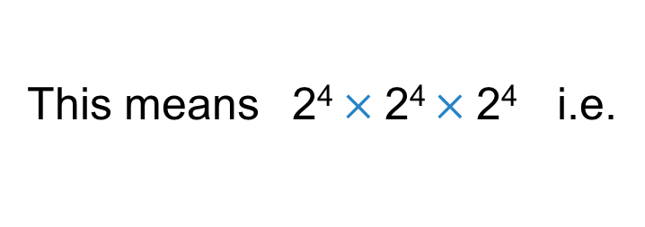
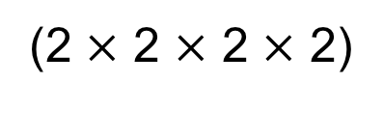

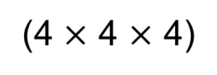
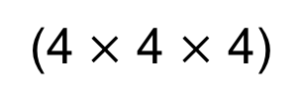

UNIT:
Indices
and
Factors
Section 2
Index Notation
Using the rules of indices, we can find the missing numbers:
(2⁴ )³ = 2?
This means 2⁴ $×$2⁴ $×$2⁴ i.e.
(2⁴ )³ =
(2 $×$ 2 $×$ 2 $×$ 2)
$$×$$
(2 $×$ 2 $×$ 2 $×$ 2)
$$×$$
(2 $×$ 2 $×$ 2 $×$ 2)
= 2¹²
Here is another example:
(4³ )² = 4?
(4³ )² =
(4 $×$ 4 $×$ 4)
$$×$$
(4 $×$ 4 $×$ 4)
= 4⁶
Can you see a rule?

Slide 13
UNIT:
Indices
and
Factors
Section 2
Index Notation
Below are two further rules of indices.
a⁰ = 1
For example: 9⁰ = 1
(a ^{m} )^{n} = a ^{m × n}
For example: (7³)⁵ = 7¹⁵
NOTE: Here m and n are integers.

Slide 14
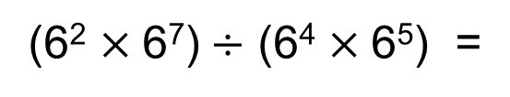
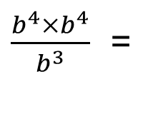
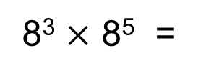
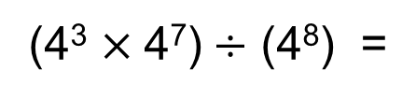
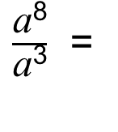
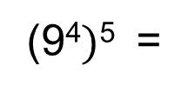
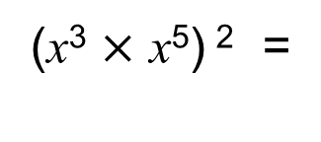
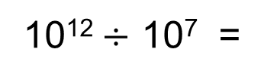
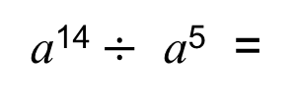
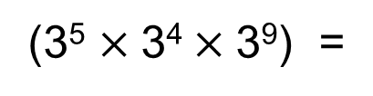
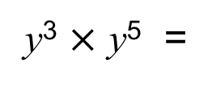
UNIT:
Indices
and
Factors
Section 2
Section 2: Fitness Check
Here are some questions to check your progress;
there are more practice questions if needed.
Do the following calculations:
8⁸
a¹⁴$÷$ a⁵ =
a⁹
8³ $×$ 8⁵ =
5⁰ =
1
y³ $×$ y⁵ =
y⁸
(3⁵ $×$3⁴$×$3⁹) =
3¹⁸
(x³ $×$ x⁵) ² =
x¹⁶
10¹²$÷$ 10⁷ =
10⁵
$\frac{\text{a}\text{8}}{\text{a}\text{3}}$ =
a⁵
(9⁴$)$⁵ =
9²⁰
(4³ $×$4⁷)$÷$ (4⁸) =
4²
$\frac{b^{4}×b^{4}}{b^{3}}$ =
b⁵
(6² $×$6⁷)$÷$ (6⁴ $×$6⁵) =
1

Slide 15
UNIT:
Indices
and
Factors
Section 2
Section 2: Review
You have completed the second Section.
If you have completed and understood this section,
click to start the next Section
If you need more examples and interactive practice,
press here
You might also find it helpful to look at:
Essential Information: press here

Slide 16
UNIT:
Indices
and
Factors
Section 3
Factors
A factor is a positive whole number which divides exactly into another number. For example, both 3 and 4 are factors of 12 (both 3 and 4 ‘go into’ 12).
In other words, factors are whole numbers we multiply together to get another number, 3 × 4 = 12).
Thinking about factor pairs can help you list all the factors of a number.
1 and 12 are a factor pair of 12
2 and 6 are a factor pair of 12
3 and 4 are a factor pair of 12
All the factors of 12 are: 1, 2, 3, 4, 6, 12

Slide 17
UNIT:
Indices
and
Factors
Section 3
Section 3: Fitness Check
Here are some questions to check your progress;
there are more practice questions if needed.
List the factors of these numbers:
50
1, 2, 5, 10, 25, 50
24
1, 2, 3, 4, 6, 8, 12, 24
18
1, 2, 3, 6, 9, 18
100
1, 2, 4, 5, 10, 20, 25, 50, 100
72
1, 2, 3, 4, 6, 8, 9, 12, 18, 24, 36, 72
48
1, 2, 3, 4, 6, 8, 12, 16, 24, 48
64
1, 2, 4, 8, 16, 32, 64
276
1, 2, 3, 4, 6, 12, 23, 46, 69, 92, 138, 276

Slide 18
UNIT:
Indices
and
Factors
Section 3
Section 3: Review
You have completed the third Section.
If you have completed and understood this section,
click to start the next Section
If you need more examples and interactive practice,
press here
You might also find it helpful to look at:
Essential Information: press here

Slide 19
UNIT:
Indices
and
Factors
Section 4
Prime Factors, HCF and LCM
Below are some reminders:
Multiples are the result of multiplying one whole number by another.
For example, 12 is a multiple of 4 (because 3 × 4 = 12).
A Prime Number is only divisible by one and itself and so always has exactly two factors, no more, no less.
The first ten prime numbers are:
2, 3, 5, 7, 11, 13, 17, 19, 23, 29,…
Whole numbers can be written as a product of prime factors.

Slide 20
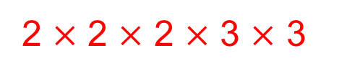
UNIT:
Indices
and
Factors
Section 4
Prime Factors, HCF and LCM
Any positive whole number can be written as the
product of prime factors.
For example, write the number 72 as a product of prime numbers.
Often, we use factor trees to help.
We start with 72, and show it as a product of two factors
72
We circle any factor which is prime
2
36
And then continue with any remaining number,
showing it as a product of two factors
2
18
2
9
Repeat
3
3
Solution:
72 written as a product of primes =
2 $×$ 2 $×$ 2 $×$ 3 $×$ 3

Slide 21
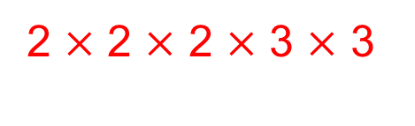
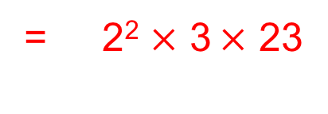
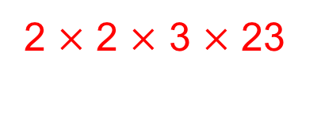

UNIT:
Indices
and
Factors
Section 4
Prime Factors, HCF and LCM
72 written as a product of primes =
2 $×$ 2 $×$ 2 $×$ 3 $×$ 3
We can also write this as
2³ $×$ 3²
Express 276 as a product of primes:
276
2
138
2
69
3
23
276 written as a product of primes =
2 $×$ 2 $×$ 3 $×$ 23
= 2² $×$ 3 $×$ 23

Slide 22



UNIT:
Indices
and
Factors
Section 4
Prime Factors, HCF and LCM
Sometimes, we want to know the Highest Common Factor (HCF)
of two (or more) numbers.
The HCF is the largest number which is a factor of both (or all)
the numbers.
For example, find the HCF of 72 and 276.
We can do this by first writing the numbers as product of primes.
72 =
2 $×$ 2 $×$ 2 $×$ 3 $×$ 3 =
2³ $×$ 3²
276 =
2 $×$ 2 $×$ 3 $×$ 23
= 2² $×$ 3 $×$ 23
Now we look to see what prime factors they have in common.
We can do this using a Venn Diagram.

Slide 23



UNIT:
Indices
and
Factors
Section 4
Prime Factors, HCF and LCM
Using a Venn Diagram to find the HCF of 72 and 276:
3
2 $×$ 2 $×$ 3 $×$ 23
72 =
2
2
3
276 =
2
2
2 $×$ 2 $×$ 2 $×$ 3 $×$ 3
72
276
2
2
3
Place any common factors in the intersection.
The product of the intersection is the Highest Common Factor:
HCF is
2 $×$ 2 $×$ 3
= 12

Slide 24

UNIT:
Indices
and
Factors
Section 4
Prime Factors, HCF and LCM
Venn diagrams can also be used to find the
Lowest Common Multiple (LCM) of two (or more) numbers.
The LCM is the lowest number into which the two (or all) numbers
can divide exactly.
For example, find the LCM of 48 and 72.
First, write the numbers as product of primes.
48 =
2 $×$ 2 $×$ 2 $×$ 2 $×$ 3
72 =
2 $×$ 2 $×$ 2 $×$ 3 $×$ 3
Next, we use a Venn Diagram to find the LCM of 48 and 72.

Slide 25



UNIT:
Indices
and
Factors
Section 4
Prime Factors, HCF and LCM
2
72 =
2
2
3
2 $×$ 2 $×$ 2 $×$ 3 $×$ 3
48 =
2
2
2
3
2 $×$ 2 $×$ 2 $×$ 2 $×$ 3
2
3
48
72
2
2
3
2
2
3
Place any common factors in the intersection.
Place remaining numbers in correct circles.
The product of all the numbers in the Venn Diagram is the LCM.
2 $×$ 2 $×$ 2 $×$ 2 $×$ 3 $×$ 3
LCM is
= 144

Slide 26




Prime Factors, HCF and LCM
UNIT:
Indices
and
Factors
Section 4
Use a Venn Diagram to find the HCF and LCM of 24 and 64.
24 =
2 $×$ 2 $×$ 2 $×$ 3
64 =
2 $×$ 2 $×$ 2 $×$ 2 $×$ 2 $×$ 2
24
64
2
2
2
2
3
2
2
HCF is:
2 $×$ 2 $×$ 2 =
8
LCM is:
3 $×$ 2 $×$ 2$×$ 2$×$ 2 $×$ 2 $×$ 2 =
192

Slide 27









Section 4: Fitness Check
UNIT:
Indices
and
Factors
Section 4
Here are some questions to check your progress;
there are more practice questions if needed.
List the first eight prime numbers:
2, 3, 5, 7, 11, 13, 17, 19
Write 168 as a product of primes
2 $×$ 2 $×$ 2 $×$ 3 $×$ 7 =
2³ $×$ 3 $×$ 7
Write 140 as a product of primes
2 $×$ 2 $×$ 5 $×$ 7 =
2² $×$ 5 $×$ 7
Find the HCF of 168 and 140
2 $×$ 2 $×$ 7 =
28
Write 56 as a product of primes
2 $×$ 2 $×$ 2 $×$ 7 =
2³ $×$ 7
Write 42 as a product of primes
2 $×$ 3$×$ 7
Find the LCM of 168 and 140
2 $×$ 2 $×$ 2 $×$ 3 $×$ 7 =
168

Slide 28
UNIT:
Indices
and
Factors
Section 4
Section 4: Review
You have completed the fourth Section.
If you have completed and understood this section,
click to start the next Section
If you need more examples and interactive practice,
press here
You might also find it helpful to look at:
Essential Information: press here

Slide 29








UNIT:
Indices
and
Factors
Section 5
Further Index Notation
Below are further rules of indices.
a⁻¹ = $\frac{\text{1}}{\text{a}}$
For example: 9⁻¹ = $\frac{\text{1}}{\text{9}}$
a^{-n} = $\frac{\text{1}}{\text{a}\text{n}}$
For example: 6⁻⁴ = $\frac{\text{1}}{\text{6}\text{4}}$
$a^{\frac{1}{2}}$ = $\sqrt{a}$
For example: ${81}^{\frac{1}{2} }$ = $\sqrt{81} =9$
$a^{\frac{1}{n}}$ = $\sqrt[n]{a}$
For example: ${125}^{\frac{1}{3}}$ = $\sqrt[3]{125} =5$

Slide 30























Further Index Notation
UNIT:
Indices
and
Factors
Section 5
Do the following calculations:
$$9^{\frac{1}{2}} \text{=}$$
$4^{\frac{3}{2}}$ =
($4^{\frac{1}{2}})$³ =
2³ =
8
$\sqrt{9}$=
3
$$\frac{\text{1}}{\text{5}}$$
$5^{−1}$=
$$\frac{\text{1}}{\text{y}\text{2}}$$
y³ $×$ y⁻⁵ =
y⁻² =
$\frac{\text{1}}{\text{4}\text{2}}$ =
$$\frac{\text{1}}{\text{16}}$$
$4^{−2}$=
${\left(2^{3}×2^{5}\right)}^{\frac{1}{2}}$ =
2⁴ =
16
$8^{\frac{1}{3}}$ =
$$\sqrt[\frac{1}{3}]{8}\text{=}$$
a⁻⁵ =
$$\frac{\text{1}}{\text{a}\text{5}}$$
2
$\frac{\text{a}\text{3}}{\text{a}\text{8}}$ =
$9^{−\frac{1}{2}}$ =
$\frac{\text{1}}{\sqrt{9}}$ =
$$\frac{\text{1}}{\text{3}}$$
${\left(\frac{n^{3}}{a}\right)}^{−2}$=
(n³a⁻¹)⁻² =
n⁻⁶a²
${\left(9^{−\frac{1}{2}}\right)}^{2}$=
$\frac{\text{1}}{\text{9}}$
= $\frac{ \text{a}\text{2} }{\text{n}\text{6}}$
9⁻¹ =

Slide 31
















UNIT:
Indices
and
Factors
Section 5
Section 5: Fitness Check
Here are some questions to check your progress;
there are more practice questions if needed.
${25}^{\frac{1}{2}}$ =
5
$8^{\frac{2}{3}}$ =
4
$$\frac{\text{1}}{\text{7}}$$
$$\frac{\text{1}}{\text{y}\text{12}}$$
7⁻¹ =
y⁻² $×$ y⁻⁶ =
y⁻¹² =
3⁻³ =
$$\frac{\text{1}}{\text{27}}$$
${\left(4^{3}×4^{5}\right)}^{\frac{1}{2}}$ =
4⁴ =
256
${125}^{\frac{1}{3}}$ =
$\frac{\text{b}\text{5}}{\text{b}\text{9}}$ =
b⁻⁴ =
$$\frac{\text{1}}{\text{b}\text{4}}$$
5
${81}^{−\frac{1}{2}}$ =
$$\frac{\text{1}}{\text{9}}$$
${\left(\frac{m^{2}}{m^{3}}\right)}^{−2}$=
${\left(m^{−1}\right)}^{−2}$ =
m²
${\left(8^{−\frac{1}{3}}\right)}^{2}$=
$$\frac{\text{1}}{\text{4}}$$

Slide 32
UNIT:
Indices
and
Factors
Section 5
Section 5: Review
You have completed the fifth and last Section.
If you have completed and mastered this last section,
click here for the Unit audit
If you need more examples and interactive practice,
press here
You might also find it helpful to look at:
Essential Information: press here

