Slide 1
Supporting and Enhancing Mathematics and Statistics
UNIT: Number Classification

Slide 2
UNIT:
Number
Classification
Number Classification
Number Classification is an important part of number work.
You have three sections to work through and there are check up audits and fitness tests for each section.
Roman Numerals
Number Classification
Binary Numbers

Slide 3
UNIT:
Number
Classification
Section 1
Roman Numerals
The number system we use is based on the
base 10 (Arabic) system.
For Roman numerals, letters from the Latin alphabet are used
in an equivalent system of representing numbers.
I for 1
V for 5
X for 10
L for 50
C for 100
D for 500
M for 1000

Slide 4
Roman Numerals
UNIT:
Number
Classification
Section 1
These are the first numbers in Roman numerals:
= I
= II
= III
= IV
11 = XI
12 = XII
= XIII
14 = XIV
15 = XV
16 = XVI
17 = XVII
18 = XVIII
19 = XIX
20 = XX
21 = XXI
22 = XXII
23 = XXXIII
24 = XXIV
25 = XXV
26 = XXVI
27 = XXVII
28 = XXVIII
29 = XXIX
30 = XXX
5 = V
= VI
= VII
= VIII
9 = IX
10 = X

Slide 5
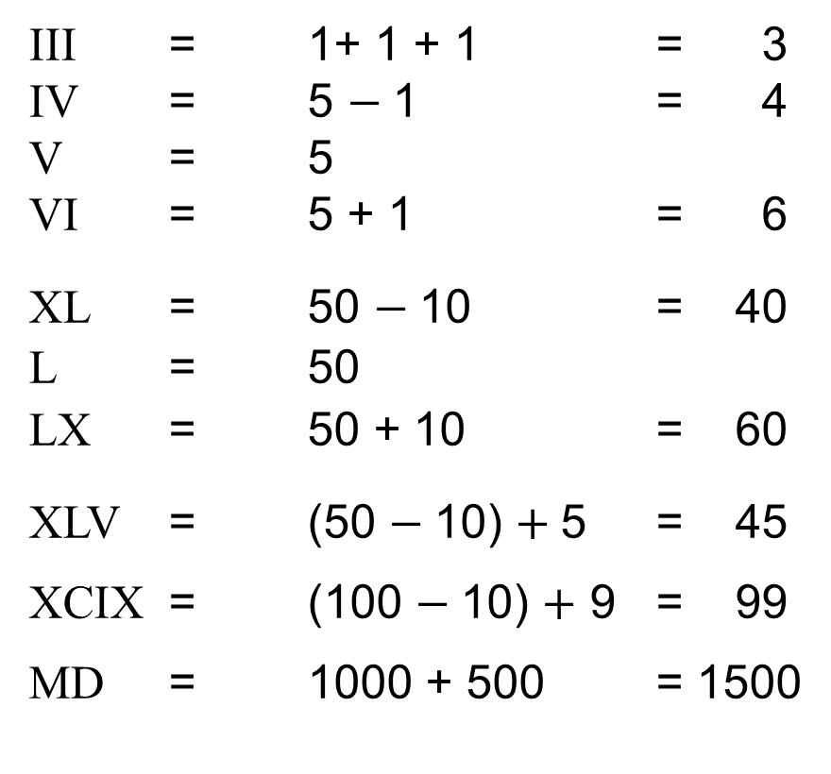
UNIT:
Number
Classification
Section 1
Roman Numerals
Examples of the effects of the order in which letters are placed:
III = 1+ 1 + 1 = 3
IV = 5 $−$1 = 4
V = 5
VI = 5 + 1 = 6
XL = 50 $−$10 = 40
L = 50
LX = 50 + 10 = 60
XLV = (50 $−$10) $+$5 = 45
XCIX = (100 $−$10) $+$ 9 = 99
MD = 1000 + 500 = 1500

Slide 6
UNIT:
Number
Classification
Section 1
Roman Numerals
I for 1
V for 5
X for 10
L for 50
C for 100
D for 500
M for 1000
Consider how the system works:
IV = 4 IX = 9 XL = 40
V = 5 X = 10 L = 50
VI = 6 XI = 11 LX = 60
XC = 90 CD = 400 CM = 900
C = 100 D = 500 M = 1000
CX = 110 DC = 600 MC = 1100

Slide 7
Roman Numerals
UNIT:
Number
Classification
Section 1
Worked examples:
MCMLXXXIV = 1000 + 900 + 80 + 4 = 1984
MMI = 2000 + 1 = 2001
MDCCLXXXIX = 1000 + 700 + 80 + 9 = 1789
MLXVI = 1000 + 60 + 6 = 1066
MCMLXVII = 1000 + 900 + 70 + 7 = 1967
MMMMDCXCI = 4000 + 600 + 90 + 1 = 4691
CMXCIX = 900 + 90 + 9 = 999

Slide 8
UNIT:
Number
Classification
Section 1
Section 1: Fitness Check
Here are some questions to check your progress;
there are more practice questions if needed.
Convert the following Roman numerals to base 10:
XIV
CDX
DLXXXIV
MDCCLXXXI
14
410
584
1782
Convert the following base 10 numbers to Roman numerals:
45
XLV
976
CMLXXVI
4399
MMMMCCCXCIX
2020
MMXX

Slide 9
UNIT:
Number
Classification
Section 1
Section 1: Review
You have completed the first Section.
If you have completed and understood this section,
click to start the next Section
If you need more examples and interactive practice,
press here
You might also find it helpful to look at:
Essential Information: press here

Slide 10
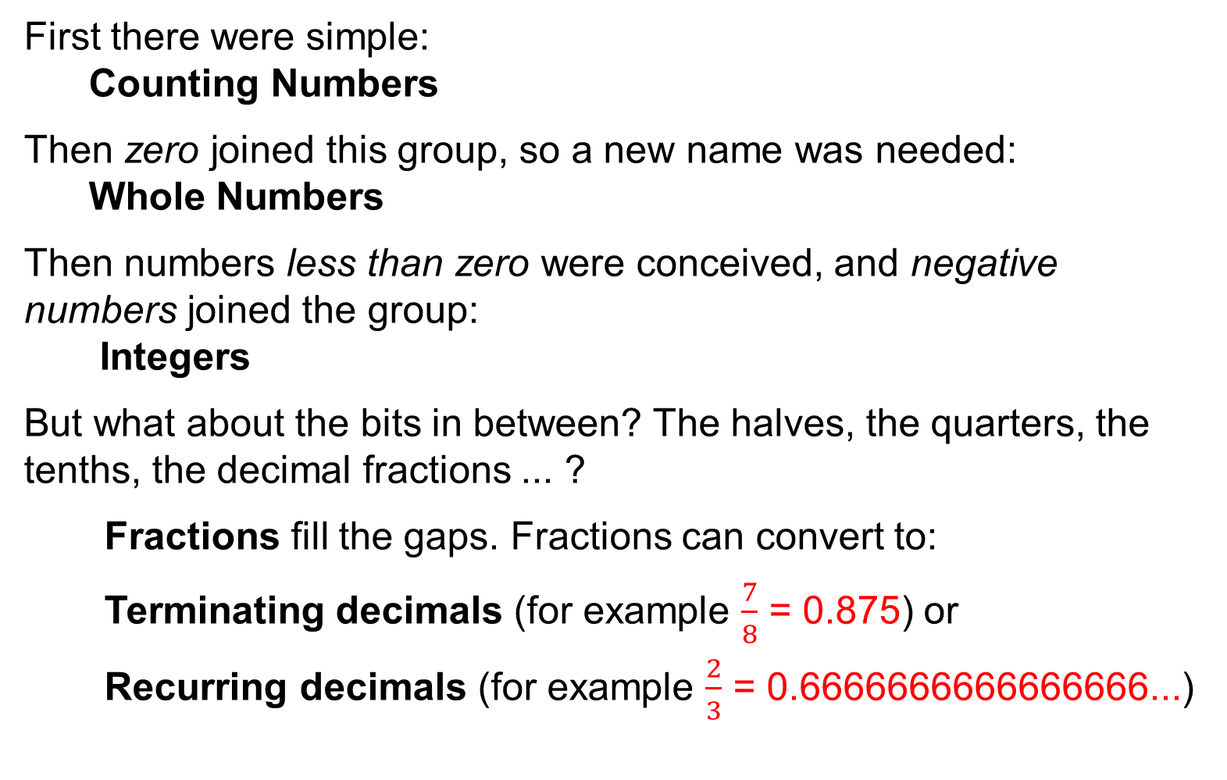

UNIT:
Number
Classification
Section 2
Evolution of Numbers
First there were simple:
Counting Numbers
Then zero joined this group, so a new name was needed:
Whole Numbers
Then numbers less than zero were conceived, and negative numbers joined the group:
Integers
But what about the bits in between? The halves, the quarters, the tenths, the decimal fractions ... ?
Fractions fill the gaps. Fractions can convert to:
Terminating decimals (for example $\frac{7}{8}$ = 0.875) or
Recurring decimals (for example $\frac{2}{3}$ = 0.6666666666666666...)
1, 2, 3, 4,…
0, 1, 2, 3, 4, …
…$−$4, $−$3, $−$2, $−$1, 0, 1, 2, 3, 4, ...

Slide 11
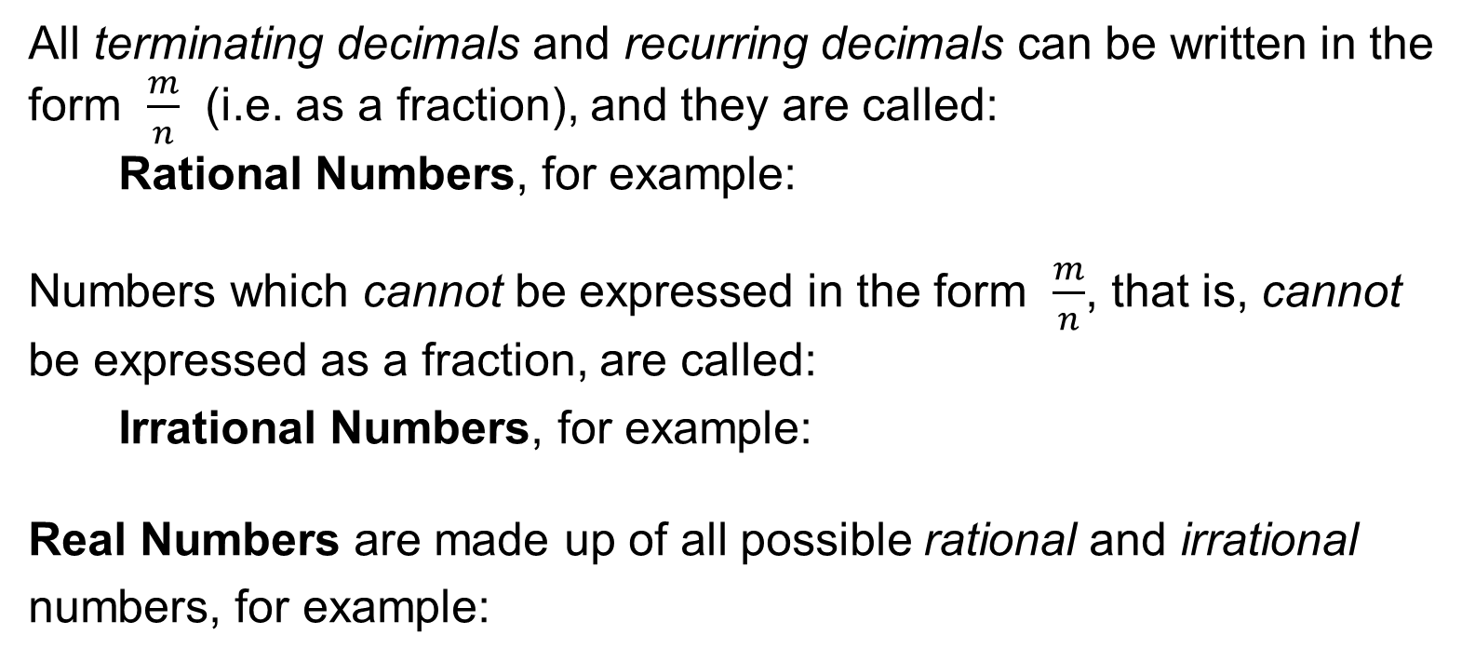
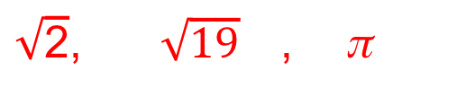
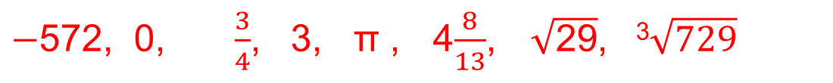
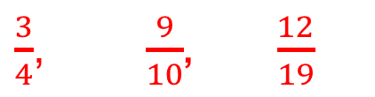
UNIT:
Number
Classification
Section 2
Evolution of Numbers
Evolution of Numbers continued...
All terminating decimals and recurring decimals can be written in the form $\frac{m}{n}$ (i.e. as a fraction), and they are called:
Rational Numbers, for example:
Numbers which cannot be expressed in the form $\frac{m}{n}$, that is, cannot be expressed as a fraction, are called:
Irrational Numbers, for example:
Real Numbers are made up of all possible rational and irrational
numbers, for example:
$\frac{3}{4}$, $\frac{9}{10}$, $\frac{12}{19}$
$\sqrt{\text{2}}$, $\sqrt{19}$ , π
$−$572, 0, $\frac{3}{4}$, 3, π , 4$\frac{8}{13}$, $\sqrt{\text{2}\text{9}}$, ³$\sqrt{729}$

Slide 12
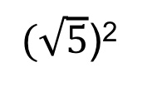
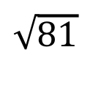


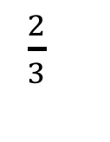
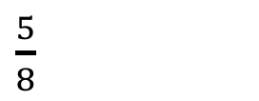
UNIT:
Number
Classification
Section 2
Section 2: Fitness Check
Here are some questions to check your progress;
there are more practice questions if needed.
Classify the following numbers as:
integers, rational, irrational, recurring decimals, terminating decimals.
$\sqrt{81}$
$\frac{2}{3}$
$$0.44444…$$
$$\sqrt{10}$$
$(\sqrt{5}$)²
π²
$\frac{5}{8}$
Answers are shown on next slide

Slide 13
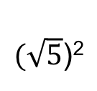


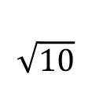










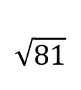


UNIT:
Number
Classification
Section 2
Section 2: Fitness Check
Answers:
 | Integer | Rational | Irrational | Recurring Decimal | Terminating Decimal
$$\sqrt{81}$$
$$✓$$
$$✓$$
$\frac{2}{3}$
$$✓$$
$$✓$$
$$0.44444…$$
$$✓$$
$$✓$$
$$\sqrt{10}$$
$$✓$$
$(\sqrt{5}$)²
$$✓$$
$$✓$$
$π$²
$$✓$$
$\frac{ 5}{ 8}$
$$✓$$
$$✓$$

Slide 14
UNIT:
Number
Classification
Section 2
Section 2: Review
You have completed the second Section.
If you have completed and understood this section,
click to start the next Section
If you need more examples and interactive practice,
press here
You might also find it helpful to look at:
Essential Information: press here

Slide 15
UNIT:
Number
Classification
Section 3
Binary Numbers
We normally work with numbers in base 10.
These are called denary (or decimal) numbers.
Numbers in base 2 are called binary numbers.
In base 10 we use the ten digits 0, 1, 2, 3, 4, 5, 6, 7, 8, 9
In base 2, we use the two digits 0, 1
Binary numbers are at the heart of all computing systems.
In base 10 we use a place value system based on a multiplier of 10.
10 000 | 1000 | 100 | 10 | 1
In base 2 we use a place value system based on a multiplier of 2.
64 | 32 | 16 | 8 | 4 | 2 | 1

Slide 16
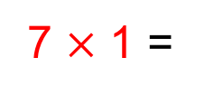
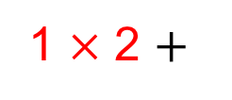
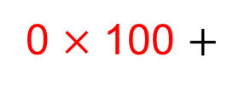
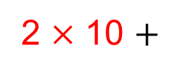
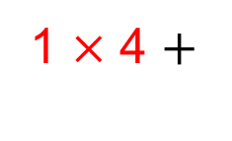
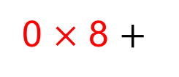
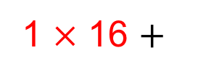
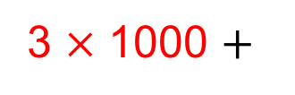
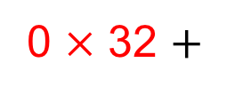
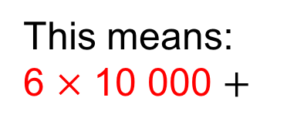
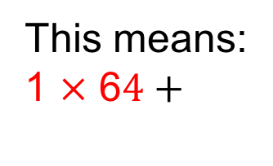
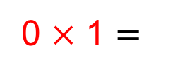
UNIT:
Number
Classification
Section 3
Binary Numbers
In base 10 the place value system looks like:
10 000 | 1000 | 100 | 10 | 1
6 | 3 | 0 | 2 | 7
This means:
6 $×$ 10 000 $+$
3 $×$ 1000 $+$
0 $×$ 100 $+$
2 $×$ 10 $+$
7 $×$ 1 =
63 027
In base 2 we use a place value system based on multiples of 2
64 | 32 | 16 | 8 | 4 | 2 | 1
1 | 0 | 1 | 0 | 1 | 1 | 0
This means:
1 $×$ 6$4+$
0 $×$ 32 $+$
1 $×$ 16 $+$
0 $×$ 8 $+$
1 $×$ 4 $+$
1 $×$ 2 $+$
0 $×$ 1 $=$
86

Slide 17
UNIT:
Number
Classification
Section 3
Binary Numbers
Worked examples:
Convert the following binary numbers to base 10:
(a) 111
(b) 1001
(c) 110011
(d) 1001111
7
9
51
79
64 | 32 | 16 | 8 | 4 | 2 | 1
(a)
1 1 1
(b)
1 0 0 1
(c)
1 1 0 0 1 1
(d)
1 0 0 1 1 1 1
Convert the following base 10 numbers into binary numbers:
(a) 16
(b) 15
(c) 32
(d) 31
10000
1111
100000
11111

Slide 18
UNIT:
Number
Classification
Section 3
Section 3: Fitness Check
Here are some questions to check your progress;
there are more practice questions if needed.
Convert the following binary numbers to base 10:
11
3
11011
27
1010
10
100001
33
Convert the following base 10 numbers to binary numbers:
65
1000001
128
10000000
257
100000001

Slide 19
UNIT:
Number
Classification
Section 3
Section 3: Review
You have completed the third and last Section.
If you have completed and mastered this last section,
click here for the Unit audit
If you need more examples and interactive practice,
press here
You might also find it helpful to look at:
Essential Information: press here

