Slide 1
Supporting and Enhancing Mathematics and Statistics
UNIT: Ratio and Proportion

Slide 2
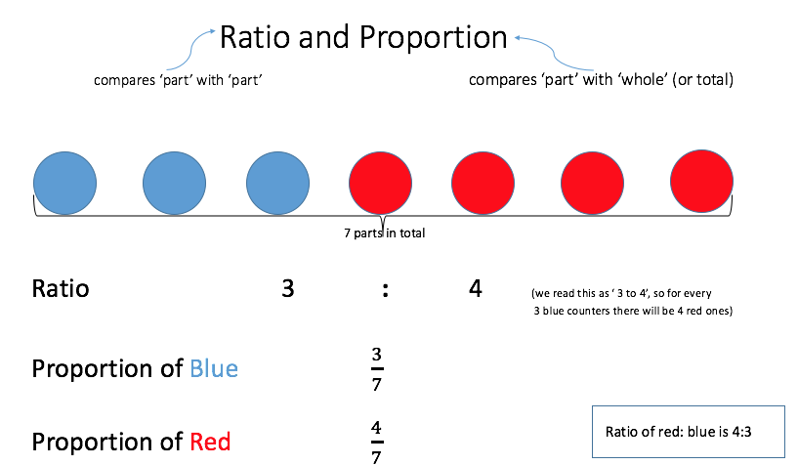
UNIT:
Ratio and
Proportion
Ratio and Proportion
It is important to understand ratio and proportion and their
similarities and differences.
There are four sections in this Unit, namely:
Simple Ratios
Proportion and Ratio
Map Scales and Ratios
Proportional Division

Slide 3
UNIT:
Ratio and
Proportion
Section 1
Simple Ratios
We start with a quick review of key facts:
Ratios are used to describe how two (or more)
quantities are related.
In other words, a ratio says how much of
one thing there is, compared with another.
We express ratios like this
48 : 12
and read this as
‘forty-eight to twelve’
Sometimes ratios can be simplified.
The key thing to remember when simplifying ratios
is to divide (or multiply) each of the numbers
by the same amount.

Slide 4
UNIT:
Ratio and
Proportion
Section 1
Simplifying Ratios: Examples
Simplify 24 : 15
Both numbers can be divided by 3, to give
8 : 5
A swimming team has 18 girls and 12 boys.
What is the ratio of girls to boys?
What is the ratio of boys to girls?
18 : 12 =
3 : 2
12 : 18 =
2 : 3
Juice is mixed with water in the ratio of 1 : 6, that is,
for every 1 part of juice, 6 parts of water are added.
How much water is added to 50 ml of juice?
Multiplying both ratios by 50, 1 : 6 gives
50 : 300
Answer 300 ml

Slide 5
UNIT:
Ratio and
Proportion
Section 1
Section 1: Fitness Check
a) Simplify 56 : 16
7 : 2
b) Simplify 100 : 25
4 : 1
c) Simplify 45 : 81
5 : 9
A basketball team has 9 girls and 54 boys.
What is the ratio of girls to boys?
What is the ratio of boys to girls?
9 : 54 =
1 : 6
54 : 9 =
6 : 1
To make orange paint, blue paint is mixed with
red paint in the ratio of 4 : 7 .
How much blue paint is mixed with 21 litres of red paint?
Multiplying both ratios by 3; 4 : 7 gives 12 : 21
12 litres
There are 30 counters in a bag. The ratio of green counters to purple counters is 2 : 13 .
How many green counters are there?:
2 : 13 gives 4 : 26
Answer 4

Slide 6
UNIT:
Ratio and
Proportion
Section 1
Section 1: Review
You have completed the first Section.
If you have completed and understood this section,
click to start the next Section.
If you need more examples and interactive practice,
press here.
You might also find it helpful to look at:
Essential Information: press here

Slide 7
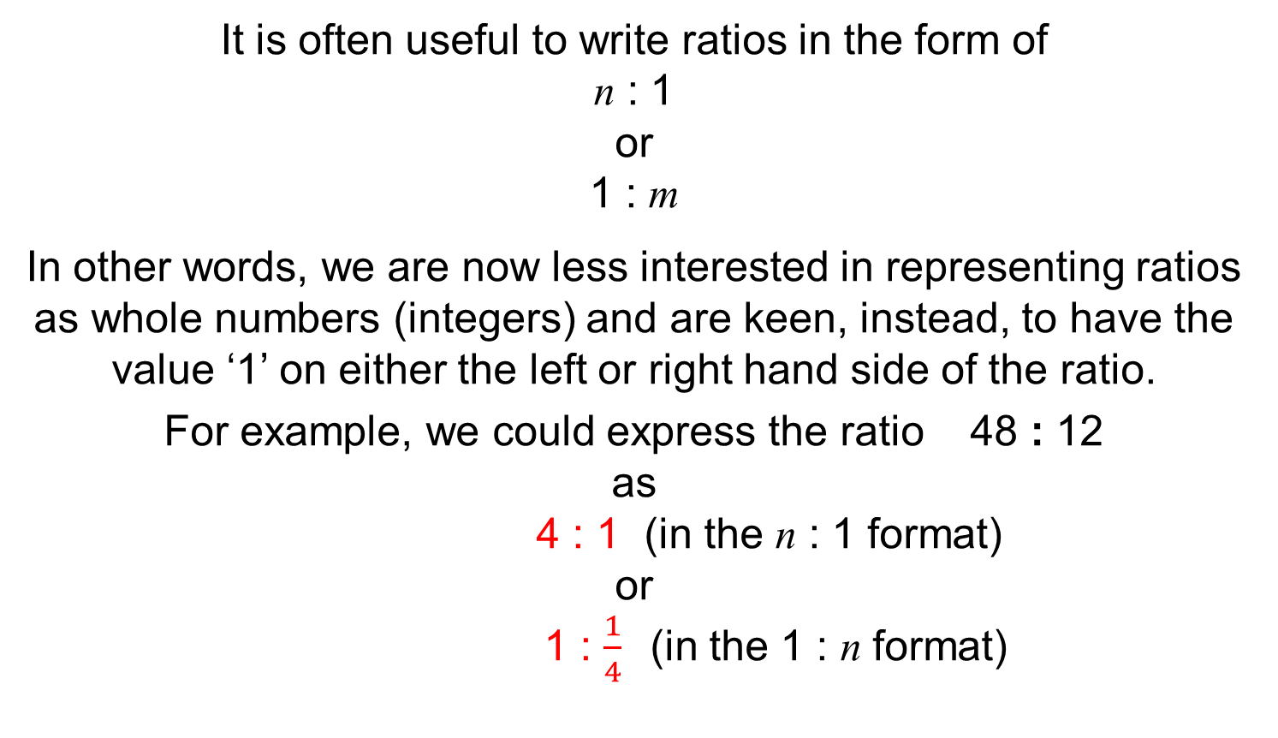
UNIT:
Ratio and
Proportion
Section 2
Proportion and Ratio
We start with a quick review of key facts:
It is often useful to write ratios in the form of
n : 1
or
1 : m
In other words, we are now less interested in representing ratios as whole numbers (integers) and are keen, instead, to have the value ‘1’ on either the left or right hand side of the ratio.
For example, we could express the ratio 48 : 12
as
4 : 1 (in the n : 1 format)
or
1 : $\frac{1}{4}$(in the 1 : n format)

Slide 8


UNIT:
Ratio and
Proportion
Section 2
Proportion and Ratio: Example
Writing ratios in the form of 1 : n or n : 1
is often useful when solving problems.
This example involves direct proportion (that is, where two quantities increase or decrease at same rate). The manager of a local store estimates that the ratio of sales of family-size ice-cream tubs to boxes of wafer cones is 5 : 2. In one day, 70 family-size ice-cream tubs were sold. How many boxes of cones were sold that day?
First, find the ratio in the form 1 : n
Ice-cream tubs : Boxes of cones
5 : 2
1 : $\frac{2}{5}$
(divide both parts by 5)
We find the ratio we need, by multiplying both parts by 70.
70 : 70$×\frac{2}{5}$
70 : 28
Answer: 28 boxes

Slide 9
UNIT:
Ratio and
Proportion
Section 2
Proportion and Ratio: Problem
Writing ratios in the form of 1 : n or n : 1 is also very useful
when solving inverse proportion problems.
Example:
Two people can complete the job of unloading 300 boxes in 7 hours.
If 5 people are to unload the boxes, instead of 2, how long will the job take, and how much time is saved?
The first thing to consider, is what will stay the same and what will change. In this scenario, the number of boxes stays the same,
so this piece of information is irrelevant at the moment.
The ratio we are interested in, is:
People : Hours
2 : 7
So the method here, is to find out how many hours it would take
1 person to do the job.
How many hours do you think?

Slide 10
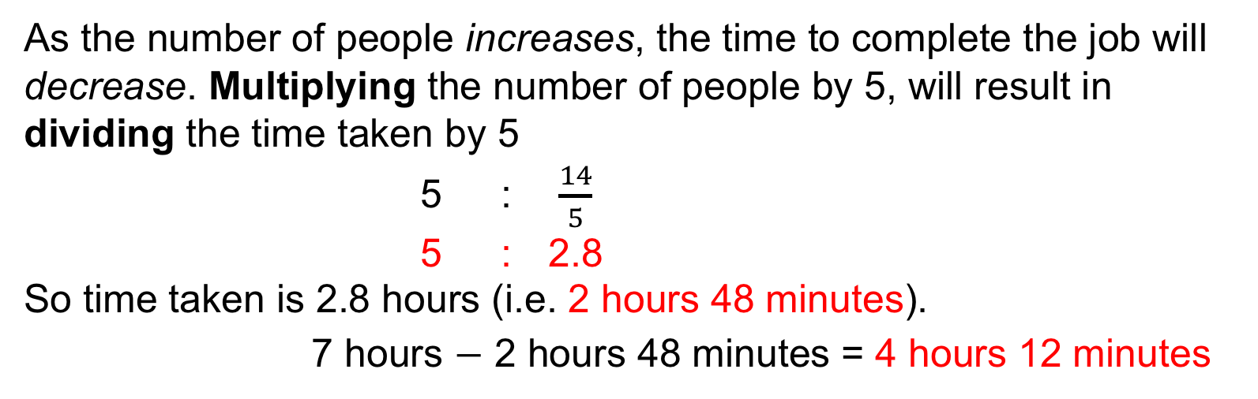
UNIT:
Ratio and
Proportion
Section 2
Proportion and Ratio: Problem
People : Hours
2 : 7
1 : ?
One person would take twice as long as two people, i.e.
1 : 14
That is, 1 person will take 14 hours. Now we have the ratio in the format of 1 : n so we can work out any other situation.
The question asked how long the job would take 5 people.
As the number of people increases, the time to complete the job will decrease. Multiplying the number of people by 5, will result in dividing the time taken by 5
5 : $\frac{14}{5}$
5 : 2.8
So time taken is 2.8 hours (i.e. 2 hours 48 minutes).
7 hours $−$ 2 hours 48 minutes = 4 hours 12 minutes
Time saved is

Slide 11
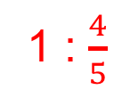
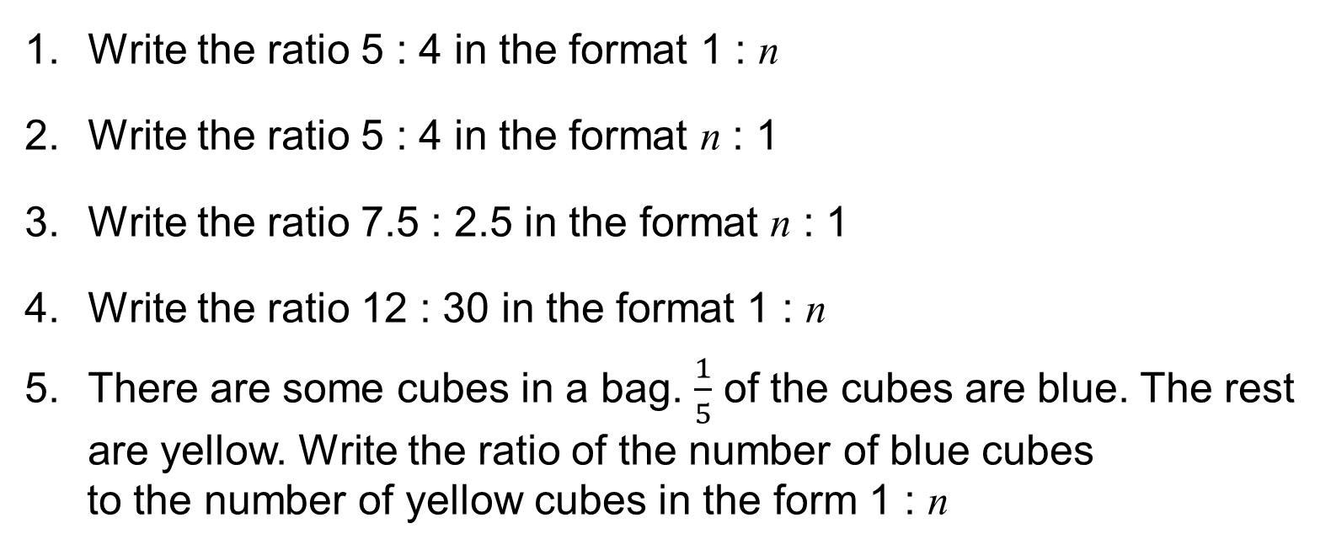
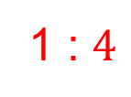
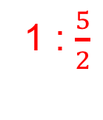
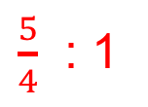
UNIT:
Ratio and
Proportion
Section 2
Section 2 Fitness Check
Write the ratio 5 : 4 in the format 1 : n
Write the ratio 5 : 4 in the format n : 1
Write the ratio 7.5 : 2.5 in the format n : 1
Write the ratio 12 : 30 in the format 1 : n
There are some cubes in a bag. $\frac{1}{5}$ of the cubes are blue. The rest are yellow. Write the ratio of the number of blue cubes
to the number of yellow cubes in the form 1 : n
1 : $\frac{4}{5}$
$\frac{5}{4}$ : 1
3 : 1
1 : $\frac{5}{2}$
1 : $4$
A recipe uses 300 grams of flour to make 8 cup cakes.
How much flour is needed for 20 cup cakes?
Answer: 750 g
Six people can build an 18 metre wall in 3 days.
How long would it take 2 people to build the
18 metre wall?
Answer: 9 days

Slide 12
UNIT:
Ratio and
Proportion
Section 2
Section 2: Review
You have completed the second Section.
If you have completed and understood this section,
click to start the next Section.
If you need more examples and interactive practice,
press here.
You might also find it helpful to look at:
Essential Information: press here

Slide 13
UNIT:
Ratio and
Proportion
Section 3
Map Scales and Ratios
We start with a quick review of key facts:
The scales on maps are simply ratios.
For example, a scale of 1 : 50 000 simply means that for every 1 unit of measurement on the map, there are 50 000 in real life.
The units do not matter as long as you remember
to compare like-for-like.
In the example above, 1 cm on the map would represent 50 000 cm in real life.
But equally true, 1 mm on the map would represent 50 000 mm in real life
and 1 metre on the map would represent
50 000 m in real life.

Slide 14
UNIT:
Ratio and
Proportion
Section 3
Map Scales and Ratios
Example 1:
The scale on a map is 1 : 300 000
On the map, the distance between two towns is 2.5 cm.
What is the distance between the two towns in reality?
Solution
1 : 300 000
2.5 : 750 000
(multiplying both parts by 2.5)
So the distance, in reality is 750 000 cm
which is 7 500 m = 7.5 km
Example 2:
Two places are 2.5 km apart. On a map they are 12.5 cm apart.
What is the scale of the map?
Solution: First convert the kilometres into centimetres
2.5 km = 2500 m = 250 000 cm
We can now compare the map and real distances
12.5 : 250 000
1 : 20 000
(dividing both parts by 12.5)

Slide 15
UNIT:
Ratio and
Proportion
Section 3
Section 3: Fitness Check
On a map with a scale of 1 : 250 000, the distance between two towns is 6 cm.
What is the distance between the two towns in reality?
The distance, in reality is 1 500 000 cm = 15 km
The direct distance between Dover and Calais is 42 km. What would be the distance between those two ports on maps with scales:
  1 : 200 000
  1 : 40 000
  1 : 2 000 000
Answer: 21 cm
Answer: 105 cm
Answer: 2.1 cm

Slide 16
UNIT:
Ratio and
Proportion
Section 3
Section 3: Review
You have completed the third Section.
If you have completed and understood this section,
click to start the next Section.
If you need more examples and interactive practice,
press here.
You might also find it helpful to look at:
Essential Information: press here

Slide 17
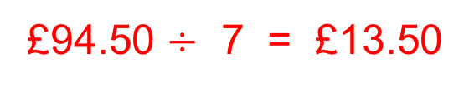
UNIT:
Ratio and
Proportion
Section 4
Proportional Division
Sometimes we need to divide a quantity into a certain ratio.
Example:
Matthew and Luca earn some money washing cars. Together they earned £94.50. Whilst Matthew worked 5 days washing cars, Luca only worked for 2 days. So to be fair, they decide to split the
money earned in the ratio of 5 : 2. How much did they each earn?
Solution
Matthew : Luca
5 : 2
This is a total of 7 ‘parts’
£94.50 is then divided by 7 to find the value of 1 ‘part’
£94.50 $÷$ 7 = £13.50
So each ‘part’ is worth £13.50
Matthew will get 5 ‘parts’ of the money, i.e. 5 x £13.50
Luca will get 2 ‘parts’ of the money, i.e. 2 x £13.50
Matthew : Luca
£67.50 : £27.00

Slide 18
UNIT:
Ratio and
Proportion
Section 4
Section 4: Fitness Check
The ratio of girls to boys in a ballet competition is 13: 2.
Find the numbers of girls and boys competing if there are 105
participants in total.
Answer: 91 girls, 14 boys
Together, Jamal, Annie, Rafique and Yasmin inherit £30 000 from a long lost relative. They have been instructed to divide the money in the ratio 2 : 4 : 1 : 3.
How much do they each get?
  Jamal: £6000, Annie: £12 000, Rafique: £3000, Yasmin: £9000

Slide 19
UNIT:
Ratio and
Proportion
Section 4
Section 4: Review
You have completed the final Section.
If you have completed and understood this last section,
click here for the Unit audit.
If you need more examples and interactive practice,
press here.
You might also find it helpful to look at:
Essential Information: press here

