Slide 1
Supporting and Enhancing Mathematics and Statistics
UNIT: Trigonometric Ratios

Slide 2
Trigonometric Ratios
UNIT:
Trigonometric Ratios
Trigonometry is a branch of mathematics that studies the relationships between the sides and angles of
right angled triangles.
You have four sections to work through and
there are check up audits for each section.
1. Sine, Cosine and Tangent
Finding Lengths in Right Angled Triangles
3. Finding Angles in Right Angled Triangles
4. Mixed Problems using Trigonometry

Slide 3
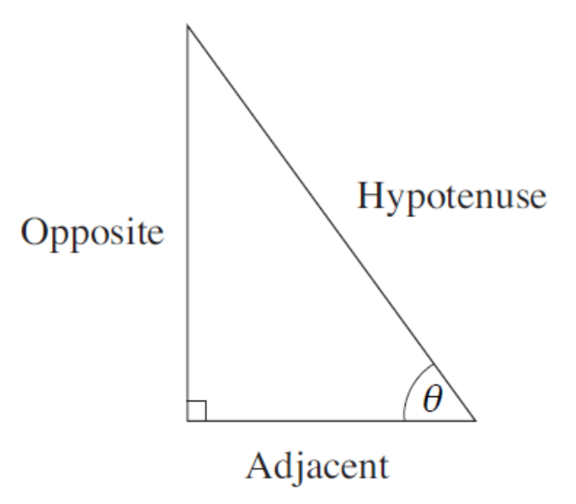
Unit:
Trigonometric Ratios
Section 1
Hypotenuse, Opposite and Adjacent
Hypotenuse, Opposite and Adjacent
When working in a right angled triangle, the longest side is known as the Hypotenuse. The other two sides are known as the Opposite and the Adjacent.
The adjacent is the side next to a marked angle, θ and the opposite side is opposite this angle.

Slide 4
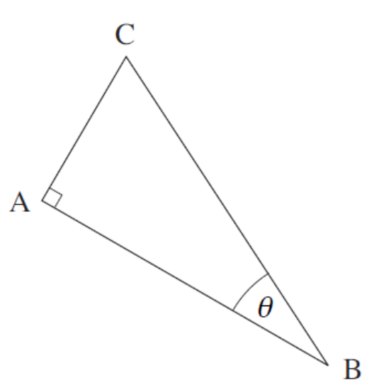
Unit:
Trigonometric Ratios
Section 1
Hypotenuse, Opposite and Adjacent
Example
For the triangle and angle shown, state which side is:
a) the hypotenuse
b) the adjacent
c) the opposite.
Solution
The hypotenuse is the longest side, which
for this triangle is CB.
b) The adjacent is the side that is next to the angle θ , which for this triangle is AB.
c) The opposite side is the side that is opposite the angle θ, which for this triangle is AC.

Slide 5
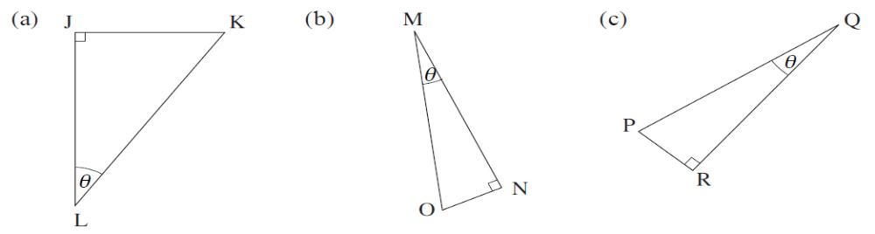
Unit:
Trigonometric Ratios
Section 1
Hypotenuse, Opposite and Adjacent
Example
For each triangle, state which side is the hypotenuse, the adjacent
and the opposite.
Solution
a) hypotenuse
KL
adjacent
JL
opposite
JK
b) hypotenuse
adjacent
MN
opposite
NO
MO
c)
hypotenuse
PQ
adjacent
QR
opposite
PR

Slide 6
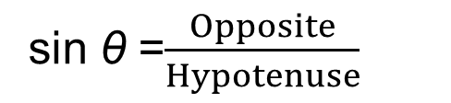
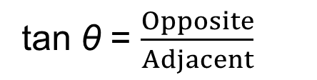
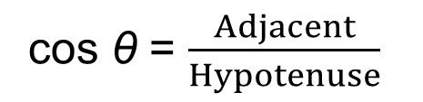
Unit:
Trigonometric Ratios
Section 1
Sine, Cosine and Tangent
Sine, Cosine and Tangent
For a right-angled triangle, the sine, cosine and
tangent of the angle θ are defined as:
sin θ =$\frac{Opposite}{Hypotenuse}$
cos θ = $\frac{Adjacent}{Hypotenuse}$
tan θ = $\frac{Opposite}{Adjacent}$
NOTE: sin θ will always have the same value regardless of the size of the triangle. (The same is true for cos θ and tan θ.)

Slide 7
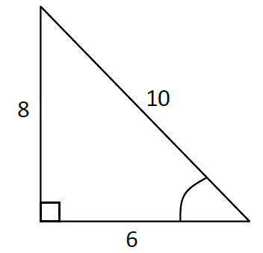
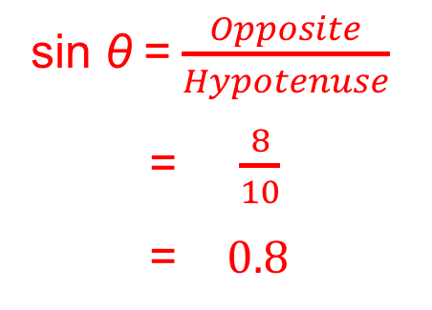
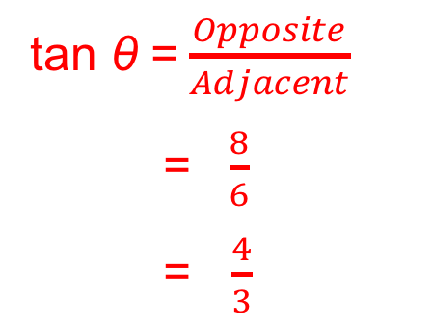
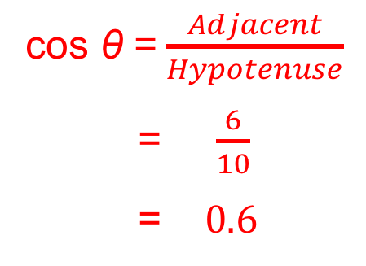
Unit:
Trigonometric Ratios
Section 1
Sine, Cosine and Tangent
Example
Write down the values of sin θ , cos θ and tan θ
for the triangle shown. Then use a calculator to
find the angle in each case.
θ
Solution
sin θ =$\frac{Opposite}{Hypotenuse}$
= $\frac{8}{10}$
= $0.8$
cos θ =$\frac{Adjacent}{Hypotenuse}$
= $\frac{6}{10}$
= $0.6$
tan θ =$\frac{Opposite}{Adjacent}$
= $\frac{8}{6}$
= $\frac{4}{3}$

Slide 8
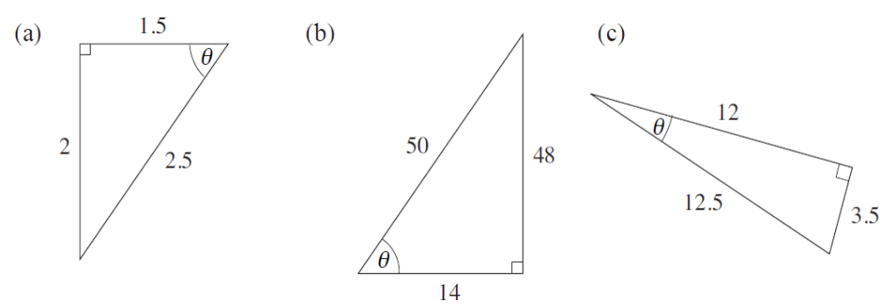
Unit:
Trigonometric Ratios
Section 1
Section 1: Fitness Check
Here are some questions to check your progress.
1. For each triangle, find sin θ, cos θ and tan θ to two decimal places.
Answers
(a) 0.80, 0.60, 1.33
(b) 0.96, 0.28, 3.43
(c) 0.28, 0.96, 0.29
2. Use a calculator to find the angles, correct to 2 decimal places.
sin 30° =
0.50
tan 75° =
3.73
cos 45° =
0.71
3. Use a calculator to find θ, correct to 1 decimal place.
cos θ = 0.5
60°
sin θ = 1
90°
tan θ = 0.45
24.2°

Slide 9
Unit:
Trigonometric Ratios
Section 1
Section 1: Review
You have completed the first section.
If you have completed and mastered this section,
click to start the next Section
If you need more examples and interactive practice,
press here
You might also find it helpful to look at:
Essential Information: press here

Slide 10
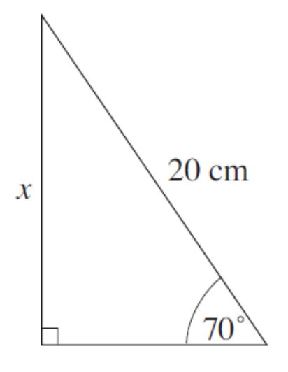
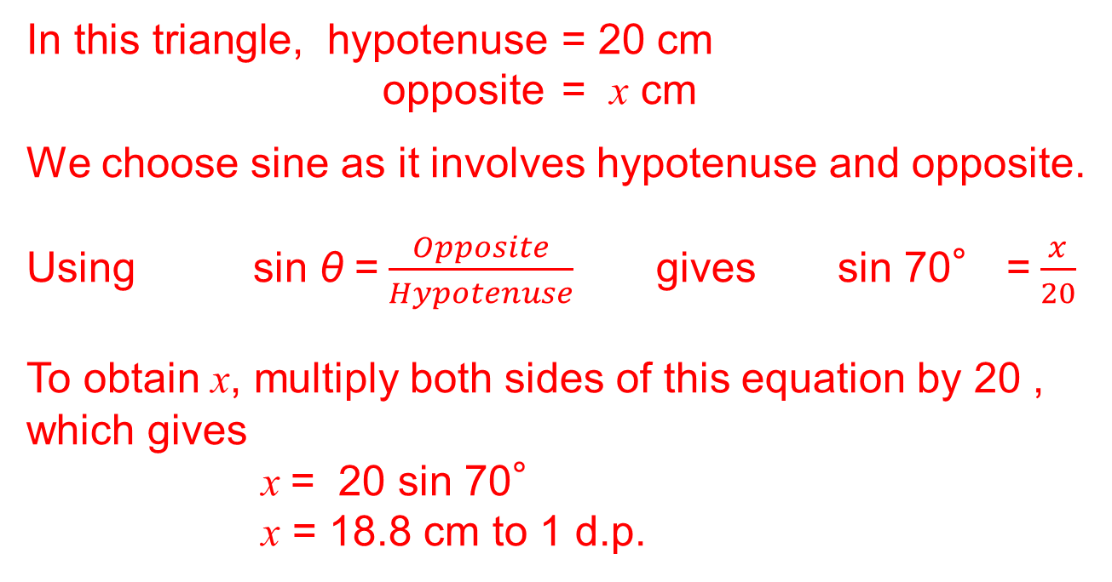
Unit:
Trigonometric Ratios
Section 2
Finding lengths in Right Angled Triangles
Example
Find the length of the side marked x in the triangle.
Solution
In this triangle, hypotenuse = 20 cm
opposite = x cm
We choose sine as it involves hypotenuse and opposite.
Using sin θ =$\frac{Opposite}{Hypotenuse}$ gives sin 70° =$\frac{x}{20}$
To obtain x, multiply both sides of this equation by 20 , which gives
x = 20 sin 70°
x = 18.8 cm to 1 d.p.

Slide 11
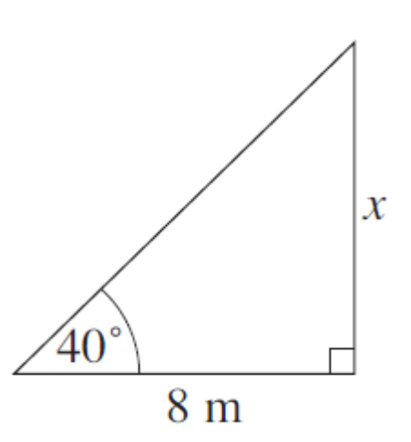
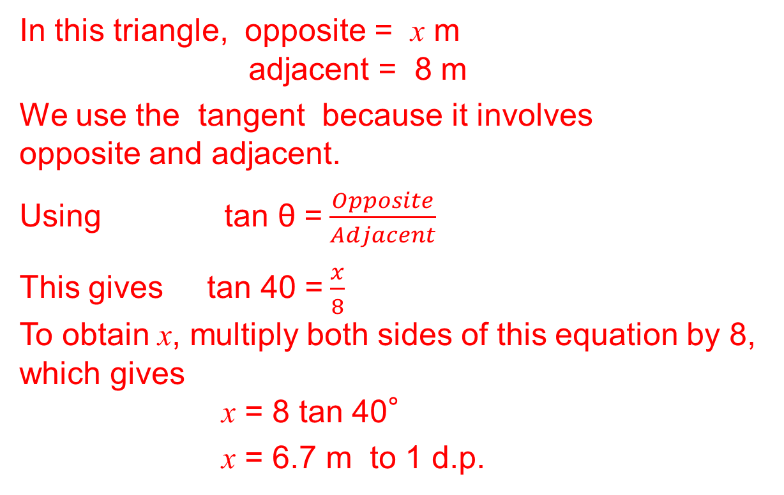
Unit:
Trigonometric Ratios
Section 2
Finding lengths in Right Angled Triangles
Example: Find the length of the side marked x in the triangle.
Solution
In this triangle, opposite = x m
adjacent = 8 m
We use the tangent because it involves opposite and adjacent.
Using tan θ =$\frac{Opposite}{Adjacent}$
This gives tan 40 =$\frac{x}{8}$
To obtain x, multiply both sides of this equation by 8, which gives
x = 8 tan 40°
x = 6.7 m to 1 d.p.

Slide 12
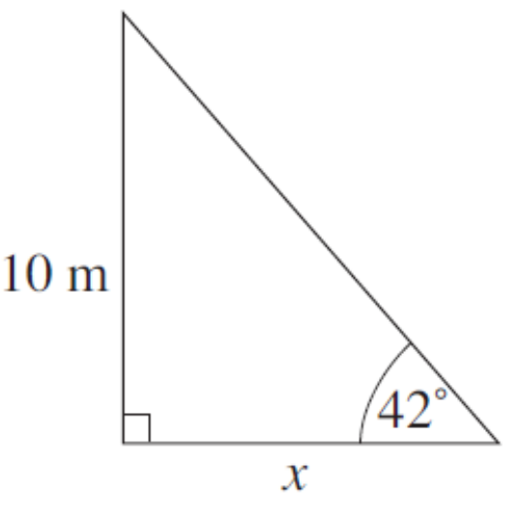
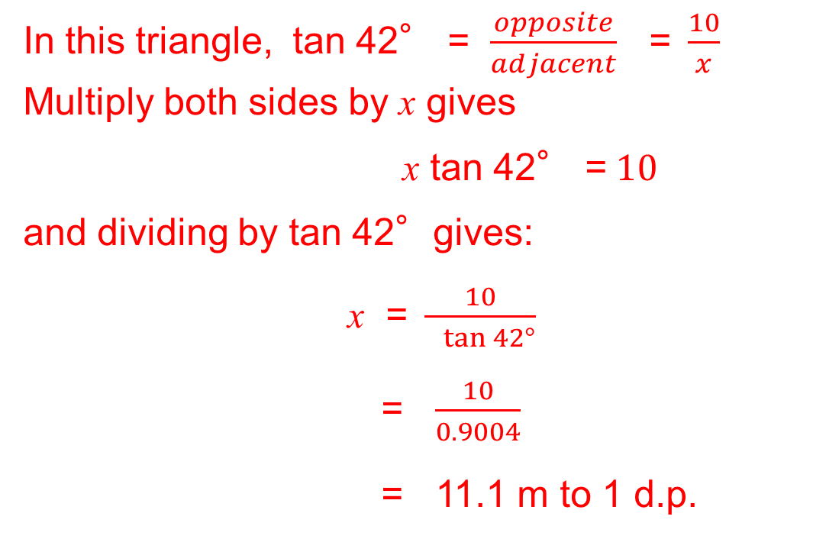
Unit:
Trigonometric Ratios
Section 2
Finding lengths in Right Angled Triangles
Example
Find the length of the side marked x in the triangle.
Solution
In this triangle, tan 42° = $\frac{opposite}{adjacent}$ =$\frac{10}{x}$
Multiply both sides by x gives
x tan 42° =$10$
and dividing by tan 42°gives:
x =$\frac{10}{ tan 42°}$
= $\frac{10}{0.9004}$
= 11.1 m to 1 d.p.

Slide 13
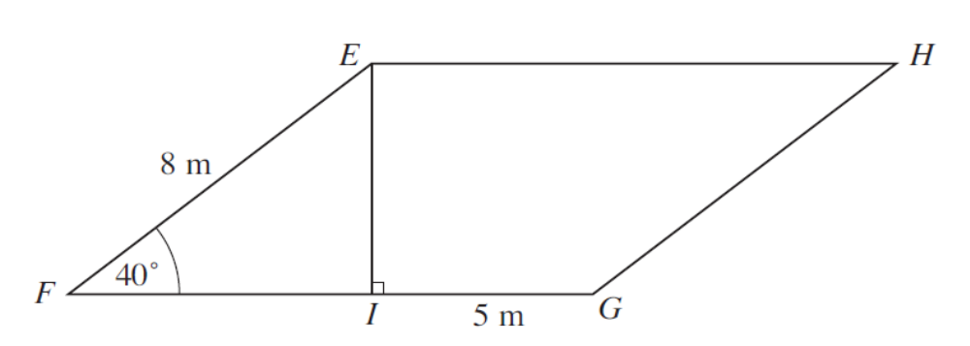
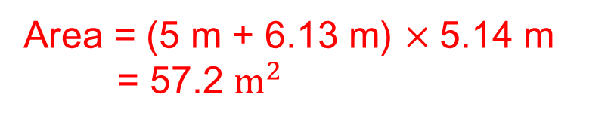
Unit:
Trigonometric Ratios
Section 2
Finding lengths in Right Angled Triangles
Example
The diagram above, not drawn to scale, represents one face of the roof of a house in the shape of a parallelogram EFGH.
Angle EFI = 40°and EF = 8 m. EI represents a rafter placed perpendicular to FG such that IG = 5 m.
Calculate FI, EI and the area of the parallelogram giving your answers to 3 significant figures.
Solution
FI = 8 cos 40 = 6.13 m
Area = (5 m + 6.13 m) $×$5.14 m
= 57.2 $m^{2}$
EI = 8 sin 40 = 5.14 m

Slide 14
Unit:
Trigonometric Ratios
Section 2
Section 2: Fitness Check
Here are some questions to check your progress.
1. Find the length of the side marked x in each triangle
Answers (a) 5.14 m (b) 11.82 m (c) 5.13 m

Slide 15
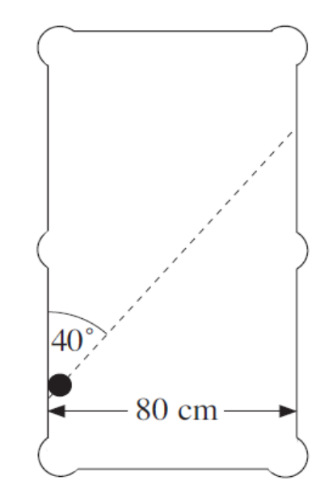
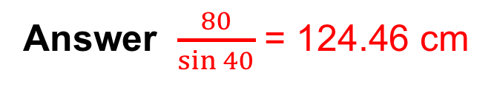
Unit:
Trigonometric Ratios
Section 2
Section 2: Fitness Check
A snooker ball rests against the
side cushion of a snooker table.
It is hit so that it moves at 40°
to the side of the table.
How far does the ball travel before
it hits the cushion on the other side of the table?
Answer $\frac{80}{\sin{40}}$ = 124.46 cm

Slide 16
Unit:
Trigonometric Ratios
Section 2
Section 2: Review
You have completed the second section.
If you have completed and mastered this section,
click to start the next Section
If you need more examples and interactive practice,
press here
You might also find it helpful to look at:
Essential Information: press here

Slide 17
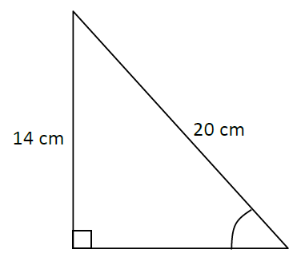
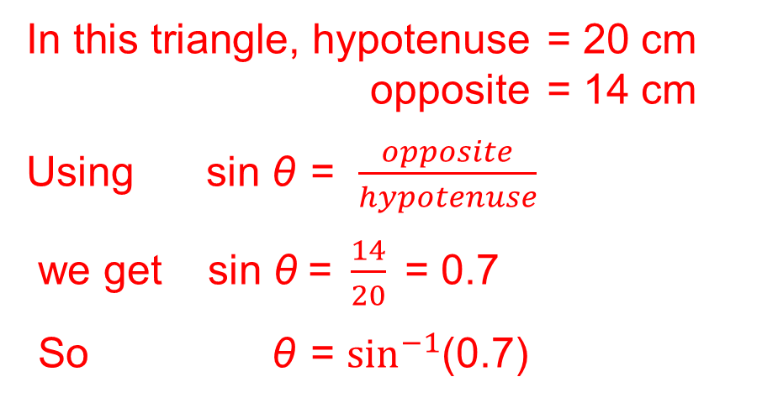
Unit:
Trigonometric Ratios
Section 3
Finding angles in Right Angled Triangles
If the lengths of any two sides of a right-angled triangle are known, then sine, cosine and tangent can be used to find the angles of the triangle.
Example
Find the angle marked θ in the triangle shown.
Solution
In this triangle, hypotenuse = 20 cm
opposite = 14 cm
Using sin θ = $\frac{opposite}{hypotenuse}$
we get sin θ =$\frac{14}{20}$= 0.7
So θ = $\sin^{−1}$(0.7)
θ
Using SHIFT and SIN buttons on a calculator gives θ = 44.4°to 1 d.p.

Slide 18
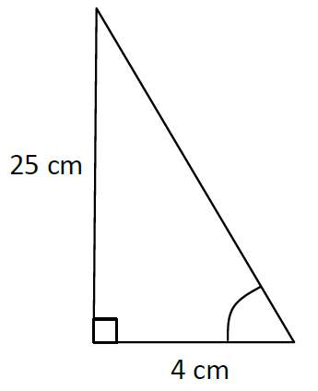
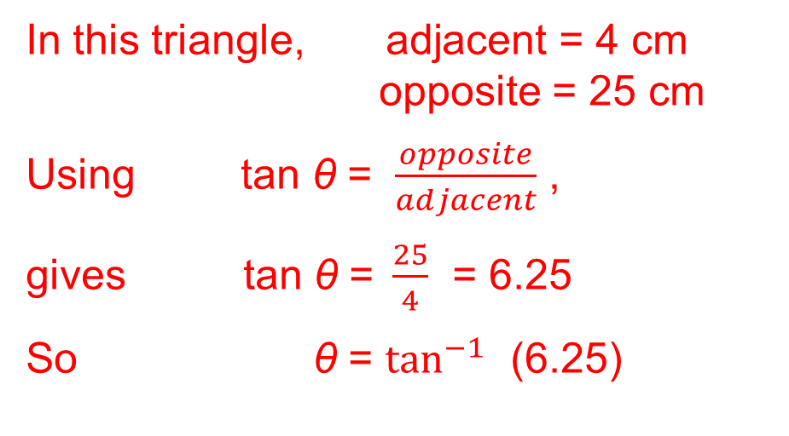
Unit:
Trigonometric Ratios
Section 3
Finding angles in Right Angled Triangles
Example
Find the angle marked θ in the triangle
shown.
Solution
In this triangle, adjacent = 4 cm
opposite = 25 cm
Using tan θ = $\frac{opposite}{adjacent}$ ,
gives tan θ =$\frac{25}{4}$ = 6.25
So θ = $\tan^{−1}$ (6.25)
θ
Using SHIFT and TAN buttons on a calculator gives θ = 80.9°to 1 d.p.

Slide 19
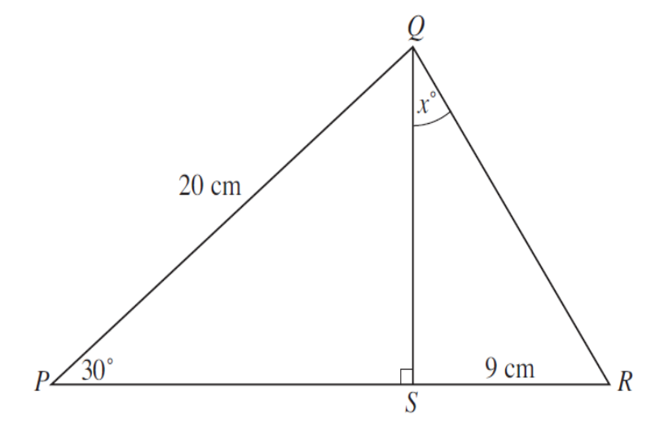
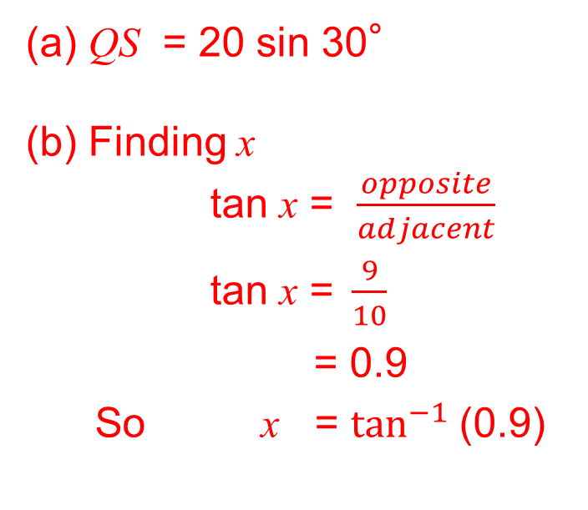
Unit:
Trigonometric Ratios
Section 3
Finding angles in Right Angled Triangles
Example
Find the angle marked x°in the triangle shown.
Solution
(a) QS = 20 sin 30°
(b) Finding x
tan x = $\frac{opposite}{adjacent}$
tan x =$\frac{9}{10}$
= 0.9
So x = $\tan^{−1}$(0.9)
Using SHIFT and TAN buttons on a calculator gives x = 41.987° (42°nearest degree )

Slide 20
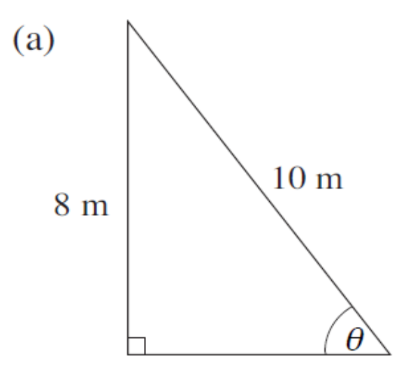
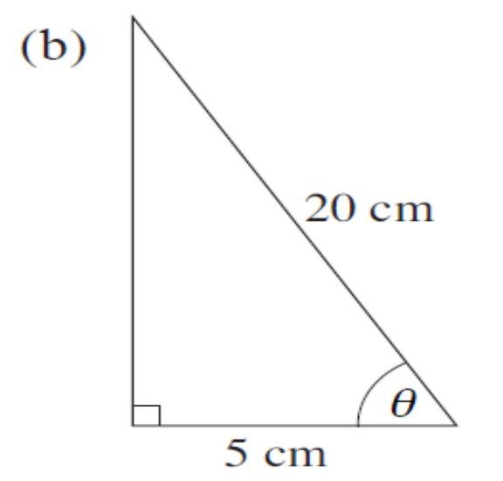
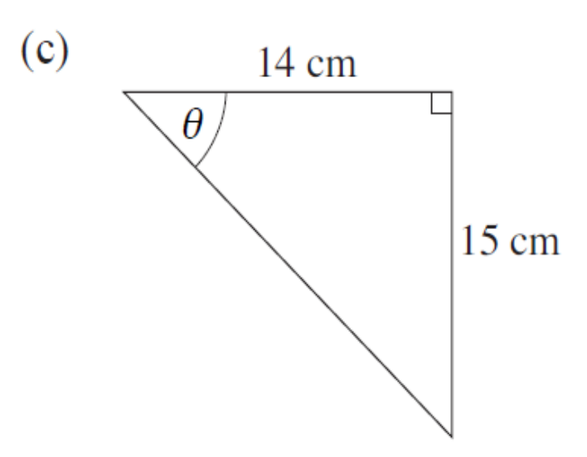
Unit:
Trigonometric Ratios
Section 3
Section 3: Fitness Check
Here are some questions to check your progress.
1. Find the angle θ.
Answers
53.13°
75.52°
46.97°

Slide 21
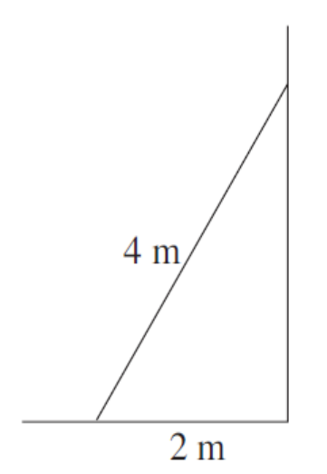
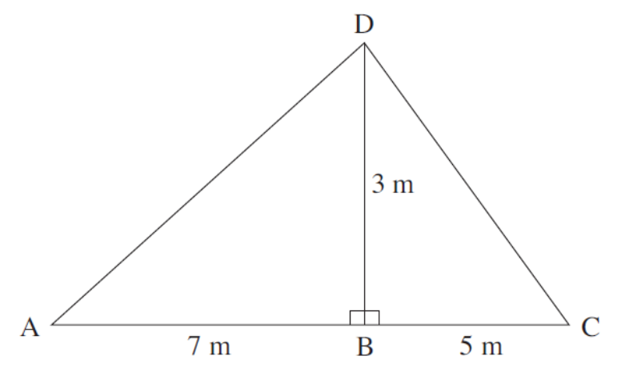
Unit:
Trigonometric Ratios
Section 3
Section 3: Fitness Check
2. A ladder leans against a wall. The length of the ladder is 4 metres and the base is 2 metres from the wall. Find the angle between the ladder and the ground.
Answer 60°
3. The diagram shows a roofing frame ABCD
(a) Calculate the length of AD.
(b) Calculate the size of angle DCB.
Answers
(a) AD = 7.62m
(b) DCB = 30.96°

Slide 22
Unit:
Trigonometric Ratios
Section 3
Section 3: Review
You have completed the third section.
If you have completed and mastered this section,
click to start the next Section
If you need more examples and interactive practice,
press here
You might also find it helpful to look at:
Essential Information: press here

Slide 23
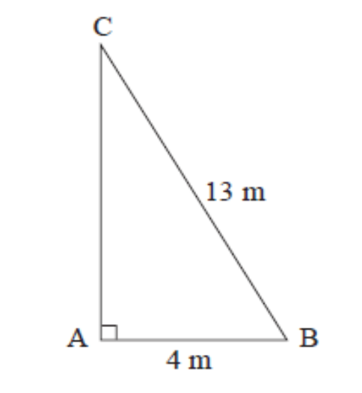
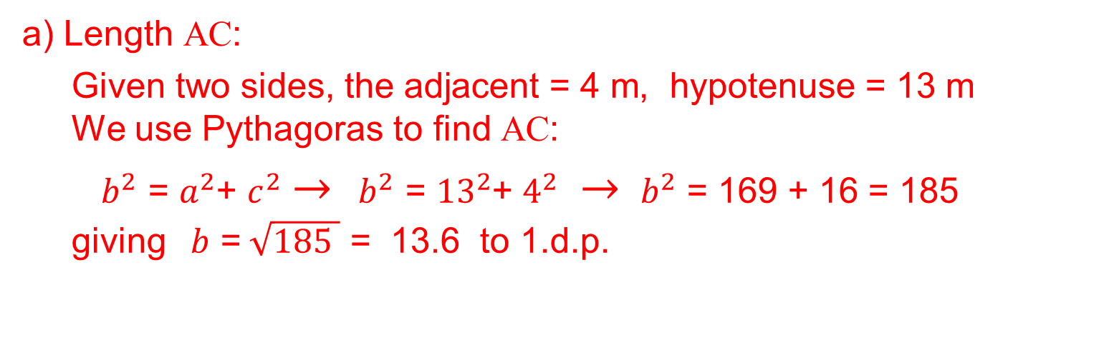
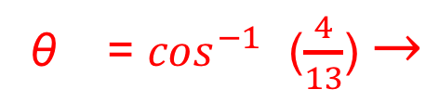
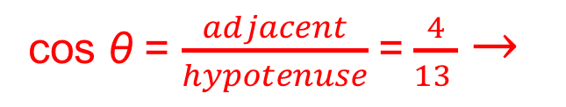
Unit:
Trigonometric Ratios
Section 4
Mixed problems using Trigonometry
Example
ABC is a right angled triangle. AB is of length 4 m and BC is of length 13 m.
Calculate the length of AC.
Calculate the size of angle ABC.
Solution
a) Length AC:
Given two sides, the adjacent = 4 m, hypotenuse = 13 m
We use Pythagoras to find AC:
$b^{2}$ = $a^{2}$+ $c^{2}$ $→$ ${ b}^{2}$ = ${13}^{2}$+ $4^{2}$ $→$ ${ b}^{2}$ = 169 + 16 = 185
giving $b$ =$\sqrt{185 }$ = 13.6 to 1.d.p.
b) Angle ABC:
cos θ = $\frac{adjacent}{hypotenuse}$ = $\frac{4}{13 }$ $→$
θ = $\cos^{−1}$ ($\frac{4}{13}$) $→$
θ = 72.1°to 1 d.p.

Slide 24
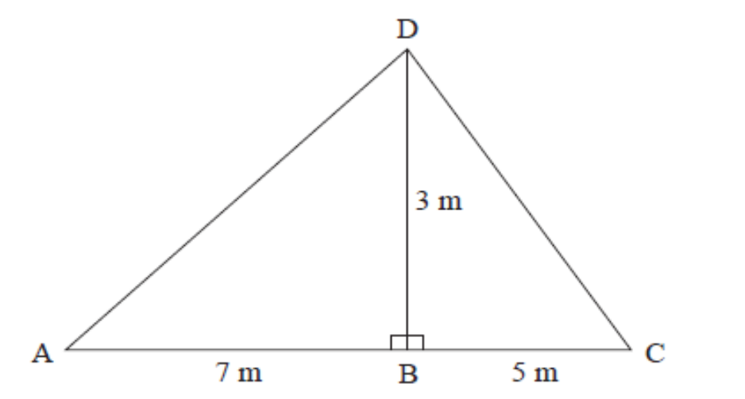
Unit:
Trigonometric Ratios
Section 4
Mixed problems using Trigonometry
Here is a question to check your progress.
The diagram shows a roofing frame ABCD.
AB =7 m, BC=5 m, and
angle ABD = angle DBC = 90°
a) Calculate the length of AD.
b) Calculate the size of angle DCB.
Answers a) 7.62 (2 d.p.) b) 31 (1 d.p.)

Slide 25
Unit:
Trigonometric Ratios
Section 4
Section 4: Review
You have completed the fourth section.
If you have completed and mastered this section,
click here for the Unit audit
If you need more examples and interactive practice,
press here
You might also find it helpful to look at:
Essential Information: press here

