Slide 1
Supporting and Enhancing Mathematics and Statistics
UNIT: Further Trigonometry

Slide 2
Strand:
Further Trigonometry
Section 1
Further Trigonometry
This unit on Further Trigonometry is divided into the following five units of work.
Radian Measure
Arc and Sector
Sine, Cosine and Tangent Functions
Solving Trigonometrical Equations
5. Properties of Trig Functions

Slide 3
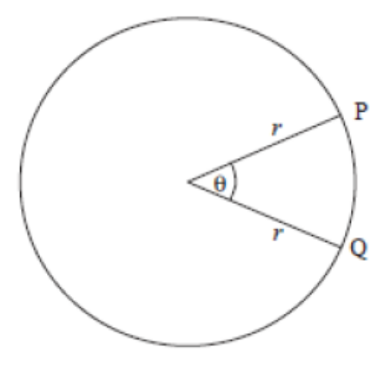
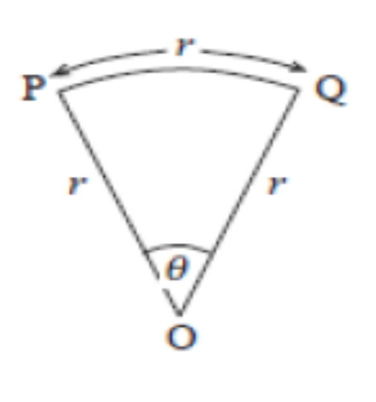
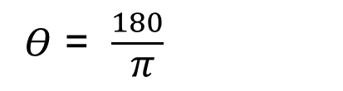
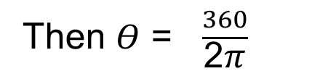

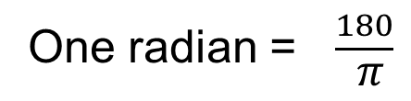
Strand:
Further Trigonometry
Section 1
Radian Measure
Radians are an alternative unit of measure for angles, often used in trigonometry.
Radians relate the arc length of a sector to its angle.
One radian corresponds to the angle which gives the same arc length as the radius.
Circumference of the circle = 2𝜋𝑟.
If PQ = r
The arc length PQ = $\frac{Θ}{360}$ $×$ 2𝜋𝑟
Then $Θ$ = $\frac{360}{\text{2}\text{π}}$
$Θ$ = $\frac{180}{ \text{π}}$
One radian = $\frac{180}{ \text{π}}$

Slide 4
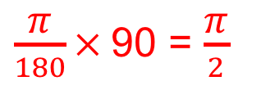
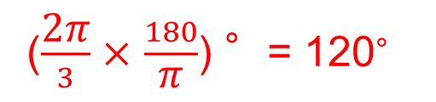
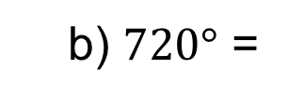
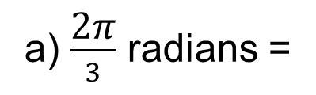
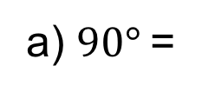

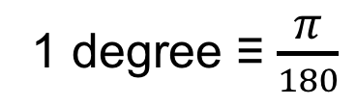
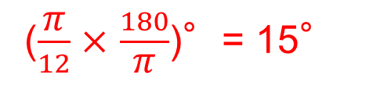
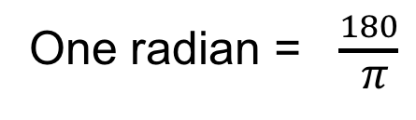
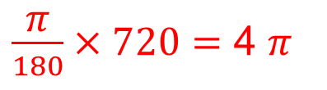
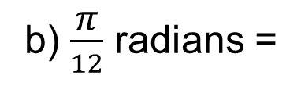
Strand:
Further Trigonometry
Section 1
Radian Measure
One radian = $\frac{180}{ \text{π}}$
This is not a very convenient definition, so it is usual to note that:
𝜋 radians = 180 degrees
1 degree ≡ $\frac{\text{π}}{180}$
Example 1
Convert the following angles in degrees to radians.
Solution
a) $90°$=
$\frac{\text{π}}{180}×$90 = $\frac{\text{π}}{2}$
b) $720°$ =
$\frac{\text{π}}{180}×720=$ 4 $\text{π}$
Example 2
Convert the following angles in radians to degrees.
Solution
a) $\frac{\text{2}\text{π}}{3}$ radians =
($\frac{\text{2}\text{π}}{3}$ $×$ $\frac{180}{\text{π}}$) °= 120°
b) $\frac{\text{π}}{12}$ radians =
($\frac{\text{π}}{12}$ $×$ $\frac{180}{\text{π}}$)°= 15°

Slide 5
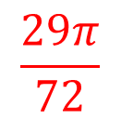
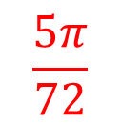
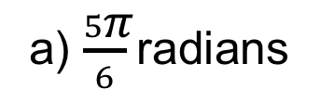
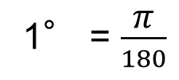
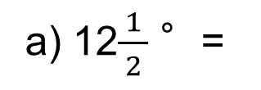
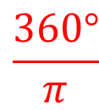
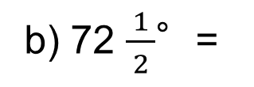
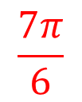
Strand:
Further Trigonometry
Section 1
Section 1 Fitness Check
Here are some questions to check your progress
1° = $\frac{\text{π}}{180}$
1. Convert these angles in degrees to radians.
$$\frac{\text{5}\text{π}}{72}$$
b) 72 $\frac{ 1 }{2}$°=
$$\frac{\text{29}\text{π}}{72}$$
$$\frac{\text{7}\text{π}}{6}$$
a) 12$\frac{ 1 }{2}$ °=
c) 210°=
2. Convert these angles in radians to degrees:
𝜋 radians = 180 degrees
a) $\frac{5\text{π}}{6}$radians
150°
b) 3𝜋 radians
540°
c) 2 radians
$$\frac{360°}{\text{π}}$$
= 114.59°

Slide 6
Strand:
Further Trigonometry
Section 1
Section 1: Review
You have completed the first section.
If you have completed and mastered this section,
click to start the next Section
If you need more examples and interactive practice,
press here
You might also find it helpful to look at:
Essential Information: press here

Slide 7
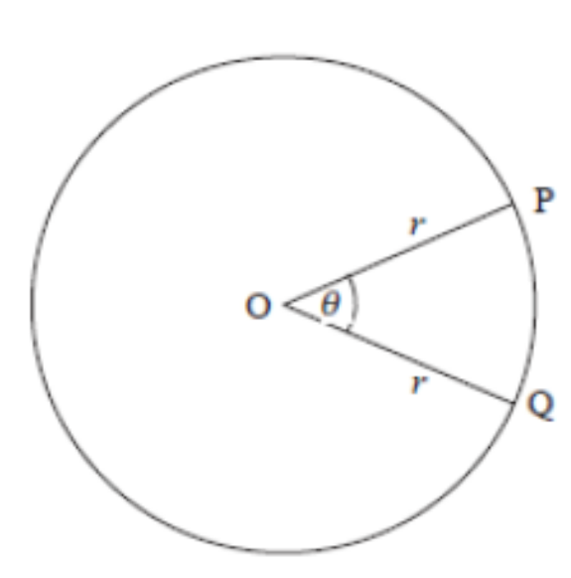
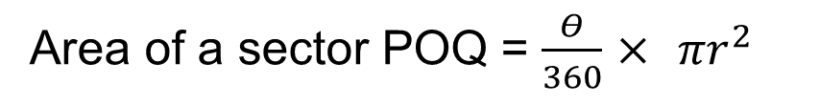
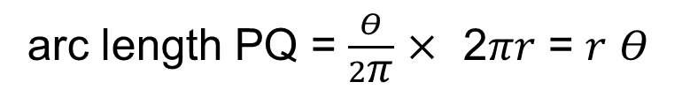
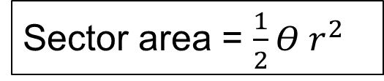
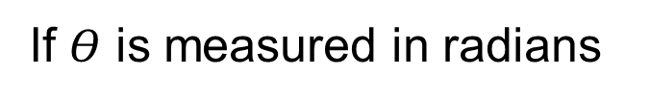

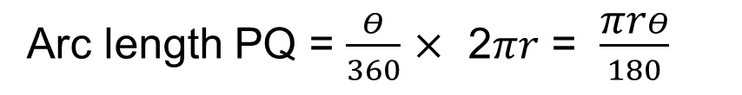
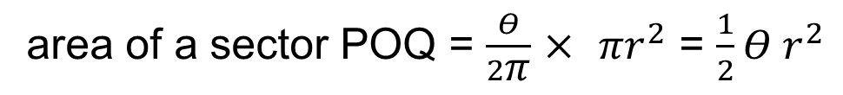

Strand:
Further Trigonometry
Section 2
Arc and Sector Area
Arc length PQ = $\frac{Θ}{360}$ $×$ 2𝜋𝑟 = $\frac{\text{π}\text{r}Θ}{180}$
If $Θ$ is measured in radians
arc length PQ = $\frac{Θ}{2\text{π}}$ $×$ 2𝜋𝑟 = 𝑟 $Θ$
The region between the two radii and the arc is called a sector of the circle.
Area of a sector POQ = $\frac{Θ}{360}$ $×$ 𝜋$r^{2}$
If $Θ$ is measured in radians
area of a sector POQ = $\frac{Θ}{2\text{π}}$ $×$ 𝜋$r^{2}$ = $\frac{1}{2}Θ r^{2}$
In summary, when $Θ$ is measured in radians,
Arc length = 𝑟 $Θ$ and
Sector area = $\frac{1}{2}Θ r^{2}$

Slide 8
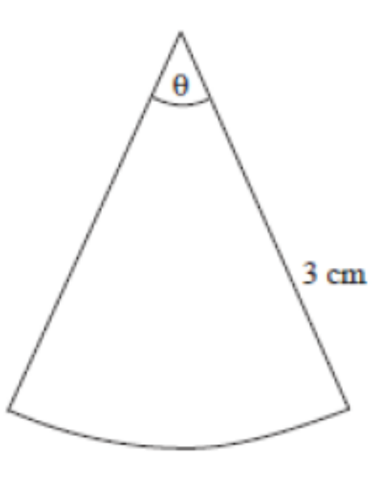
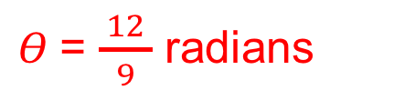


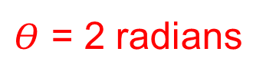

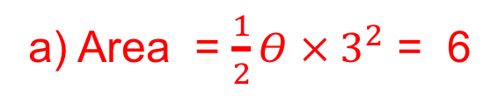
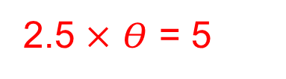


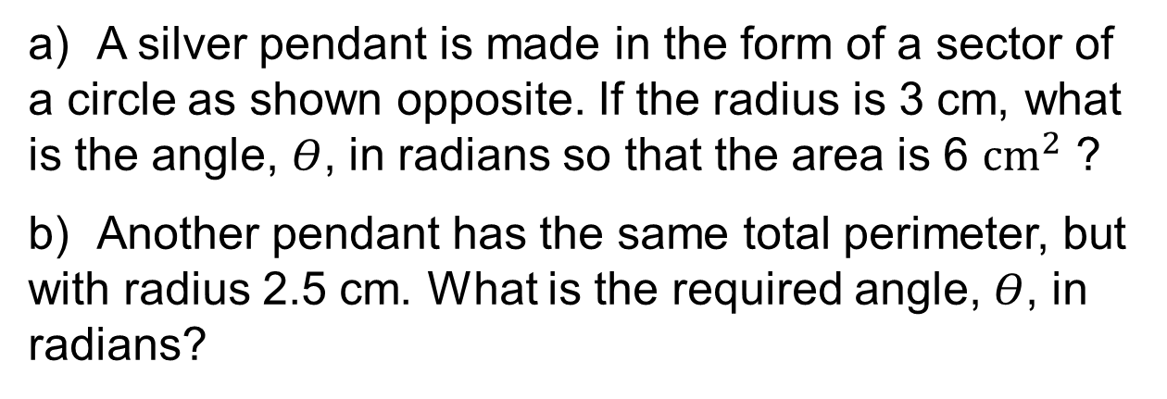
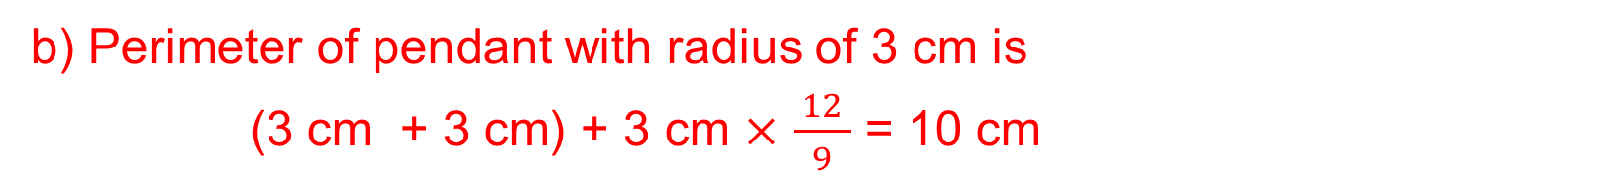

Strand:
Further Trigonometry
Section 2
Arc and Sector Area
Example
a) A silver pendant is made in the form of a sector of a circle as shown opposite. If the radius is 3 cm, what is the angle, $Θ$, in radians so that the area is 6 ${cm}^{2}$ ?
b) Another pendant has the same total perimeter, but with radius 2.5 cm. What is the required angle, $Θ$, in radians?
Solution
a) Area = $\frac{1}{2}Θ {× 3}^{2}$ = 6
$$⟹$$
$Θ × 3^{2}$ = 12
$Θ$= $\frac{ 12 }{9}$ radians
$$⟹$$
b) Perimeter of pendant with radius of 3 cm is
(3 cm + 3 cm) + 3 cm $×$ $\frac{ 12 }{9}$ = 10 cm
Perimeter of pendant with radius of 2.5 cm is 10 cm
2.5 $×$ $Θ$ = 5
$Θ$ = 2 radians
2.5 + 2.5 + 2.5 $×$ $Θ$ = 10
$$⟹$$
$$⟹$$

Slide 9
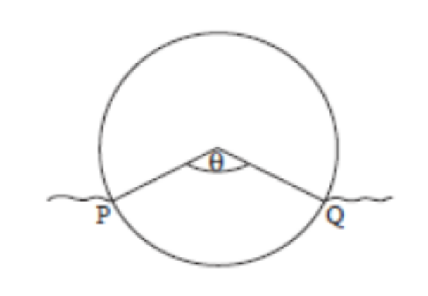
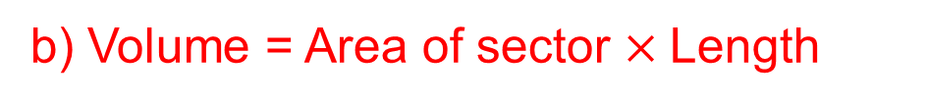

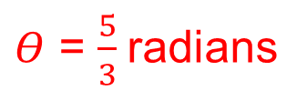
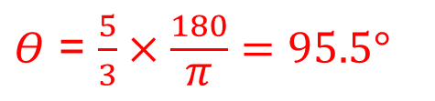

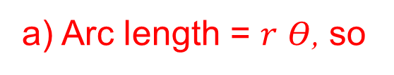
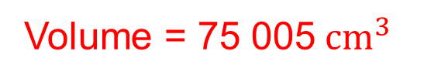


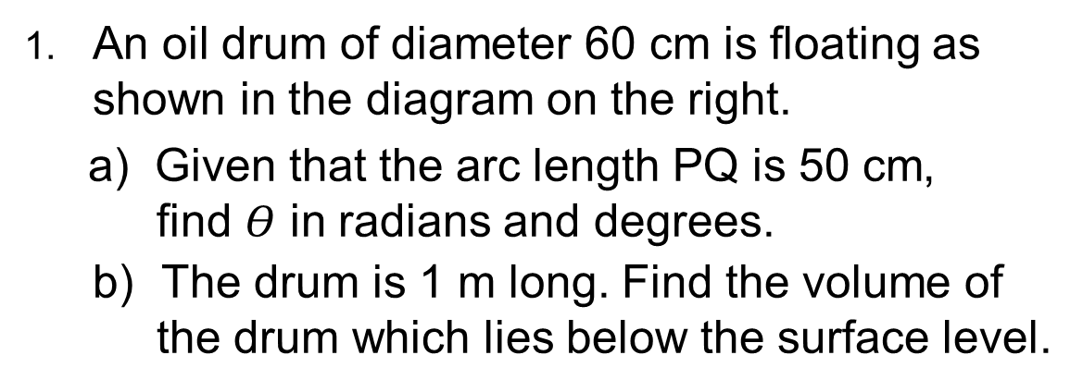


Strand:
Further Trigonometry
Section 2
Section 2 Fitness Check
Here is a question to check your progress
1. An oil drum of diameter 60 cm is floating as shown in the diagram on the right.
a) Given that the arc length PQ is 50 cm, find $Θ$ in radians and degrees.
b) The drum is 1 m long. Find the volume of the drum which lies below the surface level.
Answers
a) Arc length = 𝑟 $Θ$, so
50 = 30 𝜃
$Θ$ = $\frac{5}{3}$radians
$$⟹$$
$Θ$ = $\frac{5}{3}×\frac{180}{\text{π}}=95.5°$
$$⟹$$
b) Volume = Area of sector $×$Length
Volume = $\frac{Θ}{360}\text{π}r^{2}×\text{Length}$
$$⟹$$
Volume = ${\frac{95.5\text{π}}{360}×30}^{2}×100$
Volume = 75 005${ cm}^{3}$
$$⟹$$

Slide 10
Strand:
Further Trigonometry
Section 2
Section 2: Review
You have completed the second section.
If you have completed and mastered this section,
click to start the next Section
If you need more examples and interactive practice,
press here
You might also find it helpful to look at:
Essential Information: press here

Slide 11
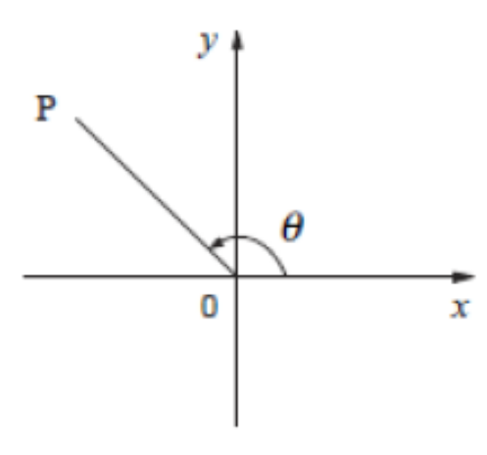
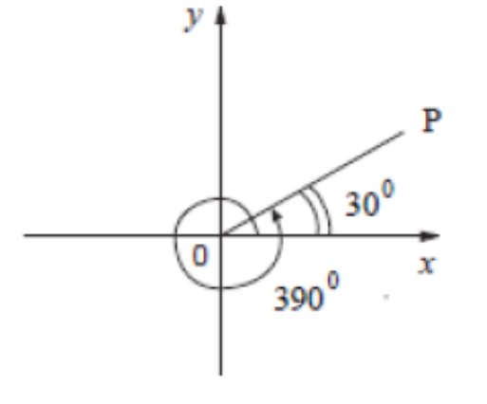
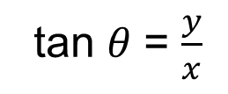
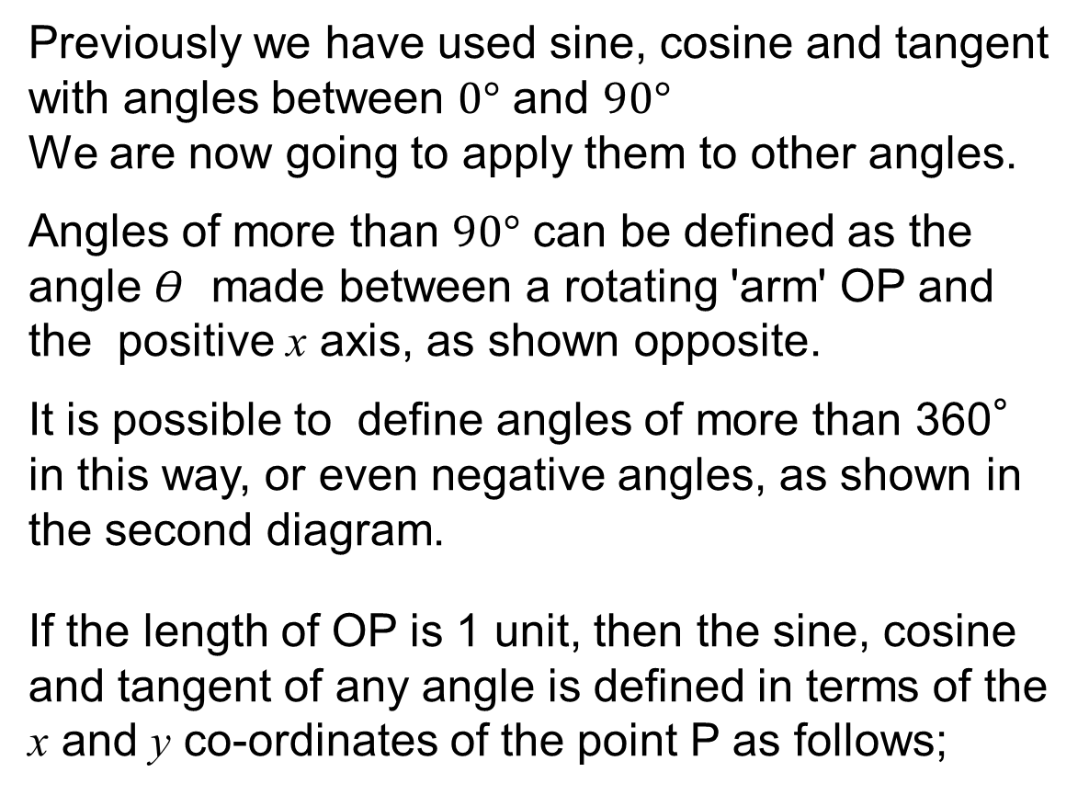
Strand:
Further Trigonometry
Section 3
Sine, Cosine and Tangent Functions
Previously we have used sine, cosine and tangent with angles between $0°$ and $90°$
We are now going to apply them to other angles.
Angles of more than $90°$ can be defined as the angle $Θ$ made between a rotating 'arm' OP and the positive x axis, as shown opposite.
It is possible to define angles of more than 360° in this way, or even negative angles, as shown in the second diagram.
If the length of OP is 1 unit, then the sine, cosine and tangent of any angle is defined in terms of the x and y co-ordinates of the point P as follows;
sin 𝜃 = 𝑦
cos 𝜃 = 𝑥
tan 𝜃 = $\frac{y}{x}$

Slide 12
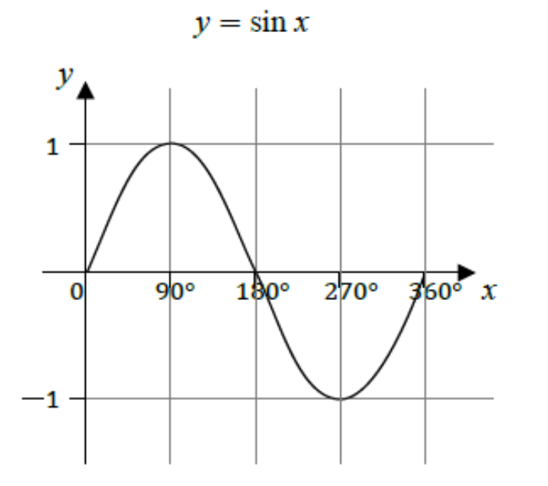
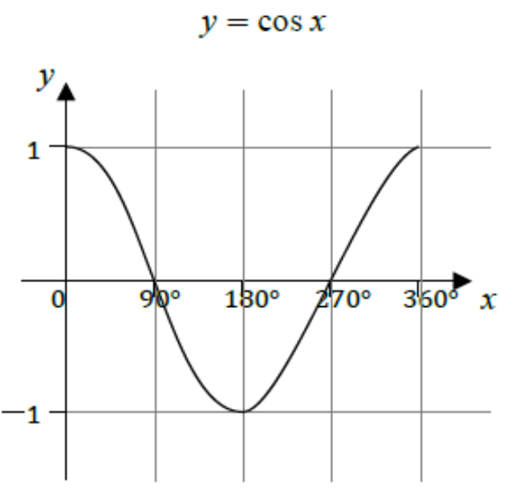

Strand:
Further Trigonometry
Section 3
Sine, Cosine and Tangent Functions
The functions y = sin x and y = cos x can be plotted on a graphic calculator or computer, or indeed by hand, between $0°$ and $360°$.
The maximum and minimum values of the function y are 1 and −1.
Both functions, sin x and cos x, lie between ±1.
The amplitude is the height from the x -axis to the peak (or trough).
The amplitude for both sine and cosine functions is 1.

Slide 13



Strand:
Further Trigonometry
Section 3
Sine, Cosine and Tangent Functions
For the range $360°$ ≤ 𝑥 ≤ $720°$, the pattern will repeat itself, and similarly for negative values.
A period is the length of one cycle before the pattern repeats. The period for both sine and cosine functions is $360°$.
The graphs are illustrated below.
You can see that the the function y = sin x is an odd function as 𝑦(−𝑥) = −𝑦(𝑥) whilst y = cos x is an even function as 𝑦(−𝑥) = 𝑦(𝑥).
Note that:
cos $Θ$ = sin $(90 − Θ°)$
sin $Θ$ = cos ($90 − Θ°$)

Slide 14

Strand:
Further Trigonometry
Section 3
Tangent Function
The last function to consider here is tan x, which has rather different properties from sin x and cos x.
We can use a graphic calculator or computer to sketch the function
𝑦 = tan 𝑥 for x in any range.
The period of the function is the distance between any two consecutive asymptotes (dotted lines);
the period for 𝑦 = tan 𝑥 $is 180°.$
Unlike the sine and cosine functions, tan x is not bounded by ±1.
In fact, as x increases to $90°$,
tan x increases without limit.

Slide 15

















Strand:
Further Trigonometry
Section 3
Sine, Cosine and Tangent Functions
Example 1
Show that sin $30°$ = $\frac{1}{2}.$
Solution
From the sketch opposite of an equilateral triangle,
sin $Θ$ = $\frac{Opp}{Hyp}$
$$⇒$$
sin $30°$= $\frac{1}{2}$
Example 2
From the graphs, find the following:
a) sin $150°$ =
sin($180°−30°)$= sin $30°$ = $\frac{1}{2}$
b) sin $210°$ =
$− \frac{1}{2}$
c) sin $390°$ =
sin $30°$ = $\frac{1}{2}$
d) sin$(−30°$) =
$−$sin $30°$ = $− \frac{1}{2}$
e) cos $60° :$
since cos $Θ$ = sin ($90 − Θ°$)
cos $60°$ =
sin($90°−60°)$= sin $30°$ = $\frac{1}{2}$

Slide 16














Strand:
Further Trigonometry
Section 3
Tangent Functions
Example
Using the values:
tan $45°$= 1 and tan $30°$ = $\frac{1}{\sqrt{3}}$
find the following without a calculator:
a) tan $135°$ =
tan ($135°−180°)$
= tan ($− 45°$) = $−$1
b) tan ($−45°$) =
$−$ tan $45°$ = $−$1
c) tan $315°$ =
$−$tan ($315°− 360°)$= $−$1
d) tan($−$30$°$) =
$−$ tan $30°$ = $−$ $\frac{1}{\sqrt{3}}$
e) tan $150°$=
$−$tan ($150°−180°$) = $−$ $\frac{1}{\sqrt{3}}$
Note that:
tan $Θ$ = $\frac{1}{(\tan{90 −Θ)}}$
f) tan $60°$ =
$\frac{\sin{60°}}{\cos{60°}}$ = $\frac{\cos{30°}}{\sin{30°}}$ = $\frac{1}{\tan{30°}}$ = $\sqrt{3}$

Slide 17








Strand:
Further Trigonometry
Section 3
Section 3: Fitness Check
Here are some questions to check your progress
1. Find the length marked x to 2 d.p.
Answer
x = $\frac{2}{\sin{50}}$ = 2.61
2. Given that sin 45$°$ = $\frac{1}{√2}$ , find, without using a calculator,
Answers
a) sin135$°$ =
sin(180$°−$ 135$°$) = sin 45$°$= $\frac{1}{√2}$
b) sin($−$45$°$) =
$−$sin 45$°$ = $− \frac{1}{√2}$
c) cos 225°=
sin(90$° −$225$°$) = sin($−$135$°$) = $− \frac{1}{√2}$
d) tan 135°=
tan (135$°$ $−$180$°$) = tan ($−$45$°$) = $−$1

Slide 18
Strand:
Further Trigonometry
Section 3
Section 3: Review
You have completed the third section.
If you have completed and mastered this section,
click to start the next Section
If you need more examples and interactive practice,
press here
You might also find it helpful to look at:
Essential Information: press here

Slide 19



Strand:
Further Trigonometry
Section 4
Solving Trigonometrical Equations
Trigonometric functions can be used to model physical phenomena but applying these functions to problems in the real world will often result in a trigonometric equation to solve.
In this section, you will consider some simple equations to solve. These will highlight the difficulties that can occur.
Example
Solve 3 cos 𝑥 = −0.6 for 0$°$≤ 𝑥 ≤ 360$°$, giving the answer to 1 d.p.
Solution
Rearranging
cos 𝑥 = $\frac{−0.6}{3}$ = − 0.2.
The graphs of the functions are shown
and using the ‘inverse cos’ button on
your calculator gives:
𝑎 = 101.5$°$
and by symmetry,
b = (180$°$ $−a)$ + 180$°$ = 360$°−a$= 258.5$°$

Slide 20

Strand:
Further Trigonometry
Section 4
Solving Trigonometrical Equations
Example
Solve the equation tan x = −2 where x is
measured in radians and −2𝜋 ≤ 𝑥 ≤ 2𝜋.
Give your answers to 2 decimal places.
(Set your calculator to radian mode.)
Solution
The graphs of y = tan x and y = −2 are
shown opposite. You can see that there
are four solutions denoted by a, b, c and d that lie between −2𝜋 and 2𝜋.
To find b, the solution between −𝜋 ≤ 𝑥 ≤ 𝜋 input −2 in your calculator and use the 'inverse tan' (or 'arctan’) button. This gives b = −1.107 .
Now 𝑎 = 𝑏 − 𝜋 = −4.249
𝑐 = 𝑏 + 𝜋 = 2.035
𝑑 = 𝑏 + 2𝜋 = 5.177

Slide 21



Strand:
Further Trigonometry
Section 4
Section 4: Fitness Check
Here are some questions to check your progress
1. Solve cos x = 0.5, 0° ≤ x ≤ 360°
𝜋 radians =180°
Answers
x = 60° x = 300°
2. Solve cos x = $\frac{1}{3}$ for $−$2𝜋 ≤ 𝑥 ≤ 2𝜋
Answers
x = $−$4.372, $−$1.231, 1.231, 4.372

Slide 22
Strand:
Further Trigonometry
Section 4
Section 4: Review
You have completed the fourth section.
If you have completed and mastered this section,
click to start the next Section
If you need more examples and interactive practice,
press here
You might also find it helpful to look at:
Essential Information: press here

Slide 23




Strand:
Further Trigonometry
Section 5
Properties of Trigonometrical Functions
Example
Find all solutions between 0$°$ and 360$°$ of the equation
sin x = 2 cos x to 2 decimal places.
Solution
Assuming cos 𝑥 ≠ 0, you can divide both sides of the equation by cos 𝑥 to give
tan 𝑥 = 2.
The graphs of y = tan 𝑥 and y = 2 show that there are 2 solutions in the range 0$°$ to 360$°$. Thus
$\tan^{−1}$(2) = 63.43$°$
giving A= 63.43$°$ and
B = 180$°$+ 63.43$°$= 243.43$°.$

Slide 24




Strand:
Further Trigonometry
Section 5
Properties of Trigonometrical Functions
Example
Find all solutions between 0$°$ and 360$°$ of the equation
cos 𝑥 sin 𝑥 = 3 cos 𝑥
Solution
The equation can be rewritten as:
cos 𝑥 sin 𝑥 − 3 cos 𝑥 = 0
or cos 𝑥 (sin 𝑥 − 3) = 0.
So either cos 𝑥 = 0 or sin 𝑥 − 3 = 0 ⟹ sin 𝑥 = 3.
However the graphs opposite, of y =sin x and y = 3, show there are no solutions.
The graph of 𝑦 = cos 𝑥 is shown opposite
for 0$°$ ≤ 𝑥 ≤ 360°.
The solutions are given by cos 𝑥 = 0,
which gives 𝑥 = 90° or x = 270°

Slide 25





Strand:
Further Trigonometry
Section 5
Properties of Trigonometrical Functions
Example
Find all solutions between 0$°$ and 360$°$ to the equation
3 cos x = 2 $\sin^{2}$ x
Solution
Using the identity
$\sin^{2}$x +$\cos^{2}$x = 1
$\sin^{2}$x = 1 − $\cos^{2}$x
makes it possible to express the equation in ‘cos’ terms only:
3 cos x = 2 (1 − $\cos^{2}$x ) = 2 − 2 $\cos^{2}$x
Rearrange to make a quadratic equation
2 $\cos^{2}$x + 3 cos x – 2 = 0
Continued on next slide

Slide 26




Strand:
Further Trigonometry
Section 5
Properties of Trigonometrical Functions
Solution Continued
2 $\cos^{2}$x + 3 cos x – 2 = 0
This can be factorised to give
(2 cos x – 1)(cos x + 2) = 0
Hence cos x = – 2 or cos x = $\frac{1}{2}$
But cos x = – 2 has no solutions.
From the graph opposite we can see that cos x = $\frac{1}{2}$ has the solutions
x = 60° and x = 300°

Slide 27


Strand:
Further Trigonometry
Section 5
Section 5: Fitness Check
Here is a question to check your progress.
Find all solutions between 0$°$ and 360$°$ to 1 decimal place, of the equation:
5 − 2 cos 𝑥 = 8 $\sin^{2}$𝑥
Answers
cos x = $\frac{3}{4}$ or cos x = $−\frac{1}{2}$ giving
x = 41.4$° , 120°$, $240° ,\text{ 316}\text{.}18°$

Slide 28
Strand:
Further Trigonometry
Section 5
Section 5: Review
You have completed the fifth section.
If you have completed and mastered this section,
click here for the Unit audit
If you need more examples and interactive practice,
press here
You might also find it helpful to look at:
Essential Information: press here

