Slide 1
TSST Strand A
UNIT A1: Decimals and Fractions

Slide 2
Decimals and Fractions
STRAND A
UNIT A1
Decimals and Fractions are two ways of representing the same amount.
You have seven sections to work through and there are fitness tests for and an interactive questions for each section.
Decimals
Multiplying and Dividing with Decimals
Fractions and Decimals
Negative Numbers
Operations with Negative Numbers
Estimating Answers
Using Brackets and Memory on a Calculator

Slide 3
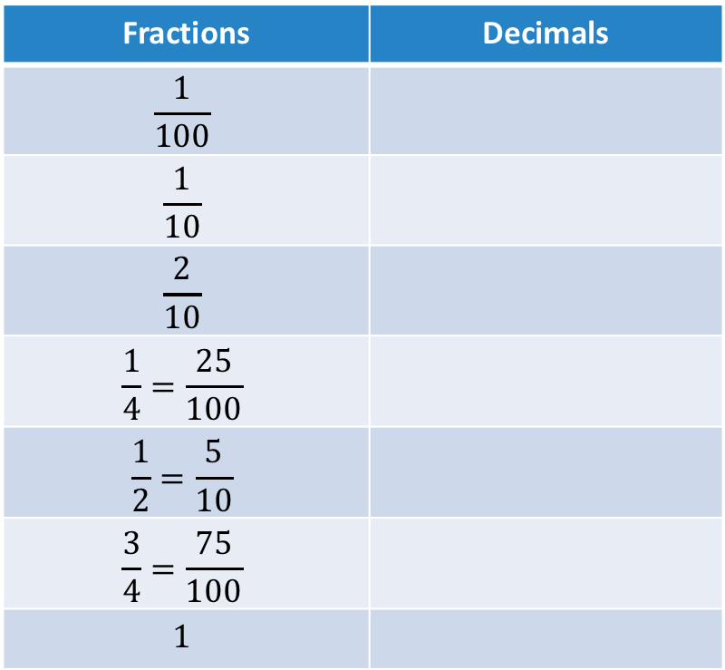
STRAND A
UNIT A1
Section A1.1
Equivalence of Decimals and Fractions
The table below shows some common fractions and their equivalent decimals.
Fractions | Decimals
$$\frac{1}{100}$$
$$\frac{1}{10}$$
$$\frac{2}{10}$$
$$\frac{1}{4}=\frac{25}{100}$$
$$\frac{1}{2}=\frac{5}{10}$$
$$\frac{3}{4}=\frac{75}{100}$$
$$1$$
0.01
0.1
0.2
0.25
0.5
0.75
1

Slide 4
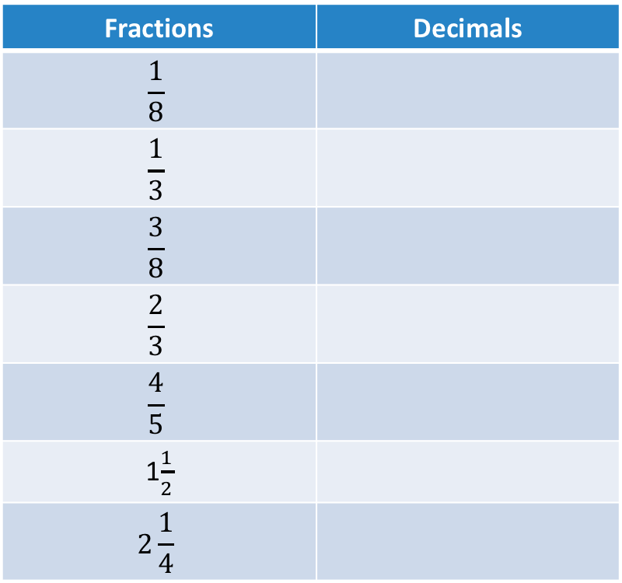
STRAND A
UNIT A1
Section A1.1
Equivalence of Decimals and Fractions
Here are more common fractions and decimals:
Fractions | Decimals
$$\frac{1}{8}$$
$$\frac{1}{3}$$
$$\frac{3}{8}$$
$$\frac{2}{3}$$
$$\frac{4}{5}$$
1$\frac{1}{2}$
$$\text{2}\frac{1}{4}$$
0.125
0.33333…
0.375
0.66666…
0.8
1.5
2.25

Slide 5

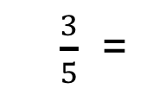

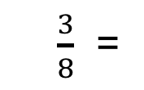
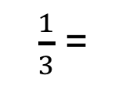
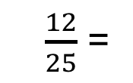
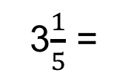

Section A1.1: Fitness Check
STRAND A
UNIT A1
Section A1.1
(a)
(b)
(c)
(d)
(e)
(f)
(g)
(h)
1. Convert between fractions and decimals.
$\frac{3}{8}$ =
0.375
$\frac{3}{5}$ =
0.4
$$\frac{3}{4}$$
0.75 =
1.25 =
1$\frac{1}{4}$
$\frac{12}{25}$ =
0.48
3$\frac{1}{5}$ =
3.2
0.7 =
$$\frac{7}{10}$$
$\frac{1}{3}$ =
0.33333…

Slide 6
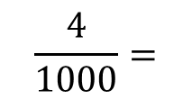

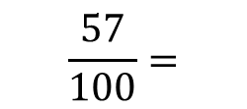
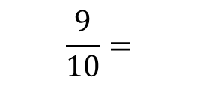
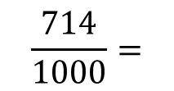



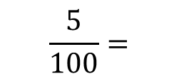

STRAND A
UNIT A1
Section A1.1
Section A1.1: Fitness Check
2. Convert to decimals
(a)
(b)
(c)
(d)
(e)
$$\frac{57}{100}=$$
$$0.57$$
$$\frac{5}{100}=$$
$$0.05$$
$$\frac{714}{1000}=$$
$$0.714$$
$$\frac{4}{1000}=$$
$$0.004$$
$$\frac{9}{10}=$$
$$0.9$$

Slide 7
STRAND A
UNIT A1
Section A1.1
Section A1.1: Review
You have completed the first Section.
If you have completed and understood this section,
click to start the next Section.
If you need more examples and interactive practice, go to
http://szalonta.hu/ske/text/A1/skea1s1.html

Slide 8
STRAND A
UNIT A1
Section A1.2
Multiplying and Dividing Decimals
Multiplying
To multiply by 10, 100, 1000, 10 000, etc.,
slide all the digits to the LEFT by 1 place, 2 places,
3 places, 4 places, etc. respectively
Empty columns are filled with zeros;
these act as placeholders.
Dividing
To divide by 10, 100, 1000, 10 000, etc.,
slide all the digits to the RIGHT by 1 place, 2 places,
3 places, 4 places, etc. respectively
Empty columns are filled with zeros;
these act as placeholders.
The following slides show some examples.

Slide 9
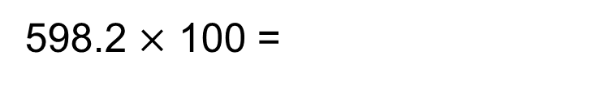
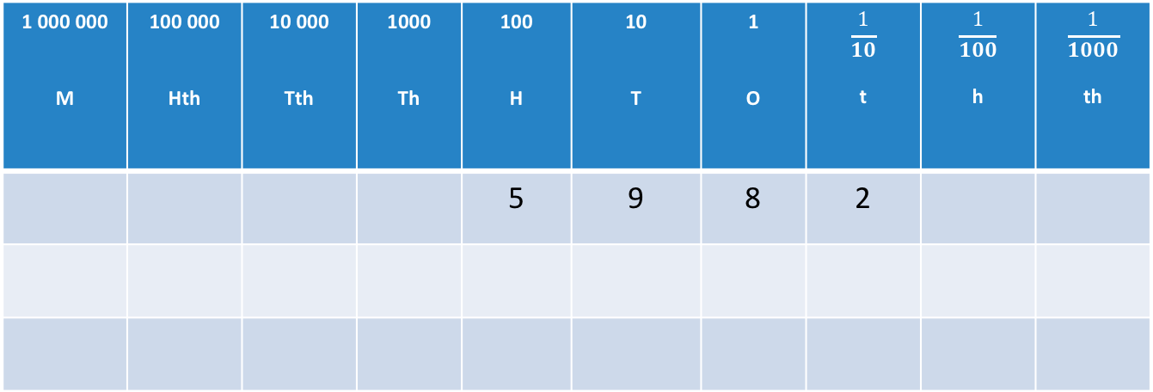
STRAND A
UNIT A1
Section A1.2
Multiplying with Decimals: Examples
1 000 000 M | 100 000 Hth | 10 000 Tth | 1000 Th | 100 H | 10 T | 1 O | $$\frac{1}{10}$$ t | $$\frac{1}{100}$$ h | $$\frac{1}{1000}$$ th
 |  |  |  | 5 | 9 | 8 | 2
598.2 $×$ 100 =

Slide 10
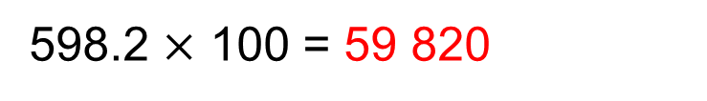
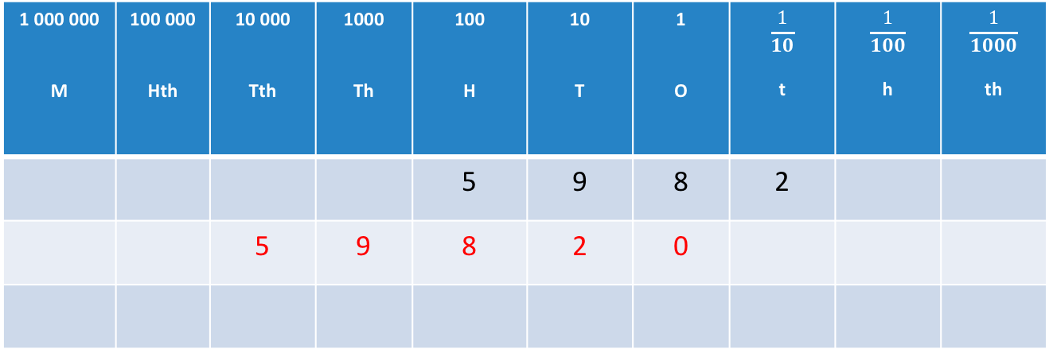
STRAND A
UNIT A1
Section A1.2
Multiplying with Decimals: Examples
1 000 000 M | 100 000 Hth | 10 000 Tth | 1000 Th | 100 H | 10 T | 1 O | $$\frac{1}{10}$$ t | $$\frac{1}{100}$$ h | $$\frac{1}{1000}$$ th
 |  |  |  | 5 | 9 | 8 | 2
 |  | 5 | 9 | 8 | 2 | 0
598.2 $×$ 100 = 59 820
To multiply by 100, slide all digits 2 places to the LEFT.
Fill empty columns with zeros; these act as placeholders.

Slide 11
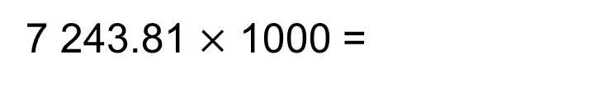
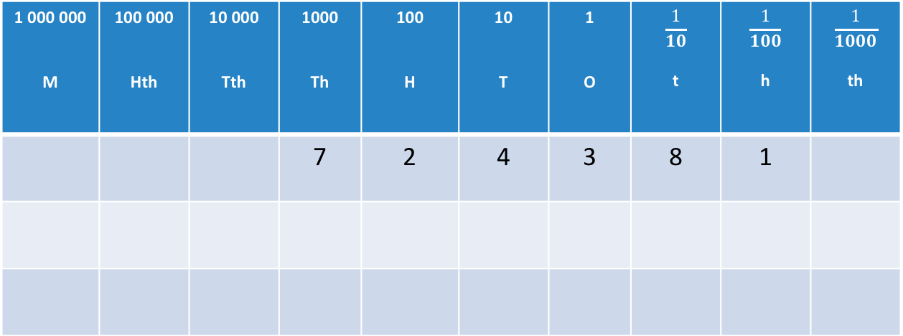
STRAND A
UNIT A1
Section A1.2
Multiplying with Decimals: Examples
1 000 000 M | 100 000 Hth | 10 000 Tth | 1000 Th | 100 H | 10 T | 1 O | $$\frac{1}{10}$$ t | $$\frac{1}{100}$$ h | $$\frac{1}{1000}$$ th
 |  |  | 7 | 2 | 4 | 3 | 8 | 1
7 243.81 $×$ 1000 =

Slide 12
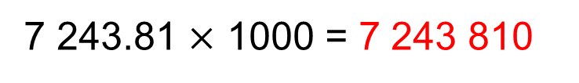
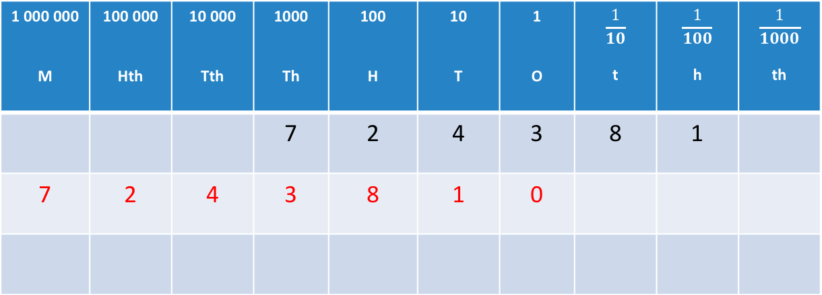
STRAND A
UNIT A1
Section A1.2
Multiplying with Decimals: Examples
1 000 000 M | 100 000 Hth | 10 000 Tth | 1000 Th | 100 H | 10 T | 1 O | $$\frac{1}{10}$$ t | $$\frac{1}{100}$$ h | $$\frac{1}{1000}$$ th
 |  |  | 7 | 2 | 4 | 3 | 8 | 1
7 | 2 | 4 | 3 | 8 | 1 | 0
7 243.81 $×$ 1000 = 7 243 810
To multiply by 1000, slide all digits 3 places to the LEFT.
Fill empty columns with zeros; these act as placeholders.

Slide 13
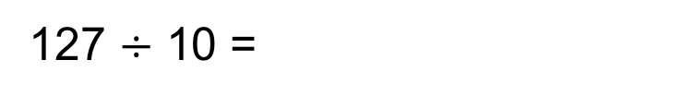
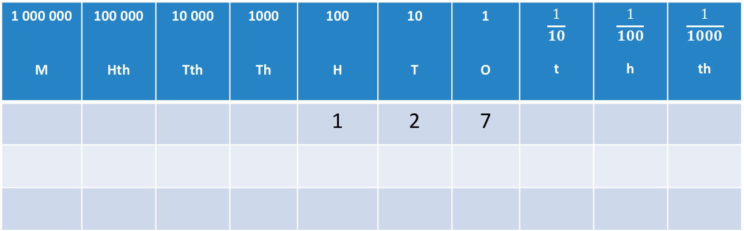
STRAND A
UNIT A1
Section A1.2
Dividing with Decimals: Examples
1 000 000 M | 100 000 Hth | 10 000 Tth | 1000 Th | 100 H | 10 T | 1 O | $$\frac{1}{10}$$ t | $$\frac{1}{100}$$ h | $$\frac{1}{1000}$$ th
 |  |  |  | 1 | 2 | 7
127 $÷$ 10 =

Slide 14
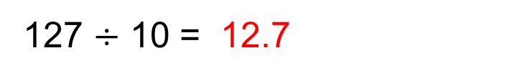
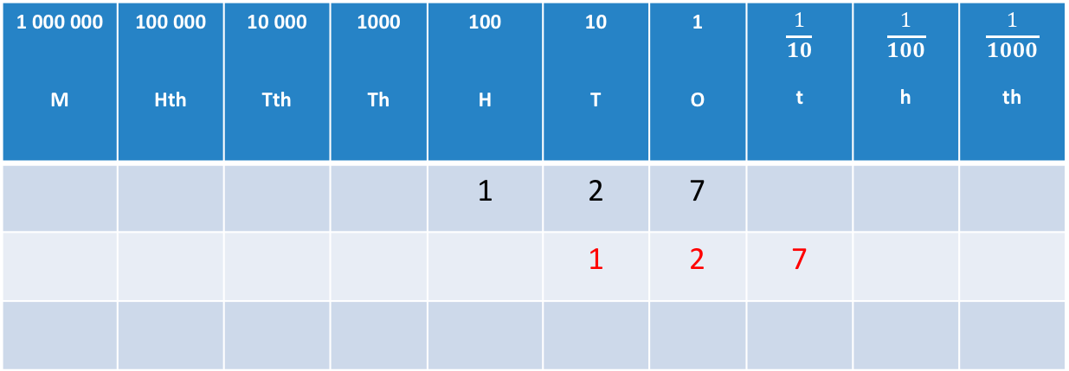
STRAND A
UNIT A1
Section A1.2
Dividing with Decimals: Examples
1 000 000 M | 100 000 Hth | 10 000 Tth | 1000 Th | 100 H | 10 T | 1 O | $$\frac{1}{10}$$ t | $$\frac{1}{100}$$ h | $$\frac{1}{1000}$$ th
 |  |  |  | 1 | 2 | 7
 |  |  |  |  | 1 | 2 | 7
127 $÷$ 10 = 12.7
To divide by 10, slide all digits 1 place to the RIGHT.
Fill empty columns with zeros; these act as placeholders.

Slide 15
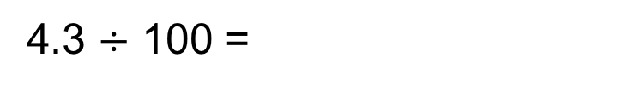
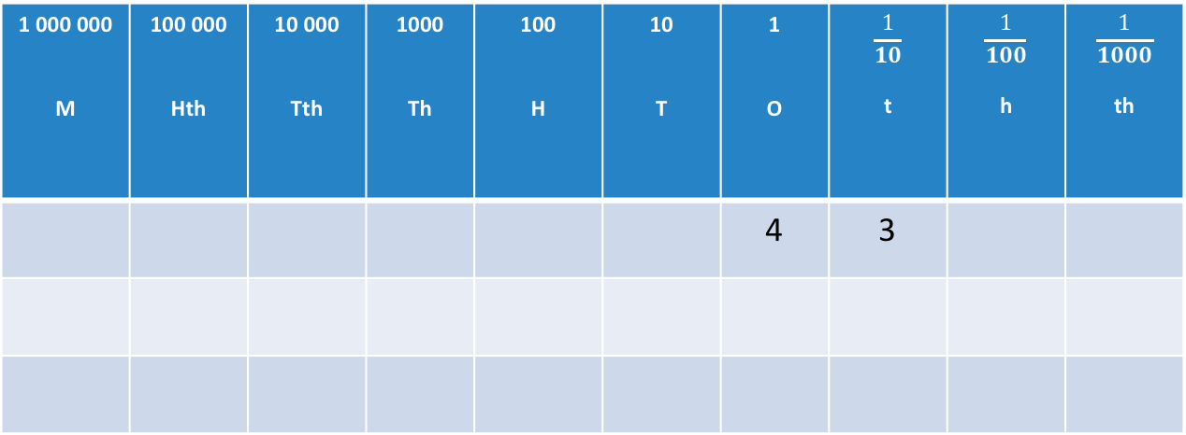
Dividing with Decimals: Examples
STRAND A
UNIT A1
Section A1.2
1 000 000 M | 100 000 Hth | 10 000 Tth | 1000 Th | 100 H | 10 T | 1 O | $$\frac{1}{10}$$ t | $$\frac{1}{100}$$ h | $$\frac{1}{1000}$$ th
 |  |  |  |  |  | 4 | 3
4.3 $÷$ 100 =

Slide 16
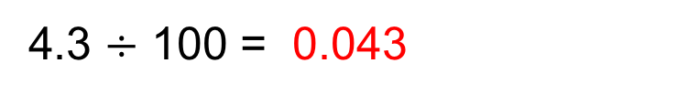
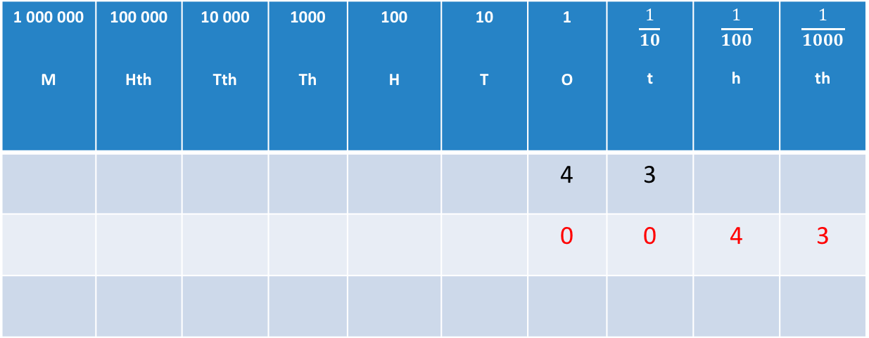
STRAND A
UNIT A1
Section A1.2
Dividing with Decimals: Examples
1 000 000 M | 100 000 Hth | 10 000 Tth | 1000 Th | 100 H | 10 T | 1 O | $$\frac{1}{10}$$ t | $$\frac{1}{100}$$ h | $$\frac{1}{1000}$$ th
 |  |  |  |  |  | 4 | 3
 |  |  |  |  |  | 0 | 0 | 4 | 3
4.3 $÷$ 100 = 0.043
To divide by 100, slide all digits 2 places to the RIGHT.
Fill empty columns with zeros; these act as placeholders.

Slide 17
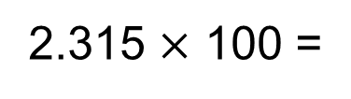
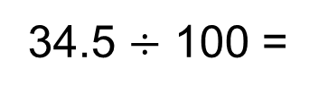
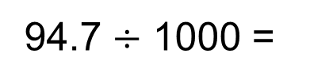
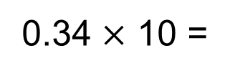
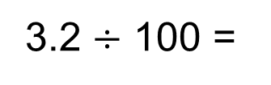
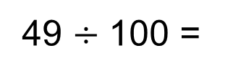
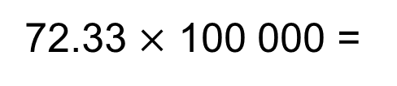
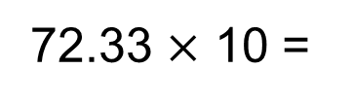
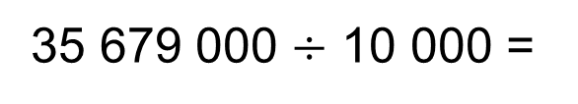
STRAND A
UNIT A1
Section A1.2
Section A1.2: Fitness Check
1.
2.
3.
4.
5.
6.
7.
8.
9.
0.34 $×$ 10 =
3.4
49 $÷$ 100 =
0.49
34.5 $÷$ 100 =
0.345
72.33 $×$ 10 =
723.3
2.315 $×$ 100 =
231.5
94.7 $÷$ 1000 =
0.0947
3.2 $÷$ 100 =
0.032
35 679 000 $÷$ 10 000 =
3567.9
72.33 $×$ 100 000 =
7 233 000

Slide 18
STRAND A
UNIT A1
Section A1.2
Section A1.2: Review
You have completed the second Section.
If you have completed and understood this section,
click to start the next Section.
If you need more examples and interactive practice, go to
http://szalonta.hu/ske/text/A1/skea1s2.html

Slide 19
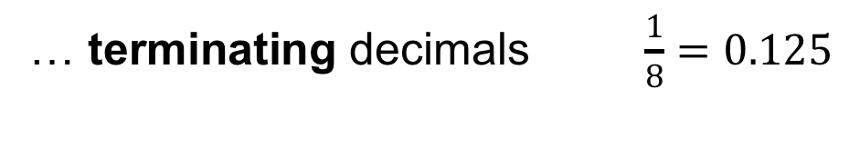
STRAND A
UNIT A1
Section A1.3
Fractions and Decimals
All fractions can be converted to decimals.
Simply divide the numerator by the denominator.
Some fractions can be written as decimals with a
fixed number of decimal places.
These are called…
… terminating decimals $\frac{1}{8}=0.125$
Some fractions can be written as decimals with
an infinite repeating pattern of decimal places.
These are called…
… recurring decimals $\frac{5}{7}=0.714285714285714285…$

Slide 20
Significant Figures and Decimal Places
STRAND A
UNIT A1
Section A1.3
Numbers with an infinite number of decimal places are rounded to a specified number of
significant figures (s.f.) or decimal places (d.p.).
Remember the rounding rules: if the following digit after the ‘cut-off’ is 5 or more, you round ‘up’.
Significant figures are counted from left to right, starting from the first non-zero digit.
Decimal places are counted starting from after the decimal point.
Round 37 185.5912… to
37 200
3 significant figures
2 decimal places
37 185.59

Slide 21
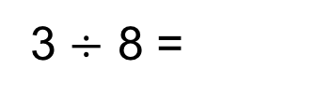

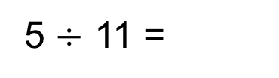

STRAND A
UNIT A1
Section A1.3
Converting Fractions to Decimals
Simply divide the numerator by the denominator.
Often this is possible to do by pen and paper.
But sometimes a calculator may be helpful!
Convert $\frac{3}{8}$ to a decimal
0.375
3 $÷$ 8 =
Convert $\frac{5}{11}$ to a decimal
5 $÷$ 11 =
0.45454545… = 0.455 (to 3 d.p.)

Slide 22

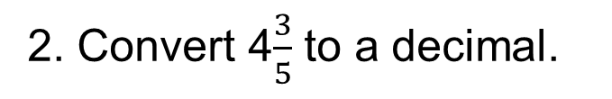

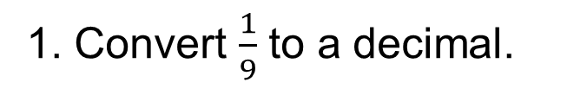
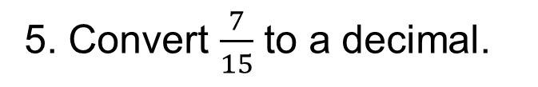
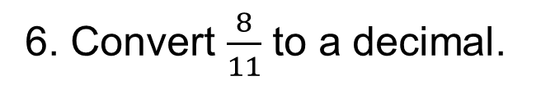
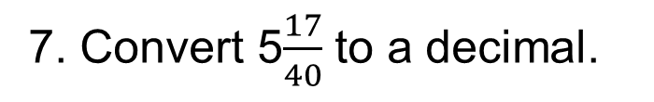
STRAND A
UNIT A1
Section A1.3
Conversion: Practice
1. Convert $\frac{1}{9}$ to a decimal.
0.111111…
2. Convert 4$\frac{3}{5}$ to a decimal.
4.6
$$\frac{9}{20}$$
3. Convert 0.45 to a fraction.
4. Convert 0.125 to a fraction.
$$\frac{1}{8}$$
5. Convert $\frac{7}{15}$ to a decimal.
0.466666…
6. Convert $\frac{8}{11}$ to a decimal.
0.727272…
7. Convert 5$\frac{17}{40}$ to a decimal.
5.425

Slide 23
STRAND A
UNIT A1
Section A1.3
Section A1.3: Fitness Check
1. Round 3.2918 to 1 d.p.
3.3
2. Round 345 756 to 2 s.f.
350 000
3. Round 256.761918 to 3 d.p.
256.762
4. Round 9 745 256 to 1 s.f.
10 000 000
5. Round 413 196 to 3 s.f.
413 000
6. Round 9.9918 to 1 d.p.
10.0
7. Round 6.5790918 to 4 d.p.
6.5791
8. Round 0.000056825 to 2 s.f.
0.000057
9. Round 0.0092356 to 2 d.p.
0.01

Slide 24
STRAND A
UNIT A1
Section A1.3
Section A1.3: Review
You have completed the third Section.
If you have completed and understood this section,
click to start the next Section.
If you need more examples and interactive practice, go to
http://szalonta.hu/ske/text/A1/skea1s3.html

Slide 25
STRAND A
UNIT A1
Section A1.4
Negative Numbers
We start with a quick review of key facts:
Positive numbers are numbers greater than zero.
Negative numbers are numbers less than zero.
Zero is neither positive nor negative.
A number line illustrates positive and negative numbers.
Note: You can extend this number line as far as you
like/need in either direction.
-5 -4 -3 -2 -1 0 1 2 3 4 5

Slide 26
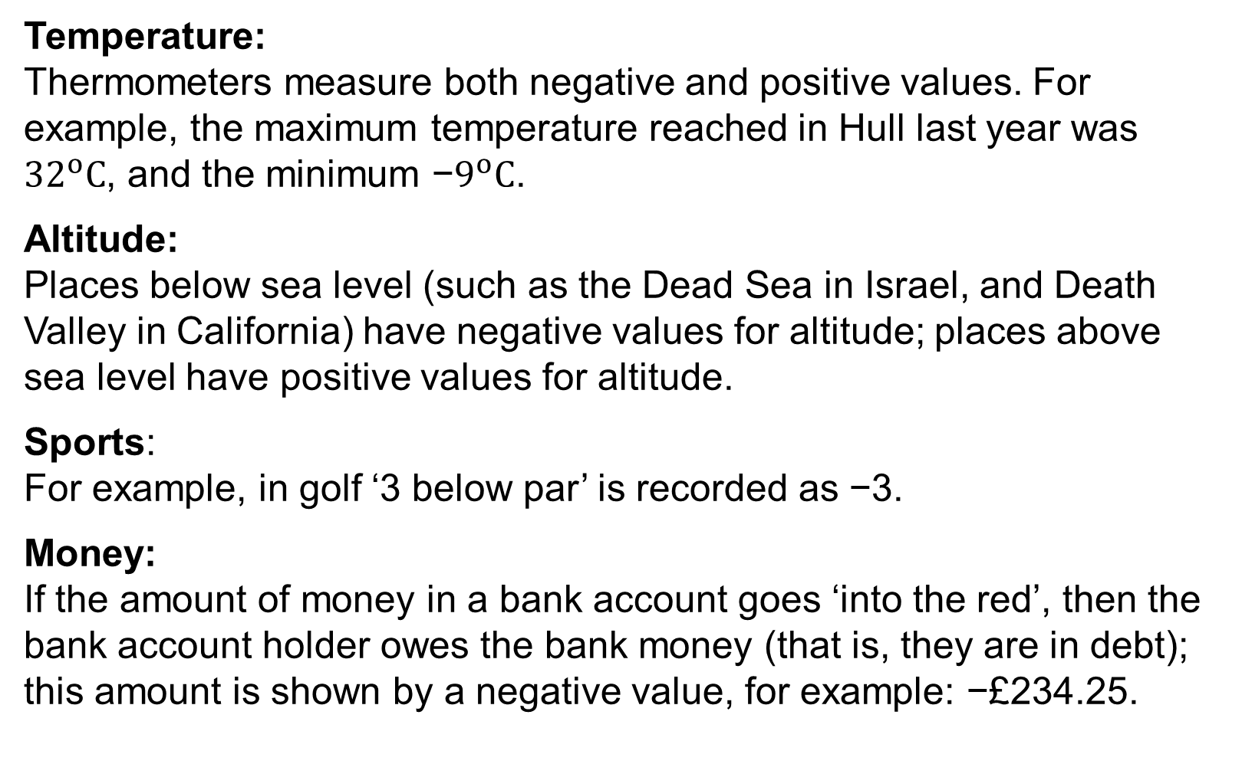
Negative Numbers in Context
STRAND A
UNIT A1
Section A1.4
Temperature:
Thermometers measure both negative and positive values. For example, the maximum temperature reached in Hull last year was ${32}^{o}C$, and the minimum −$9^{o}C$.
Altitude:
Places below sea level (such as the Dead Sea in Israel, and Death Valley in California) have negative values for altitude; places above sea level have positive values for altitude.
Sports:
For example, in golf ‘3 below par’ is recorded as −3.
Money:
If the amount of money in a bank account goes ‘into the red’, then the bank account holder owes the bank money (that is, they are in debt); this amount is shown by a negative value, for example: −£234.25.

Slide 27
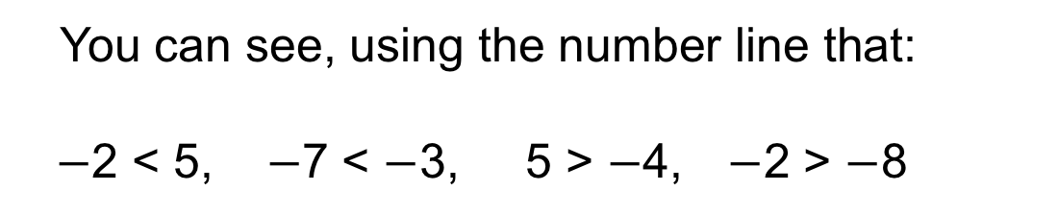
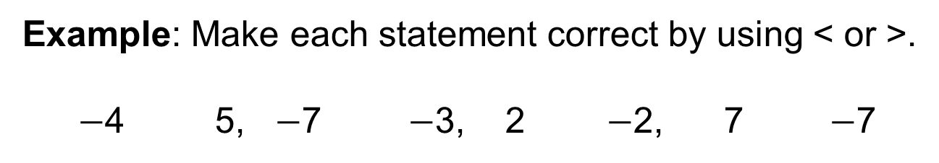
Inequalities Signs
STRAND A
UNIT A1
Section A1.4
We also use inequality signs with negative numbers.
The sign < means “is less than” as, for example 4 < 7.
The sign > means “is greater than” as in 8 > 4.
You can see, using the number line that:
$−$2 < 5, $−$7 < $−$3, 5 > $−$4, $−$2 > $−$8
Example: Make each statement correct by using < or >.
$−$4 5, $−$7 $−$3, 2 $−$2, 7 $−$7
<
<
>
>

Slide 28
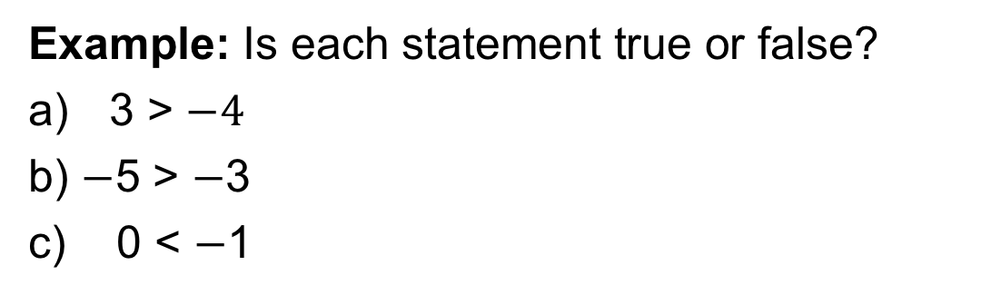
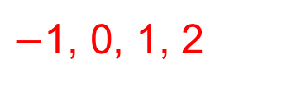



STRAND A
UNIT A1
Section A1.4
Negative Numbers: Examples
Example: Write this set of numbers in order with the smallest first:
6, $−$7, 8, $−$2, $−$5, $−$10, 3
Solution: We can use the number line above to put them in order, with $−$10 being the smallest and so on to give:
$−$10, $−$7, $−$5, $−$2, 3, 6, 8
Example: Is each statement true or false?
3 > $−4$
b) $−$5 > $−$3
c) 0 < $−$1
This is true; 3 is the right of $−$4 on the number line
False as $−$5 is to the left of $−$3 on the number line
False as 0 is to the right of $−$1 so greater than $−$1
Example: Write down any integers that could go in the box below:
$−2$ < < 3
Solution: Using the number line shows possible answers above.
$−$1, 0, 1, 2

Slide 29




Section 1.4: Fitness Check
STRAND A
UNIT A1
Section A1.4
1. Put inequality signs, < or >, between each pair of numbers to give a true statement:
(a) $−3$ 4 (b) $−$6 $−$7 (c) 2 $−$4
<
>
>
2. Write the set of numbers in order with the smallest first: 3, $−2$, 8, 0, $−$1, 1, $−3$
Answer: $−3$, $−2$, $−1$, 0, 1, 3, 8
3. Write down all integers that could go in box below to make the statement true:
$−$2 < < 4
$−$1, 0, 1, 2, 3

Slide 30
STRAND A
UNIT A1
Section A1.4
Section 1.4: Review
You have completed the fourth Section.
If you have completed and understood this section
click to start the next Section.
If you need more examples and interactive practice, go to
http://szalonta.hu/ske/text/A1/skea1s4.html

Slide 31
Negative Numbers: Adding
STRAND A
UNIT A1
Section A1.5
Example: Calculate (a) $−3+8 (b) 4+(−2)$
Solution: (a) We start at $−3$ and move 8 to the right so $−3+8$ = 5
(b) We start at $4$ and move 2 to the left giving $4+\left(−2\right)=2$

Slide 32
STRAND A
UNIT A1
Section A1.5
Negative Numbers: Subtracting
Example: Calculate (a) $5−7 (b) 4−(−2)$
Solution: (a) We start at $5$ and move 7 to the left so $5−7$ = $−2$
(b) We start at $4$ and move 2 to the right so $4−\left(−2\right)=6$

Slide 33

STRAND A
UNIT A1
Section A1.5
Negative Numbers: Multiplication
A positive number $×$ a negative number gives a negative;
a negative number $×$ a negative number gives a positive.
Hence, for example: 5 $× \left(−7\right)=−35$and $\left(−8\right)$ $× \left(−7\right)=56$

Slide 34




STRAND A
UNIT A1
Section A1.5
Negative Numbers: Multiplication
Example: Complete this multiplication grid, working down the columns.
$$−4$$
$$−2$$
0
1
0
0
0
0
$$4$$
$$2$$
0
$−$1
$$8$$
$$4$$
0
$−2$
$$12$$
$$6$$
0
$−3$

Slide 35




STRAND A
UNIT A1
Section A1.5
Negative Numbers: Division
Division with negative numbers works in a similar way, as shown in these examples:
Example
Calculate:
(a) $18÷(−3)=$
(b) $(−21)$ $÷$ $(−3)$ =
(c) $(−45)$ $÷$ $9$ =
(d) $28÷(−7)=$
$$−6$$
7
$$−5$$
$$−4$$

Slide 36






STRAND A
UNIT A1
Section A1.5
Section 1.5: Fitness Check
1. Calculate: (a)$−5+8$(b) $−6+6$ (c) 5 $−7$ (d) 5 $−$ ($−6)$
Answers:
3
0
$−2$
11
2. Write down two possible sums shown below:
Answers: $−$2 + 5 = 3 and $−$2 $−$($−$5) = 3
3. Copy and complete this addition table; the first
row has been done.
$−$7$−$5 $−$3 $−$1 1
$−5−3 −1$ 1 3
4. Overnight the temperature dropped from $5^{0}$C to $−{14}^{0}$C.
How many degrees did
it fall? ${ }^{0}$C.
$−$3 $−$1 1 3 5
$−$1 1 3 5 7
19

Slide 37









STRAND A
UNIT A1
Section A1.5
Section 1.5: Fitness Check
5. Copy and complete this multiplication grid:
$$−1$$
$$−2$$
$$−3$$
$$−4$$
$$−2$$
$$−4$$
$$−6$$
$$−8$$
$$−3$$
$$−6$$
$$−9$$
$−$12
$$−8$$
$$−6$$
$$−12$$
$−$16
6. Calculate these multiplications and divisions.
$−$18
24
$−$2
$$−4$$
(a) ($−6)×3$ (b) ($−3)×$($−8)$ (c) ($−6)÷3$ (d) 8$÷$($−2)$
$$\text{(}−2)$$
7. Calculate ($−6$ + 10) $÷\text{(}−2)$

Slide 38
Section 1.5: Review
STRAND A
UNIT A1
Section A1.5
You have completed the fifth Section.
If you have completed and understood this section
click to start the next Section.
If you need more examples and interactive practice, go to
http://szalonta.hu/ske/text/A1/skea1s4.html

Slide 39


STRAND A
UNIT A1
Section A1.6
Estimating Answers
Often it is useful to have an approximate solution to a calculation.
We can estimate answers by first rounding the numbers within the calculation.
We may choose to round the numbers to a certain number of significant figures or decimal places (see earlier slides).
For example: 29.71 $×$ 7.26
First we round the numbers to 1 significant figure:
29.71 $×$ 7.26 ≈ 30 $×$ 7
= 210

Slide 40



STRAND A
UNIT A1
Section A1.6
Estimating Answers: Examples
For example: $\frac{2.9275 + 9.36}{4.79 − 1.3592}$
First we round the numbers to 1 significant figure:
$\frac{2.9275 + 9.36}{4.79 − 1.3592}$ ≈ $\frac{3+ 9. }{5 − 1}$
= $\frac{12}{4}$
= 3
Try estimating this one, by rounding to 2 significant figures:
$$\frac{23.6371}{8.193 −2.15}$$

Slide 41






STRAND A
UNIT A1
Section A1.6
Estimating Answers: Examples
Estimating answer:
$$\frac{23.6371}{8.193 −2.15}$$
$$\frac{24}{8.2 −2.2}$$
$$\frac{24}{6}$$
≈
=
=
4
One more. This time you decide how to round.
$$\frac{48.681+1.3112}{10.81 −0.75}$$
≈
$$\frac{48.7+1.3}{10.8 −0.8}$$
(Rounding to 1 d.p.)
$$\frac{50}{10 }$$
=
=
5

Slide 42












STRAND A
UNIT A1
Section A1.6
Section A1.6: Fitness Check
Estimate the answers to the following by rounding the numbers appropriately:
1. $\frac{6.275 + 24.145}{7.95 − 6.65}≈$
$\frac{6+24 }{8 −7}≈$
$\frac{30 }{1}=$
30
$$\frac{43 −38}{90 −85}≈$$
$$\frac{5}{5}=$$
2. $\frac{42.835 −37.8702}{89.825 − 85.425} ≈$
1
3. $\frac{72.3335 +184.893}{134.19 + 1.3592} ≈$
$$\frac{70 +200}{135} ≈$$
$$\frac{270}{135}=$$
2
4. $\frac{99.78− 9.36}{25.91 +4.41882} ≈$
$$\frac{100−10}{26+4} ≈$$
$$\frac{90}{30}=$$
3

Slide 43
STRAND A
UNIT A1
Section A1.6
Section A1.6: Review
You have completed the sixth Section.
If you have completed and understood this section,
click to start the next Section.
If you need more examples and interactive practice, go to
http://szalonta.hu/ske/text/A1/skea1s6.html

Slide 44


Using Brackets and Memory on a Calculator
STRAND A
UNIT A1
Section A1.7
Brackets and memory functions can help you carry out some calculations more easily.
Let’s look at $\frac{2.9275 + 9.36}{4.79 − 1.3592}$
This actually means $(2.9275+9.36$) $÷$ $(4.79 −1.3592$).
So we need to divide the solution of $(2.9275+9.36$) by
the solution of $(4.79 −1.3592$).
We can do this by either
using Brackets or
using the the Memory function.

Slide 45





STRAND A
UNIT A1
Section A1.7
Using Brackets on a Calculator
Looking at $\frac{2.9275 + 9.36}{4.79 − 1.3592}.$
First open brackets and then input the numerator calculation (remember to close brackets).
That is $\left(2.9275+9.36 \right).$
Then type$÷$ and open a second bracket and input the denominator calculation (remember to close brackets).
That is $\left( 4.79 −1.3592\right).$
Then type $=$
You will have typed:
( | 2 | . | 9 | 2 | 7 | 5 | + | 9 | . | 3 | 6 | ) | $$÷$$ | ( | 4 | . | 7 | 9 | - | 1 | . | 3 | 5 | 9 | 2 | )

Slide 46


STRAND A
UNIT A1
Section A1.7
Using Memory on a Calculator
Again we look at $\frac{2.9275 + 9.36}{4.79 − 1.3592}.$
In other words we need to have the solution to the
denominator $(4.79 −1.3592$) sorted and saved
before we start tackling the numerator (top line).
So we first calculate the denominator and input this
solution into the memory, using the appropriate keys
on your calculator. Some useful keys are:
MC Clears the memory
Min Places the current number into the memory
M+ Adds the number displayed to the memory
MR Recalls the number that is currently in the memory

Slide 47



STRAND A
UNIT A1
Section A1.7
Using Memory on a Calculator
Press MC to clear the memory
Input the denominator calculation, i.e. $4.79 −1.359\text{2}$
Then type $=$
Press Min to place the value displayed in the memory
Now input the numerator calculation, i.e. $2.9275+9.36$
Then type $=$
Now leaving this solution on the screen, type
$÷$ MR =
This will divide the displayed value by the number in the memory.

Slide 48




STRAND A
UNIT A1
Section A1.7
Section A1.7: Fitness Test
Use brackets or the memory function to calculate:
$1. \frac{6.275+24.145}{7.95 − 6.65}$=
23.4
$2. \frac{42.835 −37.8702}{89.825 −85.425}$=
1.128363636…
$3. \frac{72.3335 +184.893}{134.79 + 1.3592}$=
1.889298652
$4. \frac{99.78− 9.36}{25.91 + 6.41882}$=
2.796885256

Slide 49
STRAND A
UNIT A1
Section A1.7
Section A1.7: Review
You have completed the last Section.
If you need more examples and interactive practice, go to
http://szalonta.hu/ske/text/A1/skea1s7.html

