Slide 1
TSST STRAND A
UNIT A2: Using Fractions and Percentages

Slide 2
STRAND A
UNIT A2
Percentages
It is important to be able to understand the connection between fractions, decimals and percentages
and to be able to complete calculations with percentages.
There are nine sections in this Unit:
Fractions, Decimals and Percentages
Percentages of Quantities
Quantities as Percentages
Addition and Subtraction of Fractions
Multiplication and Division of Fractions
Complex Percentages
Percentage Increase and Percentage Decrease
Compound Interest and Depreciation
Reverse Percentage Problems

Slide 3
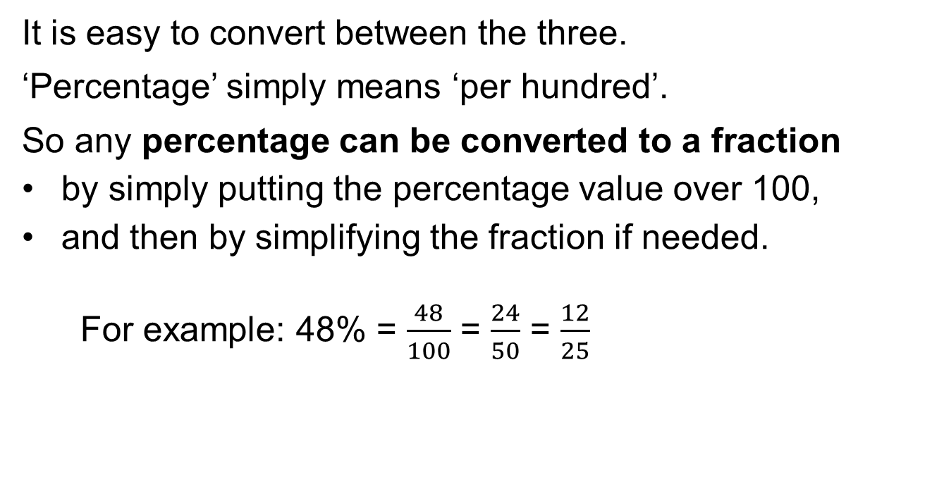
STRAND A
UNIT A2
Section A2.1
STRAND A
UNIT A2
Fractions, Decimals and Percentages
We start with a quick review of key facts:
Fractions, Decimals and Percentages are three
different ways of representing the same amount.
It is easy to convert between the three.
‘Percentage’ simply means ‘per hundred’.
So any percentage can be converted to a fraction
by simply putting the percentage value over 100,
and then by simplifying the fraction if needed.
For example: 48% = $\frac{48}{100}$ = $\frac{24}{50}$ = $\frac{12}{25}$

Slide 4
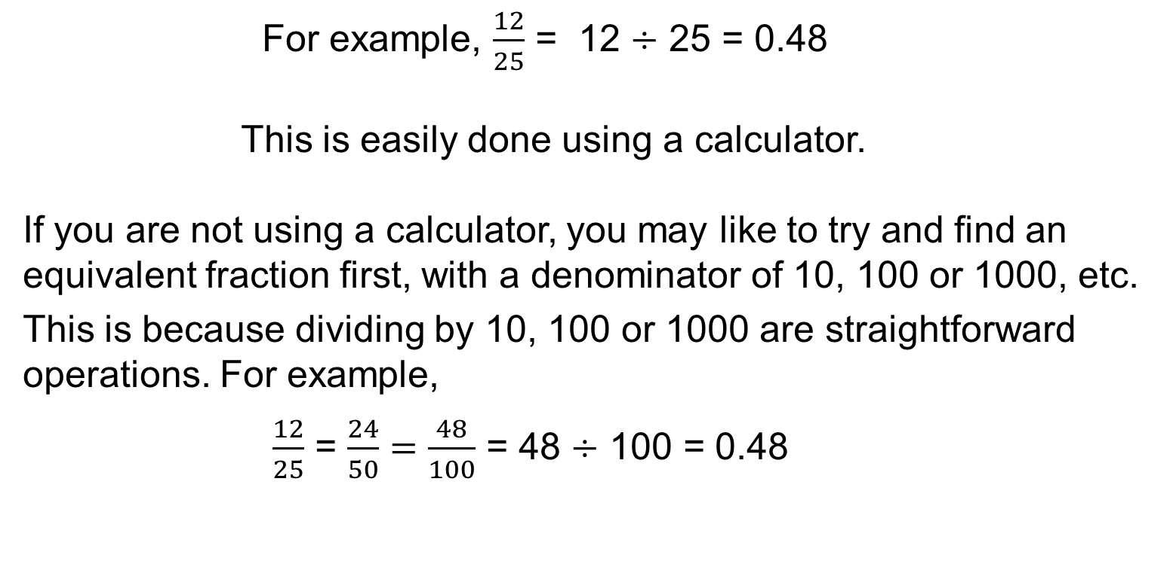
STRAND A
UNIT A2
Section A2.1
Fractions, Decimals and Percentages
Fractions can easily be converted to Decimals by
simply dividing the numerator by the denominator.
For example, $\frac{12}{25}$ = 12 $÷$ 25 = 0.48
This is easily done using a calculator.
If you are not using a calculator, you may like to try and find an equivalent fraction first, with a denominator of 10, 100 or 1000, etc.
This is because dividing by 10, 100 or 1000 are straightforward operations. For example,
$\frac{12}{25}$ = $\frac{24}{50}=\frac{48}{100}$ = 48 $÷$ 100 = 0.48

Slide 5
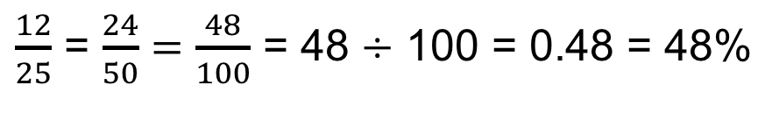
STRAND A
UNIT A2
Section A2.1
Fractions, Decimals and Percentages
Decimals can easily be converted to Percentages
by simply multiplying the decimal by 100%.
For example: 0.48 = 0.48 × 100% = 48%
This is easily done using your understanding of
place value and multiplying by 100.
Each digit moves two places to the LEFT.
To convert Fractions to Percentages, you can first
convert a fraction to a decimal and then convert
the decimal to a percentage, as above; for example:
$\frac{12}{25}$ = $\frac{24}{50}=\frac{48}{100}$ = 48 $÷$ 100 = 0.48 = 48%

Slide 6
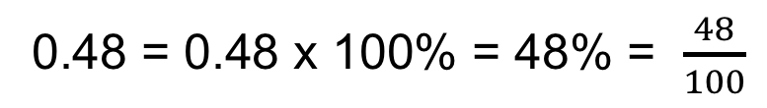

STRAND A
UNIT A2
Section A2.1
Fractions, Decimals and Percentages
Decimals can easily be converted to Percentages
by simply multiplying the decimal by 100%.
This is equivalent to converting the percentage to a fraction first.
For example: 48% = 48% $÷$ 100% = $\frac{48}{100}$ = 0.48
And Decimals can easily be converted to Fractions by first converting the decimal to a percentage and then converting that percentage into a fraction; for example:
0.48 = 0.48 x 100% = 48% = $\frac{48}{100}$
The next two slides summarise these conversions, and the slides after that show some very common conversions between
Fractions, Decimals and Percentages.

Slide 7
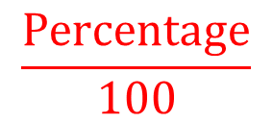
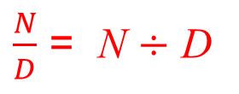
STRAND A
UNIT A2
Section A2.1
Fractions, Decimals and Percentages
Converting between
Fractions, Decimals and Percentages
Fraction
$$\frac{Percentage}{100}$$
$\frac{N}{D}$ = N $÷$ D
and then
simplify
if needed
Percentage
Decimal
Decimal × 100%

Slide 8
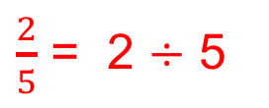


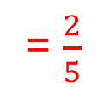
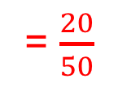
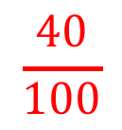
STRAND A
UNIT A2
Section A2.1
Fractions, Decimals and Percentages
Example: Convert $\frac{2}{5}$
$$\frac{2}{5}$$
Fraction
$$\frac{40}{100}$$
$\frac{2}{5}$ = 2 $÷$ 5
= $\frac{20}{50}$
= 0.4
= $\frac{2}{5}$
Decimal
Percentage
0.4
40%
0.4 × 100%

Slide 9







STRAND A
UNIT A2
Section A2.1
Fractions, Decimals and Percentages
The table below shows some common equivalent fractions, decimals and percentages.
Fractions | Decimals | Percentages
$\frac{1}{100}$
1%
0.01
$\frac{1}{10}$
0.1
10%
$\frac{2}{10}$
20%
0.2
$\frac{1}{4}= \frac{25}{100}$
0.25
25%
$\frac{1}{2}=\frac{5}{10}$
0.5
50%
$\frac{3}{4}=\frac{75}{100}$
0.75
75%
$$1$$
1
100%

Slide 10
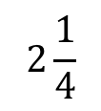






STRAND A
UNIT A2
Section A2.1
Fractions, Decimals and Percentages
Some more common fractions, decimals and percentages.
Fractions | Decimals | Percentages
$\frac{1}{8}$
0.125
12.5%
$\frac{1}{3}$
0.3333…
33.33…%
$\frac{3}{8}$
0.375
37.5%
$\frac{2}{3}$
0.6666…
66.66…%
$\frac{4}{5}$
0.8
80%
1$\frac{1}{2}$
1.5
150%
$$\text{2}\frac{1}{4}$$
2.25
225%

Slide 11


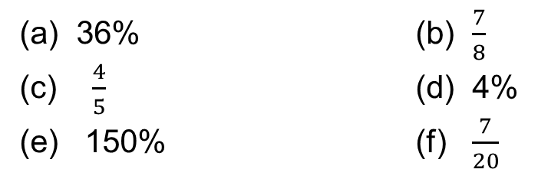


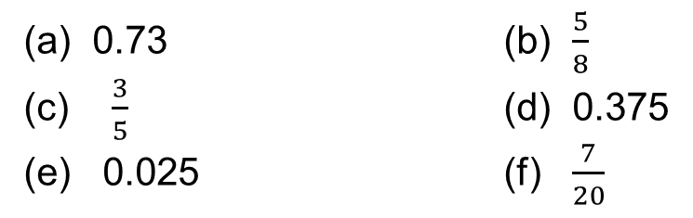
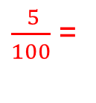

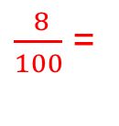



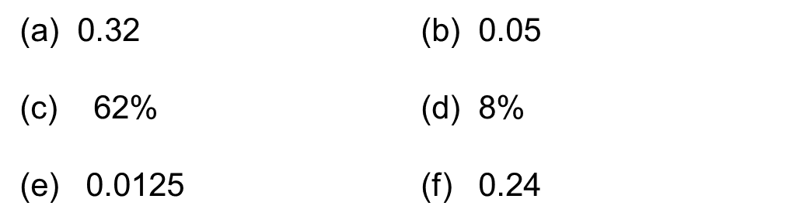


STRAND A
UNIT A2
Section A2.1
Section A2.1: Fitness Check
Convert each of the following to percentages:
(a) 0.73 (b) $\frac{5}{8}$
(c) $\frac{3}{5}$ (d) 0.375
(e) 0.025 (f) $\frac{7}{20}$
62.5%
73%
60%
37.5%
2.5%
35%
Convert each of the following to decimals:
(a) 36% (b) $\frac{7}{8}$
(c) $\frac{4}{5}$ (d) 4%
(e) 150% (f) $\frac{7}{20}$
0.875
0.36
0.8
0.04
1.5
0.35
Convert each of the following to fractions:
$\frac{ 32}{100}$ =
$\frac{ 5}{100}$ =
$\frac{ 1}{20}$
(a) 0.32 (b) $\text{0.}\text{0}\text{5}$
(c) $\text{62}\text{\%}$ (d) 8%
(e) 0.0125 (f) $\text{0.}\text{24}$
$\frac{ 8}{25}$
$\frac{ 62}{100}$ =
$\frac{ 31}{50}$
$\frac{ 8}{100}$ =
$\frac{ 2}{ 25}$
$\frac{ 125}{10000}$ =
$\frac{ 1}{80}$
$\frac{ 24}{100}$ =
$\frac{ 6}{25}$

Slide 12
STRAND A
UNIT A2
Section A2.1
Section A2.1: Review
You have completed the first Section.
If you have completed and understood this section,
click to start the next Section.
If you need more examples and interactive practice, go to
http://szalonta.hu/ske/text/A2/skea2s1.html

Slide 13
STRAND A
UNIT A2
Section A2.2
Percentages of Quantities
Percentages are often used to describe changes in price or value.
Examples:
‘20% discount on your first order’.
‘Price excluding 17.5% VAT’.
‘This year we made a loss of 10%’.
‘The number of sheep on the farm was reduced by 30%’.
‘15% off in the sale’.
To calculate percentages of an amount:
We convert the percentage to a decimal (or fraction)
We remember that, in maths, ‘of’ means ‘to multiply’
For example: Find 12% of £84
This is the same as: 0.12 × 84 = 10.08
Answer: £10.08

Slide 14
STRAND A
UNIT A2
Section A2.2
Percentage of Quantities: Examples
Examples:
‘20% discount on your first order of £250.’
20% of £250
This is the same as: 0.2 × 250 = 50
Answer: £50 discount
‘Price is £980, excluding 17.5% VAT. Calculate VAT.’
17.5% of £980
This is the same as: 0.175 × 980 = 171.5
Answer: £171.50
‘The number of sheep on the farm was reduced by 30%.
We originally had 5000 sheep.’
30% of 5000
This is the same as: 0.3 × 5000 = 1500
Answer: 1500 less sheep

Slide 15
STRAND A
UNIT A2
Section A2.2
Section A2.2: Fitness Check
Find:
(a) 10% of £580 (b) 65% of 30 kg
(c) 5% of £75 (d) 17.5% of £25 000
(e) 18% of 200 (f) 4% of 1500 seats
£58
19.5 kg
£3.75
£4375
£36
60 seats
In a school 38% of the students identify as girls.
There are 550 students in the school.
How many of the students identify as girls?
Answer: 209 students

Slide 16
STRAND A
UNIT A2
Section A2.2
Section A2.2: Review
You have completed the second Section.
If you have completed and understood this section,
click to start the next Section.
If you need more examples and interactive practice, go to
http://szalonta.hu/ske/text/A2/skea2s2.html

Slide 17


STRAND A
UNIT A2
Section A2.3
Quantities as Percentages
You scored 40 out of 50 in one maths test and 65 out of 80 in another. In which test did you do better?
Expressing the scores as percentages will help answer this question.
We will then be able to compare like with like.
First we write the scores as fractions.
Then convert the fractions to percentages.
(Earlier slides have shown us how to do this.)
Score of 40 out of 50:
Score of 65 out of 80:
$\frac{40}{50}$ = $\frac{40}{50}$ × 100%
= 0.8 × 100%
= 80%
$\frac{65}{80}$ = $\frac{65}{80}$ × 100%
= 0.8125 × 100%
= 81.25%
The second test score was the higher.

Slide 18
STRAND A
UNIT A2
Section A2.3
Section A2.3: Fitness Check
Express each of the following as percentages:
(a) 12 out of 30
(c) 72g out of 300g
(e) 1.2 out of 3
(b) £178.50 out of £210
(d) 240 out of 320
(f) 24 out of 3200
40%
85%
24%
75%
40%
0.75%
A 500ml bottle of hand-wash soap contains 150ml
of free soap. What percentage is free?
Answer: 30%

Slide 19
STRAND A
UNIT A2
Section A2.3
Section A2.3: Review
You have completed the third Section.
If you have completed and understood this section,
click to start the next Section.
If you need more examples and interactive practice, go to
http://szalonta.hu/ske/text/A2/skea2s3.html

Slide 20
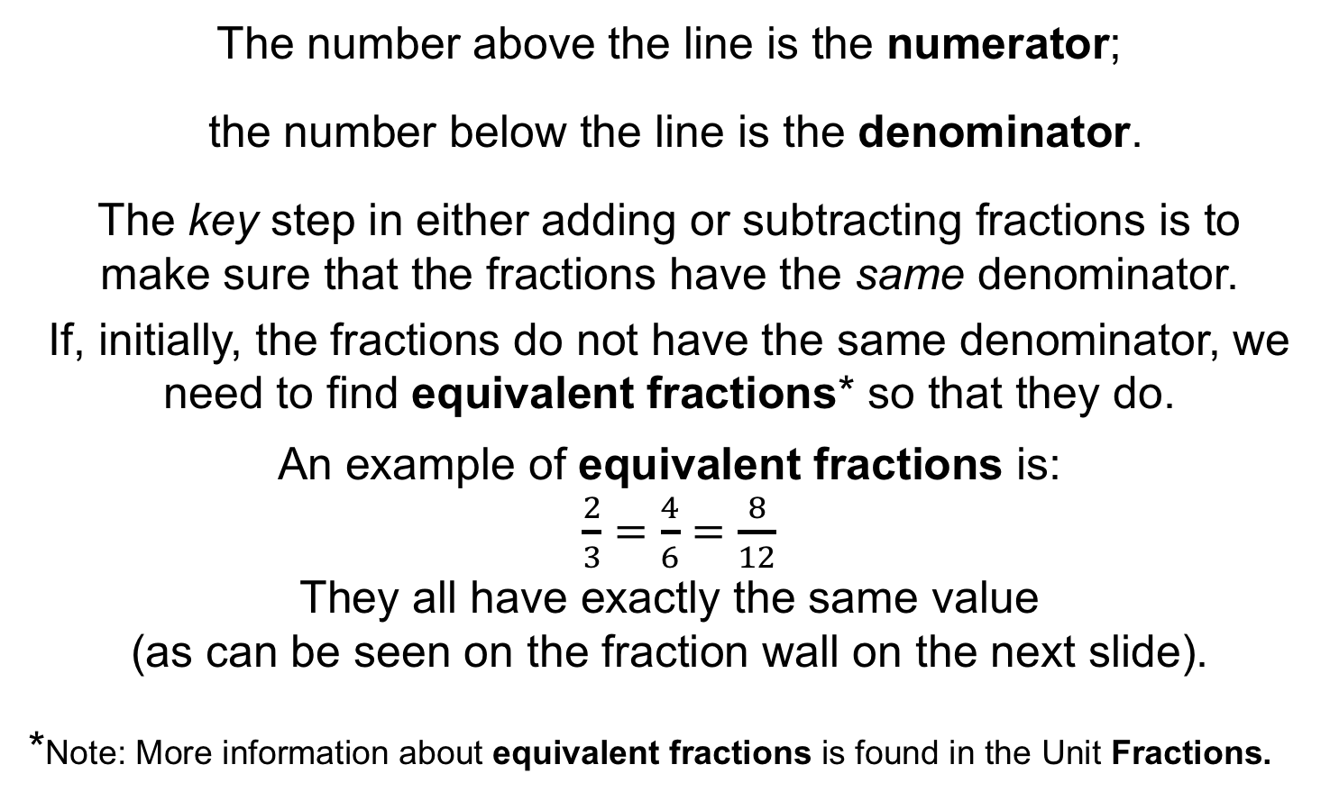
STRAND A
UNIT A2
Section A2.4
Addition and Subtraction of Fractions
We start with a quick review of key facts about fractions:
The number above the line is the numerator;
the number below the line is the denominator.
The key step in either adding or subtracting fractions is to
make sure that the fractions have the same denominator.
If, initially, the fractions do not have the same denominator, we need to find equivalent fractions* so that they do.
An example of equivalent fractions is:
$\frac{2}{3}=\frac{4}{6}=$ $\frac{8}{12}$
They all have exactly the same value
(as can be seen on the fraction wall on the next slide).
*Note: More information about equivalent fractions is found in the Unit Fractions.

Slide 21
STRAND A
UNIT A2
Section A2.4
Fraction Wall for Equivalent Fractions

Slide 22
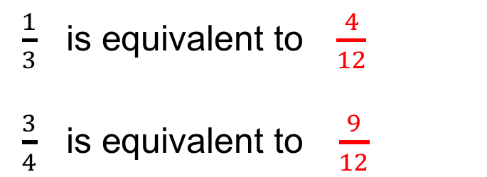
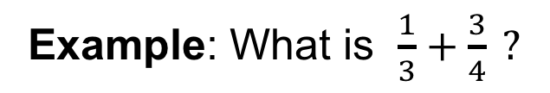
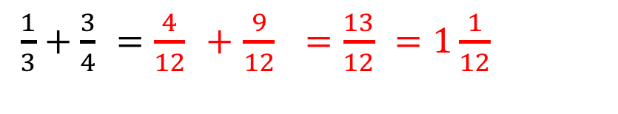
STRAND A
UNIT A2
Section A2.4
Addition of Fractions: Example
Example: What is $\frac{1}{3}+\frac{3}{4} ?$
Solution
These fractions do not have the same denominator so
we need to find equivalent fractions for each, so that
the two fractions have common (the same) denominators.
$\frac{1}{3} \text{is} \text{equivalent} \text{to} \frac{4}{12}$
$\frac{3}{4} \text{is} \text{equivalent} \text{to} \frac{9}{12}$
$\frac{1}{3}+\frac{3}{4}$ $=$ $\frac{4}{12}$ $+$ $\frac{9}{12}$ $=$ $\frac{13}{12}$ $=1\frac{1}{12}$

Slide 23
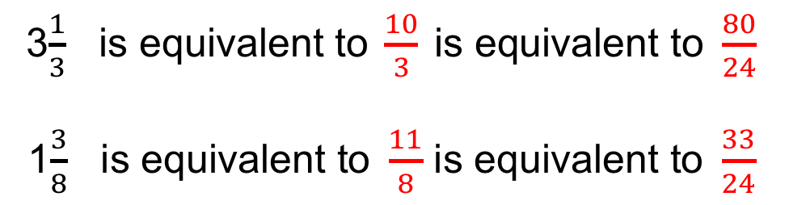
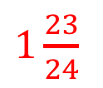
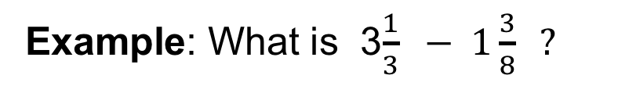
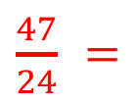
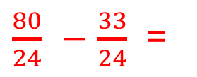
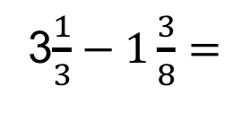
STRAND A
UNIT A2
Section A2.4
Subtraction of Fractions: Example
Example: What is 3$\frac{1}{3} − 1\frac{3}{8} ?$
Solution
These fractions do not have the same denominator,
so we need to find equivalent fractions for each,
so that the two fractions have a common denominator.
3$\frac{1}{3} \text{is} \text{equivalent} \text{to} \frac{10}{3} \text{is} \text{equivalent} \text{to} \frac{80}{24}$
1$\frac{3}{8} \text{is} \text{equivalent} \text{to} \frac{11}{8}$ $\text{is} \text{equivalent} \text{to} \frac{33}{24}$
3$\frac{1}{3}−1\frac{3}{8}=$
$\frac{80}{24}$ $−$ $\frac{33}{24}$ =
$\frac{47}{24}$ $=$
$1\frac{23}{24}$

Slide 24


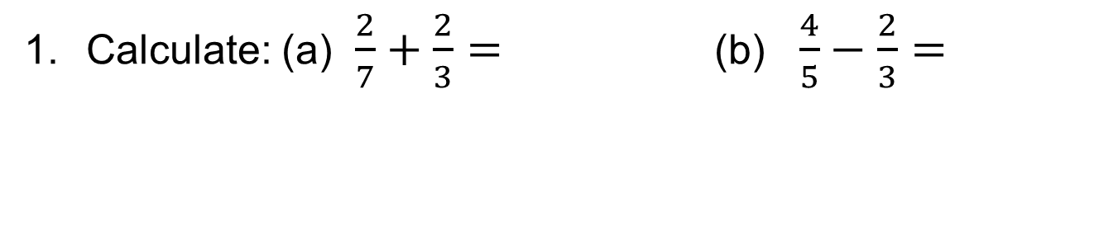

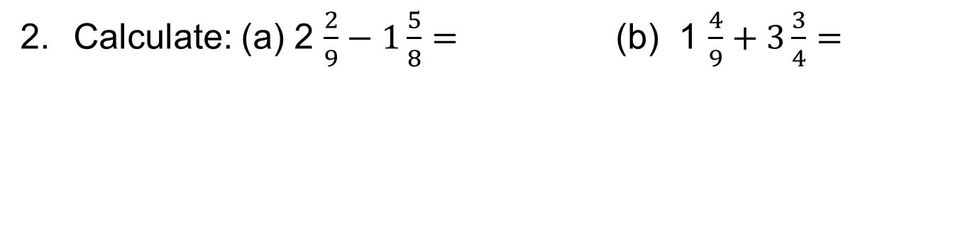



STRAND A
UNIT A2
Section A2.4
Section A2.4: Fitness Check
$$\frac{20}{21}$$
$\frac{2}{15}$
Calculate: (a) $\frac{2}{7}+\frac{2}{3}=$(b) $\frac{4}{5}−\frac{2}{3}=$
$5\frac{7}{36}$
$\frac{43}{72}$
Calculate: (a) 2 $\frac{2}{9}−1\frac{5}{8}=$ (b) 1 $\frac{4}{9}+3\frac{3}{4}=$
$\frac{11}{14}$
$\frac{112}{15}$= $7\frac{7}{15}$
Calculate: (a) 2 $\frac{1}{2}−1\frac{5}{7}=$ (b) 6 $\frac{4}{5}+\frac{2}{3}=$

Slide 25
STRAND A
UNIT A2
Section A2.4
Section A2.4: Review
You have completed the fourth Section.
If you have completed and mastered this section,
click to start the next Section.
If you need more examples and interactive practice, go to
http://szalonta.hu/ske/text/A2/skea2s4.html

Slide 26
STRAND A
UNIT A2
Section A2.5
Multiplying Fractions
We start with a quick review of key facts:
Multiplying fractions is probably the easiest
fraction calculation.
You do NOT need the same denominator.
You simply find the product of the numerators
(multiply them together).
Then find the product of the denominators
(multiply them together).
Then simplify, if necessary*.
*Note: More information about simplifying fractions is found in the Unit Fractions.

Slide 27
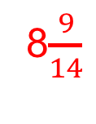
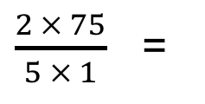
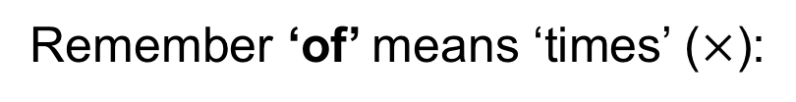
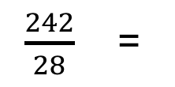
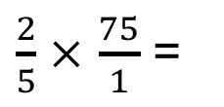
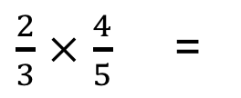
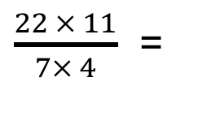
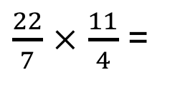
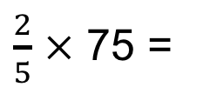
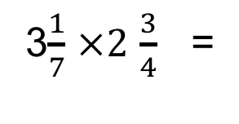
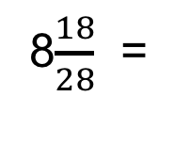
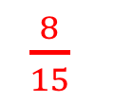
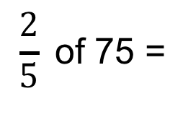
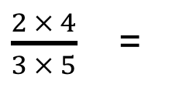
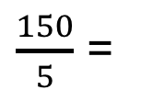
STRAND A
UNIT A2
Section A2.5
Multiplying Fractions
To multiply fractions
multiply the numerators, and
multiply the denominators;
simplify, if needed.
$\frac{2}{3}$ $×$ $\frac{4}{5}$ =
$\frac{2 × 4}{3 × 5}$ =
$\frac{8}{15}$
Remember ‘of’ means ‘times’ ($×$):
$$\frac{2}{5} \text{of}\text{ 75 }\text{=}$$
$\frac{2}{5}$ $×$ 75 =
$\frac{2}{5}$ $×$ $\frac{75}{1}$ =
$\frac{2 × 75}{5 × 1}$ =
$\frac{150}{5}$ =
30
Convert mixed numbers to improper (top-heavy) fractions first:
3$\frac{1}{7}$ $×2$ $\frac{3}{4}$ =
$\frac{22}{7}$ $×$ $\frac{11}{4}$ =
$\frac{22 × 11}{7× 4}$ =
$\frac{242}{28}$ =
8$\frac{18}{28}$ =
8$\frac{9}{14}$

Slide 28


STRAND A
UNIT A2
Section A2.5
Dividing Fractions
We start with a quick review of key facts:
Dividing by a number (any number) is exactly the same as multiplying
by the reciprocal* of that number.
For example: 10 $÷$ 2 is exactly the same as 10 $× \frac{1}{2}$ since the reciprocal of $\frac{1}{2}$ is $\frac{2}{1}$ which is just 2.
Similarly, 4 $÷$ $\frac{1}{3}$ is exactly the same as 4 $× \frac{3}{1}$ = 12
Simple steps to divide fractions
Turn the second fraction upside down (its reciprocal)
Multiply the first fraction by that reciprocal
Then simplify, if needed.
*Note: The reciprocal of a number is 1 divided by the number so the product of a number and its reciprocal is always 1; for a fraction, the reciprocal of $\frac{a}{b}$ is $\frac{b}{a}$ , that is the fraction upside down (and $\frac{a}{b}$ $×$ $\frac{b}{a}$ = 1).

Slide 29





















STRAND A
UNIT A2
Section A2.5
Dividing Fractions
To divide fractions
Turn the second fraction upside down (its reciprocal)
Then multiply the fractions;
Simplify, if needed.
$\frac{2}{3}÷\frac{3}{4}$ =
$\frac{2}{3}$ $×$ $\frac{4}{3}$ =
$\frac{2 × 4}{3 × 3}$ =
$\frac{8}{9}$
$\frac{2}{5}÷\text{8} \text{=}$
$\frac{2}{5}÷\frac{8}{1}$ =
$\frac{2}{5}$ $×$ $\frac{1}{8}$ =
$\frac{2 × 1}{5 × 8}$ =
$\frac{2}{40}$ =
$\frac{1}{20}$
7 $÷$ $\frac{2}{9} \text{=}$
$\frac{7}{1}÷\frac{2}{9}$ =
$\frac{7}{1}$ $×$ $\frac{9}{2}$ =
$\frac{7 × 9}{1 × 2}$ =
$\frac{63}{2}$ =
31$\frac{1}{2}$
Convert mixed numbers to improper (top-heavy) fractions first:
1$\frac{1}{9}÷2\frac{1}{5}$ =
$\frac{10}{9}÷\frac{11}{5}$ =
$\frac{10}{9}$ $×$ $\frac{5}{11}$ =
$\frac{10 × 5}{9 × 11}$ =
$\frac{50}{99}$

Slide 30







STRAND A
UNIT A2
Section A2.5
Section A2.5: Fitness Check
1. Calculate: a) $\frac{2}{3} × \frac{4}{5}\text{ =}$ b) $\frac{3}{8}$ $×$ $\frac{4}{5}$ =
$\frac{8}{15}$
$\frac{3}{10}$
Calculate: a) 2$\frac{1}{3} × \frac{3}{8}\text{ =}$ b) 2$\frac{2}{9}$ $×$3 $\frac{1}{5}$=
7$\frac{1}{9}$
$\frac{7}{8}$
Calculate: a) $\frac{4}{7} \text{of}\text{ 35 }\text{=}$ b) 3$\frac{2}{3}$ $\text{of} \frac{3}{8}$ =
1$\frac{3}{8}$
20

Slide 31








STRAND A
UNIT A2
Section A2.5
Section A2.5: Fitness Check
$$\frac{5}{6}$$
$$\frac{16}{21}$$
4. Calculate: (a) $\frac{2}{3}÷\frac{4}{5}\text{ =}$ (b) $\frac{4}{7}÷\frac{3}{4}$ =
$$\frac{2}{9}$$
4$\frac{2}{3}$
5. Calculate: (a) $\frac{2}{3}÷3\text{ =}$ (b) $4÷\frac{6}{7}$ =
$\frac{28}{65}$
5$\frac{22}{25}$
6. Calculate: (a) 1$\frac{2}{5}÷3\frac{1}{4}\text{ =}$ (b) 4$\frac{1}{5}÷\frac{5}{7}$ =

Slide 32
STRAND A
UNIT A2
Section A2.5
Section A2.5: Review
You have completed the fifth Section.
If you need more examples and interactive practice, go to
http://szalonta.hu/ske/text/A2/skea2s5.html

Slide 33
STRAND A
UNIT A2
Section A2.6
Complex Percentages
More complex problems with percentages use exactly
the same skill-set you are developing here.
All you need extra are confidence and fluency -
both of which are developed by practise.
So here are a few more practice questions.
Example 1:
Marni’s salary of £27 000 is to be increased by 2.25%.
Find her new salary.
Solution:
Marni’s new salary is 102.25% of her old salary.
102.25% of £27 000 = 1.0225 × £27 000
Answer: = £27 607.50

Slide 34

STRAND A
UNIT A2
Section A2.6
Complex Percentages
Example 2
A holiday cruise to the Bahamas for a family of four costs £11 999.
But the holiday company is offering a huge discount of 35%.
Find the discounted holiday price.
Solution
With a 35% discount, the holiday now costs 65% of the original price.
(100% $−$ 35% = 65%)
65% of £11 999 = 0.65 × £11 999
= £7799.35
The discounted price is £7799.35

Slide 35
STRAND A
UNIT A2
Section A2.6
Section A2.6: Fitness Check
The cost of a car is £15 000. VAT at 17.5% has
to be added to this bill. Find the total bill.
Answer: £17 625
Jamal has £592.50 in his bank account which
earns interest at 1.2% per year. How much will he
have in his bank account after the first year
(assuming he makes no withdrawals)?
Answer: £599.61

Slide 36
STRAND A
UNIT A2
Section A2.6
Section A2.6: Review
You have completed the sixth Section.
If you have completed and understood this section,
click to start the next Section.
If you need more examples and interactive practice, go to
http://szalonta.hu/ske/text/A2/skea2s6.html

Slide 37


STRAND A
UNIT A2
Section A2.7
Percentage Increase and Percentage Decrease
Often we want to calculate by how much
something has increased or decreased.
Percentage increase = $\frac{\text{actual} \text{increase} }{\text{initial} \text{value} }$ × 100%
Percentage decrease = $\frac{\text{actual} \text{de}\text{crease} }{\text{initial} \text{value} }$ × 100%
Example:
A house was bought for £350 000.
One year later it was sold for £378 000.
What was the percentage increase in value?
Percentage increase = $\frac{\text{28 000}}{\text{350 000}}$ × 100%
= 0.08 × 100%
= 8%

Slide 38


STRAND A
UNIT A2
Section A2.7
Percentage Increase and Decrease: Examples
A factory produces face-masks at a cost of 82p each
and sells them for £1.00.
Find the percentage increase.
Percentage increase = $\frac{\text{18}}{\text{84}}$ × 100%
= 0.21951... × 100%
$≈$ 21.95%
A supermarket offers £10 discount to all customers spending £50 or more. Diva spends £53.80.
Find her percentage saving.
Percentage decrease = $\frac{\text{10}}{\text{53.8}}$ × 100%
= 0.18587… × 100%
$≈$ 18.6%

Slide 39
STRAND A
UNIT A2
Section A2.7
Section A2.7: Fitness Check
The number of students in a school increases from
1150 one year to 1460 the next.
Find the percentage increase.
Answer: 26.96%
A baby’s birth weight is 3.2 kg.
After 2 days, the baby’s weight has dropped to 2.9 kg.
Find the percentage weight loss.
Answer: 9.375%

Slide 40
STRAND A
UNIT A2
Section A2.7
Section A2.7: Review
You have completed the seventh Section.
If you have completed and understood this section,
click to start the next Section.
If you need more examples and interactive practice, go to
http://szalonta.hu/ske/text/A2/skea2s7.html

Slide 41
STRAND A
UNIT A2
Section A2.8
Compound Interest and Depreciation
We start with a quick review of key facts:
Often we can earn interest on invested money.
The initial sum invested is referred to as the principal.
Simple interest is quite simply, simple!
Simple interest is where interest is calculated at the end of each year BUT the interest is NOT re-invested, That is, it is not added on to the principal. The principal remains the same.
Simple interest is easy to calculate because (assuming the interest rate remains the same) the calculation remains the same from one year to the next.
Compound interest is when the interest paid each year is added to the principal, thereby increasing the ‘principal’ amount on which interest is calculated. The interest earned therefore, increases each year.

Slide 42
STRAND A
UNIT A2
Section A2.8
Compound Interest and Depreciation: Example
Example:
A person invests £2000 in savings account which pays 3% interest at the end of each year. Find the value of the investment, after 4 years, if
(a) Simple interest is calculated each year,
(b) Compound interest is calculated each year.
Solution
(a) 3% of £2000 = 0.03 × £2000 = £60
4 years × £60 = £240 Total: £2000 + £240 = £2240
(b) Y1: 3% of £2000 = 0.03 × £2000 = £60
£60 is now added to the ’principal’ £2060
Y2: 3% of £2060 = 0.03 × £2060 = £61.80
£61.80 is now added to the ’principal’ £2121.80
Y3: 3% of £2121.80 = 0.03 × £2121.80 = £63.65
£63.65 is now added to the ’principal’ £2185.45
Y4: 3% of £2185.45 = 0.03 × £2185.45 = £65.56…
£65.56… is now added to the ’principal’ £2251.02

Slide 43
STRAND A
UNIT A2
Section A2.8
Compound Interest and Depreciation
A more efficient way to complete the calculations for compound interest, is outlined below (illustrated using the previous example).
Basically:
In Year 1, the principal amount is multiplied by 103%
(that is, 1.03, as a decimal)
In Year 2, this result is itself multiplied by 1.03
In Year 3, this new result is itself multiplied by 1.03
In Year 4, this new, new! result is itself multiplied by 1.03
3% of £2000 = (((£2000×1.03) × 1.03) × 1.03) × 1.03 for 4 years = £2000×1.03⁴
Answer: = £2251.02

Slide 44
STRAND A
UNIT A2
Section A2.8
Depreciation
Depreciation calculations work in exactly the same way.
BUT remember to subtract (instead of add) the amount to the 100%.
If a car depreciates by 15%, this is the same as saying it is now worth 85% of the original value (that is, 0.85 × the original value).
Example:
The value of a car depreciates at 15% per annum. Jack keeps the car for 3 years and then sells it. The car initially cost £18 000.
What was the value after 3 years?
Solution
85% of £9700 = (((£18 000×0.85) × 0.85) × 0.85)
for 3 years = £18 000×0.85³
Answer: = £11 054.25

Slide 45
STRAND A
UNIT A2
Section A2.8
Section A2.8: Fitness Check
A person invests £6400 in savings account which pays 2.5% interest at the end of each year.
Find the value of the investment, after 3 years, if
(a) Simple interest is calculated each year,
(b) Compound interest is calculated each year.
Answer: £6400 + £480 = £6880
Answer: £6892.10
The value of a car depreciates at 12% per annum. Ali keeps the car for 4 years and then sells it. The car initially cost £9 700.
What was the value after 4 years?
Answer: £9700 × 0.88⁴ = £5817.04

Slide 46
STRAND A
UNIT A2
Section A2.8
Section A2.8: Review
You have completed the eighth Section.
If you have completed and understood this section,
click to start the next Section.
If you need more examples and interactive practice, go to
http://szalonta.hu/ske/text/A2/skea2s8.html

Slide 47
STRAND A
UNIT A2
Section A2.9
Reverse Percentage Problems
Sometimes we know the final result once a percentage increase or percentage decrease has taken place.
What we would really like to know is the original value before this calculation has occurred.
In these cases we need to conduct, what is called, a
reverse percentage.
We need to reverse, or undo, the process so we can
reveal the original amount.
Example:
You are offered a 20% discount when buying a new laptop.
The discounted price is £860.
But what was the original full-price of the laptop?
What do you think?

Slide 48
STRAND A
UNIT A2
Section A2.9
Reverse Percentage Problem
The trick to this type of question is to know that the original amount is always the 100%. This is the amount we don’t yet know!
But we do know the discounted price (in this case) is worth 80%.
Set out what you do - and don’t - know in a table.
Original value 100% | ????
Discounted value 80% | £760
Now if we could work out the value of 1% we could thereafter work out the value of any percentage we like, including the full 100%.
How can we work out the value of 1%?

Slide 49


STRAND A
UNIT A2
Section A2.9
Reverse Percentage Problem
The value of 1% can be calculated by dividing both sides by 80.
Original value 100% | ????
Discounted value 80% | £760
80% $÷$ 80 = 1% | 760 $÷$ 80 = £9.50
Now that we know the value of 1%, we can find the value of any percentage by multiplying.
To find 100% - i.e. the original value - we multiply both sides by 100.
Original value 100% | ????
Discounted value 80% | £760
80% $÷$ 80 = 1% | 760 $÷$ 80 = £9.50
Original value: 1% x 100 = 100% | £9.50 x 100 = £950
Answer: £950

Slide 50

STRAND A
UNIT A2
Section A2.9
Reverse Percentage Example
Nadine invests some money in a savings account at 4% interest per annum. A year later her investment is worth £468.
How much did Nadine initially invest?
Set out what you do - and don’t - know in a table.
Original investment 100% | ????
Current value 104% | £468
Now we work out the value of 1%
and then we can work out the original 100%.
Original investment 100% | ????
Current value 104% | £468
104% $÷$ 104 = 1% | 468 $÷$ 104 = £4.50
Original value: 1%×100 = 100% | £4.50×100 = £450
Answer: £450

Slide 51


STRAND A
UNIT A2
Section A2.9
Reverse Percentage Problems
After you have solved several problems like these,
you may notice a short-cut.
In both the previous examples we found the value of 1% and then, to find 100%, we multiplied that value by 100.
In these examples (and in all questions like this) we can, however, do these calculations in one step. We simply divide the ‘new’ amount by the decimal equivalent of its percentage worth.
In the laptop example, the new amount is £760, and this is equivalent to 80% of the original value. As a decimal, 80% is equal to 0.80.
Original value
= $\frac{ \text{760} }{\text{0.80}}$ = 950
Original investment
= $\frac{ \text{468} }{\text{1.04}}$ = 450
Answer: £450
In the investment example, the ‘new’ (i.e. discounted) amount is £468, and this is equivalent to 104% of the original value.
As a decimal, 104% is equal to 1.04.

Slide 52



STRAND A
UNIT A2
Section A2.9
Section A2.9: Fitness Check
The price of a printer including 17.5% VAT is £225.60.
What would be the price with no VAT?
Original value
= $\frac{\text{225.60} }{\text{1.175}}$ = 192
Answer: £192
After 1 year, the value of a car has fallen by 23% to £10 395. What was the value of the car at the beginning of the year?
Original value
= $\frac{\text{10395} }{\text{0.77}}$ = 13 500
Answer: £13 500
In a furniture sale, a sofa is discounted by 15%.
The discounted price is £1096.50. Find the full price.
Original price
= $\frac{\text{1096.50} }{\text{0.85}}$ = 1290
Answer: £1290

Slide 53
STRAND A
UNIT A2
Section A2.9
Section A2.9: Review
You have completed the last Section.
If you need more examples and interactive practice, go to
http://szalonta.hu/ske/text/A2/skea2s9.html

