Slide 1
TSST: Strand B
UNIT B1: Indices and Factors

Slide 2
Indices and Factors
STRAND B
UNIT B1
Indices and Factors
Indices and Factors are an important part of number work.
You have five sections to work through and there are
check up audits and fitness tests for each section.
Squares, Cubes, Square Roots and Cube Roots
Index Notation
Factors
Prime Factors, Highest Common Factor (HCF) and Lowest Common Multiple (LCM)
Further Index Notation

Slide 3
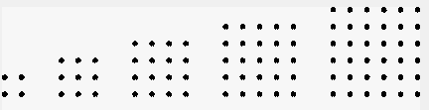
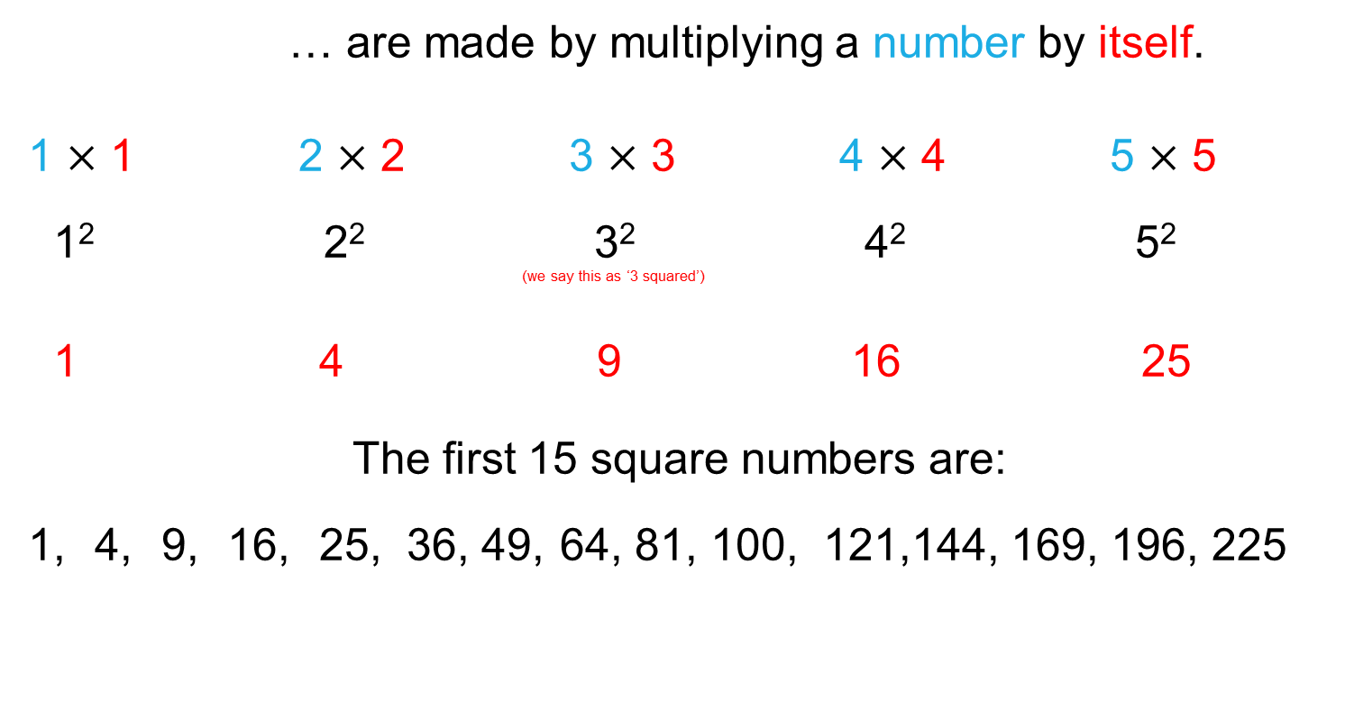
Square Numbers
Squares, Cubes, Square Roots and Cube Roots
STRAND B
UNIT B1
Section B1.1
… are made by multiplying a number by itself.
1 $×$ 1 2 $×$ 2 3 $×$ 3 4 $×$ 4 5 $×$ 5
1² 2² 3² 4² 5² ^{(we say this as ‘3 squared’)}
1 4 9 16 25
The first 15 square numbers are:
1, 4, 9, 16, 25, 36, 49, 64, 81, 100, 121,144, 169, 196, 225

Slide 4
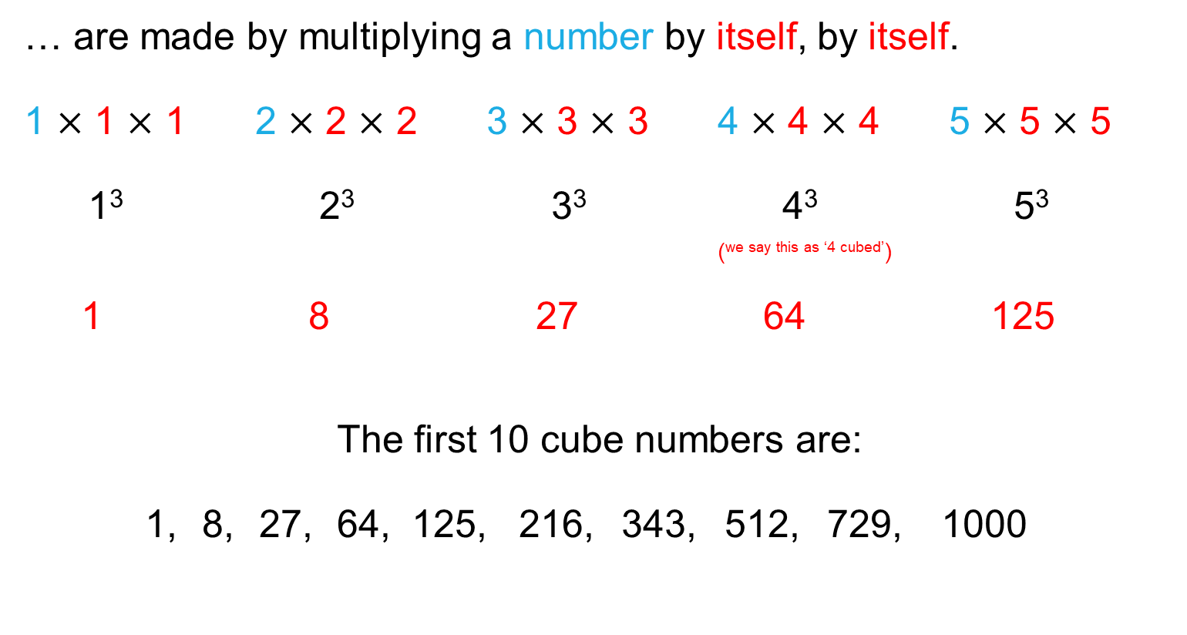
Squares, Cubes, Square Roots and Cube Roots
STRAND B
UNIT B1
Section B1.1
Cube Numbers
… are made by multiplying a number by itself, by itself.
1 $×$ 1 $×$ 1 2 $×$ 2 $×$ 2 3 $×$ 3 × 3 4 $×$ 4 $×$ 4 5 $×$ 5 $×$ 5
1³ 2³ 3³ 4³ 5³ (^{we say this as ‘4 cubed’})
1 8 27 64 125
The first 10 cube numbers are:
1, 8, 27, 64, 125, 216, 343, 512, 729, 1000

Slide 5

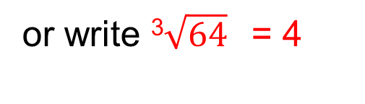
Squares, Cubes, Square Roots and Cube Roots
STRAND B
UNIT B1
Section B1.1
The reverse process to squaring a number is to
square root a number.
What number squared gives the answer 16?
The number is 4
We say that 4 is the square root of 16,
or write $\sqrt{16}$= 4
The reverse process to cubing a number is to
cube root a number.
What number cubed gives the answer 64?
The number is 4
We say that 4 is the cube root of 64,
or write ³$\sqrt{64}$= 4

Slide 6







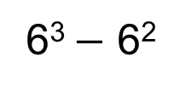



Section B1.1: Fitness Check
STRAND B
UNIT B1
Section B1.1
Here are some questions to check your progress;
there are more practice questions if needed.
Find:
Find:
$$\sqrt{100}$$
10
5²
25
$$\sqrt{36}$$
6
$$\sqrt{400}$$
20
10³
1000
$$\sqrt{196}$$
14
³$\sqrt{216}$
6
$$\sqrt{225}$$
15
Calculate:
Find:
³$\sqrt{729}$
9
6² + 7²
85
³$\sqrt{64}$
4
5³ + 10³
1125
³$\sqrt{8}$
2
6³ $−$ 6²
180
³$\sqrt{125}$
5

Slide 7
Section B1.1: Review
STRAND B
UNIT B1
Section B1.1
You have completed the first Section.
If you have completed and understood this section,
click to start the next Section
If you need more examples and interactive practice, go to
http://szalonta.hu/ske/text/B1/skeb1s1.html

Slide 8
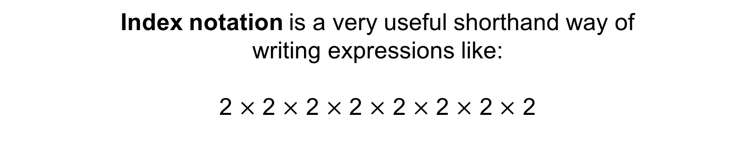
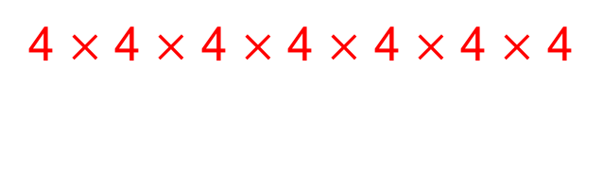
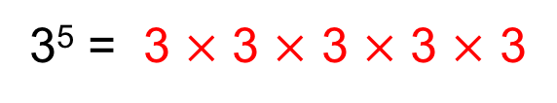
Index Notation
STRAND B
UNIT B1
Section B1.2
Index notation is a very useful shorthand way of
writing expressions like:
2 $×$ 2 $×$ 2 $×$ 2 $×$ 2 $×$ 2 $×$ 2 $×$ 2
The above could be written as
2⁸
The small number, the 8, is the index (or power).
8
8
For example:
3⁵ = 3 $×$ 3 $×$ 3 $×$ 3 $×$ 3
For example:
4⁷ =
4 $×$ 4 $×$ 4 $×$ 4 $×$ 4 $×$ 4 $×$ 4

Slide 9
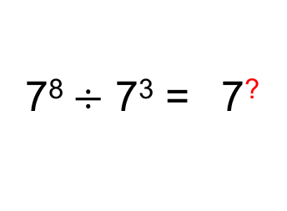
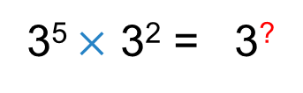
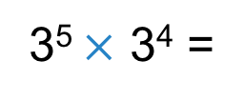
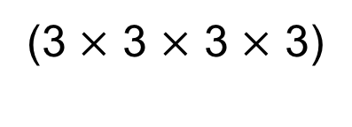
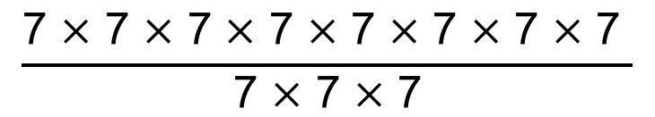

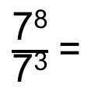
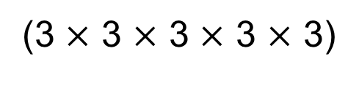

Index Notation
STRAND B
UNIT B1
Section B1.2
For example, find the missing number:
3⁵ $×$ 3² = 3?
3⁵ $×$ 3⁴ =
(3 $×$ 3 $×$ 3 $×$ 3 $×$ 3)
$$×$$
(3 $×$ 3 $×$ 3 $×$ 3)
= 3⁹
Can you see a rule?
For example, find the missing number:
7⁸$÷$ 7³ = 7?
7⁸$÷$ 7³ =
$\frac{\text{7}\text{8}}{\text{7}\text{3}}$ =
$$\frac{\text{7} ×\text{ 7} ×\text{ 7} ×\text{ 7} ×\text{ 7} ×\text{ 7} ×\text{ 7} ×\text{ 7 }}{\text{7} ×\text{ 7} ×\text{ 7}}$$
= 7⁵
Can you see a rule?

Slide 10
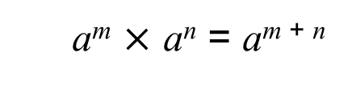
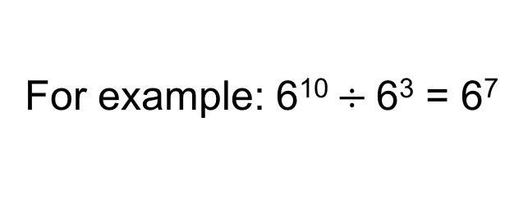
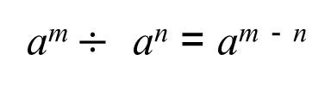
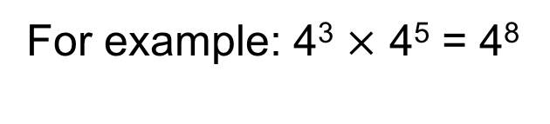
STRAND B
UNIT B1
Section B1.2
Index Notation
Below are two of the rules of indices.
a^{m} $×$ a^{n} = a^{m + n}
For example: 4³ $×$ 4⁵ = 4⁸
a^{m} $÷$ a^{n} = a^{m} ⁻ ^{n}
For example: 6¹⁰ $÷$6³ = 6⁷
NOTE: Here a, m and n are integers.

Slide 11
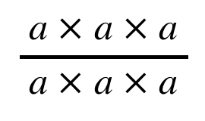
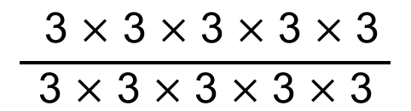
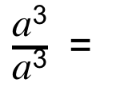

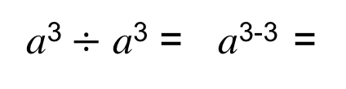
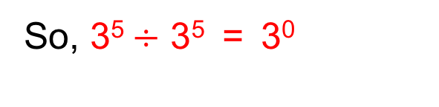
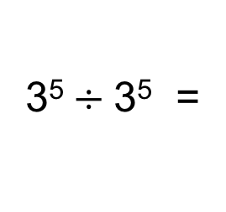
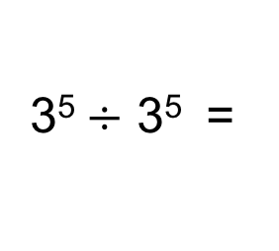
Index Notation
STRAND B
UNIT B1
Section B1.2
Using the rules of indices,
$$\frac{ \text{3} × \text{3} × \text{3} × \text{3} × \text{3} }{\text{3} × \text{3} × \text{3} × \text{3} × \text{3}}$$
3⁵$÷$ 3⁵ =
3⁵⁻⁵ =
3⁰
or
3⁵$÷$3⁵ =
= 1
So, 3⁵$÷$ 3⁵ = 3⁰
= 1
This shows the rule:
a⁰ = 1
This is shown in a general case below:
$\frac{\text{a}\text{3}}{\text{a}\text{3}}$ =
$$\frac{ \text{a} × \text{a} × \text{a} }{\text{a} × \text{a} × \text{a}}$$
a³$÷$ a³ = a³⁻³ =
a⁰
a³$÷$ a³ =
a⁰
= 1

Slide 12
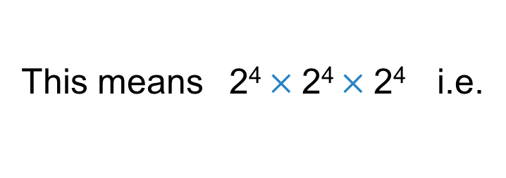
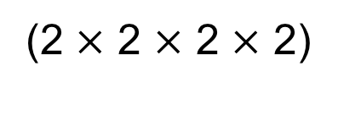

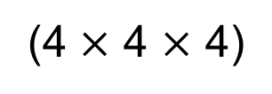
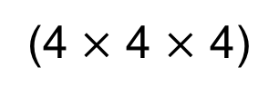

Index Notation
STRAND B
UNIT B1
Section B1.2
Using the rules of indices, we can find the missing numbers:
(2⁴ )³ = 2?
This means 2⁴ $×$2⁴ $×$2⁴ i.e.
(2⁴ )³ =
(2 $×$ 2 $×$ 2 $×$ 2)
$$×$$
(2 $×$ 2 $×$ 2 $×$ 2)
$$×$$
(2 $×$ 2 $×$ 2 $×$ 2)
= 2¹²
Here is another example:
(4³ )² = 4?
(4³ )² =
(4 $×$ 4 $×$ 4)
$$×$$
(4 $×$ 4 $×$ 4)
= 4⁶
Can you see a rule?

Slide 13
Index Notation
STRAND B
UNIT B1
Section B1.2
Below are two further rules of indices.
a⁰ = 1
For example: 9⁰ = 1
(a ^{m} )^{n} = a ^{m × n}
For example: (7³)⁵ = 7¹⁵
NOTE: Here m and n are integers.

Slide 14
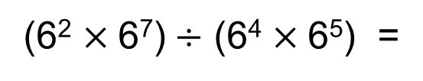
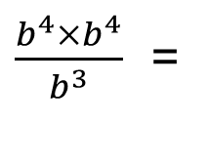
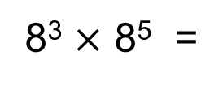
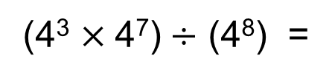
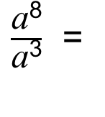
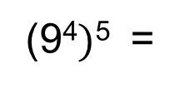
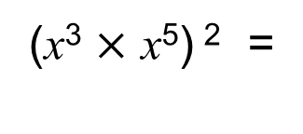
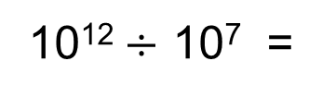
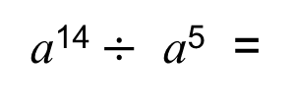
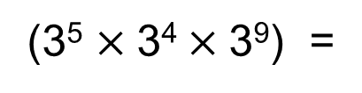
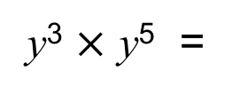
Section B1.2: Fitness Check
STRAND B
UNIT B1
Section B1.2
Here are some questions to check your progress;
there are more practice questions if needed.
Do the following calculations:
8⁸
a¹⁴$÷$ a⁵ =
a⁹
8³ $×$ 8⁵ =
5⁰ =
1
y³ $×$ y⁵ =
y⁸
(3⁵ $×$3⁴$×$3⁹) =
3¹⁸
(x³ $×$ x⁵) ² =
x¹⁶
10¹²$÷$ 10⁷ =
10⁵
$\frac{\text{a}\text{8}}{\text{a}\text{3}}$ =
a⁵
(9⁴$)$⁵ =
9²⁰
(4³ $×$4⁷)$÷$ (4⁸) =
4²
$\frac{b^{4}×b^{4}}{b^{3}}$ =
b⁵
(6² $×$6⁷)$÷$ (6⁴ $×$6⁵) =
1

Slide 15
Section B1.2: Review
STRAND B
UNIT B1
Section B1.2
You have completed the second Section.
If you have completed and understood this section,
click to start the next Section
If you need more examples and interactive practice, go to
http://szalonta.hu/ske/text/B1/skeb1s2.html

Slide 16
Factors
STRAND B
UNIT B1
Section B1.3
A factor is a positive whole number which divides exactly into another number. For example, both 3 and 4 are factors of 12 (both 3 and 4 ‘go into’ 12).
In other words, factors are whole numbers we multiply together to get another number, 3 × 4 = 12.
Thinking about factor pairs can help you list all the factors of a number.
1 and 12 are a factor pair of 12
2 and 6 are a factor pair of 12
3 and 4 are a factor pair of 12
All the factors of 12 are: 1, 2, 3, 4, 6, 12

Slide 17
Section B1.3: Fitness Check
STRAND B
UNIT B1
Section B1.3
Here are some questions to check your progress;
there are more practice questions if needed.
List the factors of these numbers:
50
1, 2, 5, 10, 25, 50
24
1, 2, 3, 4, 6, 8, 12, 24
18
1, 2, 3, 6, 9, 18
100
1, 2, 4, 5, 10, 20, 25, 50, 100
72
1, 2, 3, 4, 6, 8, 9, 12, 18, 24, 36, 72
48
1, 2, 3, 4, 6, 8, 12, 16, 24, 48
64
1, 2, 4, 8, 16, 32, 64
276
1, 2, 3, 4, 6, 12, 23, 46, 69, 92, 138, 276

Slide 18
Section B1.3: Review
STRAND B
UNIT B1
Section B1.3
You have completed the third Section.
If you have completed and understood this section,
click to start the next Section
If you need more examples and interactive practice, go to
http://szalonta.hu/ske/text/B1/skeb1s3.html

Slide 19
Prime Factors, HCF and LCM
STRAND B
UNIT B1
Section B1.4
Below are some reminders:
Multiples are the result of multiplying one whole number by another.
For example, 12 is a multiple of 4 (because 3 × 4 = 12).
A Prime Number is only divisible by one and itself and so always has exactly two factors, no more, no less.
The first ten prime numbers are:
2, 3, 5, 7, 11, 13, 17, 19, 23, 29,…
Whole numbers can be written as a product of prime factors.

Slide 20
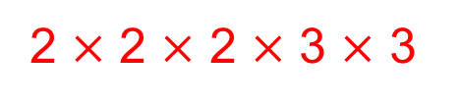
Prime Factors, HCF and LCM
STRAND B
UNIT B1
Section B1.4
Any positive whole number can be written as the
product of prime factors.
For example, write the number 72 as a product of prime numbers.
Often, we use factor trees to help.
We start with 72, and show it as a product of two factors
72
We circle any factor which is prime
2
36
And then continue with any remaining number,
showing it as a product of two factors
2
18
2
9
Repeat
3
3
Solution:
72 written as a product of primes =
2 $×$ 2 $×$ 2 $×$ 3 $×$ 3

Slide 21
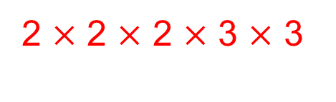



Prime Factors, HCF and LCM
STRAND B
UNIT B1
Section B1.4
72 written as a product of primes =
2 $×$ 2 $×$ 2 $×$ 3 $×$ 3
We can also write this as
2³ $×$ 3²
Express 276 as a product of primes:
276
2
138
2
69
3
23
276 written as a product of primes =
2 $×$ 2 $×$ 3 $×$ 23
= 2² $×$ 3 $×$ 23

Slide 22



Prime Factors, HCF and LCM
STRAND B
UNIT B1
Section B1.4
Sometimes, we want to know the Highest Common Factor (HCF)
of two (or more) numbers.
The HCF is the largest number which is a factor of both (or all)
the numbers.
For example, find the HCF of 72 and 276.
We can do this by first writing the numbers as product of primes.
72 =
2 $×$ 2 $×$ 2 $×$ 3 $×$ 3 =
2³ $×$ 3²
276 =
2 $×$ 2 $×$ 3 $×$ 23
= 2² $×$ 3 $×$ 23
Now we look to see what prime factors they have in common.
We can do this using a Venn Diagram.

Slide 23



Prime Factors, HCF and LCM
STRAND B
UNIT B1
Section B1.4
Using a Venn Diagram to find the HCF of 72 and 276:
3
2 $×$ 2 $×$ 3 $×$ 23
72 =
2
2
3
276 =
2
2
2 $×$ 2 $×$ 2 $×$ 3 $×$ 3
72
276
2
2
3
Place any common factors in the intersection.
The product of the intersection is the Highest Common Factor:
HCF is
2 $×$ 2 $×$ 3
= 12

Slide 24


Prime Factors, HCF and LCM
STRAND B
UNIT B1
Section B1.4
Venn diagrams can also be used to find the
Lowest Common Multiple (LCM) of two (or more) numbers.
The LCM is the lowest number into which the two (or all) numbers
can divide exactly.
For example, find the LCM of 48 and 72.
First, write the numbers as product of primes.
48 =
2 $×$ 2 $×$ 2 $×$ 2 $×$ 3
72 =
2 $×$ 2 $×$ 2 $×$ 3 $×$ 3
Next, we use a Venn Diagram to find the LCM of 48 and 72.

Slide 25



Prime Factors, HCF and LCM
STRAND B
UNIT B1
Section B1.4
2
72 =
2
2
3
2 $×$ 2 $×$ 2 $×$ 3 $×$ 3
48 =
2
2
2
3
2 $×$ 2 $×$ 2 $×$ 2 $×$ 3
2
3
48
72
2
2
3
2
2
3
Place any common factors in the intersection.
Place remaining numbers in the correct circles.
The product of all the numbers in the Venn Diagram is the LCM.
2 $×$ 2 $×$ 2 $×$ 2 $×$ 3 $×$ 3
LCM is
= 144

Slide 26




Prime Factors, HCF and LCM
STRAND B
UNIT B1
Section B1.4
Use a Venn Diagram to find the HCF and LCM of 24 and 64.
24 =
2 $×$ 2 $×$ 2 $×$ 3
64 =
2 $×$ 2 $×$ 2 $×$ 2 $×$ 2 $×$ 2
24
64
2
2
2
2
3
2
2
HCF is:
2 $×$ 2 $×$ 2 =
8
LCM is:
3 $×$ 2 $×$ 2$×$ 2$×$ 2 $×$ 2 $×$ 2 =
192

Slide 27









Section B1.4: Fitness Check
STRAND B
UNIT B1
Section B1.4
Here are some questions to check your progress;
there are more practice questions if needed.
List the first eight prime numbers:
2, 3, 5, 7, 11, 13, 17, 19
Write 168 as a product of primes
2 $×$ 2 $×$ 2 $×$ 3 $×$ 7 =
2³ $×$ 3 $×$ 7
Write 140 as a product of primes
2 $×$ 2 $×$ 5 $×$ 7 =
2² $×$ 5 $×$ 7
Find the HCF of 168 and 140
2 $×$ 2 $×$ 7 =
28
Write 56 as a product of primes
2 $×$ 2 $×$ 2 $×$ 7 =
2³ $×$ 7
Write 42 as a product of primes
2 $×$ 3$×$ 7
Find the LCM of 168 and 140
2 $×$ 2 $×$ 2 $×$ 3 $×$ 7 =
168

Slide 28
Section B1.4: Review
STRAND B
UNIT B1
Section B1.4
You have completed the fourth Section.
If you have completed and understood this section,
click to start the next Section
If you need more examples and interactive practice, go to
http://szalonta.hu/ske/text/B1/skeb1s4.html

Slide 29








Further Index Notation
STRAND B
UNIT B1
Section B1.5
Below are further rules of indices.
a⁻¹ = $\frac{\text{1}}{\text{a}}$
For example: 9⁻¹ = $\frac{\text{1}}{\text{9}}$
a^{-n} = $\frac{\text{1}}{\text{a}\text{n}}$
For example: 6⁻⁴ = $\frac{\text{1}}{\text{6}\text{4}}$
$a^{\frac{1}{2}}$ = $\sqrt{a}$
For example: ${81}^{\frac{1}{2} }$ = $\sqrt{81} =9$
$a^{\frac{1}{n}}$ = $\sqrt[n]{a}$
For example: ${125}^{\frac{1}{3}}$ = $\sqrt[3]{125} =5$

Slide 30























Further Index Notation
STRAND B
UNIT B1
Section B1.5
Do the following calculations:
$$9^{\frac{1}{2}} \text{=}$$
$4^{\frac{3}{2}}$ =
($4^{\frac{1}{2}})$³ =
2³ =
8
$\sqrt{9}$=
3
$$\frac{\text{1}}{\text{5}}$$
$5^{−1}$=
$$\frac{\text{1}}{\text{y}\text{2}}$$
y³ $×$ y⁻⁵ =
y⁻² =
$\frac{\text{1}}{\text{4}\text{2}}$ =
$$\frac{\text{1}}{\text{16}}$$
$4^{−2}$=
${\left(2^{3}×2^{5}\right)}^{\frac{1}{2}}$ =
2⁴ =
16
$8^{\frac{1}{3}}$ =
$$\sqrt[\frac{1}{3}]{8} \text{=}$$
a⁻⁵ =
$$\frac{\text{1}}{\text{a}\text{5}}$$
2
$\frac{\text{a}\text{3}}{\text{a}\text{8}}$ =
$9^{−\frac{1}{2}}$ =
$\frac{\text{1}}{\sqrt{9}}$ =
$$\frac{\text{1}}{\text{3}}$$
${\left(\frac{n^{3}}{a}\right)}^{−2}$=
n⁻⁶a²
(n³a⁻¹)⁻² =
${\left(9^{−\frac{1}{2}}\right)}^{2}$=
$\frac{\text{1}}{\text{9}}$
= $\frac{ \text{a}\text{2} }{\text{n}\text{6}}$
9⁻¹ =

Slide 31
















Section B1.5: Fitness Check
STRAND B
UNIT B1
Section B1.5
Here are some questions to check your progress;
there are more practice questions if needed.
${25}^{\frac{1}{2}}$ =
$8^{\frac{2}{3}}$ =
4
5
$$\frac{\text{1}}{\text{7}}$$
$$\frac{\text{1}}{\text{y}\text{12}}$$
7⁻¹ =
y⁻² $×$ y⁻⁶ =
y⁻¹² =
3⁻³ =
$$\frac{\text{1}}{\text{27}}$$
${\left(4^{3}×4^{5}\right)}^{\frac{1}{2}}$ =
4⁴ =
256
${125}^{\frac{1}{3}}$ =
$\frac{\text{b}\text{5}}{\text{b}\text{9}}$ =
$$\frac{\text{1}}{\text{b}\text{4}}$$
5
b⁻⁴ =
${81}^{−\frac{1}{2}}$ =
$$\frac{\text{1}}{\text{9}}$$
${\left(\frac{m^{2}}{m^{3}}\right)}^{−2}$=
${\left(m^{−1}\right)}^{−2}$ =
m²
${\left(8^{−\frac{1}{3}}\right)}^{2}$=
$$\frac{\text{1}}{\text{4}}$$

Slide 32
Section B1.5: Review
STRAND B
UNIT B1
Section B1.5
You have completed the fifth and last Section.
If you need more examples and interactive practice, go to
http://szalonta.hu/ske/text/B1/skeb1s5.html

