Slide 1
TSST: STRAND B
UNIT B2: Number Classification

Slide 2
Number Classification
STRAND B
UNIT B2
Number Classification
Number Classification is an important part of number work.
You have three sections to work through and there are check up audits and fitness tests for each section.
1. Number Classification
Binary Numbers
Adding and Subtracting Binary Numbers
Multiplying Binary Numbers
Other Bases

Slide 3

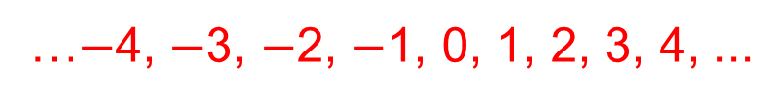
Evolution of Numbers
STRAND B
UNIT B2
Section B2.1
First there were simple:
Counting Numbers
Then zero joined this group, so a new name was needed:
Whole Numbers
Then numbers less than zero were conceived, and negative numbers joined the group:
Integers
But what about the bits in between? The halves, the quarters, the tenths, the decimal fractions ... ?
Fractions fill the gaps. Fractions can convert to:
Terminating decimals (for example $\frac{7}{8}$ = 0.875) or
Recurring decimals (for example $\frac{2}{3}$ = 0.6666666666666666...)
1, 2, 3, 4,…
0, 1, 2, 3, 4, …
…$−$4, $−$3, $−$2, $−$1, 0, 1, 2, 3, 4, ...

Slide 4

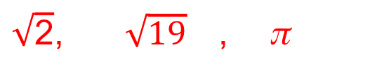
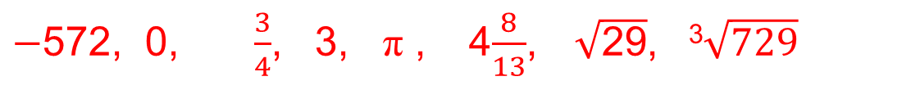
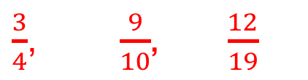
Evolution of Numbers
STRAND B
UNIT B2
Section B2.1
Evolution of Numbers continued...
All terminating decimals and recurring decimals can be written in the form $\frac{m}{n}$ (i.e. as a fraction), and they are called:
Rational Numbers, for example:
Numbers which cannot be expressed in the form $\frac{m}{n}$, that is, cannot be expressed as a fraction, are called:
Irrational Numbers, for example:
Real Numbers are made up of all possible rational and irrational
numbers, for example:
$\frac{3}{4}$, $\frac{9}{10}$, $\frac{12}{19}$
$\sqrt{\text{2}}$, $\sqrt{19}$ , π
$−$572, 0, $\frac{3}{4}$, 3, π , 4$\frac{8}{13}$, $\sqrt{\text{2}\text{9}}$, ³$\sqrt{729}$

Slide 5
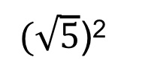




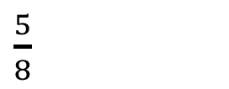
Section B2.1: Fitness Check
STRAND B
UNIT B2
Section B2.1
Here are some questions to check your progress;
there are more practice questions if needed.
Classify the following numbers as:
integers, rational, irrational, recurring decimals, terminating decimals.
$\sqrt{81}$
$\frac{2}{3}$
$$0.44444…$$
$$\sqrt{10}$$
$(\sqrt{5}$)²
π²
$\frac{5}{8}$
Answers are shown on next slide

Slide 6



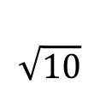










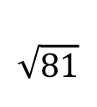


Section B2.1: Fitness Check
STRAND B
UNIT B2
Section B2.1
Answers:
 | Integer | Rational | Irrational | Recurring Decimal | Terminating Decimal
$$\sqrt{81}$$
$$✓$$
$$✓$$
$\frac{2}{3}$
$$✓$$
$$✓$$
$$0.44444…$$
$$✓$$
$$✓$$
$$\sqrt{10}$$
$$✓$$
$(\sqrt{5}$)²
$$✓$$
$$✓$$
$π$²
$$✓$$
$\frac{ 5}{ 8}$
$$✓$$
$$✓$$

Slide 7
Section B2.1: Review
STRAND B
UNIT B2
Section B2.1
You have completed the first Section.
If you have completed and understood this section,
click to start the next Section
If you need more examples and interactive practice, go to
http://szalonta.hu/ske/text/B2/skeb2s1.html

Slide 8
Binary Numbers
STRAND B
UNIT B2
Section B2.2
We normally work with numbers in base 10.
These are called denary (or decimal) numbers.
Numbers in base 2 are called binary numbers.
In base 10 we use the ten digits 0, 1, 2, 3, 4, 5, 6, 7, 8, 9
In base 2, we use the two digits 0, 1
Binary numbers are at the heart of all computing systems.
In base 10 we use a place value system based on a multiplier of 10.
10 000 | 1000 | 100 | 10 | 1
In base 2 we use a place value system based on a multiplier of 2.
64 | 32 | 16 | 8 | 4 | 2 | 1

Slide 9
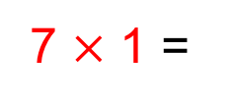
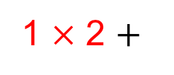
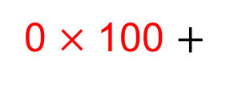
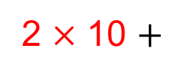

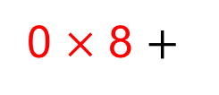
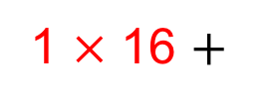
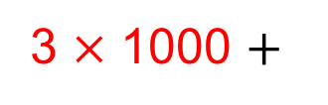
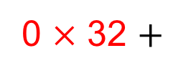
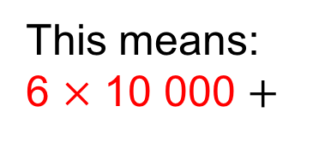
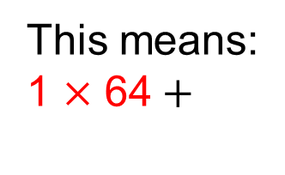
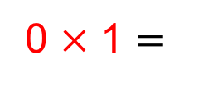
Binary Numbers
STRAND B
UNIT B2
Section B2.2
In base 10 the place value system looks like:
10 000 | 1000 | 100 | 10 | 1
6 | 3 | 0 | 2 | 7
This means:
6 $×$ 10 000 $+$
3 $×$ 1000 $+$
0 $×$ 100 $+$
2 $×$ 10 $+$
7 $×$ 1 =
63 027
In base 2 we use a place value system based on multiples of 2:
64 | 32 | 16 | 8 | 4 | 2 | 1
1 | 0 | 1 | 0 | 1 | 1 | 0
This means:
1 $×$ 6$\text{4}+$
0 $×$ 32 $+$
1 $×$ 16 $+$
0 $×$ 8 $+$
1 $×$ 4 $+$
1 $×$ 2 $+$
0 $×$ 1 $=$
86

Slide 10
Binary Numbers
STRAND B
UNIT B2
Section B2.2
Worked examples:
Convert the following binary numbers to base 10:
(a) 111
(b) 1001
(c) 110011
(d) 1001111
7
9
51
79
64 | 32 | 16 | 8 | 4 | 2 | 1
(a)
1 1 1
(b)
1 0 0 1
(c)
1 1 0 0 1 1
(d)
1 0 0 1 1 1 1
Convert the following base 10 numbers into binary numbers:
(a) 16
(b) 15
(c) 32
(d) 31
10000
1111
100000
11111

Slide 11
Section B2.2: Fitness Check
STRAND B
UNIT B2
Section B2.2
Here are some questions to check your progress;
there are more practice questions if needed.
Convert the following binary numbers to base 10:
11
3
11011
27
1010
10
100001
33
Convert the following base 10 numbers to binary numbers:
65
1000001
128
10000000
257
100000001

Slide 12
Section B2.2: Review
STRAND B
UNIT B2
Section B2.2
You have completed the second Section.
If you have completed and understood this section,
click to start the next Section
If you need more examples and interactive practice, go to
http://szalonta.hu/ske/text/B2/skeb2s2.html

Slide 13
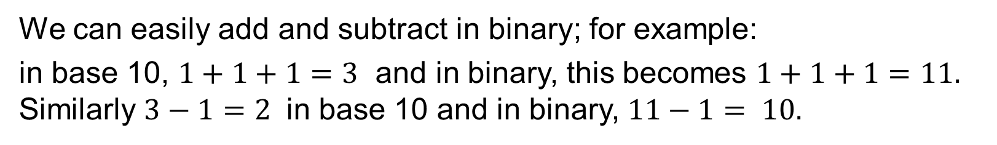
Adding and Subtracting Binary Numbers
STRAND B
UNIT B2
Section B2.3
We can easily add and subtract in binary; for example:
in base 10, $1+1+1=3$ and in binary, this becomes $1+1+1=11.$
Similarly $3−1=2$ in base 10 and in binary, $11−1= 10.$

Slide 14
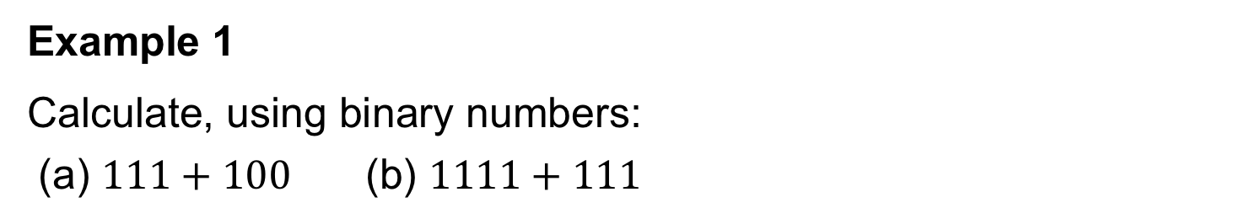
Adding in Binary: Worked Example
STRAND B
UNIT B2
Section B2.3
Example 1
Calculate, using binary numbers:
(a) $111+100$(b) $1111+111$
Solution
1 1 1
+ 1 0 0
1 0 1 1
1
(b) 1 1 1 1
+ 1 1 1
1 0 1 1 0
1 1 1
Note: It is important to “carry” correctly.

Slide 15
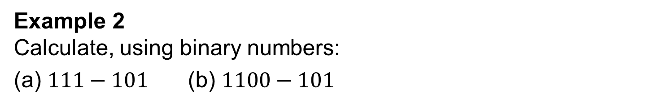
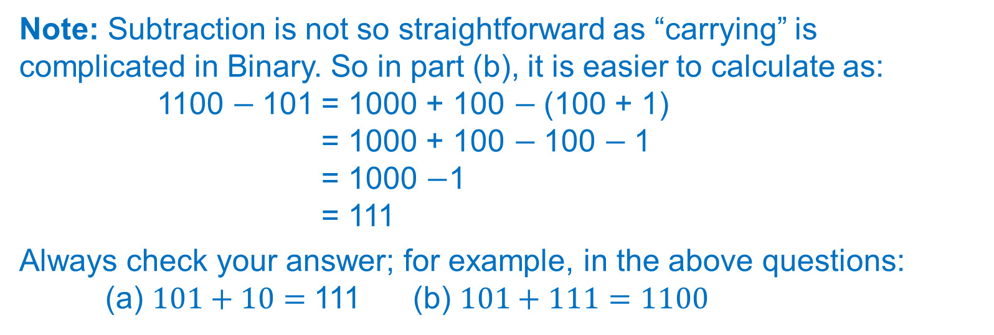
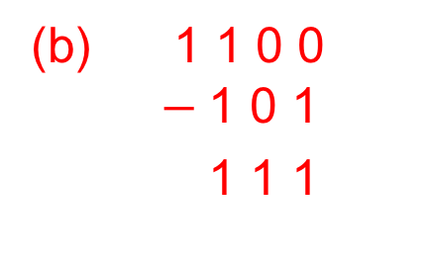

Subtracting in Binary: Worked Example
STRAND B
UNIT: B2
Section B2.3
Example 2
Calculate, using binary numbers:
(a) $111−101$(b) $1100−101$
Solution
1 1 1
$−$1 0 1
1 0
(b) 1 1 0 0
$−$1 0 1
1 1 1
Note: Subtraction is not so straightforward as “carrying” is complicated in Binary. So in part (b), it is easier to calculate as:
1100 $−$101 = 1000 + 100 $−$(100 + 1)
= 1000 + 100 $−$100 $−$1
= 1000 $−$1
= 111
Always check your answer; for example, in the above questions:
(a) $101+10=$111 (b) $101+111=1100$

Slide 16
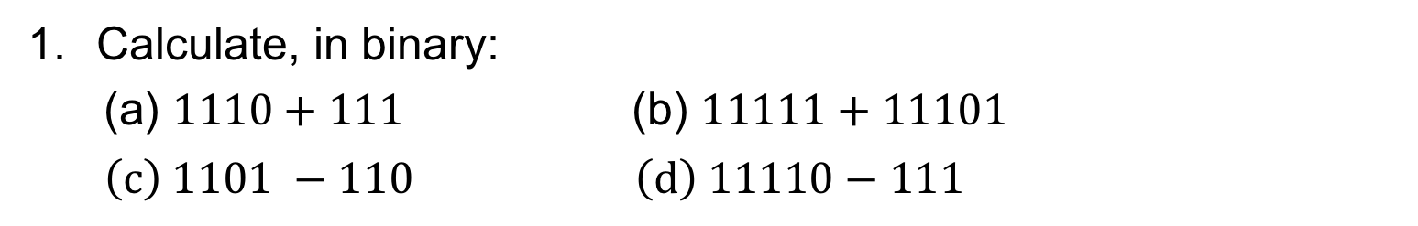
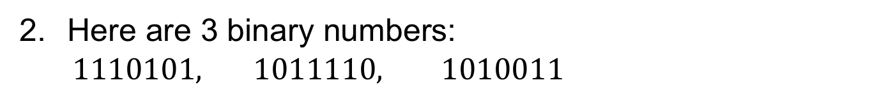
Section B2.3: Fitness Check
STRAND B
UNIT B2
Section B2.3
Here are some questions to check your progress;
there are more practice questions if needed.
Calculate, in binary:
(a) $1110+111$ (b) $11111+11101$
$\left(c\right) 1101 −110 \left(d\right) 11110−111$
10101
111100
111
10111
Here are 3 binary numbers:
$1110101, 1011110, 1010011$
Giving answers in binary:
(a) add together the two smaller numbers,
add together the two larger numbers,
subtract the smallest number from the largest number,
add together all three numbers.
10110001
11010011
100010
100100110

Slide 17
Section B2.3: Review
STRAND B
UNIT B2
Section B2.3
You have completed the third Section.
If you have completed and understood this section,
click to start the next Section
If you need more examples and interactive practice, go to
http://szalonta.hu/ske/text/B2/skeb2s3.html

Slide 18
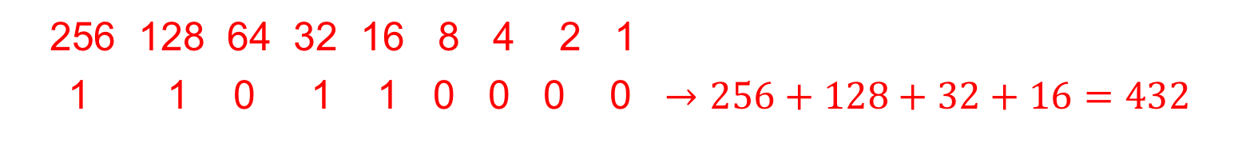
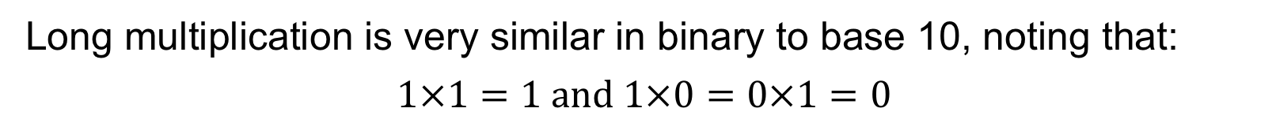
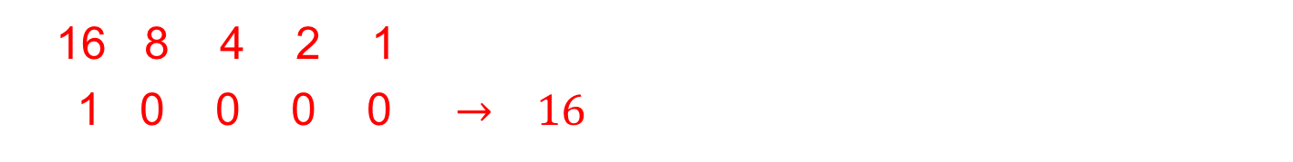
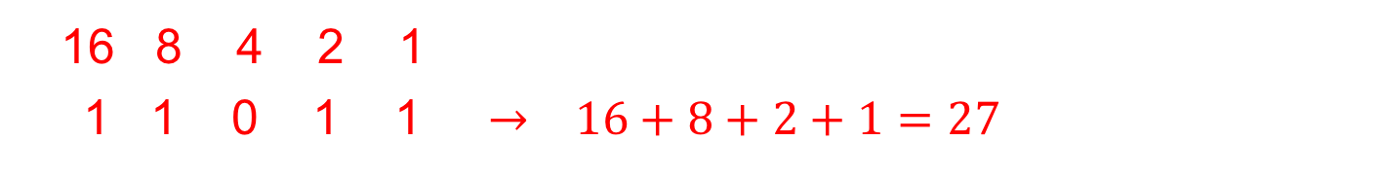
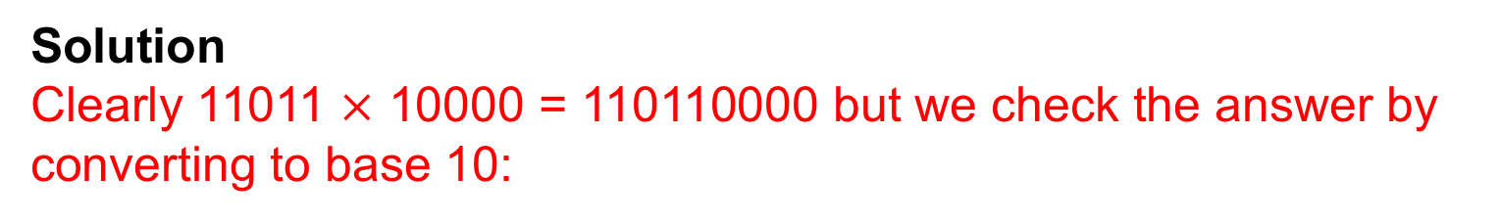
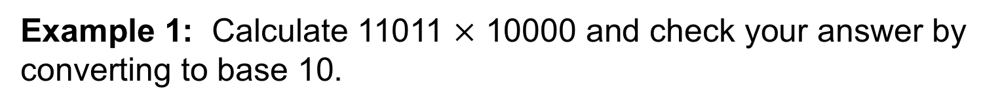
Multiplying Binary Numbers
STRAND B
UNIT B2
Section B2.4
Long multiplication is very similar in binary to base 10, noting that:
$$1×1=1 and 1×0=0×1=0$$
Example 1: Calculate 11011 $×$ 10000 and check your answer by converting to base 10.
Solution
Clearly 11011 $×$ 10000 = 110110000 but we check the answer by converting to base 10:
16 8 4 2 1
1 1 0 1 1 $→ 16+8+2+1=27$
16 8 4 2 1
1 0 0 0 0 $→ 16$
256 128 64 32 16 8 4 2 1
1 1 0 1 1 0 0 0 0 $→256+128+32+16=432$
and note that 27$×$16 = 432

Slide 19
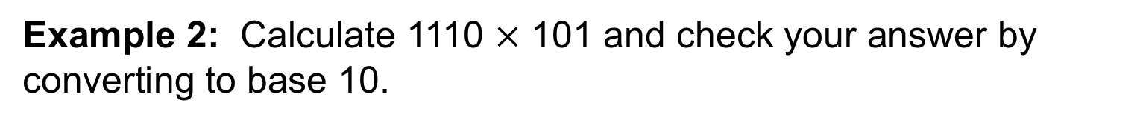
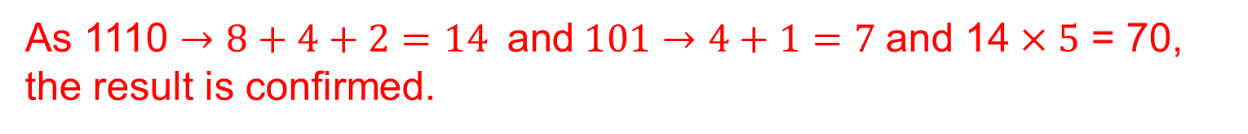
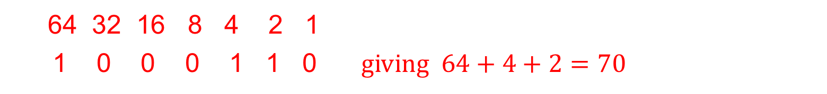
Multiplying Binary Numbers
STRAND B
UNIT B2
Section B2.4
Example 2: Calculate 1110 $×$ 101 and check your answer by converting to base 10.
Solution
1 1 1 0
× 1 0 1
1 1 1 0
1 1 1 0 0 0
1 0 0 0 1 1 0
1 1 1
64 32 16 8 4 2 1
1 0 0 0 1 1 0 $giving 64+4+2=70$
As 1110 $→8+4+2=14 \text{and} 101→4+1=7$and 14$×5$ = 70, the result is confirmed.

Slide 20
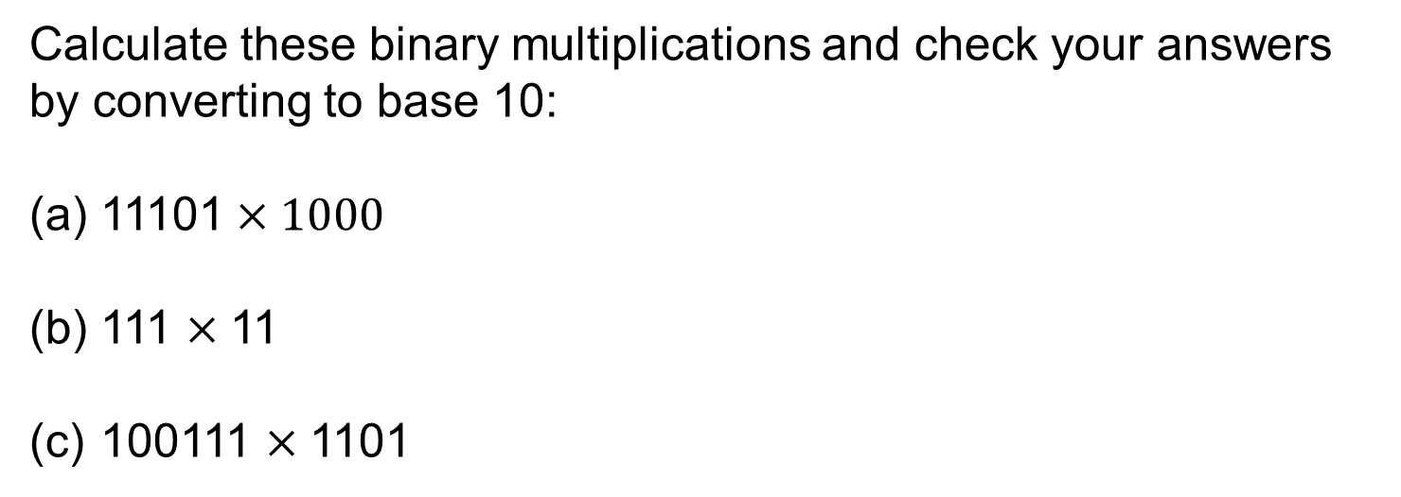
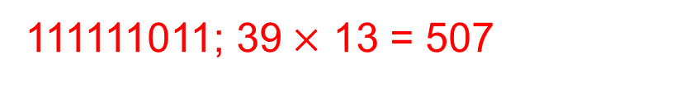
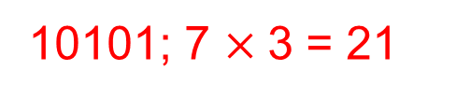
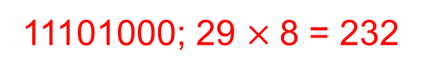
Section B2.4: Fitness Check
STRAND B
UNIT B2
Section B2.4
Here are some questions to check your progress;
there are more practice questions if needed.
Calculate these binary multiplications and check your answers by converting to base 10:
(a) 11101$×1000$
111 $×$11
100111 $×$1101
11101000; 29 $×$8 = 232
10101; 7 $×$3 = 21
111111011; 39$×$ 13 = 507

Slide 21
Section B2.4: Review
STRAND B
UNIT B2
Section B2.4
You have completed the fourth Section.
If you have completed and understood this section,
click to start the next Section
If you need more examples and interactive practice, go to
http://szalonta.hu/ske/text/B2/skeb2s4.html

Slide 22
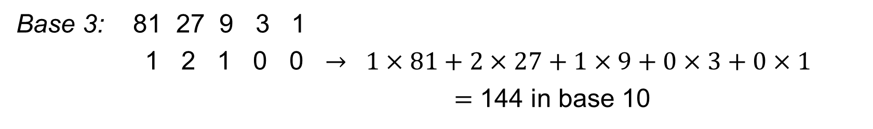
Other Bases
STRAND B
UNIT B2
Section B2.5
The ideas that we have considered can
be extended to other number bases
The table opposite lists the digits used
in some other number bases.
The powers of the base number give
the place values when you convert to base 10.
For base 3, the place values are the powers of 3,
i.e. 1, 3, 9, 27, 81,… 243, etc.
This is shown in the following example, which also shows how the base 3 number 12100 is equivalent to the base 10 number 144.
Base 3: 81 27 9 3 1
1 2 1 0 0 $→ 1×81+2×27+1×9+0×3+0×1$
$=\text{1}\text{44 }$in base 10

Slide 23
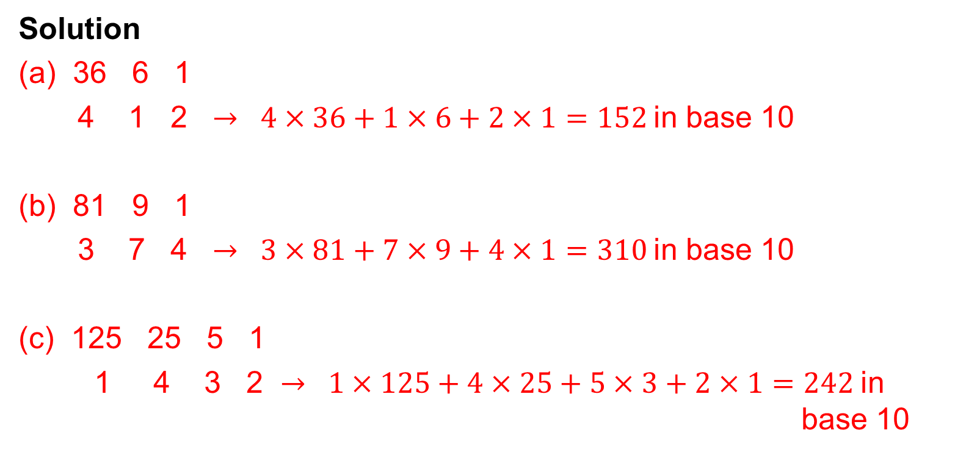
Other Bases: Worked Examples
STRAND B
UNIT B2
Section B2.5
Example 1 Convert each of these numbers to base 10 numbers:
(a) 412 in base 6 (b) 374 in base 9 (c) 1432 in base 5
Solution
36 6 1
4 1 2 $→ 4×36+1×6+2×1=152$in base 10
(b) 81 9 1
3 7 4 $→ 3×81+7×9+4×1=310$in base 10
(c) 125 25 5 1
1 4 3 2 $→ 1×125+4×25+5×3+2×1=242$in base 10

Slide 24
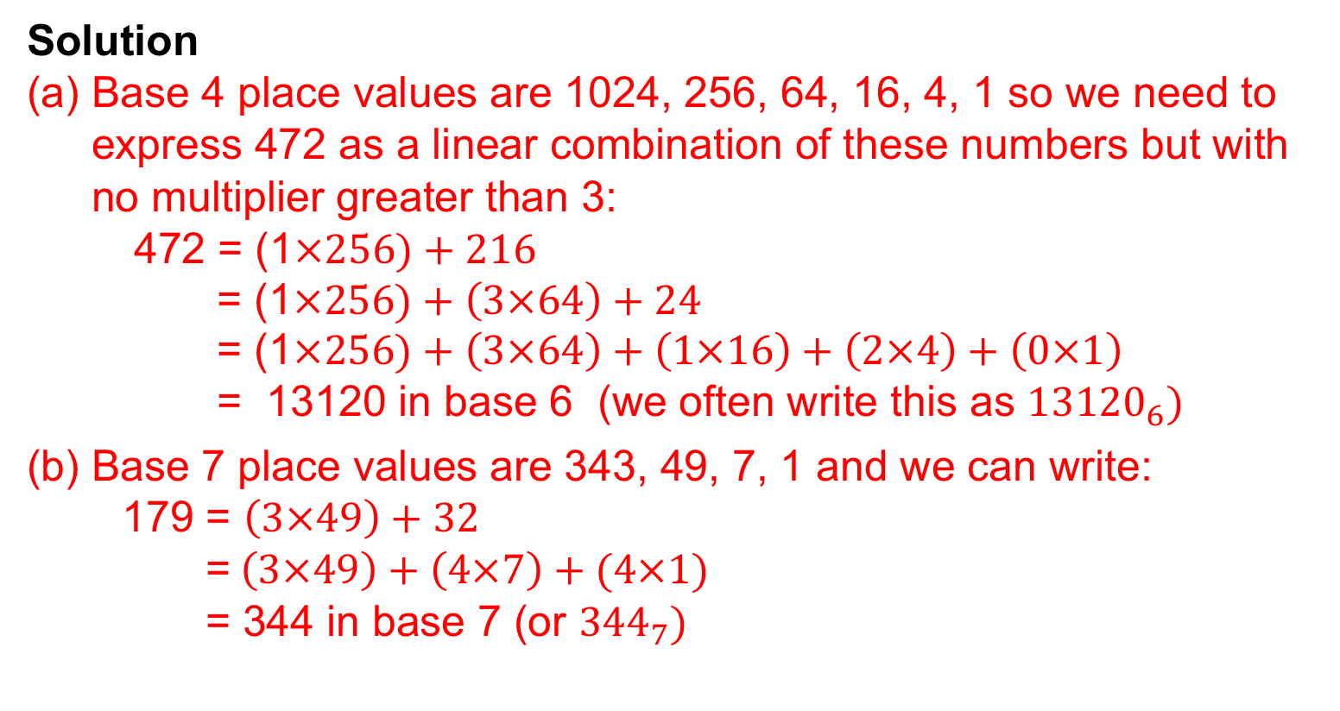
Other Bases: Worked Examples
STRAND B
UNIT B2
Section B2.5
Example 2
Convert these numbers in base 10 to numbers in the base stated:
(a) 472 to base 4 (b) 179 to base 7
Solution
Base 4 place values are 1024, 256, 64, 16, 4, 1 so we need to express 472 as a linear combination of these numbers but with no multiplier greater than 3:
472 = (1$×256)+216$
= (1$×256)+\left(3×64\right)+24$
= (1$×256)+\left(3×64\right)+\left(1×16\right)+\left(2×4\right)+\left(0×1\right)$
= 13120 in base 6 (we often write this as ${13120}_{6})$
(b) Base 7 place values are 343, 49, 7, 1 and we can write:
179 = $\left(3×49\right)+32$
=$\left(3×49\right)+\left(4×7\right)+(4×1)$
= 344 in base 7 (or ${344}_{7})$

Slide 25
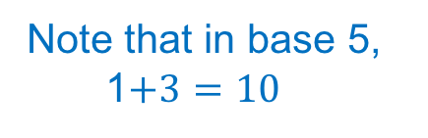


Other Bases: Worked Examples
STRAND B
UNIT B2
Section B2.5
Example 3
Carry out each of the following calculations in the base stated:
141 + 104 in base 5 (b) 16 + 32 in base 7
Check your answer to (b) by changing to base 10.
Solution
(a) 141
+ 104
300
1 1
(b) 16
+ 32
51
1
Note that in base 5,
1$+3=10$
Note that in base 7,
6$+2=11$
Check: In (b), 16 (in base 7) = (1$×7)+(6×$ 1) = $7+6=13$in base 10
and 32 (in base 7) = (3 $×7)+(2×$ 1) = $21+2=23$in base 10
$13+23=36$in base 10
and 36 = (5 $×$ 7)$+\left(1×1\right)=51$in base 7 (as above)

Slide 26




Other Bases: Worked Examples
STRAND B
UNIT B2
Section B2.5
Example 4
Carry out each of the following multiplication: 141$×$in base 5.
Check your answer to by changing to base 10.
Solution
141
$×$ 23
1021
3320
4343
Note that in base 5,
3$×4=22$ and 2$×4=13$
Check
141(in base 5) = (1 $×25)+\left(4×5\right)+\left(1×1\right)=$46 in base 10
23 (in base 5) = (2 $×5)+\left(3×1\right)=$13 in base 10
4343 (in base 5) = (4$×125)+\left(3×25\right)+\left(4×5\right)+\left(3×1\right)=598$ in base 10 and 46$×13=598 ($as expected)

Slide 27

Section B2.5: Fitness Check
STRAND B
UNIT B2
Section B2.5
Here are some questions to check your progress;
there are more practice questions if needed.
Convert 351 in base 6 to base 10.
Convert the number 342 to base 3.
Carry out this calculation, where numbers are in base 3:
212 + 121
Give your answer in base 3 and base 10.
Carry out this calculation, where numbers are in base 6:
512 $×$ 24
Give your answer in base 6 and base 10.
139
11200
410 (base 3), 39
21532 (base 6), 3008

Slide 28
Section B2.5: Review
STRAND B
UNIT B2
Section B2.5
You have completed the fifth and last Section.
If you need more examples and interactive practice, go to
http://szalonta.hu/ske/text/B2/skeb2s5.html

