Slide 1
TSST STRAND B
UNIT B3: Number Sequences

Slide 2
STRAND B
UNIT B3
Number Sequences
Number Sequences
Number Sequences are an important aspect of mathematics.
You have five sections to work through and there are
check up audits and fitness tests for each section.
Simple Number Patterns
Recognising Number Patterns
Extending Number Patterns
Formulae for Number Sequences
General Laws

Slide 3
STRAND B
UNIT B3
Section B3.1
Simple Number Patterns
A list of numbers which form a pattern is called a sequence.
To continue a number sequence, it is often very useful to
look for the difference between numbers.
Sequence
7, 11, 15, 19, 23, …
Difference
4 4 4 4
In this sequence, the difference is 4.
The next two terms are:
27 + 4 = 31, giving
7, 11, 15, 19, 23, 27, 31, …
23 + 4 = 27 and

Slide 4
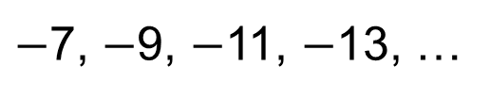
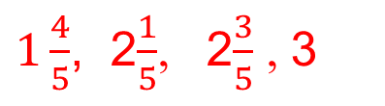
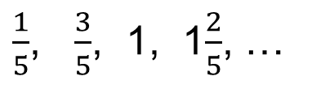
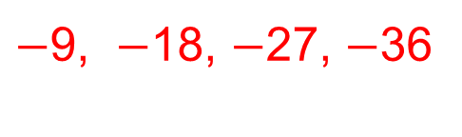
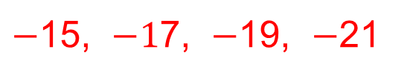
STRAND B
UNIT B3
Section B3.1
Section B3.1: Fitness Check
Here are some questions to check your progress;
there are more practice questions if needed.
Find the next four numbers in each sequence.
4, 9, 14, 19, …
24, 29, 34, 39
3, 20, 37, 54, …
71, 88, 105, 122
$−$7, $−$9, $−$11, $−$13, …
$−$15, $−1$7, $−$19, $−$21
18, 9, 0, …
$−$9, $−$18, $−$27, $−$36
2, 2.25, 2.5, 2.75,…
3, 3.25, 3.5, 3.75
1.9, 3.3, 4.7, 6.1, …
7.5, 8.9, 10.3, 11.7
$\frac{1}{5}$, $\frac{3}{5}$, 1, 1$\frac{2}{5}$, …
$1\frac{4}{5}$, 2$\frac{1}{5}$, 2$\frac{3}{5}$ , 3
0.91, 0.84, 0.77, 0.7, …
0.63, 0.56, 0.49, 0.42

Slide 5
STRAND B
UNIT B3
Section B3.1
Section B3.1: Review
You have completed the first Section.
If you have completed and understood this section,
click to start the next Section
If you need more examples and interactive practice, go to
http://szalonta.hu/ske/text/B3/skeb3s1.html

Slide 6
STRAND B
UNIT B3
Section B3.2
Recognising Number Patterns
Some number sequences follow different patterns.
Look at the ones below.
Can you spot the patterns?
Fibonacci Sequence:
Square Numbers:
Triangular Numbers:
(Note: Two consecutive Triangular Numbers sum to a Square Number, for example: 10 + 15 = 25)
Cube Numbers:
1, 1, 2, 3, 5, 8, 13, 21, 34,…
1, 4, 9, 16, 25, 36, 49, …
1, 3, 6, 10, 15, 21, 28, 36, ...
1, 8, 27, 64, 125, 216, ...

Slide 7
STRAND B
UNIT B3
Section B3.2
Recognising Number Patterns
1, 1, 2, 3, 5, 8, 13, 21, 34,…
Fibonacci Sequence:
is obtained by adding together two consecutive terms to obtain the next term.
Square Numbers sequence:
is obtained by squaring 1, then squaring 2, then squaring 3, then squaring 4, then squaring 5, ...
Triangular Numbers sequence:
the difference increases by 1 each time, starting with +2, then +3, then +4, …
Cube Numbers sequence:
is obtained by cubing 1, then cubing 2, then cubing 3, then cubing 4, then cubing 5, ...
1 + 1 = 2
1 + 2 = 3
2 + 3 = 5
3 + 5 = 8 and so on
1, 4, 9, 16, 25, 36, 49, …
1², 2², 3², 4², 5², 6², 7², …
1, 3, 6, 10, 15, 21, 28, 36, ...
1, 8, 27, 64, 125, 216, ...
1³, 2³, 3³, 4³, 5³, 6³, …

Slide 8
STRAND B
UNIT B3
Section B3.2
Recognising Number Patterns
Number sequences sometimes require detective work.
Often they are very similar to ones previously encountered - with just an added tweak or two.
2, 5, 10, 17, 26, 37, 50, …
Look at this one:
What comes next?
This is the square number sequence with one more added to each term.
And this one?
This is the triangular number sequence with each term doubled.
Try this one…
Similar to the Fibonacci sequence, this sequence is obtained by adding together two consecutive terms to obtain the next term.
2, 5, 10, 17, 26, 37, 50, 65, 82, …
2, 6, 12, 20, 30, 42, ...
2, 6, 12, 20, 30, 42, 56, 72, ...
1, 5, 6, 11, 17, 28, …

Slide 9

STRAND B
UNIT B3
Section B3.2
Recognising Number Patterns
Describe how the following sequences are related, and
find the next term for each:
(a) 1, 1, 2, 3, 5, 8, 13, 21, …
(b) 5, 5, 6, 7, 9, 12, 17, 25, …
(c) 2, 2, 4, 6, 10, 16, 26, 42, …
Find the next 2 terms in this number sequence:
$−$1, 2, 7, 14, 23, 34, …
34
38
68
The first is the Fibonacci sequence;
the second is the Fibonacci sequence with 4 added to each term;
the third is the Fibonacci sequence with each term doubled.
47, 62
This is the square number sequence with 2 subtracted from
each term.

Slide 10
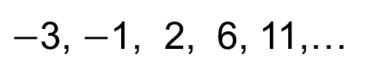
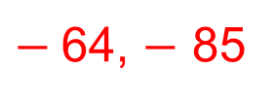
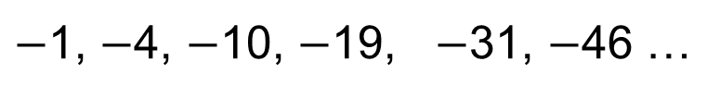
STRAND B
UNIT B3
Section B3.2
Section B3.2: Fitness Check
Here are some questions to check your progress;
there are more practice questions if needed.
Find the next two numbers in each sequence.
1, 8, 27, 64, 125, ...
216, 343
5, 6, 11, 17, 28, …
45, 73
$−$3, $−$1, 2, 6, 11,…
17, 24
1, 4, 9, 16, 25, …
36, 49
1, 3, 6, 10, 15, 21,…
28, 36
2, 8, 18, 32, 50, 72, …
98, 128
$−$1, $−$4, $−$10, $−$19, $−$31, $−$46 …
$−$64, $−$ 85

Slide 11
STRAND B
UNIT B3
Section B3.2
Section B3.2: Review
You have completed the second Section.
If you have completed and understood this section,
click to start the next Section
If you need more examples and interactive practice, go to
http://szalonta.hu/ske/text/B3/skeb3s2.html

Slide 12
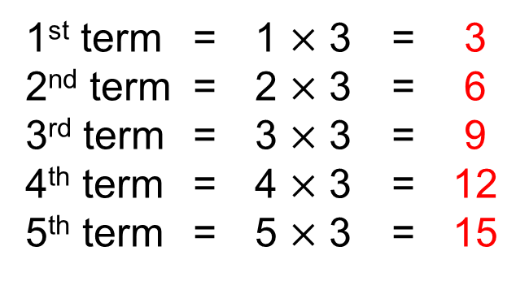
STRAND B
UNIT B3
Section B3.3
Extending Number Patterns
A formula or rule can be used to work out any term of a sequence without having to work out all the terms.
For example, we can work out the 100th term of
2, 5, 8, 11, 14,…
without having to work out all the interspersing terms.
Let’s look at this example first: 3, 6, 9, 12, 15, 18,…
The terms of the sequence can be obtained as shown below:
1st term = 1 $×$ 3 = 3
2nd term = 2 $×$ 3 = 6
3rd term = 3 $×$ 3 = 9
4th term = 4 $×$ 3 = 12
5th term = 5 $×$ 3 = 15
This pattern can be extended to give…
Continued on next slide

Slide 13

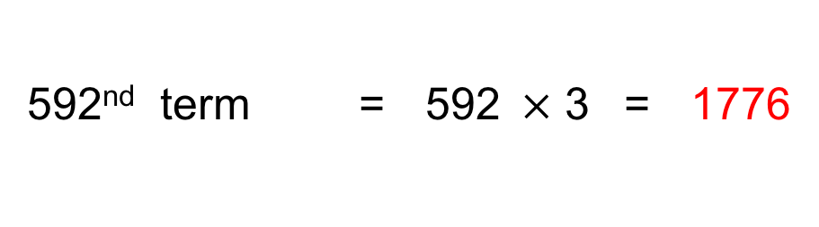
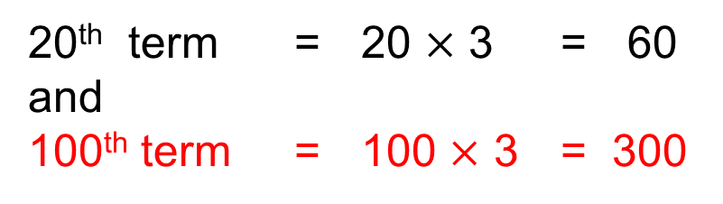
STRAND B
UNIT B3
Section B3.3
Extending Number Patterns
Continued
20th term = 20 $×$ 3 = 60
and
100th term = 100 $×$ 3 = 300
In fact, we can find any term we like.
What about the 1000th term? Or the 592nd term? Or the millionth term?
We simply multiply the term number by 3.
592nd term = 592$×$ 3 = 1776
We can generalise this by finding a rule for the n^{th} term
(that is for any term).
n^{th} term = n $×$ 3
n^{th} term = 3n

Slide 14
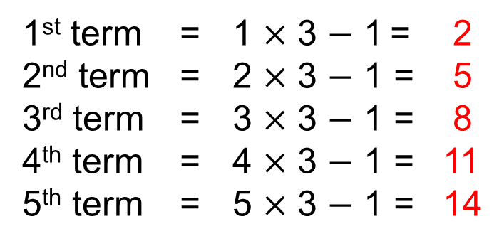
STRAND B
UNIT B3
Section B3.3
Extending Number Patterns
Let’s look again at:
Can we work out the 100th term?
2, 5, 8, 11, 14,…
And the n^{th} term?
First we spot the pattern, and notice that there is a
common difference of 3.
So the general term will be based on a multiple of 3.
But something else is happening too.
We also need to subtract 1.
The terms of the sequence are obtained as shown below:
1st term = 1 $×$ 3 $−$ 1 = 2
2nd term = 2 $×$ 3 $−$ 1 = 5
3rd term = 3 $×$ 3 $−$ 1 = 8
4th term = 4 $×$ 3 $−$ 1 = 11
5th term = 5 $×$ 3 $−$ 1 = 14
This pattern can be extended to give…
Continued on next slide

Slide 15
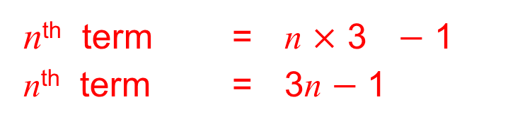
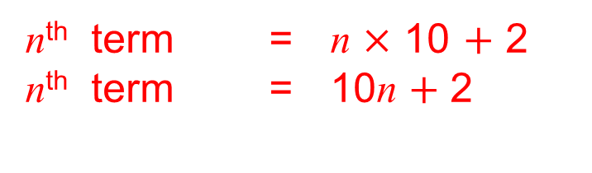
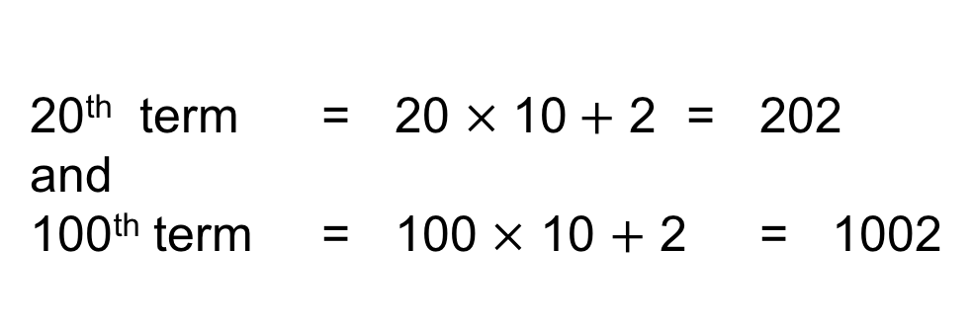
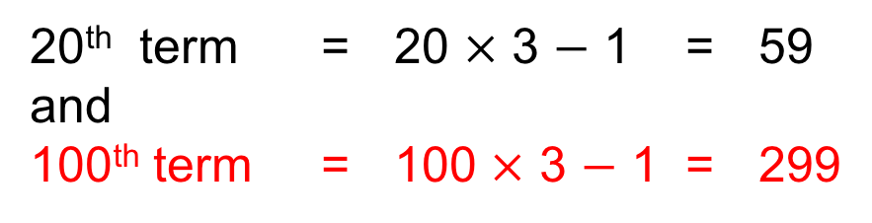
STRAND B
UNIT B3
Section B3.3
Extending Number Patterns
Continued
20th term = 20 $×$ 3 $−$ 1 = 59
and
100th term = 100 $×$ 3 $−$ 1 = 299
n^{th} term = n $×$ 3 $−$ 1
n^{th} term = 3n $−$ 1
Find the n^{th} term for this sequence:
12, 22, 32, 42, 52, 62,…
We simply multiply the term number by 10 and add 2.
For example,
20th term = 20 $×$ 10$+$ 2 = 202
and
100th term = 100 $×$ 10 $+$ 2 = 1002
n^{th} term = n $×$ 10 $+$ 2
n^{th} term = 10n $+$ 2

Slide 16
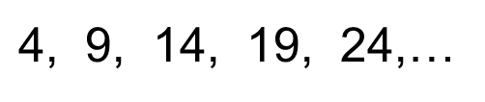
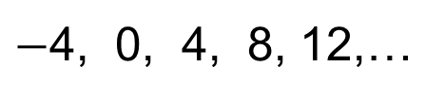
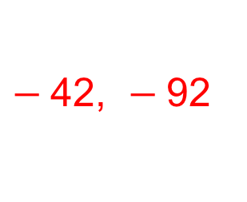
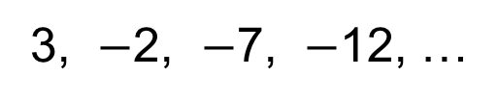
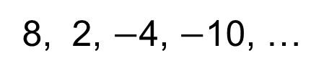
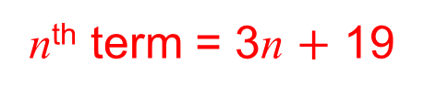
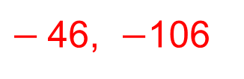
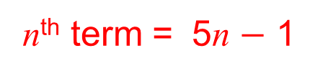
STRAND B
UNIT B3
Section B3.3
Section B3.3: Fitness Check
Here are some questions to check your progress;
there are more practice questions if needed.
Find the 10th and 20th terms of each sequence below:
7, 12, 17, 22, 27, ...
52, 102
8, 2, $−$4, $−$10, …
$−$46, $−$106
$−$4, 0, 4, 8, 12,…
32, 72
3, $−$2, $−$7, $−$12, …
$−$42, $−$92
Find the n^{th} terms of each sequence below:
$\text{4}$, 9, 14, 19, 24,…
n^{th} term = 5n $−$ 1
22, 25, 28, 31, …
n^{th} term = 3n $+$ 19

Slide 17
STRAND B
UNIT B3
Section B3.3
Section B3.3: Review
You have completed the third Section.
If you have completed and understood this section,
click to start the next Section
If you need more examples and interactive practice, go to
http://szalonta.hu/ske/text/B3/skeb3s3.html

Slide 18
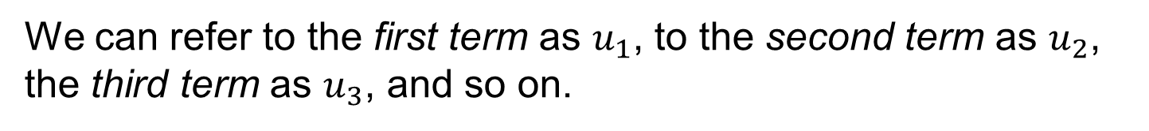
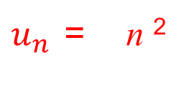
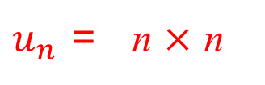
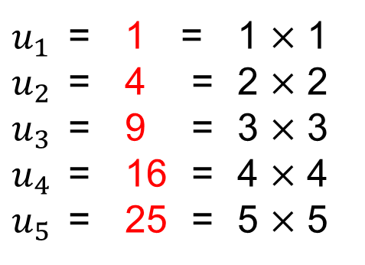
STRAND B
UNIT B3
Section B3.4
Formulae for Number Sequences
In the last section we found the n^{th} term for linear sequences, that is, for sequences which go up or down by a constant amount.
We can also find a formulae for the n^{th} term for other sequences.
For example:
1, 4, 9, 16, 25,…
We can refer to the first term as $u_{1}$, to the second term as $u_{2}$,
the third term as $u_{3}$, and so on.
$u_{1}$ = 1 = 1 $×$ 1
$u_{2}$ = 4 = 2 $×$ 2
$u_{3}$ = 9 = 3 $×$ 3
$u_{4}$ = 16 = 4 $×$ 4
$u_{5}$ = 25 = 5 $×$ 5
This sequence can be described by the general formula:
$u_{n}$ = n $×$ n
$u_{n}$ = n ²

Slide 19
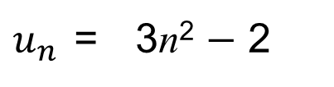
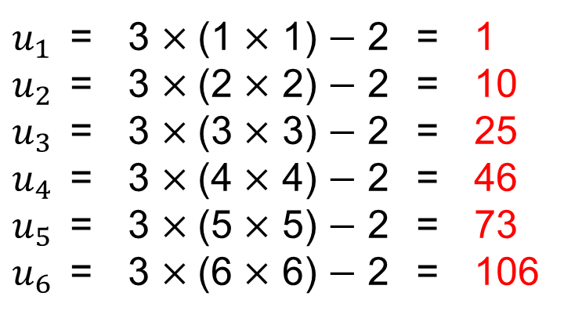
STRAND B
UNIT B3
Section B3.4
Formulae for Number Sequences
Example
Use the formula below to find the first 6 terms of the sequence:
$u_{n}$ = 3n² $−$ 2
Solution
We can work out each term in turn:
$u_{1}$ = 3 $×$(1 $×$ 1) $−$ 2 = 1
$u_{2}$ = 3 $×$(2 $×$ 2) $−$ 2 = 10
$u_{3}$ = 3 $×$(3 $×$ 3) $−$ 2 = 25
$u_{4}$ = 3 $×$(4 $×$ 4) $−$ 2 = 46
$u_{5}$ = 3 $×$(5 $×$ 5) $−$ 2 = 73
$u_{6}$ = 3 $×$(6 $×$ 6) $−$ 2 = 106
This sequence is:
1, 10, 25, 46, 73, 106,…

Slide 20
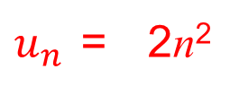
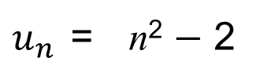
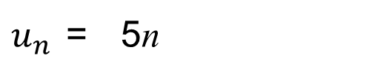
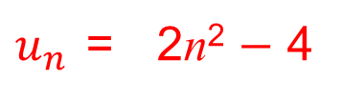
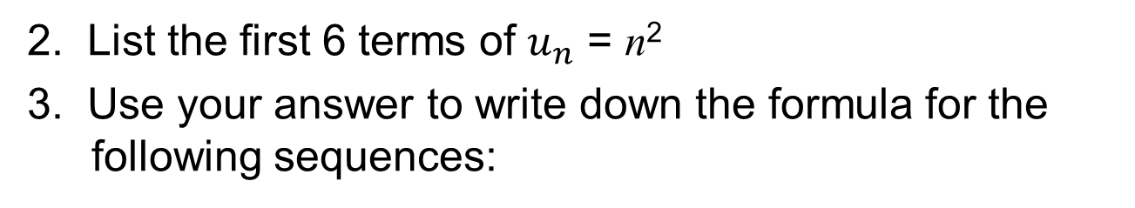
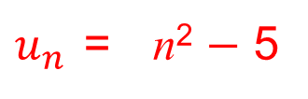
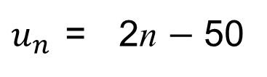
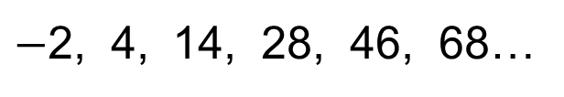
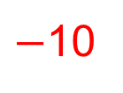
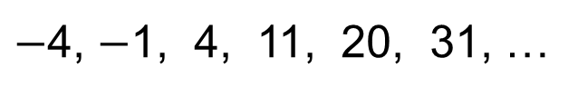
STRAND B
UNIT B3
Section B3.4
Section B3.4: Fitness Check
Here are some questions to check your progress;
there are more practice questions if needed.
1. Find the 20th term of each sequence below:
$u_{n}$ = 5n
100
$u_{n}$ = 2n $−$ 50
$−$10
398
$u_{n}$ = n² $−$ 2
2. List the first 6 terms of $u_{n}$ = n²
3. Use your answer to write down the formula for the
following sequences:
1, 4, 9, 16, 25, 36, …
2, 8, 18, 32, 50, 72, …
$u_{n}$ = 2n²
$−$4, $−$1, 4, 11, 20, 31, …
$u_{n}$ = n² $−$ 5
$−$2, 4, 14, 28, 46, 68…
$u_{n}$ = 2n² $−$ 4

Slide 21
STRAND B
UNIT B3
Section B3.4
Section B3.4: Review
You have completed the fourth Section.
If you have completed and understood this section,
click to start the next Section
If you need more examples and interactive practice, go to
http://szalonta.hu/ske/text/B3/skeb3s4.html

Slide 22
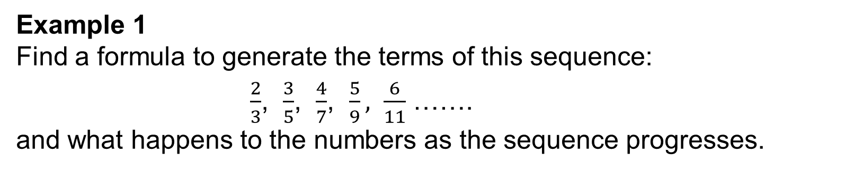
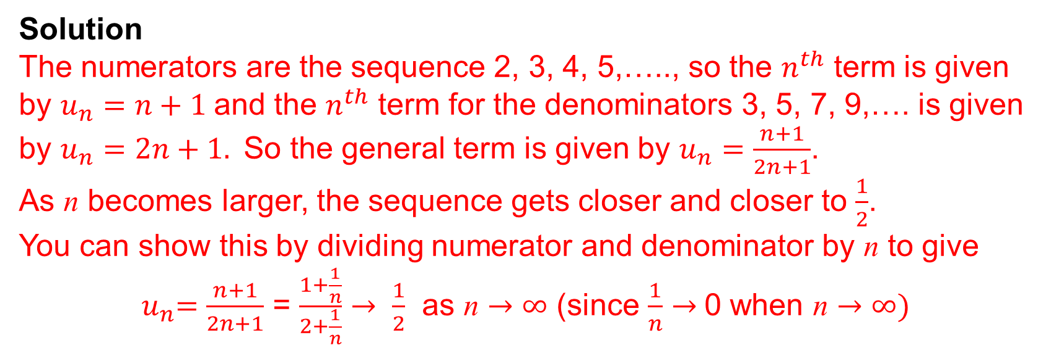
STRAND B
UNIT B3
Section B3.5
General Laws
We consider here ways to determine the rule for particular sequences, including iterative sequences and what happens to terms of a sequence in the long run. We will start with some illustrative sequences.
Example 1
Find a formula to generate the terms of this sequence:
$\frac{2}{3}$, $\frac{3}{5}$, $\frac{4}{7}$, $\frac{5}{9},$ $\frac{6}{11}$ …….
and what happens to the numbers as the sequence progresses.
Solution
The numerators are the sequence 2, 3, 4, 5,….., so the $n^{th}$ term is given by $u_{n}=n+1$and the $n^{th}$ term for the denominators 3, 5, 7, 9,…. is given by $u_{n}=2n+1.$So the general term is given by $u_{n}=\frac{n+1}{2n+1}$.
As n becomes larger, the sequence gets closer and closer to $\frac{1}{2}$.
You can show this by dividing numerator and denominator by n to give ${ u}_{n}=\frac{n+1}{2n+1}$ = $\frac{1+\frac{1}{n}}{2+\frac{1}{n}}$ $→ \frac{1}{2}$ as n $→$ $∞$ (since $\frac{1}{n}$ $→$0 when n $→$ $∞)$

Slide 23
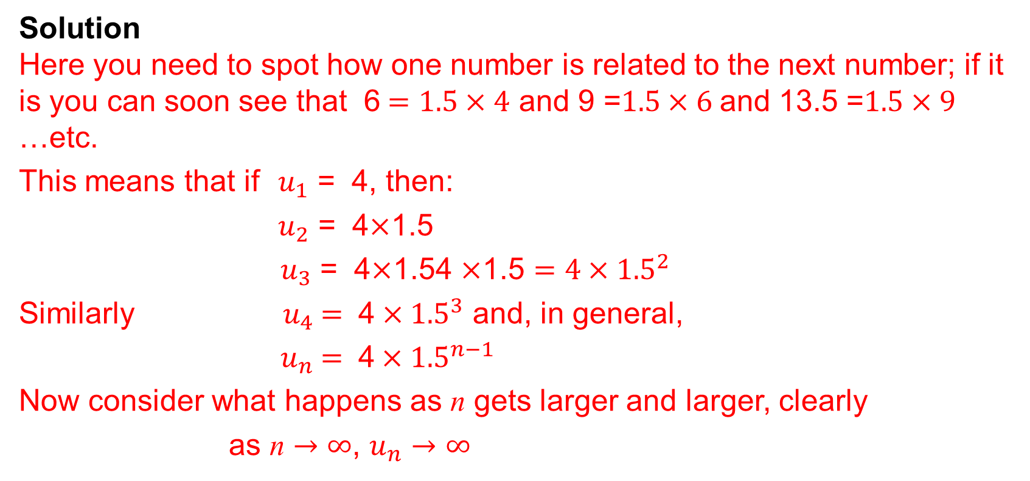
STRAND B
UNIT B3
Section B3.5
Examples
Example 2
Find a formula to generate the terms of this sequence:
4, 6, 9, 13.5, 20.25, ………….
and what happens to the numbers as the sequence progresses.
Solution
Here you need to spot how one number is related to the next number; if it is you can soon see that 6$=1.5×4$ and 9 =$1.5×6$and 13.5 =$1.5×9$ …etc.
This means that if $u_{1}$ = 4, then:
$u_{2}$ = 4$×$1.5
${ u}_{3}$ = 4$×$1.54 $×$1.5 $=4×{1.5}^{2}$
Similarly ${ u}_{4} = \text{4}×{1.5}^{3}$ and, in general,
${ u}_{n} = \text{4}×{1.5}^{n−1}$
Now consider what happens as n gets larger and larger, clearly
as n $→$ $∞$, $u_{n}$ $→$ $∞$
Note that this is called an iterative formula

Slide 24
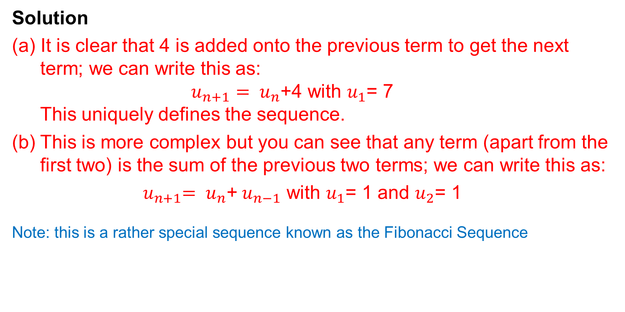
STRAND B
UNIT B3
Section B3.5
Iterative Formulae
Example 3
Find iterative formulae to generate the terms of this sequence:
(a) 7, 11, 15, 19, 23, 27, …. (b) 1, 1, 2, 3, 5, 8, 13, 21, …..
Solution
(a) It is clear that 4 is added onto the previous term to get the next term; we can write this as:
$u_{n+1}= u_{n}$+4 with $u_{1}$= 7
This uniquely defines the sequence.
(b) This is more complex but you can see that any term (apart from the first two) is the sum of the previous two terms; we can write this as:
${ u}_{n+1}= u_{n}$+$u_{n−1}$ with $u_{1}$= 1 and $u_{2}$= 1
Note: this is a rather special sequence known as the Fibonacci Sequence

Slide 25
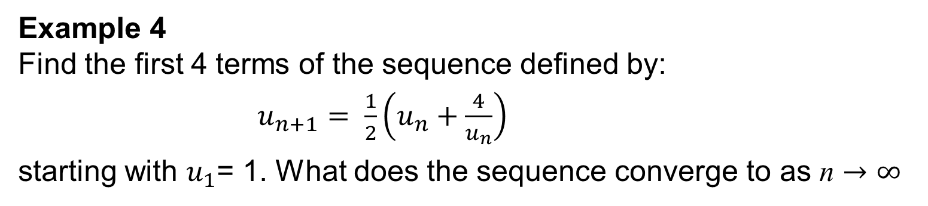
STRAND B
UNIT B3
Section B3.5
Iterative Formulae
Example 4
Find the first 4 terms of the sequence defined by:
$u_{n+1}= \frac{1}{2}\left(u_{n}+\frac{4}{u_{n}}\right)$
starting with $u_{1}$= 1. What does the sequence converge to as n $→$ $∞$
Solution
Here:
So it does look as if it is converging to 2 as n $→$ $∞$
Continued on next slide

Slide 26
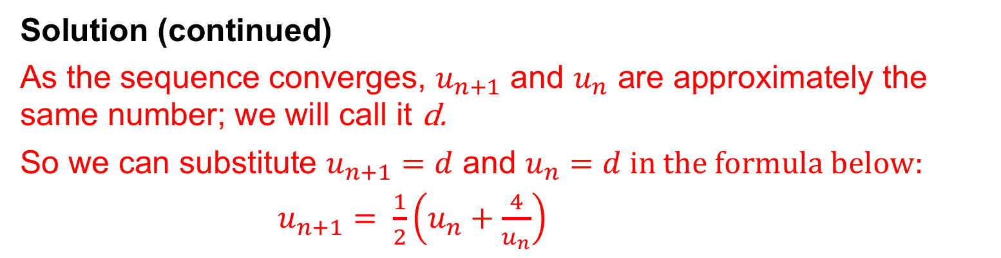
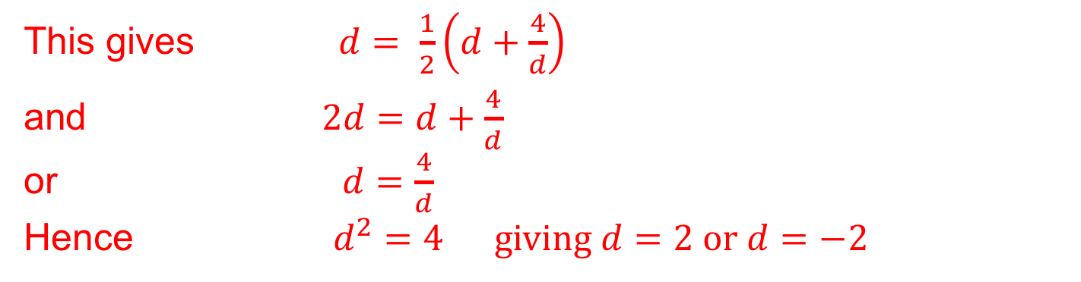
STRAND B
UNIT B3
Section B3.5
Iterative Formulae
Solution (continued)
As the sequence converges, $u_{n+1}$ and $u_{n}$ are approximately the same number; we will call it d.
So we can substitute $u_{n+1}=d$ and $u_{n}=d in the formula below:$
$u_{n+1}= \frac{1}{2}\left(u_{n}+\frac{4}{u_{n}}\right)$
This gives $d$ $= \frac{1}{2}\left(d+\frac{4}{d}\right)$
and $2d$ $=d+\frac{4}{d}$
or $d$ $=\frac{4}{d}$
Hence $d^{2}=4 giving d=2 or d=−2$
Clearly $d=2$ is the required answer as all terms are positive.

Slide 27

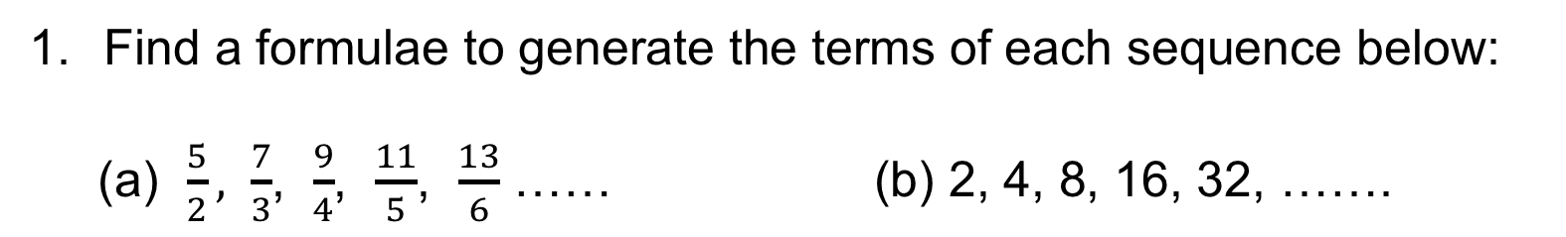


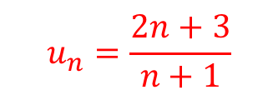

STRAND B
UNIT B3
Section B3.5
Section B3.5: Fitness Check
Here are some questions to check your progress;
there are more practice questions if needed.
Find a formulae to generate the terms of each sequence below:
(a) $\frac{5}{2}, \frac{7}{3}$, $\frac{9}{4}$, $\frac{11}{5}$, $\frac{13}{6}$ …… (b) 2, 4, 8, 16, 32, …….
$$u_{n}=\frac{2n+3}{n+1}$$
$u_{n}$=$2^{n}$
2. Find the iterative formulae for each of these sequencies:
(a) 5, 20, 80, 320, 1280, ….. (b) 3, 3, 6, 9, 15, 24, 39, ….
$u_{n+1}=4u_{n}$, $u_{1}=5$
$u_{n+1}= u_{n}$+$u_{n−1}$ with $u_{1}$= 3 and $u_{2}$= 3
3. The iterative formula $u_{n+1}= \frac{1}{2}\left(u_{n}+\frac{6}{u_{n}}\right)$ with ${ u}_{1 }=1$defines a sequence. Find the first 5 terms and show that it converges to $\sqrt{6.}$
1, 3.5, 2.6071, 2.4543, 2.4495

Slide 28
STRAND B
UNIT B3
Section B3.5
Section B3.5: Review
You have completed the fifth and last Section.
If you need more examples and interactive practice, go to
http://szalonta.hu/ske/text/B3/skeb3s5.html

