Slide 1
TSST Strand C
UNIT C1: Units of Measurement

Slide 2
STRAND C
UNIT C1
Units of Measurement
Units of Measurement and their application are essential in all branches of the sciences.
You have four sections to work through and there are check up audits and fitness tests for each section.
Units and Measuring
Upper and Lower Bounds
Estimating Areas
Conversion of Units

Slide 3
STRAND C
UNIT C1
Section C1.1
Units and Measuring
Different units of measurement can be used to measure the same quantities. It is important to use sensible units. Some important units are listed below.
Quantity | Units of Measurement
Length | 1 km = 1000 m 1 m = 100 cm 1 m = 1000 mm 1 cm = 10 mm
Weight | 1 tonne = 1000 kg 1 kg = 1000 g
Volume/Capacity | 1 litre = 1000 ml 1 m³ = 1000 litres 1 cm³ = 1 ml

Slide 4
STRAND C
UNIT C1
Section C1.1
Units and Measuring: Examples
Example 1
What would be the best units to use when measuring,
(a) the distance between London and Plymouth
(b) the width of a watch-face
(c) the mass of a person
(d) the mass of a letter
(e) the mass of a lorry
(f) the volume of medicine in a spoon
(g) the volume of water in a swimming pool?
Solutions
(a) km (or miles)
(b) mm or cm
(c) kg
(d) grams
(e) tonnes
(f) ml
(g) m³

Slide 5
STRAND C
UNIT C1
Section C1.1
Units and Measuring: Examples
Example 2
(a) How many mm are there in 3.72m?
(b) How many cm are there in 4.23m?
(c) How many m are there in 102.5 km?
(d) How many kg are there in 4.32 tonnes?
1 m = 1000 mm; so 3.72 m = 3.72 × 1000 = 3720 mm
1 m = 100 cm; so 4.23m = 4.23 × 100 = 423 cm
1 km = 1000 m; so 102.5 km = 102.5 × 1000 = 102 500 m
1 tonne = 1000 kg; so 4.32 tonnes = 4.32 × 1000 = 4320 kg

Slide 6



STRAND C
UNIT C1
Section C1.1
Units and Measuring: Examples
Example 3
What value does each arrow point to?
(a)
(b)
(c)
Here the marks are 0.1 units apart
so the arrow points to 12.6.
Here the marks are 0.2 units apart
so the arrow points to 11.8.
Here the marks are 0.4 units apart
so the arrow points to 6.8.

Slide 7
STRAND C
UNIT C1
Section C1.1
Section C1.1: Fitness Check
Here are some questions to check your progress;
there are more practice questions if needed.
Which units do you think would be the most suitable to use when measuring:
(a) the distance between two towns
(b) the length of a sheet of paper
(c) the mass of a sheet of paper
(d) the mass of a sack of cement
(e) the volume of a water in a cup
(f) the volume of water in a large tank?
Answers
(a) km or miles
(b) cm
(c) mg or grams
(d) kg
(e) ml
(f) m³ or litres

Slide 8
STRAND C
UNIT C1
Section C1.1
Section C1.1: Fitness Check
2. Complete the missing quantities in this table
Length in m | Length in cm | Length in mm
4
 | 311
 |  | 1500
 | 374
8.62
400 4000
3.11 3110
1.5 150
3.74 3740
862 8620

Slide 9
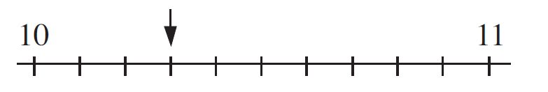


STRAND C
UNIT C1
Section C1.1
Section C1.1: Fitness Check
3. What value does each arrow point to?
(a)
(b)
(c)
10.3
130
6.6

Slide 10
STRAND C
UNIT C1
Section C1.1
Section C1.1: Review
You have completed the first Section.
If you have completed and understood this section,
click to start the next Section
If you need more examples and interactive practice, go to
http://szalonta.hu/ske/text/C1/skec1s1.html

Slide 11
STRAND C
UNIT C1
Section C1.2
Upper and Lower Bounds
When measurements are made, they can only be obtained to a limited degree of accuracy.
For example, if the length of a line is given as 11 mm, this means that it
is 11 mm to the nearest mm.
This means, for example, that the original measurement could have
been 11.3 mm, as 11.3 mm would round to 11 mm but the original measurement could also have had a value of 10.6 mm, as 10.6 mm
would also round to 11 mm. There are many values that the original measurement could have taken.
In fact, if l is the length of 11 mm then it must lie in the range
10.5 ≤ l < 11.5
This just says that the length can be anything between 10.5 mm and
11.5 mm.

Slide 12
STRAND C
UNIT C1
Section C1.2
Upper and Lower Bounds: Examples
For each length below state the range of values within which the length must be.
(a) 18 cm
(b) 12.7 cm
(c) 11.06 m
17.5 cm ≤ l < 18.5 cm
12.65 cm ≤ l < 12.75 cm
11.055 cm ≤ l < 11.065 cm

Slide 13
STRAND C
UNIT C1
Section C1.2
Upper and Lower Bounds: Note
The lower bound is the smallest number which will round to the given number, while the upper bound is the smallest number which will not round to the given number.
So in the previous example, for 18 cm
17.5 cm ≤ l < 18.5 cm
and the lower bound is 17.5 cm
while the upper bound is 18.5 cm.

Slide 14
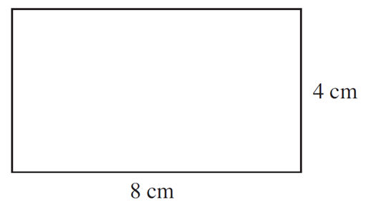
STRAND C
UNIT C1
Section C1.2
Upper and Lower Bounds: Example
If the length of the sides of the rectangle
below are given to the nearest cm, find:
(a) The minimum possible perimeter.
First note that the length, l, of the rectangle is 8 cm to the nearest cm,
so 7.5 cm ≤ l < 8.5 cm
Similarly for w to the nearest cm, 3.5 cm ≤ w < 4.5 cm
To find the minimum possible perimeter, we use the minimum length and widths, giving:
Minimum perimeter = 7.5 cm + 3.5 cm + 7.5 cm + 3.5 cm = 22 cm
(b) The range of possible areas.
We use the maximum and minimum lengths of each side.
Minimum area = 3.5 cm × 7.5 cm = 26.25 cm²
Maximum area = 4.5 cm × 8.5 cm = 38.25 cm²
This gives 26.25 cm ≤ area < 38.25 cm²

Slide 15
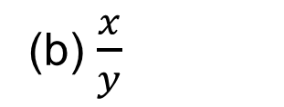
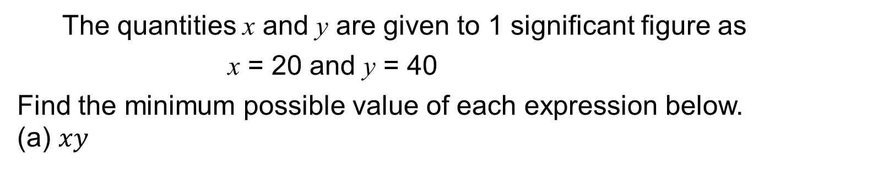
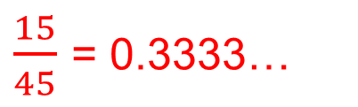
STRAND C
UNIT C1
Section C1.2
Upper and Lower Bounds: Example
The quantities x and y are given to 1 significant figure as
x = 20 and y = 40
Find the minimum possible value of each expression below.
(a) $xy$
x and y are given to 1 significant figure as x = 20 and y = 40 ,
so the ranges are:
15 ≤ x < 25 and 35 ≤ y < 45
The minimum possible value is 15 × 35 = 525
(b) $\frac{x}{y}$
The smallest value is now obtained by dividing the lower bound
by the upper bound, as dividing by a bigger number gives a
smaller answer.
$\frac{15}{45}$ = 0.3333…

Slide 16
STRAND C
UNIT C1
Section C1.2
Section C1.2: Fitness Check
Here are some questions to check your progress;
there are more practice questions if needed.
For each quantity below, state the range of values within which it must lie.
(a) x = 4.7
(b) r = 11.68
(c) w = 218
(d) v = 20.0
    4.65 ≤ x < 4.75
      11.675 ≤ r <11.685
        217.5 ≤ w < 218.5
        19.95 ≤ v < 20.05

Slide 17
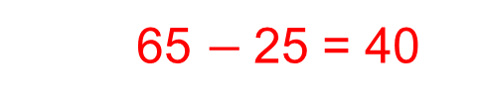
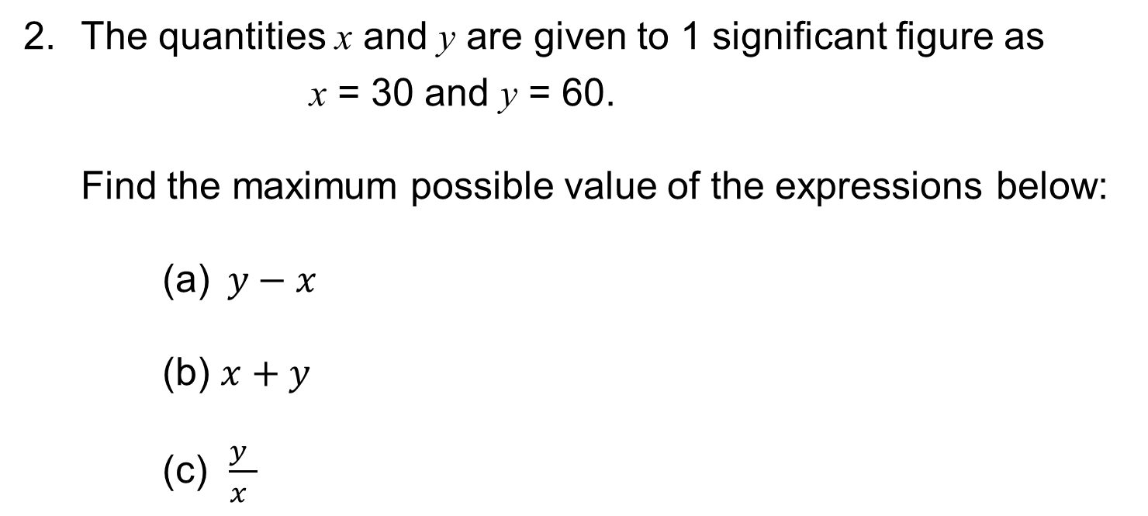
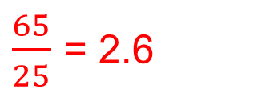
STRAND C
UNIT C1
Section C1.2
Section C1.2: Fitness Check
2. The quantities x and y are given to 1 significant figure as
x = 30 and y = 60.
Find the maximum possible value of the expressions below:
(a) $y−x$
(b) $x+y$
(c) $\frac{y }{x }$
  65 $−$25 = 40
65 + 35 = 100
$\frac{65}{25}$ = 2.6

Slide 18
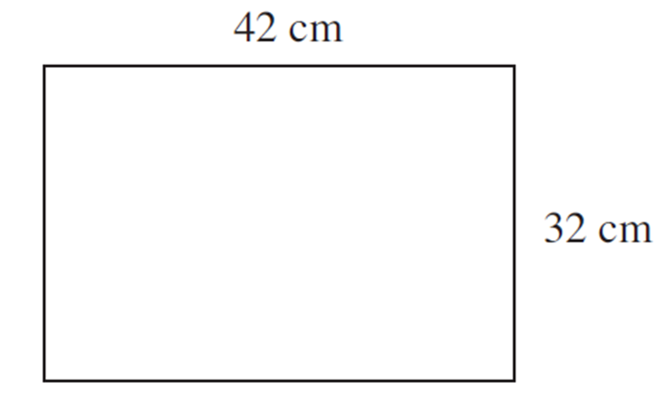
STRAND C
UNIT C1
Section C1.2
Section C1.2: Fitness Check
3. If the length of the sides of the rectangle are given to
the nearest cm, find:
(a) the maximum possible area
(b) the range of possible perimeters.
43.5 cm × 32.5 cm = 1413.75 cm²
148 cm ≤ perimeter < 152 cm

Slide 19
STRAND C
UNIT C1
Section C1.2
Section C1.2: Review
You have completed the second Section.
If you have completed and understood this section,
click to start the next Section
If you need more examples and interactive practice, go to
http://szalonta.hu/ske/text/C1/skec1s2.html

Slide 20
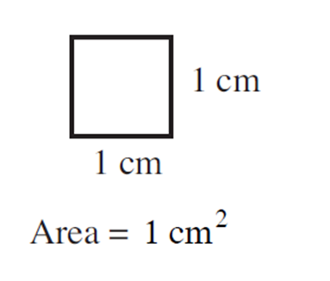
STRAND C
UNIT C1
Section C1.3
Areas Concept
A square with sides of 1 cm has an area of 1 cm^{2.}
The area of shapes can be either counted or estimated to see how many of these squares fit inside the shape.
The next examples illustrate this method.
In the following slides, = 1 cm².

Slide 21
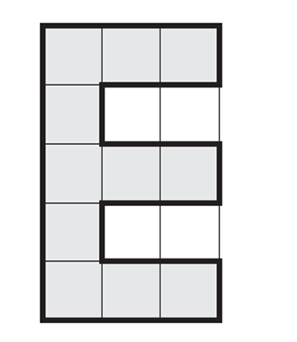
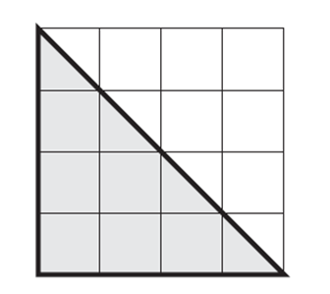
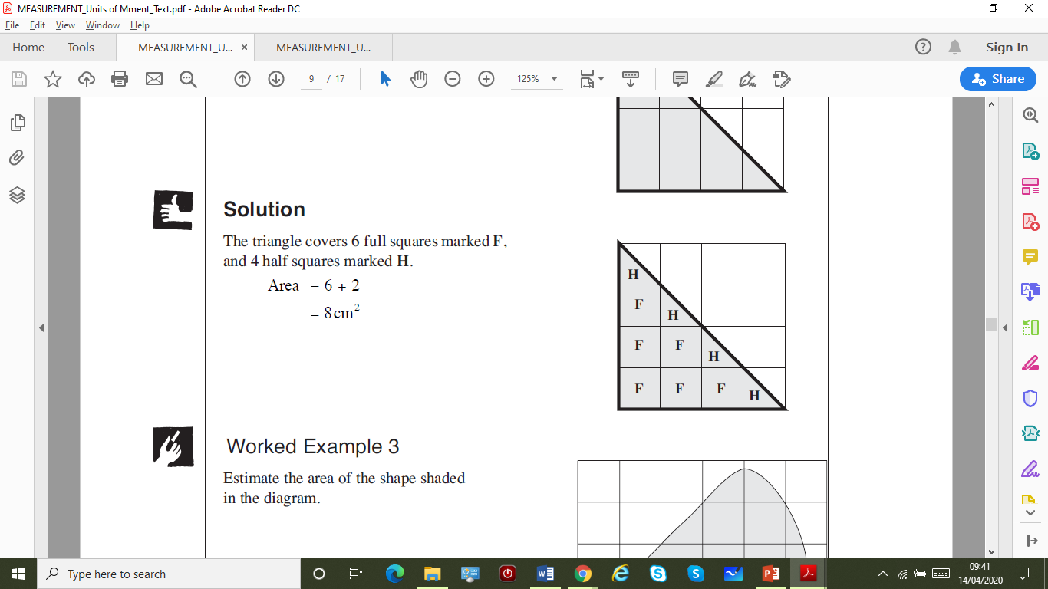
STRAND C
UNIT C1
Section C1.3
Areas of Shapes: Examples
Example 1
Find the area of the shaded shape
on the right.
Solution
The shape covers 11 squares,
so its area is 11 cm^{2.}
Example 2
Find the area of this
shaded shape.
Solution
The triangle covers 6 full squares marked F, and 4 half squares marked H, the half squares combine to give an area of 2.
Area = 6 cm + 2 cm = 8 cm²

Slide 22
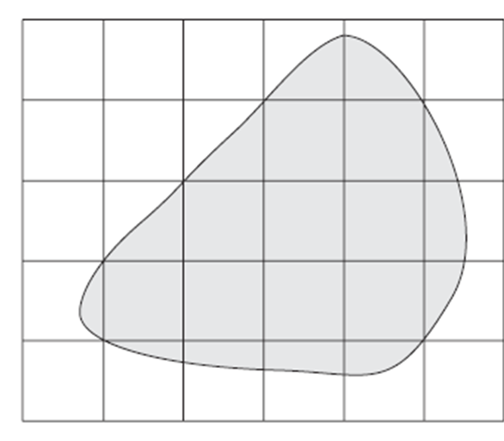
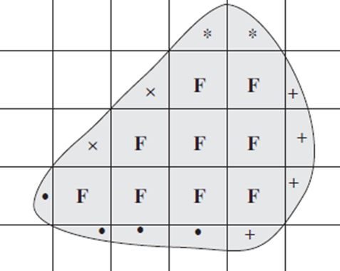
STRAND C
UNIT C1
Section C1.3
Areas of Shapes: Examples
Example 3
Estimate the area of the shaded shape.
Solution
This is a more complicated problem as there are only 9 full squares marked F, but many other part squares. You need to combine part squares that approximately make a whole square, as shown below.
Note that squares marked
* or × or + or • make about
1 full square; so this gives:
approximate area = 9 + 4 = 13 cm²

Slide 23
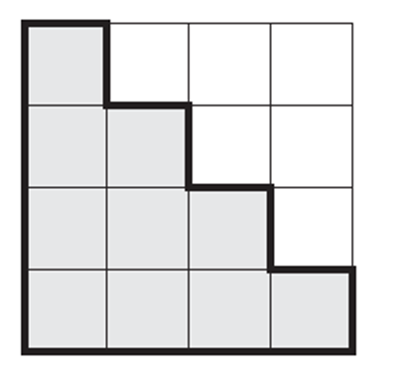
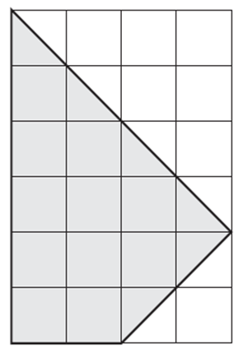
STRAND C
UNIT C1
Section C1.3
Section C1.3: Fitness Check
1. Find the area of the shaded shape.
Answer
10 cm²
2. Find the area of the shaded shape.
Answer
14 cm²

Slide 24
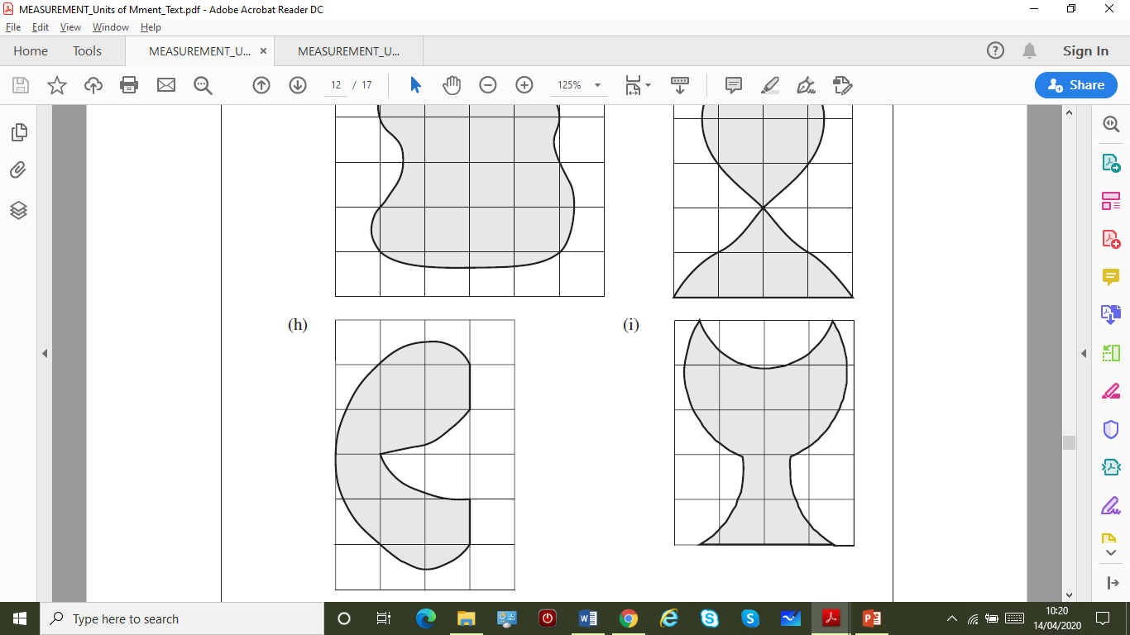
STRAND C
UNIT C1
Section C1.3
Section C1.3: Fitness Check
3. Estimate the area of the shape
shaded in the diagram.
Answer
You should get an estimate
somewhere between
9 cm² and 11 cm²

Slide 25
STRAND C
UNIT C1
Section C1.3
Section C1.3: Review
You have completed the third Section.
If you have completed and understood this section,
click to start the next Section
If you need more examples and interactive practice, go to
http://szalonta.hu/ske/text/C1/skec1s3.html

Slide 26
STRAND C
UNIT C1
Section C1.4
Conversion of Units
It is useful to be aware of both metric and imperial units and
to be able to convert between them.
The following table shows conversions within
imperial units of measurement.
1 foot = 12 inches
1 yard = 3 feet
1 mile = 1760 yards
1 pound (lb) = 16 ounces
1 stone = 14 pounds
1 gallon = 8 pints

Slide 27
STRAND C
UNIT C1
Section C1.4
Conversion of Units
You can convert between metric and imperial units using
the following facts.
Conversion Facts
1 kg is about 2.2 lbs.
1 gallon is about 4.5 litres.
1 litre is about 1.75 pints.
5 miles is about 8 km.
1 inch is about 2.5 cm.
1 foot is about 30 cm.

Slide 28
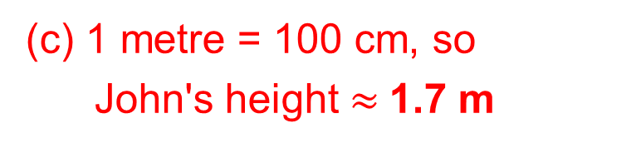
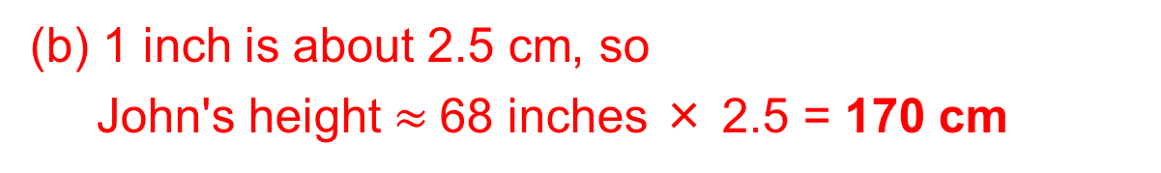
STRAND C
UNIT C1
Section C1.4
Conversion of Units: Examples
Example 1
John is measured. His height is 5 feet and 8 inches.
Find his height in:
(a) inches (b) centimetres (c) metres
Solutions
(a) There are 12 inches in one foot, so
John's height = 5×12 inches + 8 inches
= 60 inches + 8 inches
= 68 inches
(b) 1 inch is about 2.5 cm, so
John's height $≈$68 inches × 2.5 = 170 cm
(c) 1 metre = 100 cm, so
John's height $≈$1.7 m

Slide 29
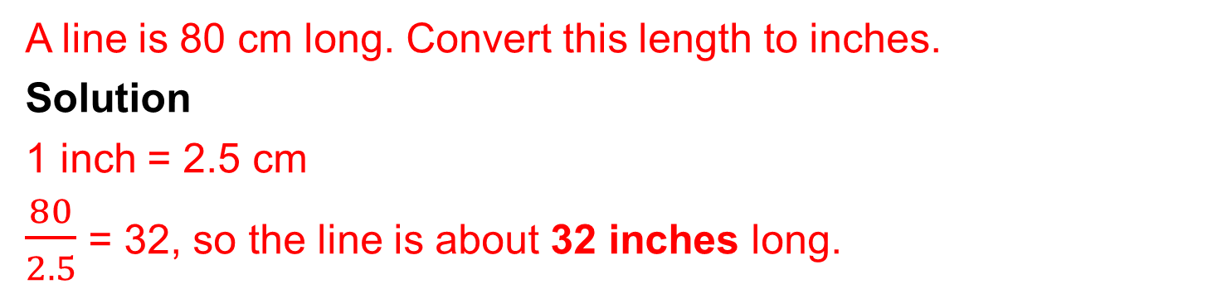
STRAND C
UNIT C1
Section C1.4
Conversion of Units: Examples
Example 2
A family travels 65 miles on holiday. Convert this distance to km.
Solution
As 5 miles is approximately equal to 8 km, first divide the distance by 5 and then multiply by 8.
65 ÷ 5 = 13
13 × 8 = 104
So 65 miles is approximately the same as 104 km.
Example 3
A line is 80 cm long. Convert this length to inches.
Solution
1 inch = 2.5 cm
$\frac{80}{2.5}$ = 32, so the line is about 32 inches long.

Slide 30
STRAND C
UNIT C1
Section C1.4
Conversion of Units: Examples
Example 4
John weighs 8 stone and 5 lbs. Find John's weight in:
(a) lbs (b) kg
Solution
(a) There are 14 lbs in 1 stone.
8 ×14 + 5 = 112 + 5
= 117
John's weight is 117 lbs.
(b) 1 pound is about 0.45 kg.
117 × 0.45 = 53
John's weight is 53 kg (to the nearest kg).

Slide 31
STRAND C
UNIT C1
Section C1.4
Section C1.4: Fitness Check
Here are some questions to check your progress;
there are more practice questions if needed.
1. Convert each quantity to the units given.
(a) 3 inches to cm (b) 18 stone to lbs
(c) 6 lbs to ounces (d) 6 feet 3 inches to inches
(e) 15 kg to lbs (f) 3 yards to inches
(g) 3 feet to cm (h) 5 gallons to litres
(i) 45 kg to lbs (j) 9 litres to pints
(l) 45 gallons to litres (m) 8 litres to pints
7.5 cm
96 ounces
33 lbs
90 cm
99 lbs
202.5 litres
252 lbs
75 inches
108 inches
22.5 litres
15.75 pints
14 pints

Slide 32
STRAND C
UNIT C1
Section C1.4
Section C1.4: Fitness Check
2. Convert each quantity to the units given.
Give answers correct to 1 decimal place.
3.6 kg
9.1 litres
13.3 feet
13.0 stones
7.0 feet
(a) 8 lbs to kg (b) 3 lbs to kg
(c) 16 pints to litres (d) 10 cm to inches
(e) 400 cm to feet (f) 80 ounces to lbs
(g) 182 lbs to stones (h) 50 litres to gallons
(i) 84 inches to feet (j) 52 cm to inches
1.4 kg
4.0 inches
5.0 lbs
11.1 gallons
20.8 inches

Slide 33
STRAND C
UNIT C1
Section C1.4
Section C1.4: Fitness Check
3. Jimar is 6 feet 2 inches tall and weighs 11 stone 5 pounds.
Sam is 180 cm tall and weighs 68 kg.
Who is the taller and who is the heavier?
Find your answer by converting Jimar’s measurements
into metric measurements.
Answer
Jimar is both taller and heavier than Sam (Jimar is 185 cm tall and weighs over 70 kg).

Slide 34
STRAND C
UNIT C1
Section C1.4
Section C1.4: Fitness Check
4. A car travels on average 10 km for every litre of fuel.
The car is driven from Chichester to Woking, a distance of 41 miles.
(a) How far does the car travel in km?
(b) How many litres of fuel are used?
(c) How many gallons of fuel are used?
65.6 km
6.56 litres
1.46 gallons

Slide 35
STRAND C
UNIT C1
Section C1.4
Section C1.4: Review
You have completed the fourth and last Section.
If you need more examples and interactive practice, go to
http://szalonta.hu/ske/text/C1/skec1s4.html

