Slide 1
TSST Strand C
UNIT C2: Solids

Slide 2
STRAND C
UNIT: C2
Solids
Solids
This Unit focuses on Solids, 3-dimensional shapes, how they can
be described and constructed.
You have four sections to work through and there are check up audits
and fitness tests for each section.
Making Solids Using Nets
Constructing Nets
Plans and Elevations
Using Isometric Paper

Slide 3
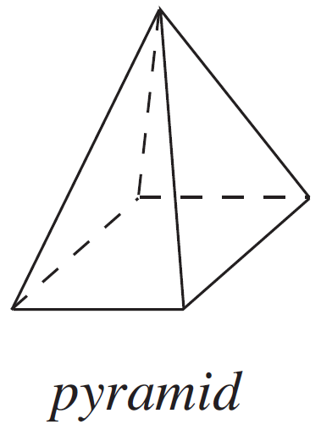
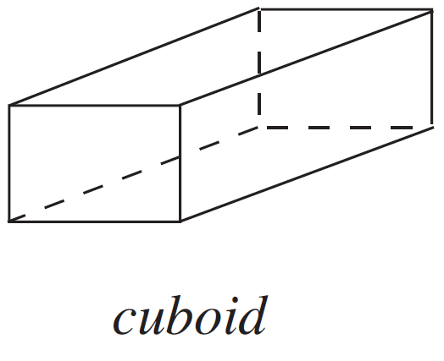
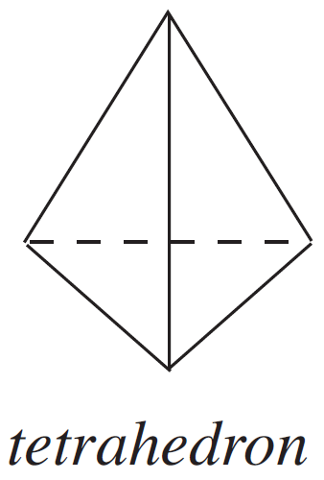
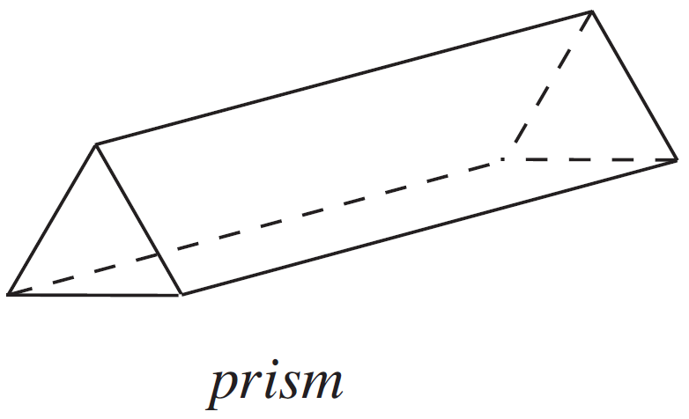
STRAND C
UNIT: C2
Solids
Section C2.1
3-Dimensional Shapes
In this unit you will be dealing with 3-dimensional shapes such as:

Slide 4
STRAND C
UNIT: C2
Solids
Section C2.1
Prisms
Prisms are a common 3-dimensional shape. They can be formed
by taking any two-dimensional shape and extending (‘extruding’) it
to create a 3-dimensional shape with a cross section of the original
2D shape. The prism can be named after the 2D shape, for
example, the prism below could be named a triangular prism.

Slide 5
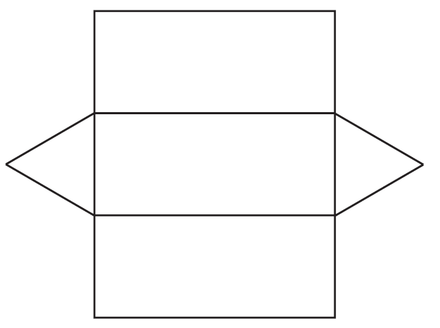
STRAND C
UNIT: C2
Solids
Section C2.1
Making Solids Using Nets
Example 1
A net can be cut out, folded and glued to make a hollow shape.
What solid is made when the net shown is folded and glued?
You can try this question and check your answer on the next slides.

Slide 6

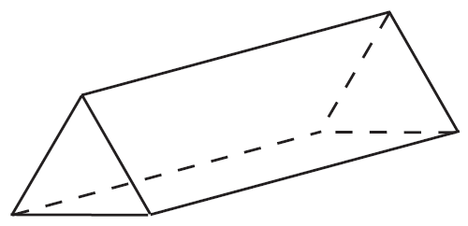
STRAND C
UNIT: C2
Solids
Section C2.1
Making Solids Using Nets
Solution
It is important to add tabs to the net so that it can be glued. You could put tabs on every edge, but this would mean gluing tabs to tabs. The first diagram shows one possible position of the tabs.
The final solid is a triangular prism.

Slide 7
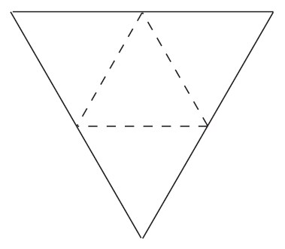

STRAND C
UNIT: C2
Solids
Section C2.1
Section C2.1: Fitness Check
Here are some questions to check your progress; there are more practice questions if needed.
Copy and cut out larger versions of the following nets. What are the names of the solids you make?

Slide 8
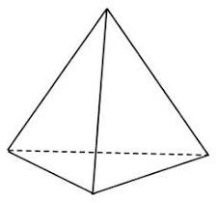
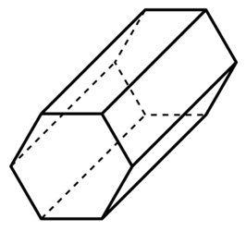
STRAND C
UNIT: C2
Solids
Section C2.1
Section C2.1: Fitness Check
Answers
The first shape is a pyramid, with a triangular base. The second shape is a prism, with a hexagon cross section, which can be named a hexagonal prism.

Slide 9
STRAND C
UNIT: C2
Solids
Section C2.1
Section C2.1: Review
You have completed the first Section.
If you have completed and mastered this section,
click to start the next Section
If you need more examples and interactive practice, go to
http://szalonta.hu/ske/text/C2/skec2s1.html

Slide 10
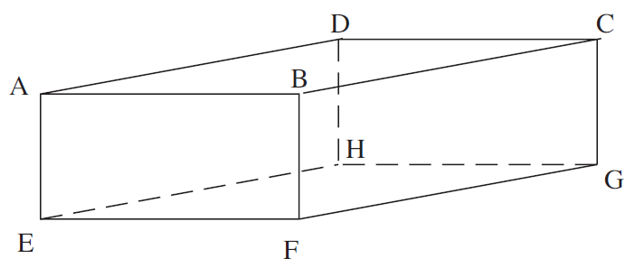
STRAND C
UNIT: C2
Solids
Section C2.2
Constructing Nets
A net for a solid can be visualised by imagining that the shape is cut along its edges until it can be laid flat.
Example 1
Draw the net for the cuboid shown in the diagram.

Slide 11

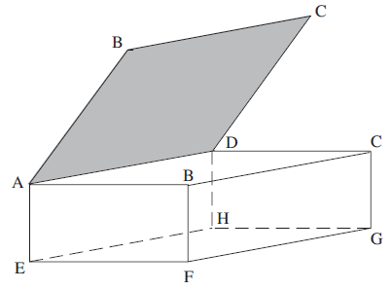
STRAND C
UNIT: C2
Solids
Section C2.2
Constructing Nets
Solution
A possible solution is
shown on the left.
It then can be folded together to make the cuboid, as below.

Slide 12
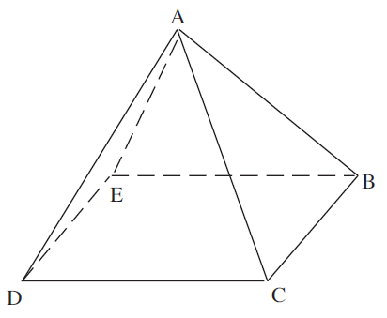
STRAND C
UNIT: C2
Solids
Section C2.2
Constructing Nets
Example 2
Draw the net for this square-based pyramid.

Slide 13
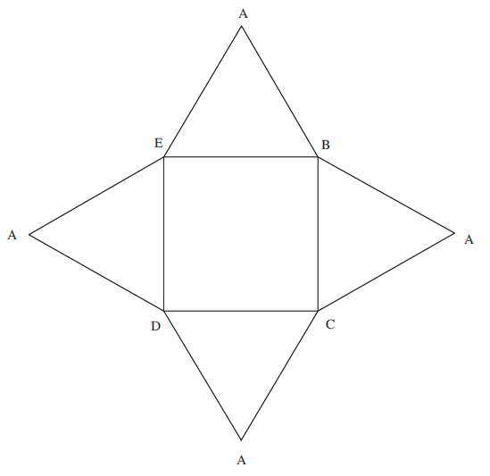
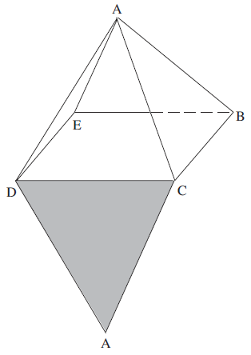
STRAND C
UNIT: C2
Solids
Section C2.2
Constructing Nets
Solution
A possible solution is
shown on the left.
It then can be folded together to make the shape, as below.

Slide 14
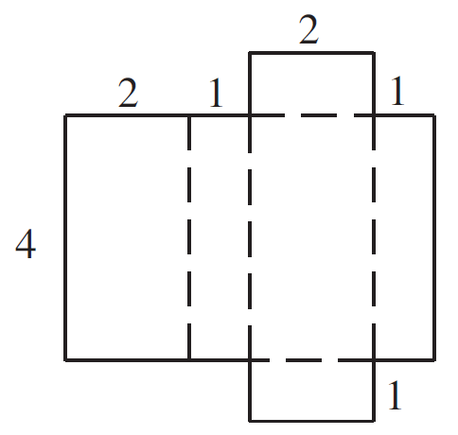
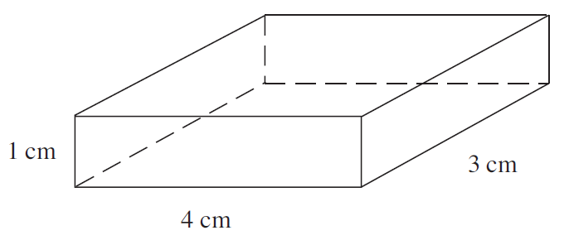
STRAND C
UNIT: C2
Solids
Section C2.2
Section C2.2: Fitness Check
Here are some questions to check your progress; there are more practice questions if needed.
1. Draw an accurate net for the cuboid below.
Answer
One possible answer
is shown above.

Slide 15
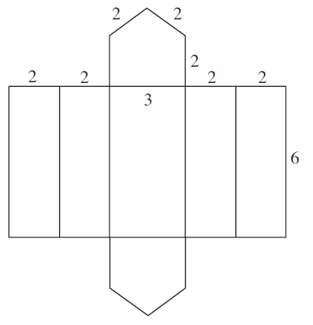
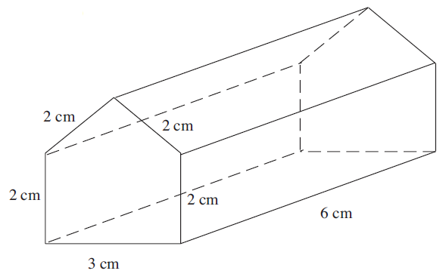
STRAND C
UNIT: C2
Solids
Section C2.2
Section C2.2: Fitness Check
2. Draw an accurate net for the prism below.
Answer
Note: this is just one possible answer.

Slide 16
STRAND C
UNIT: C2
Solids
Section C2.2
Section C2.2: Review
You have completed the second Section.
If you have completed and mastered this section,
click to start the next Section
If you need more examples and interactive practice, go to
http://szalonta.hu/ske/text/C2/skec2s2.html

Slide 17
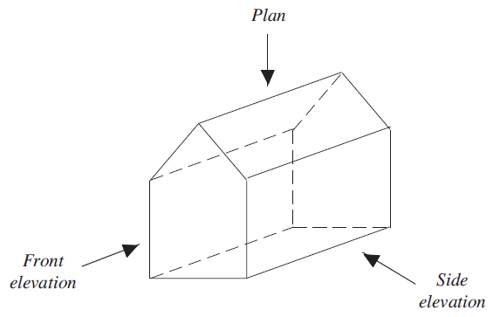
STRAND C
UNIT: C2
Solids
Section C2.3
Plans and Elevations
The plan of a solid is the view from above, as in the diagram below.
The elevation of a solid is the view from a side.
We often use the terms front elevation and side elevation.

Slide 18
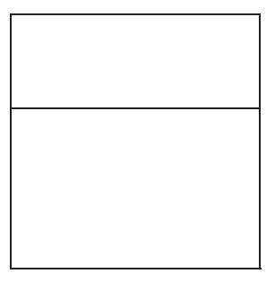
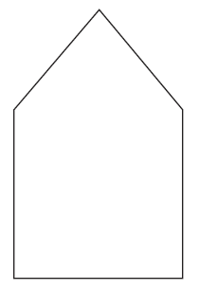
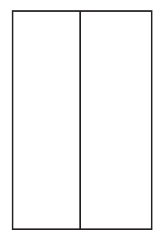
STRAND C
UNIT: C2
Solids
Section C2.3
Plans and Elevations
Looking from the side gives the
Side elevation
Looking from the front gives the
Front elevation
Looking from above gives the
Plan

Slide 19
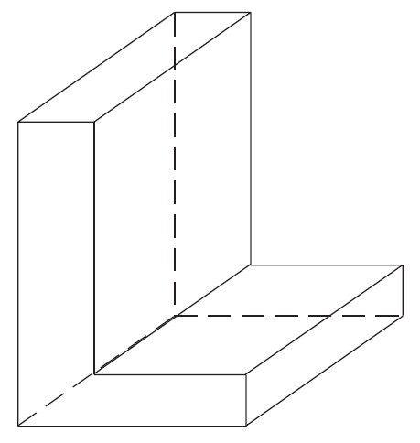
STRAND C
UNIT: C2
Solids
Section C2.3
Plans and Elevations
Example
Draw the front elevation, side elevation and plan of this shape, taking the L face to be the ‘front’ of the shape.

Slide 20
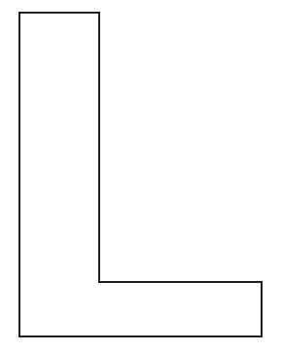
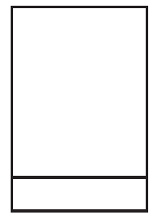

STRAND C
UNIT: C2
Solids
Section C2.3
Plans and Elevations
Solution
Looking from the front gives the
Front elevation
Looking from the side gives the
Side elevation
Looking from above gives the
Plan

Slide 21
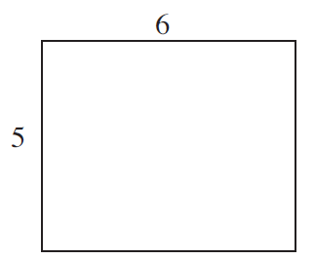
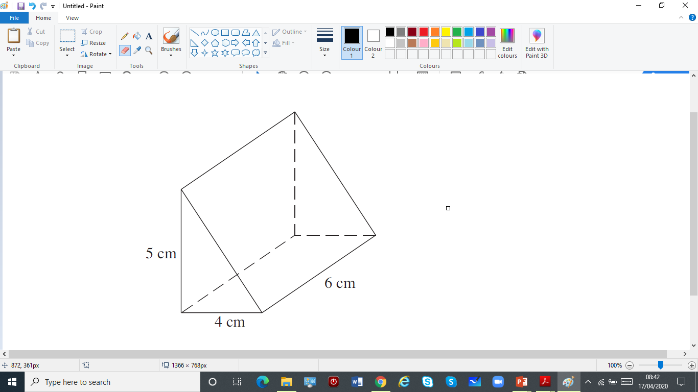
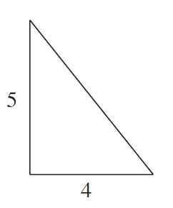

STRAND C
UNIT: C2
Solids
Section C2.3
Section C2.3: Fitness Check
Here is a question to check your progress; there are more practice questions if needed.
Side elevation
Draw the front elevation, side elevation and plan
of this shape, taking the triangular face to be the
‘front’ of the shape.
Front elevation
Plan

Slide 22
STRAND C
UNIT: C2
Solids
Section C2.3
Section C2.3: Review
You have completed the third Section.
If you have completed and mastered this section,
click to start the next Section
If you need more examples and interactive practice, go to
http://szalonta.hu/ske/text/C2/skec2s3.html

Slide 23
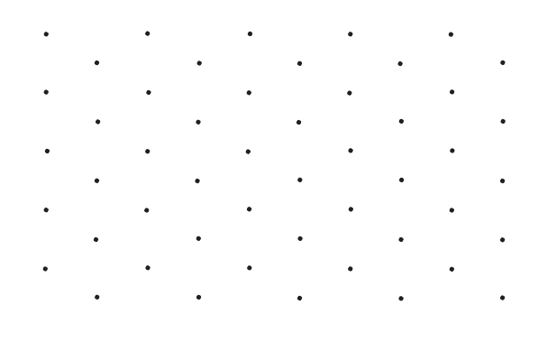
STRAND C
UNIT: C2
Solids
Section C2.4
Isometric Paper
The spots on isometric paper are arranged
at the corners of equilateral triangles.
Isometric
paper

Slide 24
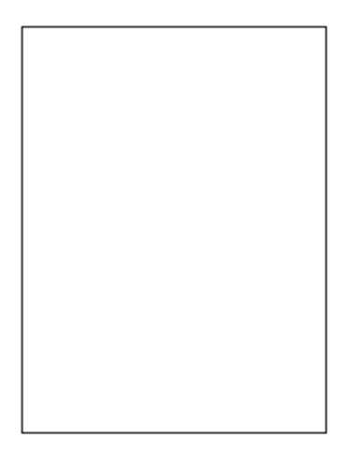

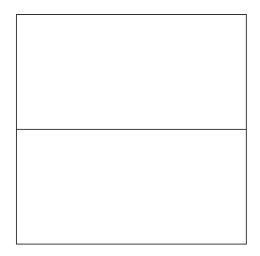
STRAND C
UNIT: C2
Solids
Section C2.4
Using Isometric Paper
Example
The diagrams below show the plan and elevations of a solid object.
Plan Front elevation Side elevation
Draw the object on isometric paper.

Slide 25
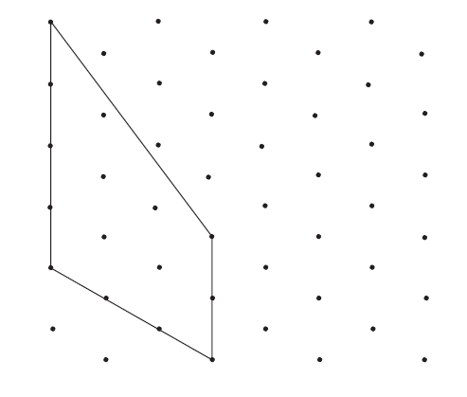

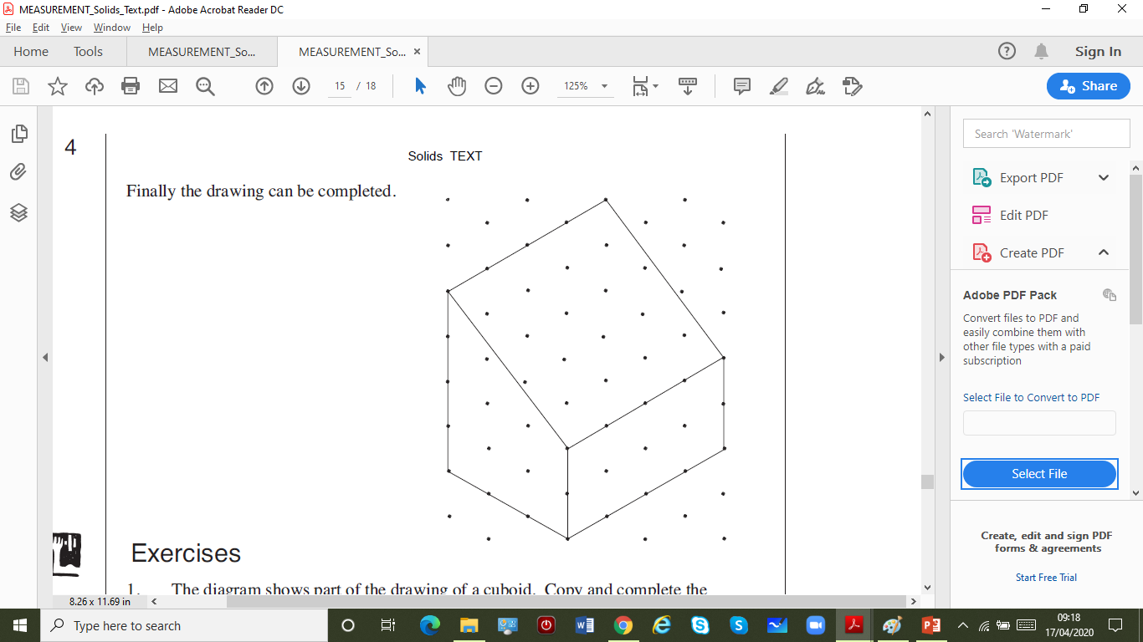
STRAND C
UNIT: C2
Solids
Section C2.4
Using Isometric Paper
Solution
From the front elevation
the front can be drawn.
Then using the side elevation the lower part of the side can be drawn.
Finally the drawing can be completed.

Slide 26
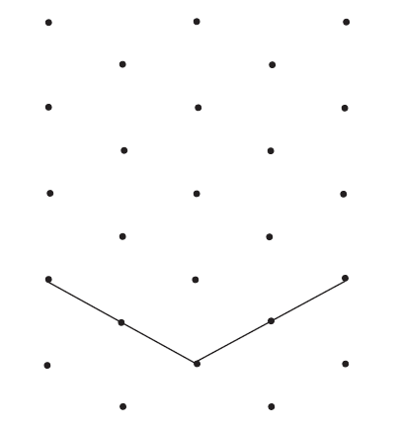
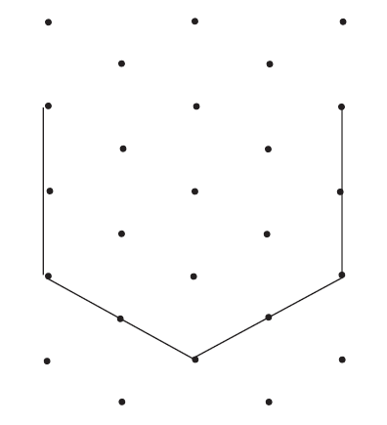
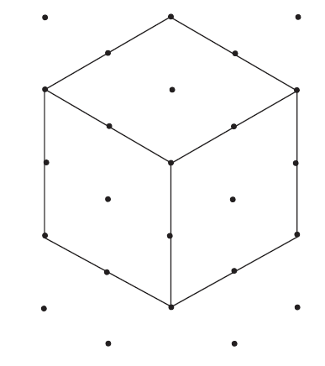
STRAND C
UNIT: C2
Solids
Section C2.4
Section C2.4: Fitness Check
Here is a question to check your progress; there are more practice questions if needed.
On isometric paper draw a cube with sides of 2 cm.
Answer (note that you may draw the sides in a different order, but the end result will be the same).

Slide 27
STRAND C
UNIT: C2
Solids
Section C2.4
Section C2.4: Review
You have completed the fourth and last Section.
If you need more examples and interactive practice, go to
http://szalonta.hu/ske/text/C2/skec2s4.html

