Slide 1
TSST Strand C
UNIT C4: Volume

Slide 2
STRAND C
UNIT C4
Volume
This Unit will explain how to find the volume of a number of common
shapes, along with some applications, such as in finding density.
You have four sections to work through and there are check up audits
and fitness tests for each section.
Volumes of Cubes, Cuboids, Cylinders and Prisms
Mass, Volume and Density
Volumes of Pyramids, Cones and Spheres
Dimensions

Slide 3
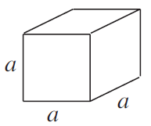
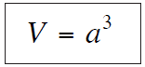
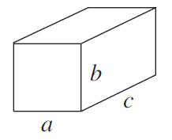
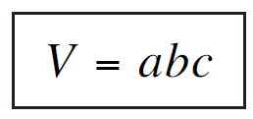
STRAND C
UNIT C4
Section C4.1
Volume of Cubes and Cuboids
The volume of a cube is given by
where $a$ is the length of each side of the cube.
For a cuboid the volume is given by
where $a$, $b$ and $c$ are the lengths shown in the diagram.

Slide 4
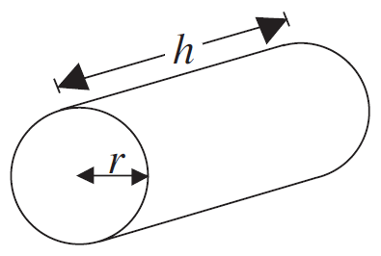
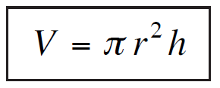
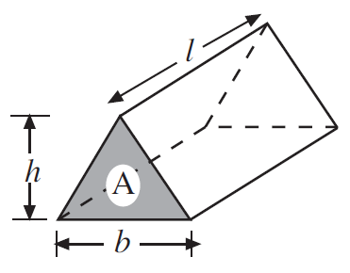
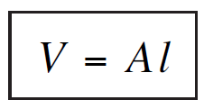
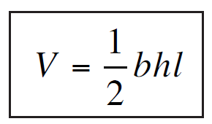
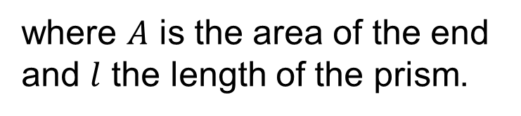
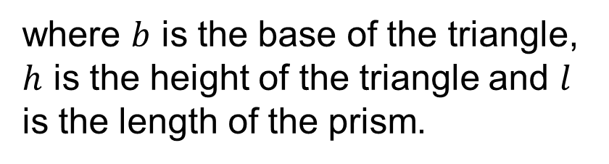
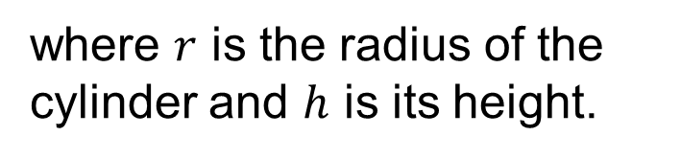
STRAND C
UNIT C4
Section C4.1
Volume of Cylinders and Triangular Prisms
The volume of a cylinder is given by
where $r$ is the radius of the cylinder and $h$ is its height.
The volume of a triangular prism is given by
where $A$ is the area of the end and $l$ the length of the prism.
or
where $b$ is the base of the triangle, $h$ is the height of the triangle and $l$ is the length of the prism.

Slide 5
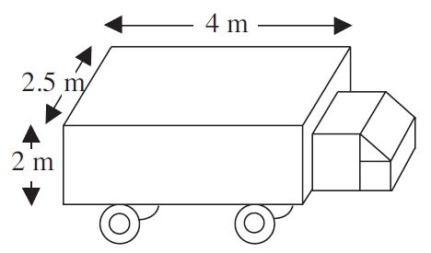
STRAND C
UNIT C4
Section C4.1
Volumes of Cubes, Cuboids, Cylinders and Prisms: Examples
Example 1
The diagram shows a truck.
Find the volume of the load-carrying part of the truck.
Solution
The load-carrying part of the truck is represented by a cuboid, so its volume is given by
V = 2 m× 2.5 m × 4 m
= 20 m³

Slide 6
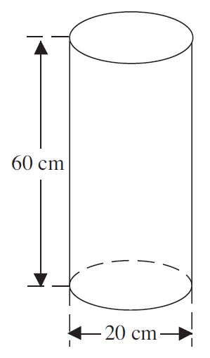
STRAND C
UNIT C4
Section C4.1
Volumes of Cubes, Cuboids, Cylinders and Prisms: Examples
Example 2
The cylindrical body of a fire extinguisher has the dimensions shown in the diagram. Find the maximum volume of water the extinguisher could hold.
Solution
The body of the extinguisher is a cylinder with radius 10 cm and height 60 cm, so its volume is given by
V = π×10² cm × 60 cm
= 18 850 cm³
Note: the diagram shows the diameter as 20 cm, the radius is 10 cm.

Slide 7
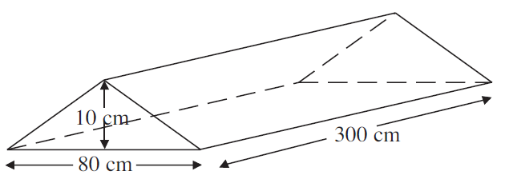
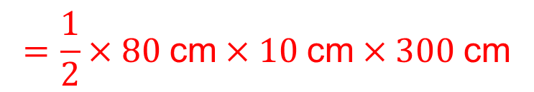
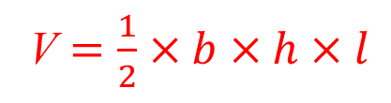
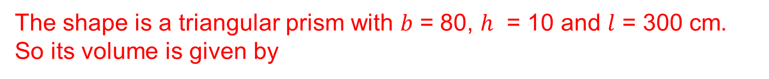
STRAND C
UNIT C4
Section C4.1
Volumes of Cubes, Cuboids, Cylinders and Prisms: Examples
Example 3
A traffic calming road hump (sleeping policeman) is made of concrete and has the dimensions shown in the diagram. Find the volume of concrete needed to make one road hump.
Solution
The shape is a triangular prism with 𝑏 = 80, ℎ = 10 and $l$ = 300 cm. So its volume is given by
V $=\frac{1}{2}×b×h×l$
$$=\frac{1}{2}×80 \text{cm}×10 \text{cm}×300 \text{cm}$$
= 120 000 cm³

Slide 8
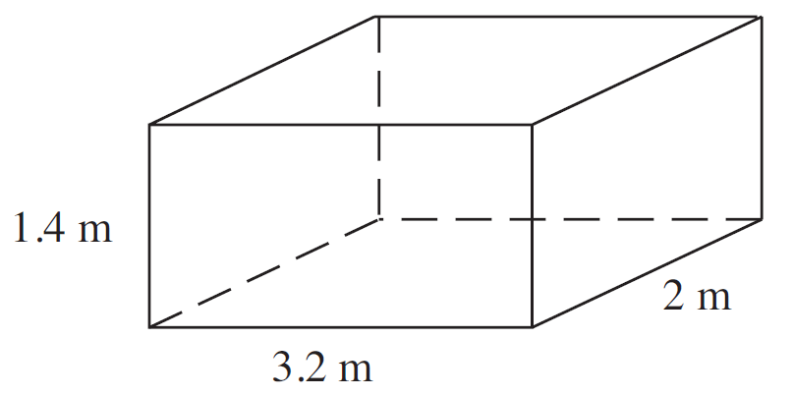
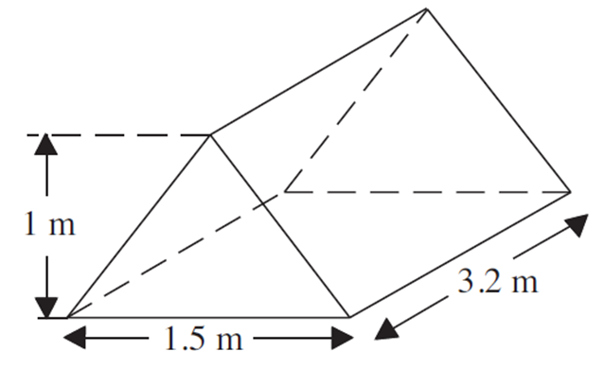
STRAND C
UNIT C4
Section C4.1
Section C4.1: Fitness Check
Here are some questions to check your progress; there are more practice questions if needed.
1. Find the volumes of the solids shown below.
(a) (b)
Answers
(a) V = 8.96 m³ (b) V = 2.4 m³

Slide 9
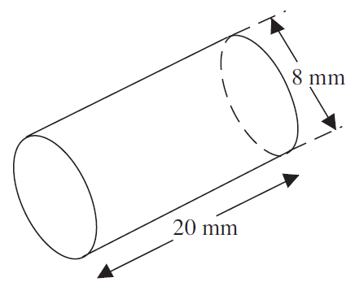
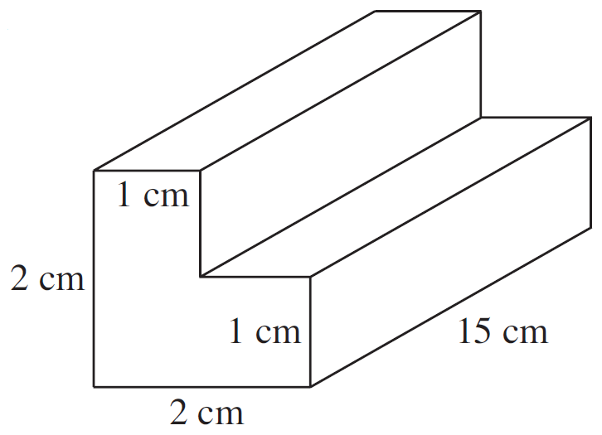
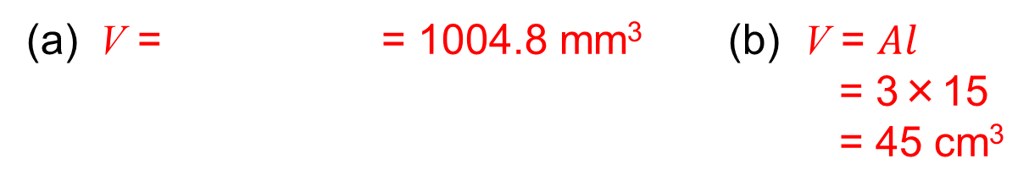
STRAND C
UNIT C4
Section C4.1
Section C4.1: Fitness Check
Here are some questions to check your progress; there are more practice questions if needed.
2. Find the volumes of the solids shown below.
(a) (b)
Answers
π×4²×20
(a) V = = 1004.8 mm³ (b) V = $Al$
= 3×15
= 45 cm³

Slide 10
STRAND C
UNIT C4
Section C4.1
Section C4.1: Review
You have completed the first Section.
If you have completed and understood this section, click to start the next Section
If you need more examples and interactive practice, go to
http://szalonta.hu/ske/text/C4/skec4s1.html

Slide 11
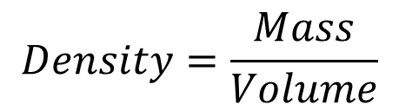
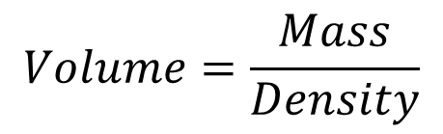

STRAND C
UNIT C4
Section C4.2
Mass, Volume and Density
Density is a term used to describe the mass of a unit of volume of a substance. For example, if the density of a metal is 2000 kg/m³, then 1 m³ of the substance has a mass of 2000 kg.
Mass, volume and density are related by the following equations.
$$Mass=Volume×Density$$
$$Volume=\frac{Mass}{Density}$$
$$Density=\frac{Mass}{Volume}$$
The density of water is 1 gram / cm³ (or 1 g cm⁻³) or 1000 kg / m³ (or 1000 kg m⁻³ ).

Slide 12
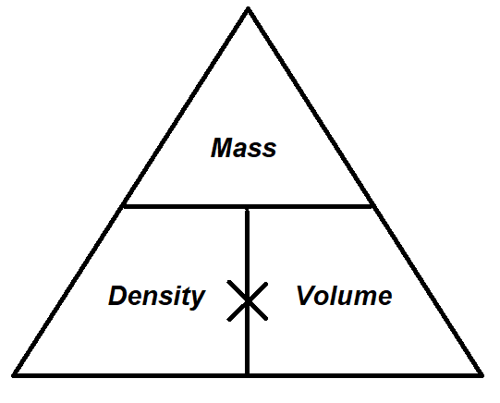
STRAND C
UNIT C4
Section C4.2
Mass, Volume and Density
You may find it helpful to use the following triangle, especially if you are already familiar with it; it summarises in one diagram the three equations on the previous slide.
You cover up the quantity you wish to find. For example, to find Volume, cover up Volume on the diagram and the triangle tells you to work out Mass ‘over’ Density (Mass ÷ Density).

Slide 13
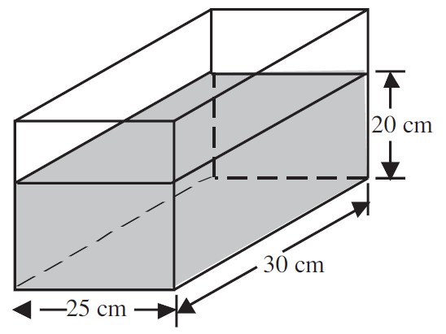
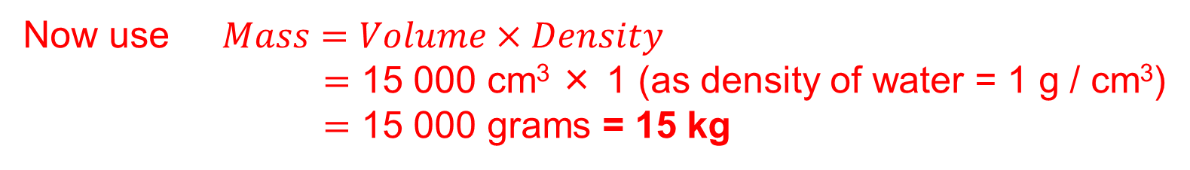
STRAND C
UNIT C4
Section C4.2
Mass, Volume and Density: Examples
Example 1
Find the mass of water in the fish tank shown in the diagram.
Solution
First calculate the volume of water.
V = 25 cm × 30 cm × 20 cm = 15 000 cm³
Now use $Mass=Volume×Density$
$=$ 15 000 cm³ × 1 (as density of water = 1 g / cm³)
$=$ 15 000 grams = 15 kg

Slide 14
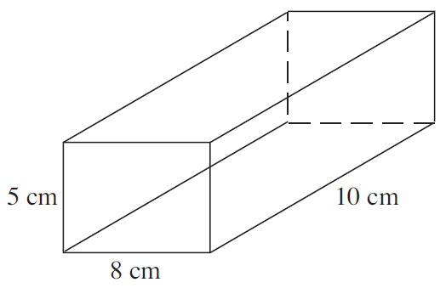
STRAND C
UNIT C4
Section C4.2
Mass, Volume and Density: Examples
Example 2
The block of metal shown has a mass of 500 grams.
Find its density in
(a) g / cm³
(b) kg / m³

Slide 15
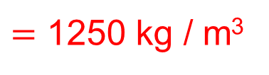
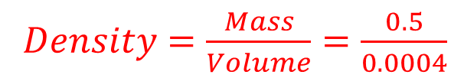
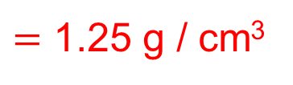

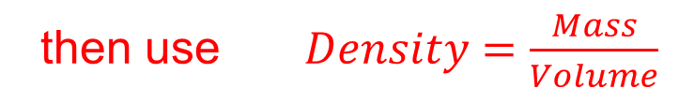
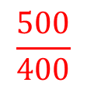
STRAND C
UNIT C4
Section C4.2
Mass, Volume and Density: Examples
Solution
mass 500 grams
(a) First find the Volume, V = 5 cm × 8 cm × 10 cm = 400 cm³
then use $Density=\frac{Mass}{Volume}$
$$\frac{500}{400}$$
$=$ 1.25 g / cm³
$$=$$
(b) The process can then be repeated working in kg and m.
Volume, V = 0.05 m × 0.08 m × 0.1 m = 0.0004 m³
$Density=\frac{Mass}{Volume}=\frac{0.5}{0.0004}$
$=$ 1250 kg / m³

Slide 16
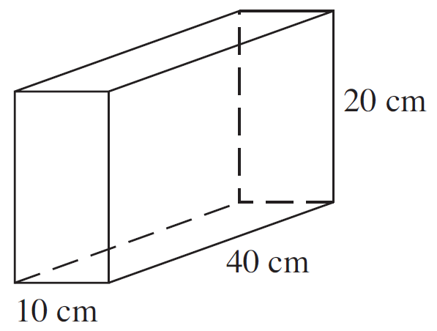
STRAND C
UNIT C4
Section C4.2
Section C4.2: Fitness Check
Here are some questions to check your progress; there are more practice questions if needed.
The diagram shows a concrete block of mass 6 kg.
(a) Find the volume of the block.
(b) What is the density of the concrete?
Answers
(a) V = 8000 cm³
(b) Density = 0.75 g / cm³

Slide 17
STRAND C
UNIT C4
Section C4.2
Section C4.2: Fitness Check
Here are some questions to check your progress; there are more practice questions if needed.
A barrel is a cylinder with radius 40 cm and height 80 cm.
It is full of water.
(a) Find the volume of the barrel.
(b) What is the mass of the water in the barrel?
Answers
(a) V = 402 124 cm³ (to the nearest whole cm³)
(or 401 920 cm³ if you use π rounded as 3.14)
(b) Mass = 402 124 g = 402.124 kg

Slide 18
STRAND C
UNIT C4
Section C4.2
Section C4.2: Review
You have completed the second Section.
If you have completed and understood this section, click to start the next Section
If you need more examples and interactive practice, go to
http://szalonta.hu/ske/text/C4/skec4s2.html

Slide 19
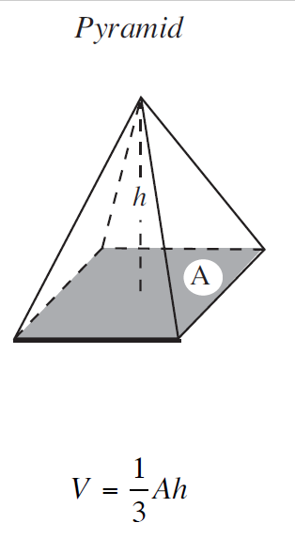
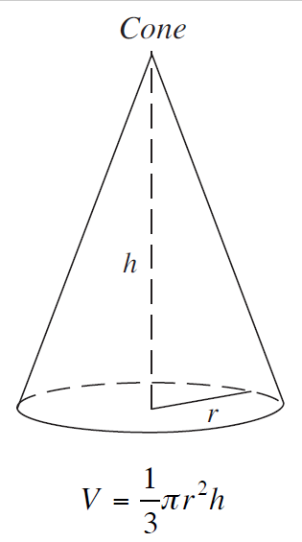
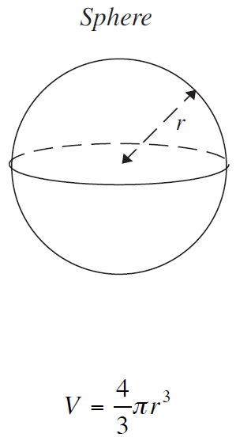
STRAND C
UNIT C4
Section C4.3
Volumes of Pyramids, Cones and Spheres
The volumes of a pyramid, a cone and a sphere are found using the following formulae.

Slide 20
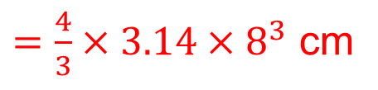
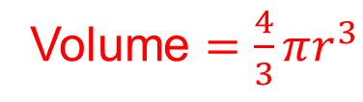
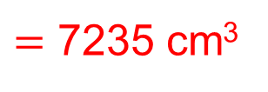
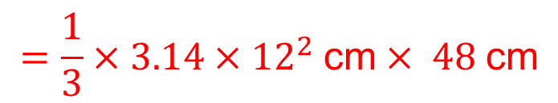
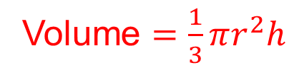
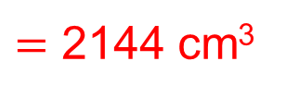
STRAND C
UNIT C4
Section C4.3
Volumes of Pyramids, Cones and Spheres: Examples
Example 1
A cone has the radius of 12 cm and height 48 cm. Find the volume of the cone to the nearest cm³.
Solution
$$=\frac{1}{3}×3.14×{12}^{2} \text{cm}× 48 \text{cm}$$
Volume $=\frac{1}{3}πr^{2}h$
$=$ 7235 cm³
Example 2
A sphere has the radius of 8 cm. Find its volume to the nearest cm³.
Volume $=\frac{4}{3}πr^{3}$
$=\frac{4}{3}×3.14×8^{3}$ cm
$=$ 2144 cm³

Slide 21
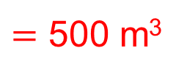
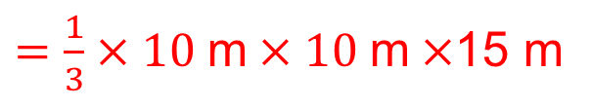
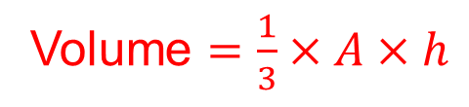
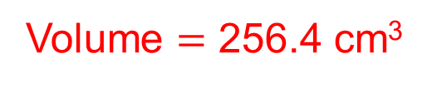
STRAND C
UNIT C4
Section C4.3
Section C4.3: Fitness Check
Here are some questions to check your progress; there are more practice questions if needed.
1. Find the volume of a cone with radius of 7 cm and height 5 cm, to one decimal place.
Answer
Volume $=$ 256.4 cm³
2. Find the volume of a pyramid of square base, 10 m side lengths, and height 15 m.
Answer
Volume $=\frac{1}{3}×A×h$
$=\frac{1}{3}×10 \text{m}×10 \text{m}×$15 m
$=$ 500 m³

Slide 22
STRAND C
UNIT C4
Section C4.3
Section C4.3: Review
You have completed the third Section.
If you have completed and understood this section, click to start the next Section
If you need more examples and interactive practice, go to
http://szalonta.hu/ske/text/C4/skec4s3.html

Slide 23



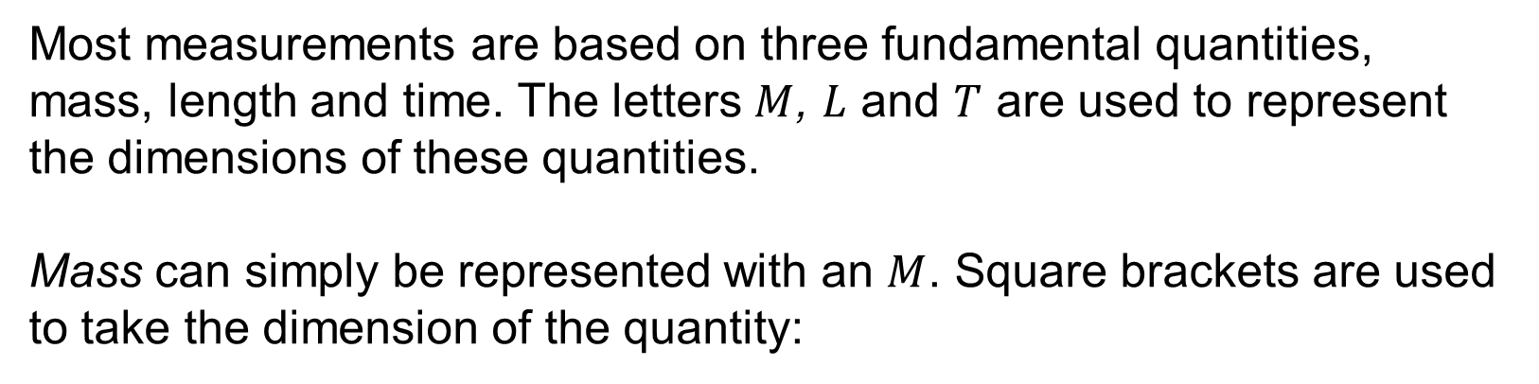

STRAND C
UNIT C4
Section C4.4
Dimensions
Most measurements are based on three fundamental quantities, mass, length and time. The letters $M$, $L$ and $T$ are used to represent the dimensions of these quantities.
Mass can simply be represented with an $M$. Square brackets are used to take the dimension of the quantity:
$$\left[mass\right]=\left[m\right]=M$$
Similarly $L$ represents length, so, for example, if $x$ is a length, then:
$\left[x\right]=$ $L$
also
$$\left[x2\right]=L2$$
and
$\left[x3\right]=L$³

Slide 24
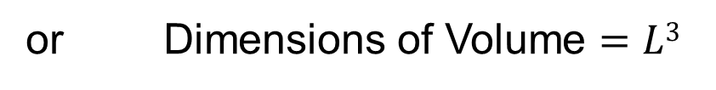




STRAND C
UNIT C4
Section C4.4
Dimensions
If t is a time, then
$$\left[\text{t}\right]=T$$
We can also use the principle that area is found by multiplying two lengths together and volume is found by multiplying three lengths together to represent the dimensions of area and volume:
$$\left[Area\right]=L2$$
or Dimensions of Area $=L2$
Similarly,
$\left[Volume\right]=L$³
or Dimensions of Volume $=L3$
These ideas can be used to find the dimensions of an algebraic expression involving measurements.

Slide 25









STRAND C
UNIT C4
Section C4.4
Dimensions: Examples
Example 1
Does the following expression represent a length, an area or a volume?
$$x+y+z$$
Solution
$$\left[x+y+z\right]$$
$$=\left[x\right]+\left[y\right]+\left[z\right]$$
$$=L+L+L$$
Adding together lengths gives you a greater length, so the expression represents a length.
Example 2
Does the following expression represent a length, an area or a volume? (Note: you can ignore any numbers, such as 2, 3, π, etc.)
$$3xyz$$
Solution
$$\left[3xyz\right]$$
$$=L×L×L$$
$$=L3$$
$L3$ represents a volume.

Slide 26









STRAND C
UNIT C4
Section C4.4
Dimensions: Examples
Example 3
Does the following expression represent a length, an area or a volume?
$$\frac{xy}{z}$$
Solution
$$\left[\frac{xy}{z}\right]$$
$$=\frac{\left[x\right]×\text{[}\text{y}\text{]}}{\left[z\right]}$$
$$=\frac{L×L}{L}$$
$$=L$$
The expression represents a length.
Example 4
Does the following expression represent a length, an area or a volume?
$$xz+xy+xz$$
Solution
$$\left[xy+xz+yz\right]$$
$$=\left[xy\right]+\left[xz\right]+\left[yz\right]$$
$$=L2+L2+L2$$
Adding together areas gives you a greater area, so the expression represents an area.

Slide 27





STRAND C
UNIT C4
Section C4.4
Section C4.4: Fitness Check
Here are some questions to check your progress; there are more practice questions if needed.
If $x$, $y$ and $z$ all represent lengths, consider each expression and decide if it could be a length, an area, or a volume.
(a) $xy+z2$
(b)
$$\frac{xy}{z}$$
(c)
$$\frac{2x2y}{z}$$
(d)
$$zy2+2x3+3y3$$
Answers
(a) Area
(b) Length
(c) Area
(d) Volume

Slide 28
STRAND C
UNIT C4
Section C4.4
Section C4.4: Review
You have completed the fourth and last Section.
If you need more examples and interactive practice, go to
http://szalonta.hu/ske/text/C4/skec4s4.html

