Slide 1
TSST Strand E
UNIT E1: Data Collection

Slide 2
STRAND E
UNIT E1
Data Collection
Collecting data is a key part of Data Science.
Here we will introduce the concept and begin to show how data can be recorded.
There are four sections in this Unit, namely:
Questionnaires and Surveys
Sampling
Charts and Tables
Pictograms and Bar Charts

Slide 3
STRAND E
UNIT E1
Section E1.1
Questionnaires and Surveys
Key Aspects
What is the purpose of your questionnaire?
Questions must be non biased
Questions must be clear and unambiguous
Questions can result in qualitative or quantitative data
Always pilot any questionnaire

Slide 4
STRAND E
UNIT E1
Section E1.1
Biased Questions
Are the questions on this questionnaire biased?
Are you concerned about the environment?
Are you concerned about the level of pollution caused by vehicles?
Do you think the health of young children is at risk due to exhaust fumes from vehicles?
Is there too much traffic congestion in towns?
Is public transport under-used?
Do you think vehicles should be banned from main shopping streets?
Yes, they are biased as they lead you to answer ‘Yes’ to the last question!

Slide 5
STRAND E
UNIT E1
Section E1.1
Poor Questionnaire?
Why is this a poor questionnaire?
Many ways it could be improved; for example:
Major sports such as Football left off
Participants might have two sports as equal favourites
It might be more interesting to ask for their views of each sport using a scale of interest

Slide 6
STRAND E
UNIT E1
Section E1.1
Sample Likert Scales for Responses
You can use what is termed a Likert scale to get responses to questions: see below
You could have more or less options but note that
for 4 options, there is no middle value.
You often see, for example at Airports, coloured button responses to reflect the service with the results
automatically saved and analysed.

Slide 7
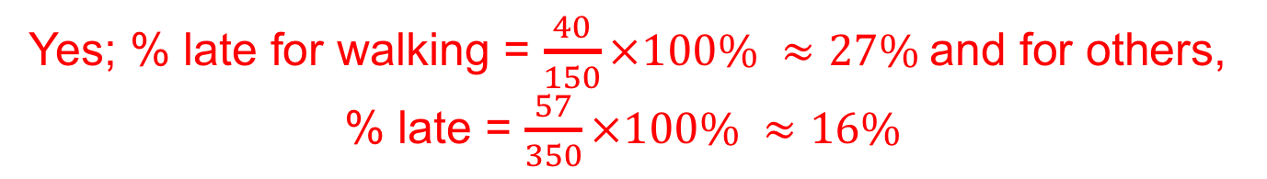
STRAND E
UNIT E1
Section E1.1
Section E1.1: Fitness Check
Louis thinks that learners who walk to school are more likely to be late than those who do not walk to school.
To test if his view is correct, he carries out a survey of 100 learners from Year 7 for 5 consecutive Tuesdays.
Here are his results.
1. Do the results support his view?
Yes; % late for walking = $\frac{40}{150}×100\% ≈27\%$and for others, % late = $\frac{57}{350}×100\% ≈16\%$
2. Suggest ways in which Louis could improve his survey.
Survey other days; how late would be useful; sample should be random.

Slide 8
STRAND E
UNIT E1
Section E1.1
Section E1.1: Review
You have completed the first Section.
If you have completed and understood this section,
click to start the next Section.
If you need more examples and interactive practice, go to
http://szalonta.hu/ske/text/E1/skee1s1.html

Slide 9
STRAND E
UNIT E1
Section E1.2
Sampling
When conducting a survey it is often impossible to ask every individual who might be concerned or involved. For example, for a political opinion poll it is only possible to ask a sample of the population how they would vote.
Population is used for any group for which information is required.
For example, the following could be populations:
• Plymouth Argyle Football Club supporters,
• Laptops produced in a factory,
• Adult voters in England,
• All students in your school or college
Conclusions are reached by looking at samples taken from a population.
There are many methods for selecting a sample from a population but we will look carefully at 3 of these here:
Random Stratified Systematic

Slide 10
STRAND E
UNIT E1
Section E1.2
Random Sample
The sample is formed by selecting a number of members of the population at random.
It is important to make sure that each member of the population is equally likely to be selected.
Tables of random numbers* can be used to help this process but more mundane methods, such as using numbers from a telephone directory or even choosing a number from a hat of numbers, can be used.
Scientific calculators also provide you with random numbers.
* Note: the next slide has a table of random numbers.

Slide 11
STRAND E
UNIT E1
Section E1.2
Random Numbers
To use this table, you start at a random number and move in any direction.
Example: Find a random sample of size 5 for a group of 60 learners.
Solution:
The learners are numbered:
01, 02, 03……..59, 60
Working from the start of the 7th row, taking the digits in pairs, we get:
14, 95, 40, 52, 34, 96, 60
We reject 95 and 96 as they are more than 60 to give the sample:
14, 40, 52, 34, 60

Slide 12
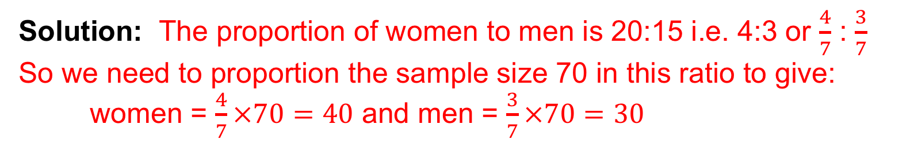
STRAND E
UNIT E1
Section E1.2
Stratified Sample
This is an important method of sampling, particularly when the population under study is split into a number of distinct groups.
Random samples are taken from each group so that the ratio of the sizes of the sample is the same as the ratio of the number of members of the groups in the population.
For example, if a population contains 1000 women and 500 men, a stratified sample of total size 75 would contain 50 women and 25 men.
Example:
A population contains 2000 women and 1500 men. We require a stratified sample of total size 70. How many women and men would be needed?
Solution: The proportion of women to men is 20:15 i.e. 4:3 or $\frac{4}{7}$ : $\frac{3}{7}$
So we need to proportion the sample size 70 in this ratio to give:
women = $\frac{4}{7}×70=40$ and men = $\frac{3}{7}×70=30$

Slide 13
STRAND E
UNIT E1
Section E1.2
Systematic Sample
This type of sample is formed by taking members of the population at regular intervals.
For example, by selecting every 5th or every 10th or every 20th member of the population, depending on the population number and sample size.
1. Mrs Powell
2. Mrs Grant
3. Mrs Clarke
4. Mrs Bailey
5. Mrs Miller
6. Mr Gordon
7. Mr Francis
8. Mr Brown
9. Mr Wright
10. Mr Gray
11. Mr Davis
12. Mr Lawrence
Example: There are 12 teachers in this small primary school. A sample of size 3 is to be selected using systematic sampling.
Solution: Selecting every 4th teacher, starting arbitrary with the third teacher gives:
Mrs Clarke, Mr Francis, Mr Davis
Notes: This is not a unique sample nor random as once the first teacher is chosen, there is not an equal chance for other teachers to be in the sample.

Slide 14
STRAND E
UNIT E1
Section E1.2
Random Sample
In reality with only 12 teachers to sample, it would be easier to survey the complete population; we call this a CENSUS. As an example though, we will use the same data to obtain a random sample of size 3.
Example: Find a random sample of size 3 for this population.
1. Mrs Powell
2. Mrs Grant
3. Mrs Clarke
4. Mrs Bailey
5. Mrs Miller
6. Mr Gordon
7. Mr Francis
8. Mr Brown
9. Mr Wright
10. Mr Gray
11. Mr Davis
12. Mr Lawrence
Solution: We can select the numbers:
01, 02, 03, 04, 05, 06, 07, 08, 09, 10, 11, 12
from our table of random numbers.
The first 28 numbers in third row of the table, taken in pairs reads:
04, 92, 89, 43, 72, 12, 54, 52, 20, 08, 89, 91, 46, 44
giving: Mrs Bailey, Mr Lawrence, Mr Brown
Note: A more efficient use of random number table is to take 01 and every 12th number after it for Mrs Powell, that is the numbers 01, 13, 25, 37, 49, 61, 73, 85, 97, etc.

Slide 15
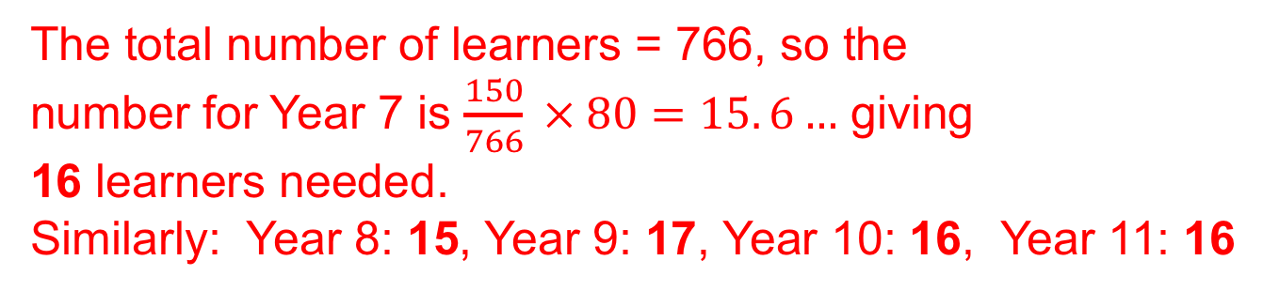
STRAND E
UNIT E1
Section E1.2
Section E1.2: Fitness Check
1. What is the difference between a census and a sample?
A census consists of the complete population whereas a sample is a subgroup of the population.
2. What are the advantages of taking a sample?
The main advantages are that it is easier to implement, costs less and is easier to analyse.
3. This table shows the number of learners
in each school year. How many learners
should be selected from each year to
create a stratified sample of size 80?
The total number of learners = 766, so the
number for Year 7 is $\frac{150}{766} × 80=15. 6…$ giving
16 learners needed.
Similarly: Year 8: 15, Year 9: 17, Year 10: 16, Year 11: 16

Slide 16
STRAND E
UNIT E1
Section E1.2
Section E1.2: Fitness Check
1. Mrs Powell
2. Mrs Grant
3. Mrs Clarke
4. Mrs Bailey
5. Mrs Miller
6. Mr Gordon
7. Mr Francis
8. Mr Brown
9. Mr Wright
10. Mr Gray
11. Mr Davis
12. Mr Lawrence
4. For these teachers, use
this following list of random
numbers to find a random
sample of size 4.
Taking pairs and working horizontally, the first 4 numbers needed are:
12, 10, 02, (reject 12), 01;
that is: Mr Lawrence, Mr Gray, Mrs Grant, Mrs Powell

Slide 17
STRAND E
UNIT E1
Section E1.2
Section E1.2: Review
You have completed the second Section.
If you have completed and understood this section,
click to start the next Section.
If you need more examples and interactive practice, go to
http://szalonta.hu/ske/text/E1/skee1s2.html

Slide 18
STRAND E
UNIT E1
Section E1.3
Charts and Tables
The chart can be used to show the mileage between some Scottish towns and cities.
What is the distances in miles between:
Fort William and Perth?
Edinburgh and Stranraer?
103
123
Which places are furthest apart?
Inverness and Stranraer: 249 miles

Slide 19
STRAND E
UNIT E1
Section E1.3
Charts and Tables
In a school 37 learners took exams in both Mathematics and Physics.
Their results are given in this table:
a) How many got the same grade in both subjects?
b) How many obtained a higher grade in Physics
than in Mathematics?
c) Which was the most common grade in Physics?
10
11
7 (C)

Slide 20
STRAND E
UNIT E1
Section E1.3
Section E1.3: Fitness Check
The table gives the distances, in kilometres, between some English towns and cities.
1. Nicole travels from Birmingham to Leeds and then to Manchester.
a) How far does she travel?
b) By how many km would the distance she travels be reduced if she went from Birmingham to Manchester and then to Leeds?
239 kms
43 kms

Slide 21
STRAND E
UNIT E1
Section E1.3
Section E1.3: Fitness Check
2. The table shows the favourite sports selected by a
sample of learners each year in a secondary school.
In each year, each learner chose just one sport.
a) How many chose basketball in Year 8?
b) How many more chose football in Year 7 than in Year 10?
c) In which year was 'track and field’ the most popular sport?
7
6
Year 10

Slide 22
STRAND E
UNIT E1
Section E1.3
Section E1.3: Review
You have completed the third Section.
If you have completed and understood this section,
click to start the next Section.
If you need more examples and interactive practice, go to
http://szalonta.hu/ske/text/E1/skee1s3.html

Slide 23
STRAND E
UNIT E1
Section E1.4
Data Presentation: Bar Charts
Here is some data for Manchester City, the winners of the Premier League in the 2018/19 season.
The table below gives their scoring record in their 38 matches (20 teams in the Premier League; each team plays every other team, at home and away).
4 | 1 | 1 | 2 | 1 | 1 | 2 | 2 | 3 | 1 | 1 | 6 | 2 | 3 | 1 | 3 | 3 | 2 | 3
1 | 2 | 3 | 0 | 2 | 3 | 4 | 3 | 6 | 1 | 5 | 0 | 2 | 5 | 3 | 2 | 1 | 6 | 2
What does this data show?
Overall Manchester City are good at scoring goals!
How can we illustrate this data to show its meaning?
We can make some progress by analysing the data using a tally table to show the frequency of each
number of goals scored in the 38 games played

Slide 24
STRAND E
UNIT E1
Section E1.4
Tally Table
In a tally table each data item is shown as a vertical line (I).
Goals per match | Tally | Frequency
0 | II | 2
1 | IIII IIII | 10
2 | IIII IIII | 10
3 | IIII IIII | 9
4 | II | 2
5 | II | 2
6 | I | 3
Total number of matches |  | 38
After four data items, the fifth is indicated by a line drawn through the previous 4 and a space left before starting the next set of lines.
For example the entry IIII III
shows a frequency of 5 + 3 = 8
This gives some summary data; there are many ways of illustrating this.
What is missing though for you to make any useful conclusions?
We need to know not just how many goals were scored but how many were scored by the opposition in the games.

Slide 25
STRAND E
UNIT E1
Section E1.4
Bar Chart
Here is a bar chart to illustrate the frequency of goals scored by Manchester City in the 2018/19 Premier League.
Number of goals

Slide 26
STRAND E
UNIT E1
Section E1.4
Horizontal Bar Chart
Here is another bar chart but this has been turned round.

Slide 27
STRAND E
UNIT E1
Section E1.4
Pictogram: Example
There are many other ways to display data; the aim is for someone to look at the display and have a good idea of what it is showing.
Here is a different type of data. The table below gives the number and colour of cars sold by a garage over a month.
How can this data be illustrated?
A pictograms is one possible way of showing this data.

Slide 28
STRAND E
UNIT E1
Section E1.4
Pictogram to Illustrate Data
Here one car picture represents exactly 1 car.
Sometimes it might represent more if the numbers were much larger.
You have to look at the ‘key’ to the pictogram.

Slide 29
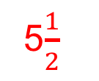
STRAND E
UNIT E1
Section E1.4
Section E1.4: Fitness Check
1. The pictogram shows how many suitcases were sold by a store from 2013 to 2019, with one row missing.
2013
2014
2015
2016
2017
2018
2019
a) How many cases were sold in 2014?
b) What is the smallest number of cases sold in a year?
c) What is the greatest number of cases sold in a year?
d) In 2018 a total of 550 cases were sold.
How many suitcase symbols should be there?
400
250
700
5$\frac{1}{2}$

Slide 30
STRAND E
UNIT E1
Section E1.4
Section E1.4: Fitness Check
2. The bar chart below shows the shoe sizes of a group of 15-year-old boys.
23
a) How many boys are there in the group?
b) Comment on the shape of the bar chart, saying whether or
not this is the shape you would expect.
We would expect there to be many more boys with shoe sizes around 8 and 9 than 5 or 12, so the results are surprising.

Slide 31
STRAND E
UNIT E2
Section E2.1
Section E1.4: Review
You have completed the last Section.
If you need more examples and interactive practice, go to
http://szalonta.hu/ske/text/E1/skee1s4.html

