Slide 1
TSST STRAND E
UNIT E2: Data Presentation

Slide 2
STRAND E
UNIT E2
Data Presentation
Presenting data is an informative and helpful way is another key aspect of Data Science.
Here we consider some of the ways in which this can be done with aspects of data analysis.
There are five sections in this Unit, namely:
Pie Charts
Line Graphs
Stem and Leaf Plots
Frequency Graphs: Histograms

Slide 3
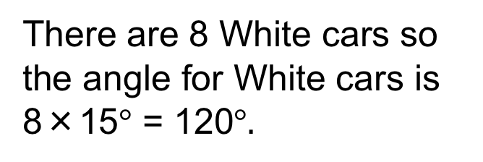

STRAND E
UNIT E2
Section E2.1
Data Presentation: Pie Charts
We will use our colour of cars data from the first section.
To construct a pie chart, the angles around the circle must be in proportion to the number of cars of each colour. It is the AREA that represents the size of the data.
There are 24 cars in total and 360$°$ around the circle, so each car is represented by angle: 360$°$ ÷ 24 = 15$°$
There are 8 White cars so the angle for White cars is 8×15$°$ = 120$°.$
Colour | Number | Mutiplier | Angle
White | 8
Silver | 6
Blue | 6
Black | 2
Red | 2
15
15
15
15
15
120
90
90
30
30
We calculate the angles for each colour in the same way as in the table.

Slide 4
STRAND E
UNIT E2
Section E2.1
Pie Chart for Colour of Cars
Using the angles calculated, here is the pie chart
This is a straightforward way of illustrating qualitative data (that is, the colour of cars); we will next look at how to illustrate quantitative data.

Slide 5


STRAND E
UNIT E2
Section E2.1
Section E2.1: Fitness Check
This pie chart, not drawn to scale, shows the Saturday morning activities of a group of 120 children.
a) The sector for soccer is represented by an angle of 150°.
How many children play soccer on Saturday mornings?
b) Given that 46 children swim on Saturday mornings,
calculate the value of x.
Number = $\frac{150}{360}$ $× 120=50$
Angle x = $\frac{46}{120}$ $× 360°=138°$

Slide 6
STRAND E
UNIT E2
Section E2.1
Section E2.1: Review
You have completed the first Section.
If you have completed and understood this section,
click to start the next Section.
If you need more examples and interactive practice, go to
http://szalonta.hu/ske/text/E2/skee2s1.html

Slide 7
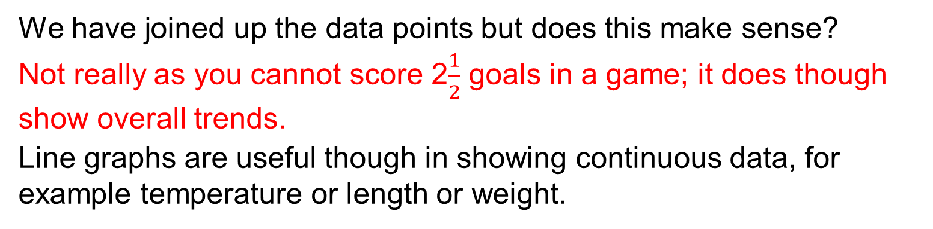
STRAND E
UNIT E2
Section E2.2
Data Presentation: Line Graphs
Here is another way to illustrate the goals-scored data.
We have joined up the data points but does this make sense?
Not really as you cannot score 2$\frac{1}{2}$ goals in a game; it does though show overall trends.
Line graphs are useful though in showing continuous data, for example temperature or length or weight.

Slide 8

STRAND E
UNIT E2
Section E2.2
Illustrating Temperature Data
Here is the average monthly temperature at Chichester.
$$°C$$
J F M A M J J A S O N D
A line graph does make sense here as the data trend can be seen; that is, increasing from Feb to Aug and then decreasing until the end of the year.

Slide 9


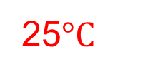
STRAND E
UNIT E2
Section E2.2
Line Graphs: Example
Samuel recorded the temperature in his shed at 6 am each day for a week. His records are shown on this line graph.
a) What was the temperature on Wednesday?
b) What was the lowest temperature recorded?
c) What was the highest temperature recorded?
25$°C$
19$°C$
30$°C$

Slide 10
STRAND E
UNIT E2
Section E2.2
Section E2.2: Fitness Check
This line graph shows how the height of a sunflower plant changed in the weeks after it was planted.
a) What was the height of the plant when planted?
b) How much did the plant grow in the first week?
c) What is the greatest height reached so far?
d) How long did it take to go from 54 to 78 cm?
8 cm
22 cm
84 cm
3 weeks

Slide 11
STRAND E
UNIT E2
Section E2.2
Section E2.2: Review
You have completed the second Section.
If you have completed and understood this section,
click to start the next Section.
If you need more examples and interactive practice, go to
http://szalonta.hu/ske/text/E2/skee2s2.html

Slide 12
STRAND E
UNIT E2
Section E2.3
STEM and LEAF Plots
Here is another very simple way which quickly gives an overall view of the general characteristics of the data. This is called a stem and leaf plot and here how it works.
Example:
The marks gained out of 50 by 15 pupils in a Biology test are as given below: 27, 36, 24, 17, 35, 18, 23, 25, 34, 25, 41, 18, 22, 24, 42
The stem and leaf plot uses 'tens' as the stem
and the 'units' as the leaf.
The leaf part is reordered
to give a final plot.
This gives at a glance an impression of the spread
and average of the marks.
STEM LEAF
0
1 7 8 8
2 7 4 3 5 5 2 4
3 6 5 4
4 1 2
STEM LEAF
0
1 7 8 8
2 2 3 4 4 5 5 7
3 4 5 6
4 1 2

Slide 13
STRAND E
UNIT E2
Section E2.3
Times for One Mile
Example: Here are the times in minutes for a group of adults to walk or run one mile:
Illustrate the data in a stem and leaf plot; what can you say about the data?
Solution: We first list and secondly reorder
0 7 9 5 5 9
1 7 5 7 9 8 0 7 8 6 7 9
2 1 2 2 3 1 2 1 0
3 1
0 5 5 7 9 9
1 0 5 6 7 7 7 7 8 8 9 9
2 0 1 1 1 2 2 3 3
3 1
It looks as if one group ran (or at least jogged) while the other group just walked at varying speeds!

Slide 14
STRAND E
UNIT E2
Section E2.3
Section E2.3: Fitness Test
Blood samples were taken from 40 blood donors and the lead concentration (mg per 100 ml) recorded.
a) Construct a stem and leaf plot to represent the data.
b) What are the values of the range and the median (middle) value?
a)
STEM LEAF
1 7 7 8 8 9
2 0 2 3 4 4 4 5 5 5 5 8 8 8 8
3 0 0 0 1 1 2 5 6 8 9
4 1 2 3 4 5 5
5 3 3
6 0 4 5
b) Range = 65 – 17= 48 and median = 30

Slide 15
STRAND E
UNIT E2
Section E2.3
Section E2.3: Review
You have completed the third Section.
If you have completed and understood this section,
click to start the next Section.
If you need more examples and interactive practice, go to
http://szalonta.hu/ske/text/E2/skee2s3.html

Slide 16
STRAND E
UNIT E2
Section E2.4
Histograms
For continuous data, when any value over a range of values is possible, a frequency graph like the one below can be used to illustrate the data.
This is called a histogram, and is characterised by having a continuous scale along the horizontal axis. Care must be taken about the end points. For example, the interval (in mins) would normally be 30 ≤ time < 35, so that a time of 35 minutes would be in the second interval.

Slide 17
STRAND E
UNIT E2
Section E2.4
Using the Histogram
Problems:
How many people completed the Fun Run in
a) between 40 and 45 minutes
b) less than 40 minutes
c) less than one hour?
21
10 + 8 = 18
10 + 8 + 21 + 28 + 7 = 74

Slide 18
STRAND E
UNIT E2
Section E2.4
Histogram: Worked Example
A group of students measured the reaction times of 50 other students. The times are given below, correct to the nearest hundredth of a second.
To draw a histogram, we first need to group the data:

Slide 19
STRAND E
UNIT E2
Section E2.4
Histogram: Worked Example
Now we can draw the histogram, as below.
Frequency
Reaction Time(s)

Slide 20
STRAND E
UNIT E2
Section E2.4
Section E2.4: Fitness Test
This histogram shows the weights of learners in a school.
Frequency
Weight (kg)
a) How many had a weight greater than 70 kg?
b) How many had a weight between 50 and 65 kg?
c) How many had a weight less than 50 kg?
d) How many learners were there in the school?
5
55
15
81

Slide 21
STRAND E
UNIT E2
Section E2.4
Section E2.4: Review
You have completed the last Section.
If you need more examples and interactive practice, go to
http://szalonta.hu/ske/text/E2/skee2s4.html

