Slide 1
TSST Strand E
UNIT E4: Measures of Variation

Slide 2
Strand E
Unit E4
Measures of Variation
Analysing data is another key aspect of Data Science.
Here we look at measures of variation, that is, how to compare one data set to another.
There are three sections in this unit, namely:
Cumulative Frequency
Box and Whisker Plots
Standard Deviation

Slide 3
Strand E
Unit E4
Section E4.1
Cumulative Frequency
Cumulative frequencies are useful if more detailed information is required about a set of data.
In particular, they can be used to find the median and inter-quartile range.
The median is the middle value when the data values are put in numerical order.
The inter-quartile range contains the middle 50%of the sample and describes how spread out the data are.
This is illustrated in the next Example.

Slide 4
Strand E
Unit E4
Section E4.1
Cumulative Frequency
Example
For the data below, draw up a cumulative frequency table and then draw a cumulative frequency graph.
We first add a cumulative frequency column on the right in the table and then keep adding on the frequencies.

Slide 5
Strand E
Unit E4
Section E4.1
Cumulative Frequency Graph
A graph can then be plotted using points as shown below, starting with the point (90, 0) and finishing on (150, 112).
Cumulative
Frequency
Height (cm)

Slide 6
Strand E
Unit E4
Section E4.1
Estimating the Median and Quartiles
This cumulative frequency graph gives the test results for 120 students. We will find estimates for the median and the lower and upper quartiles.
For the median, move horizontally from 60 on the vertical axis.
When the line reaches the curve, move vertically down to the horizontal axis. The line cuts this axis at the median.
Median estimate is 53

Slide 7
Strand E
Unit E4
Section E4.1
Estimating the Median and Quartiles
This cumulative frequency graph gives the test results for 120 students. We will use this to find estimates for the median and the lower (LQ) and upper (UQ) quartiles.
The lower quartile is at 25% of 120, that is 30 and this has value
LQ = 45
The upper quartile is at 75% of 120, that is 90 and has value
UQ = 60
The inter-quartile range is given by:
UQ – LQ = 60 – 45
= 15

Slide 8
Strand E
Unit E4
Section E4.1
Estimating Answers
We can also find more information from the graph. For example,
a) Estimate the mark attained by the top 10% of students
b) Estimate the number of students who scored more than 65 marks.
Solution
a) 90% of 120 =108,
so we draw the horizontal line from 108 to the curve and vertically to
76
b) This time we start on the horizontal axis at 75 and move vertically to the curve and across to
98

Slide 9
Strand E
Unit E4
Section E4.1
Section E4.1: Fitness Check
The table below shows how the height of children of a certain age varies. The data was gathered using a large-scale survey.
A doctor wishes to classify children according to their heights.
Use a cumulative frequency graph to find the heights of children in each category.
Answers: to the nearest cm:
Very Tall 75 < h < 85
Tall 70 < h < 75
Normal 62 < h < 70
Short 58 < h < 62
Very Short 50 < h < 58

Slide 10
STRAND E
UNIT E4
Section E4.1
Section E4.1: Review
You have completed the first Section.
If you have completed and understood this section,
click to start the next Section.
If you need more examples and interactive practice, go to
http://szalonta.hu/ske/text/E4/skee4s1.html

Slide 11
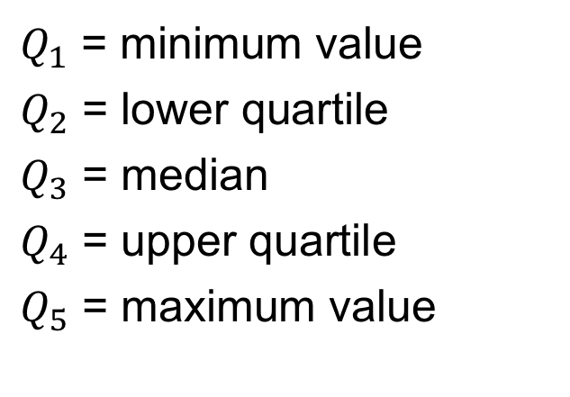
STRAND E
UNIT E4
Section E4.2
Median and Quartiles
A quartile is one of 3 values, lower quartile, median and upper quartile, which divides data into 4 equal groups.
A percentile is one of 99 values which
divides data into 100 equal groups.
The lower quartile corresponds to the 25th percentile. The median corresponds to the 50th percentile.
The upper quartile corresponds to the 75th percentile.
We sometimes talk about a 5-number summary of data that enables location and variation to be judged and compared for data sets. Here:
$Q_{1}$ = minimum value
$Q_{2}$ = lower quartile
$Q_{3}$ = median
$Q_{4}$ = upper quartile
$Q_{5}$ = maximum value

Slide 12
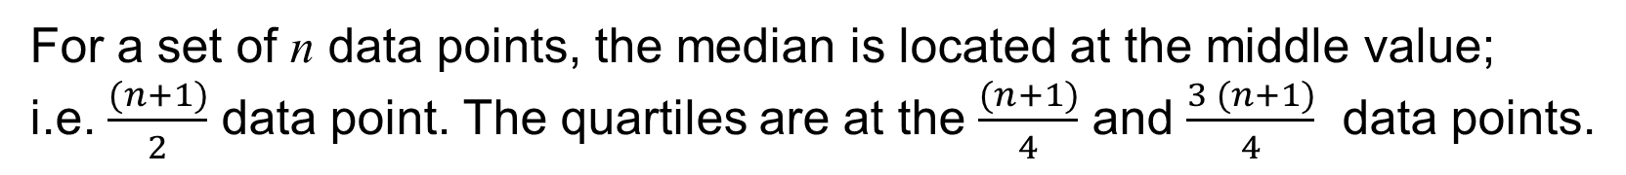
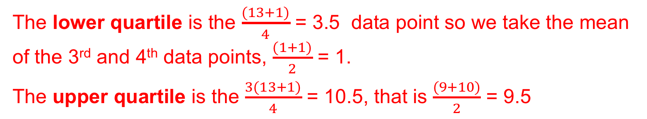
STRAND E
UNIT E4
Section E4.2
Quartiles with n Data Points
For a set of n data points, the median is located at the middle value;
i.e. $\frac{(n+1)}{2}$ data point. The quartiles are at the $\frac{(n+1)}{4}$ and $\frac{3 (n+1)}{4}$ data points.
Example: The number of goals scored by the 13 members of a football team are:
9 0 0 8 12 2 1 2 1 10 6 11 8
Determine the median and quartiles for this data.
Solution We put the data in order:
0 0 1 1 2 2 6 8 8 9 10 11 12
Here n = 13 and median is the $\frac{(13+1)}{2}$ = 7th data point, 6
The lower quartile is the $\frac{(13+1)}{4}$ = 3.5 data point so we take the mean of the 3rd and 4th data points, $\frac{(1+1)}{2}$ = 1.
The upper quartile is the $\frac{3(13+1)}{4}$ = 10.5, that is $\frac{(9+10)}{2}$ = 9.5

Slide 13
STRAND E
UNIT E4
Section E4.2
Box and Whisker Plots
The box and whisker plot is another measure of variation that enables you to illustrate and compare the measures of both location and variation through the median and quartiles. Consider the data set below,
We can find the lower quartile, median and upper quartile.
The box is formed by the two quartiles, with the median marked by a line, whilst the whiskers are fixed by the two extreme values, 4 and 15.

Slide 14
STRAND E
UNIT E4
Section E4.2
Comparing Data Sets
Here are two data sets for comparison
The box and whisker plots below clearly show the key differences.

Slide 15
STRAND E
UNIT E4
Section E4.2
Measures of Variation: Example
The ages, in years, of drivers involved in fatal road accidents
in one week in England are shown below.
82 40 45 21 35 23 24 18 57 62 45
21 33 27 24 37 58 69 65 19 15 21
71 43 31 73 26 18 21 34 35 51 21
23 65 22 45 23 27 18 19 32 25 61 36
We can show these data with a box and whisker plot. First construct a stem and leaf diagram:
1 5 7 8 8 8 9 9
2 0 1 1 1 1 1 2 3 3 3 4 4 5 6 7 7 8
3 1 2 3 4 5 5 6 7
4 0 3 5 5 5
5 1 7 8
6 1 2 5 5 9
7 1 3
8 2
Median is the mean of the 24th and 25th ages;
(28 + 31) ÷ 2 = 29.5
Lower Quartile is approximated by the 12th age, that is 21
Upper Quartile is approximated by the 37th age, that is 45
Continued

Slide 16
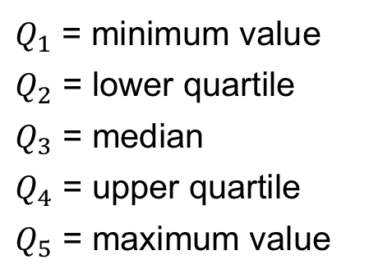
STRAND E
UNIT E4
Section E4.2
Measures of Variation: Example
Continued
The 5-number summary for the data on the previous slide is given by:
$Q_{1}$ = minimum value
$Q_{2}$ = lower quartile
$Q_{3}$ = median
$Q_{4}$ = upper quartile
$Q_{5}$ = maximum value
15
21
29.5
45
82
Here is the box and whisker plot, showing that the data is non symmetric with 50% of drivers under the age of 30.
x
x

Slide 17
STRAND E
UNIT E4
Section E4.2
Outliers
Outliers are extreme values in data sets and are often ignored as they can distort the data analysis. They could be errors or an extreme value. One definition is in terms of the interquartile range (IQR):
IQR = Upper Quartile (UQ) – Lower Quartile (LQ)
An outlier is “any value that is 1.5 times the IQR more than the UQ
or 1.5 × IQR less than the LQ”.
Example: Are there any outliers in the data from the last slide where min = 15, LQ = 21, UQ = 45, max = 82 ?
Solution: IQR = UQ – LQ = 45 – 21 = 24;
UQ + 1.5×IQR = 45 + 1.5×24 = 81 < 82 (max value)
LQ – 1.5×IQR = 21 – 1.5×24 = – 15 < 15 (min value)
Hence 82 is (just) an outlier but 15 is not an outlier.

Slide 18
STRAND E
UNIT E4
Section E4.2
Section E4.2 : Fitness Check
1.The ages in years of a group of people visiting a club are shown below.
Determine the 5-number summary for this data set.
Identify any outliers.
c) Illustrate the data using a box and whisker plot.
Answers a) $Q_{1}$= 14, $Q_{1}$= 27, $Q_{1}$= 30, $Q_{1}$= 37, $Q_{1}$= 76
b) The only outlier is 76
c)

Slide 19
STRAND E
UNIT E4
Section E4.2
Section E4.2: Fitness Check
2. The length of reign of each of the last 19 English monarchs is given in the table.
Find the median and quartiles of the length of reign of these 19 monarchs.
b) Write down the name of any monarch whose length of reign is an outlier.
LQ = 7, Median = 14, UQ=26
George III (60 years) and
Victoria (64 years)

Slide 20
STRAND E
UNIT E4
Section E4.2
Section E4.2: Review
You have completed the second Section.
If you have completed and understood this section,
click to start the next Section.
If you need more examples and interactive practice, go to
http://szalonta.hu/ske/text/E4/skee4s2.html

Slide 21
STRAND E
UNIT E4
Section E4.3
Standard Deviation (s.d.)
This is another measure of variation; it is based on adding the square of the distance each data point is from the mean value.
Note that you square the differences, divide by the number of values and then take the square root.
Clearly if all the data points are equal, then the s.d. is 0.
Note: The next slide shows how to evaluate this but it is much easier and quicker to use a calculator, and you need to make sure you can use stats mode on your calculator.

Slide 22
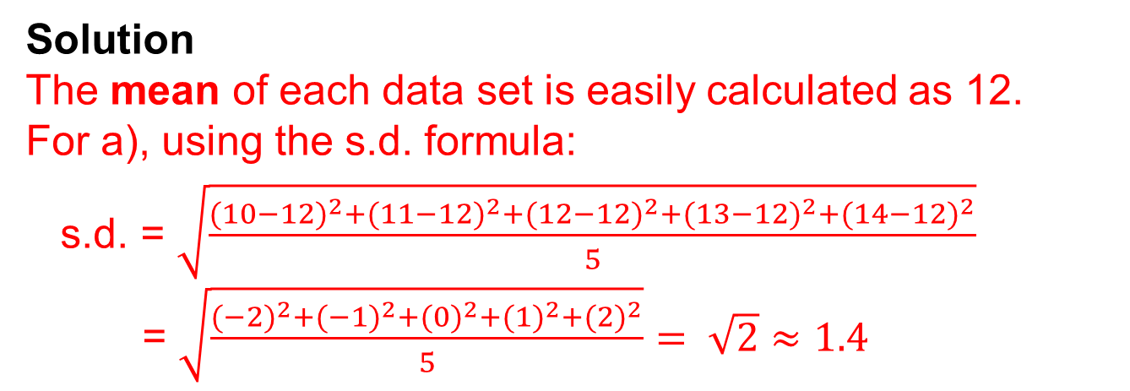
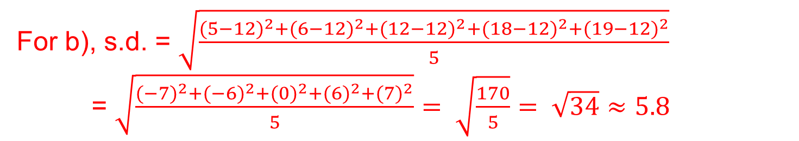
STRAND E
UNIT E4
Section E4.3
Standard Deviation: Example
Example
Find the mean and standard deviation of each of these number sets:
a) 10, 11, 12, 13, 14 b) 5, 6, 12, 18, 19
Solution
The mean of each data set is easily calculated as 12.
For a), using the s.d. formula:
s.d. = $\sqrt{\frac{{(10−12)}^{2}+{(11−12)}^{2}+{(12−12)}^{2}+{(13−12)}^{2}+{(14−12)}^{2}}{5}}$
= $\sqrt{\frac{{(−2)}^{2}+{(−1)}^{2}+{(0)}^{2}+{(1)}^{2}+{(2)}^{2}}{5}}=$ $\sqrt{2}$ $≈1.4$
For b), s.d. = $\sqrt{\frac{{(5−12)}^{2}+{(6−12)}^{2}+{(12−12)}^{2}+{(18−12)}^{2}+{(19−12)}^{2}}{5}}$
= $\sqrt{\frac{{(−7)}^{2}+{(−6)}^{2}+{(0)}^{2}+{(6)}^{2}+{(7)}^{2}}{5}}=$ $\sqrt{\frac{170}{5}}$ $= \sqrt{34}≈5.8$
Note: Set b) has a much larger standard deviation. This is expected, as the spread in set b) is clearly far more than in set a).

Slide 23
STRAND E
UNIT E4
Section E4.3
Standard Deviation: Example in Context
Example
Two machines, A and B, fill packets with soap powder.
A sample of packets was taken from each machine and the weight of powder (in kg) was recorded.
a) Find the mean and standard deviation for each machine.
b) Which machine is most consistent?
Solution
a) Using stats mode on a calculator gives:
Machine | Mean (kg) | Standard Deviation
A | 2.24 | 0.04
B | 2.64 | 0.07
b) Although Machine A has a smaller mean, it is more consistent with a lower standard deviation.

Slide 24
STRAND E
UNIT E4
Section E4.3
Standard Deviation: Scientific Calculators
Most scientific calculators now have a ”statistical” mode and you can input data to determine the mean and standard deviation and other statistical measures.
Whilst the calculations on the previous slide do give an understanding of the concept of standard deviation, it is important to be able to use stats mode on your calculator.
If you have “lost” your instruction on how to use stats mode, just google:
“model number and how to use stats mode”
and you will get the instructions you need.
It is really important that you can use and understand the stats mode on your calculator!

Slide 25
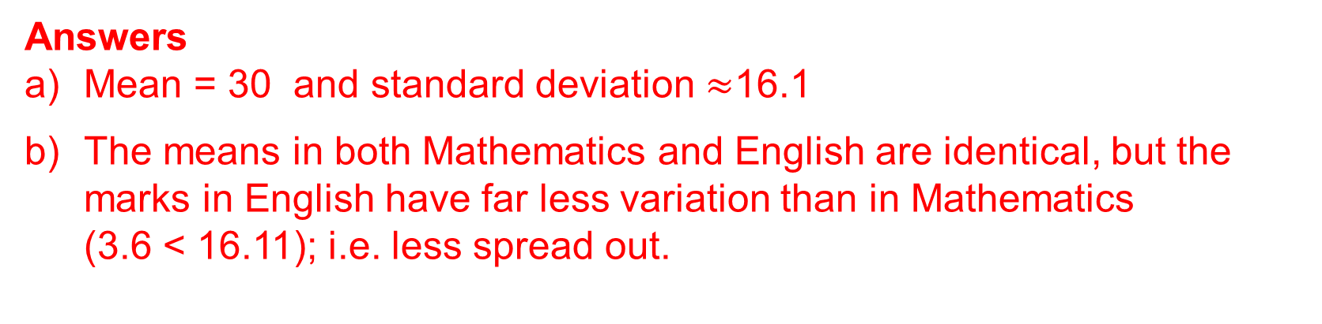
STRAND E
UNIT E4
Section E4.3
Section 3: Fitness Check
Ten students sat a test in Mathematics, marked out of 50.
The results are shown below for each student.
25, 27, 35, 4, 49, 10, 12, 45, 45, 48
Calculate the mean and standard deviation of the data.
The same students also sat an English test, marked out of 50. Their mean was 30 and standard deviation 3.6.
b) Comment on and contrast the results in Mathematics and English.
Answers
Mean = 30 and standard deviation $≈$16.1
The means in both Mathematics and English are identical, but the marks in English have far less variation than in Mathematics (3.6 < 16.11); i.e. less spread out.

Slide 26
STRAND E
UNIT E4
Section E4.3
Section E4.3: Review
You have completed the last Section.
If you need more examples and interactive practice, go to
http://szalonta.hu/ske/text/E4/skee4s3.html

