Slide 1
TSST Strand F
Unit F2: Algebraic Concepts

Slide 2
Strand F
Unit F2
Algebraic Concepts
Algebraic concepts are an important part of algebra work.
You have five sections to work through and there are check up audits and fitness tests for each section.
Simplifying Expressions
Simple Equations
Solving Linear Equations
Algebraic Manipulation
Algebraic Fractions

Slide 3
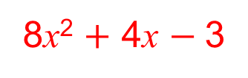
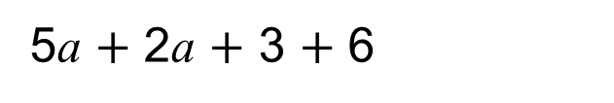
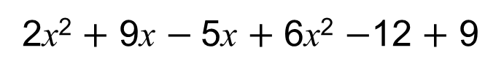
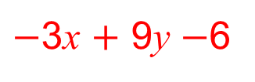
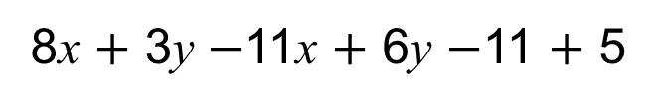
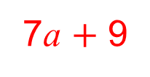
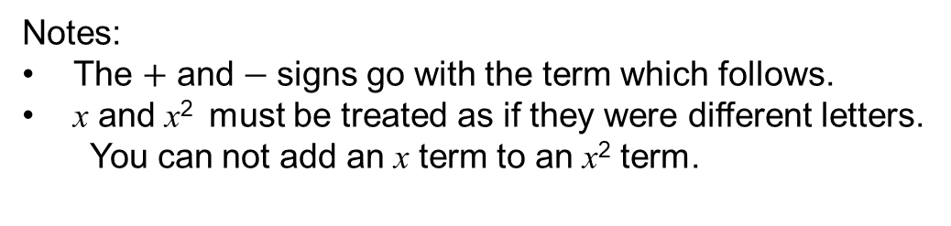
Strand F
Unit F2
Section F2.1
Simplifying Expressions
An expression is a group of terms.
To simplify an expression, we collect together ‘like terms’,
i.e. terms with the same variable.
Simplify
5a $+$ 2a $+$ 3 $+$ 6
Solution:
7a $+$ 9
Simplify
8x $+$ 3y $−$11x $+$ 6y $−$11 $+$ 5
Solution:
$−$3x $+$ 9y $−$6
Simplify
2x² $+$ 9x $−$5x $+$ 6x² $−$12 $+$ 9
Solution:
8x² $+$ 4x $−$3
Notes:
The $+$ and$−$ signs go with the term which follows.
x and x² must be treated as if they were different letters.
You can not add an x term to an x² term.

Slide 4
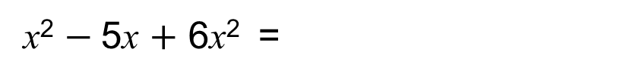
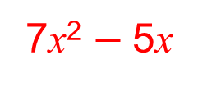
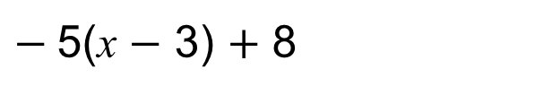
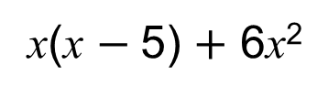
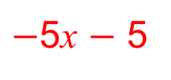

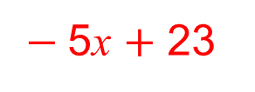
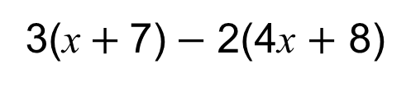
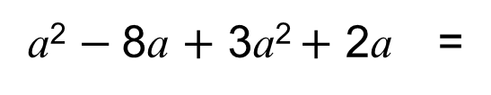
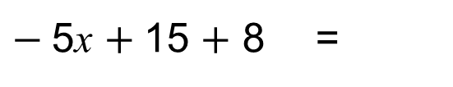
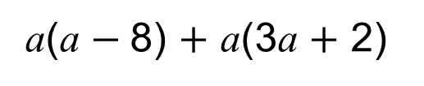
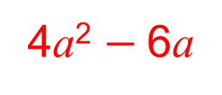
Simplifying Expressions
Strand F
Unit F2
Section F2.1
To simplify an expression with brackets, we first expand the expression.
Simplify
$−$5(x $−$ 3) $+$ 8
Solution:
$−$5x $+$15 $+$ 8 =
$−$5x $+$ 23
Simplify
3(x$+$7)$−$ 2(4x $+$ 8)
Solution:
$$\text{3}\text{x}+\text{21}−\text{8}\text{x}−\text{16 =}$$
$−$5x $−$ 5
Simplify
x(x $−$5) $+$ 6x²
Solution:
7x² $−$5x
x² $−$5x $+$ 6x² =
Simplify
a(a $−$8) $+$ a(3a $+$ 2)
Solution:
a² $−$8a $+$ 3a² $+$ 2a =
4a² $−$6a

Slide 5
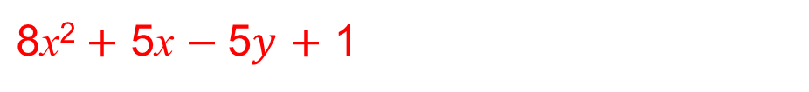
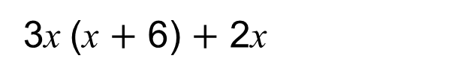
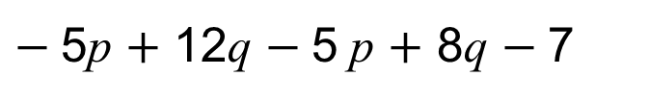
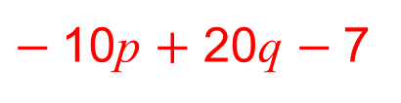
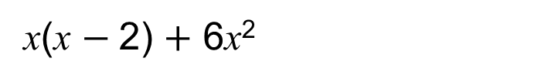
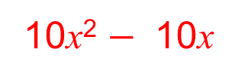
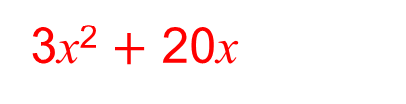
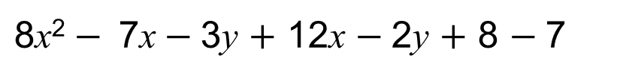
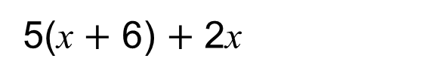
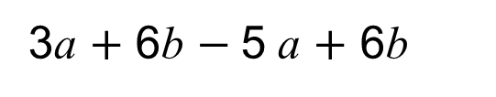
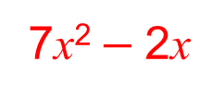
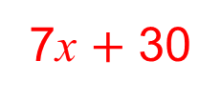

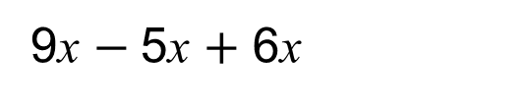
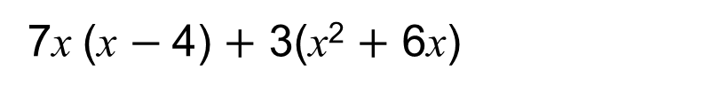
Section F2.1: Fitness Check
Strand F
Unit F2
Section F2.1
Here are some questions to check your progress;
there are more practice questions if needed.
Simplify each of these expressions.
9x $−$5x $+$ 6x
10x
3a $+$ 6b $−$5 a $+$ 6b
$−$2a $+$ 12b
$−$5p $+$ 12q $−$5 p $+$ 8q $−$7
$−$10p $+$ 20q $−$7
$\text{8}\text{x}\text{2}− \text{7}\text{x}−$3y $+$ 12x $−$2y $+$ 8 $−$7
$\text{8}\text{x}\text{2}+$ 5$\text{x}$ $−$5$y$ $+$ 1
5(x $+$ 6) $+$ 2x
7$\text{x}$ $+$ 30
x(x $−$2) $+$ 6x²
7$\text{x}$² $−$2$\text{x}$
3x (x $+$ 6) $+$ 2x
3$\text{x}$² $+$ 20$\text{x}$
7x (x $−$4) $+$ 3(x² $+$ 6x)
10$\text{x}$² $−$ 10$\text{x}$

Slide 6
STRAND F
Unit F2
Section F2.1
Section F2.1: Review
You have completed the first Section.
If you have completed and understood this section,
click to start the next Section.
If you need more examples and interactive practice, go to
http://szalonta.hu/ske/text/F2/skef2s1.html

Slide 7
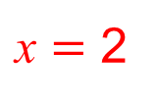
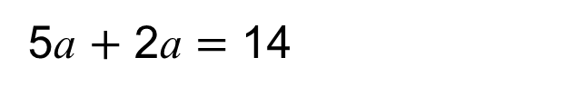
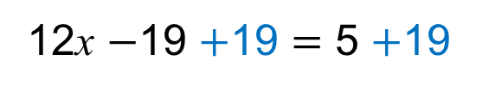
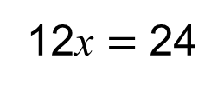
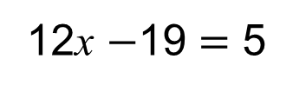
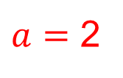
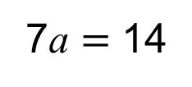
STRAND F
Unit F2
Section F2.2
Simple Equations
An equation has terms on both sides of an equals sign.
To solve simple equations, we collect together ‘like terms’ on each side of the equals sign.
Then, we make sure the equation always remains balanced:
so whatever operation we do on one side of the equation, we must also do on the other.
Solve
5$\text{a}$ $+$ 2$\text{a}$ $=$ 14
Solution:
7$\text{a}$ $=$ 14
Collect like terms
Now divide both sides by 7
$a$ $=$ 2
Solve
12x $−$19 $=$ 5
Solution:
Eliminate the ‘$−$19’ by adding 19 to both sides
12x $−$19 $+$19 $=$ 5 $+$19
12x $=$ 24
Now divide both sides by 12
$\text{x}$ $=$ 2

Slide 8
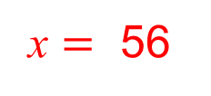
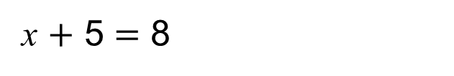

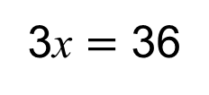

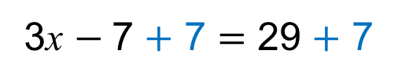
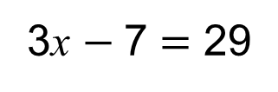
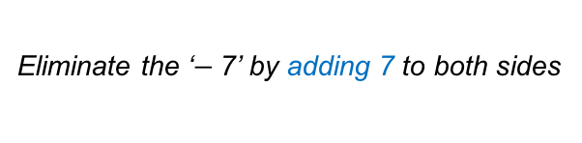
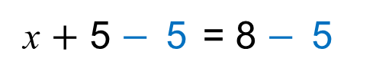
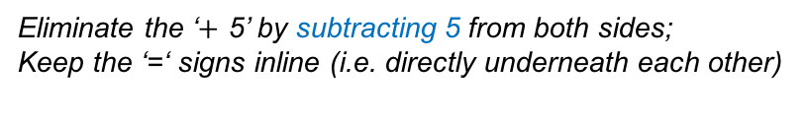
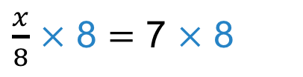
STRAND F
Unit F2
Section F2.2
Simple Equations
Further examples 1:
Solve
x $+$ 5 $=$ 8
Solution:
Eliminate the ‘$+$ 5’ by subtracting 5 from both sides;
Keep the ‘=‘ signs inline (i.e. directly underneath each other)
x $+$ 5 $−$5 = 8 $−$5
x = 3
Solve
3x $−$7 $=$ 29
Eliminate the ‘$−$7’ by adding 7 to both sides
Solution:
3x $−$7 $+$ 7 $=$ 29 $+$ 7
3x $=$ 36
Now divide both sides by 3
$$\text{x}=\text{12}$$
Solve
$\frac{x}{8}$ $=$ 7
Solution:
To eliminate the ‘$÷$ 8’ multiply both sides by 8
$\frac{x}{8}$ $×$ 8 $=$ 7 $×$ 8
x $=$ 56

Slide 9













STRAND F
Unit F2
Section F2.2
Simple Equations
Further examples 2:
Solve
2x $−$ 8 $=$ $−$18
Eliminate the ‘$−$ 8’ by adding 8 to both sides;
Solution:
2x $−$8$+$ 8 $=$ $−$18 $+$ 8
2x $=$ $−$10
x $=$ $−$5
Solve
5x $−$4 $=$ 26
Eliminate the ‘$−$4’ by adding 4 to both sides
Solution:
5x $−$4 $+$ 4 $=$ 26 $+$ 4
5x $=$ 30
Now divide both sides by 5
$$\text{x}=\text{6}$$
Solve
$\frac{\text{m}}{\text{3}}=$ $−$6
Solution:
To eliminate the ‘$÷$ 3’ multiply both sides by 3
$\frac{\text{m}}{\text{3}}×$ 3 $=$ $−$6 $×$ 3
m $=$ $−$18

Slide 10
















Section F2.2: Fitness Check
STRAND F
Unit F2
Section F2.2
Here are some questions to check your progress;
there are more practice questions if needed.
Solve each of these equations.
9$\text{x}$ $−$5 $=$ 31
$\text{x}$ $=$ 4
3a $+$ 6 $=$ $−$144
a $=$ $−$50
$−$5p $+$ 12 $=$ 62
p $=$ $−$10
$\frac{m}{7}$ $=$ 11
m $=$ 77
5$\text{x}$ $+$ 6 $=$ 61
$\text{x}$ $=$ 11
$\text{x}$ $−$2 $=$ $−$6
$\text{x}$ $=$ $−$4
$−$3$\text{x}$ $+$ 6 $=$ $−$6
$\text{x}$ $=$ 4
7($\text{x}$ $−$4) $=$ 35
$\text{x}$ $=$ 9

Slide 11
STRAND F
Unit F2
Section F2.2
Section F2.2: Review
You have completed the second Section.
If you have completed and understood this section,
click to start the next Section.
If you need more examples and interactive practice, go to
http://szalonta.hu/ske/text/F2/skef2s2.html

Slide 12




STRAND F
Unit F2
Section F2.3
Solving Linear Equations
Linear equations are simple equations which would
draw a straight (linear) line if plotted.
To solve linear equations, we sometimes need to complete
a number of steps along the way.
For example, 3x $+$ 8 $=$ $−$4(x $+$ 5)
To solve an equation with brackets, we can first expand the expression.
$\text{3}\text{x}+\text{ 8} =$ $−$4x$−$ 20
Now look for the smallest number of ‘x’ and eliminate this term
(remember: $−$4x is smaller than 3x).
To eliminate $−$4x we must $+$ 4x
$\text{3}\text{x}+\text{ 8} +$ 4x$=−$4x$−$ 20 $+$ 4x
this is continued on the next slide...

Slide 13






STRAND F
Unit F2
Section F2.3
Solving Linear Equations
Continued …
$\text{3}\text{x}+\text{ 8} +$ 4x$=−$4x$−$ 20 $+$ 4x
Now, collect together any like terms on each side
$\text{7}\text{x} +\text{ 8 }=−$20
To get the ‘7x’ term on its own, we must eliminate the 8.
(remember: to eliminate $+$ 8 we must $−$8)
7x $+$ 8 $−$8 $=$ $−$20 $−$8
$\text{7}\text{x}=$ $−$ 28
Now to find the value of one x, we divide both sides by 7.
x $=$ $−$4

Slide 14









STRAND F
Unit F2
Section F2.3
Solving Linear Equations
$\frac{\text{m}}{\text{2}}$ $=$ 3$\text{m}$ $−$10
Here is another example:
To solve this equation, we first need to multiply throughout by 2;
this will eliminate the ‘divide by 2’ on the left hand side.
$\text{m}=$ 6$\text{m}$ $−$20
Now look for the smallest number of ‘$\text{m}$’ and eliminate this term
To eliminate ‘$\text{m}$’ we must $−\text{m}$from each side.
$\text{m}−\text{m}=$ 6$\text{m}$ $−$20 $−\text{m}$
$\text{0}=$ 5$\text{m}$ $−$20
To get the ‘$\text{m}$’ term on its own, we must eliminate the $−$20.
(remember: to eliminate $−$20 we must $+$20)
$\text{0}+ \text{20}=$ 5$\text{m}$ $−$20 $+$20
$\text{2}\text{0}=$ 5$\text{m}$
Now to find the value of one $\text{m}$, we divide both sides by 5 to give:
$\text{4}=$ m
Which is, of course, exactly the same as: m $=\text{4}$

Slide 15
















STRAND F
Unit F2
Section F2.3
Section F2.3: Fitness Check
Here are some questions to check your progress;
there are more practice questions if needed.
Solve each of these equations.
9(x $−$4) $=$ 18
x $=$ 6
3(a $+$ 6) $=$ $−$3(a $+$ 6)
a $=$ $−$6
$−$5(p $+$ 12) $=$ 6 $−$4p
p $=$ $−$66
$\frac{\text{m}}{\text{3}}=$ 2(m $−$5)
m $=$ 6
$−$5x $+$ 6 $=$ $−$3x$−$ 6
x $=$ 6
x $−$4 $=$ $−$6 (x $−$4)
x $=$ 4
$−$3x $+$ 6(x $−$4) $=$ $−$5x
x $=$ 3
9(x $−$4) $=$ 3(x $−$4)
x $=$ 4

Slide 16
STRAND F
Unit F2
Section F2.3
Section F2.3: Review
You have completed the third Section.
If you have completed and understood this section,
click to start the next Section.
If you need more examples and interactive practice, go to
http://szalonta.hu/ske/text/F2/skef2s3.html

Slide 17


STRAND F
Unit F2
Section F2.4
Algebraic Manipulation
Sometimes we want to rearrange an equation to make a different variable (letter) the subject.
For example: Make x the subject of this equation:
y $=$ x $+$ 24
We rearrange, by subtracting 24 from each side:
y $−$ 24 $=$ x
x $=$ y $−$ 24
Sometimes a variable may appear twice in a formula or equation.
For example: Make x the subject of this equation:
5x $−$ 4 $=$ 3x $+$ a
First bring all the terms containing x to one side of the equation. Subtract 3 x to give: 2x $−$ 4 $=$ a
Now add 4: 2x $=$ a $+$ 4
Divide by 2: x $=$ $\frac{\text{a} +\text{ 4} }{\text{2}}$

Slide 18



STRAND F
Unit F2
Section F2.4
Algebraic Manipulation
Example 1: Make x the subject of this equation:
2(x $−$ 5) $=$ 5a $−$ 3x
Solution
First expand the brackets and bring all the terms containing x to one side of the equation:
2x $−$ 10 $=$ 5a $−$ 3x
2x $+$ 3x $−$ 10 $=$ 5a
5x $=$ 5a $+$ 10
x $=$ $\frac{\text{5}\text{a} + \text{10} }{\text{5}}$
Now eliminate the $−$10
by adding 10 to each side:
Divide both sides by 5:
x $=$ a $+$ 2

Slide 19




STRAND F
Unit F2
Section F2.4
Algebraic Manipulation
Example 2: Make x the subject of the equation: p $=\sqrt{\frac{\text{x} +\text{10} }{\text{x}}}$ (p $≠±1)$
Solution
First square each side of the equation, to eliminate the square root:
p² $=\frac{\text{x} +\text{10} }{\text{x}}$
Now - even though all the terms containing x are already on one side of the equation - we need to multiply throughout by x to eliminate x as a denominator:
Now we bring all the terms containing x to one side of the equation: xp² $−$ $\text{x}$ $= \text{10}$
And factorise: x(p² $−$ $\text{1)}$ $= \text{10}$
xp² $=\text{x} +\text{10}$
Finally, divide throughout by (p² $−$ $\text{1)} \text{to} \text{give}\text{:}$
x$=$ $\frac{\text{10} }{\text{(}\text{p}\text{2} −\text{ 1)}}$

Slide 20















STRAND F
Unit F2
Section F2.4
Section F2.4: Fitness Check
Here are some questions to check your progress;
there are more practice questions if needed.
Make x the subject of each of the following:
$$\text{x} = \frac{\text{a} −\text{5}}{\text{6}}$$
7x $−$a $=$x $−$5
$$\text{x} = \frac{\text{1} }{\text{a} −\text{b}}$$
$xa$ $−$ 6 $=$ bx $−$5
5(x $−$ a) $=$9(a $−$x)
$\text{x} =$a
p(x $−$ 1) $=$q(x $−$1)
$\text{x} =$1
$$\text{x} = \frac{\text{a} −\text{2}}{\text{3}}$$
2(x$+$ 1) $=$a $−$x
$$\text{x} = \frac{\text{15} +\text{3}\text{b}}{\text{18}}$$
$$= \frac{\text{5} +\text{b}}{\text{6}}$$
$−$3(3x $−$2 $−$b) $=$9(x $−$1)
$$\frac{\text{2}\text{x} − \text{a}}{\text{6}}= \frac{\text{x} + \text{b}}{\text{6}}$$
$$\text{x} = \frac{\text{a} +\text{b}}{\text{3}}$$

Slide 21
STRAND F
Unit F2
Section F2.4
Section F2.4: Review
You have completed the fourth Section.
If you have completed and understood this section,
click to start the next Section.
If you need more examples and interactive practice, go to
http://szalonta.hu/ske/text/F2/skef2s4.html

Slide 22






STRAND F
Unit F2
Section F2.5
Algebraic Fractions
To add or subtract fractions, we first need a common denominator.
For example: $\frac{\text{3}}{\text{5}}$ $+\frac{\text{1}}{\text{3}}$ $=$
The same is true, when working with algebraic fractions. For example: Express $\frac{\text{x}}{\text{6}}$ $+\frac{\text{x}}{\text{4}}$ as a single fraction.
$\frac{\text{x}}{\text{6}}$ $+\frac{\text{x}}{\text{4}}$ $=$
$\frac{\text{9}}{\text{15}}$ $+\frac{\text{5}}{\text{15}}$
$$=\frac{\text{14}}{\text{15}}$$
$\frac{\text{4}\text{x}}{\text{24}}$ $+\frac{\text{6}\text{x}}{\text{24}}$
$$=\frac{\text{10}\text{x}}{\text{24}}$$
$$=\frac{\text{5}\text{x}}{\text{12}}$$

Slide 23




STRAND F
Unit F2
Section F2.5
Algebraic Fractions
Further example:
Express: $\frac{\text{3}}{\text{x}}$ $+ \frac{\text{2}}{\text{x} +\text{ 4}}$ as a single fraction.
$\frac{\text{3}}{\text{x}}$ $+ \frac{\text{2}}{\text{x} +\text{ 4}}$
In this case, the common denominator will be x($\text{x} +\text{ 4}$)
$$=\frac{\text{3}\text{(}\text{x} +\text{ 4}\text{)}}{\text{x}\text{(}\text{x} +\text{ 4}\text{)}} + \frac{\text{2}\text{x}}{\text{x}\text{(}\text{x} +\text{ 4}\text{)}}$$
$$=\frac{\text{3}\text{x} + \text{12}}{\text{x}\text{(}\text{x} +\text{ 4}\text{)}} + \frac{\text{2}\text{x}}{\text{x}\text{(}\text{x} +\text{ 4}\text{)}}$$
$$=\frac{\text{5}\text{x} +\text{ 12}}{\text{x}\text{(}\text{x} +\text{ 4}\text{)}}$$

Slide 24










STRAND F
Unit F2
Section F2.5
Section F2.5: Fitness Check
Here are some questions to check your progress;
there are more practice questions if needed.
Simplify each expression:
$\frac{\text{1}}{\text{x} +\text{ 4}}+ \frac{\text{2}}{\text{x} − \text{3}}$ $=$
$$\frac{\text{3}\text{x} +\text{5}}{\text{(}\text{x} +\text{ 4}\text{)(}\text{x} − \text{3)}}$$
$$\frac{\text{3} \text{x}\text{2} }{\text{(}\text{x} + \text{2}\text{)(}\text{x}− \text{4}\text{)}}$$
$\frac{\text{x}}{\text{x} + \text{2}}+ \frac{\text{2}\text{x}}{\text{x} −\text{ 4}}$ $=$
$\frac{\text{3}\text{x}}{\text{x}}$ $+ \frac{\text{2}}{\text{x} +\text{ 4}}$ $=$
$$\frac{\text{3} \text{x}\text{2} +\text{1}\text{4}\text{x} }{\text{x} \text{(}\text{x} +\text{ 4)}}$$
$\frac{\text{5}\text{x}}{\text{6} − \text{x}}− \frac{\text{2}}{\text{x} +\text{ 4}}$ $=$
$$\frac{\text{5} \text{x}\text{2} +\text{2}\text{2}\text{x}−\text{12}}{\text{(6} − \text{x}\text{)(}\text{x}+\text{ 4)}}$$
$$\frac{\text{5} \text{x}\text{2} −\text{19}\text{x}}{\text{(}\text{7} − \text{x}\text{)(}\text{x}+ \text{1}\text{)}}$$
$\frac{\text{2}\text{x}}{\text{7} − \text{x}}− \frac{\text{3}\text{x}}{\text{x} + \text{1}}$ $=$

Slide 25
STRAND F
Unit F2
Section F2.5
Section F2.5: Review
You have completed the last Section.
If you need more examples and interactive practice, go to
http://szalonta.hu/ske/text/F2/skef2s5.html

