Slide 1
TSST Strand F
UNIT F3: Algebraic Manipulation

Slide 2
Strand F
Unit F3
Algebraic Manipulation
Algebraic manipulation is an important part of algebra work as it helps with Solving Simultaneous Linear Equations and Factorisation.
You have four sections to work through and there are check up audits and fitness tests for each section.
Simultaneous Linear Equations
Expanding Brackets
Linear Factorisation
Quadratic Factorisation

Slide 3

Strand F
Unit F3
Section F3.1
Simultaneous Linear Equations
Try solving: x $+$ y $=$ 24
What could ‘x’ be? What could ‘y’ be?
There are simply too many possible solutions.
So if we have more than one ‘unknown’ (variable),
we must have more than one equation.
With two ‘unknowns’, we must have at least two equations.
And we must solve them at the same time, i.e. simultaneously.
x $+$ y $=$ 24 and
2 x $=$ 20
Try again:
Can you solve it now?
See next slide for worked solution.

Slide 4


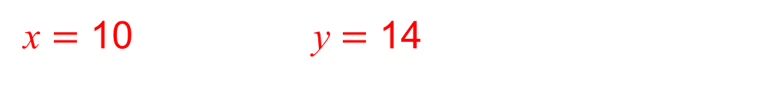

Strand F
Unit F3
Section F3.1
Simultaneous Linear Equations
x $+$ y $=$ 24
2x $=$ 20
Solve:
1
2
What could ‘x’ be?
From the 2nd equation,
What could ‘y’ be?
First, label the equations.
we can work out x $=$ 10
And so now we can use this solution and ‘plug’ it in
(i.e. substitute) this value into the 1st equation.
x $+$ y $=$ 24
10 $+$ y $=$ 24
y $=$ 14
Substitute x value into equation 1
Now solve for y
Solutions:
x $=$ 10 y $=$ 14

Slide 5

Strand F
Unit F3
Section F3.1
Simultaneous Linear Equations
There are 3 ways to solve simultaneous linear equations:
by substitution (as in the example on previous slides);
by drawing graphs (and finding the coordinates of where
the 2 lines cross);
by elimination.
We will look at the method of elimination next.
Try solving:
x $+$ 2y $=$ 5 and
3x $+$ y $=$ 5
See next slide for worked solution.

Slide 6
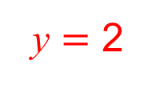



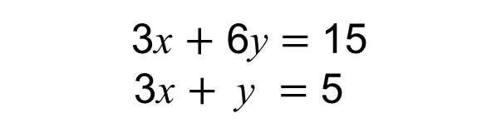

Strand F
Unit F3
Section F3.1
Simultaneous Linear Equations
x $+$ 2y $=$ 5
3x $+$ y $=$ 5
Label the equations:
1
2
Equation 1
is multiplied by 3, so that it contains the
same number of x’s as equation 2 .
Let the new equation be labelled 3 .
equation 1 is multiplied
throughout by 3
3x $+$ 6y $=$ 15
3x $+$ y $=$ 5
3
2
To eliminate a variable (in this case, the x’s),
equation 2 is now subtracted from equation 3 .
3x $+$ 6y $=$ 15
3x $+$ y $=$ 5
5y $=$ 10
$$−$$
________________
________________
Solving 5y $=$ 10 gives
y $=$ 2

Slide 7

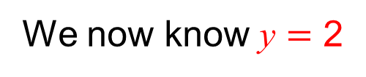
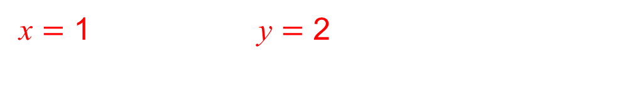
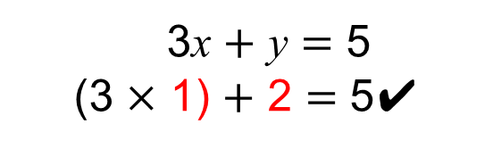
Strand F
Unit F3
Section F3.1
Simultaneous Linear Equations
We now know y $=$ 2
This value of y is now substituted into equation 1 to give:
x $+$ 2y $=$ 5
x $+$ (2 × 2) $=$ 5
x $+$ 4 $=$ 5
x $=$ 1
We check these solutions in equation 2
3x $+$ y $=$ 5
(3 × 1) $+$ 2 $=$ 5✔
Solutions:
x $=$ 1 y $=$ 2

Slide 8



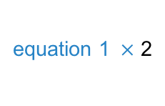

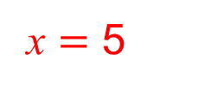
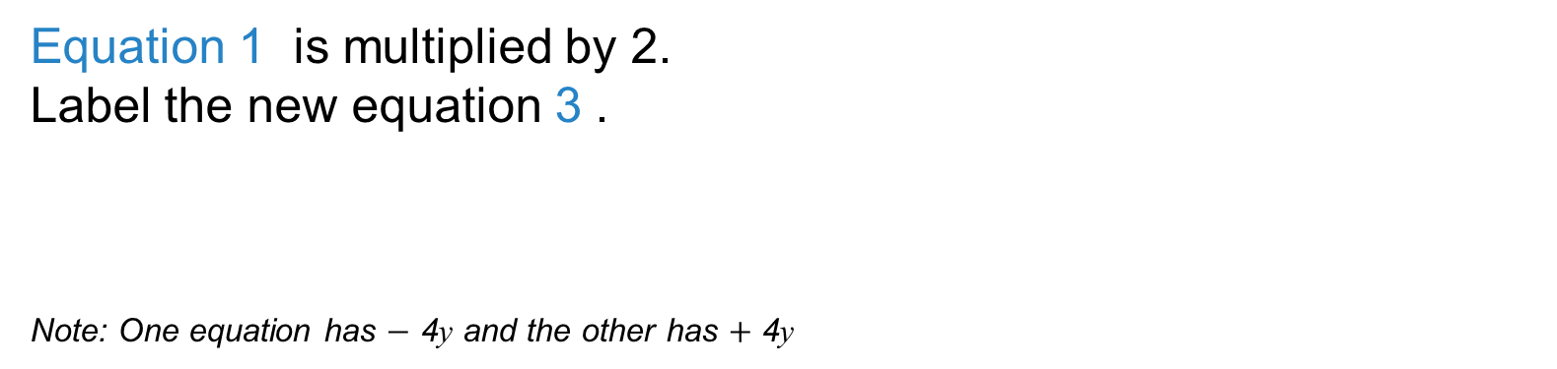

Strand F
Unit F3
Section F3.1
Simultaneous Linear Equations
Here is another example:
Label the equations:
7x $−$ 2y $=$ 23
3x $+$ 4y $=$ 39
1
2
Equation 1 is multiplied by 2.
Label the new equation 3 .
Note: One equation has $−$ 4y and the other has $+$ 4y
equation 1 $×$ 2
14x $−$ 4y $=$ 46
3x $+$ 4y $=$ 39
3
2
To eliminate the y’s, equation 3 is now added to equation 2 .
14x $−$ 4y $=$ 46
3x $+$ 4y $=$ 39
17x $=$ 85
$$+$$
_____________
_____________
Solving 17x $=$ 85 gives
x $=$ 5

Slide 9


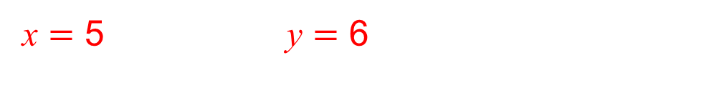
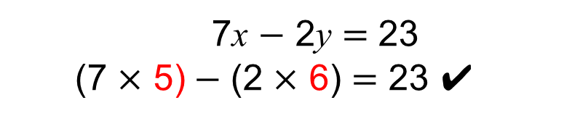
Strand F
Unit F3
Section F3.1
Simultaneous Linear Equations
We now know x $=$ 5
This value of x is now substituted into equation 2 to give:
3x $+$ 4y $=$ 39
(3 × 5) $+$ 4y $=$ 39
15 $+$ 4y $=$ 39
4y $=$ 24
y $=$ 6
We check these solutions in equation 1
7x $−$ 2y $=$ 23
(7 × 5)$−$ (2 × 6) $=$ 23 ✔
Solutions:
x $=$ 5 y $=$ 6

Slide 10



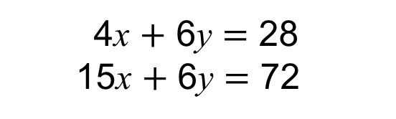
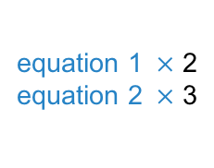

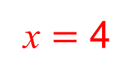
Strand F
Unit F3
Section F3.1
Simultaneous Linear Equations
Here is another example:
Label the equations:
2x $+$ 3y $=$ 14
5x $+$ 2y $=$ 24
1
2
Equation 1 is multiplied by 2, and equation 2 is multiplied by 3,
so both equations contain the same number of y’s.
Label the new equations 3 and 4 .
equation 1 $×$ 2
equation 2 $×$ 3
4x $+$ 6y $=$ 28
15x $+$ 6y $=$ 72
3
4
To eliminate the y’s, equation 3 is now subtracted from equation 4 .
15x $+$ 6y $=$ 72
4x $+$ 6y $=$ 28
11x $=$ 44
$$−$$
______________
______________
Solving 11x $=$ 44 gives
x $=$ 4

Slide 11

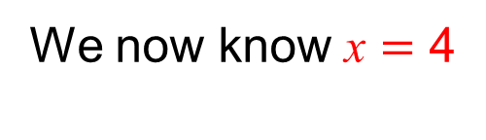
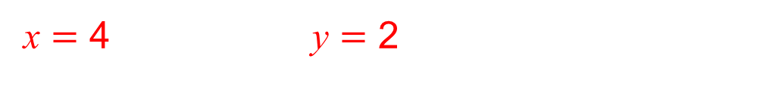
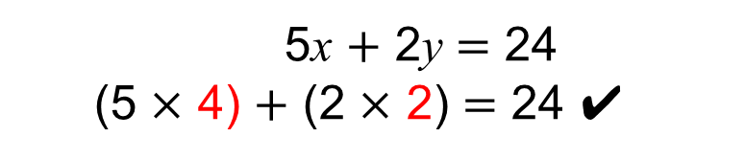
Strand F
Unit F3
Section F3.1
Simultaneous Linear Equations
We now know x $=$ 4
This value of x is now substituted into equation 1 to give:
2x $+$ 3y $=$ 14
(2 × 4) $+$ 3y $=$ 14
8 $+$ 3y $=$ 14
3y $=$ 6
y $=$ 2
We check these solutions in equation 2
5x $+$ 2y $=$ 24
(5 × 4) $+$ (2 × 2) $=$ 24 ✔
Solutions:
x $=$ 4 y $=$ 2

Slide 12
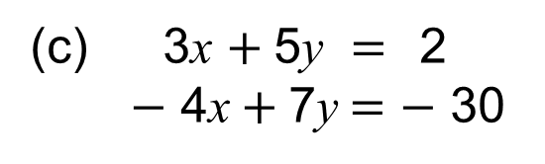
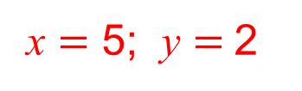
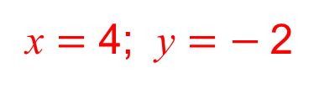
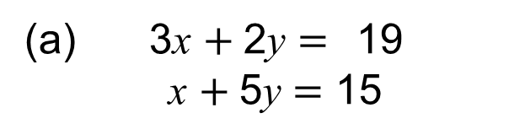
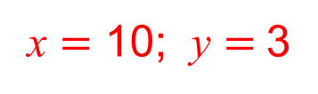
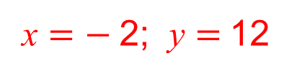
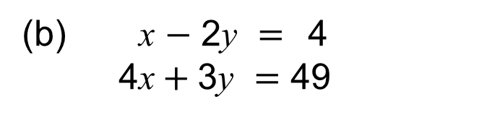
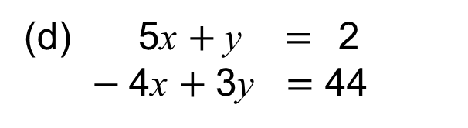
Strand F
Unit F3
Section F3.1
Section F3.1: Fitness Check
Here are some questions to check your progress;
there are more practice questions if needed.
Solve each pair of simultaneous equations.
3x $+$2y $=$19
x $+$5y $=\text{15}$
x $=$ 5; y $=$2
(b) x $−$ 2y $=$4
4x$+$3y $=\text{4}\text{9}$
x $=$ 10; y $=$3
(c) 3x $+$5y $=$2
$−$ 4x$+$7y$=−$30
x $=$ 4; y $=−$2
(d) 5x $+$y $=$2
$−$4x $+$3y $=\text{44}$
x $=$ $−$2; y $=$12

Slide 13
STRAND F
Unit F3
Section F3.1
Section F3.1: Review
You have completed the first Section.
If you have completed and understood this section,
click to start the next Section.
If you need more examples and interactive practice, go to
http://szalonta.hu/ske/text/F3/skef3s1.html

Slide 14
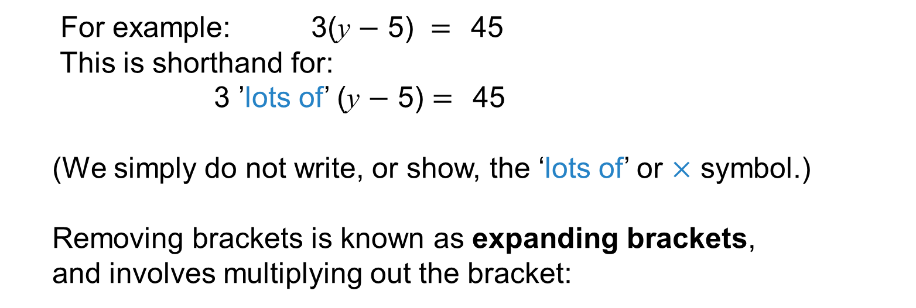
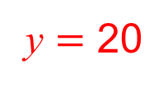
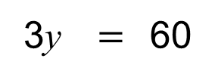
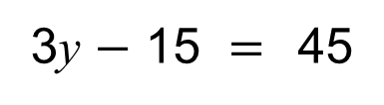
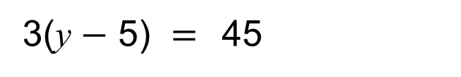
STRAND F
Unit F3
Section F3.2
Expanding Brackets
Expressions and equations may contain brackets.
For example: 3(y $−$ 5) $=$45
This is shorthand for:
3 ’lots of’ (y $−$ 5) $=$45
(We simply do not write, or show, the ‘lots of’ or $×$ symbol.)
Removing brackets is known as expanding brackets,
and involves multiplying out the bracket:
3(y $−$ 5) $=$45
3y $−$ 15 $=$45
Now we can solve:
3y $=$60
y $=$ 20
Note: The reverse of expanding brackets is the process
of factorisation.

Slide 15
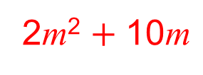
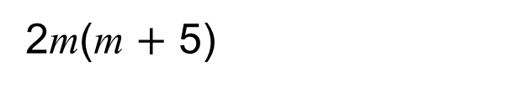
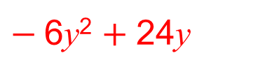
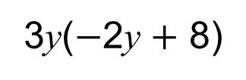
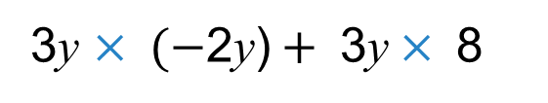
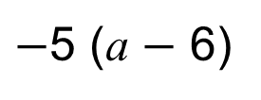
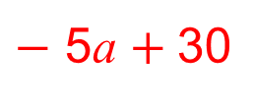
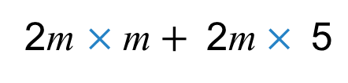
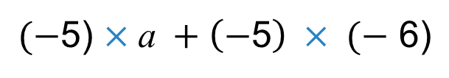
STRAND F
Unit F3
Section F3.2
Expanding Brackets
Further examples 1:
Expand:
2m(m $+$ 5)
Solution:
2m $×\text{m}+ \text{2}\text{m}× \text{5}$
2m² $+ \text{10}\text{m}$
Expand:
$−$5 (a $−$ 6)
Solution:
$(−$5) $×\text{a} +\left(−\text{5}\right) × (−\text{ 6}\text{)}$
$−$ 5a $+ \text{3}\text{0}$
Expand:
3y($−$2y $+$ 8)
Solution:
3y $× (−\text{2}\text{y}\text{)}+ \text{3}\text{y}× \text{8}$
$−$6y² $+ \text{24}\text{y}$

Slide 16
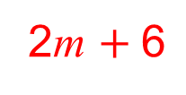
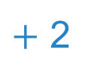
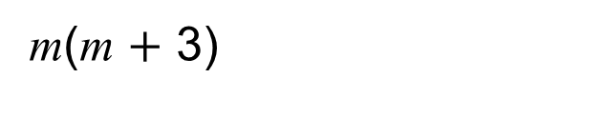
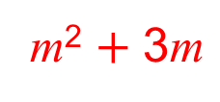

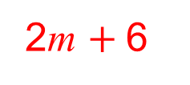

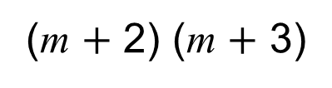
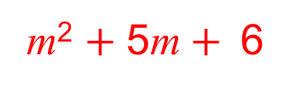
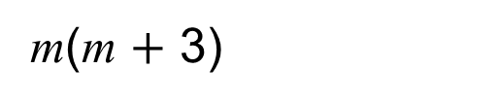
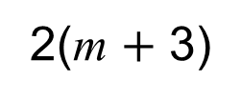
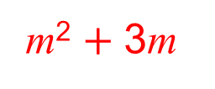

STRAND F
Unit F3
Section F3.2
Expanding Brackets
Further examples 2:
Expand:
m(m $+$ 3)
Solution:
m² $+ \text{3}\text{m}$
Expand:
2(m $+$ 3)
Solution:
2m $+ \text{6}$
NOW Expand:
m
(m $+$ 2) (m $+$ 3)
$+$ 2
This is exactly the same as:
m
$+$ 2
$+$ 2 (m $+$ 3)
m(m $+$ 3)
Solution:
m² $+ \text{3}\text{m}$
$$+$$
2m $+ \text{6}$
m² $+ \text{5}\text{m}+$6

Slide 17
STRAND F
Unit F3
Section F3.2
Expanding Brackets
Further examples 3:
2y
Expand:
(2y$−$ 3)(y $+$ 4)
$−$ 3
Solution:
2y (y $+$ 4)
2y
$−$ 3(y$+$ 4)
$−$ 3
2y² $+ \text{8}\text{y}$
$$−$$
3y $−\text{12}$
$2$y² $+ \text{5}\text{y}−$12
Expand:
(m $+$ 2)²
Solution:
(m $+$ 2) $×$ (m $+$ 2)
m
$+$ 2
m
m(m $+$ 2)
$+$ 2
$+$ 2(m $+$ 2)
m ² $+ \text{2}\text{m}$
$$+$$
2m $+ \text{4}$
m ² $+ \text{4}\text{m}+$4

Slide 18














STRAND F
Unit F3
Section F3.2
Section F3.2: Fitness Check
Here are some questions to check your progress;
there are more practice questions if needed.
Expand each of these expressions.
9(x $−$5)
9x $−$45
3(a $+$ 6)
3a $+$ 18
$−$5($p−$ 12)
$−$5p $+$ 60
$−$5m ($−$m $−$6)
5m² $+$ 30m
(2x$+$ 2) (x $−$2)
2x² $−$2x $−$4
$(−$3x$+$ 2) (x $−$2)
$−$3x²$+$ 8x $−$4
(7x $−$4) (2x$+$ 2)
14x² $+$ 6x $−$8

Slide 19





STRAND F
Unit F3
Section F3.3
Linear Factorisation
The reverse process of expanding brackets
is known as factorisation.
When factorised, an expression is written as a product of terms.
To factorise an expression, it is necessary to identify
what factors each term has in common.
In other words, what ‘goes into’ all the terms?
For example:
Factorise 8m $+$ 12
In this example, we are looking for the biggest factor of 8m and of 12.
The largest common factor is 4.
$$\text{8}\text{m}+\text{ 12}$$
is the same as
$($4 $×$2m)$+\text{ (}\text{4} × \text{3})$
4 $×$(2m$+ \text{3})$
4 (2m$+ \text{3})$

Slide 20








STRAND F
Unit F3
Section F3.3
Linear Factorisation
Further examples:
Factorise:
6a $−$21
The largest common factor is 3
Solution:
$($3 $×$2a) $+ \text{(}\text{3} × −\text{7})$
3 $×$ $($2a $− \text{7})$
3 $($2a $− \text{7})$
Factorise:
$$\text{6}\text{y}\text{2}+ \text{8}\text{y}$$
The largest common factor is 2y
Solution:
$($2y $×$3$\text{y}$)$+\text{ (}\text{2}\text{y}× \text{4})$
2y $×$(3$\text{y} + \text{4})$
2y (3y$+ \text{4})$

Slide 21














STRAND F
Unit F3
Section F3.3
Section F3.3: Fitness Check
Here are some questions to check your progress;
there are more practice questions if needed.
Factorise each of these expressions.
9x $−$45
9(x $−$5)
3a $+$ 18
3(a $+$ 6)
$−$5p $−$ 60
$−$5(p $+$ 12)
15m $−$6
3(5m$−$2)
2b²$+$ 12b
2b(b $+$ 6)
12x $−$ 8y $+$ 16
4(3x$−$ 2$\text{y}+$ 4)
7n³ $−$14n ²
7n ² (n$−$2)

Slide 22
STRAND F
Unit F3
Section F3.3
Section F3.3: Review
You have completed the second Section.
If you have completed and understood this section,
click to start the next Section.
If you need more examples and interactive practice, go to
http://szalonta.hu/ske/text/F3/skef3s3.html

Slide 23



STRAND F
Unit F3
Section F3.4
Quadratic Factorisation
It is possible to factorise expressions such as:
x² $+$ 5x $+$ 6
Expressions such as this are called quadratic expressions;
they have an x² term.
x² $+$ 5x $+$ 6
is factorised to obtain
(x $+$ 2) (x $+$ 3)
If we now expand (x $+$ 2) (x $+$ 3) we will get back to
where we started, i.e.
x ² $+$ 5x $+$ 6
Factorising and expanding are opposite processes.

Slide 24





STRAND F
Unit F3
Section F3.4
Quadratic Factorisation
x²
5
To factorise a quadratic expressions such as x² $+$ 5x $+$ 6
6
we set up a pair of brackets like this:
(x $+$ ?) (x $+$ ?)
(Note: if we were to expand the brackets,
the x multiplied by the x will give us the x ².)
We now need to find two numbers which
when added together make 5
and
when multiplied together make 6.
5
2 $+$ 3 $=$ 5
6
2 $×$ 3 $=$ 6
These two numbers are:
2 and 3
We can now factorise x² $+$ 5x $+$ 6:
(x $+$ ?) (x $+$ ?)
(x $+$ 2) (x $+$ 3)
Note: If we now expand (x $+$ 2) (x $+$ 3)
we will get back to where we started, i.e.
x² $+$ 5x $+$ 6

Slide 25










STRAND F
Unit F3
Section F3.4
Quadratic Factorisation
x²
$−$9
14
Here is another example. Factorise: x² $−$ 9x $+$ 14
we set up a pair of brackets like this:
(x $+$ ?) (x $+$ ?)
(Note: if we were to expand the brackets,
the x multiplied by the x will give us the x .)
We now need to find two numbers which
when added together make $−$9
and
when multiplied together make 14
$−$9
$−$7 $+$ $−$2 $=$ $−$9
14
$−$7 $×$ $−$2 $=$ 14
These two numbers are:
$−$7 and $−$2
We can now factorise x² $+$ 5x $+$ 6:
(x $+$ ?) (x $+$ ?)
(v $−$7 ) (x $−$2)
Note: If we now expand (x $−$7) (x $−$2)
we will get back to where we started, i.e.
x $−$9x $+$ 14
(x $+$ $−$7 ) (x $+$ $−$2) $=$

Slide 26


STRAND F
Unit F3
Section F3.4
Quadratic Factorisation
It is also possible to factorise expressions such as:
2a² $+$ 9a $−$ 5
2a²
Note: we now have more than one a²
We still set up a pair of brackets, but now they will look like:
(2a $+$ ?) (a $+$ ?)
This is because, when expanded, 2a $×$ a
will give us the 2a²
But how do we find the missing numbers?
We can use a ‘trial and improvement method’ called the
‘cross method’.
Note: Sometimes a few trials are necessary before we get a ‘hit’.
The next slide shows the solution.

Slide 27









Quadratic Factorisation
STRAND F
Unit F3
Section F3.4
Example 1: Factorise
2a²
using the cross method:
2a² $+$ 9a $−$ 5
9a
$−$ 5
We write two terms which can
multiply to make 2a² in the first column
We then write two terms which can
multiply to make $−$ 5 in the second column
$−$1a
2a $−$1
2a
1a
$−$1
5
1a 5
10a
We then cross multiply like so:
9a
We now sum
9a
If the sum matches the middle term,
then we have found the solution.
We simply populate the brackets, by reading across the rows, as so:
2a $−$1
($+$ )($+$ )
1a 5
(2a$−$1) (a $+$ 5)

Slide 28




STRAND F
Unit F3
Section F3.4
Quadratic Factorisation
6a²
17a
$+$ 5
Example 2: Factorise
6a² $+$17a $+$ 5
using the cross method:
We write two terms which can
multiply to make 6a² in the first column
We then write two terms which can
multiply to make 5 in the second column
1a
6a
1a
1
5
30a
We then cross multiply like so:
31a
We now sum
31a
The sum does NOT match the middle term,
so we have NOT found the solution.
Don’t worry! We simply need to try again.

Slide 29







STRAND F
Unit F3
Section F3.4
Quadratic Factorisation
17a
Example 2 continued…
6a² $+$17a $+$ 5
6a²
$+$ 5
We write two terms which can
multiply to make 6a² in the first column
We then write two terms which can
multiply to make 5 in the second column
2a
3a
2a
3a 1
1
5
2a 5
15a
We then cross multiply like so:
17a
We now sum
17a
The sum DOES match the middle term,
so we HAVE found the solution.
We simply populate the brackets, by reading across the rows, as so:
3a 1
($+$ )($+$ )
2a 5
(3a$+$ 1) (2a $+$ 5)

Slide 30








STRAND F
Unit F3
Section F3.4
Quadratic Factorisation
$+$12
6x² $−$17x $+$12
Example 3: Factorise
6x²
$−$17x
using the cross method:
We write two terms which can
multiply to make 6a² in the first column
We then write two terms which can
multiply to make 5 in the second column
$−$4x
6x
1x
$−$4
$−$ 3
$−$18x
We then cross multiply like so:
$−$22x
We now sum
$−$22x
Nope! The sum does NOT match the middle term,
so we have NOT found the solution.
Don’t worry! We simply need to try again.

Slide 31














STRAND F
Unit F3
Section F3.4
Quadratic Factorisation
$+$12
6x² $−$17x $+$12
Example 3 continued…
6x²
$−$17x
We write two terms which can
multiply to make 6a² in the first column
We then write two terms which can
multiply to make 5 in the second column
$−$8x
3x
2x
3x $−$4
$−$4
$−$3
2x $−$3
$−$9x
We then cross multiply like so:
$−$17x
We now sum
$−$17x
The sum DOES match the middle term,
so we HAVE found the solution.
We simply populate the brackets, by reading across the rows, as so:
($+$ )($+$ )
3x $−$4
2x $−$3
(3x $−$4) (2x$− \text{3}$)

Slide 32


STRAND F
Unit F3
Section F3.4
Quadratic Factorisation
Factorising quadratic expressions takes plenty of practise.
The more you do – the easier it will become!
And remember – it is often a good idea to check the answers you obtain by expanding the brackets:
(3x $−$ 4) (2x $−$ 3)
6x² $−$ 17v $+$ 12
In special circumstances, there is one very important result.
It is known as the ‘difference between two squares’ and
can be used to factorise some expressions
The next slide shows how.

Slide 33





STRAND F
Unit F3
Section F3.4
Quadratic Factorisation
You may know that (a $−$ b) (a $+$ b) $=$ a ²$−$b ²
This result is known as the ‘difference between two squares’
For example:
(x $−$ 4) (x $+$ 4)$=$x²$−$ 16$= \text{x}\text{2}−$ x²
We can use this result, in reverse, to help us factorise some expressions, i.e.
$\text{x}\text{2}−$ 4² $=$(x $−$ 4) (x $+$ 4)
Now look at: 4x² $−$ 25
The expression is a difference of two squares, namely
(2x)² and 5²
and can be factorised as below:
4x² $−$ 25 $=$
(2x $−$ 5)(2x $+$ 5)

Slide 34








STRAND F
Unit F3
Section F3.4
Quadratic Factorisation
Another example: 9$\text{x}\text{2}−$ 81
$$−$$
First look to see if both terms are ‘squares’.
Answer: Yes (3$\text{x}$)² and 9²
Now check to see whether they are being subtracted (i.e. a ‘difference’ is being sought).
Answer: Yes
Now you can factorise easily:
( $−$ ) ( $+$ )
3$\text{x}$ 9 3$\text{x}$ 9
And another example: 16$\text{x}\text{2}−$ 36
(4$\text{x}$ $−$ 6) (4$\text{x}$ $+$ 6)
And one more: $\text{x}\text{2}−$ 49
(remember 1 is a square number!!)
($\text{x} −$ 7) ($\text{x}$ $+$ 7)

Slide 35














STRAND F
Unit F3
Section F3.4
Section 4: Fitness Check
Here are some questions to check your progress;
there are more practice questions if needed.
Factorise each of these quadratic expressions.
$\text{p}$²$+$ 4$\text{p}$ $+$ 4
(p$+$2)²
$\text{a}$²$+$ 6$\text{a}$ $+$ 8
(a$+$ 2) (a $+$ 4)
$\text{x}$²$+$ 9x $+$ 14
(x $+$ 2) (x $+$ 7)
y²$−$ 9y $+$20
(y $−$ 4) (y $−$ 5)
b²$−$81
(b $−$ 9) (b $+$ 9)
4x²$−$100
(2$x$ $−$10) (2$x$ $+$ 10)
2n²$+\text{ 9}\text{n}− \text{5}$
(2$\text{n} −$ 1) ($\text{n}$ $+$ 5)

Slide 36
STRAND F
Unit F3
Section F3.4
Section F3.4: Review
You have completed the last Section.
If you need more examples and interactive practice, go to
http://szalonta.hu/ske/text/F3/skef3s4.html

