Slide 1
TSST Strand F
UNIT F4: Solving Quadratic Equations

Slide 2
Strand F
Unit F4
Solving Quadratic Equations
Solving Quadratic Equations is another important part of algebra work.
You have three sections to work through and there are check up audits and fitness tests for each section.
Factorisation
Using the Formula
Completing the Square

Slide 3
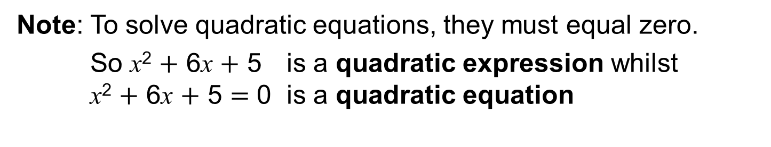
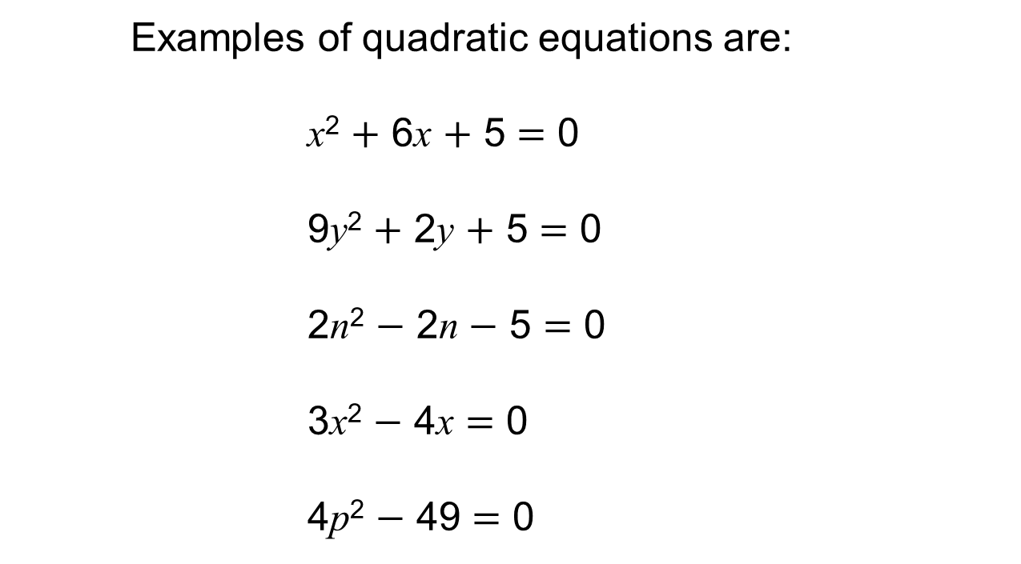
Strand F
Unit F4
Quadratic Equations
Examples of quadratic equations are:
x² $+$ 6x $+$ 5 $=$ 0
9y² $+$ 2y $+$ 5 $=$ 0
2n² $−$ 2n $−$ 5 $=$ 0
3x² $−$ 4x $=$ 0
4p² $−$ 49 $=$ 0
Note: To solve quadratic equations, they must equal zero.
So x² $+$ 6x $+$ 5 is a quadratic expression whilst
x² $+$ 6x $+$ 5 $=$ 0 is a quadratic equation

Slide 4
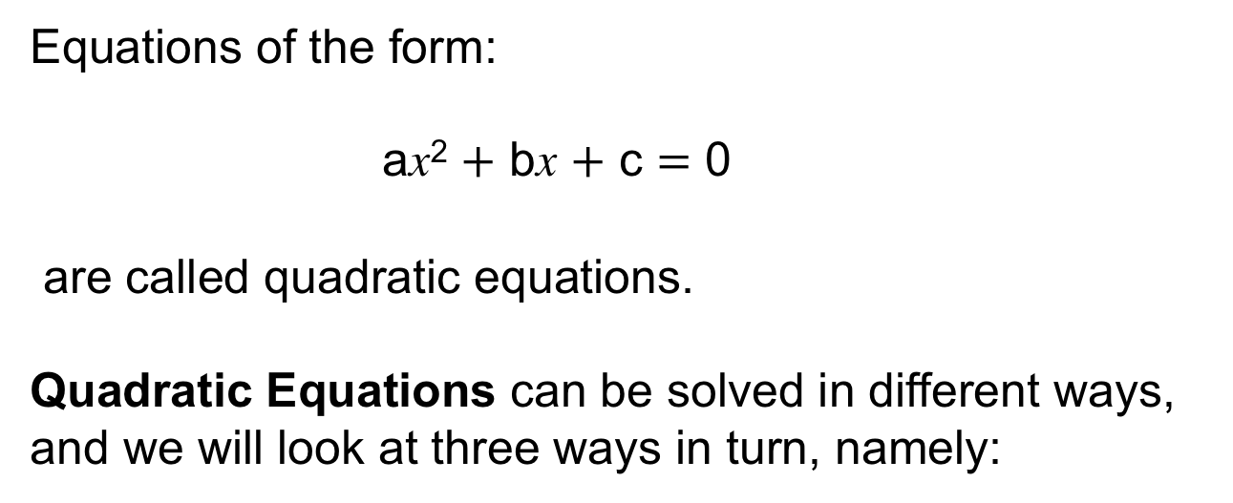
Strand F
Unit F4
Quadratic Equations
Equations of the form:
ax² $+$ bx $+$ c $=$ 0
are called quadratic equations.
Quadratic Equations can be solved in different ways, and we will look at three ways in turn, namely:
Factorisation
Using the Formula
Completing the Square

Slide 5
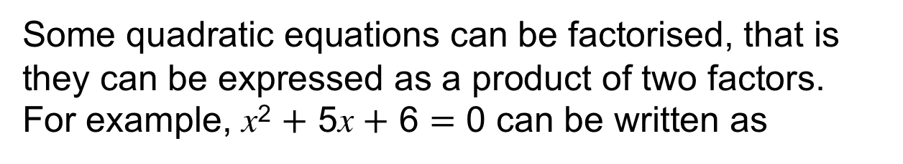

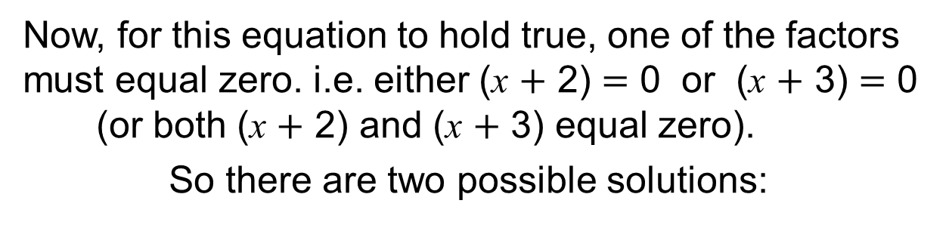
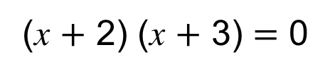
Strand F
Unit F4
Section F4.1
Factorisation
Some quadratic equations can be factorised, that is they can be expressed as a product of two factors.
For example, x² $+$ 5x $+$ 6 $=$ 0 can be written as
(x $+$ 2) (x $+$ 3) $=$ 0
Now, for this equation to hold true, one of the factors must equal zero. i.e. either (x $+$ 2) $=$ 0 or (x $+$ 3) $=$ 0
(or both (x $+$ 2) and (x $+$ 3) equal zero).
So there are two possible solutions:
If (x $+$ 2) $=$ 0 x $=$ $−$2
If (x $+$ 3) $=$ 0 x $=$ $−$3
Before we solve any more quadratic equations
we will recap factorising quadratic expressions.

Slide 6
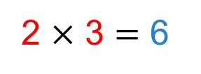
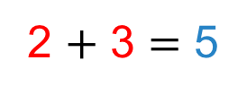


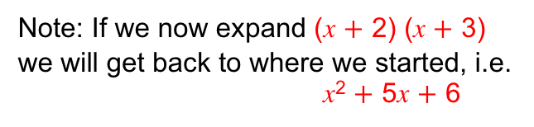
Strand F
Unit F4
Section F4.1
Factorisation
5
6
To factorise a quadratic expression, such as x² $+$ 5x $+$ 6
x²
we set up a pair of brackets like this:
(x $+$ ?) (x $+$ ?)
(Note: if we were to expand the brackets,
the x multiplied by the x will give us the x².)
We now need to find two numbers which
when added together make 5
and
when multiplied together make 6.
5
2 $+$ 3 $=$ 5
6
2 $×$ 3 $=$ 6
These two numbers are:
2 and 3
We can now factorise x² $+$ 5x $+$ 6:
(x $+$ ?) (x $+$ ?)
(x $+$ 2) (x $+$ 3)
Note: If we now expand (x $+$ 2) (x $+$ 3)
we will get back to where we started, i.e.
x² $+$ 5x $+$ 6

Slide 7
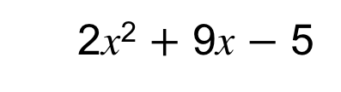
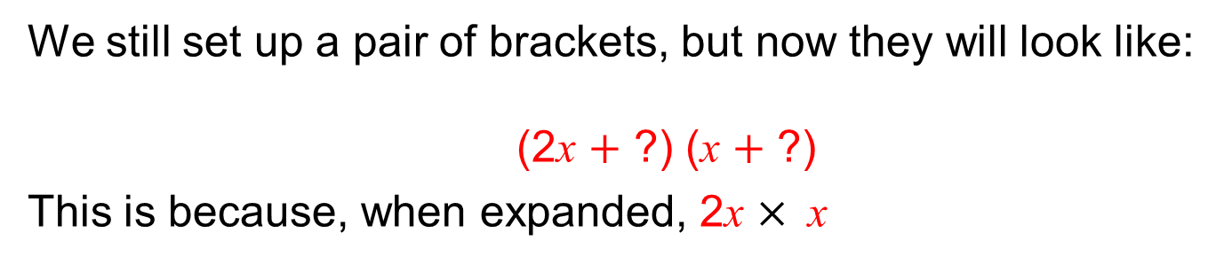
Strand F
Unit F4
Section F4.1
Factorisation
It is also possible to factorise expressions such as:
2x² $+$ 9x $−$ 5
2x²
Note: we now have more than one x²
We still set up a pair of brackets, but now they will look like:
(2x $+$ ?) (x $+$ ?)
This is because, when expanded, 2x $× \text{x}$
will give us the 2x ²
But how do we find the missing numbers?
We can use a ‘trial and improvement method’ called the ‘cross method’.
Note: Sometimes a few trials are necessary before we get a ‘hit’.
The next slide shows the solution.

Slide 8
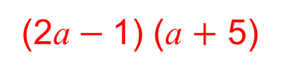
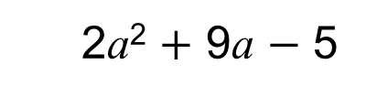
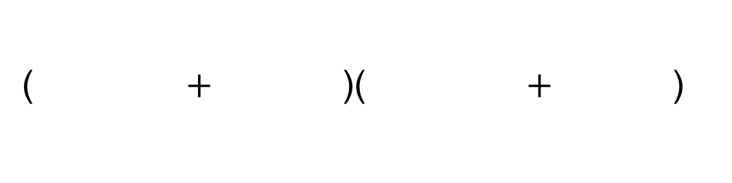
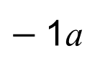
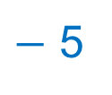
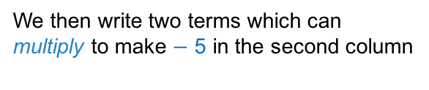
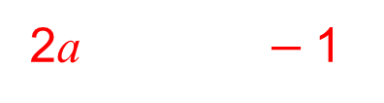


Strand F
Unit F4
Section F4.1
Factorisation
Example 1: Factorise
2a²
$−$ 5
using the cross method:
2a² $+$ 9a $−$ 5
9a
We write two terms which can
multiply to make 2a² in the first column
We then write two terms which can
multiply to make $−$ 5 in the second column
$−$1a
2a
1a
$−$1
5
2a $−$1
1a 5
10a
We then cross multiply like so:
9a
We now sum
9a
If the sum matches the middle term,
then we have found the solution.
We simply populate the brackets, by reading across the rows, as so:
2a $−$1
($+$ )($+$ )
1a 5
(2a$−$1) (a $+$ 5)

Slide 9
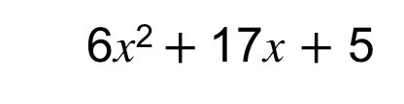
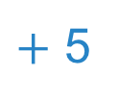
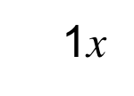
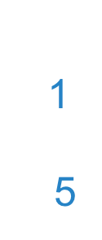
Strand F
Unit F4
Section F4.1
Factorisation
17x
$+$ 5
6x² $+$17x $+$ 5
Example 2: Factorise
6x²
using the cross method:
We write two terms which can
multiply to make 6x² in the first column
We then write two terms which can
multiply to make 5 in the second column
1x
6x
1x
1
5
30x
We then cross multiply like so:
31x
We now sum
31x
The sum does NOT match the middle term,
so we have NOT found the solution.
Don’t worry! We simply need to try again.

Slide 10
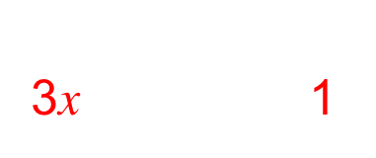
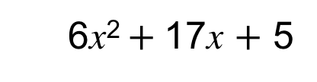
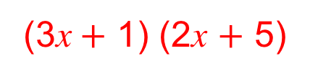
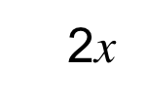

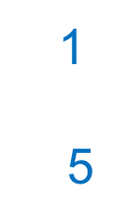
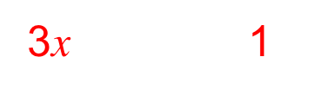
Factorisation
Strand F
Unit F4
Section F4.1
Example 2 continued…
6x²
17x
$+$ 5
6x² $+$17x $+$ 5
We write two terms which can
multiply to make 6x² in the first column
We then write two terms which can
multiply to make 5 in the second column
3x 1
2x
3x
2x
1
5
2x 5
15x
We then cross multiply like so:
17x
We now sum
17x
The sum DOES match the middle term,
so we HAVE found the solution.
We simply populate the brackets, by reading across the rows, as so:
3x 1
($+$ )($+$ )
2x 5
(3x$+$ 1) (2x $+$ 5)

Slide 11
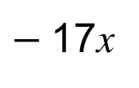
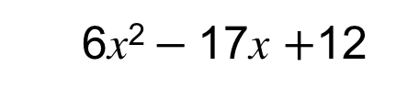

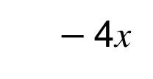

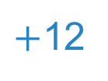
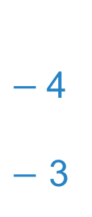

Strand F
Unit F4
Section F4.1
Factorisation
6x² $−$17x $+$12
Example 3: Factorise
6x²
$−$17x
$+$12
using the cross method:
We write two terms which can
multiply to make 6x² in the first column
We then write two terms which can
multiply to make 12 in the second column
$−$4x
6x
1x
$−$4
$−$ 3
$−$18x
We then cross multiply like so:
$−$22x
We now sum
$−$22x
Nope! The sum does NOT match the middle term,
so we have NOT found the solution.
Don’t worry! We simply need to try again.

Slide 12
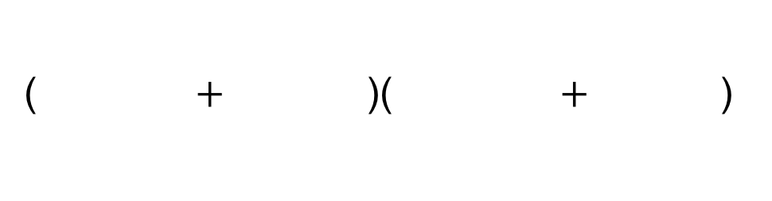
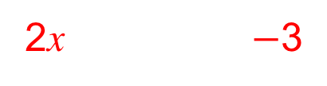
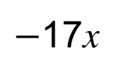
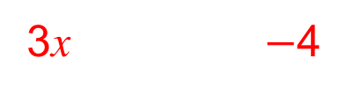
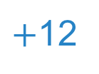
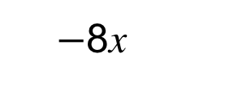
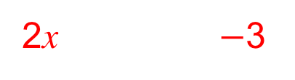
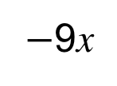
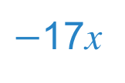
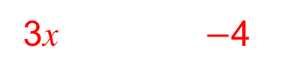

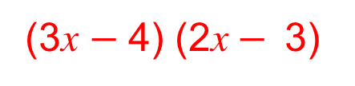
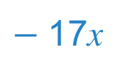
Strand F
Unit F4
Section F4.1
Factorisation
$−$17x
$+$12
Example 3 continued…
6x² $−$17x $+$12
6x²
We write two terms which can
multiply to make 6x² in the first column
We then write two terms which can
multiply to make 12 in the second column
$−$8x
$−$4
$−$3
3x $−$4
3x
2x
2x $−$3
$−$9x
We then cross multiply like so:
$−$17x
We now sum
$−$17x
The sum DOES match the middle term,
so we HAVE found the solution.
We simply populate the brackets, by reading across the rows, as so:
($+$ )($+$ )
3x $−$4
2x $−$3
(3x $−$4) (2x$− \text{3}$)

Slide 13


Factorisation
Strand F
Unit F4
Section F4.1
Factorising quadratic expressions takes plenty of practice.
The more you do - the easier it will become!
And remember - it is often a good idea to check the answers you obtain by expanding the brackets:
(3x $−$ 4) (2x $−$ 3)
6x² $−$ 17x $+$ 12
In special circumstances, there is one very important result.
It is known as the ‘difference between two squares’ and
can be used to factorise some expressions
The next slide shows how.

Slide 14





Strand F
Unit F4
Section F4.1
Factorisation
You may know that (a $−$ b) (a $+$ b) $=$ a ²$−$b ²
This result is known as the ‘difference between two squares’
For example:
(x $−$ 4) (x $+$ 4)$=$x²$−$ 16$= \text{x}\text{2}−$ 4²
We can use this result, in reverse, to help us factorise some expressions, i.e.
$\text{x}\text{2}−$ 4² $=$(x $−$ 4) (x $+$ 4)
Now look at: 4x² $−$ 25
The expression is a difference of two squares, namely
(2x)² and 5²
and can be factorised as below:
4x² $−$ 25 $=$
(2x $−$ 5)(2x $+$ 5)

Slide 15






Strand F
Unit F4
Section F4.1
1
Factorisation
Another example: 9$\text{x}\text{2}−$ 81
$$−$$
First look to see if both terms are ‘squares’.
Answer: Yes (3x)² and 9²
Now check to see whether they are being subtracted (i.e. a ‘difference’ is being sought).
Answer: Yes
Now you can factorise easily:
( $−$ ) ( $+$ )
3x 9 3x 9
And another example: 16$\text{x}\text{2}−$ 36
(4x $−$ 6) (4x $+$ 6)
And one more: $\text{x}\text{2}−$ 49
(remember 1 is a square number!!)
(x $−$ 7) (x $+$ 7)

Slide 16






Strand F
Unit F4
Section F4.1
Factorisation to Solve Quadratic Equations
Now we know how to factorise quadratic expressions, we have
a straightforward method to solve quadratic equations.
Remember if the product of two factors is zero,
at least one of those factors must itself be zero.
Solve: 2x² $−$ 3x $−$ 5 $=$ 0
We rewrite this as:
Now: (x $+$ 1) $=$ 0 or (2x $−$ 5) $=$ 0
We solve each:
The two possible solutions:
(x $+$ 1) (2x $−$ 5) $=$ 0
x $=$ $−$1
2x $=$ 5
x $=$ 2.5
x $=$ $−$1 and x $=$ 2.5

Slide 17












Strand F
Unit F4
Section F4.1
Factorisation to Solve Quadratic Equations
Further Examples:
Solve: 3x² $−$ 7x $+$ 4 $=$ 0
We rewrite this as:
Now: (3x $−$ 4) $=$ 0 or (x $−$ 1) $=$ 0
We solve each:
(3x $−$ 4) (x $−$ 1) $=$ 0
3x $=$ 4
x $=$1
x $=$ $\frac{4}{3}$
x $=$ 1
Solve: 2x² $−$ 19x $+$ 35 $=$ 0
We rewrite this as:
Now: (2x $−$ 5) $=$ 0 or (x $−$ 7) $=$ 0
We solve each:
(2x $−$ 5) (x $−$ 7) $=$ 0
2x $=$ 5
x $=$ 7
x $=$ 2.5
x $=$ 7

Slide 18










Strand F
Unit F4
Section F4.1
Factorisation to Solve Quadratic Equations
Further Examples:
Solve: 16$\text{x}\text{2}−$ 36 $=$ 0
We rewrite this as:
Now: (4x $−$ 6) $=$ 0 or (4x $+$ 6) $=$ 0
We solve each:
(4x $−$ 6) (4x $+$ 6) $=$ 0
4x $=$ 6
4x $=$ $−$6
x $=$ $\frac{3}{2}$
x $=−\frac{3}{2}$
Solve: $\text{x}\text{2}−$ 49 $=$ 0
We rewrite this as:
Now: (x $−$ 7) $=$ 0 or (x $+$ 7) $=$ 0
We solve each:
(x $−$ 7) (x $+$ 7) $=$ 0
x $=$ 7
x $=$ $−$7
Note: Not all quadratic equations can be solved by factorisation; these are dealt with later.

Slide 19








Strand F
Unit F4
Section F4.1
Section F4.1: Fitness Check
Here are some questions to check your progress;
there are more practice questions if needed.
Solve these quadratic equations, by factorising.
4x² $+$ x $−$3 $=$ 0
x $=$ $−$1 x $= \frac{3}{4}$
(b) 2x² $+$ 5x $−$3 $=$ 0
x $=$ $\frac{1}{2}$ x $= −$3
(c) x² $−$ 11x $+$ 28 $=$ 0
x $=$ 7 x $=$4
(d) 9x² $−$ 64$=$ 0
x $=$ $\frac{8}{3}$ x $=−\frac{8}{3}$

Slide 20
STRAND F
Unit F4
Section F4.1
Section F4.1: Review
You have completed the first Section.
If you have completed and understood this section,
click to start the next Section.
If you need more examples and interactive practice, go to
http://szalonta.hu/ske/text/F4/skef4s1.html

Slide 21


STRAND F
Unit F4
Section F4.2
Using the Formula
It is not possible to factorise all quadratic expressions, so
we need alternative methods to solve quadratic equations.
When a quadratic expression cannot be factorised
(or when it is not easy to do so), we can use
the quadratic formula.
The solutions of the quadratic equation where a, b and c are numbers ax² $+$ bx $+$ c $=$ 0
are given by:
$$x=\frac{−b±\sqrt{b^{2}−4ac}}{2a}$$
We prove this result on the next slide but if you want to go
straight to its applications, then ignore the next slide.

Slide 22


STRAND F
Unit F4
Section F4.2
Proving the Formula
We will solve ax² $+$ bx $+$ c $=$ 0 where a ($≠0)$, b and c are numbers.
We first divide by a to give $x^{2}+\frac{b}{a}x+\frac{c}{a}$ = 0 and note that:
${\left(x+\frac{b}{2a}\right)}^{2}$= $x^{2}$ + $\frac{b}{2a}$ x + $\frac{b}{2a}$ x + $\frac{b^{2}}{4a^{2}}$ = $x^{2}$ + $\frac{b}{a}x$+ $\frac{b^{2}}{4a^{2}}$
Hence ${\left(x+\frac{b}{2a}\right)}^{2}−\frac{b^{2}}{4a^{2}}$ = $x^{2}$ + $\frac{b}{a}x$ and substituting back in the equation:
${\left(x+\frac{b}{2a}\right)}^{2}−\frac{b^{2}}{4a^{2}}$ $+\frac{c}{a}$ = 0 giving ${\left(x+\frac{b}{2a}\right)}^{2}$= $\frac{b^{2}}{4a^{2}}$ $−\frac{c}{a}=\frac{b^{2}−4ac}{4a^{2}}$
Taking the square root of both sides of ${\left(x+\frac{b}{2a}\right)}^{2}$= $\frac{b^{2}−4ac}{4a^{2}}$ gives:
$x+\frac{b}{2a}$ = $±\frac{\sqrt{b^{2}−4ac}}{2a}$
Taking the $\frac{b}{2a}$ term to the other side gives:
$$x=\frac{−b±\sqrt{b^{2}−4ac}}{2a}$$

Slide 23







STRAND F
Unit F4
Section F4.2
Using the Formula
Example 1:
3
Solve: 4$x$² $−$ 7$x$ $+$ 3 $=$ 0
Solution:
Here a $=$ 4, b $=$ $−$7 and c $=$ 3
4
$−$ 7
4
$−$7
3
$$x=\frac{−b±\sqrt{b^{2}−4ac}}{2a}$$
$$x=\frac{−(−\text{7)}±\sqrt{{(−\text{7})}^{2 }− (4×4×3)}}{2×4}$$
gives
$$x=\frac{\text{7}±\sqrt{49−48}}{8}$$
$$x=\frac{\text{7}±\sqrt{1}}{8}$$
Continued on the next slide

Slide 24







STRAND F
Unit F4
Section F4.2
Using the Formula
Example 1 continued…
$$x=\frac{\text{7}±\sqrt{1}}{8}$$
$$x=\frac{\text{7}+\sqrt{1}}{8}$$
$$x=\frac{\text{7}−\sqrt{1}}{8}$$
or
$$x=\frac{8}{8}$$
$$x=\frac{6}{8}$$
or
$$x=\frac{3}{4}$$
$$x=1$$
or

Slide 25




STRAND F
Unit F4
Section F4.2
Using the Formula
Example 2:
Solve: 4x² $−$ 12x $+$ 9 $=$ 0
Solution:
Here a $=$ 4, b $=$ $−$12 and c $=$ 9
$$x=\frac{−b±\sqrt{b^{2}−4ac}}{2a}$$
$$x=\frac{−(−\text{12)}±\sqrt{{(−\text{12})}^{2}−(4×4×9)}}{2×4}$$
gives
$$x=\frac{\text{12}±\sqrt{144−144}}{8}$$
$$x=\frac{\text{12}±\sqrt{0}}{8}$$
Continued on the next slide

Slide 26



STRAND F
Unit F4
Section F4.2
Using the Formula
Example 2 continued…
$$x=\frac{\text{12}±\sqrt{0}}{8}$$
$$x=\frac{12}{8}$$
$$x=1.5$$
Note: In this example, there is only one solution.
Do you know why?
If not, you will find out why on later slides.

Slide 27





STRAND F
Unit F4
Section F4.2
Using the Formula
Example 3:
Solve: x² $+$ x $+$ 5 $=$ 0
Solution:
Here a $=$ 1, b $=$ 1 and c $=$ 5
$$x=\frac{−b±\sqrt{b^{2}−4ac}}{2a}$$
$$x=\frac{−\text{1}±\sqrt{{\text{1}}^{2}−(4×1×5)}}{2×1}$$
gives
$$x=\frac{−\text{1}±\sqrt{1−20}}{8}$$
$$x=\frac{−\text{1}±\sqrt{−\text{1}9}}{2}$$
Continued on the next slide

Slide 28


STRAND F
Unit F4
Section F4.2
Using the Formula
Example 3 continued…
$$x=\frac{−\text{1}±\sqrt{−\text{1}9}}{2}$$
$$\text{As} \text{it} \text{is} \text{not} \text{possible} \text{to} \text{find} \sqrt{−\text{1}9}\text{, }\text{this} \text{equation}$$
$$\text{has} \text{no} \text{solutions}$$
Do you know why?
If not, you will find out why on later slides.

Slide 29






STRAND F
Unit F4
Section F4.2
Using the Formula
The three previous examples illustrate that a
quadratic equation can have 2, 1 or 0 solutions.
The graphs below illustrate y = ax² $+$ bx $+$ c and show how
the number of solutions depends on the value of ${(\text{b}}^{2}−4\text{ac})$
Note: We call ${\text{b}}^{2}−4\text{ac} t$he discriminant

Slide 30










STRAND F
Unit F4
Section F4.2
Section F4.2: Fitness Check
Here are some questions to check your progress;
there are more practice questions if needed.
Solve these quadratic equations, using the quadratic formula.
Give your answers to 2 decimal places.
4x² $−$ 6x $−$ 9 $=$ 0
x $=$ 2.43 or x $=$ $−$0.93
(b) 3x² $−$ 5x $−$ 7 $=$ 0
x $=$ 2.57 or x $= −$0.91
(c) x² $−$ 6x $−$ 5 $=$ 0
x $=$ 6.74 or x $= −$0.74
(d) 9x² $−$ 6x $−$11$=$ 0
x $=$ 1.49 or x $=−\text{0.82}$
(e) 5x² $−$ 4x $+$ 12 $=$ 0
Discriminant $= −$224;
therefore, no solutions

Slide 31
STRAND F
Unit F4
Section F4.2
Section F4.2: Review
You have completed the second Section.
If you have completed and understood this section,
click to start the next Section.
If you need more examples and interactive practice, go to
http://szalonta.hu/ske/text/F4/skef4s2.html

Slide 32


STRAND F
Unit F4
Section F4.3
Completing the Square
Completing the square is another method for solving
quadratic equations.
We can use this method for quadratic equations that do not factorise.
It is also a very useful technique for finding
the minimum and maximum value of a quadratic.
A general quadratic equation a$\text{x}$² $+$ b$\text{x}$ $+$ c $=$ 0
is written in the form a(x $+$ p) ² $+$ q $=$ 0
when completing the square.
We need to find the constants p and q so that the two expressions are identical, i.e.
$$\text{a}\text{x}\text{2} + \text{b}\text{x} + \text{c} = \text{a}\text{(}\text{x} + \text{p}\text{) }\text{2} + \text{q}$$

Slide 33








STRAND F
Unit F4
Section F4.3
Completing the Square
Example 1:
Complete the square for: x² $+$ 10$\text{x}$ $+$ 8 $=$ 0
Solution:
First we consider the terms x² $+$ 10$\text{x}$
We are looking for an expression, that when squared,
matches these first two terms.
So we halve the 10, and try: (x $+$ 5) ²
Now, let’s see what happens when we expand:
(x $+$ 5) (x $+$ 5) $=$
$\text{x}\text{2}+\text{10}\text{x}+$ 25
$\text{(}\text{x}+\text{5)}\text{ 2} = \text{x}\text{2}+\text{10}\text{x}+$ 25
To get just the x² $+$ 10x ,
we simply need to eliminate the $+$ 25
We subtract 25 from each side:
$$\text{(}\text{x}+\text{5)}\text{ 2}−\text{ 25}= \text{x}\text{2}+\text{10}\text{x}$$
Continued…

Slide 34








STRAND F
Unit F4
Section F4.3
Completing the Square
Example 1 continued…
$\text{(}\text{x} +\text{ 5)}\text{ 2}−\text{ 25}$
We now know:
$$\text{x}\text{2}+\text{10}\text{x}=$$
Now, to match the original expression, we simply
need to $+$ 8 to each side:
$+$ 8
$$+ \text{8}$$
$\text{x}\text{2}+\text{10}\text{x} +\text{ 8}$ $=\text{(}\text{x} +\text{ 5)}\text{ 2}−\text{ 25}+\text{ 8}$
Original expression
$$+ \text{ 8}$$
$$\text{x}\text{2}+\text{10}\text{x}+\text{ 8}=\text{(}\text{x} +\text{ 5)}\text{ 2}− \text{17}$$
So, we have now found an expression equivalent to $\text{x}\text{2}+\text{10}\text{x}$ $+$ 8,
That is, we have completed the square.
So we can now write: ($\text{x} +\text{ 5)}\text{ 2}−\text{ 17}=\text{0}$

Slide 35








STRAND F
Unit F4
Section F4.3
Completing the Square
Now we have completed the square we can solve the quadratic equation:
$$\text{(}\text{x}+\text{ 5)}\text{ 2}−\text{17}=\text{0}$$
Eliminate $−\text{17,}$
by adding 17 to both sides$\text{:}$
$\text{(}\text{x}+\text{ 5)}\text{ 2} =$ $\text{17}$
Square root both sides:
$\text{x}+\text{ 5} =$ $± \sqrt{\text{17 }}$
Eliminate $+\text{5,}$
by subtracting 5 from both sides$\text{:}$
$$\text{x} =−\text{ 5}± \sqrt{\text{17 }}$$
Solutions:
$$\text{x}=−\text{ 5}+ \sqrt{\text{17 }}$$
or
$$\text{x}=−\text{ 5}− \sqrt{\text{17 }}$$
$$\text{x}=−\text{0.877}$$
$\text{x}=−\text{9}\text{.}\text{123}$
or

Slide 36








STRAND F
Unit F4
Section F4.3
Completing the Square
Example 2:
Complete the square for: x² $−$ 8x $−$ 2 $=$ 0
Solution:
First we consider the terms x² $−$ 8x
We are looking for an expression, that when squared, matches these first two terms.
So we halve the 8, and use: (x $−$ 4) ²
Now, let’s see what happens when we expand:
(x $−$ 4) (x $−$ 4) $=$
$\text{x}\text{2}−\text{8}\text{x}+$ 16
$\text{(}\text{x}−\text{4}\text{)}\text{ 2} = \text{x}\text{2}−\text{8}\text{x}+$ 16
To get just the x² $−$ 8x ,
we simply need to eliminate the $+$ 16
We subtract 16 from each side:
$$\text{(}\text{x}−\text{4}\text{)}\text{ 2}− \text{16}= \text{x}\text{2}−\text{8}\text{x}$$
Continued…

Slide 37





STRAND F
Unit F4
Section F4.3
Completing the Square
Example 2 continued…
$\text{(}\text{x} − \text{4}\text{)}\text{2}− \text{16}$
We now know:
$$\text{x}\text{2}−\text{8}\text{x} =$$
Now, to match the original expression, we simply
need to $−$2 to each side:
Original expression
$\text{x}\text{2}−\text{8}\text{x} − \text{2}$ $=\text{(}\text{x} − \text{4}\text{)}\text{ 2}− \text{16}− \text{2}$
$$\text{x}\text{2}−\text{8}\text{x} − \text{2}=\text{(}\text{x} − \text{4}\text{)}\text{ 2}− \text{18}$$
So, we have now found an expression equivalent to $\text{x}\text{2}$ $−8x−2$,
That is, we have completed the square.
So we can now write: ($\text{x} − \text{4}\text{)}\text{ 2}−\text{ 1}\text{8}=\text{0}$

Slide 38









STRAND F
Unit F4
Section F4.3
Completing the Square
Now we have completed the square we can solve the quadratic equation:
$$\text{(}\text{x} − \text{4}\text{)}\text{ 2}−\text{1}\text{8}=\text{0}$$
Eliminate $−\text{18,}$
by adding 18 to both sides$\text{:}$
$\text{(}\text{x} − \text{4}\text{)}\text{ 2} =$ $\text{18}$
Square root both sides:
$\text{x} − \text{4} =$ $± \sqrt{\text{1}\text{8} }$
Eliminate $−\text{4,}$
by adding 4 to both sides$\text{:}$
$$\text{x} =\text{4}± \sqrt{\text{1}\text{8} }$$
Solutions:
$$\text{x} =\text{4}+ \sqrt{\text{1}\text{8} }$$
or
$$\text{x} =\text{4}− \sqrt{\text{1}\text{8} }$$
$$\text{x}=\text{8.243}$$
$\text{x}=−\text{0}\text{.}\text{243}$
or

Slide 39







STRAND F
Unit F4
Section F4.3
Completing the Square
Example 3:
Complete the square for: 3x² $+$ 12x $+$ 7 $=$ 0
Solution:
First we re-write the equation: 3 (x² $+$ 4x) $+$ 7 $=$ 0
Note: There are now more than one x²
Note: we have factorised the first two terms
We are looking for an expression that,
when squared, matches:
So we halve the 4, and use: (x $+$ 2)²
(x² $+$ 4x)
Now, let’s see what happens when we expand:
$\text{(}\text{x}+\text{2}\text{)}\text{2} = \text{x}\text{2}+\text{4}\text{x}+$ 4
To get just the x² $+$ 4x ,
we simply need to eliminate the $+$ 4
We subtract 4 from each side:
$$\text{(}\text{x}+\text{2}\text{)}\text{ 2}− \text{4}= \text{x}\text{2}+\text{4}\text{x}$$
Continued…

Slide 40







STRAND F
Unit F4
Section F4.3
Completing the Square
Example 3 continued…
$\text{(}\text{x} + \text{4}\text{)}\text{2}− \text{4}$
We now know:
$$\text{x}\text{2}+\text{4}\text{x} =$$
To match the original expression,
we first need to multiply each side by 3: 3(x² $+$ 4x) $=$3$[\text{(}\text{x} +\text{ 4)}\text{2}−\text{ 4}\text{]}$
and then $+$ 7:
3(x² $+$ 4x) $+$ 7 $=$3$[\text{(}\text{x} +\text{ 4)}\text{2}−\text{ 4]}+\text{ 7}$
$=$3$\text{(}\text{x} +\text{ 4)}\text{2}− \text{12}+\text{ 7}$
$= \text{3(}\text{x} +\text{ 4)}\text{2}− \text{5}$
$$\text{3}\text{x}\text{2} +\text{ 12}\text{x} +\text{ 7}=\text{3(}\text{x} +\text{ 4)}\text{2}−\text{ 5}$$
So, we have now found an expression equivalent to $\text{3}\text{x}\text{2}+\text{12}\text{x}+\text{7}$
That is, we have completed the square.
So we can now write: $\text{3(}\text{x} +\text{ 4)}\text{2}−\text{ 5}=\text{0}$

Slide 41










STRAND F
Unit F4
Section F4.3
Completing the Square
Now we have completed the square we can solve the quadratic equation:
$$\text{3(}\text{x} +\text{ 4)}\text{2}−\text{ 5}=\text{0}$$
Eliminate $−\text{5,}$
by adding 5 to both sides$\text{:}$
$\text{3}\text{(}\text{x} + \text{4}\text{)}\text{ 2} =$ $\text{5}$
$\text{(}\text{x} +\text{ 4)}\text{ 2} =\frac{\text{5}}{\text{3}}$
Divide both sides by 3:
$\text{x} + \text{4} =$ $± \sqrt{\frac{\text{5}}{\text{3}}}$
Square root both sides:
Eliminate $+ \text{4,}$
by subtracting 4 from both sides$\text{:}$
$\text{x} =−\text{4}± \sqrt{\frac{\text{5}}{\text{3}}}$
Solutions:
$\text{x} =−\text{4}+ \sqrt{\frac{\text{5}}{\text{3}}}$
$\text{x} =−\text{4}− \sqrt{\frac{\text{5}}{\text{3}}}$
or
$$\text{x}=−\text{2.709}$$
or
$\text{x}=−\text{5.291}$

Slide 42






STRAND F
Unit F4
Section F4.3
Completing the Square
Completing the square is also a useful technique for finding
the minimum or maximum value of a quadratic.
We will look at an example, to see how this is done.
Example 4:
(a) Complete the square for y $=$2x² $−$ 8x $+$ 2
(b) Find the minimum value of y
(c) Sketch the graph of y $=$2x² $−$ 8x $+$ 2
Solution:
(a) First complete the square:
$$\text{y} = \text{2}\text{x}\text{2} − \text{8}\text{x} +\text{ 2}$$
$$\text{y} = \text{2}\text{(}\text{x}\text{2} − \text{4}\text{x}\text{)} +\text{ 2}$$
$$\text{y} = \text{2}\text{[}\text{(}\text{x} − \text{2}\text{)}\text{2}−\text{ 4}]+\text{ 2}$$
$$\text{y} = \text{2(}\text{x} − \text{2}\text{)}\text{2}− \text{8}+\text{ 2}$$
$\text{y} = \text{2(}\text{x} − \text{2}\text{)}\text{2}−$6

Slide 43






STRAND F
Unit F4
Section F4.3
Completing the Square
(b) We want to know the minimum possible value for y, when
y $= \text{2(}\text{x} −\text{ 2)}\text{2}−\text{6}$ ,
For y to have the smallest value, we need $\text{2(}\text{x} −\text{ 2)}\text{2}$ to be as small as possible.
So what could $\text{(}\text{x} −\text{ 2)}$ be, so that $\text{2(}\text{x} −\text{ 2)}\text{2}$ is as small as possible?
(Remember: When we square a number, the result is always positive.)
For$\text{2(}\text{x} −\text{ 2)}\text{2}$ to be as small as possible, $\text{(}\text{x} − \text{2}\text{)} \text{must} \text{equal}$0,
i.e. $\text{(}\text{x} − \text{2}\text{)}=$ 0
and $\text{x}$ $=$ $\text{2}$
$$\text{(}\text{x} −\text{ 2)}$$
$−$6
$$\text{(}\text{x} −\text{ 2)}$$
$\text{a}\text{nd}$ when $\text{x}$ $=$ $\text{2}$
$\text{y} =−$6

Slide 44



STRAND F
Unit F4
Section F4.3
Completing the Square
(c) Before sketching the graph, it is useful to know where the
curve crosses the $\text{x}$-axis.
Remember: The curve crosses the x-axis when y $=$ 0.
0 $= \text{2(}\text{x} −\text{ 2)}\text{2}−\text{6}$
$\text{2(}\text{x} −\text{ 2)}\text{2}−\text{6}$ $=$0
$\text{2(}\text{x} −\text{ 2)}\text{2}=\text{6}$
$\text{(}\text{x} −\text{ 2)}\text{2}=$3
$\text{x} −\text{ 2}$ $= ± \sqrt{\text{3} }$
$\text{x} =\text{2}± \sqrt{\text{3 }}$
So the curve crosses the $\text{x}$-axis at:
$\text{x} =\text{2}+ \sqrt{\text{3 }}$and $\text{x} =\text{2}− \sqrt{\text{3 }}$
and has a minimum at
That is, when:
This is, of course, the same as:
$(\text{2}, −$6)

Slide 45







STRAND F
Unit F4
Section F4.3
Completing the Square
Here is an example, to find the maximum turning point:
Example 5:
The height of a ball thrown into the air is given by
h $=$1 $+$ 20t $−$ 10t²
Find the maximum height reached by the ball.
Solution:
First complete the square:
$$\text{h} = \text{1 }+ \text{20}\text{t} −\text{ 10}\text{t}\text{2}$$
h $= −$10t² $+$ 20t $+$ 1
$$\text{h} =−\text{10}\text{(}\text{t}\text{2} − \text{2}\text{t}\text{)} + \text{1}$$
$$\text{h} =−\text{10[}\text{(}\text{t} − \text{1}\text{)}\text{2}−\text{1}]+ \text{1}$$
$$\text{h} =−\text{10(}\text{t} − \text{1}\text{)}\text{2}+\text{10}+ \text{1}$$
$\text{h} =−\text{10(}\text{t} − \text{1}\text{)}\text{2}+$11

Slide 46






STRAND F
Unit F4
Section F4.3
Completing the Square
We want to know the maximum possible value for h, when
$\text{h} =−\text{10(}\text{t}−\text{ 1)}\text{2}+\text{ 11}$,
For h to have the highest value, we need$−\text{10(}\text{t}−\text{ 1)}\text{2}$ to be as big as possible.
So what could $\text{(}\text{t}− \text{1}\text{)}$ be, so that $−\text{10(}\text{t}−\text{ 1)}\text{2}$is as big as possible?
(Remember: When we square a number, the result is always positive.)
For$−\text{10(}\text{t}−\text{ 1)}\text{2}$ to be as big as possible, $\text{(}\text{t}− \text{1}\text{)} \text{must} \text{equal}$0,
(What would happen if $\text{(}\text{t} −\text{ 1}\text{)}$ was greater than zero?)
i.e. $\text{(}\text{t}− \text{1}\text{)}=$ 0
and $\text{t}$ $=$ $\text{1}$
$$\text{(}\text{t}− \text{1)}$$
$+$11
$$\text{(}\text{t}− \text{1}\text{)}$$
$\text{a}\text{nd} \text{when} \text{t}=\text{ 1}$:
$\text{h} =$11

Slide 47




STRAND F
Unit F4
Section F4.3
Completing the Square
Before sketching the graph, it is useful to know where the
curve crosses the x-axis.
Remember: The curve crosses the x-axis when h $=$ 0.
0 $=−\text{10(}\text{t}−\text{ 1)}\text{2}+\text{ 11}$
Hence $\text{10(}\text{t} −\text{ 1)}\text{2} = \text{11}$
$\text{(}\text{t} − \text{1}\text{)}\text{2}=\text{1.1}$
$\text{t} − \text{1}$ $= ± \sqrt{\text{1.1} }$
$\text{t} =\text{1}± \sqrt{\text{1.1} }$
So the curve crosses the x-axis at
$\text{t} =\text{1}+ \sqrt{\text{1.1} }$and $\text{t} =\text{1}− \sqrt{\text{1.1} }$
and has a maximum at
This is shown on the graph opposite.
That is, when:
$\text{t}$ =1
$(\text{1},$11)

Slide 48


STRAND F
Unit F4
Section F4.3
Completing the Square
Have you noticed anything?
When a quadratic equation is in the completed the square form, it is easy to spot the minimum or maximum “turning” point.
For example:
$\text{y}$ $=$ $\text{2}\text{(}\text{x} − \text{3}\text{)}\text{2}− \text{9}$
The minimum possible value of $\text{y}$
$\text{y} =−\text{ 9 }$
is obtained when $(\text{x} −\text{ 3}\text{)}$ $=0$
that is, when $\text{x}=\text{3}$
$$\text{The} \text{turning} \\ \text{point} \text{will} \text{be} \text{at}\text{:}$$
$(\text{ 3}, −\text{9}$)

Slide 49










STRAND F
Unit F4
Section F4.3
Section F4.3: Fitness Check
Here are some questions to check your progress;
there are more practice questions if needed.
1) Complete the square for each of these quadratic expressions:
x² $−$ 20x $+$ 10
(x $−$10)² $−$90
(b) x² $−$ x $+$ 4
(x $− \frac{\text{1}}{\text{2}}$)² $− \frac{\text{15}}{ \text{4 }}$
(c) 7x² $−$ 14x $+$ 2
7(x $−$1)² $−$5
2) Use the complete the square method to solve each of these
quadratic expressions:
(a) x² $−$ 6x $−$4$=$ 0
$$\text{x} =\text{3}+\sqrt{\text{1}\text{3 }} \text{x} =\text{3}−\sqrt{\text{1}\text{3 }}$$
$$\text{x} =\text{2}+\sqrt{\frac{\text{1}\text{9}}{ \text{5} } } \text{x} =\text{2}−\sqrt{\frac{\text{19}}{ \text{5} } }$$
(b) 5x² $−$ 20x $+$ 1 $=$ 0

Slide 50
STRAND F
Unit F4
Section F4.3
Section F4.3: Review
You have completed the last Section.
If you need more examples and interactive practice, go to
http://szalonta.hu/ske/text/F4/skef4s3.html

