Slide 1
TSST Strand F
UNIT F5: Solving Equations

Slide 2
STRAND F
Unit F5
Solving Equations
Solving Equations is an important part of algebra work.
You have three sections to work through and there are check up audits and fitness tests for each section.
Algebraic Fractions
Algebraic Fractions and Quadratic Equations
Algebraic Solution of Simultaneous Equations - One Linear and One Quadratic

Slide 3




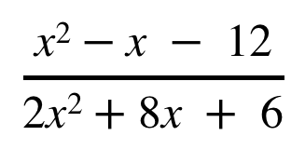

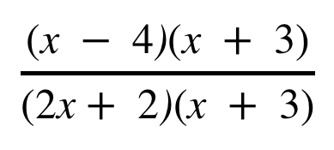
STRAND F
Unit F5
Section F5.1
Algebraic Fractions
Some algebraic fractions can be easily simplified if
the numerator and the denominator are first factorised.
For example, simplify:
Both the top and bottom of the fraction can be factorised to give:
$\frac{\text{(}\text{x} − \text{4}\text{)}\text{(}\text{x} + \text{3)}}{\begin{aligned}\text{(}\text{2}\text{x} +\text{ 2)(}\text{x} + \text{3)} \\ \\ \end{aligned}}$
$$\frac{\text{x}\text{2} −\text{x} −\text{ 12}}{\text{2}\text{x}\text{2} +\text{8}\text{x} + \text{6}}$$
$$\frac{\text{x}\text{2} −\text{x} −\text{ 12}}{\text{2}\text{x}\text{2} +\text{8}\text{x} +\text{ 6}}$$
$$\frac{\text{(}\text{x} − \text{4}\text{)}\text{(}\text{x} +\text{ 3)}}{\text{(}\text{2}\text{x} +\text{ 2}\text{)}\text{(}\text{x} +\text{ 3)}}$$
$$=$$
The term $\text{(}\text{x} +\text{ 3)}$appears as a factor on both the top and bottom
of the fraction so it cancels to give:
$$\frac{\text{x} − \text{4}}{\text{2}\text{x} +\text{ 2}}$$
$$=$$
No further simplification is possible.

Slide 4





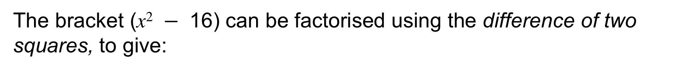






Algebraic Fractions
STRAND F
Unit F5
Section F5.1
Example 1:
Simplify:
Solution: First multiply together the fractions to give:
$\frac{\text{x}\text{2} \text{(}\text{x} − \text{4}\text{)}\text{(}\text{x} +\text{ 4)}}{\text{(}\text{x} +\text{ 4)}\text{x}\text{3} }$
$\frac{\text{x}\text{2} }{\text{x} + \text{4}}$ $×$ $\frac{\text{x}\text{2} − \text{16}}{\text{x}\text{3} }$
$$\frac{\text{x}\text{2} \text{(}\text{x}\text{2} − \text{16}\text{)}}{\text{(}\text{x} + \text{4}\text{)}\text{x}\text{3} }$$
The bracket $\text{(}\text{x}\text{2} − \text{16}\text{)}$ can be factorised using the difference of two squares, to give:
$$\frac{\text{x}\text{2} \text{(}\text{x}\text{2} − \text{16}\text{)}}{\text{(}\text{x} +\text{ 4)}\text{x}\text{3} }$$
$$\frac{\text{x}\text{2} \text{(}\text{x} − \text{4)(}\text{x} + \text{4}\text{)}}{\text{(}\text{x} +\text{ 4)}\text{x}\text{3} }$$
$$=$$
The term $\text{(}\text{x} +\text{ 4)}$can be cancelled to give:
$$\frac{\text{x}\text{2} \text{(}\text{x} − \text{4})}{\text{x}\text{3 }}$$
$$=$$
$$\text{1}$$
$$\frac{ \text{(}\text{x} − \text{4})}{\text{x}}$$
The term$\text{x}\text{2}$ can be cancelled to give:
No further simplification is possible.

Slide 5


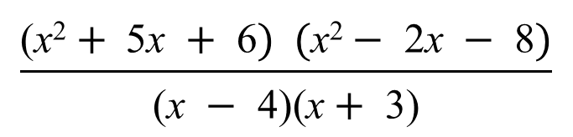

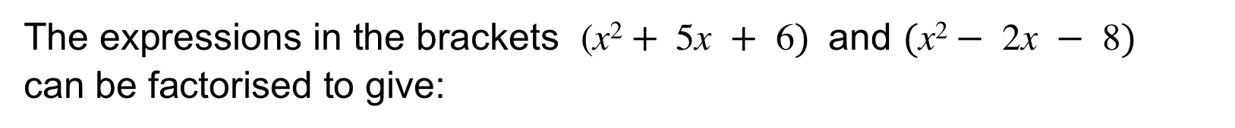
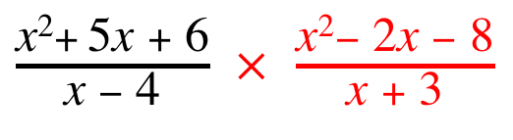


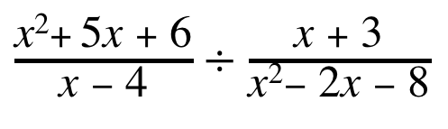
STRAND F
Unit F5
Section F5.1
Algebraic Fractions
Example 2:
Simplify:
Solution: So we now have a multiplication:
$\frac{\text{(}\text{x} + \text{2}\text{)}\text{(}\text{x} +\text{ 3)} \text{(}\text{x} −\text{ 4)}\text{(}\text{x} + \text{2}\text{)} }{\text{(}\text{x} −\text{ 4)}\text{(}\text{x} +\text{ 3)} }$
$\frac{\text{x}\text{2} + \text{5}\text{x} + \text{6} }{\text{x} − \text{4}}$ $÷$ $\frac{\text{x} + \text{3}}{\text{x}\text{2} − \text{2}\text{x} − \text{8} }$
$\frac{\text{x} +\text{ 3}}{\begin{aligned}\text{x}\text{2} − \text{2}\text{x} −\text{ 8} \\ \end{aligned}}$
Note: To divide by a fraction, we multiply by its reciprocal.
$\frac{\text{x}\text{2} + \text{5}\text{x} +\text{ 6} }{\text{x} −\text{ 4}}$ $×$ $\frac{\text{x}\text{2} − \text{2}\text{x} −\text{ 8}}{\text{x} +\text{ 3} }$
$$\frac{\text{(}\text{x}\text{2} + \text{5}\text{x} +\text{ 6}) (\text{x}\text{2} − \text{2}\text{x} −\text{ 8})}{\text{(}\text{x} −\text{ 4}\text{)}\text{(}\text{x} + \text{3}\text{)} }$$
$$=$$
The expressions in the brackets $\text{(}\text{x}\text{2} + \text{5}\text{x} +\text{ 6}) \text{an}\text{d} (\text{x}\text{2} − \text{2}\text{x} −\text{ 8})$
can be factorised to give:
$$=$$
$$\text{(}\text{x}+\text{ 2)(}\text{x}+\text{ 2)}$$
Cancelling terms simplifies this expression
This can be simplified to:
$$\text{(}\text{x}+\text{ 2)}\text{2}$$

Slide 6



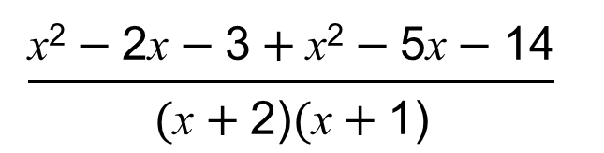


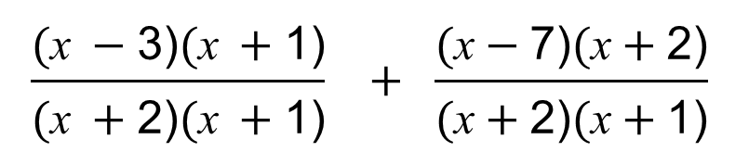
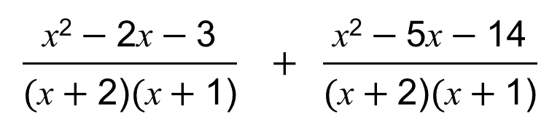

STRAND F
Unit F5
Section F5.1
Algebraic Fractions
Further Example 3:
Simplify:
In this case, the lowest common denominator is ($\text{x} +\text{ 2}) (\text{x} + \text{1)}$
Algebraic fractions are added in the same
way as ordinary fractions, by using the
lowest common denominator.
$\frac{\text{x} − \text{3} }{\text{x} + \text{2}}$ $+$ $\frac{\text{x} − \text{7}}{\text{x} + \text{1} }$
$\frac{\text{x} −\text{ 3} }{\text{x} +\text{ 2}}$ $+$ $\frac{\text{x} −\text{ 7}}{\text{x} +\text{ 1} }$
$$\frac{\text{(}\text{x} −\text{3}\text{)} \text{(}\text{x} +\text{1)} }{\text{(}\text{x} +\text{2}\text{)}\text{(}\text{x} +\text{1)} } + \frac{\text{(}\text{x}−\text{7}\text{)}\text{(}\text{x}+\text{2}\text{)} }{\text{(}\text{x}+\text{2)} \text{(}\text{x}+\text{1)} }$$
$$=$$
Now we can expand the brackets in the numerators:
$$\frac{\text{x}\text{2} −\text{2}\text{x}−\text{3}}{\text{(}\text{x}+\text{2)}\text{(}\text{x}+\text{1)} } + \frac{\text{x}\text{2} −\text{5}\text{x}−\text{14}}{\text{(}\text{x}+\text{2)} \text{(}\text{x}+\text{1)} }$$
$$=$$
And now add:
$$\frac{\text{x}\text{2} −\text{2}\text{x}−\text{3}+\text{x}\text{2} −\text{5}\text{x}−\text{14}}{\text{(}\text{x}+\text{2)}\text{(}\text{x}+\text{1)} }$$
$$=$$
$$\frac{\text{2}\text{x}\text{2} −\text{7}\text{x}−\text{17}}{\text{(}\text{x}+\text{2)}\text{(}\text{x}+\text{1)} }$$
Which can be simplified to:

Slide 7
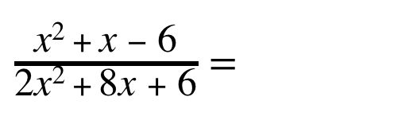
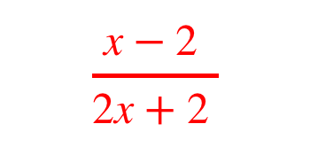
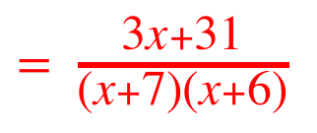
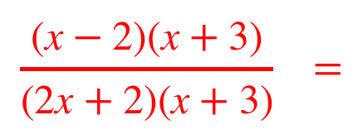
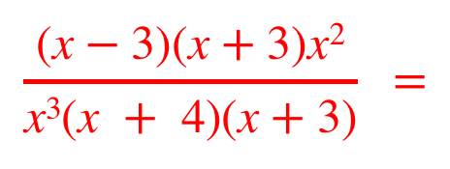
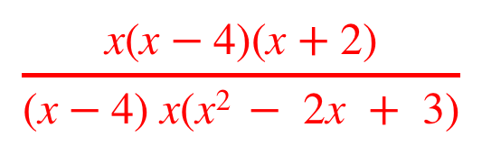
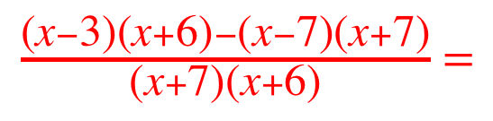
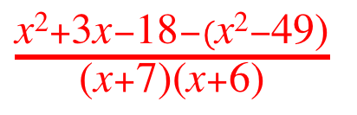
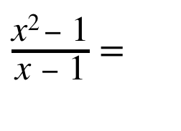
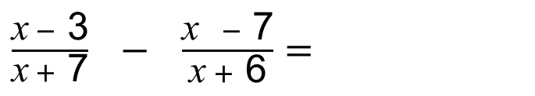
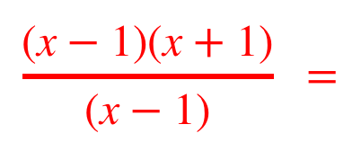
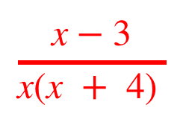
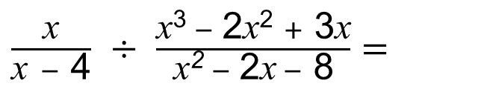
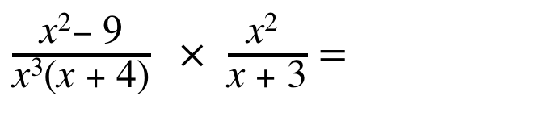

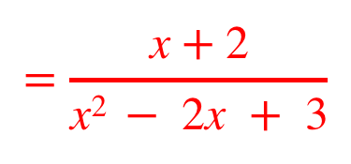
STRAND F
Unit F5
Section F5.1
Section F5.1: Fitness Check
Here are some questions to check your progress;
there are more practice questions if needed.
Simplify each expression:
$$\frac{\text{(}\text{x} −\text{2)}\text{(}\text{x} +\text{3}\text{)}}{\text{(}\text{2}\text{x} +\text{2)}\text{(}\text{x} +\text{3)}} =$$
$$\frac{\text{x} −\text{2} }{\text{2}\text{x} +\text{2} }$$
$\frac{\text{x}\text{2} + \text{x} − \text{6}}{\text{2}\text{x}\text{2} + \text{8}\text{x} +\text{ 6}}=$
$$\frac{\text{(}\text{x} −\text{1}\text{)}\text{(}\text{x} +\text{1}\text{)}}{\text{(}\text{x} −\text{1)}} =$$
$\frac{\text{x}\text{2} − \text{1}}{\text{x} − \text{1}}$ $=$
$$\text{x} +\text{1}$$
$\frac{\text{x}\text{2}− \text{9} }{\text{x}\text{3} \text{(}\text{x} +\text{ 4}\text{)}}$ $×$ $\frac{\text{x}\text{2} }{\text{x} + \text{3} }=$
$$\frac{\text{(}\text{x} −\text{3}\text{)}\text{(}\text{x} +\text{3}\text{)}\text{x}\text{2} }{\text{x}\text{3} \text{(}\text{x} +\text{ 4)}\text{(}\text{x} +\text{3}\text{)}} =$$
$$\frac{\text{x} −\text{3} }{\text{x}\text{(}\text{x} +\text{ 4)} }$$
$\frac{\text{x} }{\text{x} −\text{ 4}}$ $÷$ $\frac{\text{x}\text{3 } − \text{2}\text{x}\text{2} +\text{ 3}\text{x}}{\text{x}\text{2} − \text{2}\text{x} −\text{ 8} }=$
$$\frac{\text{x}\text{(}\text{x} −\text{4}\text{)}\text{(}\text{x} +\text{2}\text{)}}{\text{(}\text{x} −\text{4}\text{)} \text{x}\text{(}\text{x}\text{2} − \text{2}\text{x} +\text{ 3}\text{)}}$$
$$=\frac{\text{x} +\text{2}}{\text{x}\text{2 } − \text{2}\text{x} +\text{ 3}}$$
$\frac{\text{x} −\text{ 3} }{\text{x} + \text{7}}$ $−$ $\frac{\text{x} −\text{ 7}}{\text{x} + \text{6} }=$
$\frac{\text{(}\text{x} −\text{3}\text{)}\text{(}\text{x}+\text{6}\text{)}−\text{(}\text{x} −\text{7}\text{)}\text{(}\text{x} +\text{7}\text{)}}{\text{(}\text{x}+\text{7}\text{)}\text{(}\text{x} +\text{6}\text{)}}$ $=$
$\frac{\text{x}\text{2}+\text{3}\text{x} −\text{18}−(\text{x}\text{2}−\text{49}\text{)}}{\text{(}\text{x}+\text{7)}\text{(}\text{x} +\text{6)}}$
$= \frac{\text{3}\text{x} +\text{31}}{\text{(}\text{x}+\text{7)}\text{(}\text{x} +\text{6)}}$

Slide 8
STRAND F
Unit F5
Section F5.1
Section F5.1: Review
You have completed the first Section.
If you have completed and understood this section,
click to start the next Section.
If you need more examples and interactive practice, go to
http://szalonta.hu/ske/text/F5/skef5s1.html

Slide 9
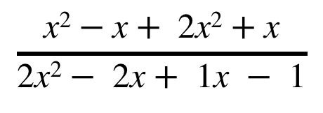

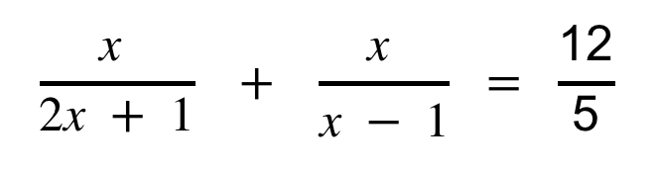




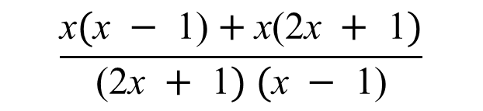

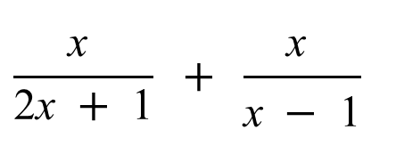
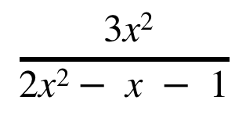
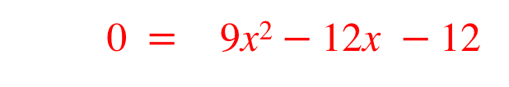
STRAND F
Unit F5
Section F5.2
Algebraic Fractions and Quadratic Equations
Some quadratic equations may be presented in algebraic fraction form. We need to first simplify the fraction, then solve the equation.
For example: simplify and solve:
$$\frac{\text{x} }{\text{2}\text{x} + \text{1}} + \frac{\text{x} }{\text{x} − \text{1} } = \frac{\text{12}}{\text{5}}$$
In this case, the lowest common denominator is ($\text{2}\text{x} +\text{ 1}) (\text{x} −\text{ 1)}$
So:
$$\frac{\text{x} }{\text{2}\text{x} +\text{ 1}} + \frac{\text{x} }{\text{x} −\text{ 1} }$$
$$\frac{\text{x}(\text{x} −\text{ 1)}+\text{x}\text{(2}\text{x} +\text{ 1})}{\text{(2}\text{x} +\text{ 1}) (\text{x} −\text{ 1)}}$$
$$= \frac{\text{12}}{\text{5}}$$
Expanding
brackets:
$$\frac{\text{x}\text{2}−\text{x}+ \text{2}\text{x}\text{2}+\text{x}}{\text{2}\text{x}\text{2}− \text{2}\text{x}+\text{ 1}\text{x} −\text{ 1}}$$
$$\frac{ \text{3}\text{x}\text{2}}{\text{2}\text{x}\text{2}− \text{x} −\text{ 1}}$$
$$= \frac{\text{12}}{\text{5}}$$
Simplifying by cross multiplying:
$$\text{5} × \text{3}\text{x}\text{2}$$
$$= \text{12}×\text{(}\text{2}\text{x}\text{2}− \text{x} −\text{ 1}\text{)}$$
$$\text{1}\text{5}\text{x}\text{2}$$
$$= \text{2}\text{4}\text{x}\text{2}−\text{12}\text{x}−\text{12}$$
Now we are ready to solve!
0 $= \text{9}\text{x}\text{2}−\text{12}\text{x} −\text{12}$

Slide 10









STRAND F
Unit F5
Section F5.2
Algebraic Fractions and Quadratic Equations
We can now solve the quadratic equation:
This is the same as:
$$\text{0} = \text{9}\text{x}\text{2}−\text{12}\text{x}−\text{12}$$
$$\text{9}\text{x}\text{2}−\text{12}\text{x} −\text{12}= \text{0 }$$
First we factorise:
$$\text{(}\text{3}\text{x} + \text{2})\text{(3}\text{x}− \text{6}\text{)}=\text{ 0}$$
So:
$$\text{(3}\text{x} +\text{ 2})=\text{ 0}$$
or
$$\text{(3}\text{x}−\text{ 6)}=\text{ 0}$$
We solve each:
$$\text{3}\text{x} =−\text{2}$$
or
$$\text{3}\text{x}= \text{6}$$
$$\text{x} =−\frac{\text{2}}{\text{3}}$$
or
$$\text{x} =\text{ 2}$$

Slide 11










STRAND F
Unit F5
Section F5.2
Section F5.2: Fitness Check
Here are some questions to check your progress;
there are more practice questions if needed.
Simplify each expression:
$$\frac{\text{8}\text{x} }{\text{x} + \text{3}} − \frac{\text{x} }{\text{x} − \text{2} } =\text{1 }$$
$$\text{3 }\text{and} \frac{\text{1} }{\text{3} }$$
$$\frac{\text{4} }{\text{x} } + \frac{\text{3} }{\text{1}\text{0}−\text{x} } =\text{2 }$$
$$\text{8} \text{and} \frac{\text{5 }}{\text{2} }$$
$\frac{\text{1} }{\text{2}\text{x} + \text{3}} +\frac{\text{1} }{\text{6 }−\text{x} }= \frac{\text{2}}{\text{5}}$
$$\text{1} \text{and} \frac{\text{9} }{\text{4} }$$
$$\frac{\text{2} }{\text{x} }− \frac{\text{1 } }{\text{x} + \text{6} } = \frac{\text{7}}{\text{8}}$$
$$\text{2} \text{and}−\frac{\text{48} }{\text{7} }$$
$$\frac{\text{1} }{\text{10}−\text{x} }+ \frac{\text{x} }{\text{x} + \text{4} } = \frac{\text{4}}{\text{7}}$$
$$\text{3 }\text{and} \frac{\text{44}}{\text{3} }$$

Slide 12
STRAND F
Unit F5
Section F5.2
Section F5.2: Review
You have completed the second Section.
If you have completed and understood this section,
click to start the next Section.
If you need more examples and interactive practice, go to
http://szalonta.hu/ske/text/F5/skef5s2.html

Slide 13












STRAND F
Unit F5
Section F5.3
Algebraic Solution of Simultaneous Equations
Previously you will have solved simultaneous equations where both equations are linear. Now we will solve simultaneous equations where one equation is linear and one equation is quadratic.
For example, solve:
$$\text{y} =\text{2}\text{x}\text{2}+ \text{x} − \text{3}$$
$$\text{y} =\text{3}\text{x} +\text{ 1 }$$
$$\text{(}\text{1}\text{)}$$
$$\text{(2)}$$
Now the $\text{y} \text{from} \text{equation} \text{(1)} \text{ha}\text{s} \text{exactly} \text{the} \text{same} \text{value}$
$\text{as} \text{the} \text{y} \text{from} \text{equation} \text{(}\text{2}\text{)}$, in other words:
$\text{y} = \text{y}$
$\text{(}\text{equation}\text{ 1) (}\text{equation}\text{ 2}\text{)}$
$$= \text{3}\text{x} +\text{ 1 }$$
Therefore:
$$\text{2}\text{x}\text{2}+ \text{x} − \text{3}$$
This equation simplifies to:
$$\text{2}\text{x}\text{2}−\text{2}\text{x} − \text{4}= \text{0}$$
Factorising:
$$\text{(}\text{2}\text{x} +\text{ 2})\text{(}\text{x}− \text{2}\text{)}= \text{ 0}$$
And solving:
$$\text{(2}\text{x} +\text{ 2})=\text{ 0}$$
or
$$\text{(}\text{x}−\text{ 2)}=\text{ 0}$$
$$\text{x} = −\text{1}$$
$\text{x} = \text{2}$

Slide 14









STRAND F
Unit F5
Section F5.3
Algebraic Solution of Simultaneous Equations
The values of x are now substituted into one of the original equations to find the corresponding values of y. It is usually easier to use the linear equation for this.
$$\text{y} =\text{2}\text{x}\text{2}+ \text{x} − \text{3}$$
$$\text{y} =\text{3}\text{x} +\text{ 1 }$$
$$\text{(}\text{1}\text{)}$$
$$\text{(2)}$$
$$\text{x} = −\text{1} \text{or} \text{x} =\text{ 2}$$
Substituting the first solution into$\text{equation} \text{(}\text{2}\text{)}$:
$\text{y} =\text{3}\text{x} +\text{ 1}$
gives:
$$\text{y} =\text{3}x−\text{1}+\text{ 1}$$
$$= −\text{2}$$
Substituting the first solution into$\text{equation} \text{(}\text{2}\text{)}$:
$$\text{y} =\text{3}\text{x} +\text{ 1}$$
gives :
$$= \text{7}$$
$$\text{y} =\text{3}×\text{2}+\text{ 1}$$
The solutions are:
$$\text{x} = −\text{1}\text{, }\text{y}= −\text{2}$$
and
$$\text{x} = \text{2,} \text{y}= \text{7}$$

Slide 15











STRAND F
Unit F5
Section F5.3
Algebraic Solution of Simultaneous Equations
$$\text{y} =\text{3}\text{x}\text{2}− \text{4}$$
$$\text{y} =\text{2}\text{x} + \text{3}$$
Example 1: Solve
$$\text{(1)}$$
$$\text{(}\text{2}\text{)}$$
Solution $\text{3}\text{x}\text{2}−\text{ 4}$ $=\text{2}\text{x} +\text{ 3}$
$\text{3}\text{x}\text{2}−\text{ 4}−\text{2}\text{x} −\text{ 3}=\text{0}$
$$\text{3}\text{x}\text{2}−\text{2}\text{x} − \text{7}=\text{0}$$
This quadratic does not factorise, so we need to use the formula:
$$x=\frac{−b±\sqrt{b^{2}−4ac}}{2a}$$
Here:
$$a=\text{3,} b=−\text{2} \text{a}\text{n}\text{d} c=−\text{7}$$
$$\text{x}= \frac{\text{2}±\sqrt{4+84}}{\text{6}}$$
Substituting:
$$\text{x}= \frac{\text{2}+\sqrt{88}}{\text{6}} ≈\text{1.8968}$$
$\text{x}= \frac{\text{2}−\sqrt{88}}{\text{6}}≈$ $−\text{1.2301}$
And solving:
$$\text{x} =\text{ 1}\text{. (}\text{to}\text{ 2.}\text{d}\text{.}\text{p}\text{.)}$$
or
$$\text{x} = −\text{1.}\text{23}\text{ (}\text{to}\text{ 2.}\text{d}\text{.}\text{p}\text{.)}$$

Slide 16











STRAND F
Unit F5
Section F5.3
Algebraic Solution of Simultaneous Equations
The values of $x$ are now substituted into one of the original equations to find the corresponding values of y.
It is usually easier to use the linear equation for this.
$$\text{y} =\text{3}\text{x}\text{2}− \text{4}$$
$$\text{y} =\text{2}\text{x} + \text{3}$$
$$\text{(}\text{1}\text{)}$$
$$\text{x} ≈\text{ 1.}\text{8968}$$
$$\text{x} ≈ −\text{1.23}\text{01}$$
$$\text{(2)}$$
Substituting the first solution into$\text{equation} \text{(}\text{2}\text{)}$:
$\text{y} =\text{2}\text{x} +\text{ 3 }$
gives:
$$\text{y} =\text{2} × \text{1.8968}+ \text{3}$$
$$≈ \text{6}\text{.7936}$$
Substituting the first solution into$\text{equation} \text{(}\text{2}\text{)}$:
$$\text{y} =\text{2}\text{x} +\text{ 3}$$
gives :
$$≈ \text{0.539}8$$
$$\text{y} =\text{2} × −\text{1.2301}+\text{3}$$
The solutions are:
$$\text{x} =\text{ 1.90}\text{, }\text{y}= \text{6}\text{.79}$$
and
$$\text{x} = −\text{1.23}\text{,} \text{y}= \text{0.5}\text{4}$$

Slide 17












STRAND F
Unit F5
Section F5.3
Algebraic Solution of Simultaneous Equations
$\text{x}\text{2}+ \text{y}\text{2}=$ 10
$$\text{y} =\text{x} +\text{ 2 }$$
$$\text{(}\text{1}\text{)}$$
Example 2:
$$\text{x} +\text{ 2 }$$
$$\text{(2)}$$
This is the equation of a circle
Solution: In this case, we use the value of $\text{y}$from$\text{equation} \text{(}\text{2}\text{) }$and substitute it into $\text{equation} \text{(}\text{1}\text{)}$
$$\text{x}\text{2}+ \text{y}\text{2} =\text{ 10}$$
$$\text{x}\text{2}+ \text{(}\text{x} +\text{ 2}\text{)}\text{2}=\text{ 10}$$
$$\text{x} +\text{ 2}$$
Expanding:
$$\text{x}\text{2}+\text{x}\text{2}+\text{4}\text{x} + \text{4}=\text{ 10}$$
Simplifying:
$$\text{2}\text{x}\text{2}+\text{4}\text{x} − \text{6}=\text{ 0}$$
Simplifies again:
$$\text{x}\text{2}+\text{2}\text{x} − \text{3}=\text{ 0}$$
Factorising:
$$\text{(}\text{x} +\text{ 3})\text{(}\text{x} − \text{1})=\text{0}$$
$$\text{x} +\text{ 3}=\text{0} \text{x} −\text{ 1}=\text{0}$$
Solve for $\text{x}$:
$$\text{x} = −\text{3}$$
and
$$\text{x} =\text{ 1}$$

Slide 18












STRAND F
Unit F5
Section F5.3
Algebraic Solution of Simultaneous Equations
The values of $\text{x}$ are now substituted into one of the original equations to find the corresponding values of $y$.
It is usually easier to use the linear equation for this.
$\text{x}\text{2}+ \text{y}\text{2}=$ 10
$$\text{y} =\text{x} +\text{ 2 }$$
$$\text{(}\text{1}\text{)}$$
$$\text{x} = −\text{3}$$
$$\text{x} =\text{ 1}$$
$$\text{(2)}$$
Substituting the first solution into$\text{equation} \text{(}\text{2}\text{)}$:
$\text{y} =\text{x} + \text{2}$
gives:
$$\text{y} =−\text{3}+ \text{2}$$
$$= −\text{1}$$
Substituting the first solution into$\text{equation} \text{(}\text{2}\text{)}$:
$$\text{y} =\text{x} + \text{2}$$
gives :
$$= \text{3}$$
$$\text{y} =\text{1} +\text{2}$$
$$\text{x} = −\text{3, }\text{y}= −\text{1}$$
$$\text{x} =\text{ 1}\text{,} \text{y}= \text{3}$$
The solutions are:
and

Slide 19












STRAND F
Unit F5
Section F5.3
Algebraic Solution of Simultaneous Equations
$\text{x} +\text{2}$y $= \text{2}$
$\text{x}\text{2} +\text{8}\text{y}= \text{8}$
$$\text{(}\text{1}\text{)}$$
Example 3:
$$\text{(2)}$$
Solution: We first rearrange $\text{equation} \text{(1) }$to make x the subject:
and then substitute ($\text{2}−\text{2}\text{y}\text{) }$from$\text{equation} \text{(}\text{3}\text{) }$into $\text{equation} \text{(}\text{2}\text{)}\text{:}$
$$\text{x} = \text{2}−\text{2}\text{y}$$
$$\text{2}−\text{2}\text{y}$$
$$\text{(}\text{3}\text{)}$$
$$\text{x}\text{2} +\text{8}\text{y}= \text{8}$$
$$\text{(}\text{2}−\text{2}\text{y}\text{)}\text{2}+\text{8}\text{y}= \text{8}$$
$$\text{2}−\text{2}\text{y}$$
$$\text{2}−\text{2}\text{y}$$
Expanding:
$$\text{4} −\text{4}\text{y} +\text{4}\text{y}\text{2}+\text{8}\text{y}=\text{ 8}$$
Simplifying:
$$\text{4}\text{y}\text{2} \text{+ 4}\text{y}−\text{4}= \text{0}$$
Simplifies again:
$$\text{y}\text{2} +y−\text{1}=\text{ 0}$$
Now we have a quadratic equation we can solve to find $\text{y}$.
(This quadratic does not factorise, so we would need to use
the quadratic formula to solve.)
Once solutions for $\text{y}$ have been found, solutions for $x$ can also
be found by substituting the $\text{y}$ values into $\text{equation} \text{(}\text{3}\text{)}$.

Slide 20










STRAND F
Unit F5
Section F5.3
Section F5.3: Fitness Check
Here are some questions to check your progress;
there are more practice questions if needed.
Solve each pair of simultaneous equations.
y $= \text{x}\text{2} − \text{4}$
y $= \text{3}\text{x}$
$$\text{x}=\text{4}\text{,} \text{y}=\text{12 }\text{and}$$
$$\text{x}=−\text{1,} \text{y}=−\text{3}$$
$$\text{x}=\text{2}\text{, }\text{y}=\text{7} \text{and}$$
$$\text{x}=−\text{1,} \text{y}=−\text{2}$$
(b) y $= \text{2}\text{x}\text{2} +\text{x} − \text{3}$
y $= \text{3}\text{x} + \text{1}$
(c) y $= \text{2}\text{x}\text{2} +\text{12}\text{x} − \text{4}$
y $= \text{2}\text{x} − \text{1}$
$$\text{x}=\text{0.28}\text{, }\text{y}=−\text{0.43} \text{and}$$
$$\text{x}=−\text{5.28}\text{,} \text{y}=−\text{11.57}$$
(d) $\text{x} +\text{2}$y $= \text{2}$
$\text{x}\text{2} +\text{8}\text{y}= \text{8}$
$$\text{x}=\text{0}\text{, }\text{y}=\text{1} \text{and}$$
$$\text{x}=\text{4}\text{,} \text{y}=−\text{1}$$
(e) $\text{x}\text{2} +$y$\text{2}$ $= \text{8}$
y $= \text{x} +\text{4}$
x $=$ $−$2; y $=$2
There is only one solution which actually
means the straight line is a tangent to
(and only just touches) the circle.

Slide 21
STRAND F
Unit F4
Section F5.3
Section F5.3: Review
You have completed the last Section.
If you need more examples and interactive practice, go to
http://szalonta.hu/ske/text/F5/skef5s3.html

