Slide 1
TSST Strand F
UNIT F6: Solving Inequalities

Slide 2
Strand F
Unit F6
Solving Inequalities
Solving Inequalities is another key part of algebra.
You have five sections to work through.
There are fitness tests for each section, audits
and interactive examples and exercises
Inequalities on a Number Line
Solution of Linear Inequalities
3. Inequalities Involving Quadratic Terms
4. Graphical Approach to Inequalities
5. Dealing with more than One Inequality

Slide 3
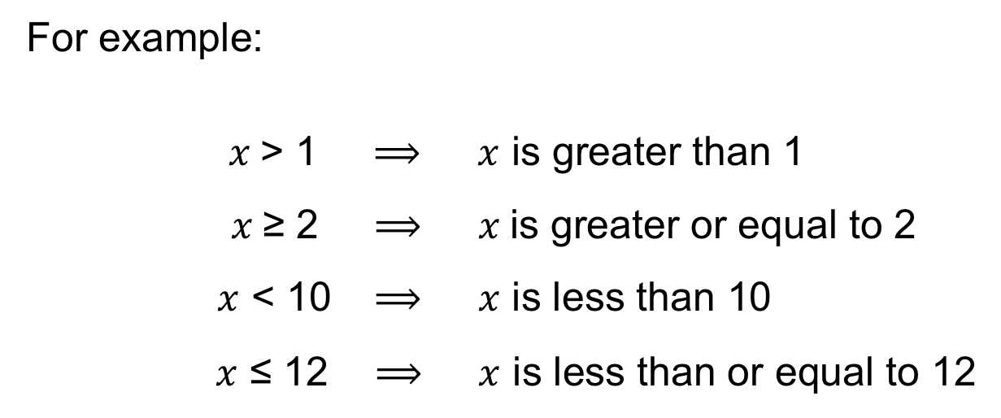
Strand F
Unit F6
Section F6.1
Inequalities on a Number Line
An Inequality involves using one or more of these signs:
>, ≥, < or ≤
For example:
$x$> 1 $⟹$ $x$ is greater than 1
$x$≥ 2 $⟹$ $x$is greater or equal to 2
$x$ < 10 $⟹$ $x$ is less than 10
$x$ ≤ 12 $⟹$ $x$ is less than or equal to 12
We will see how to represent inequalities on a number line.

Slide 4
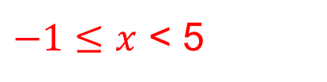
Example
Strand F
Unit F6
Section F6.1
What is the inequality shown in each of these diagrams?
Solution: We use filled dot when the point is included and no fill if not
a)
$$x>−1$$
b)
$x≤2$
c)
$−1≤x$ < 5

Slide 5
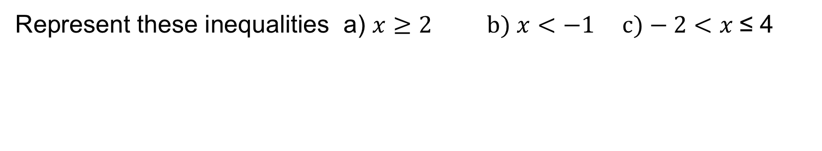
Example
Strand F
Unit F6
Section F6.1
Represent these inequalities a) $x≥2 b) x<−1 c)−2<x \text{≤} \text{4}$
a) Here $x$ is greater than or equal to 2
Solution
b) Here $x$ is less than $−1$
c) Here $x$ is greater than $−2$ and less than or equal to 4

Slide 6

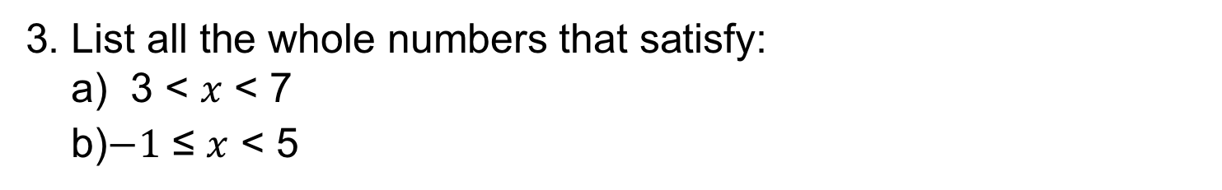
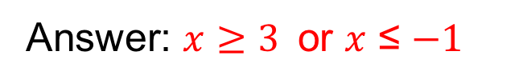
Strand F
Unit F6
Section F6.1
Section F6.1: Fitness Check
Here are some questions to check your progress;
there are more practice questions if needed.
1. Represent the inequality $−1≤x<4$on the number line below.
2. What inequality is represented on this number line?
Answer: $x≥3$or $x$ ≤ $−1$
3. List all the whole numbers that satisfy:
a) 3 < $x$ < 7
b)$−1$ ≤ $x$ < 5
Answer: {4, 5, 6}
Answer: {$−1$, 0, 1, 2, 3, 4}

Slide 7
STRAND F
Unit F6
Section F6.1
Section F6.1: Review
You have completed the first Section.
If you have completed and understood this section,
click to start the next Section.
If you need more examples and interactive practice, go to
http://szalonta.hu/ske/text/F6/skef6s1.html

Slide 8
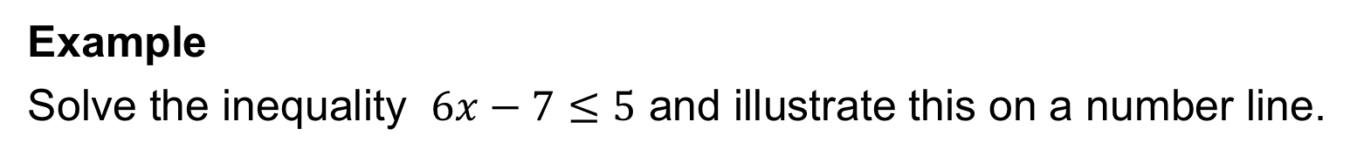
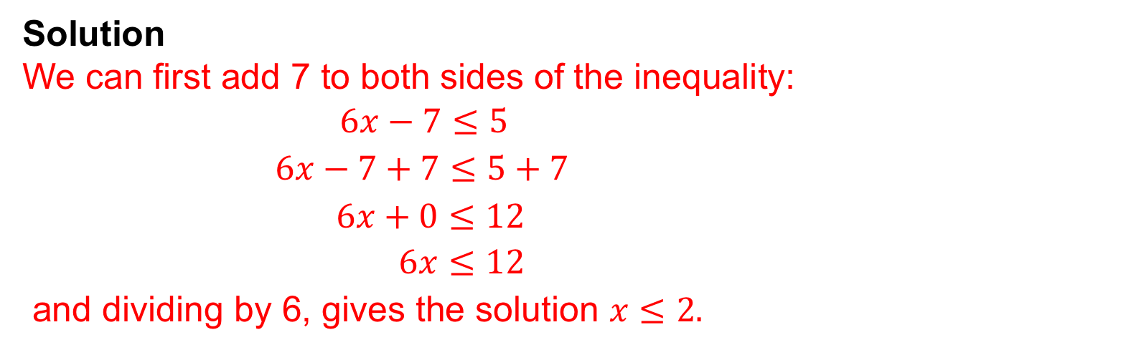
STRAND F
Unit F6
Section F6.2
Solution of Linear Inequalities
We can solve linear inequalities in a similar way to linear equations as we see in the following examples.
Example
Solve the inequality $6x−7≤5$ and illustrate this on a number line.
Solution
We can first add 7 to both sides of the inequality:
$6x−7≤5$
$6x−7+7≤5+7$
$6x+0≤12$
$6x≤12$
and dividing by 6, gives the solution $x≤2.$
This is shown on the number line below:

Slide 9
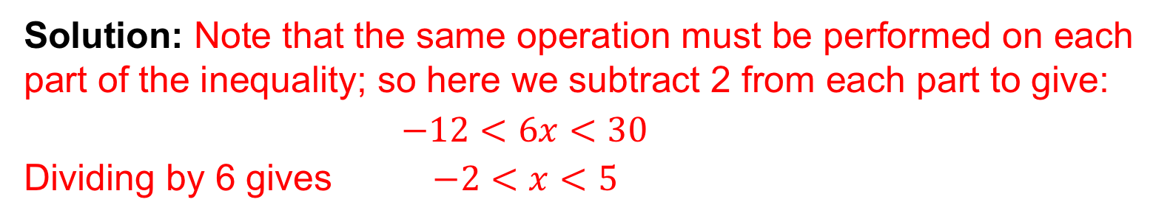
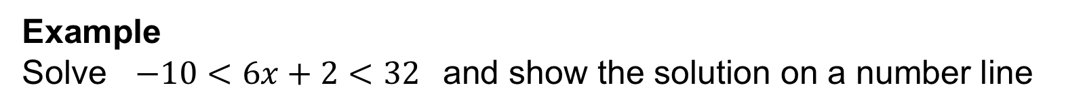
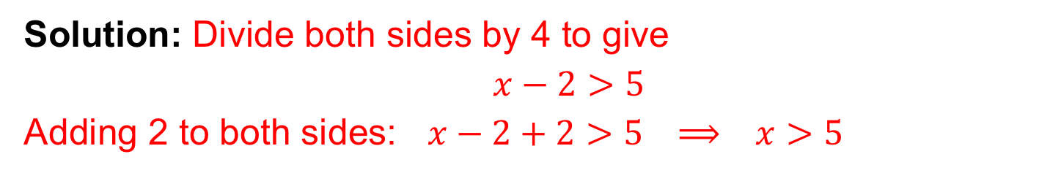
STRAND F
Unit F6
Section F6.2
More Examples
Example: Solve the inequality $4\left(x−2\right)>20$
Solution: Divide both sides by 4 to give
$$x−2>5$$
Adding 2 to both sides: $x−2+2>5 ⟹ x>5$
Example
Solve $−10<6x+2<32$and show the solution on a number line
Solution: Note that the same operation must be performed on each part of the inequality; so here we subtract 2 from each part to give:
$−12<6x<30$
Dividing by 6 gives $−2<x<5$
This solution is shown on the number line below:

Slide 10
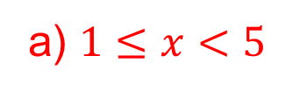
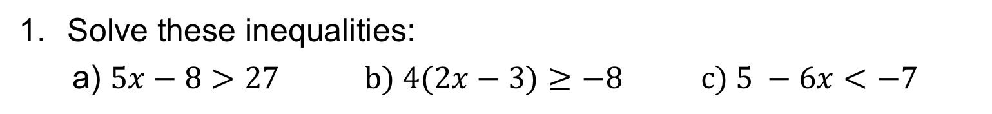
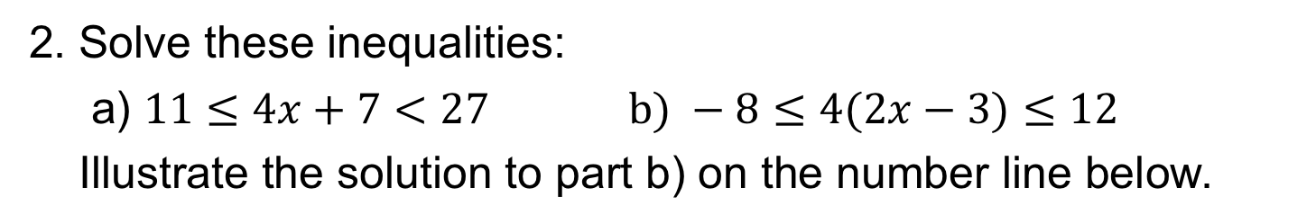
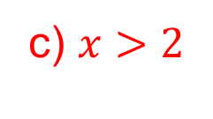

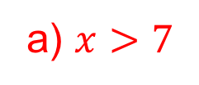
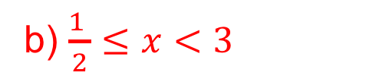
STRAND F
Unit F6
Section F6.2
Section F6.2: Fitness Check
Here are some questions to check your progress;
there are more practice questions if needed.
Solve these inequalities:
a) $5x−8>27 b) 4(2x−3)≥−8 c) 5 −6x<−7$
$$b) x≥\frac{1}{2}$$
Answers
a) $x>7$
c) $x>2$
2. Solve these inequalities:
a) $11≤4x+7<27 b) −8≤4(2x−3)≤12$
Illustrate the solution to part b) on the number line below.
Answers
a) $1≤x<5$
b) $\frac{1 }{2}≤x<3$

Slide 11
STRAND F
Unit F6
Section F6.2
Section F6.2: Review
You have completed the second Section.
If you have completed and understood this section,
click to start the next Section.
If you need more examples and interactive practice, go to
http://szalonta.hu/ske/text/F6/skef6s2.html

Slide 12
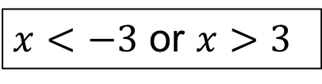
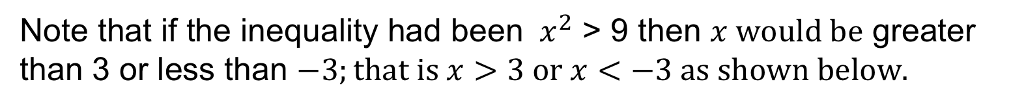

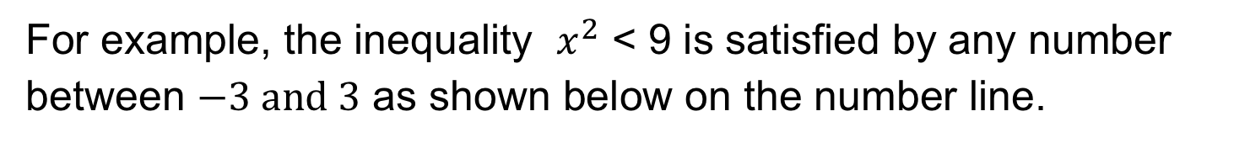
STRAND F
Unit F6
Section F6.3
Solving Quadratic Inequalities
We now consider how to solve inequalities that involve $x^{2}$ terms.
For example, the inequality $x^{2}$ < 9 is satisfied by any number
between $−3 and 3$ as shown below on the number line.
$$−3<x<3$$
Note that if the inequality had been ${ x}^{2}$ > 9 then $x would be$ greater than 3 or less than $−3;that is x>3 or x<−3 as shown below.$
$x<−3$ or $x>3$

Slide 13
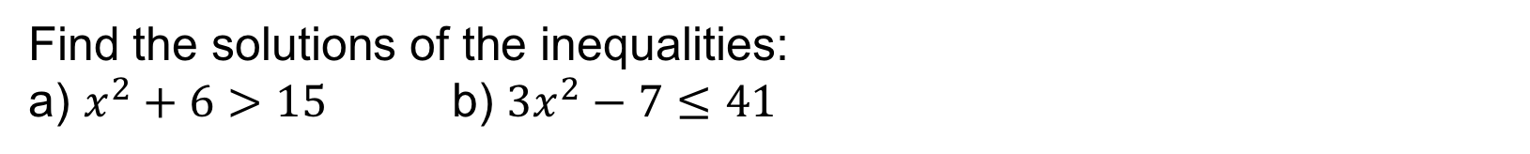
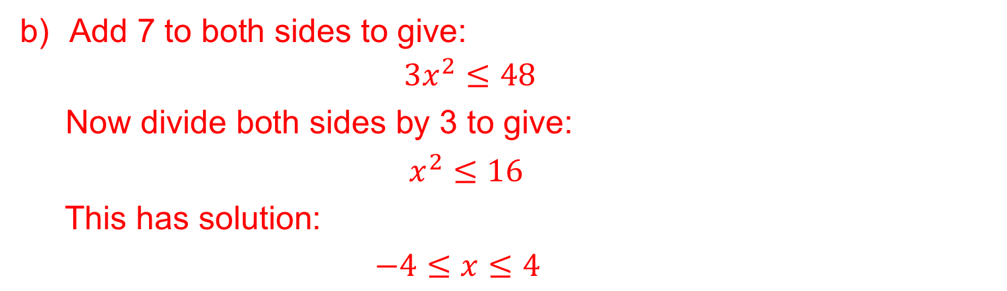
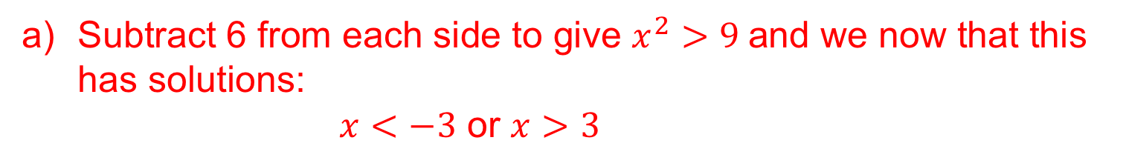
STRAND F
Unit F6
Section F6.3
Example
Find the solutions of the inequalities:
a) $x^{2}+6>15$ b) $3x^{2}−7≤41$
Solutions
Subtract 6 from each side to give $x^{2}>9$and we now that this has solutions:
$x<−3$ or $x>3$
Add 7 to both sides to give:
$3x^{2}≤48$
Now divide both sides by 3 to give:
$x^{2}≤16$
This has solution:
$−4≤x≤4$

Slide 14
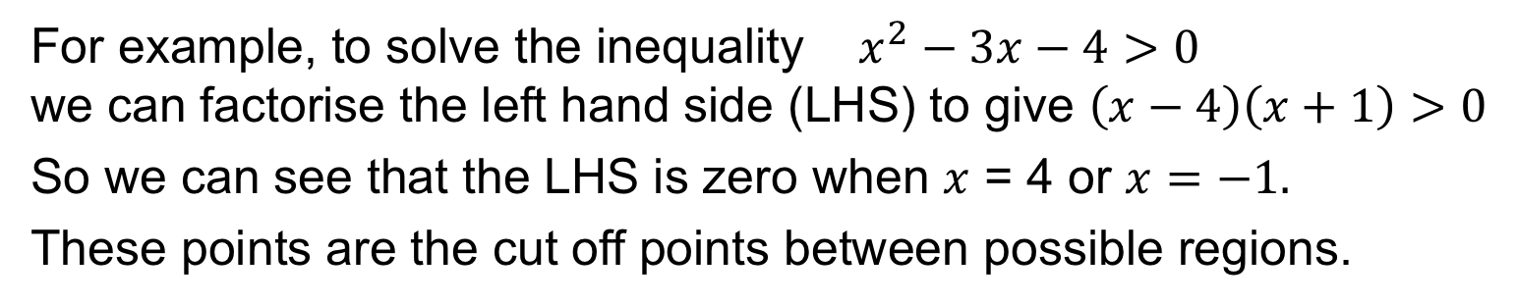
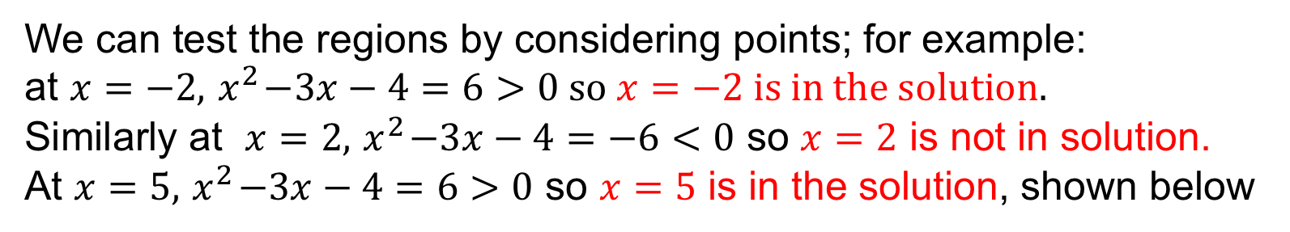
STRAND F
Unit F6
Section F6.3
Example: Factorising
In some examples, we need to factorise the quadratic expression.
For example, to solve the inequality $x^{2}−3x−4>0$
we can factorise the left hand side (LHS) to give $\left(x−4\right)\left(x+1\right)>0$
So we can see that the LHS is zero when $x$ = 4 or $x=−1.$
These points are the cut off points between possible regions.
We can test the regions by considering points; for example:
at $x=−2, { x}^{2}−3x−4=6>0 so x=−2 is in the solution.$
Similarly at $x=2, { x}^{2}−3x−4=−6<0$ so $x=2$ is not in solution.
At $x=5, { x}^{2}−3x−4=6>0$ so $x=5$ is in the solution, shown below

Slide 15
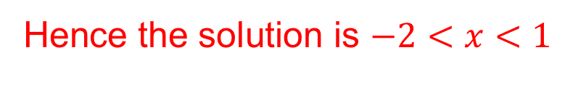
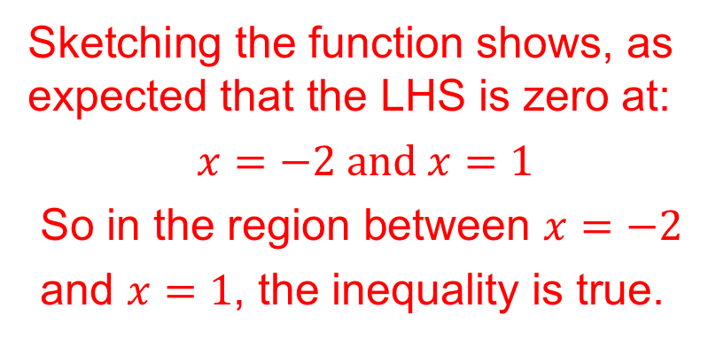
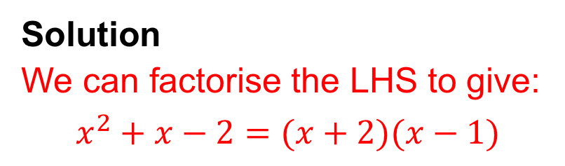
STRAND F
Unit F6
Section F6.3
Example: Graphical Approach
Sometimes it is more straight forward to
graph the quadratic to solve the inequality
Example: Solve the inequality $x^{2}+x−2<0$
Solution
We can factorise the LHS to give:
$$x^{2}+x−2=(x+2)(x−1)$$
Sketching the function shows, as expected that the LHS is zero at:
$$x=−2 and x=1$$
So in the region between $x=−2$
and $x=1$, the inequality is true.
Hence the solution is $−2<x<1$

Slide 16
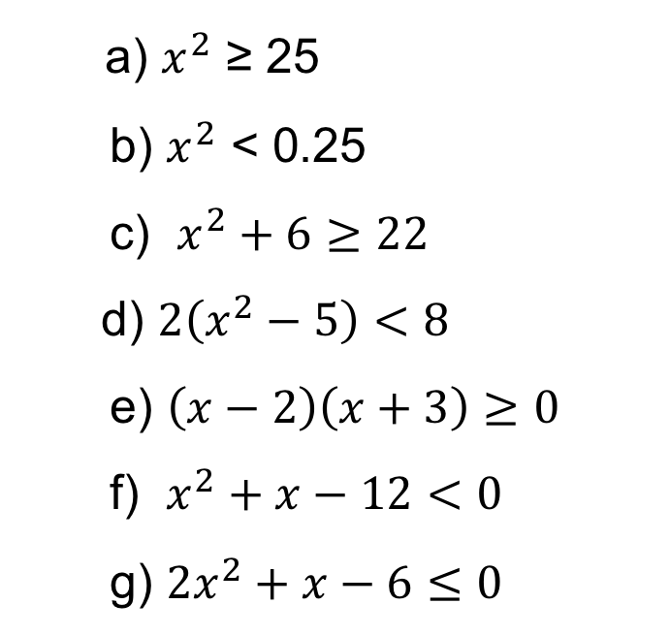
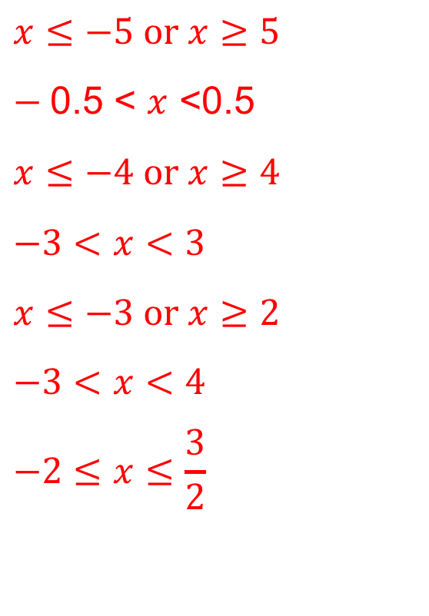
STRAND F
Unit F6
Section F6.3
Section F6.3: Fitness Check
Here are some questions to check your progress;
there are more practice questions if needed.
Solve these inequalities, using a sketch when helpful:
a) $x^{2}$ ≥ 25
b) $x^{2}$ < 0.25
c) $x^{2}+6≥22$
d) $2\left(x^{2}−5\right)<8$
e) $\left(x−2\right)\left(x+3\right)≥0$
f) $x^{2}+x−12<0$
g) $2x^{2}+x−6≤0$
$$x≤−5 or x≥5$$
$−$0.5 < $x$ <0.5
$$x≤−4 or x≥4$$
$$−3<x<3$$
$$x≤−3 or x≥2$$
$$−3<x<4$$
$$−2≤x≤\frac{3}{2}$$

Slide 17
STRAND F
Unit F6
Section F6.3
Section F6.3: Review
You have completed the third Section.
If you have completed and understood this section,
click to start the next Section.
If you need more examples and interactive practice, go to
http://szalonta.hu/ske/text/F6/skef6s3.html

Slide 18
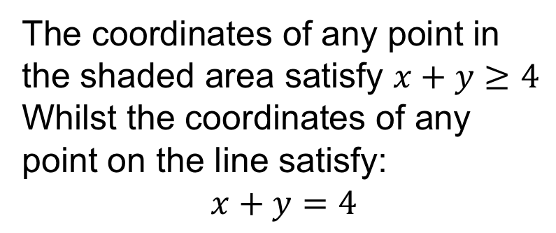
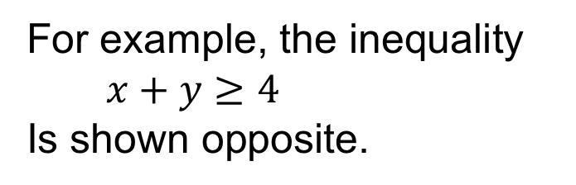
STRAND F
Unit F6
Section F6.4
Graphical Approach to Inequalities
When an inequality involves
2 variables, we can represent in a region on a graph.
For example, the inequality
$x+y≥4$
Is shown opposite.
The coordinates of any point in the shaded area satisfy $x+y≥4$
Whilst the coordinates of any point on the line satisfy:
$$x+y=4$$

Slide 19
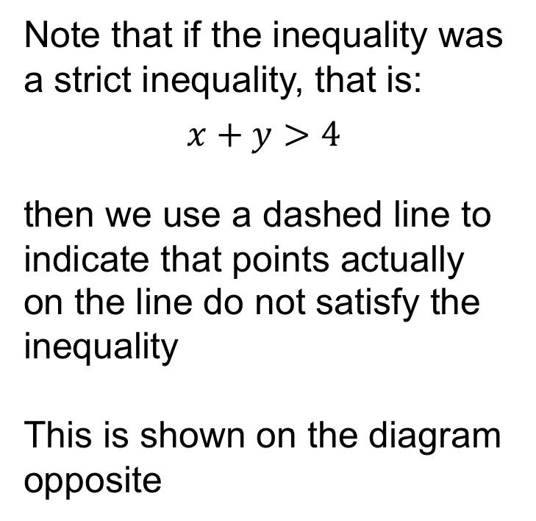
STRAND F
Unit F6
Section F6.4
Graphical Approach to Inequalities
Note that if the inequality was a strict inequality, that is:
$$x+y>4$$
then we use a dashed line to indicate that points actually on the line do not satisfy the inequality
This is shown on the diagram opposite

Slide 20
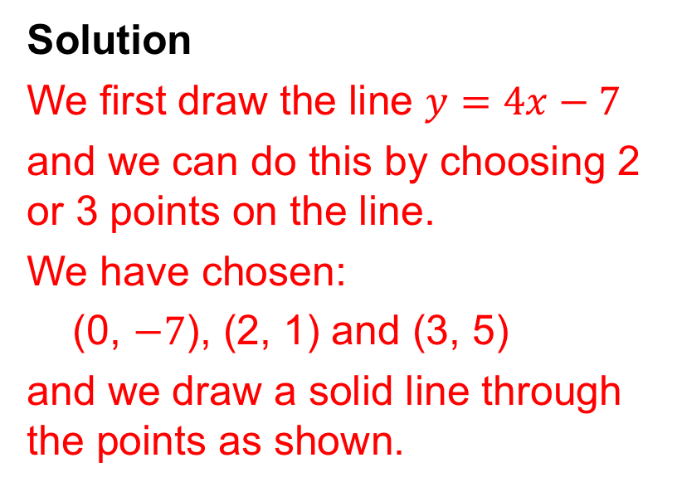
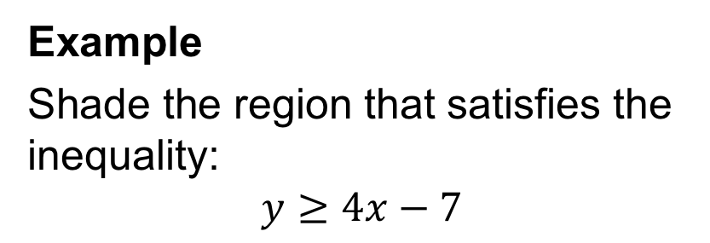
STRAND F
Unit F6
Section F6.4
Graphical Approach: Example
Example
Shade the region that satisfies the inequality:
$$y≥4x−7$$
Solution
We first draw the line $y=4x−7$
and we can do this by choosing 2 or 3 points on the line.
We have chosen:
(0, $−7$), (2, 1) and (3, 5)
and we draw a solid line through the points as shown.
Solution continued on next slide

Slide 21
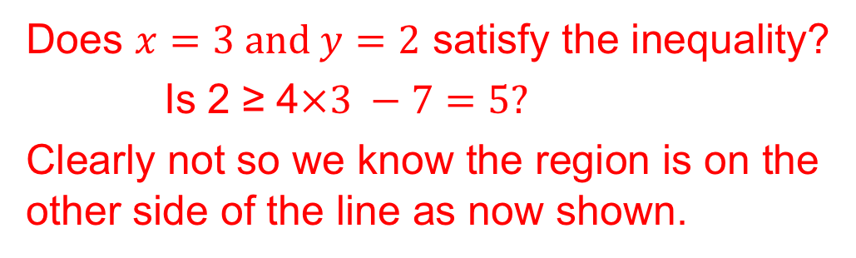

STRAND F
Unit F6
Section F6.4
Graphical Approach: Example
Now we have to determine which region on the graph represents:
$$y≥4x−7$$
We can do this by testing a point; for example, we will use (3, 2) but any point NOT on the line can be used.
Does $x=3 and y=2$ satisfy the inequality?
Is 2 ≥ 4$×3 −7=5?$
Clearly not so we know the region is on the other side of the line as now shown.

Slide 22


STRAND F
Unit F6
Section F6.4
Section F6.4: Fitness Check
Here are some questions to check your progress;
there are more practice questions if needed.
For each of the examples below, determine the
inequality represented by the shaded region
1.
2.
Answer
$$y≤x+1$$
Answer
$$y>2x$$

Slide 23


STRAND F
Unit F6
Section F6.4
Section F6.4: Fitness Check
For each of the examples below, determine the
inequality represented by the shaded region
3.
4.
Answer
$$x+y>4$$
Answer
$$y<x+1$$

Slide 24
STRAND F
Unit F6
Section F6.4
Section F6.4: Review
You have completed the fourth Section.
If you have completed and understood this section,
click to start the next Section.
If you need more examples and interactive practice, go to
http://szalonta.hu/ske/text/F6/skef6s4.html

Slide 25
STRAND F
Unit F6
Section F6.5
More than One Inequality
Here we extend our graphical approach in the previous section and now look at problems with more than one inequality.
This is the beginning of a topic called “Linear Programming” which has applications in many different contexts from Business planning and scheduling to Economic modelling.
Problem
A small factory employs people at two rates of pay. The maximum number of people who can be employed is 10. More workers are employed on the lower rate than on the higher rate.
Describe this situation using inequalities, and draw a graph to show the feasible region in which they are satisfied.
This continues on the next slide

Slide 26
STRAND F
Unit F6
Section F6.5
More than One Inequality
Let x = number employed at the lower rate of pay
and y = number employed at the higher rate of pay
Maximum number employed is 10 so x + y ≤ 10
See diagram, noting that we shade out the side not wanted
More people employed at lower rate so x > y
See diagram
As x and y must be positive,
x ≥ 0 and y ≥ 0
See diagram
The feasible region is the lower RED triangle as shown.
Only integer solutions are possible and these are marked with RED dots

Slide 27

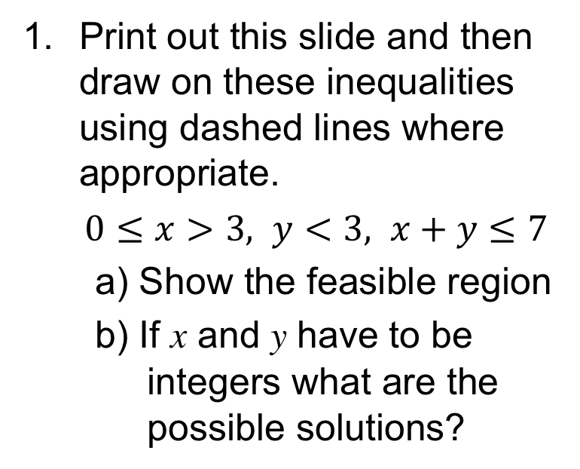
STRAND F
Unit F6
Section F6.5
Section F6.5: Fitness Check
Here are some questions to check your progress
y
Print out this slide and then draw on these inequalities using dashed lines where appropriate.
$0≤x>3, y<3, x+y≤7$
a) Show the feasible region
b) If x and y have to be
integers what are the
possible solutions?
8
7
6
5
4
3
2
1
0
Answers
Feasible Region
See diagram
(4, 0), (4, 1), (4, 2), (5, 0), (5, 1), (5, 2), (6, 0), (6, 1), (7, 0)
x
0 1 2 3 4 5 6 7

Slide 28
STRAND F
Unit F6
Section F6.5
Section F6.5: Fitness Check
2. Each diagram shows a region which satisfies 3 inequalities.
Find the three inequalities in each case.
a)
b)
Answer
x ≤ 5, y ≥ 2, y ≤ x+2
Answer
x ≥ −2, y ≥ x−2, y ≤ 2−x

Slide 29
STRAND F
Unit F6
Section F6.5
Section F6.5: Review
You have completed the last Section.
If you need more examples and interactive practice, go to
http://szalonta.hu/ske/text/F6/skef6s5.html

