Slide 1
TSST Strand G
UNIT G3: Using Graphs to Solve Equations

Slide 2
STRAND G
Unit G3
Using Graphs to Solve Equations
A graph is a diagram showing the relationship between some variable quantities.
You have four sections to work through and there are check up audits and fitness tests for each section.
Solution of Simultaneous Equations by Graphs
Graphs of Common Functions
Graphical Solutions of Equations
Tangents to Curves

Slide 3

STRAND G
Unit G3
Section G3.1
Solutions of Simultaneous Equations by Graphs
Try solving: x $+$ y $=$ 24
What could ‘x’ be? What could ‘y’ be?
There are simply too many possible solutions.
So if we have more than one ‘unknown’ (variable),
we must have more than one equation.
With two ‘unknowns’, we must have at least two equations,
and we must solve them at the same time, i.e. simultaneously.
x $+$ y $=$ 24 and
2x $=$ 20
Try again:
Can you solve it now?
See next slide for worked solution.

Slide 4


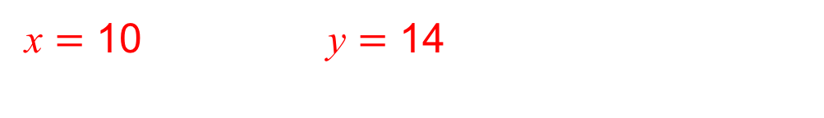

STRAND G
Unit G3
Section G3.1
Solutions of Simultaneous Equations by Graphs
x $+$ y $=$ 24
2x $=$ 20
Solve:
1
2
What could x be?
From the equation 2,
What could y be?
First, label the equations.
we can work out x $=$ 10
So now we can use this solution and ‘plug’ it in
(i.e. substitute) this value into the equation 1.
x $+$ y $=$ 24
10 $+$ y $=$ 24
y $=$ 14
Substitute x value into equation 1
Now solve for y:
Solutions:
x $=$ 10 y $=$ 14

Slide 5

STRAND G
Unit G3
Section G3.1
Solutions of Simultaneous Equations by Graphs
There are 3 ways to solve simultaneous linear equations:
In another Unit we have seen how to solve by:
substitution (as in the example on previous slides);
elimination.
In this Unit, we will look at solving simultaneous linear
equations by:
drawing graphs (and finding the coordinates of where
the 2 lines cross).
Now try solving graphically:
x $+$ y $=$ 24
2x $=$ 20
See next slide for worked solution.

Slide 6
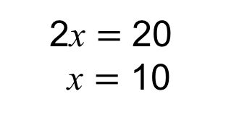

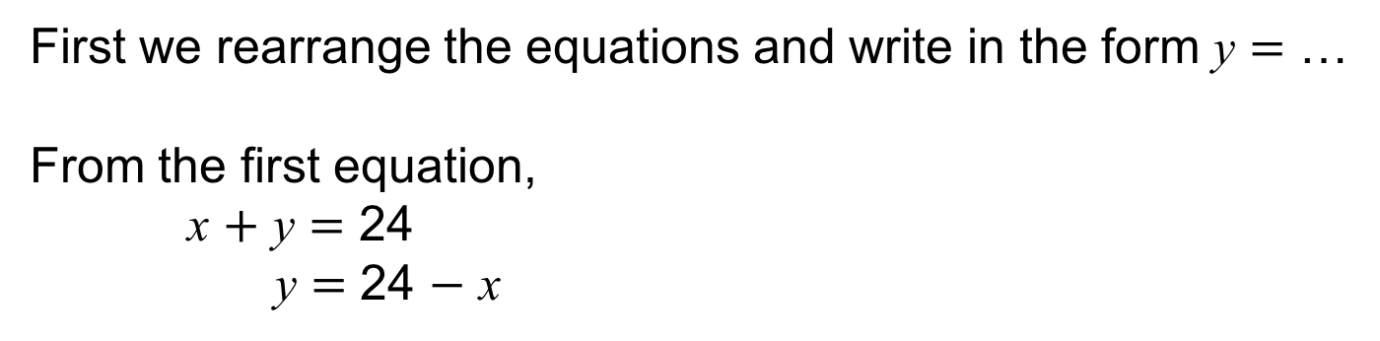

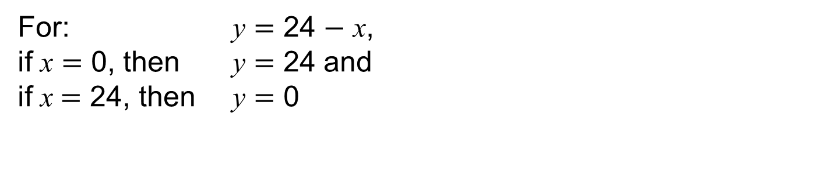
STRAND G
Unit G3
Section G3.1
Solutions of Simultaneous Equations by Graphs
First we rearrange the equations and write in the form y $=$ …
From the first equation,
x $+$ y $=$ 24
y $=$ 24 $−$ x
From the second equation,
2x $=$ 20
x $=$ 10
(there is no ‘y’ in this equation)
These are both linear (straight line) equations.
To draw a straight line, only two pairs of coordinates are required.
For: y $=$ 24 $−$ x,
if x $=$ 0, then y $=$ 24 and
if x $=$ 24, then y $=$ 0
For: x $=\text{10}$,
for each and every ‘y’ coordinate,
x $=$ 10
(0, 24)
(24, 0)
This is the vertical line
going through x $=$ 10
Graphs shown on next slide…

Slide 7
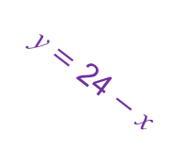

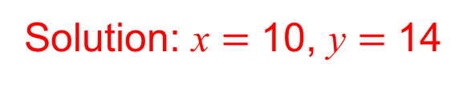
STRAND G
Unit G3
Section G3.1
Solutions of Simultaneous Equations by Graphs
y
24
x $=$ 10
y $=$ 24 $−$ x
(10, 14)
0
x
10
24
Solution: x $=$ 10, y $=$ 14

Slide 8

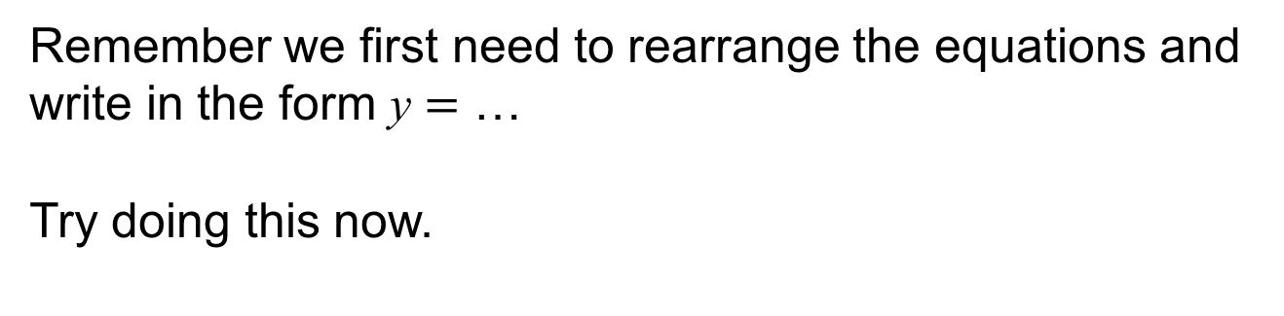
STRAND G
Unit G3
Section G3.1
Solutions of Simultaneous Equations by Graphs
Example:
By drawing graphs, try solving:
x $+$ y $=$ 8 and
2x $+$ 3y $=$ 21
Remember we first need to rearrange the equations and
write in the form y $=$ …
Try doing this now.
See next slide for worked solution.

Slide 9

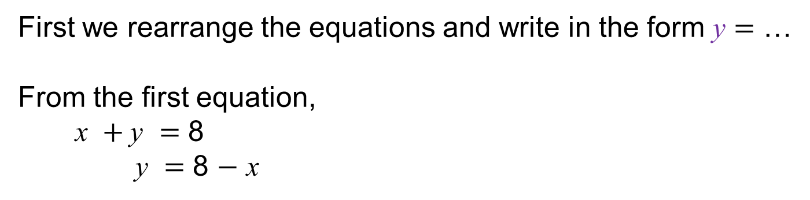
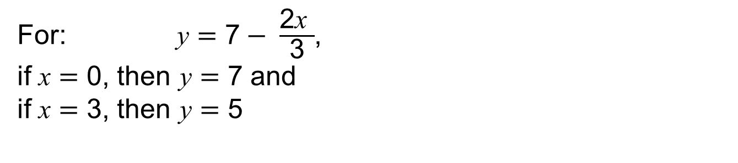
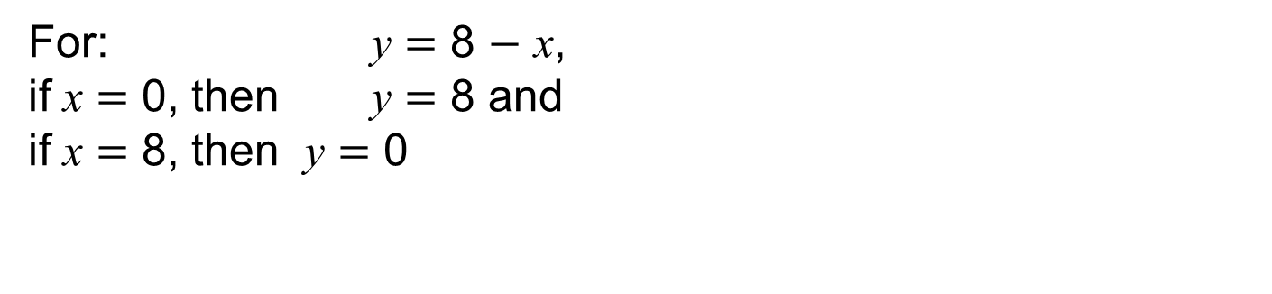
STRAND G
Unit G3
Section G3.1
Solutions of Simultaneous Equations by Graphs
First we rearrange the equations and write in the form y $=$ …
From the first equation,
x $+$y $=$ 8
y $=$ 8 $−$ x
2x $+$ 3y $=$ 21
3y $=$ 21 $−$2 x y $=$ 21 $−$2x
y $=\frac{\text{21} − \text{2}\text{x}}{\text{3}}$
y $=\text{7}− \frac{\text{2}\text{x}}{\text{3}}$
From the second equation,
These are both linear (straight line) equations.
To draw a straight line, only two pairs of coordinates are required.
For: y $=\text{7}− \frac{\text{2}\text{x} }{\text{3}}$,
if x $=$ 0, then y $=$ 7 and
if x $=$ 3, then y $=$ 5
For: y $=$ 8 $−$ x,
if x $=$ 0, then y $=$ 8 and
if x $=$ 8, then y $=$ 0
(0, 8)
(8, 0)
(0, 7)
(3, 5)

Slide 10
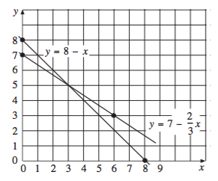
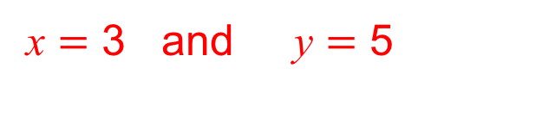
STRAND G
Unit G3
Section G3.1
Solutions of Simultaneous Equations by Graphs
These points are then plotted:
(0, 8)
(8, 0)
and
(0, 7)
(3, 5)
The two lines intersect at the point (3, 5), so the solution is
x $=$ 3 and y $=$ 5
Top tip: Graphing software (such as DESMOS) can be used to plot and explore graphs effortlessly.

Slide 11
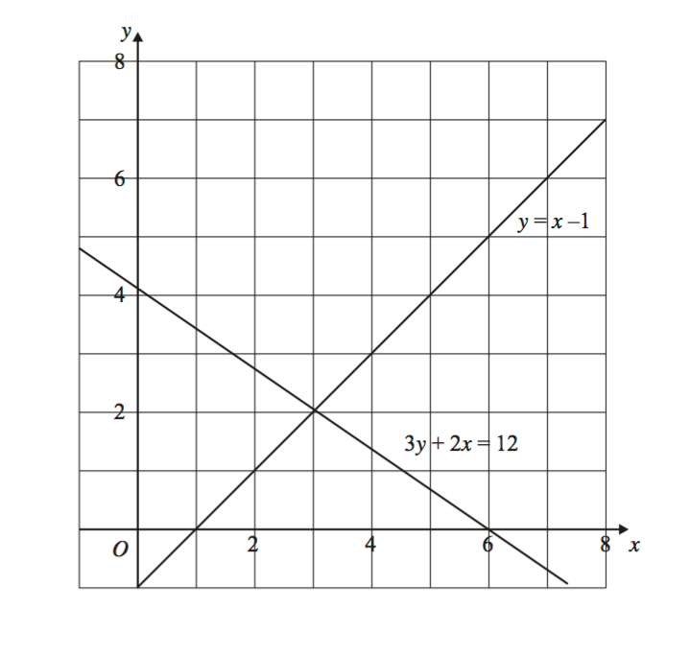

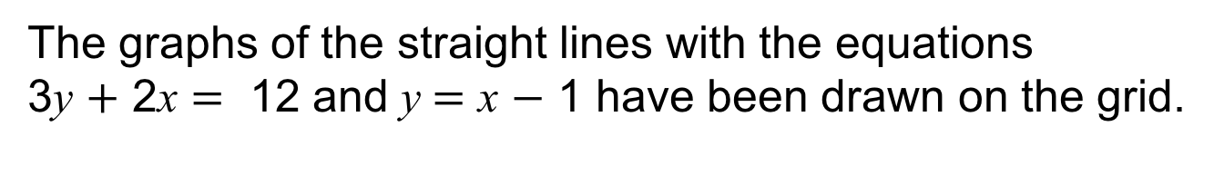
STRAND G
Unit G3
Section G3.1
Solutions of Simultaneous Equations by Graphs
The graphs of the straight lines with the equations
3y $+$ 2$\text{x}= \text{12 }$and y $=$ x $−$ 1 have been drawn on the grid.
Use the graph to solve the simultaneous equations.
$\text{x} = \text{3}$ y $=$ 2

Slide 12
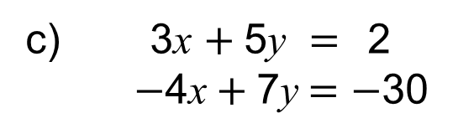
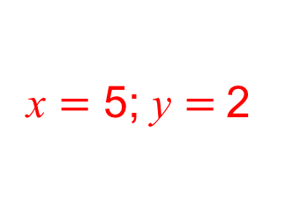
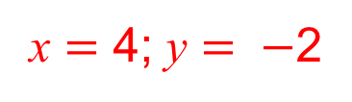
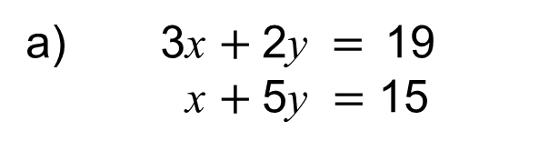
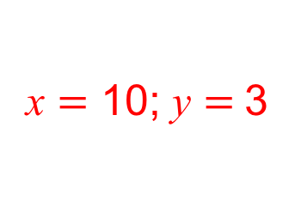
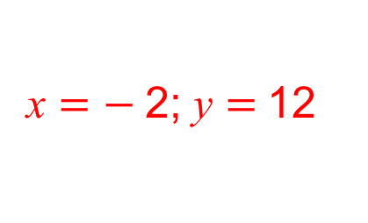
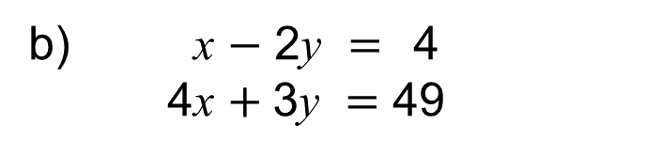
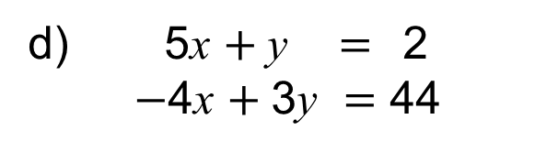
STRAND G
Unit G3
Section G3.1
Section G3.1: Fitness Check
Here are some questions to check your progress;
there are more practice questions if needed.
Use the graph method to solve each pair of simultaneous equations.
3x $+$2y $=$19
x $+$5y $=\text{15}$
x $=$ 5; y $=$2
b) x $−$ 2y $=$4
4x $+$3y $=\text{4}\text{9}$
x $=$ 10; y $=$3
c) 3x $+$5y $=$2
$−$4x$+$7y$=−$30
x $=$ 4; y $= −$2
d) 5x $+$y $=$2
$−$4x $+$3y $=\text{44}$
x $=$ $−$2; y $=$12

Slide 13
STRAND G
Unit G3
Section G3.1
Section G3.1: Review
You have completed the first Section.
If you have completed and understood this section,
click to start the next Section.
If you need more examples and interactive practice, go to
http://szalonta.hu/ske/text/G3/skeg3s1.html

Slide 14
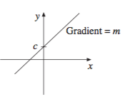
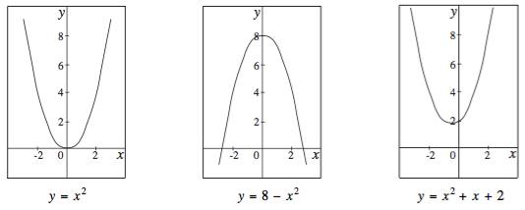
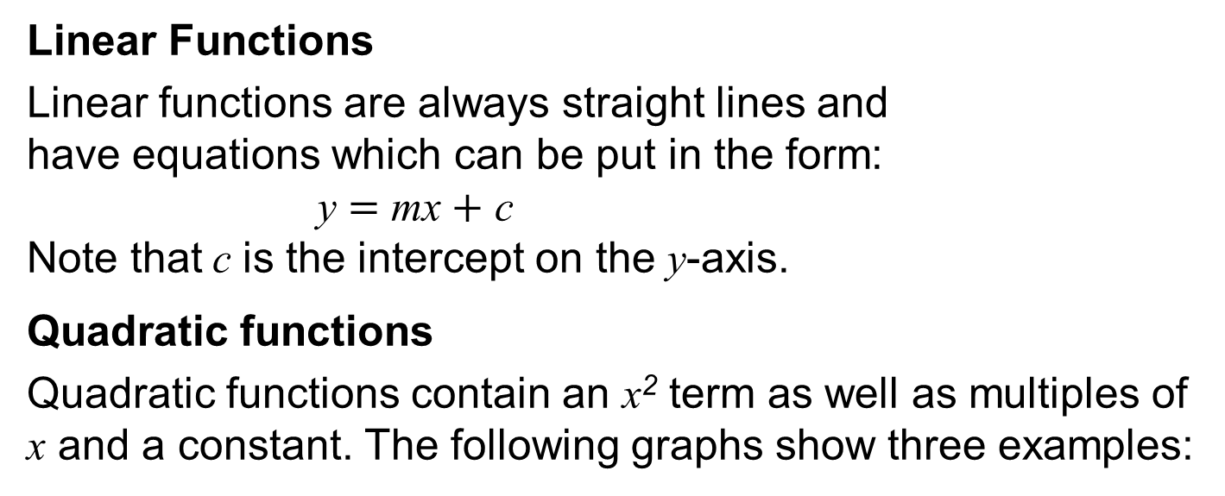
STRAND G
Unit G3
Section G3.2
Graphs of Common Functions
Linear Functions
Linear functions are always straight lines and
have equations which can be put in the form:
y $=$ mx $+$ c
Note that c is the intercept on the y-axis.
Quadratic functions
Quadratic functions contain an x² term as well as multiples of x and a constant. The following graphs show three examples:

Slide 15
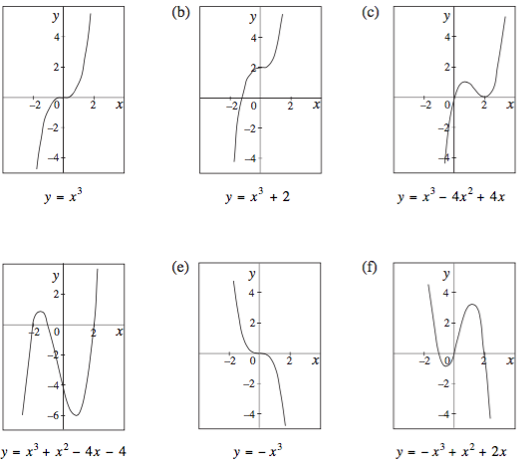
STRAND G
Unit G3
Section G3.2
Graphs of Common Functions
Cubic Functions
Cubic functions contain
an x³ term as well as
multiples of x², x and
a constant.
Some examples are
shown opposite:

Slide 16
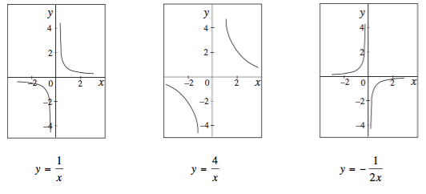
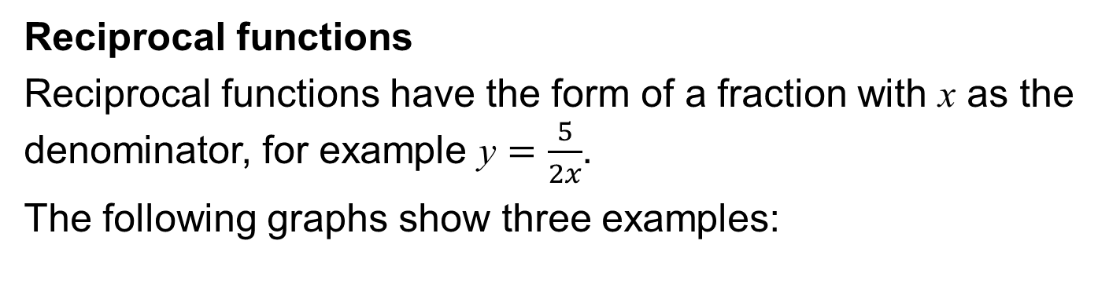
STRAND G
Unit G3
Section G3.2
Graphs of Common Functions
Reciprocal functions
Reciprocal functions have the form of a fraction with x as the denominator, for example y $=\frac{5}{2x}$.
The following graphs show three examples:

Slide 17
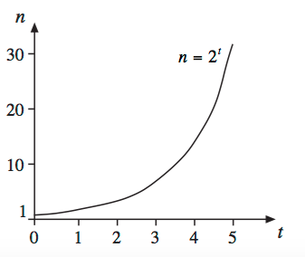
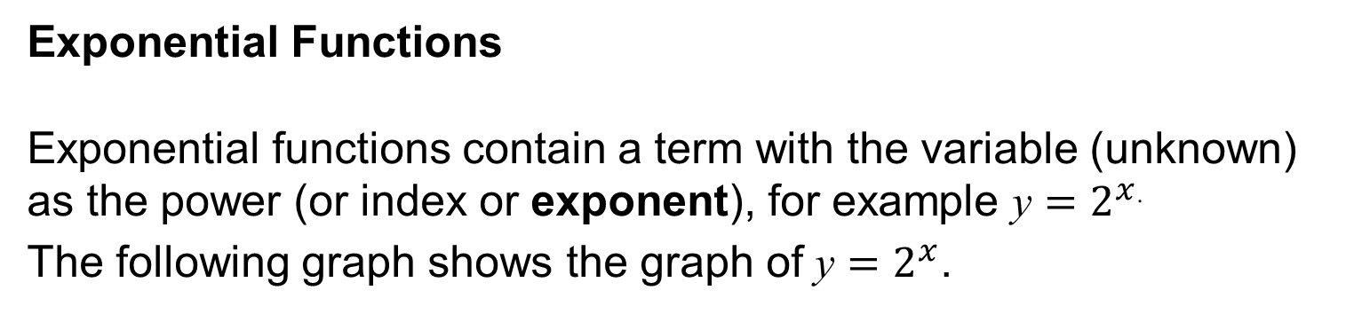

STRAND G
Unit G3
Section G3.2
Graphs of Common Functions
Exponential Functions
Exponential functions contain a term with the variable (unknown) as the power (or index or exponent), for example y $=2^{x}$.
The following graph shows the graph of y $=2^{x}$.
y
y $=2^{x}$
x

Slide 18
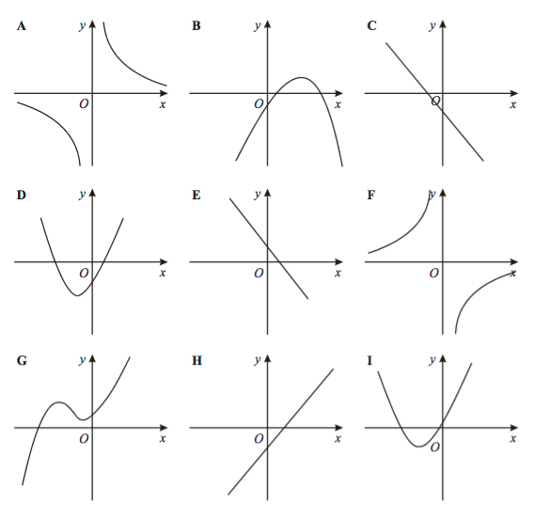

STRAND G
Unit G3
Section G3.2
Graphs of Common Functions
Example 1:
Write down the letter of the
graph which could have
the equation:
a) y $=$ 3x $−$2
b) y $=$ $\text{2}$x ² $+$ $\text{5}$x $−$3
c) y $=$ $\frac{\text{3} }{\text{x}}$
H
D
A

Slide 19
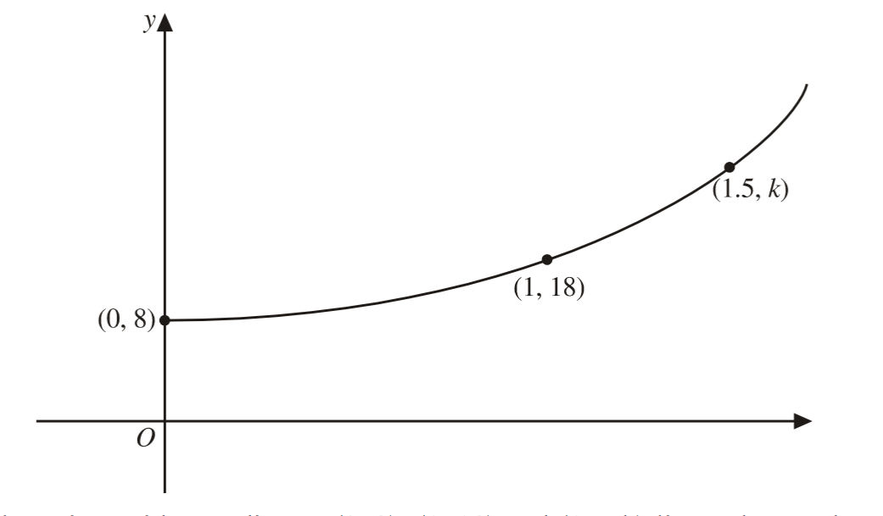
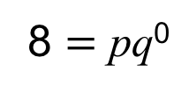



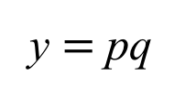
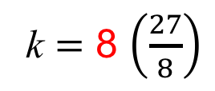

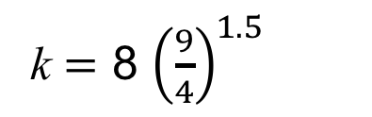
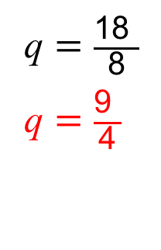
STRAND G
Unit G3
Section G3.2
Graphs of Common Functions
Example 2:
This sketch shows part of the
graph with equation y $=$ pq^{x}
where p and q are constants.
The points with coordinates
(0, 8), (1, 18) and (1.5, k)
lie on the graph.
Work out the values of p, q and k.
y $=$ pq^{x}
x
Solution:
Using (0, 8):
Using (1, 18) and p $=$ 8:
8 $=$ pq⁰
y $=$ pq
18 $=$ 8q¹
p = 8
q $=$ $\frac{\text{18} }{\text{8}}$
q $=$ $\frac{\text{9} }{\text{4}}$
k $=$ 8 ${\left(\frac{9}{4}\right)}^{1.5}$
Using (1.5, k):
k $=$ 8 $\left(\frac{27}{8}\right)$
k $=$ 27

Slide 20
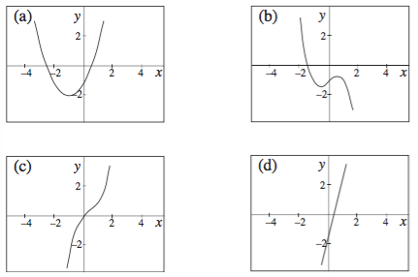
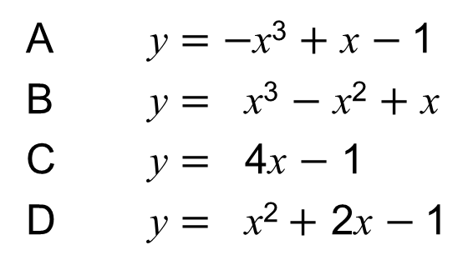
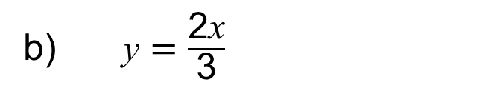
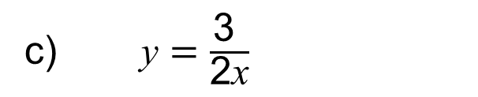
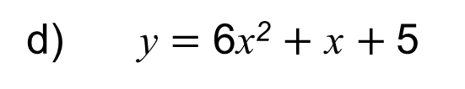
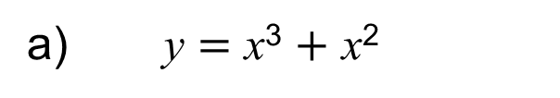
STRAND G
Unit G3
Section G3.2
Section G3.2: Fitness Check
Here are some questions to check your progress;
there are more practice questions if needed.
State whether each equation below would produce the graph
of a linear, quadratic, cubic, reciprocal or exponential function.
b) y $=$ $\frac{\text{2}\text{x}}{\text{3}}$
y $=$ x³ $+$ x²
cubic
linear
c) y $=$ $\frac{\text{3} }{\text{2}\text{x}}$
d) y $=$ 6x² $+$ x $+ \text{5}$
quadratic
reciprocal
2. Match each graph to the appropriate equation:
A y $=$ $−$x³ $+$ x $−$1
B y $=$ x³ $−$ x² $+$ x
C y $=$ 4x $−$ 1
D y $=$ x²$+$ $\text{2}$x $−$1
D
A
B
C

Slide 21
STRAND G
Unit G3
Section G3.2
Section G3.2: Review
You have completed the second Section.
If you have completed and understood this section,
click to start the next Section.
If you need more examples and interactive practice, go to
http://szalonta.hu/ske/text/G3/skeg3s2.html

Slide 22
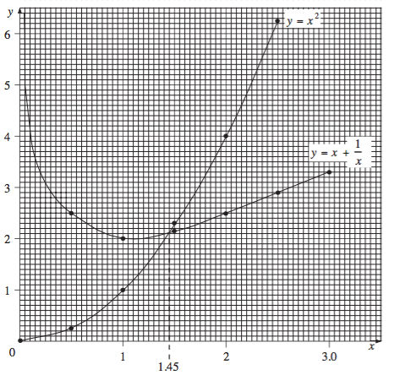


STRAND G
Unit G3
Section G3.3
Graphical Solutions of Equations
x² $=$ x$+$ $\frac{\text{1} }{\text{x}}$
How can we solve:
by a graphical method?
We can plot the graphs of:
y $=$ x²
and y $=$ x$+$ $\frac{\text{1 }}{\text{x}}$
(Try plotting these graphs
using the DESMOS software.)
The solution will be where the
graphs intersect (cross).
This is because the y values will be equal at this point, and so
x² $=$ x$+$ $\frac{\text{1 }}{\text{x}}$
The curves intersect at x $≈$ 1.45 and so this is the approximate solution to the equation.

Slide 23

STRAND G
Unit G3
Section G3.3
Graphical Solutions of Equations
Example:
How would you find the solution to:
2x$−$ x² $=$ x³ ?
Plot the graphs of:
y $=$ 2x$−$ x²
and y $=$ x³
(Try plotting these graphs using the DESMOS or other software.)
The solution will be where the graphs intersect (cross).
At this point the y values will be equal and so:
2x$−$ x² $=$ x³
The curves intersect at x $=$ 0, $−$2, 1 and so these are the
solutions to the equation.

Slide 24






STRAND G
Unit G3
Section G3.3
Section G3.3: Fitness Check
Here are some questions to check your progress;
there are more practice questions if needed.
Use graphs to find solutions to the following equations.
a) x² $=$ 5x $−$ 6
x $=$ 2 or x $=$ 3
b) 3^{x} $=$x $−$ 2
no solutions
c) x² $=\text{x}+\text{2}$
x $=$ 2 or x $=$ $−$1
d) $\frac{ \text{1} }{\text{x}} =$x² $−$ 2
about 1.6

Slide 25
STRAND G
Unit G3
Section G3.3
Section G3.3: Review
You have completed the third Section.
If you have completed and understood this section,
click to start the next Section.
If you need more examples and interactive practice, go to
http://szalonta.hu/ske/text/G3/skeg3s3.html

Slide 26

STRAND G
Unit G3
Section G3.4
Tangents to Curves
A tangent is a line that touches a curve at one point only, as shown here.
The gradient of the tangent gives the gradient of the curve at that point. A gradient of the curve gives the rate at which a quantity is changing.
For example, the gradient of a distance-time curve gives the rate of distance with respect to time, which actually gives us the velocity.

Slide 27

STRAND G
Unit G3
Section G3.4
Tangents to Curves
You may have seen tangents whilst working with circles.
BA and BC each touch the circle at just one point.

Slide 28


STRAND G
Unit G3
Section G3.4
Tangents to Curves
Example:
Draw the graph of y $=$x³ for $−$2 $≤$ x $≤$ 2. Draw tangents to the curve at x $= −$1 and x $=$1.
Find the gradients of these tangents.
Using the triangles shown under each tangent, we can see that the gradients of both tangents are 3.

Slide 29







STRAND G
Unit G3
Section G3.4
Section G3.4: Fitness Check
Here are some questions to check your progress;
there are more practice questions if needed.
1. Draw the graph of y $=$x² for 0 $≤$ x $≤$ 4
Try using DESMOS, to plot graph
By drawing tangents find the gradient of the curve at
x $=$0, x $=$1, x $=$2, x $=$3 and x $=$4
b) Comment on any patterns.
gradient $=$2x
2. This graph represents the cooling curve for a certain liquid.
Use the graph to estimate:
The temperature when
the time, t, is 12 secs
approximately 24ºC
b) The gradient of the curve when
the time, t, is 4 secs
Gradient $≈\frac{\text{0} − \text{60}}{\text{1}\text{2} − \text{0}}$ $= −$5ºC per sec

Slide 30
STRAND G
Unit G3
Section G3.4
Section G3.4: Review
You have completed the last Section.
If you need more examples and interactive practice, go to
http://szalonta.hu/ske/text/G3/skeg3s4.html

