Slide 1
TSST Strand H
UNIT H1: Angles and Symmetry

Slide 2
Strand H
Unit H1
Angles and Symmetry
This Unit introduces angles, their measurement and relationships
between angles on straight lines and in shapes.
You have five sections to work through and there are check up audits
and fitness tests for each section.
Measuring Angles
Line and Rotational Symmetry
Angle Geometry
Angles with Parallel and Intersecting Lines
5. Angle Symmetry in Regular Polygons

Slide 3
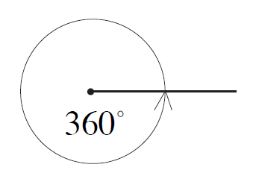
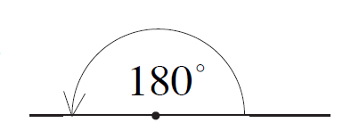
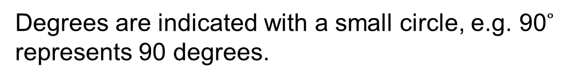
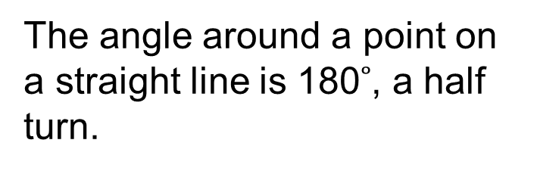
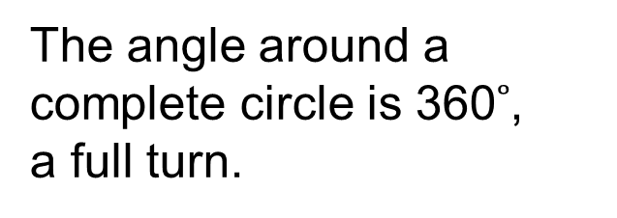
Strand H
Unit H1
Section H1.1
Measuring Angles
An angle is a measure of turn. Angles can be measured in degrees:
180 degrees is a half turn, 360 degrees a full turn and 90 degrees a quarter turn, known as a right angle.
Degrees are indicated with a small circle, e.g. 90$˚$ represents 90 degrees.
The angle around a
complete circle is 360$˚$,
a full turn.
The angle around a point on a straight line is 180$˚$, a half turn.
A protractor can be used to measure or draw angles.

Slide 4
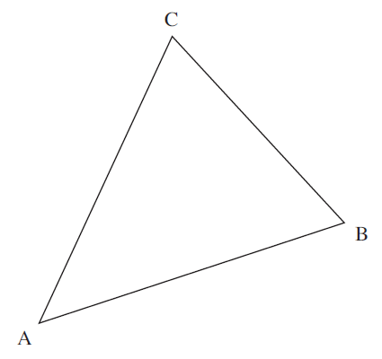
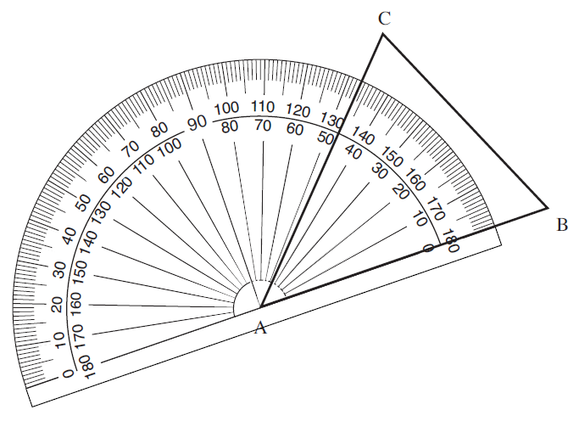
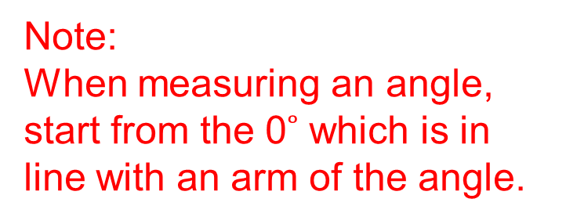
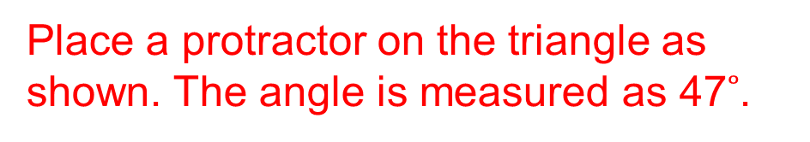
Strand H
Unit H1
Section H1.1
Measuring Angles: Examples
Example 1
Measure the angle CAB in the triangle shown.
Solution
Place a protractor on the triangle as shown. The angle is measured as 47$˚$.
Note:
When measuring an angle, start from the 0$˚$ which is in line with an arm of the angle.

Slide 5
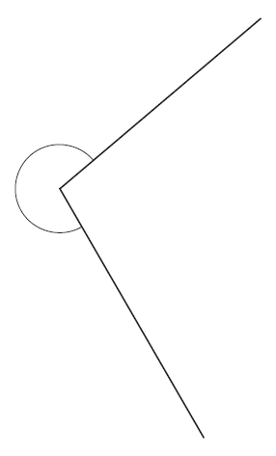
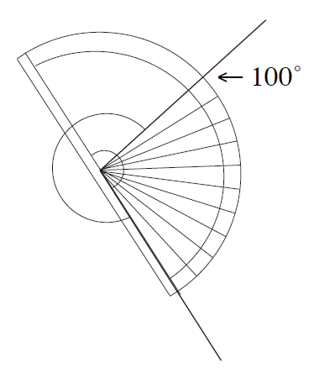
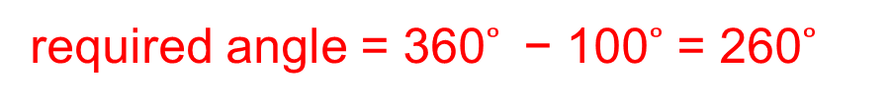
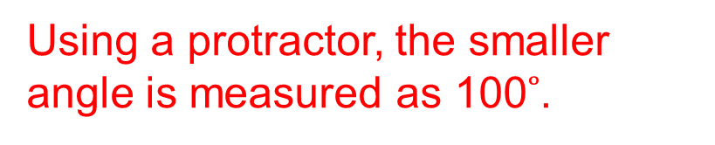
Strand H
Unit H1
Section H1.1
Measuring Angles: Examples
Example 2
Measure the marked angle.
Solution
Using a protractor, the smaller angle is measured as 100$˚$.
required angle = 360$˚$ − 100$˚$ = 260$˚$

Slide 6
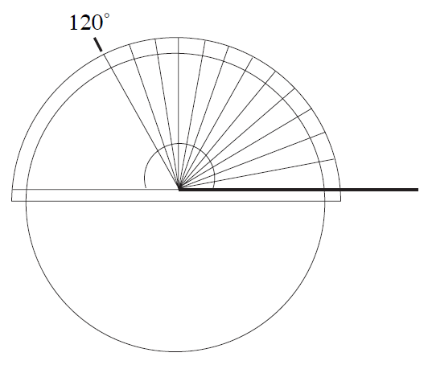
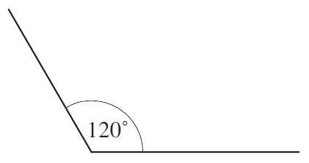
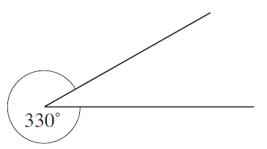
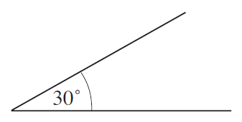
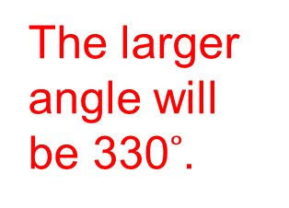
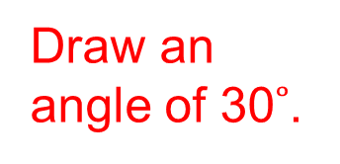


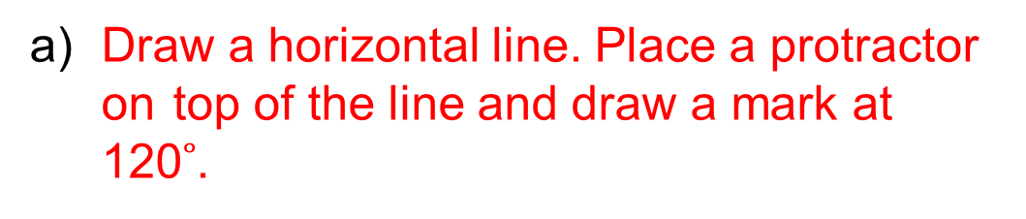
Strand H
Unit H1
Section H1.1
Measuring Angles: Examples
Example 3
Draw angles of a) 120$˚$ b) 330$˚$
Solution
a) Draw a horizontal line. Place a protractor on top of the line and draw a mark at 120$˚$.
Then remove the protractor and draw the angle.
b) To draw the angle of 330$˚$, first subtract 330$˚$ from 360$˚$ :
required angle = 360$˚$ − 330$˚$ = 30$˚$
The larger angle will be 330$˚$.
Draw an angle of 30$˚$.

Slide 7
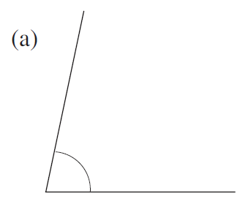
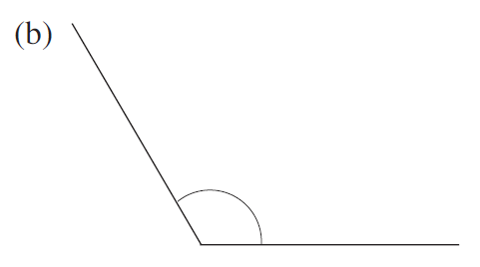
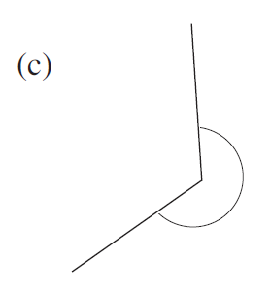
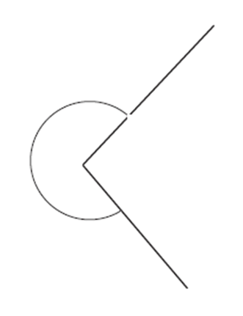
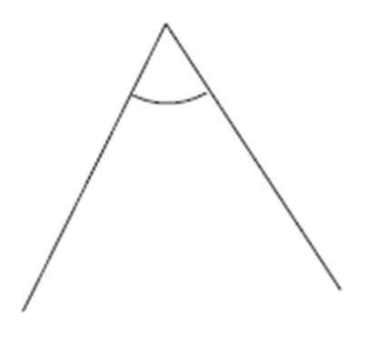
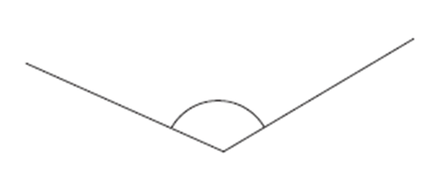
Section H1.1: Fitness Check
Strand H
Unit H1
Section H1.1
Here are some questions to check your progress; there are more practice questions if needed.
1. Estimate the size of each angle, then measure it with a protractor.
Draw angles of a) 125$˚$ b) 60$˚$ c) 264$˚$
Answers
1. a) 78$˚$ b) 120$˚$ c) 240$˚$
2. a) b) c)

Slide 8
STRAND H
Unit H1
Section H1.1
Section H1.1: Review
You have completed the first Section.
If you have completed and understood this section,
click to start the next Section.
If you need more examples and interactive practice, go to
http://szalonta.hu/ske/text/H1/skeh1s1.html

Slide 9


STRAND H
Unit H1
Section H1.2
Rotational Symmetry
An object has rotational symmetry if it can be rotated about a point so that it fits on top of itself without completing a full turn. The shapes below have rotational symmetry.
In a complete turn this shape fits on top of itself two times.
It has rotational symmetry of order 2.
In a complete turn this shape fits on top of itself four times.
It has rotational symmetry of order 4.

Slide 10
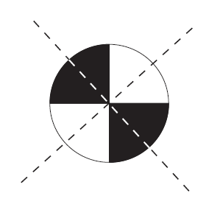
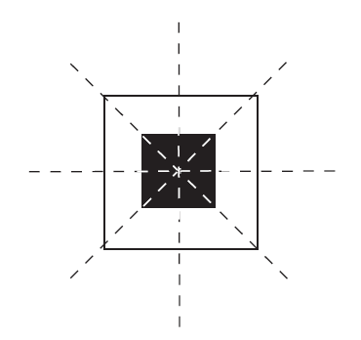
STRAND H
Unit H1
Section H1.2
Line Symmetry and Reflection
Shapes have line symmetry if a mirror could be placed so that one side is an exact reflection of the other. These imaginary 'mirror lines' are shown by dotted lines in the diagrams below.
This shape has 2 lines of symmetry.
This shape has 4 lines of symmetry.

Slide 11
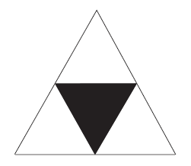
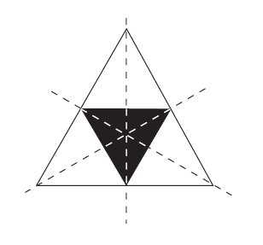
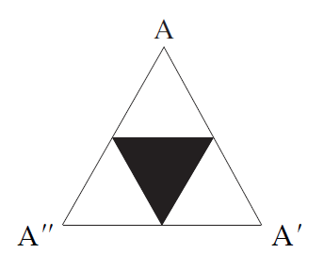
STRAND H
Unit H1
Section H1.2
Line and Rotational Symmetry: Example
Example 1
For the given shape, state:
a) the number of lines of symmetry,
b) the order of rotational symmetry.
Solution
a) There are 3 lines of symmetry, as shown.
b) There is rotational symmetry with order 3
because the point marked A could be rotated
to A' then to A'' and fit exactly over its original
shape at each of these points.

Slide 12
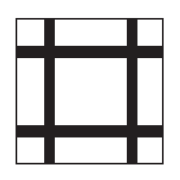
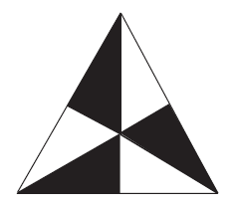

STRAND H
Unit H1
Section H1.2
Section H1.2: Fitness Check
Here are some questions to check your progress; there are more practice questions if needed.
Which of the shapes below have
line symmetry b) rotational symmetry?
For line symmetry, copy the shape and draw in the mirror lines.
For rotational symmetry state the order.
A B C
Answers
A - 4 lines, B - no lines, G - 2 lines
A - order 4, B - order 3, G - order 2

Slide 13
STRAND H
Unit H1
Section H1.2
Section H1.2: Review
You have completed the second Section.
If you have completed and understood this section,
click to start the next Section.
If you need more examples and interactive practice, go to
http://szalonta.hu/ske/text/H1/skeh1s2.html

Slide 14
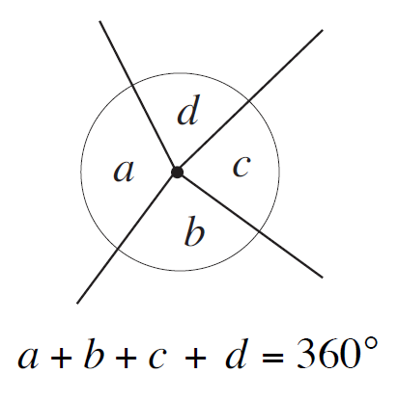
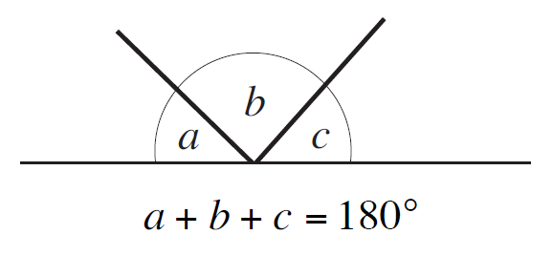
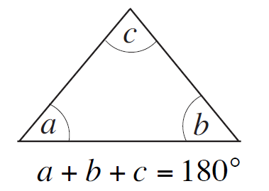
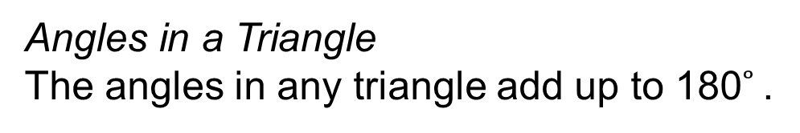
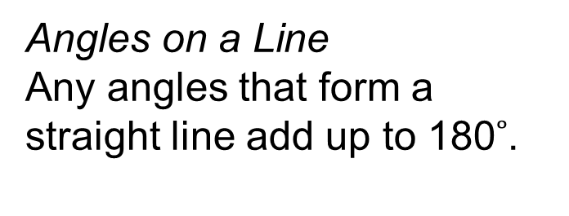
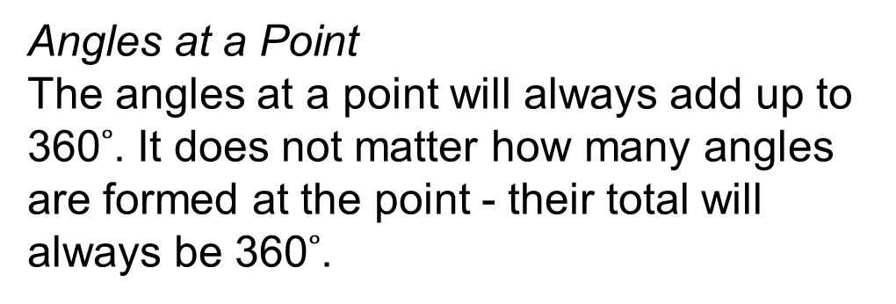
STRAND H
Unit H1
Section H1.3
Angle Geometry
There are a number of important results concerning angles in different shapes, at a point and on a line. In this section the results from the following two slides will be used.
Angles at a Point
The angles at a point will always add up to 360$˚$. It does not matter how many angles are formed at the point - their total will always be 360$˚$.
Angles on a Line
Any angles that form a straight line add up to 180$˚$.
Angles in a Triangle
The angles in any triangle add up to 180$˚$.

Slide 15
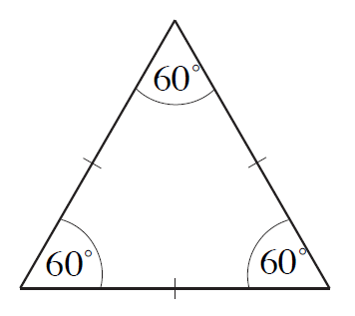
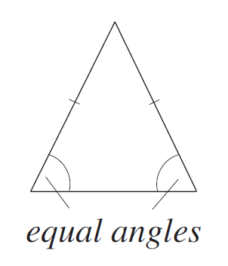
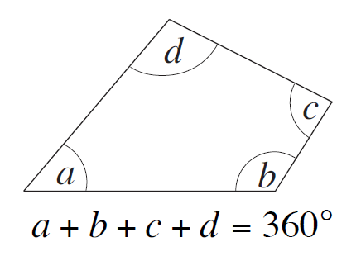
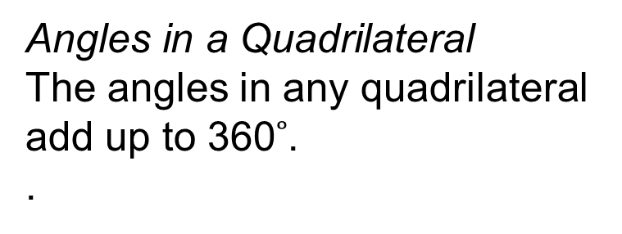
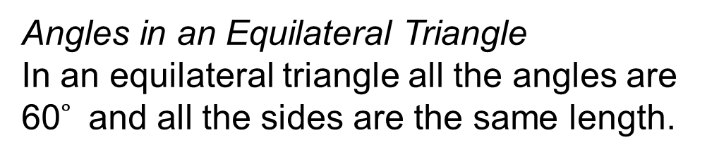
STRAND H
Unit H1
Section H1.3
Angle Geometry
Angles in an Equilateral Triangle
In an equilateral triangle all the angles are 60$˚$ and all the sides are the same length.
Note that the tick marks mean lines of equal length
Angles in an Isosceles Triangle
In an isosceles triangle two sides are the same length
and two angles are the same size.
Angles in a Quadrilateral
The angles in any quadrilateral add up to 360$˚$.
.

Slide 16
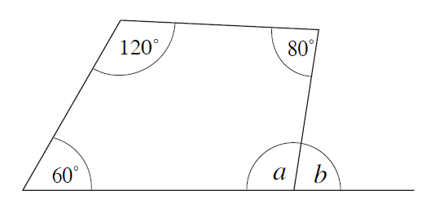

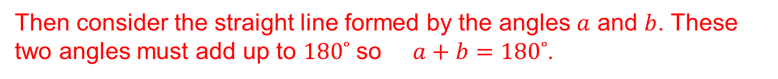


STRAND H
Unit H1
Section H1.3
Angle Geometry: Examples
Example 1
Find the sizes of angles 𝑎 and 𝑏 in the diagram on the right.
Solution
First consider the quadrilateral. All the angles of this shape must add up to $360˚$, so
$60˚+120˚+80˚+a=360˚$ which solves to give $a=100˚$
Then consider the straight line formed by the angles $a$ and $b$. These two angles must add up to $180˚$ so $a+b=180˚$.
but $a=100˚$ so
$100˚+b=180˚$ which gives $b=80˚.$

Slide 17
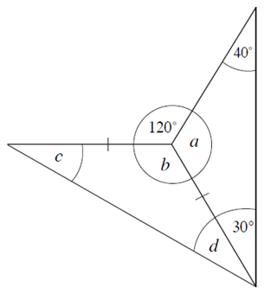
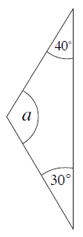
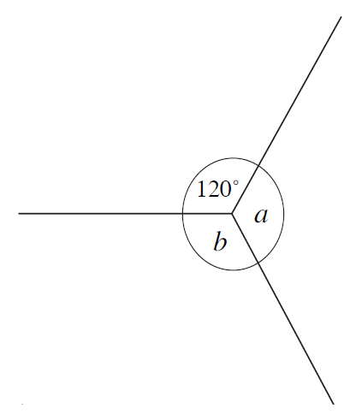
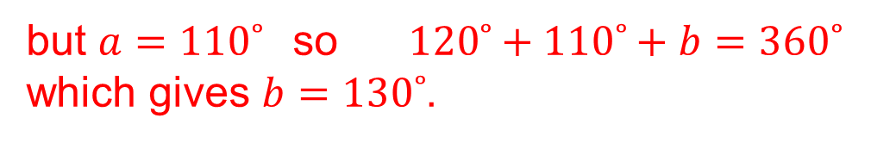


STRAND H
Unit H1
Section H1.3
Angle Geometry: Examples
Example 2
Find the angles 𝑎, $b$, $c$ and $d$ in the diagram.
Solution
First consider the triangle shown.
The angles of this triangle must add up to $180˚$, so,
$40˚+30˚+a=180˚$
$a=110˚$
Next consider the angles round the point shown. The three angles must add up to $360˚$ , so,
$$120˚+b+a=360˚$$
but $a=110˚$ so $120˚+110˚+b=360˚$
which gives $b=130˚$.
Solution continued on next slide

Slide 18



STRAND H
Unit H1
Section H1.3
Angle Geometry: Examples
Solution (continued)
Finally, consider the second triangle.
The angles of this triangle must add up to $180˚$, so,
$c+b+d=180˚$
As this is an isosceles triangle the two angles, $c$ and $d$, must be equal,
so using $c=d$ and the fact that $b=130˚$, gives
$$c+130˚+c=180˚$$
solving this equation gives $c=25˚$ and it follows that $d=25˚.$

Slide 19




STRAND H
Unit H1
Section H1.3
Angle Geometry: Examples
Example 3
In the figure, not drawn to scale, ABC is an isosceles triangle with
∠CAB = $p˚$ and ∠ABC $=(p+3)˚$.
a) Write an expression in terms of $p$ for the value of the angle at C.
b) Determine the size of EACH angle in the triangle.
Solution
a) As ABC is an isosceles triangle,
∠ACB $=p+3˚$
b) For triangle ABC, $p+\left(p+3\right)+(p+3)=180˚$
$3p+6=180˚$
which gives $p=58˚$, and so it follows that the angles at A, B and C are $58˚$, $61˚$ and $61˚$, respectively.

Slide 20




STRAND H
Unit H1
Section H1.3
Section H1.3: Fitness Check
Here are some questions to check your progress; there are more practice questions if needed.
1. Find the size of the angles marked with a letter in each diagram.
i) ii)
iii) iv)
Answers
i) $a=50˚$ ii) $a=45˚$ iii) $x=82˚$ vi) $a=50˚$, $b=80˚$

Slide 21





STRAND H
Unit H1
Section H1.3
Section H1.3: Fitness Check
Here are some questions to check your progress; there are more practice questions if needed.
2. Find the size of the angles marked with a letter in each diagram.
i) ii)
Answers
i) $x=114˚$
ii) $b=106˚$
iii) $a=80˚$
$b=45˚$
$c=45˚$
$d=55˚$
$e=80˚$
iv) $a=65˚$
$b=65˚$
$c=58˚$
$d=90˚$
$e=35˚$
iii) iv)

Slide 22
STRAND H
Unit H1
Section H1.3
Section H1.3: Review
You have completed the third Section.
If you have completed and understood this section,
click to start the next Section.
If you need more examples and interactive practice, go to
http://szalonta.hu/ske/text/H1/skeh1s3.html

Slide 23







STRAND H
Unit H1
Section H1.4
Angles with Parallel and Intersecting Lines
Opposite Angles
When any two lines intersect, two pairs of equal angles are formed.
The two angles marked $a$ are a pair of opposite equal angles.
The angles marked $b$ are also a pair of opposite equal angles.
Corresponding Angles
When a line intersects a pair of parallel lines, angle $a=\text{angle} b;$the angles $a$ and $b$ are called corresponding angles.
Alternate Angles
The angles $c$ and $d$ are equal.
Supplementary Angles
The angles 𝑏 and $c$ add up to $180˚.$

Slide 24






STRAND H
Unit H1
Section H1.4
Angles with Parallel and Intersecting Lines: Examples
Example 1
Find the sizes of angles 𝑎 and 𝑏 and $c$ in the diagram on the right.
Solution
There are two pairs of opposite angles here so:
$b=100˚$ and $a=c .$
Also $a$ and $b$ form a straight line so
$a+b=180˚$
$a+100˚=180˚$
so $a=80˚$ then
$c=80˚.$

Slide 25




STRAND H
Unit H1
Section H1.4
Angles with Parallel and Intersecting Lines: Examples
Example 2
Find the sizes of angles 𝑎 and 𝑏, $c$ and$d$ in the diagram on the right.
Solution
The angle $a$ and the angle marked $70˚$ are opposite angles, so $a=70˚$.
The angles $a$ and $b$ are alternate angles so $a=b=$ $70˚$.
The angles $b$ and $c$ are opposite angles so $b=c=$ $70˚$.
The angles $a$ and $d$ are a pair of interior angles, so $a+d=180˚$, but $a=$ $70˚$ so $70˚+d=180˚$
$d=180˚−70˚$
$d=110˚$

Slide 26




STRAND H
Unit H1
Section H1.4
Angles with Parallel and Intersecting Lines: Examples
Example 3
Find the angles 𝑎 and 𝑏, $c$ and$d$ in the diagram.
Solution
To find the angle $a$, consider the three angles that form a straight line. So
$60+a+70=180˚$
$a=50˚$
The angle marked $b$ is opposite the angle $a$, so $b=a=50˚$.
Now $c$ and $d$ can be found using corresponding angles.
The angle $c$ and the $70˚$ angle are corresponding angles, so $c=70˚$.
The angle $d$ and the $60˚$ angle are corresponding angles, so $d=60˚.$

Slide 27



STRAND H
Unit H1
Section H1.4
Angles with Parallel and Intersecting Lines: Examples
Example 4
In the diagram on the right, not drawn to scale, AB is parallel to CD and EG is parallel to FH,
angle IJL $=50˚$ and angle KIJ $=95˚$
Calculate the values of $x$, $y$ and $z$, showing clearly the steps in your calculations.
Solution
Value of $x$:
Angles BIG and END are supplementary angles, so
$95+END=180˚$
$END=$ $85˚$
But angles END and FMD are corresponding angles, so $x=85˚$
Solution continued on next slide

Slide 28




STRAND H
Unit H1
Section H1.4
Angles with Parallel and Intersecting Lines: Examples
Solution (continued)
Value of $y$:
Angles BCD ($y$) and ABC are alternate angles, so $y=$ ABC
In triangle BIJ $y+95+50=180˚$ $y=$ $35˚$
Value of $z$:
Angles AKH ($z$) and FMD ($x$) are alternate angles,
so $z=x$
i.e. $z=85˚$

Slide 29






STRAND H
Unit H1
Section H1.4
Section H1.4: Fitness Check
Here are some questions to check your progress; there are more practice questions if needed.
1. Find the angles marked in each diagram, giving reasons for your answers.
i) ii) iii)
Solutions
i) $a=$ 60$˚$, straight line;
$b$ $=$ 120$˚,$ opposite angles; $c=$ 60$˚,$ opposite angles.
ii) $a=$ 60$˚$, straight line; $b$ $=$ 60$˚,$ corresponding angles;
$c=$ 120$˚$, straight line.
iii) $a=$ 160$˚$, straight line; $b$ $=$ 160$˚$, corresponding angles;
$c=$ 20$˚$, alternate angles.

Slide 30







STRAND H
Unit H1
Section H1.4
Section H1.4: Fitness Check
2. Find the size of the angles marked with a letter in each diagram.
i) ii)
Solutions
i) $a=70˚$ $b=140˚$ ii) $a=48˚$ $b=48˚$ $c=132˚$ $d=138˚$ $e=42˚$ $f=48˚$
3. By considering each diagram, write down an equation and find the value of $x$.
i) ii)
Solutions
i) $4x=180˚$
$x=45˚$
ii) $8x=180˚$
$x=22.5˚$

Slide 31
STRAND H
Unit H1
Section H1.4
Section H1.4: Review
You have completed the fourth Section.
If you have completed and understood this section,
click to start the next Section.
If you need more examples and interactive practice, go to
http://szalonta.hu/ske/text/H1/skeh1s4.html

Slide 32




STRAND H
Unit H1
Section H1.5
Angle Symmetry in Regular Polygons
Regular polygons have sides which are all equal in length; all interior angles are equal too. Regular polygons will have both line and rotational symmetry.
This symmetry can be used to find the interior angles of a regular polygon.
Example 1
Find the interior angle of a regular dodecagon (12 sides).
Solution
The diagram shows how a regular dodecagon can be split into 12 isosceles triangles.
As there are $360˚$ around the centre of the dodecagon, the centre angle in each triangle is
$$\frac{360˚ }{12}=30˚$$
Continued on next slide

Slide 33





Angle Symmetry in Regular Polygons: Examples
STRAND H
Unit H1
Section H1.5
Example 1 (continued)
Next we will find the angle indicated on the diagram on the right. The other angles of
each triangle will together add up to
$$180˚−30˚=150˚$$
Therefore the angle on the diagram is
$$\frac{150}{2}=75˚$$
As two adjacent angles are required to form each interior angle of the dodecagon, each interior angle will be
$$75˚×2=150˚$$
As there are 12 interior angles, the sum of these angles will be
$12×150˚=1800˚$.

Slide 34




Angle Symmetry in Regular Polygons: Examples
STRAND H
Unit H1
Section H1.5
Example 2
Find the sum of the interior angles of a regular heptagon.
Solution
Split the heptagon into 7 isosceles triangles.
Each triangle contains three angles which add up to $180˚$, so the total of all the marked angles will be
$$7×180˚=1260˚$$
However the angles at the point where all the triangles meet should not be included, so the sum of the interior angles is given by
$$1260˚−360˚=900˚$$

Slide 35




STRAND H
Unit H1
Section H1.5
Angle Symmetry in Regular Polygons: Examples
Example 3
a) Copy the octagon shown in the diagram and draw in any lines of symmetry.
b) Copy the octagon and shade in extra triangles so that it now has rotational symmetry.
Solutions
a) There is only one line of symmetry.
b) The original octagon has no rotational symmetry.
After shading the extra triangle shown, it has rotational symmetry of order 4.
After shading all the triangles, it has rotational symmetry of order 8.

Slide 36


STRAND H
Unit H1
Section H1.5
Section H1.5: Fitness Check
Here are some questions to check your progress; there are more practice questions if needed.
1. Find the interior angle for a regular:
a) pentagon b) hexagon c) octagon d) decagon (10 sides).
2. Find the sum of the interior angles in each polygon shown below.
i) ii)
3. Which regular polygons have interior angles of: a)$90°$ b) $120°$c) 108°
Answers
a) $108°$ b) $120°$ c) $135°$ d) $144°$
2. i) $1260°$ ii) $1620°$
3. a) Square b) Hexagon c) Pentagon

Slide 37
STRAND H
Unit H1
Section H1.5
Section H1.5: Review
You have completed the last Section.
If you need more examples and interactive practice, go to
http://szalonta.hu/ske/text/H1/skeh1s5.html

