Slide 1
TSST Strand H
UNIT H2: Angles, Circles and Tangents

Slide 2
Strand H
Unit H2
Angles, Circles and Tangents
This Unit describes relationships between angles and lengths formed
in and around circles and lines, each one is described as a result;
ten results are given. Proofs are provided for some of the results.
You have four sections to work through; Results 1- 4 are given in Section 2, Results 5-7 in Section 3 and Results 8-10 in Section 4.
There are check up audits and fitness tests for each section.
Bearings
Angles and Circles 1
Angles and Circles 2
Circles and Tangents

Slide 3
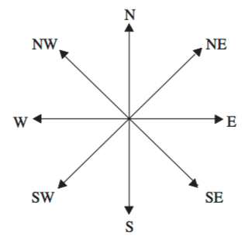
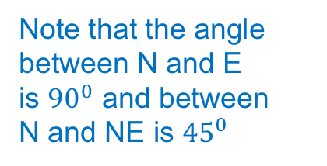
Strand H
Unit H2
Section H2.1
Bearings
A compass bearing tells us direction.
The 4 main directions are North, South, East and West.
We can remember the order (starting from north, and going clockwise)
as ‘Never Eat Shredded Wheat’:
N
NW
NE
Note that the angle between N and E is ${90}^{0}$ and between N and NE is ${45}^{0}$
W
E
SW
SE
S
Notice that the bearings in between start with either North or South:
North-East, South-East, South-West, North-West.

Slide 4
Strand H
Unit H2
Section H2.1
Bearings
In between these bearings we have:
North-North-East (NNE)*
East-North-East (ENE)
East-South-East (ESE)
South-South-East (SSE)
South-South-West (SSW)
West-South-West (WSW)
West-North-West (WNW)
North-North-West (NNW)
Notice the bearings in between start with:
North, East, South or West:
NNE, ENE, ESE, SSE, SSW, WSW, WNW, NNW
NNW
NNE
WNW
ENE
WSW
ESE
SSW
SSE
* NNE can be read as North of North-East

Slide 5
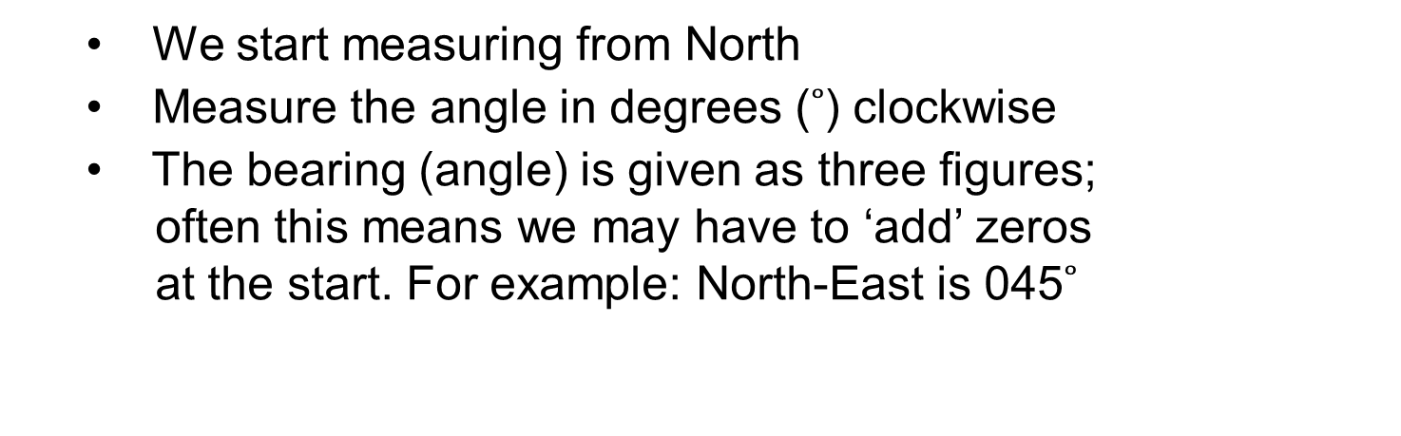
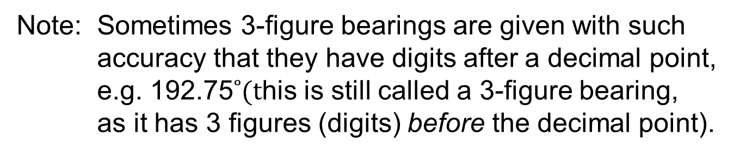
Strand H
Unit H2
Section H2.1
Bearings
Three figure bearings can also be used as an
alternative to compass bearings.
They are measured in a particular way:
  We start measuring from North
  Measure the angle in degrees ($˚$) clockwise
  The bearing (angle) is given as three figures;
  often this means we may have to ‘add’ zeros
  at the start. For example: North-East is 045$˚$
The advantage of 3-figure bearings is that they
can describe direction uniquely.
Note: Sometimes 3-figure bearings are given with such
accuracy that they have digits after a decimal point,
e.g. 192.75$˚(t$his is still called a 3-figure bearing,
as it has 3 figures (digits) before the decimal point).

Slide 6
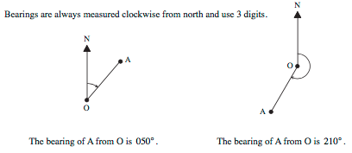
Strand H
Unit H2
Section H2.1
Bearings
Examples of 3-figure bearings:
Bearings can be especially useful in navigation, be it at sea or for people walking in the wild, on open moorland or hills.

Slide 7
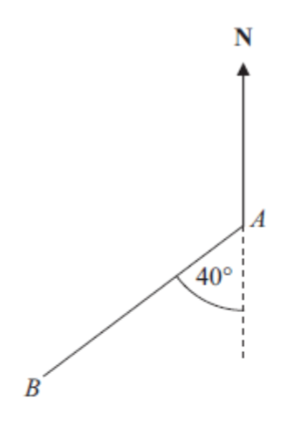

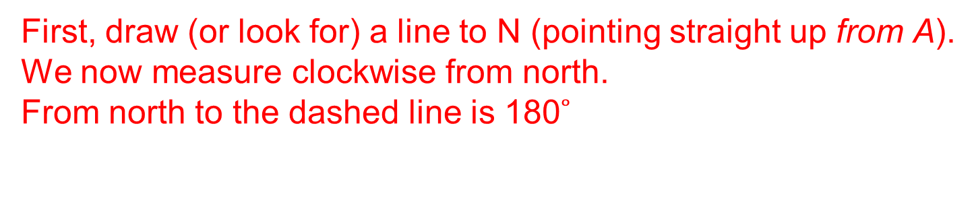
Strand H
Unit H2
Section H2.1
Bearings
Example 1:
Work out the bearing of B from A.
Top tip: Always look for the word:
‘from’. It is from this point
your draw the arrow to N
Solution
First, draw (or look for) a line to N (pointing straight up from A).
We now measure clockwise from north.
  From north to the dashed line is 180$˚$
(angles on a straight line).
  We now simply add on the extra 40$˚.$
  Answer: Bearing of B from A is: 180$˚+\text{40}˚=$ 220$˚$

Slide 8
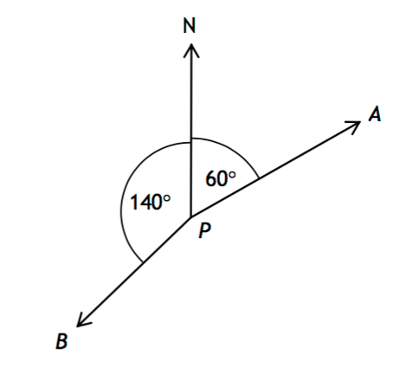
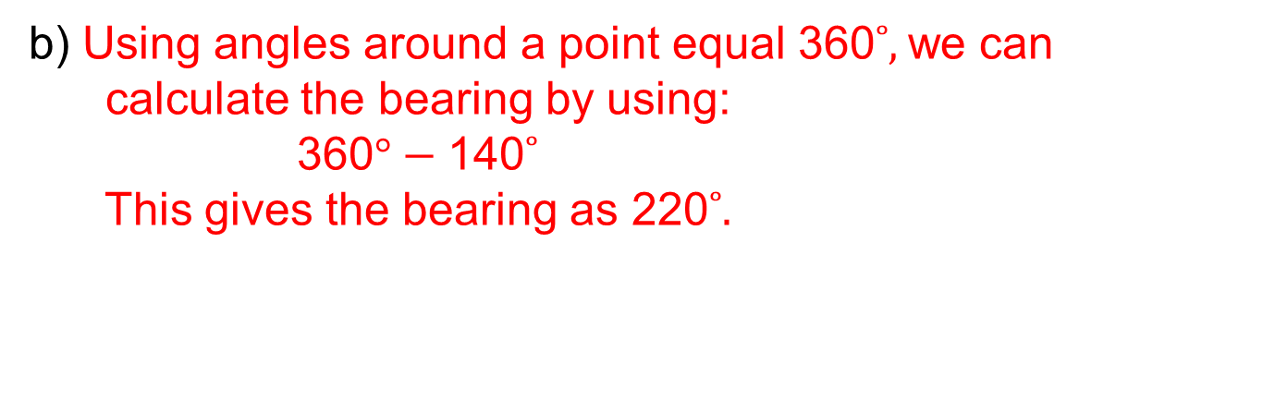
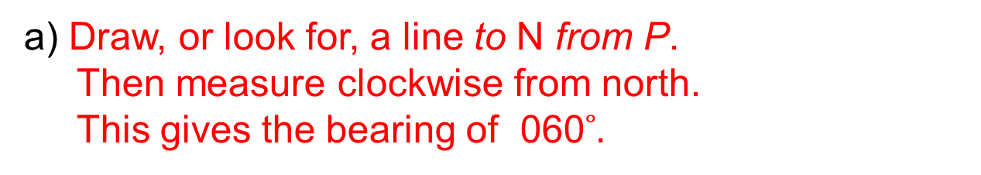
Strand H
Unit H2
Section H2.1
Bearings
Example 2:
Write down the bearing of A from P.
b) Work out the bearing of B from P.
  a) Draw, or look for, a line to N from P.
  Then measure clockwise from north.
  This gives the bearing of 060$˚.$
  b) Using angles around a point equal 360$˚,$we can
  calculate the bearing by using:
  360$°−\text{140}˚$
  This gives the bearing as 220$˚.$

Slide 9

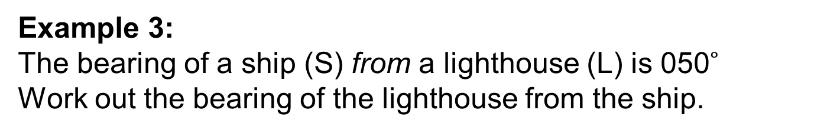

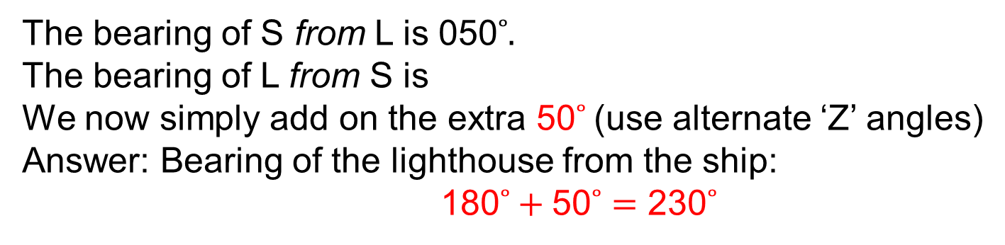

Strand H
Unit H2
Section H2.1
Bearings
Example 3:
The bearing of a ship (S) from a lighthouse (L) is 050$˚$
Work out the bearing of the lighthouse from the ship.
N
N
S
50$°$
50$°$
Solution
L
The bearing of S from L is 050$˚.$
The bearing of L from S is
We now simply add on the extra 50$˚$(use alternate ‘Z’ angles)
  Answer: Bearing of the lighthouse from the ship:
  180$˚+\text{5}\text{0}˚=$ 230$˚$
180$˚$plus …

Slide 10
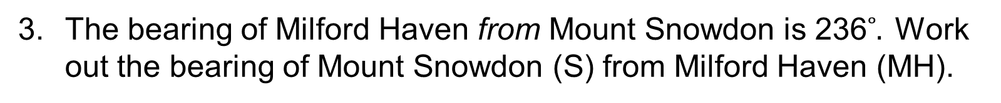

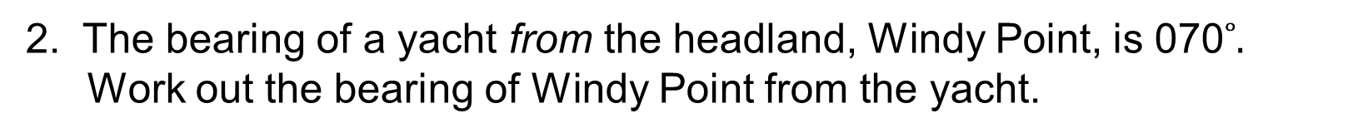


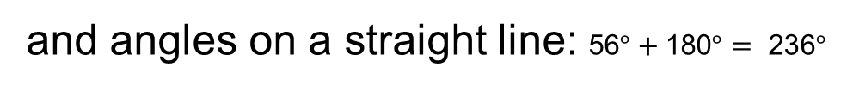




Strand H
Unit H2
Section H2.1
Section H2.1: Fitness Check
Here are some questions to check your progress;
there are more practice questions if needed.
1. What 3-figure bearing is equivalent to the compass bearings:
NE
  $$\text{04}\text{5}˚$$
NW
  $$\text{31}\text{5}˚$$
ESE ?
  $$\text{1}\text{1}\text{2}\text{.}\text{5}˚$$
2. The bearing of a yacht from the headland, Windy Point, is 070$˚.$
Work out the bearing of Windy Point from the yacht.
Answer:
  $$\text{180}˚+\text{70}˚=\text{ 2}\text{5}\text{0}˚$$
The bearing of Milford Haven from Mount Snowdon is 236$˚.$ Work out the bearing of Mount Snowdon (S) from Milford Haven (MH).
Tips: Use corresponding angles
N
  and angles on a straight line: $\text{56}°+\text{180}°= \text{23}\text{6}°$
N
  56$°$
Answer:
  $$\text{236}˚−\text{180}˚= \text{5}\text{6}˚$$
  56$°$
S
MH
$$\text{180}°$$

Slide 11
STRAND H
Unit H2
Section H2.1
Section H2.1: Review
You have completed the first Section.
If you have completed and understood this section,
click to start the next Section.
If you need more examples and interactive practice, go to
http://szalonta.hu/ske/text/H2/skeh2s1.html

Slide 12
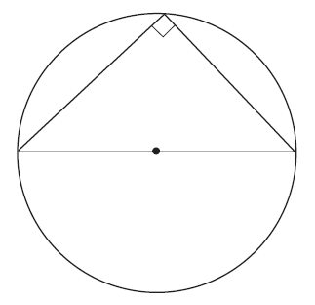
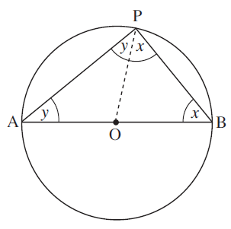
Strand H
Unit H2
Section H2.2
Angles and Circles 1
The following result is true in any circle.
Result 1
When a triangle is drawn in a semi-circle
as shown, the angle on the circumference
is always a right angle.
O
Proof
Join the centre, O, to the point, P, on the perimeter.
Notice now that the lines OA, OP and OB are all equal, as each is a radius of the circle.

Slide 13
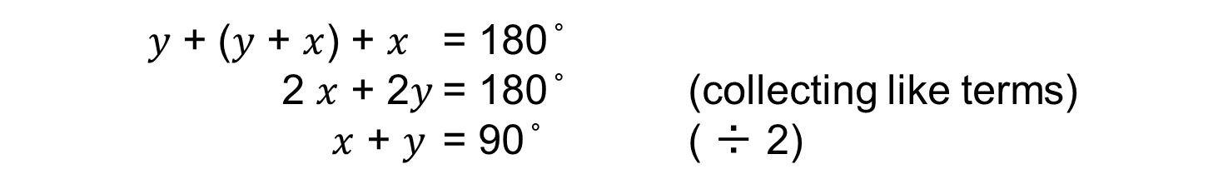
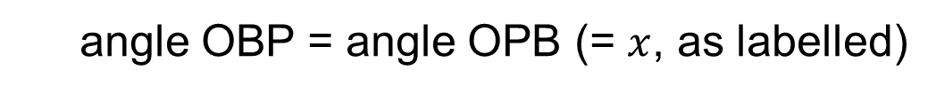
Angles and Circles 1
Strand H
Unit H2
Section H2.2
Proof (continued)
Since OB = OP (equal radii) then
angle OBP = angle OPB (= $x$, as labelled)
because triangle OBP is isosceles.
Similarly, triangle AOP is also isosceles, so
angle OAP = angle APO (= 𝑦, say)
In triangle ABP, the sum of the angles must be 180 ̊ , so
𝑦 + (𝑦 + $x$) + $x$ = 180 ̊
2 $x$ + 2𝑦 = 180 ̊ (collecting like terms)
$x$ + 𝑦 = 90 ̊ ( ÷ 2)
But angle APB = $x$ + 𝑦, so this is a right angle, as the result states.

Slide 14
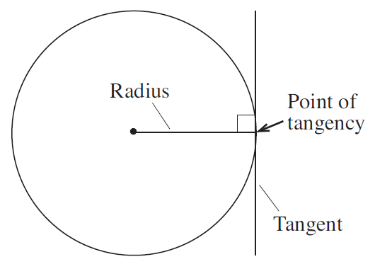
Strand H
Unit H2
Section H2.2
Angles and Circles 1
A tangent is a line that touches
only one point on the circumference
of a circle.
This point is known as the
point of tangency.
O
Result 2
A tangent is always perpendicular to the radius of the circle.

Slide 15
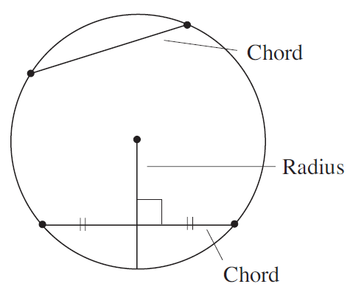
Strand H
Unit H2
Section H2.2
Angles and Circles 1
A chord is a line joining any two points on the circle.
The perpendicular bisector is a second line that divides the chord in half and is at right angles to it.
O
Result 3
The perpendicular bisector of a chord always passes through the centre of the circle.

Slide 16
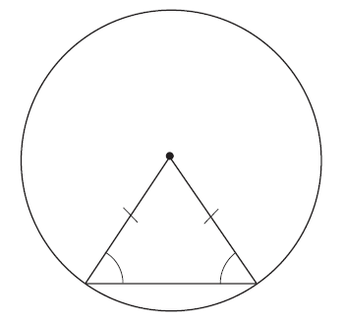
Strand H
Unit H2
Section H2.2
Angles and Circles 1
Result 4
When the ends of a chord are joined to the centre of a circle, an isosceles triangle is formed, so the two angles marked are equal.
O

Slide 17
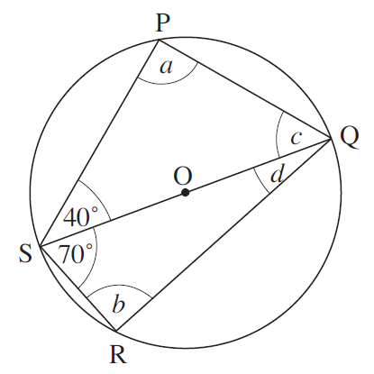
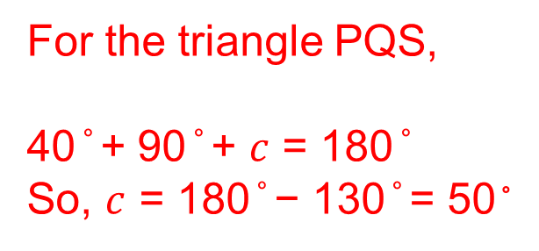
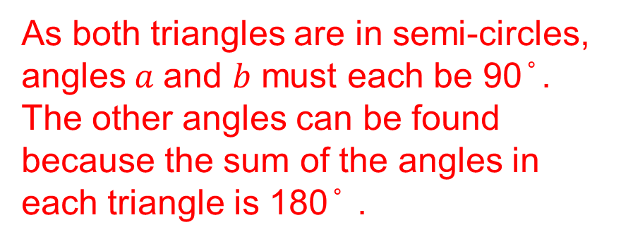
Strand H
Unit H2
Section H2.2
Angles and Circles 1: Examples
Example 1
Find the angles marked with letters in the diagram, if O is the centre of the circle.
Solution
As both triangles are in semi-circles, angles$a$ and 𝑏 must each be 90 ̊ .
The other angles can be found because the sum of the angles in each triangle is 180 ̊ .
For the triangle PQS,
40 ̊ + 90 ̊ + $c$ = 180 ̊
So, $c$ = 180 ̊ − 130 ̊ = 50 ̊
For the triangle QRS,
70 ̊ + 90 ̊ + 𝑑 = 180 ̊
So, 𝑑 = 180 ̊ − 160 ̊ = 20 ̊

Slide 18
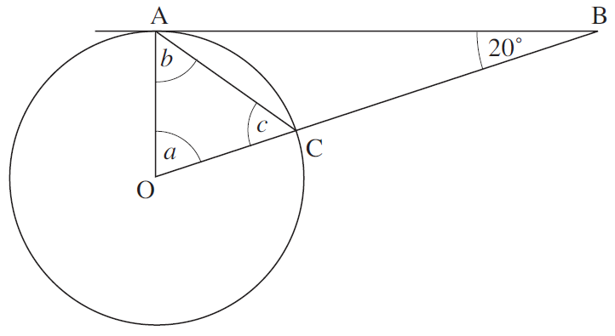
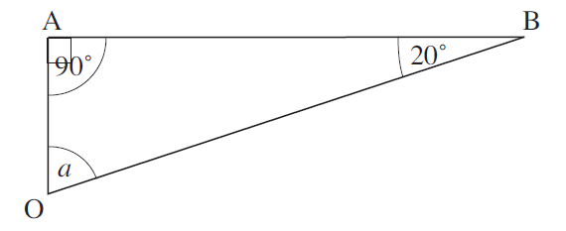
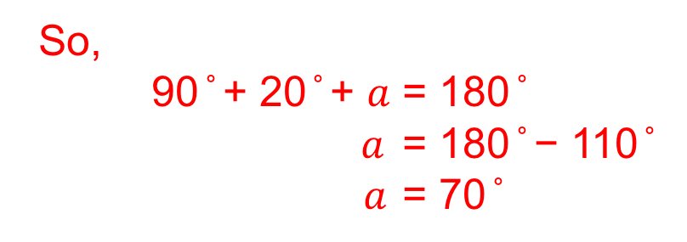
Strand H
Unit H2
Section H2.2
Angles and Circles 1: Examples
Example 2
Find the angles 𝑎, 𝑏 and c, if AB is a tangent and O is the centre of the circle.
Solution
First consider the triangle OAB. As OA is a radius and AB is a tangent, the angle between them is 90 ̊
So,
90 ̊ + 20 ̊ + $a$ = 180 ̊
$a$ = 180 ̊ − 110 ̊
$a$ = 70 ̊
Continued on next slide

Slide 19
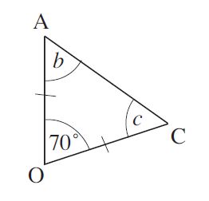
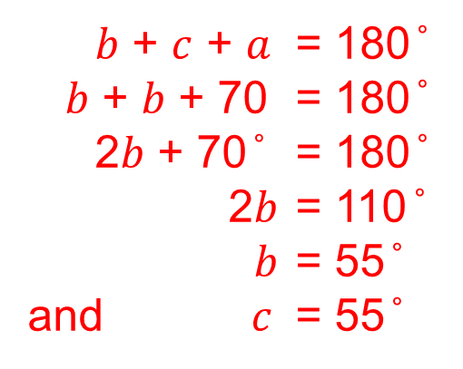
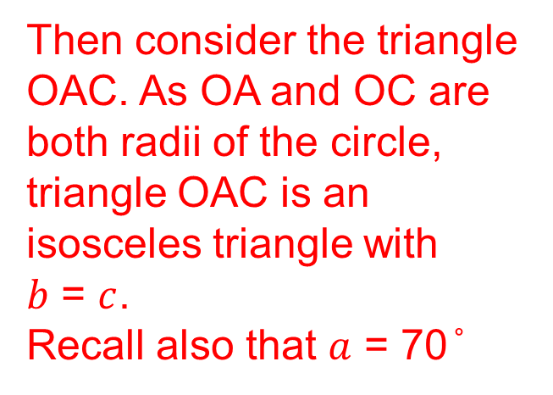
Strand H
Unit H2
Section H2.2
Angles and Circles 1: Examples
Solution (continued)
Then consider the triangle OAC. As OA and OC are both radii of the circle, triangle OAC is an isosceles triangle with
𝑏 = $c$.
Recall also that $a$ = 70 ̊
𝑏 + $c$ + $a$ = 180 ̊
𝑏 + 𝑏 + 70 = 180 ̊
2𝑏 + 70 ̊ = 180 ̊
2𝑏 = 110 ̊
𝑏 = 55 ̊
and $c$ = 55 ̊

Slide 20
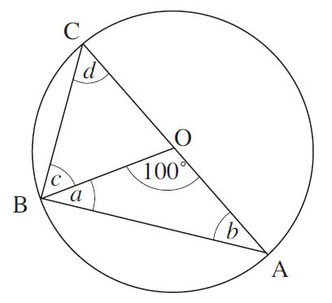
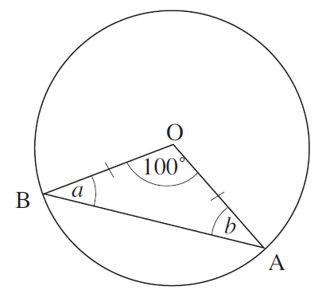
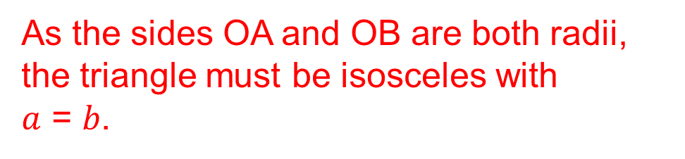
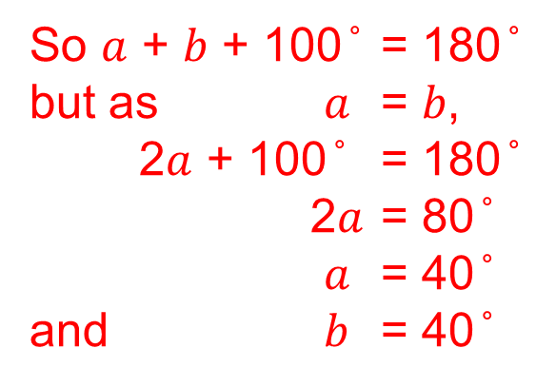
Strand H
Unit H2
Section H2.2
Angles and Circles 1: Examples
Example 3
Find the angles marked in the diagram, where O is the centre of the circle.
Solution
First consider the triangle OAB.
As the sides OA and OB are both radii, the triangle must be isosceles with
$a$ = 𝑏.
So $a$ + 𝑏 + 100 ̊ = 180 ̊
but as $a$ = 𝑏,
2$a$ + 100 ̊ = 180 ̊
2$a$ = 80 ̊
$a$ = 40 ̊
and 𝑏 = 40 ̊
Continued on next slide

Slide 21
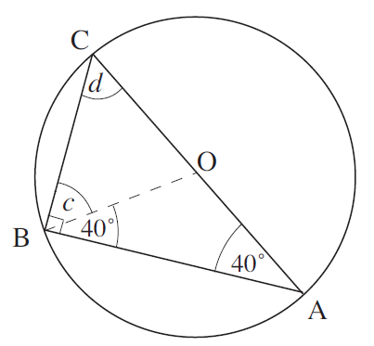
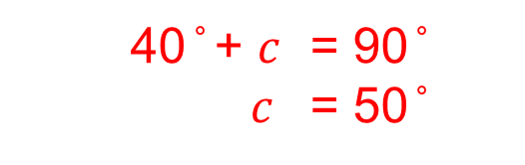
Angles and Circles 1: Examples
Strand H
Unit H2
Section H2.2
Solution (continued)
We can write the 40 ̊ angles on the diagram, as shown on the right.
Now consider the triangle ABC.
As the line AC is a diameter of the circle, the angle ABC must be 90 ̊ .
So
40 ̊ + $c$ = 90 ̊
$c$ = 50 ̊
The angles in the triangle ABC must total 180 ̊ ,
so 40 ̊ + 90 ̊ + 𝑑 = 180 ̊
𝑑 = 50 ̊

Slide 22
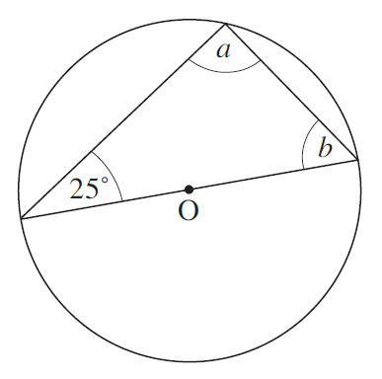
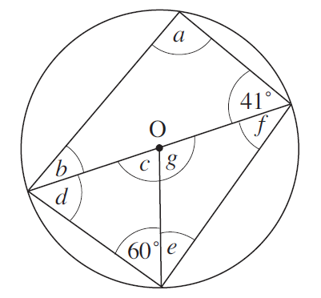
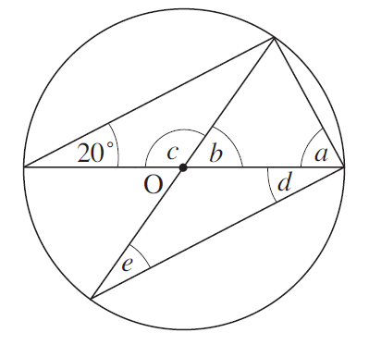
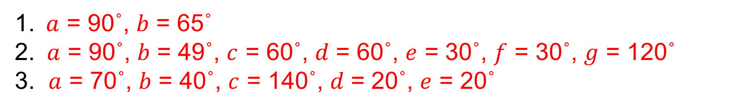
Strand H
Unit H2
Section H2.2
Angles and Circles 1: Fitness Check
Here are some questions to check your progress; there are more practice questions if needed.
Find the angles marked with a letter in each of the following diagrams. In each case the centre of the circle is marked O.
1. 2. 3.
Solutions
$\text{1}\text{.} a$ = 90˚, 𝑏 = 65˚
2. $a$ = 90˚, 𝑏 = 49˚, $c$ = 60˚, 𝑑 = 60˚, $e$ = 30˚, $f$ = 30˚, $g$ = 120˚
3. $a$ = 70˚, 𝑏 = 40˚, $c$ = 140˚, 𝑑 = 20˚, $e$ = 20˚

Slide 23
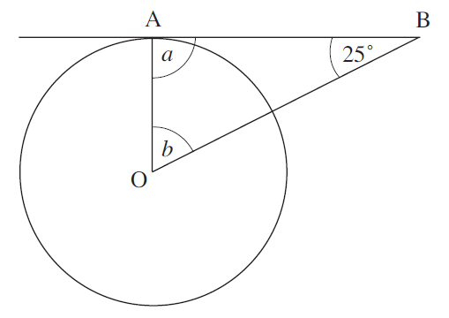
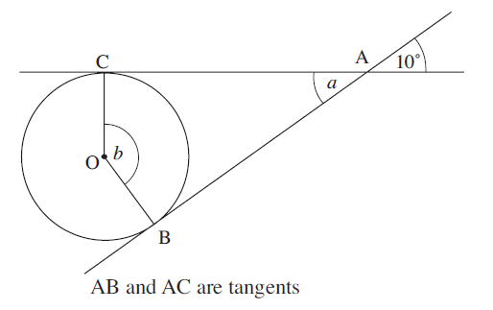
Strand H
Unit H2
Section H2.2
Section H2.2: Fitness Check
Here are some questions to check your progress; there are more practice questions if needed.
Find the angles marked with a letter in each of the following diagrams. In each case the centre of the circle is marked O.
4. 5.
Solutions
4. $a$ = 90˚, 𝑏 = 65˚ 5. $a$ = 10˚, 𝑏 = 170˚

Slide 24
STRAND H
Unit H2
Section H2.2
Section H2.2: Review
You have completed the second Section.
If you have completed and understood this section,
click to start the next Section.
If you need more examples and interactive practice, go to
http://szalonta.hu/ske/text/H2/skeh2s2.html

Slide 25
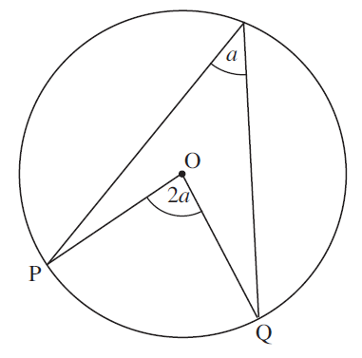
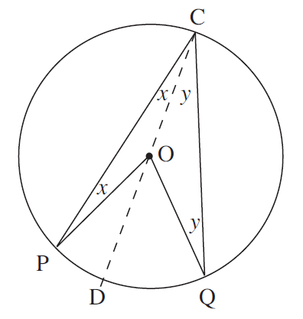
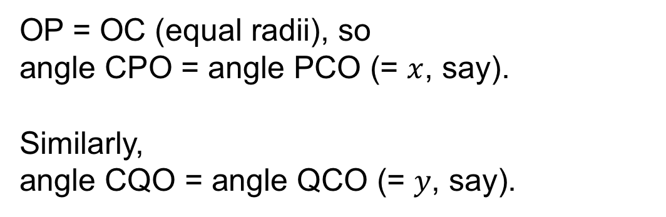
Strand H
Unit H2
Section H2.3
Angles and Circles 2
The following further results are true in any circle.
Result 5
The angle subtended by an arc, PQ, at
the centre is twice the angle subtended at
the circumference.
Proof
OP = OC (equal radii), so
angle CPO = angle PCO (= $x$, say).
Similarly,
angle CQO = angle QCO (= 𝑦, say).
Continued on next slide

Slide 26
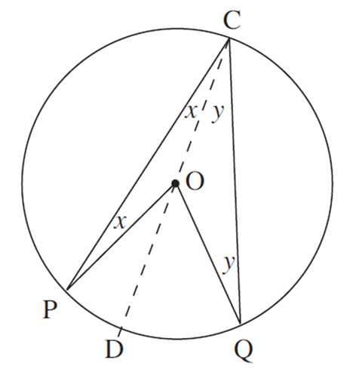
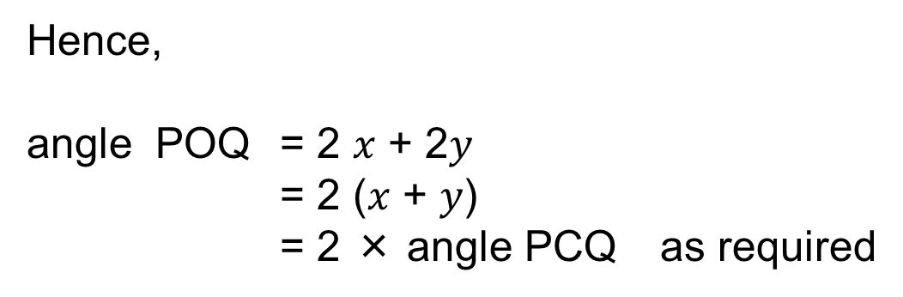
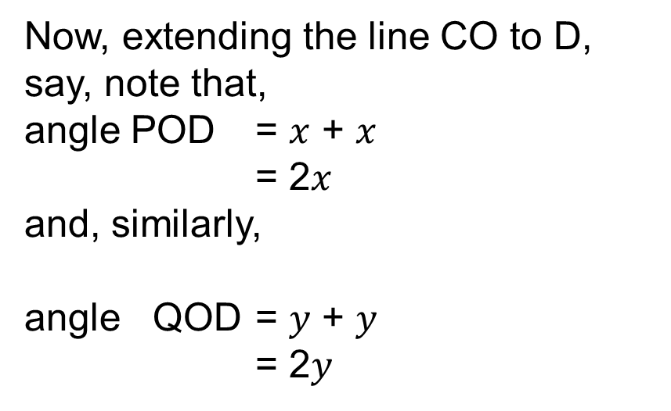
Angles and Circles 2
Strand H
Unit H2
Section H2.3
Proof (continued)
We label the angles as $x$ and 𝑦, as shown below
Now, extending the line CO to D, say, note that,
angle POD = $x$ + $x$
= 2$x$
and, similarly,
angle QOD = 𝑦 + 𝑦
= 2𝑦
Hence,
angle POQ = 2 $x$ + 2𝑦
= 2 ($x$ + 𝑦)
= 2 × angle PCQ as required

Slide 27
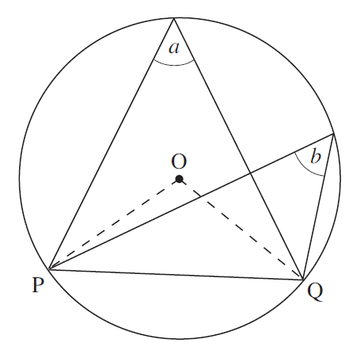
Strand H
Unit H2
Section H2.3
Angles and Circles 2
Result 6
Angles subtended at the circumference
by a chord (on the same side of the
chord) are equal; that is, in the diagram
𝑎 = 𝑏
Proof
Because angle 𝑎 is on the circumference, the angle at the centre is 2𝑎, according to Result 5.
But if you consider the angle 𝑏, which is also at the circumference, the angle at the centre is 2𝑏, according to Result 5.
Thus 2𝑎 = 2𝑏; divide both sides to obtain 𝑎 = 𝑏, as required.

Slide 28



Angles and Circles 2
Strand H
Unit H2
Section H2.3
Result 7
In cyclic quadrilaterals (quadrilaterals where all 4 vertices lie on a circle), opposite angles sum to 180 ̊ :
𝑎 + 𝑐 = 180 ̊
and 𝑏 + 𝑑 = 180 ̊
Proof
Construct the diagonals AC and BD, as shown. Then label the angles subtended by AB as $w$; that is angle ADB = angle ACB (= $w$)
Similarly for the other chords, the angles being marked $x$, 𝑦 and $z$ as shown.
Continued on next slide

Slide 29



Angles and Circles 2
Strand H
Unit H2
Section H2.3
Proof (continued)
Now that we have labelled the angles, as shown on the right, we can prove the result.
In triangle ABD, the sum of the angles is 180 ̊ , so
$w$ + $z$ + ($x$ + 𝑦) = 180 ̊
You can rearrange this as
($x$ + $w$) + (𝑦 + $z$) = 180 ̊
which shows that angle CDA + angle CBA = 180 ̊
This proves that the angle at D and the angle at B, the opposite sides on the quadrilateral, add to 180 ̊ .
The result that the angles at A and C add to 180 ̊ can be shown in a similar way.

Slide 30


Angles and Circles 2: Examples
Strand H
Unit H2
Section H2.3
Example 1
A
B
Find the angles marked with letters in the diagram, if O is the centre of the circle.
Solutions
A: As both angles are drawn on the same chord, the angles are equal, so 𝑎 = 35 ̊
B: Angle 𝑏 and the 25 ̊ angle are drawn on the same chord, so
𝑏 = 25 ̊
Angle a is drawn at the centre O on the same chord as the 25 ̊ angle, so 𝑎 = 2 × 25 ̊ = 50 ̊

Slide 31

Angles and Circles 2: Examples
Strand H
Unit H2
Section H2.3
Example 2
Find the angles marked with in the diagram. O is the centre of the circle.
Solution
Opposite angles in a cyclic quadrilateral
add up to 180 ̊ .
So 𝑎 + 80 ̊ = 180 ̊ , giving 𝑎 = 100 ̊
and 𝑏 + 110 ̊ = 180 ̊ , giving 𝑏 = 70 ̊

Slide 32




Strand H
Unit H2
Section H2.3
Angles and Circles 2: Examples
Example 3: Find the angles marked in the diagram. O is the centre of the circle
Solution
Consider the angles $c$ and 210 ̊ . Since the angle at the centre is double the angle in a segment drawn on the same arc, 2$c$ = 210 ̊ and $c$ = 105 ̊
Angles $c$ and $e$ add up to 180 ̊ because
they are opposite angles in a cyclic
quadrilateral, $c$ + $e$ = 180 ̊
105 ̊ + $e$ = 180 ̊ which gives $e$ = 75 ̊
Consider the quadrilateral BODC. The four angles in any quadrilateral add up to 360 ̊ , so $d$ + $e$ + 210 ̊ + 20 ̊ = 360 ̊
but $e$ = 75 ̊ , so $d$ + 75 ̊ + 210 ̊ + 20 ̊ = 360 ̊
Re-arrange this to give $d$ = 360 ̊ − 210 ̊ − 20 ̊ − 75 ̊ = 55 ̊

Slide 33

Angles and Circles 2: Examples
Strand H
Unit H2
Section H2.3
Example 4
In the diagram the line AB is a diameter and O is the
centre of the circle. Find the angles marked.
Solution
Consider triangle OAC. Since OA and OC are radii, triangle OAC is isosceles. So 𝑎 = 50 ̊
Continued on next slide

Slide 34




Angles and Circles 2: Examples
Strand H
Unit H2
Section H2.3
Solutions (continued)
The angles in a triangle add to 180 ̊, so for triangle OAC,
𝑎 + 𝑏 + 50 ̊ = 180 ̊
𝑏 = 180 ̊ − 50 ̊ − 𝑎
𝑏 = 80 ̊ (as 𝑎 = 50 ̊ )
Since AB is a diameter of the circle, the angle ACB is a right angle, so
𝑎 + 20 ̊ + $c$ = 90 ̊
$c$ = 90 ̊ − 20 ̊ − 50 ̊ = 20 ̊
Angle $d$ and angle OAC are angles in the same segment, so
$d$ = angle OAC = 50 ̊
Angle $e$ is drawn on the same arc as the angle at the centre, AOC, so 𝑏 = 2$e$
$e$ = ½ 𝑏 = 40 ̊

Slide 35

Strand H
Unit H2
Section H2.3
Angles and Circles 2: Examples
Example 5
In the diagram the chords AB and CD are parallel. Prove that the triangles ABE and DEC are isosceles.
Solution
Angles 𝑎 and BDC are angles in the same segment, so angle BDC = 𝑎
Since AB and DC are parallel, angles 𝑎 and ACD are equal alternate angles
angle ACD = 𝑎 = angle BDC
Hence in triangle DEC, the base angles at C and D are equal, so the triangle is isosceles.
The angle at B, angle ABD, equals the angle at C, angle ACD, because they are angles in the same segment:
angle ABD = angle ACD = 𝑎
Hence triangle ABE is isosceles, since the angles at A and B are equal.

Slide 36




Strand H
Unit H2
Section H2.3
Section H2.3: Fitness Check
Here are some questions to check your progress; there are more practice questions if needed.
Find the angles marked with a letter in each of the following diagrams. In each case the centre of the circle is marked O.
1. 2. 3.
Solutions
1. 𝑎 = 30˚
2. 𝑥 = $y$ = 43˚
3. 𝑎 = 27 ̊, 𝑏 = 126 ̊, $c$ = 63 ̊

Slide 37


Strand H
Unit H2
Section H2.3
Section H2.3: Fitness Check
Here are some questions to check your progress; there are more practice questions if needed.
Find the angles marked with a letter in each of the following diagrams. In each case the centre of the circle is marked O.
4. 5.
Solutions
4. 𝑎 = 75 ̊, 𝑏 = 100 ̊ 5. 𝑎 = 32.5 ̊, 𝑏 = 147.5 ̊

Slide 38
STRAND H
Unit H2
Section H2.3
Section H2.3: Review
You have completed the third Section.
If you have completed and understood this section,
click to start the next Section.
If you need more examples and interactive practice, go to
http://szalonta.hu/ske/text/H2/skeh2s3.html

Slide 39

STRAND H
Unit H2
Section H2.4
Circles and Tangents
Three further important results are now presented.
Result 8
If two tangents are drawn from a point T to a circle with centre O, and P and R are the points of contact of the tangents with the circle, then, using symmetry,
PT = RT
b) Triangles TPO and TRO
are congruent*
* Congruent shapes are identical; that is, corresponding angles are equal
and corresponding sides are equal

Slide 40

STRAND H
Unit H2
Section H2.4
Circles and Tangents
Result 9
The angle between a tangent and a chord equals an angle at the circumference subtended by the same chord;
e.g. 𝑎 = 𝑏 in the diagram.
This is known as the alternate segment theorem and needs a proof, as it is not obviously true!

Slide 41




STRAND H
Unit H2
Section H2.4
Circles and Tangents
Proof
We need to show that
angle RPT = angle PQR
Construct the diameter POS, as shown.
We know that angle SRP = 90 ̊
since PS is a diameter.
Now,
angle PSR = angle PQR = $x$ ̊ , say
So, angle SPR = 180 ̊ − 90 ̊ − $x$ = 90 ̊ − $x$ ̊
But,
angle RPT = 90 ̊ − (angle SPR)
= 90 ̊ − (90 ̊ − $x$ ̊ ) = $x$ ̊ = angle PQR, as required

Slide 42



STRAND H
Unit H2
Section H2.4
Circles and Tangents
Result 10
For any two intersecting chords, as shown,
Proof
In triangles AXB and DXC,
angle BAC = angle BDC
(equal angles subtended by chord BC)
and
angle ABD = angle ACD (equal angles subtended by chord AD)
This tells us that AXB and DXC are similar*,
It follows that
as required.
* Similar shapes differ only in size so that corresponding angles are
the same and corresponding lengths are in the same ratio

Slide 43



STRAND H
Unit H2
Section H2.4
Circles and Tangents
Note that these follow from particular cases of Result 10:
This result will still be true even when the chords intersect outside the circle, as illustrated opposite
When the chord BD becomes a tangent,
and B and D coincide at the point P, then
AX × CX = PX × PX

Slide 44

STRAND H
Unit H2
Section H2.4
Circles and Tangents: Examples
Example 1
Find the angle 𝑎 in the diagram.
Solution
The triangles TOR and TOP are congruent, so angle TOR = 65 ̊
Since TR is a tangent to the circle and OR is a radius,
angle TRO = 90 ̊ .
Hence
𝑎 = 180 ̊ − 90 ̊ − 65 ̊ = 25 ̊

Slide 45



Circles and Tangents: Examples
STRAND H
Unit H2
Section H2.4
Example 2
Find the angles $x$ and 𝑦 in the diagram.
Solution
The alternate angle segment theorem gives
𝑥 = 62 ̊
The tangents TA and TB are equal in length, so the triangle TAB is isosceles.
So
angle ABT = 𝑥 = 62 ̊
Hence
$y$ + 62 ̊ + 62 ̊ = 180 ̊ (the angles in triangle TAB add up to 180 ̊ )
$y$ = 56 ̊

Slide 46


STRAND H
Unit H2
Section H2.4
Circles and Tangents: Examples
Example 3
Find the unknown lengths, x and y, in the diagram.
Solution
Since AT is a tangent,
AT² = BT × DT
36 = BT × 4
BT = 9 cm
Hence
$y$ + 8 = BT = 9
$y$ = 1 cm
AC and BD are intersecting chords, so
AP×PC = BP×PD
2.5𝑥 = 1 × 4
𝑥 = 1.6 cm

Slide 47




STRAND H
Unit H2
Section H2.4
Section H2.4: Fitness Check
Here are some questions to check your progress; there are more practice questions if needed.
Find the angles marked with a letter in each of the following diagrams. In each case the centre of the circle is marked O.
1. 2. 3.
Solutions
1. 𝑎 = 40˚
2. $b$ = 55, $c$ = 35˚
3. 𝑎 = $b$ = $c$ = 24 ̊, $d$ = 62 ̊

Slide 48



STRAND H
Unit H2
Section H2.4
Section H2.4: Fitness Check
Here are some questions to check your progress; there are more practice questions if needed.
Find the unknown lengths in the following diagrams.
4. 5.
Solutions
4. 𝑥 = 4.8 ̊
5. $x$ = 7 , $y$ = 3.5

Slide 49
STRAND H
Unit H2
Section H2.4
Section H2.4: Review
You have completed the last Section.
If you need more examples and interactive practice, go to
http://szalonta.hu/ske/text/H2/skeh2s4.html

