Slide 1
TSST Strand H
UNIT H4: Congruence and Similarity

Slide 2
Strand H
Unit H4
Congruence and Similarity
This Unit will explain how shapes can be compared using the concepts of Congruence and Similarity.
You have two sections to work through and there are
check up audits and fitness tests for each section.
1. Congruence
2. Similarity

Slide 3
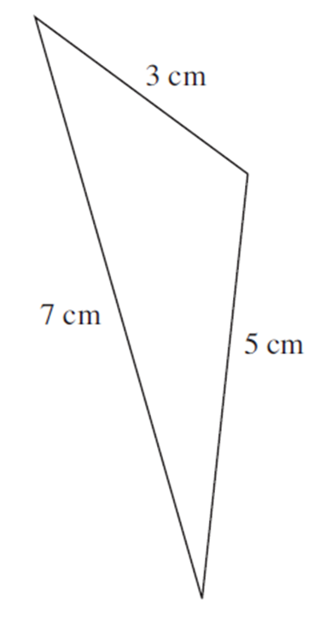

Strand H
Unit H4
Section H4.1
Congruence and Similarity
Two shapes are said to be congruent if they are the same shape and
size: that is, the corresponding sides of both shapes are the same
length and corresponding angles are the same.
The two triangles shown here are congruent.

Slide 4
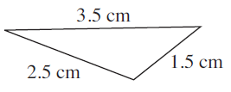
Strand H
Unit H4
Section H4.1
Congruence and Similarity
Shapes which are of different sizes but which have the same shape
are said to be similar.
The two triangles shown here are similar.
If you double the lengths for the triangle on the left, its sides will match those of the triangle on the right.

Slide 5
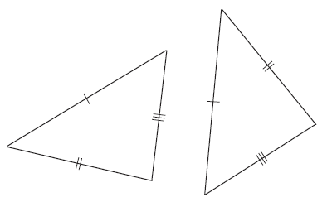
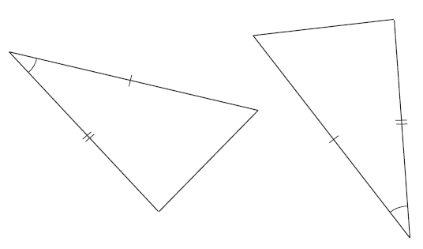
Strand H
Unit H4
Section H4.1
Congruence Tests for Triangles
There are four tests for congruence with triangles.
TEST 1 (Side, Side, Side)
If all three sides of one triangle
are the same as the lengths of the
sides of the second triangle, then
the two triangles are congruent.
This test is referred to as SSS.
TEST 2 (Side, Angle, Side)
If two sides of one triangle are
the same length as two sides of
the other triangle and the angle
between these two sides is the
same in both triangles, then the
triangles are congruent.
This test is referred to as SAS.
The single (double or treble) crosses on sides correspond to equal sides

Slide 6
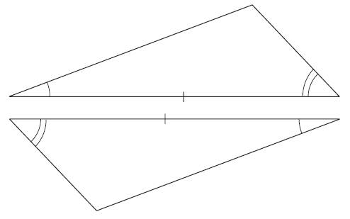
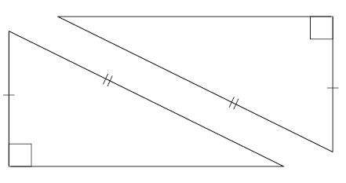
Strand H
Unit H4
Section H4.1
Congruence Tests for Triangles
Four tests for congruence with triangles.
TEST 3 (Angle, Angle, Side)
If two angles and the length of
one corresponding side are the
same in both triangles, then
they are congruent.
This test is referred to as AAS.
TEST 4 (Right angle, Hypotenuse, Side)
If both triangles contain a right angle, have hypotenuses of the same length and one other side of the same length,
then they are congruent.
This test is referred to as RHS.
The single or double arcs on angles correspond to equal angles

Slide 7
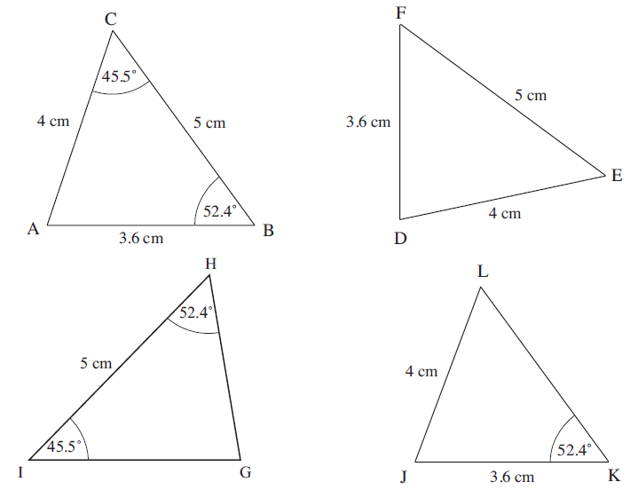
Strand H
Unit H4
Section H4.1
Congruence: Examples
Example 1
Which of the triangles below are congruent to the triangle ABC, and
why?

Slide 8
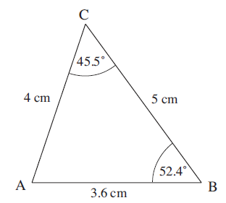
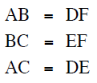
Strand H
Unit H4
Section H4.1
Congruence: Examples
Solution
Triangle DEF is congruent to triangle ABC because sides lengths are
the same in both triangles as shown below. (SSS)
Solutions continued on next slide.

Slide 9
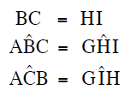

Strand H
Unit H4
Section H4.1
Congruence: Examples
Solution (continued)
Triangle GHI is congruent to triangle ABC because they have one side
and two angles the same, as shown below. (AAS)
(Note that we indicate angles with a ^ symbol above the letter)
Solutions continued on next slide.

Slide 10
Congruence: Examples
Strand H
Unit H4
Section H4.1
Solution (continued)
Triangle JKL is not congruent to triangle ABC because two sides are known and match in lengths but the angle between them is unknown.

Slide 11
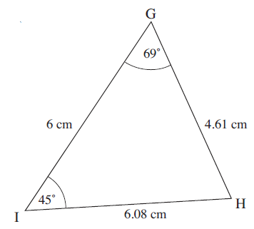
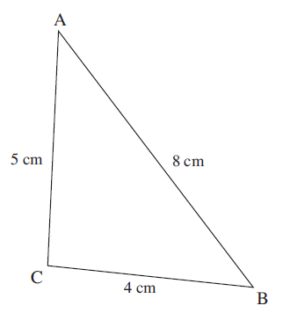
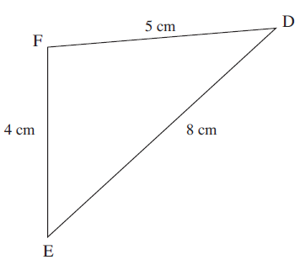
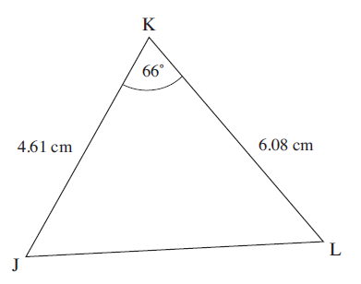
Strand H
Unit H4
Section H4.1
Section H4.1: Fitness Check
Here are some questions to check your progress; there are more practice questions if needed.
Identify the triangles which are congruent
and give the reasons why.

Slide 12
Strand H
Unit H4
Section H4.1
Section H4.1: Fitness Check
Solution
ABC and DEF (SSS);
JKL and GHI (SAS)

Slide 13
STRAND H
Unit H4
Section H4.1
Section H4.1: Review
You have completed the first Section.
If you have completed and understood this section,
click to start the next Section.
If you need more examples and interactive practice, go to
http://szalonta.hu/ske/text/H4/skeh4s1.html

Slide 14
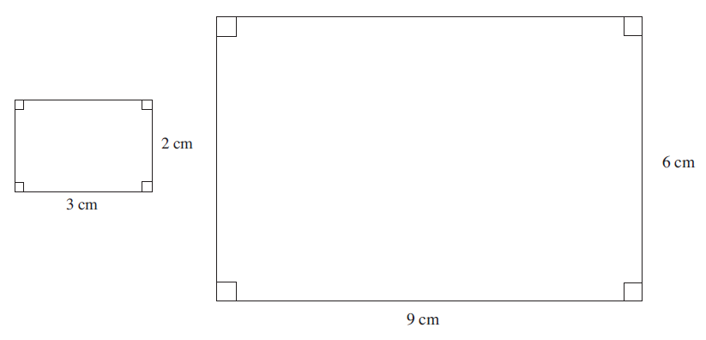
STRAND H
Unit H4
Section H4.2
Similarity
Similar shapes have the same shape but may be different sizes. The
two rectangles shown below are similar - they have the same shape
but one is smaller than the other.
They are similar because they are both rectangles and the sides of the larger rectangle are three times longer than the sides of the smaller rectangle.

Slide 15
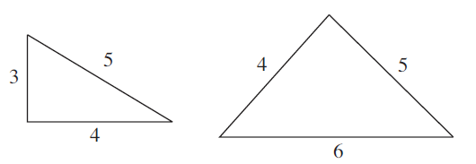
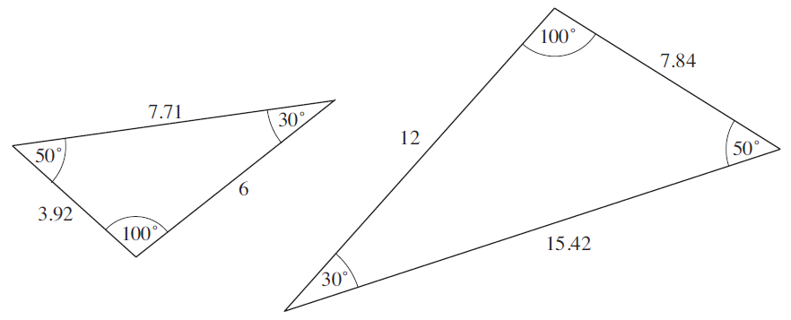
STRAND H
Unit H4
Section H4.2
Similarity
These two triangles are not similar. The sides lengths of the triangles
are not in the same ratio and so the triangles are not similar.
For two triangles to be similar, they must have the same internal angles, as shown in the similar shapes below.

Slide 16
STRAND H
Unit H4
Section H4.2
Similarity and Area
It is interesting to compare the area of two similar rectangles. The
area of the smaller rectangle is 6 cm² and the area of the larger
rectangle is 54 cm², which is nine times (3²) greater.
In general, if the lengths of the sides of a shape are increased by a factor k, then the area is increased by a factor k².

Slide 17
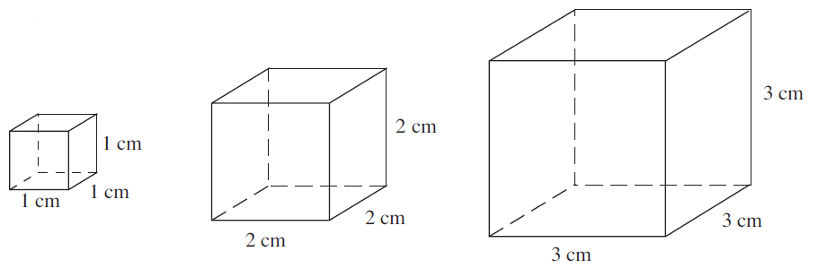
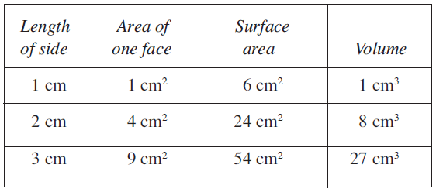
STRAND H
Unit H4
Section H4.2
Similarity and Volume
The diagrams below show 3 similar cubes.
The table gives the lengths of sides, area of one face, total surface area and volume.

Slide 18
STRAND H
Unit H4
Section H4.2
Similarity and Volume
Comparing the larger cubes with the 1 cm cube we can note that:
For the 2 cm cube The lengths are 2 times greater.
The areas are 4 (2²) times greater.
The volume is 8 (2³) times greater.
For the 3 cm cube The lengths are 3 times greater.
The areas are 9 (3²) times greater.
The volume is 27 (3³) times greater.
If the lengths of a solid are increased by a factor, k, its surface area
will increase by a factor k² and its volume will increase by a factor k³.

Slide 19
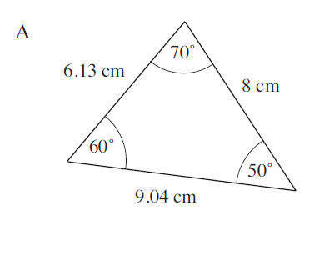
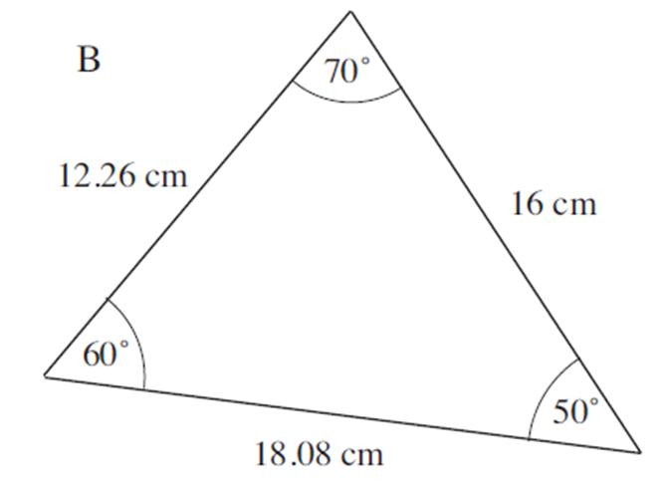
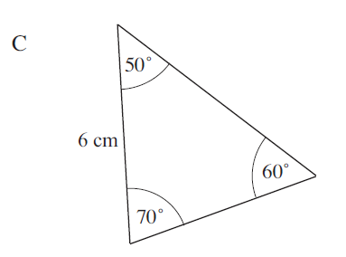
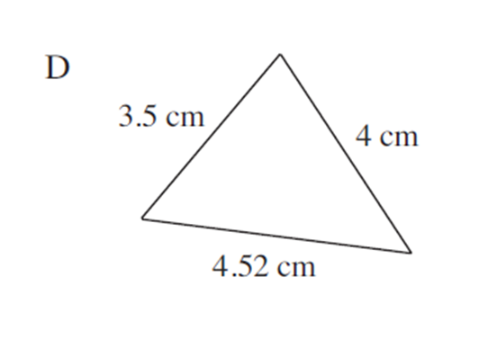
STRAND H
Unit H4
Section H4.2
Similarity: Examples
Example 1
Which of the triangles, A, B, C, D, shown below are similar?
How do the areas of the triangles which are similar compare?

Slide 20
Similarity: Examples
STRAND H
Unit H4
Section H4.2
Solution
First compare triangles A and B.
Here all the lengths of the sides are twice the length of the sides of
triangle A, so the two triangles are similar.
Solutions continued on next slide.

Slide 21
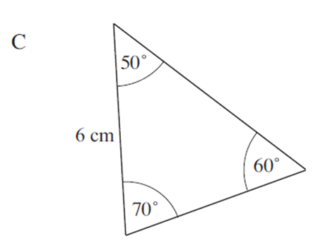
Similarity: Examples
STRAND H
Unit H4
Section H4.2
Solution (continued)
Then compare triangles A and C.
Here all the angles are the same in both triangles, so the triangles
must be similar.
Solutions continued on next slide.

Slide 22
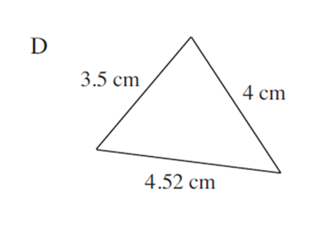
STRAND H
Unit H4
Section H4.2
Similarity: Examples
Solution (continued)
Finally, compare triangles A and D.
These triangles are not similar because if you halve the sides on the
first triangle, two of the sides match, but not all three:
$4=\frac{1}{2}×8$ and $4.52=\frac{1}{2}×9.04$ but $3.5≠\frac{1}{2}×6.13$
So these triangles are not similar as the matching lengths on
triangle D must all be half of those on A.

Slide 23
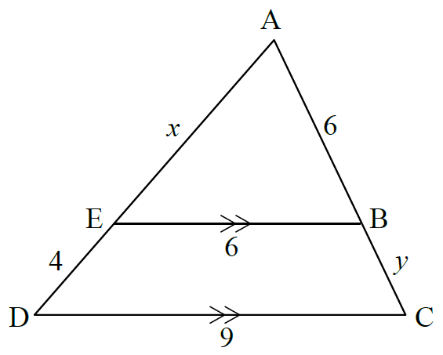
STRAND H
Unit H4
Section H4.2
Similarity: Examples
Example 2
Explain why triangles ABE and ACD are similar.
Find the lengths of x and y.
Find the ratio of the area of triangle ABE to triangle ACD.

Slide 24

STRAND H
Unit H4
Section H4.2
Similarity: Examples
Solution
a) As the lines BE and CD are parallel,
and
Also the vertex A, is common to both triangles, so
So the three angles are the same in both triangles and therefore they are similar.
Solutions continued on next slide.

Slide 25
STRAND H
Unit H4
Section H4.2
Similarity: Examples
Solution (continued)
b) Comparing the sides BE and CD, the lengths in the larger triangle are 1.5 times the lengths in the smaller triangle (alternatively, it can be stated that the ratio of the lengths is 2 : 3).
So the length AC will be 1.5 times the length AB.
AC = 1.5 × 6 = 9
So y = 3
In the same way, AD = 1.5 × AE,
so 4 + x = 1.5x
4 = 0.5x
x = 8
Solutions continued on next slide.

Slide 26
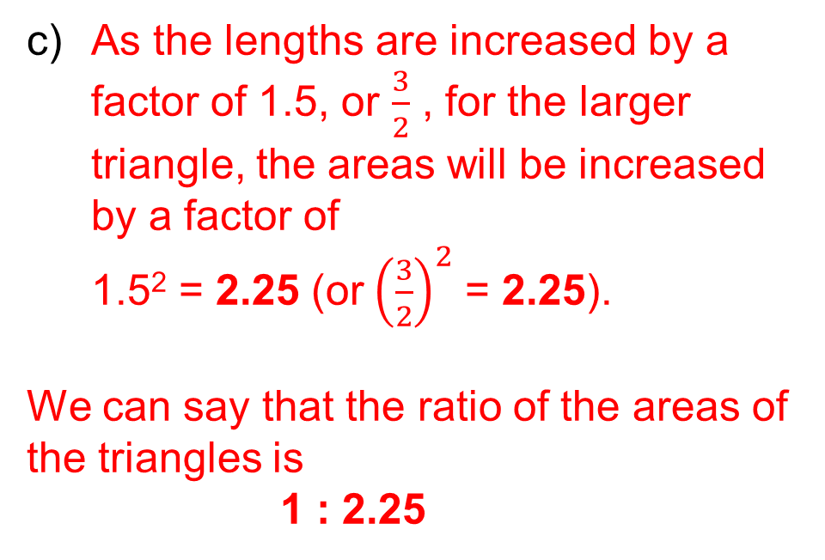
STRAND H
Unit H4
Section H4.2
Similarity: Examples
Solution (continued)
c) As the lengths are increased by a
factor of 1.5, or $\frac{3}{2}$ , for the larger triangle, the areas will be increased by a factor of
1.5² = 2.25 (or${\left(\frac{3}{2}\right)}^{2}$ = 2.25).
We can say that the ratio of the areas of
the triangles is
1 : 2.25
So the ratio of the area of triangle ABE to triangle ACD is, by multiplying both sides of the ratio by 4,
4 : 5

Slide 27
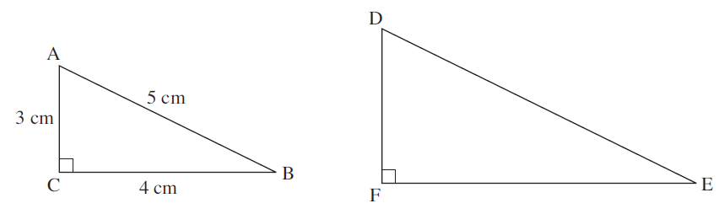
STRAND H
Unit H4
Section H4.2
Similarity: Examples
Example 3
The diagrams show two similar triangles.
If the area of triangle DEF is 26.46 cm², find the lengths of its sides.

Slide 28
STRAND H
Unit H4
Section H4.2
Similarity: Examples
Solution
If the lengths of the sides of triangle DEF are a factor k greater than
the lengths of the sides of triangle ABC, then its area will be a factor
k² greater than the area of ABC.
Area of ABC is $\frac{1}{2}×4×3=$6 cm²
So 6 ×k² = 26.46
k² = 4.41
k = 2.1
Solutions continued on next slide.

Slide 29
STRAND H
Unit H4
Section H4.2
Similarity: Examples
Solution (continued)
So the lengths of the sides of triangle DEF will be 2.1 times greater
than the lengths of the sides of triangle ABC.
DE = 2.1 × 5
= 10 5. cm
EF = 2.1 × 4
= 8 2. cm
  DF = 2.1 × 3
= 6 3. cm

Slide 30
STRAND H
Unit H4
Section H4.2
Similarity: Examples
Example 4
A can has a height of 10 cm and has a volume of 200 cm³. A can with
a similar shape has a height of 12 cm.
a) Find the volume of the larger can.
b) Find the height of a similar can with a volume of 675 cm³.
Solution
a) The lengths are increased by a factor of 1.2, so the volume will be
  increased by a factor of 1.2³
Volume = 200 × 1.2³ = 345.6 cm³
b) If the lengths are increased by a factor of k, then the volume will be increased by k ³.
675 = 200× k ³
k ³ = 3.375
k = 1.5 (by taking the cube root )
So the height must be increased by a factor of 1.5, to give
height = 1.5 × 10 = 15 cm

Slide 31
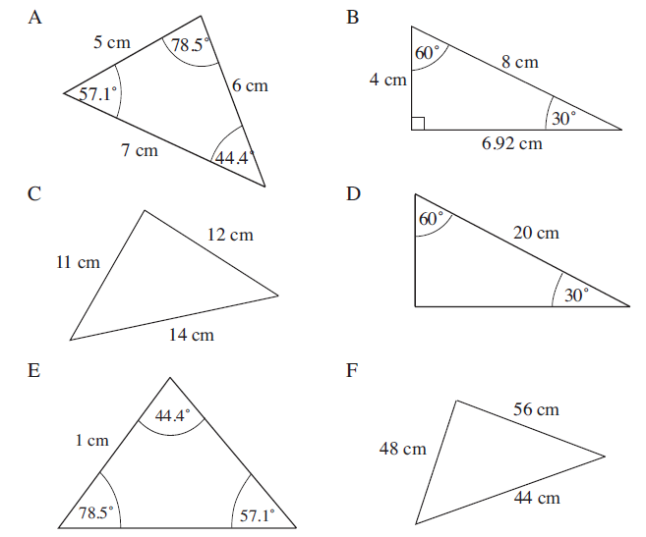
STRAND H
Unit H4
Section H4.2
Section H4.2: Fitness Check
The following slides give questions to check your progress; there are more practice questions if needed.
Which of the triangles below are similar?
Diagrams are not drawn to scale.

Slide 32
STRAND H
Unit H4
Section H4.2
Section H4.2: Fitness Check
Solution
A and E
C and F
B and D

Slide 33
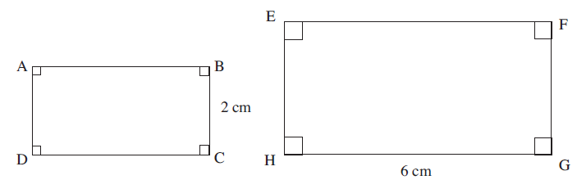
STRAND H
Unit H4
Section H4.2
Section H4.2: Fitness Check
More questions to check your progress:
2. The diagram shows two similar rectangles, ABCD and EFGH.
Find the lengths of AB and EH if the ratio of the area of ABCD to the area of EFGH is:
a) 1 : 4 b) 4 : 9.
Solution
a) AB = 3 cm, DH = 4 cm b) AB = 4 cm, EH = 3 cm

Slide 34
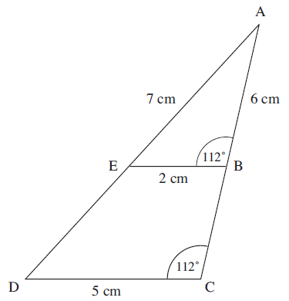
STRAND H
Unit H4
Section H4.2
Section H4.2: Fitness Check
Another question to check your progress:
3. a) Explain why the triangles
ABE and ACD are similar.
b) Find the lengths of:
(i) AD
(ii) DE
(iii) BC
c) Find the ratio of
the area of triangle ABE to triangle ACD.

Slide 35
Section H4.2: Fitness Check
STRAND H
Unit H4
Section H4.2
Solutions
3. a) Angles at B and C for triangles ABE and ACD, respectively, are equal
Shared angle at A
Angles at E and D for triangles ABE and ACD, respectively, are equal
b) (i) 17.5 cm
(ii) 10.5 cm
(iii) 9 cm
c) 4 : 25

Slide 36
STRAND H
Unit H4
Section H4.2
Section H4.2: Review
You have completed the last Section.
If you need more examples and interactive practice, go to
http://szalonta.hu/ske/text/H4/skeh4s2.html

