Slide 1
TSST Strand I
UNIT I1: Pythagoras’ Theorem & Trigonometric Ratios

Slide 2
Strand I
Unit I1
Pythagoras’ Theorem & Trigonometric Ratios
Pythagoras' Theorem gives a relationship between the lengths of the sides of a right-angled triangle. Trigonometry is a branch of mathematics that studies the relationships between the sides and angles of right angled triangles.
You have five sections to work through and there are check up audits and fitness tests for each section.
Pythagoras' Theorem
Further Work With Pythagoras’ Theorem
Sine, Cosine and Tangent
Finding Lengths in Right Angled Triangles
Finding Angles in Right Angled Triangles

Slide 3
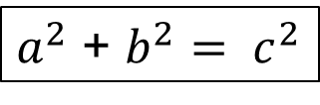
Strand I
Unit I1
Section I1.1
Pythagoras’ Theorem
Pythagoras' Theorem states that:
In any right-angled triangle, the area of the square on the hypotenuse (the side opposite the right angle) is equal to the sum of the areas of the squares on the other two sides (the two sides that meet at the right angle).
Area A + Area B = Area C
For the triangle shown opposite
$a^{2}$ + $b^{2}= c^{2}$
Note: The longest side of a right-angled triangle is called the hypotenuse.

Slide 4
Strand I
Unit I1
Section I1.1
Pythagoras: Finding the Hypotenuse
Hypotenuse
The hypotenuse is the side opposite the largest angle in a right-angled triangle. In the diagram opposite “a” is opposite the
90 degree angle (largest angle).
a
Use the idea above to identify the hypotenuse on the following:
Solution
Side PQ
Side YZ
Side JK
Side TS

Slide 5
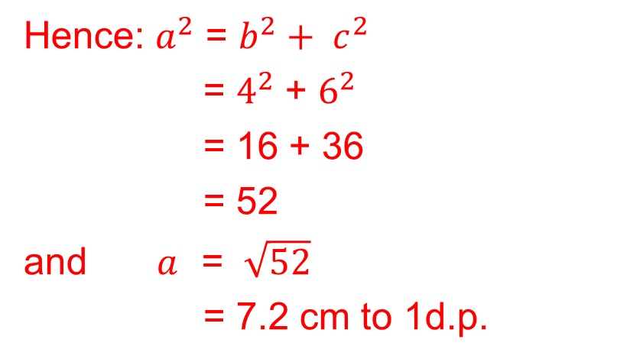
Strand I
Unit I1
Section I1.1
Pythagoras: Finding the Hypotenuse
Example
Find the length of the hypotenuse of the triangle shown in the diagram. Give your answer correct to 2 decimal places.
Solution
As this is a right-angled triangle Pythagoras’ Theorem can be used.
If the length of the hypotenuse is a, then b = 4 cm and c = 6 cm
Hence: $a^{2}$ = $b^{2}+ c^{2}$
= $4^{2}$ + $6^{2}$
= 16 + 36
= 52
and $a$ = $\sqrt{52}$
= 7.2 cm to 1d.p.

Slide 6
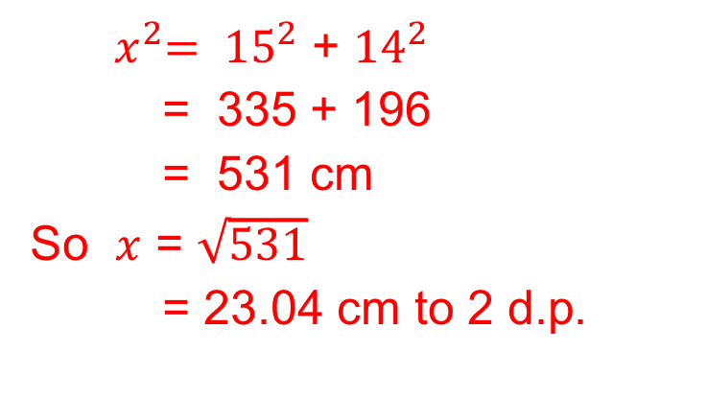
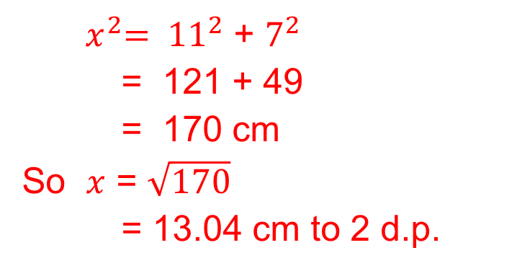
Strand I
Unit I1
Section I1.1
Pythagoras: Finding the Hypotenuse
Example
Find the length of the hypotenuse of the triangles shown in the diagrams below. Give your answers correct to 2 decimal places.
Solutions
${ x}^{2}= {11}^{2}$ + $7^{2}$
= 121 + 49
= 170 cm
So $x$ = $\sqrt{170}$
= 13.04 cm to 2 d.p.
${ x}^{2}= {15}^{2}$ + ${14}^{2}$
= 335 + 196
= 531 cm
So $x$ = $\sqrt{531}$
= 23.04 cm to 2 d.p.
a)
b)

Slide 7
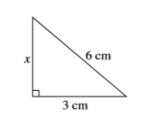
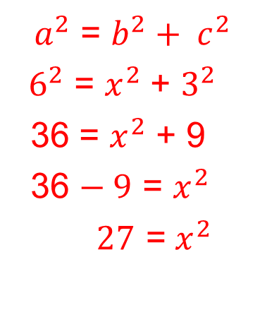
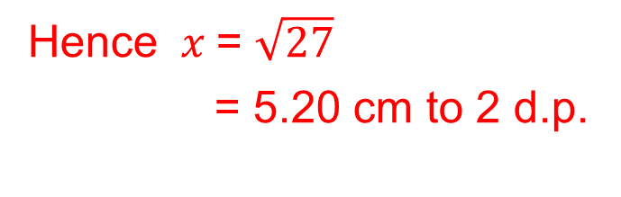
Strand I
Unit I1
Section I1.1
Pythagoras: Finding the Shorter Side
Example
Find the length of the side marked x in this triangle.
Solution
As this is a right-angled triangle,
Pythagoras’ Theorem can be used.
Here the length of the hypotenuse, a
is 6 cm and c = 3 cm with b = x ,
so we have:
${ a}^{2}$ = $b^{2}+ c^{2}$
${ 6}^{2}$ = $x^{2}$ + $3^{2}$
36 = $x^{2}$ + 9
36 $− 9$ = $x^{2}$
$27$ = $x^{2}$
Hence $x$= $\sqrt{27}$
= 5.20 cm to 2 d.p.

Slide 8
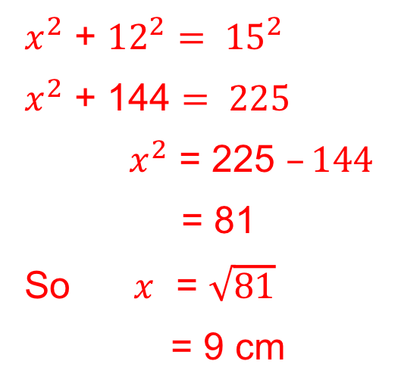
Strand I
Unit I1
Section I1.1
Pythagoras: Finding the Shorter Side
Example
Find the length of the side marked x in this triangle.
Solution
$x^{2}$ + ${12}^{2}= {15}^{2}$
$x^{2}$ + 144 $= 225$
$x^{2}$ = 225 $–144$
= 81
So $x$ = $\sqrt{81}$
= 9 cm

Slide 9
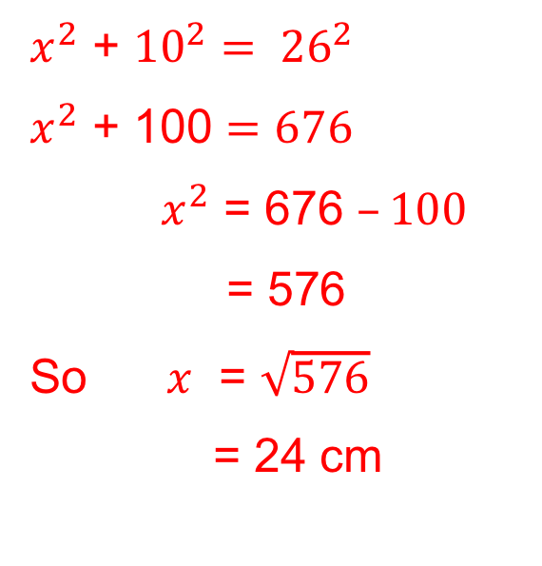
Strand I
Unit I1
Section I1.1
Pythagoras: Finding the Shorter Side
Example
Find the length of the side marked x in this triangle.
Solution
$x^{2}$ + ${10}^{2}= {26}^{2}$
$x^{2}$ + 100 $=676$
$x^{2}$ = 676 $–100$
= 576
So $x$ = $\sqrt{576}$
= 24 cm

Slide 10
Strand I
Unit I1
Section I1.1
Section I1.1: Fitness Check
Here are some questions to check your progress.
Find the length of the side x in each of the triangles below.
Solutions
(a)14.97 cm
(b) 6.4 cm
(c) 10.47 cm
(d) 7.07 cm

Slide 11
Strand I
Unit I1
Section I1.1
Section I1.1: Fitness Check
Here is a problem solving question to solve.
Solutions (a) 320 m
(b) 233.2 m
(c) 86.8 m

Slide 12
STRAND I
Unit I1
Section I1.1
Section I1.1: Review
You have completed the first Section.
If you have completed and understood this section,
click to start the next Section.
If you need more examples and interactive practice, go to
http://szalonta.hu/ske/text/I1/skei1s1.html

Slide 13
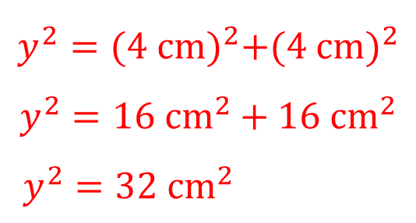
STRAND I
Unit I1
Section I1.2
Further work with Pythagoras’ Theorem
Example
Find the length of the side marked x in the diagram.
Solution
First consider triangle ABC. The unknown length of the hypotenuse has been marked y.
$$y^{2}={(4 cm)}^{2}+{(4 cm)}^{2}$$
$$y^{2}={16 cm}^{2}+{16 cm}^{2}$$
$y^{2}={32 cm}^{2}$
Solution continued on next slide

Slide 14
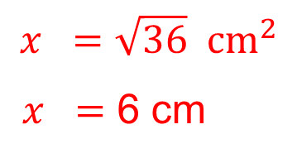
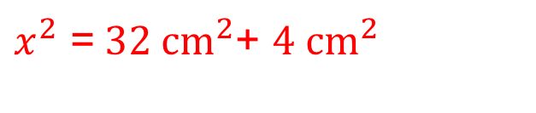
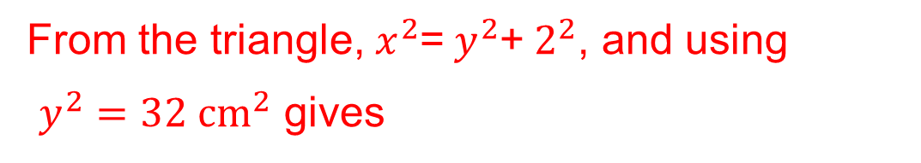
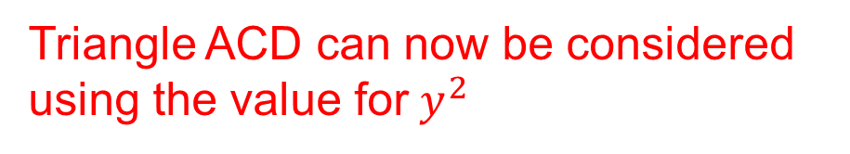
STRAND I
Unit I1
Section I1.2
Further work with Pythagoras’ Theorem
Solution continued
Triangle ACD can now be considered using the value for${ y}^{2}$
From the triangle, $x^{2}$=$y^{2}$+$2^{2}$, and using
$y^{2}={32 cm}^{2}$ gives
$x^{2}$ =${ 32 cm}^{2}$+ ${4 cm}^{2}$
$$x =\sqrt{36} {cm}^{2}$$
$x =$ 6 cm

Slide 15
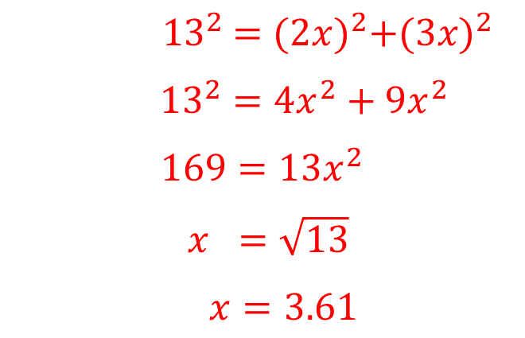
STRAND I
Unit I1
Section I1.2
Further work with Pythagoras’ Theorem: 2
Example continued
Find the value of x as shown on the diagram.
Solution
Using Pythagoras' Theorem gives
$${ 13}^{2} ={(2x)}^{2}+{(3x)}^{2}$$
${13}^{2}={4x}^{2}+{9x}^{2}$
$$169={13x}^{2}$$
$x =\sqrt{13}$
$x=3.61$

Slide 16


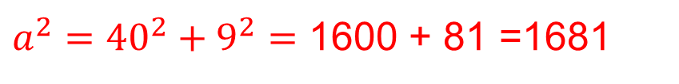

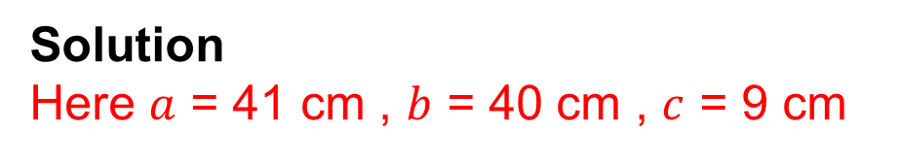
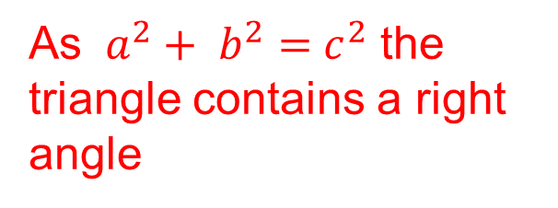
STRAND I
Unit I1
Section I1.2
Further work with Pythagoras’ Theorem 3
Example
Verify Pythagoras' Theorem for the right-angled triangle opposite.
Solution
Here $a$ = 41 cm , $b$ = 40 cm , $c$ = 9 cm
$a^{2}$ $=b^{2}+{ c}^{2}$
${a^{2}=40}^{2}+9^{2}=$ 1600 + 81 =1681
$$a =\sqrt{1681}$$
$$=41 cm$$
As $a^{2}+ b^{2}={ c}^{2}$ the triangle contains a right angle

Slide 17
STRAND I
Unit I1
Section I1.2
Section I1.2: Fitness Check
Here are some questions to check your progress.
Find the value of x, giving your answer to 2 decimal places.
Solution
(a) 5.39
(b) 10.95
Solution
(c) 3.16
(d) 1.29

Slide 18
STRAND I
Unit I1
Section I1.2
Section I1.2: Fitness Check
Here are some questions to check your progress.
Use Pythagoras Theorem to check that the following triangles contain a right angle.
Solution
(a) Yes
(b) No
(c) Yes
(d) No

Slide 19
STRAND I
Unit I1
Section I1.2
Section I1.2: Review
You have completed the second Section.
If you have completed and understood this section,
click to start the next Section.
If you need more examples and interactive practice, go to
http://szalonta.hu/ske/text/I1/skei1s2.html

Slide 20
STRAND I
Unit I1
Section I1.3
Hypotenuse, Opposite and Adjacent
Hypotenuse, Opposite and Adjacent
When working in a right angled triangle, the longest side is known as the Hypotenuse. The other two sides are known as the Opposite and the Adjacent.
The adjacent is the side next to a marked angle, θ and the opposite side is opposite this angle.

Slide 21
STRAND I
Unit I1
Section I1.3
Hypotenuse, Opposite and Adjacent
Example
For the triangle and angle shown, state which side is:
a) the hypotenuse
b) the adjacent
c) the opposite.
Solution
The hypotenuse is the longest side, which
for this triangle is CB.
b) The adjacent is the side that is next to the angle θ , which for this triangle is AB.
c) The opposite side is the side that is opposite the angle θ, which for this triangle is AC.

Slide 22
STRAND I
Unit I1
Section I1.3
Hypotenuse, Opposite and Adjacent
Example
For each triangle, state which side is the hypotenuse, the adjacent
and the opposite.
Solution
a) hypotenuse
KL
adjacent
JL
opposite
JK
b) hypotenuse
adjacent
MN
opposite
NO
MO
c)
hypotenuse
PQ
adjacent
QR
opposite
PR

Slide 23
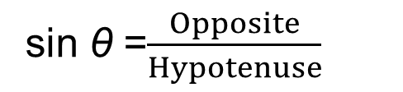
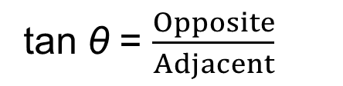
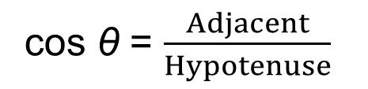
STRAND I
Unit I1
Section I1.3
Sine, Cosine and Tangent
Sine, Cosine and Tangent
For a right-angled triangle, the sine, cosine and
tangent of the angle θ are defined as:
sin θ =$\frac{Opposite}{Hypotenuse}$
cos θ = $\frac{Adjacent}{Hypotenuse}$
tan θ = $\frac{Opposite}{Adjacent}$
NOTE: sin θ will always have the same value regardless of the size of the triangle. (The same is true for cos θ and tan θ.)

Slide 24
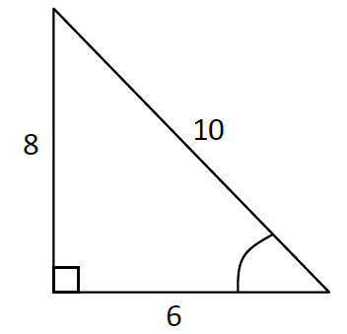
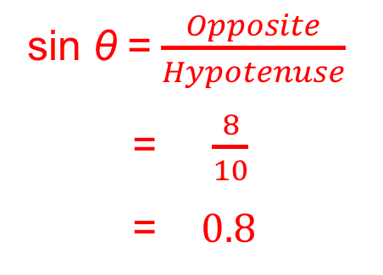
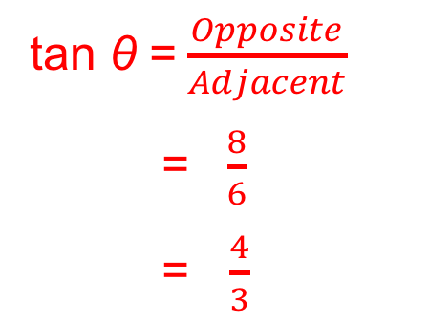
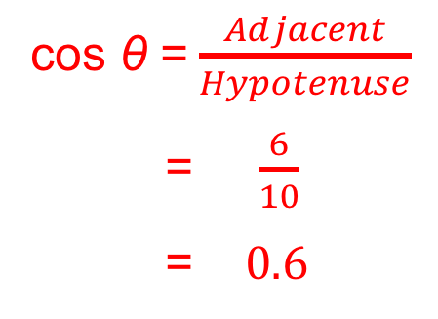
STRAND I
Unit I1
Section I1.3
Sine, Cosine and Tangent
Example
Write down the values of sin θ , cos θ and tan θ
for the triangle shown. Then use a calculator to
find the angle in each case.
θ
Solution
sin θ =$\frac{Opposite}{Hypotenuse}$
= $\frac{8}{10}$
= $0.8$
cos θ =$\frac{Adjacent}{Hypotenuse}$
= $\frac{6}{10}$
= $0.6$
tan θ =$\frac{Opposite}{Adjacent}$
= $\frac{8}{6}$
= $\frac{4}{3}$

Slide 25
STRAND I
Unit I1
Section I1.3
Section I1.3: Fitness Check
Here are some questions to check your progress.
1. For each triangle, find sin θ, cos θ and tan θ to two decimal places.
Answers
(a) 0.80, 0.60, 1.33
(b) 0.96, 0.28, 3.43
(c) 0.28, 0.96, 0.29
2. Use a calculator to find the angles, correct to 2 decimal places.
sin 30° =
0.50
tan 75° =
3.73
cos 45° =
0.71
3. Use a calculator to find θ, correct to 1 decimal place.
cos θ = 0.5
60°
sin θ = 1
90°
tan θ = 0.45
24.2°

Slide 26
STRAND I
Unit I1
Section I1.3
Section I1.3: Review
You have completed the third Section.
If you have completed and understood this section,
click to start the next Section.
If you need more examples and interactive practice, go to
http://szalonta.hu/ske/text/I1/skei1s3.html

Slide 27
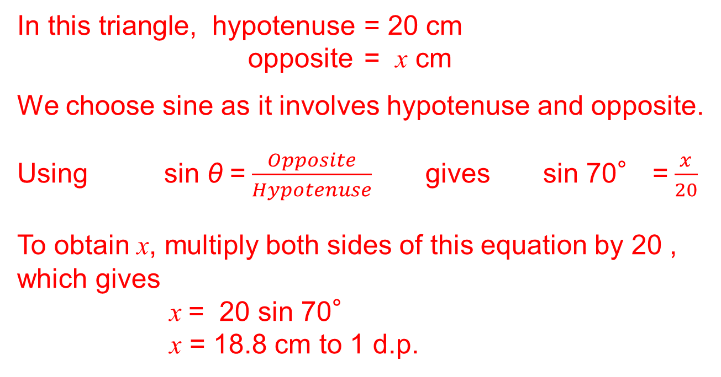
STRAND I
Unit I1
Section I1.4
Finding lengths in Right Angled Triangles
Example
Find the length of the side marked x in the triangle.
Solution
In this triangle, hypotenuse = 20 cm
opposite = x cm
We choose sine as it involves hypotenuse and opposite.
Using sin θ =$\frac{Opposite}{Hypotenuse}$ gives sin 70° =$\frac{x}{20}$
To obtain x, multiply both sides of this equation by 20 , which gives
x = 20 sin 70°
x = 18.8 cm to 1 d.p.

Slide 28
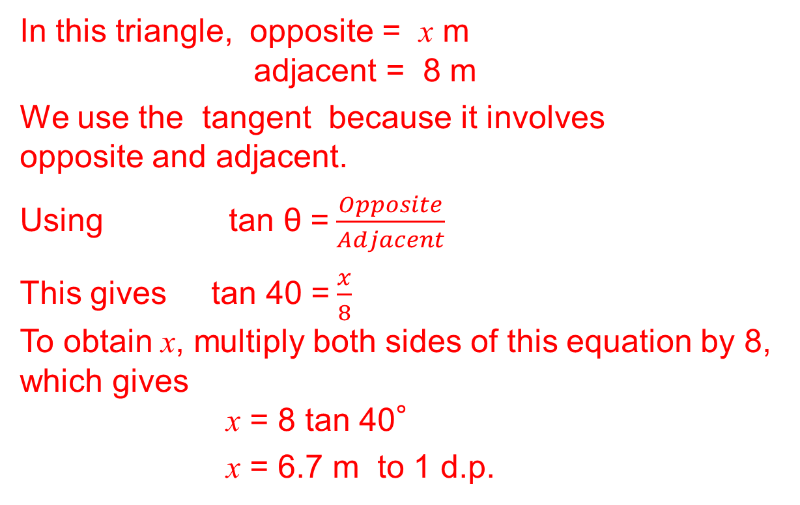
STRAND I
Unit I1
Section I1.4
Finding lengths in Right Angled Triangles
Example: Find the length of the side marked x in the triangle.
Solution
In this triangle, opposite = x m
adjacent = 8 m
We use the tangent because it involves opposite and adjacent.
Using tan θ =$\frac{Opposite}{Adjacent}$
This gives tan 40 =$\frac{x}{8}$
To obtain x, multiply both sides of this equation by 8, which gives
x = 8 tan 40°
x = 6.7 m to 1 d.p.

Slide 29
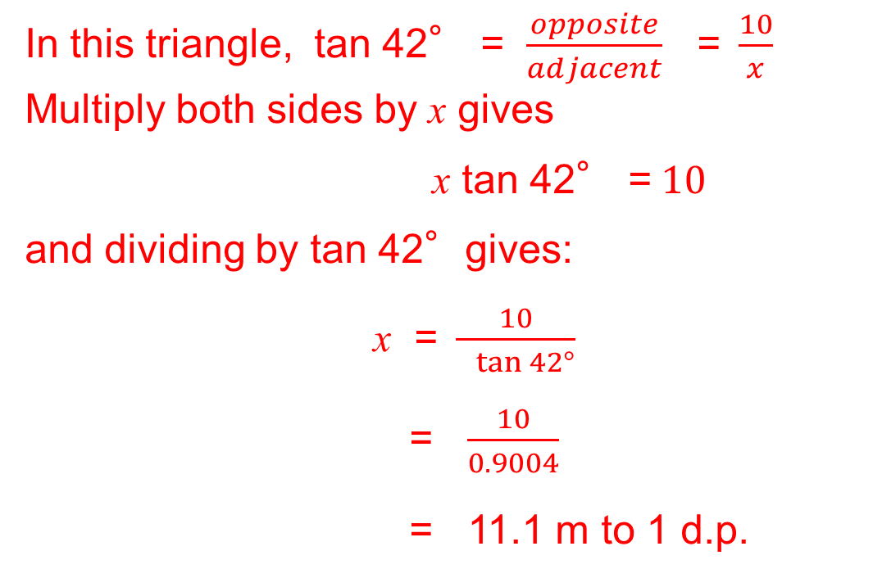
STRAND I
Unit I1
Section I1.4
Finding lengths in Right Angled Triangles
Example
Find the length of the side marked x in the triangle.
Solution
In this triangle, tan 42° = $\frac{opposite}{adjacent}$ =$\frac{10}{x}$
Multiply both sides by x gives
x tan 42° =$10$
and dividing by tan 42°gives:
x =$\frac{10}{ tan 42°}$
= $\frac{10}{0.9004}$
= 11.1 m to 1 d.p.

Slide 30
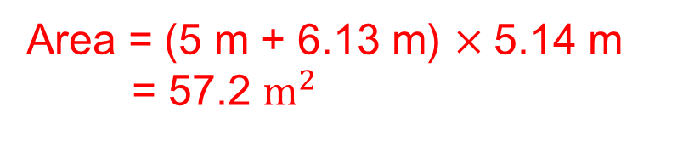
STRAND I
Unit I1
Section I1.4
Finding lengths in Right Angled Triangles
Example
The diagram above, not drawn to scale, represents one face of the roof of a house in the shape of a parallelogram EFGH.
Angle EFI = 40°and EF = 8 m. EI represents a rafter placed perpendicular to FG such that IG = 5 m.
Calculate FI, EI and the area of the parallelogram giving your answers to 3 significant figures.
Solution
FI = 8 cos 40 = 6.13 m
Area = (5 m + 6.13 m) $×$5.14 m
= 57.2 $m^{2}$
EI = 8 sin 40 = 5.14 m

Slide 31
STRAND I
Unit I1
Section I1.4
Section I1.4: Fitness Check
Here are some questions to check your progress.
1. Find the length of the side marked x in each triangle
Answers (a) 5.14 m (b) 11.82 m (c) 5.13 m

Slide 32
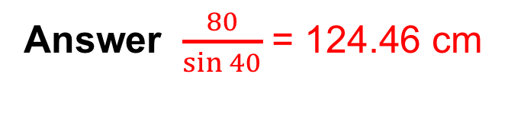
STRAND I
Unit I1
Section I1.4
Section I1.4: Fitness Check
A snooker ball rests against the
side cushion of a snooker table.
It is hit so that it moves at 40°
to the side of the table.
How far does the ball travel before
it hits the cushion on the other side of the table?
Answer $\frac{80}{\sin{40}}$ = 124.46 cm

Slide 33
STRAND I
Unit I1
Section I1.4
Section I1.4: Review
You have completed the fourth Section.
If you have completed and understood this section,
click to start the next Section.
If you need more examples and interactive practice, go to
http://szalonta.hu/ske/text/I1/skei1s4.html

Slide 34
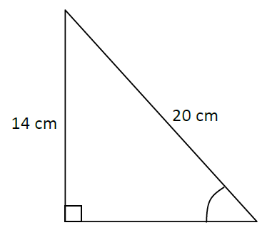
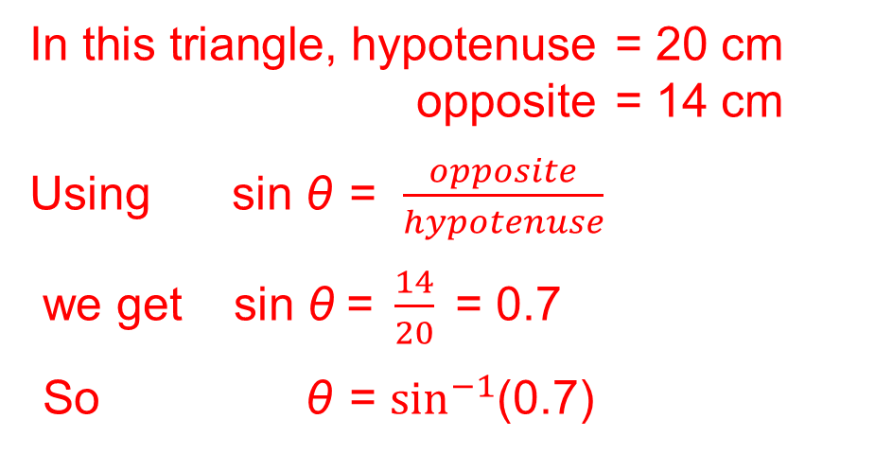
STRAND I
Unit I1
Section I1.5
Finding Angles in Right Angled Triangles
If the lengths of any two sides of a right-angled triangle are known, then sine, cosine and tangent can be used to find the angles of the triangle.
Example
Find the angle marked θ in the triangle shown.
Solution
In this triangle, hypotenuse = 20 cm
opposite = 14 cm
Using sin θ = $\frac{opposite}{hypotenuse}$
we get sin θ =$\frac{14}{20}$= 0.7
So θ = $\sin^{−1}$(0.7)
θ
Using SHIFT and SIN buttons on a calculator gives θ = 44.4°to 1 d.p.

Slide 35
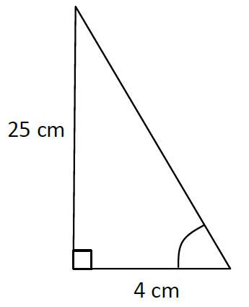
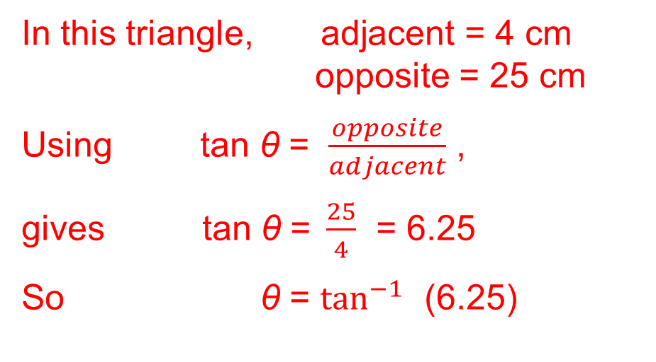
STRAND I
Unit I1
Section I1.5
Finding Angles in Right Angled Triangles
Example
Find the angle marked θ in the triangle
shown.
Solution
In this triangle, adjacent = 4 cm
opposite = 25 cm
Using tan θ = $\frac{opposite}{adjacent}$ ,
gives tan θ =$\frac{25}{4}$ = 6.25
So θ = $\tan^{−1}$ (6.25)
θ
Using SHIFT and TAN buttons on a calculator gives θ = 80.9°to 1 d.p.

Slide 36
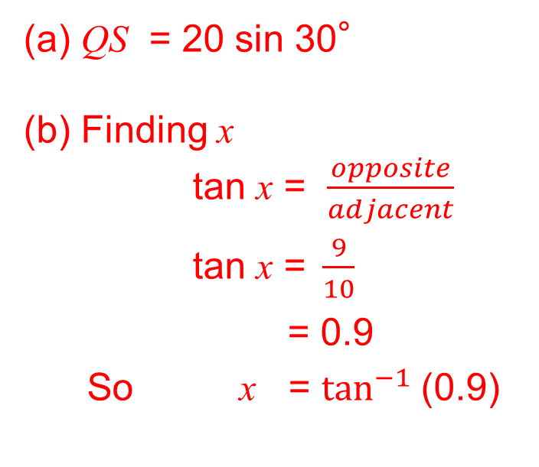
STRAND I
Unit I1
Section I1.5
Finding Angles in Right Angled Triangles
Example
Find the angle marked x°in the triangle shown.
Solution
(a) QS = 20 sin 30°
(b) Finding x
tan x = $\frac{opposite}{adjacent}$
tan x =$\frac{9}{10}$
= 0.9
So x = $\tan^{−1}$(0.9)
Using SHIFT and TAN buttons on a calculator gives x = 41.987° (42°nearest degree )

Slide 37
STRAND I
Unit I1
Section I1.5
Section I1.5: Fitness Check
Here are some questions to check your progress.
1. Find the angle θ.
Answers
53.13°
75.52°
46.97°

Slide 38
STRAND I
Unit I1
Section I1.5
Section I1.5: Fitness Check
2. A ladder leans against a wall. The length of the ladder is 4 metres and the base is 2 metres from the wall. Find the angle between the ladder and the ground.
Answer 60°
3. The diagram shows a roofing frame ABCD
(a) Calculate the length of AD.
(b) Calculate the size of angle DCB.
Answers
(a) AD = 7.62m
(b) DCB = 30.96°

Slide 39
STRAND I
Unit I1
Section I1.5
Section I1.5: Review
You have completed the last Section.
If you need more examples and interactive practice, go to
http://szalonta.hu/ske/text/I1/skei1s5.html

